Slide 1
Development Environment
Lecture 2
Hartmut Kaiser
https://teaching.hkaiser.org/fall2025/csc7103/

Slide 2
Git & Github
Managing Source Code Histories

Slide 3
Git and GitHub
Git and GitHub are common tools used in programming
  Help managing different versions of your code and collaborate with other developers
Git was developed in 2005 by Linus Torvalds
  Open source software for tracking changes in a distributed version control system
Git is made freely available for anyone to modify and use
  Available on all platforms, widely used
Git tracks changes via a distributed version control system
  Git can track the state of different versions of all files in your project
  It is distributed because you can access your code files from another computer – and so can other developers.

Slide 4
Git and Github
GitHub is a web-based platform where Git users build software together
GitHub is also an hosting provider and version control platform you can use to collaborate on open source projects and share files
When you're using GitHub, you're working with Git under the hood
Git is the (command-line) tool that manages the files
  VSCode (and many other IDEs) have a graphical user interface that sits on top of Git
Github is (one of the existing and free) web-platforms you can use to host your Git repositories

Slide 5
Git and Github
Millions of people all over the world use these tools, and the numbers just keep going up
  It is being used for any programming language
More companies are requiring new hires to know how to use Git and GitHub
  So if you're looking for a developer job, these are essential skills to have

Slide 6
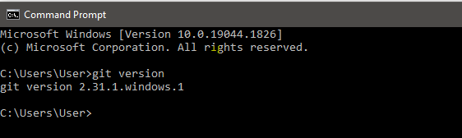
Setting Things Up
Install Git
  Comes preinstalled in some Macs and Linux-based systems
  Simple install for all platforms: https://git-scm.com/download
Create account on Github: https://github.com

Slide 7
Connect Git to Github
Set Git user name and email address (do this once)
  git config --global user.name "Hartmut Kaiser"
  git config --global user.email "hartmut.kaiser@gmail.com"
Use same email address as you used for registering on Github

Slide 8
Github Classroom
Website helping to manage assignments
Based on starter codes in a repository
  Manages clones (copies) of this repository for each student
  All repositories are hosted on Github
Enables automatic grading
Enables individual feedback to each student
Well integrated in VSCode

Slide 9
Version Control

Slide 10
What is Version Control?
A database that keeps track of all changes to files over time
Allows for collaborative development
Allows to track who made what changes and when
Allows to revert changes and go back to previous state

Slide 11
What is Git
Distributed version control system
Entire code and history is kept on user’s machine
  Changes can be made without internet access
  (Except pushing and pulling from a remote server)
One of many different version control systems
  Subversion, Perforce, Mercurial
  Git one of the most widely used ones

Slide 12
How does Git work?
Can be complicated at first, but it is based on a few key concepts
Based on Snapshots
  All history is based on snapshots
  Records what all files look like at a given point in time
  User decides when to take snapshots and of what files
  Can go back to any previous snapshot
    Later snapshots are still available

Slide 13
How does Git work?
Key concept: Commit
The act of taking a snapshot
  Verb: the user committed the code
  Noun: the user made a new commit
Every project is made of many commits
  List of commits defines the timeline of changes applied to files
Three pieces of information:
  How did files changes from previous state
  A reference of the commit that came before it
    Parent commit
  A unique hash code identifying the commit
    Something like: c374f26626038f020dd12f842d4dc5d67d02f59d

Slide 14
How does Git work?
Key concept: Repositories
  Often shortened to repo
A collection of all files and their history
  Consists of all commits
  Place were all the work is stored
Can live on a local machine or on a remote server (Github)
Copying a remote repository to your local machine is called cloning
  Allows for teams to work collaboratively
Downloading commits from remote repository: pulling changes
Adding local changes to a remote repository: pushing changes

Slide 15
How does Git work?
Key concept: Branches
All commits live on a branch
  Each branch is a sequence of commits
There can be many branches
The main branch is often called main or master branch

Slide 16
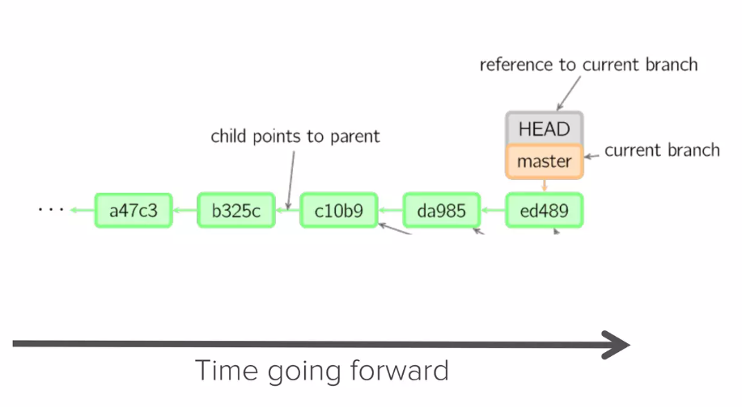
Typical Structure of a Project

Slide 17
Typical Structure of a Project
HEAD: Reference to the most recent commit
MASTER: The main branch in a project
  Sometimes called ‘main’
Key concept: branching off master branch
  Start of a branch points to a specific commit
  Any changes to a project should start with a new branch

Slide 18
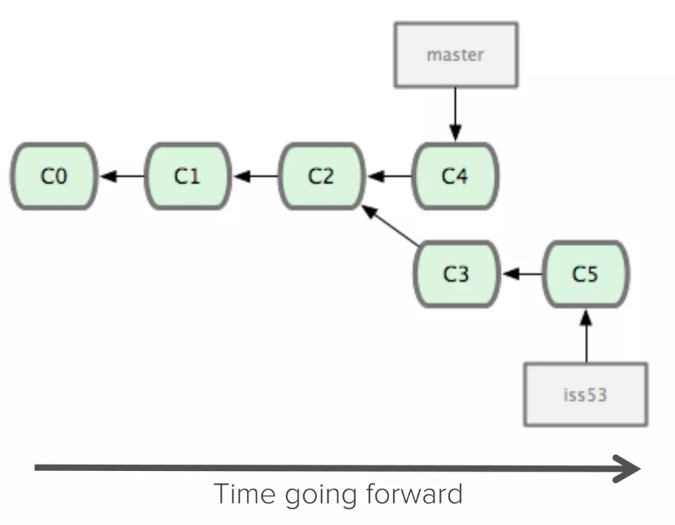
Branching off master

Slide 19
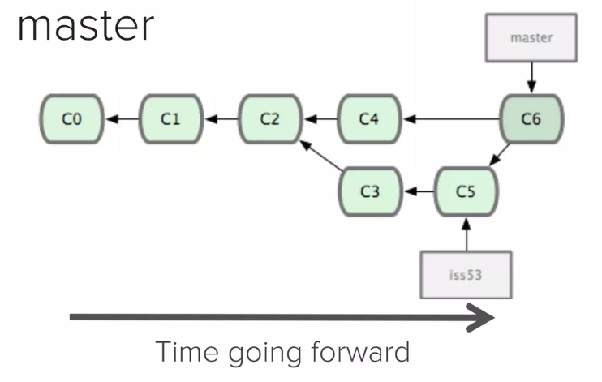
Typical Structure of a Project
Key concept: Merging
Once done with a feature the branch will be merged back to master

Slide 20
Making a Commit
Files can be a in a lot of states and places
Files are being edited in your local file system
  The working directory
A file that is ready to be committed needs to be staged (added to the index)
  Use 'git add ...' command to define the set of files that should be part of a commit
  Use 'git commit ...' command to create actual commit

Slide 21
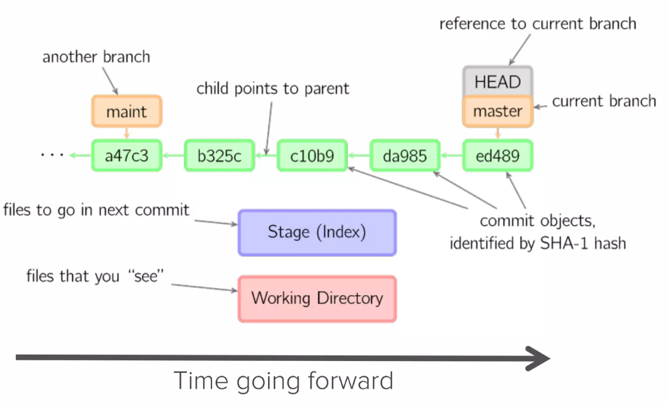
Making a Commit

Slide 22
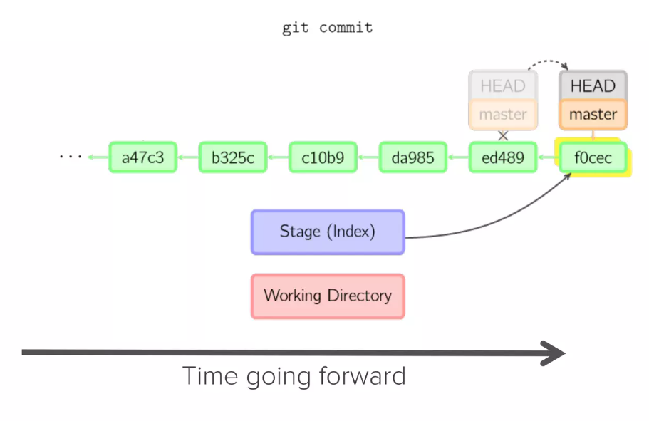
Making a Commit

Slide 23
Additional Resources
Official Git site: https://git-scm.com
Github guides: https://guides.github.com
Interactive Git tutorial: https://try.github.io
Git cheatsheet: https://www.ndpsoftware.com/git-cheatsheet.html

Slide 24
Remote Repositories on Github
Pulling and pushing code
Pull requests
Github Classroom creates pull request ‘Feedback’
  Allows to see all changes to start code
  Don’t close this PR

Slide 25
