Slide 1
Welcome and Introduction
Lecture 1
Hartmut Kaiser
https://teaching.hkaiser.org/fall2025/csc7103/

Slide 2
Introduction to Operating Systems
Administrative introduction to course
Why study Operating Systems?
What is an Operating System?
Principles to be covered in this course
A (very) brief history of Operating Systems
Operating System Goals

Slide 3
This Course
This is a revised curriculum with new goals:
Understanding and exploiting OS services
Foundation concepts and principles
Common problems that have been solved in OS
Evolving directions in system architecture
This is not a course in how to build an OS
You will not read or write any kernel-mode code
You will not study or build any parts of a toy OS

Slide 4
Learning Objectives
We started with a list of learning objectives
Over 300 concepts, issues, approaches and skills
All activities in this course are based on them
The reading has been chosen introduce them
The lectures are designed to reinforce them
The projects have been chosen to exercise them
The exams will test your mastery of them
Study this list to understand the course goals
Use this list to guide your pre-exam review

Slide 5
Administrativia

Slide 6
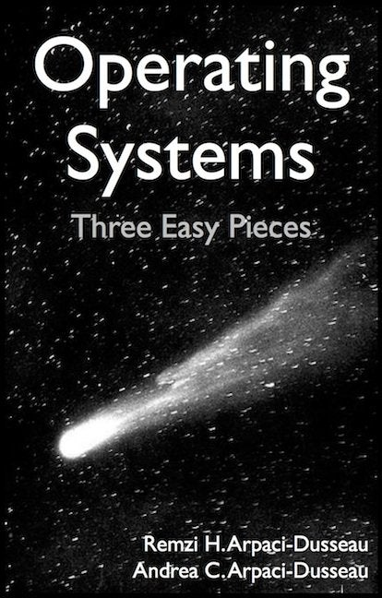
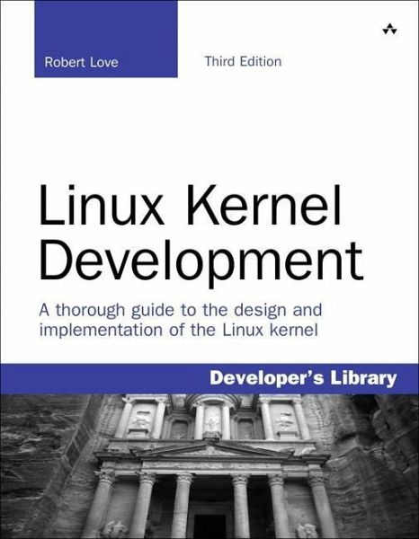
Infrastructure, Textbook & Readings
Infrastructure
Website: https://teaching.hkaiser.org
Discord: https://discord.gg/FIXME
Textbook: Operating Systems: Principles and Practice (2nd Edition) Anderson and Dahlin
Not required, get a copy if you feel that lectures are not sufficient
Suggested readings posted along with lectures
Try to keep up with material in book as well as lectures
Supplementary Material
Operating Systems: Three Easy Pieces, by Remzi and Andrea Arpaci-Dusseau, available for free online
Linux Kernel Development, 3rd edition, by Robert Love
Homework, project, quizzes, grading, honesty
Use Github classroom for assignments
Use VSCode as a tool

Slide 7
Class Expectations
Lectures
Come! Cannot guarantee content will be identical to previous years
Electronic devices used only for note taking
Will explain many things related to assignments not otherwise explained
Attendance not mandatory but highly advised
If you decide to come, please be on time
Meet your fellow students, they are your future colleagues!
Office Hours
Come and ask for help early. There are no stupid questions!
We like teaching and want to meet you!
Communicate with course staff through Discord and Email.

Slide 8
Important Dates
Lectures
Tuesday and Thursday, 1:30pm to 2:50pm, 1236 PFT
Grading
Homework 50%
Project 25%
Midterm exam 10%
Final exam 15%
Exams
Midterm exam: TBD
Final exam: TBD

Slide 9
Honesty
The LSU Code of Student Conduct defines plagiarism in Section 5.1.16:
"Plagiarism is defined as the unacknowledged inclusion of someone else's words, structure, ideas, or data. When a student submits work as his/her own that includes the words, structure, ideas, or data of others, the source of this information must be acknowledged through complete, accurate, and specific references, and, if verbatim statements are included, through quotation marks as well. Failure to identify any source (including interviews, surveys, etc.), published in any medium (including on the internet) or unpublished, from which words, structure, ideas, or data have been taken, constitutes plagiarism;“
Plagiarism will not be tolerated and will be dealt with in accordance with and as outlined by the LSU Code of Student Conduct: https://www.lsu.edu/saa/students/codeofconduct.php

Slide 10
ChatGPT?

Slide 11
ChatGPT
The goal for this course is to train our brains, not ChatGPT
So, do yourself a favor and don’t use it
There are too many software ‘developers’ out there who copy & paste their way to the next paycheck
However, if you do use it:
Never use anything without carefully reviewing it
Assume what you got is wrong! Prove to yourself it is correct!
The skill of reading (and understanding) code becomes more important than ever
Cite and annotate the copied code
Whatever you do, remember:
It’s plagiarism if you submit the same code as your neighbor
No matter where you got it from, be it Google, ChatGPT, or your neighbors computer

Slide 12
How to Learn
Ask yourself at the beginning of this semester
What scientific problem you want to solve?
What do you want to learn from this course that can prepare you?
Can you write a sequential program to solve it?
What is the performance of it?
…
Ask yourself at the end of this semester
Did you master the skillset to solve your scientific problem?
Can you write a high-performance program to solve it?
What is the performance of it?
What is the speedup?
Compare your sequential program with your high-performance program

Slide 13
OS Research

Slide 14
OS Research Actually
Not really just about building Oses
Any large code base converges on becoming an OS
Manages memory, programming for space/performance, hardware details
database, JVM, browser, parallel/distributed systems, internet services
How to structure systems and deal with complexity
Modularize and encapsulate
Choose interfaces/abstractions carefully
Themes in this class
Abstractions for managing/accessing resources: storage, replication, naming
Correctness: concurrency and sharing
Guarantees in real systems: security, fault tolerance, etc.

Slide 15
How to “structure” a System
Applications
programmer- visible interface
user
process
files
pipes
user-mode
Runtimes/libs
LIBC/CLR
OS interface
OS-level abstractions
kernel
process
files
pipes
Hardware interface
HAL
driver
driver
driver
HW
CPU
I/O dev
DISK
NIC

Slide 16
How to “structure” a System
OSes designed for old hardware
Old OS assumptions: CPUs, disks, networks, OS is the only resource manager
Applications
programmer- visible interface
device APIs
device
APIs
device
APIs
Runtime
user
device
APIs
Runtime
Runtime
Runtime
no OS-level abstractions!
Runtime support
kernel
ioctl
mmap
Vendor-specific
driver
Fat driver, proprietary interfaces
HW
FPGA
GPU
ASIC
CPU
Hardware
interface
NVM
DSP
CRYPT
DISK

Slide 17
Today’s Readings

Slide 18
Today’s Readings: Motivation & Professional Development
Levin & Redell: “How (and How Not) to write a Good Systems Paper”
Summary:
Rules of thumb for writing good systems papers
Most papers are limited
A few researchers consistently publish at top conferences
Learn from them or risk a second-rate career
A good framework to use for thinking about the papers we read in this class
Haldane ’28: On being the right size
Summary: scale and use case are determinants for the fitness of a system
(Optional) Hamming: “You and Your Research”
Summary:
Stay open to people and ideas
Research is both time-consuming and exciting
Research inspiration comes from unexpected directions

Slide 19
How (and How Not) to write a Good Systems Paper (Levin & Redell)
Categories
Real system
Unimplemented system
Theoretical topic
Most SOSP/OSDI papers are about prototypes
Some differences by field
E.g. architecture: more simulation (why?)
Prototype is not enough
Why build a system?
“The purpose of (scientific) computing is…
insight, not numbers.” – Richard Hamming
Adapt old techniques to new technology
 |  | Effort | SOSP Accept | SOSP Reject
Real system | Used by others | Huge | Occasional | Occasional
Worked once | Benchmarks ran by deadline | Large | Common | Occasional
Simulated | Simulations run | Large/med | Occasional | Common
Paper design | Sounds good | minimal | Rare | Common

Slide 20
On being the right Size (Haldane)
Why did we read this paper?
Bold statements that are unusual in scientific literature
Intellectual pursuits require breadth and depth
Can you draw out lessons relevant to computer systems?
Incommensurate scaling: eye size, jumping height
Hardware constraints influence system design: strength of femur limits height
Distribution of complexity and even basic assumptions change as a function of scale
E.g. MapReduce algorithm is a handful of lines of code
Apache Hadoop: 2,422,127 SLoC (as of 9/5/17)

Slide 21
