Slide 1
Refreshing C
Hartmut Kaiser
https://teaching.hkaiser.org/fall2025/csc7103

Slide 2
C History
Developed in the 1970s – in conjunction with development of UNIX operating system
  When writing an OS kernel, efficiency is crucial
  This requires low-level access to the underlying hardware:
    e.g. programmer can leverage knowledge of how data is laid out in memory, to enable faster data access
  UNIX originally written in low-level assembly language – but there were problems:
    No structured programming (e.g. encapsulating routines as “functions”, “methods”, etc.) – code hard to maintain
    Code worked only for particular hardware – not portable

Slide 3
C Characteristics
C takes a middle path between low-level assembly language…
  Direct access to memory layout through pointer manipulation
  Concise syntax, small set of keywords
… and a high-level programming language like Java:
  Block structure
  Some encapsulation of code, via functions
  Type checking (pretty weak)

Slide 4
C Dangers
C is not object oriented!
  Can’t “hide” data as “private” or “protected” fields
  You can follow standards to write C code that looks object-oriented, but you have to be disciplined – will the other people working on your code also be disciplined?
C has portability issues
  Low-level “tricks” may make your C code run well on one platform – but the tricks might not work elsewhere
The compiler and runtime system will rarely stop your C program from doing stupid/bad things
  Compile-time type checking is weak
  No run-time checks for array bounds errors, etc. like in Java

Slide 5
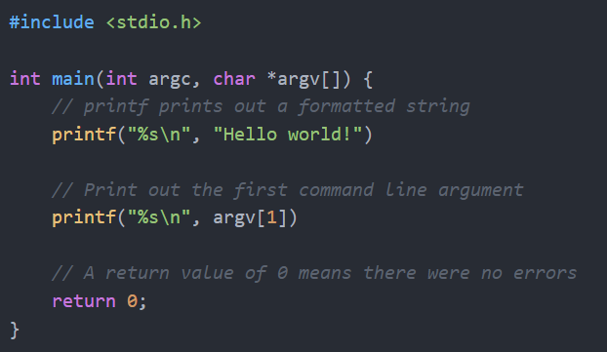
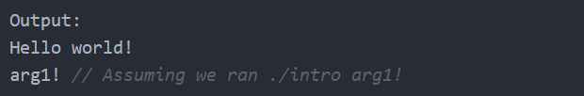
Compiling your C program
  gcc intro.c -o intro
  and run the program using
  ./intro arg1!
If we just run ./intro
  We may get a segfault!

Slide 6
Compiling your C program
All C programs begin with a main function
  The first argument argc denotes the number of elements in argv
  The second argument argv is a list of string arguments passed from the command line to the program
  The return value of a function indicates the exit code where 0 means successful
At the top of the file we have an #include statement to include stdio.h, a library that makes available functions such as printf.
We can use printf to print formatted strings. In this case %s treats the input as a string.
  printf is your friend for debugging!
  printf doesn't emit a newline, so you'll have to add a \n if you want a newline

Slide 7
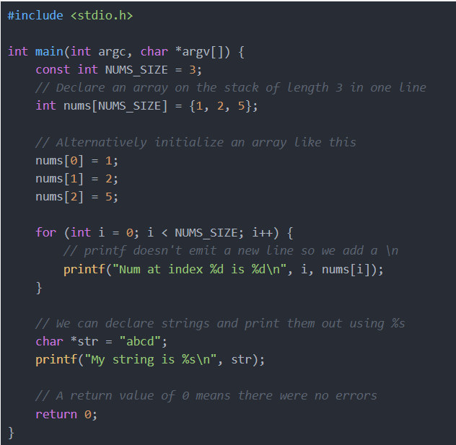
C Syntax
At the top of the file we have an include statement to include stdio.h, a library that contains functions such as printf.
Next is an array declaration using the
int {name}[{size}] syntax.
This array is declared on the stack. The distinction between declaration on the stack and heap is important to keep in mind!
We can initialize the values by using the {elem1, elem2, ...} initializer syntax.

Slide 8
The printf() function
printf("Original input: %s\n", input);
printf() is a library function declared in <stdio.h>
Syntax: printf(FormatString, Expr...)
  FormatString: String of text to print
  Expr...: Values to print
  FormatString has placeholders to show where to put the values (note: #placeholders should match #Exprs)
  Placeholders: %s (print as string), %c (print as char),
  %d (print as integer),
  %f (print as floating-point)
  \n indicates a newline character
Make sure you pick
the right one!

Slide 9
Separate compilation
A C program consists of source code in one or more files
Each source file is run through the preprocessor and compiler, resulting in a file containing object code
Object files are tied together by the linker to form a single executable program
Source code
file1.c
Preprocessor/
Compiler
Object code
file1.o
Source code
file2.c
Preprocessor/
Compiler
Object code
file2.o
Libraries
Linker
Executable code
a.out

Slide 10
The Preprocessor
The preprocessor takes your source code and – following certain directives that you give it – tweaks it in various ways before compilation.
A directive is given as a line of source code starting with the # symbol
The preprocessor works in a very crude, “word-processor” way, simply cutting and pasting –
  it doesn’t really know anything about C!
Your
source
code
Enhanced and
obfuscated
source code
Object
code
Preprocessor
Compiler

Slide 11
Preprocessor Directives
  #define MAX_COLS 20
  #define MAX_INPUT 1000
The #define directives perform
  “global replacements”:
  every instance of MAX_COLS is replaced with 20, and every instance of MAX_INPUT is replaced with 1000.
Other directives:
  #include <> / #include ""
  #ifdef / #else / #endif

Slide 12
Preprocessor directives
  #include <stdio.h>
  #include <stdlib.h>
  #include <string.h>
The #include directives “paste” the contents of the files stdio.h, stdlib.h and string.h into your source code, at the very place where the directives appear.
These files contain information about some library functions used in the program:
  stdio stands for “standard I/O”, stdlib stands for “standard library”, and string.h includes useful string manipulation functions.
Want to see the files? Look in /usr/include (or similar)

Slide 13
Pointers, Arrays, Strings
The notions of string, array, and pointer are somewhat interchangeable:
  An array of characters could be declared, for purposes of holding the input string:
  char input[MAX_INPUT];
  Yet when it’s passed in as an argument to a function, input has morphed into a pointer to a character (char *):
    void some_function(char const *input, ...)

Slide 14
Pointers, Arrays, Strings
In C, the three concepts are indeed closely related:
  A pointer is simply a memory address. The type char* (i.e. “pointer to character”) signifies that the data at the address the pointer is holding is to be interpreted as a character.
  An array is simply a pointer – of a special kind:
    The array ‘name’ refers to the first of a sequence of data items stored sequentially in memory
    How do you get to the other array elements? By incrementing the pointer value
  A string is simply an array of characters – unlike Java, which has a predefined String class.

Slide 15
String Layout and Access
p
(char)
o
(char)
i
(char)
n
(char)
t
(char)
e
(char)
r
(char)
NUL
(char)
NUL ('\0') is a special value
indicating end-of-string
(char *)
How do we get to the “n”?
Follow the input pointer,
then hop 3 to the right
*(input + 3)
- or -
input[3]
input
What is input?
It’s a string!
It’s a pointer to char!
It’s an array of char!

Slide 16
Data Types in C

Slide 17
Four basic data types
Integers: char, short int, int, long int, enum
Floating-point types: float, double, long double
Pointers
Aggregates: struct, union
Integer and floating-point types stand for themselves, but pointers and aggregate types combine with other types, to form a virtually limitless variety of types

Slide 18
Characters are of integer Type
From a C perspective, a character is indistinguishable from its numeric ASCII value –
  the only difference is in how it’s displayed
Ex: converting a character digit to its numeric value
  The value of '2' is not 2 – it’s 50 (hexadecimal 0x32)
  To convert, subtract the ASCII value of '0' (which is 48, or 0x30)
    char digit, digit_num_value;
    ...
    digit_num_value = digit - '0';
Behaviorally,
this is identical to
digit - 48
Why is
digit - '0'
preferable?

Slide 19
Integer Values play the Role of “Booleans”
There is no “Boolean” type
  Relational operators (==, <, etc.) return either 0 or 1
  Boolean operators (&&, ||, etc.) return either 0 or 1,
    and take any int values as operands
How to interpret an arbitrary int as a Boolean value:
  0 → false
  Any other value → true

Slide 20
The infamous = Blunder
Easy to confuse equality with assignment
  In C, the test expression of an if statement can be any int expression — including an assignment expression
    if (y = 0)
    printf("Sorry, can't divide by zero.\n");
    else
    result = x / y;
The compiler will not catch this bug!
  Some compilers will issue a warning
Assignment performed;
y set to 0 (oops)
Expression returns
result of assignment:
0, or "false"
else clause executed:
divide by 0!

Slide 21
The less infamous “relational chain” Blunder
Using relational operators in a “chain” doesn't work
Ex: “age is between 5 and 13”
5 <= age <= 13
A correct solution: 5 <= age && age <= 13
evaluate 5 <= age
result is either 0 or 1
Next, evaluate either
0 <= 13
or
1 <= 13
result is always 1

Slide 22
Ranges of Integer Types
Type | Min value | Max value
char | 0 | UCHAR_MAX (≥ 127)
signed char | SCHAR_MIN (≤ -127) | SCHAR_MAX (≥ 127)
unsigned char | 0 | UCHAR_MAX (≥ 255)
short int | SHRT_MIN (≤ -32767) | SHRT_MAX (≥ 32767)
unsigned short int | 0 | USHRT_MAX (≥ 65535)
int | INT_MIN (≤ -32767) | INT_MAX (≥ 32767)
unsigned int | 0 | INT_MAX (≥ 65535)
long int | LONG_MIN (≤ -2147483647) | LONG_MAX (≥ 2147483647)
unsigned long int | 0 | ULONG_MAX (≥ 4294967295)

Slide 23
Ranges of Integer Types
Ranges for a given platform can be found at /usr/include/limits.h
char can be used for very small integer values
Plain char may be implemented as signed or unsigned on a given platform – safest to “assume nothing” and just use the range 0...127
short int “supposed” to be smaller than int ―
  but it depends on the underlying platform

Slide 24
Ranges of Floating-Point Types
Type | Min value | Max value
float | FLT_MIN (≤ -10³⁷) | FLT_MAX (≤ -10³⁷)
double | DBL_MIN (≤ -FLT_MIN) | DBL_MAX(≥ FLT_MAX)
long double | LDBL_MIN (≤ -DBL_MIN) | LDBL_MAX (≥ DBL_MAX)
Floating-point literals must contain a decimal point, an exponent, or both.
3.14159 25. 6.023e23

Slide 25
Danger: Precision of Floating-Point Values
Testing for equality between two floating-point values: almost always a bad idea
  One idea: instead of simply using ==, call an “equality routine” to check whether the two values are within some margin of error.

Slide 26
Casting: Converting one Type to Another
The compiler will do a certain amount of type conversion for you (silently):
  int a = 'A'; /* char literal converted to int */
In some circumstances, you need to explicitly cast an expression as a different type – by putting the desired type name in parentheses before the expression
  e.g. (int)3.14159 will return the int value 3

Slide 27
Pointers

Slide 28
Review of Pointers
A pointer is just a memory location (an address).
A memory location is simply an integer value, that we interpret as an address in memory.
The contents at a particular memory location is just a collection of bits - there’s nothing special about them that makes them ints, chars, etc.
  How you want to interpret the bits is up to you (that’s what types are for).
  Is this... an int value?
  ... a pointer to a memory address?
  ... a series of char values?
0xfe4a10c5

Slide 29
Review of pointer variables
A pointer variable is just a variable, that contains a value that we interpret as a memory address.
Just like an uninitialized int variable holds some arbitrary “garbage” value,
  an uninitialized pointer variable points to some arbitrary “garbage address”
  char* m;
???
(char *)
m

Slide 30
Following a “garbage” pointer
What will happen? Depends on what the arbitrary memory address is:
  If it’s an address to memory that the OS has not allocated to our program, we get a segmentation fault
  If it’s a nonexistent address, we get a bus error
  Some systems require multibyte data items, like ints, to be aligned: for instance, an int may have to start at an even-numbered address, or an address that’s a multiple of 4. If our access violates a restriction like this, we get a bus error
  If we’re really unlucky, we’ll access memory that is allocated for our program –
    We can then proceed to destroy our own data!

Slide 31
How can you Test whether a Pointer points to Something Meaningful?
There is a special pointer value NULL, that signifies “pointing to nothing”. You can also use the value 0.
  char* m = NULL;
  ...
  if (m) { ... safe to follow the pointer ... }
Here, m is used as a boolean value
  If m is “false”, aka 0, aka NULL, it is not pointing to anything
  Otherwise, it is (presumably) pointing to something good
  Note: It is up to the programmer to assign NULL values when necessary

Slide 32
Indirection operator *
Moves from address to contents
  char* m = "dog";
  char result = *m;
m is an address of a char
  *m instructs us to take the contents of that address
  result gets the value ′d′
d
(char)
o
(char)
g
(char)
NUL
(char)
(char *)
(char)
d
(char)
m
result

Slide 33
Address operator &
Instead of contents, returns the address
  char* m = "dog";
  char** pm = &m;
pm needs a value of type char **
  Can we assign to it *m? No – type is char
  Can we assign to it m? No – type is char *
  &m gives it the right value – the address of a char * value
d
(char)
o
(char)
g
(char)
NUL
(char)
(char *)
m
(char **)
pm

Slide 34
Pointer Arithmetic
C allows pointer values to be incremented by integer values
  char* m = "dog";
  char result = *(m + 1);
m is an address of a char
  (m + 1) is the address of the next char
  *(m + 1) instructs us to take the contents of that address
  result gets the value ′o′
d
(char)
o
(char)
g
(char)
NUL
(char)
(char *)
(char)
o
(char)
m
result

Slide 35
Pointer Arithmetic
A slightly more complex example:
  char* m = "dog";
  char result = *++m;
m is an address of a char
++m changes m, to the address one byte higher,
  and returns the new address
*++m instructs us to take the contents of that location
result gets the value 'o'
d
(char)
o
(char)
g
(char)
NUL
(char)
(char *)
(char)
o
(char)
m
result

Slide 36
Pointer Arithmetic
How about multibyte values?
  Q: Each char value occupies exactly one byte, so obviously incrementing the pointer by one takes you to a new char value...
    But what about types like int that span more than one byte?
  A: C “does the right thing”: increments the pointer by the size of one int value
  int a[2] = {17, 42};
  int* m = a;
  int result = *++m;
17
(int)
42
(int)
(int *)
(char)
42
(int)
m
result

Slide 37
Example: Initializing an Array
  #define N_VALUES 5
  float values[N_VALUES];
  float* vp;
  for (vp = &values[0]; vp < &values[N_VALUES]; /**/)
  *vp++ = 0;
&values
[N_VALUES]
&values[0]
(float [])
(float)
(float)
(float)
(float)
(float)
0
(float)
0
(float)
0
(float)
0
(float)
0
(float)
(done!)
values
(float *)
vp

Slide 38
A Note on Assignment: Rvalues vs. Lvalues
What’s really going on in an assignment?
  Different things happen on either side of the ‘=‘
  int a = 17, b = 42;
  b = a;
17
(int)
42
(int)
a
b
a is the “rvalue” (right value)
We go to the address given by a...
and get the contents (17)
b is the “lvalue” (left value)
We go to the address given by b...and get the contents?
No! We don’t care about 42!
We just want the address of b – to store 17 into

Slide 39
A Note on Assignment: Rvalues vs. Lvalues
This explains a certain “asymmetry” in assignments involving pointers:
char* m = NULL, **pm = NULL;
m = "dog";
pm = &m;
d
(char)
o
(char)
g
(char)
NUL
(char)
(char *)
Here, m is an lvalue – It’s understood that the address of m is what’s needed
m
(char **)
pm
Once again, we need the address of m –
but since it’s an rvalue, just plain m will give the contents of m – use & to get the address instead

Slide 40
Example: strcpy “string copy”
  char* strcpy(char* dest, const char* src)
(assume that) src points to a sequence of char values that we wish to copy, terminated by '\0'
(assume that) dest points to an accessible portion of memory large enough to hold the copied chars
strcpy copies the char values of src to the memory pointed to by dest
strcpy also gives dest as a return value

Slide 41
Example: strcpy “string copy”
char* strcpy(char* dest, const char* src) {
const char* p;
char* q;
for(p = src, q = dest; *p != '\0'; ++p, ++q)
*q = *p;
*q = '\0';
return dest;
}
(char *)
d
(char)
o
(char)
g
(char)
NUL
(char)
src
(char *)
(char *)
p
q
(char)
d
(char)
(char)
o
(char)
(char)
g
(char)
(char)
(char *)
NUL
(char)
dest

Slide 42
Pointer Subtraction and relational Operations
Only meaningful in special context: where you have two pointers referencing different elements of the same array
  q – p gives the difference (in number of array elements, not number of bytes between p and q (in this example, 2)
  p < q returns 1 if p has a lower address than q; else 0
    (in this example, it returns 1)
(float *)
(float *)
p
q
(float)
(float)
(float)
(float)
(float)
(float)
(float)
(float)
(float)
(float)

Slide 43
Arrays

Slide 44
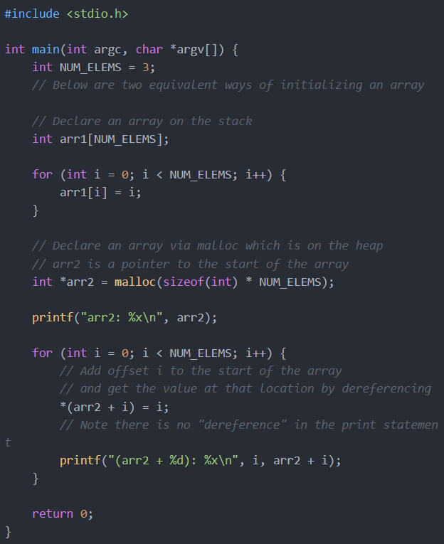
Arrays
C arrays can be tricky since we can represent them using the [] syntax or as pointers using the * syntax.
In the case of the [] syntax
  We can access elements by using the familiar arr1[index] syntax
In the case of the pointer * syntax
  malloc returns a pointer to the start of a buffer that is the same size as the argument that is passed in
  The value of int* arr2 in this case is a pointer to the start of a buffer of size 12
    Each int is 4 bytes and there are 3 of them

Slide 45

Review of arrays
There are no array variables in C – only array names
  Each name refers to a constant pointer (address of first element of array)
  Space for array elements is allocated at declaration time
Can’t change where the array name refers to…
  but you can change the array elements,
    via pointer arithmetic
  int m[4];
(int [])
???
(int)
???
(int)
???
(int)
???
(int)
m

Slide 46
Subscripts and pointer arithmetic
array[subscript] equivalent to *(array + (subscript))
Strange but true: Given earlier declaration of m, the expression 2[m] is legal!
  Not only that: it’s equivalent to:
      2[m]
      *(2+m)
      *(m+2)
      m[2]

Slide 47
Array names and Pointer Variables, playing together
(int [])
  int m[3];
  int* mid = m + 1;
  int* right = &mid[1];
  int* left = &mid[-1];
  int* beyond = &mid[2];
???
(int)
???
(int)
???
(int)
subscript OK
with pointer variable
m
int*
mid
int*
right
int*
(int [])
left
compiler may not catch this –
runtime environment certainly won’t
beyond

Slide 48
Array names as function arguments
In C, arguments are passed “by value”
  A temporary copy of each argument is created, solely for use within the function call:
  void f(int x, int* y) { … }
  void g(...) {
  int a = 17, b = 42;
  f(a, &b);
  …
  }
Pass-by-value is “safe” in that the function plays only in its “sandbox” of temporary variables –
  can’t alter the values of variables in the callee (except via the return value)
17
(int)
42
(int)
17
(int)
(int [])
a
b
x
y
g
f

Slide 49
Array Names as Function Arguments
But, functions that take arrays as arguments can exhibit what looks like “pass-by-reference” behavior, where the array passed in by the callee does get changed
  Remember the special status of arrays in C
    They are basically just pointers.
  So arrays are indeed passed by value
    but only the pointer is copied, not the array elements!
  Note the advantage in efficiency (avoids a lot of copying)
    But - the pointer copy points to the same elements as the callee’s array
    These elements can easily be modified via pointer manipulation

Slide 50
Array names as function arguments
The strcpy “string copy” function puts this “pseudo” call-by-reference behavior to good use:
  void strcpy(char* buffer, char const* string);
  void f(...) {
  char original[4] = "dog";
  char copy[4];
  strcpy(copy, original);
  }
(char [])
(char const*)
d
(char)
o
(char)
g
(char)
NUL
(char)
string
original
(char [])
(char*)
d
(char)
o
(char)
g
(char)
NUL
(char)
???
(char)
???
(char)
???
(char)
???
(char)
copy
buffer
f
strcpy

Slide 51
When can array size be omitted?
There are a couple of contexts in which an array declaration need not have a size specified:
  Parameter declaration:
  int strlen(char string[]); // same as: int strlen(char* string);
    As we’ve seen, the elements of the array argument are not copied, so the function doesn’t need to know how many elements there are.
  Array initialization:
  int vector[] = {1, 2, 3, 4, 5};
    In this case, just enough space is allocated to fit all (five) elements of the initializer list

Slide 52
Multidimensional arrays
How to interpret a declaration like:
int d[2][4];
This is an array with two elements:
  Each element is an array of four int values
The elements are laid out sequentially in memory, just like a one-dimensional array
  Row-major order: the elements of the rightmost subscript are stored contiguously
(int)
(int)
(int)
(int)
(int)
(int)
(int)
(int)
d[0][0]
d[0][1]
d[0][2]
d[0][3]
d[1][0]
d[1][1]
d[1][2]
d[1][3]
d[0]
d[1]

Slide 53
Subscripting in a multidimensional array
int d[2][4];
d[1][2]
*(d+1)
Then increment by the
size of 2 ints
*(*(d+1)+2)
Increment by the size of
1 array of 4 ints
(int)
(int)
(int)
(int)
(int)
(int)
(int)
(int)
d[0][0]
d[0][1]
d[0][2]
d[0][3]
d[1][0]
d[1][1]
d[1][2]
d[1][3]
d[0]
d[1]

Slide 54
Why do we care about Storage Order?
If you stay within the “paradigm” of the multidimensional array, the order doesn’t matter…
But if you use tricks with pointer arithmetic,
  it matters a lot
It also matters for initialization
  To initialize d like this:
    use this:
    int d[2][4] = {0, 1, 2, 3, 4, 5, 6, 7};
    rather than this
    int d[2][4] = {0, 4, 1, 5, 2, 6, 3, 7};
0 | 1 | 2 | 3
4 | 5 | 6 | 7

Slide 55
Multidimensional Arrays as Parameters
Only the first subscript may be left unspecified:
    void f(int matrix[][10]); /* OK */
    void g(int (*matrix)[10]); /* OK */
    void h(int matrix[][]); /* not OK */
Why?
  Because the other sizes are needed for scaling when evaluating subscript expressions (see previous slides)
  This points out an important drawback to C:
    Arrays do not carry information about their own sizes!
    If array size is needed, you must supply it somehow
    (e.g., when passing an array argument, you often have to pass an additional “array size” argument) – bummer

Slide 56
Malloc

Slide 57
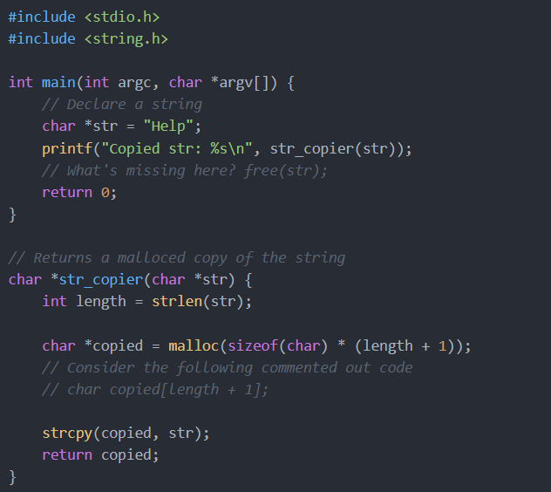
Using malloc
malloc returns a pointer to the start of a region of memory on the heap. It takes in the number of bytes to allocate.
Knowing the differences between malloc-ing data on the heap and declaring data on the stack is important for CSC4103.
Consider the commented out code
char copied[length + 1]
  If we were to use this line of code instead of the line with malloc, what would happen?
  It's possible we get a segfault or the returned string is garbage!
  This happens because we declared our string on the stack inside the str_copier function frame and returned a pointer to the string located in the function frame
  But when we return from str_copier, the stack frame is deallocated so now we have a dangling pointer to a location in the deallocated function frame!
  So never declare things on the stack and then return them!

Slide 58
Overview of Memory Management
Stack-allocated memory
  When a function is called, memory is allocated for all of its parameters and local variables.
  Each active function call has memory on the stack (with the current function call on top)
  When a function call terminates,
    the memory is deallocated (“freed up”)
Ex: main() calls f(),
f() calls g()
g() recursively calls g()
g()
g()
f()
main()

Slide 59
Overview of Memory Management
Heap-allocated memory
  This is used for persistent data, that must survive beyond the lifetime of a function call
    global variables
    dynamically allocated memory – C statements can create new heap data (similar to new in Java/C++)
  Heap memory is allocated in a more complex way than stack memory
  Like stack-allocated memory, the underlying system determines where to get more memory – the programmer doesn’t have to search for free memory space!

Slide 60
Allocating new Heap Memory
void* malloc(size_t size);
Allocate a block of size bytes,
  return a pointer to the block
  (NULL if unable to allocate block)
void* calloc(size_t num_elements, size_t element_size);
Allocate a block of num_elements * element_size bytes,
  initialize every byte to zero,
  return pointer to the block
  (NULL if unable to allocate block)
Note: void * denotes a generic pointer type

Slide 61
Allocating new Heap Memory
void* realloc(void* ptr, size_t new_size);
Given a previously allocated block starting at ptr,
  change the block size to new_size,
  return pointer to resized block
    If block size is increased, contents of old block may be copied to a completely different region
    In this case, the pointer returned will be different from the ptr argument, and ptr will no longer point to a valid memory region
If ptr is NULL, realloc is identical to malloc
Note: may need to cast return value of malloc/calloc/realloc:
  char* p = (char*) malloc(BUFFER_SIZE);

Slide 62
Deallocating Heap Memory
void free(void* pointer);
Given a pointer to previously allocated memory,
  put the region back in the heap of unallocated memory
Note: easy to forget to free memory when no longer needed...
  especially if you’re used to a language with “garbage collection” like Java
  This is the source of the notorious “memory leak” problem
  Difficult to trace – the program will run fine for some time, until suddenly there is no more memory!

Slide 63
Checking for successful Allocation
Call to malloc might fail to allocate memory, if there’s not enough available
Easy to forget this check, annoying to have to do it every time malloc is called...

Slide 64
Memory errors
Using memory that you have not initialized
Using memory that you do not own
Using more memory than you have allocated
Using faulty heap memory management

Slide 65
Structs

Slide 66
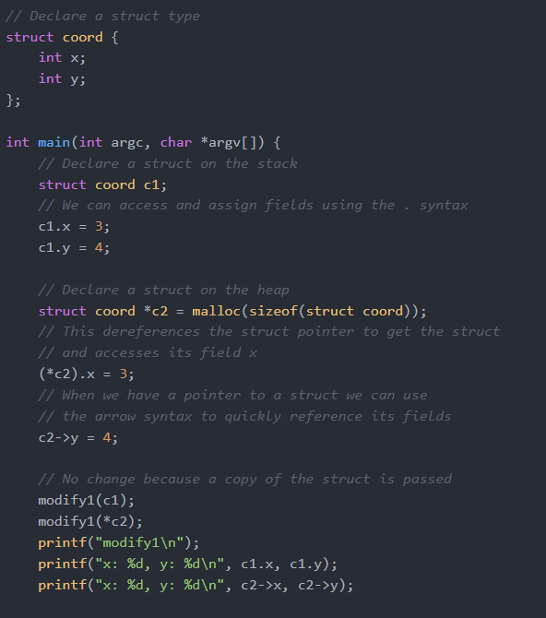
Structs
Structs organize and group variables in a container so that they're easily accessible by a single pointer.
As in other languages, creating objects is extremely helpful in keeping your abstractions clean!
Let's analyze the code
  We can declare a struct type by using the struct name {fields}; syntax.
  To access fields of a struct value, we can use the . (dot) syntax.
  To access fields of a struct pointer, we have two choices
    We can dereference the pointer to get a struct value and then use the . (dot) notation
    Or we can use the arrow notation -> to quickly do the first option
    The arrow notation is probably the cleaner and quicker method

Slide 67
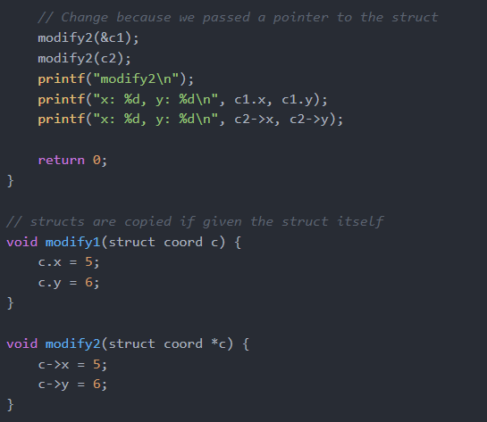
Structs
When we pass struct values into functions (such as modify1), they are copied
  This means any changes we make to that struct are not reflected in the original struct
When we pass struct pointers into functions (such as modify2), the original struct may be modified
  Since we have a pointer, we can go to the location of the struct and modify that struct

Slide 68
C structures: aggregate, yet scalar
aggregate in that they hold multiple data items at one time
  named members hold data items of various types
  like the notion of class/field in C++
    but without the data hiding features
scalar in that C treats each structure as a unit
  as opposed to the “array” approach: a pointer to a collection of members in memory
  entire structures (not just pointers to structures) may be passed as function arguments, assigned to variables, etc.
  Interestingly, they cannot be compared using ==
    (rationale: too inefficient)

Slide 69
Structure Declarations
Combined variable and type declaration
  struct tag {member-list} variable-list;
Any one of the three portions can be omitted
struct { int a, b; char* p; } x, y; /* omit tag (type name) */
  variables x, y declared with members as described:
    int members a, b and char pointer p.
  x and y have same type, but differ from all others –
    even if there is another declaration:
      struct { int a, b; char *p; } z;
    /* z has different type from x, y */

Slide 70
Structure Declarations
struct S { int a, b; char* p; }; /* omit variables */
No variables are declared, but there is now a type struct S that can be referred to later
struct S z; /* omit members */
  Given an earlier declaration of struct S, this declares a variable of that type
typedef struct { int a, b; char* p; } S;
/* omit both tag and variables */
  This creates a simple type name S
    (more convenient than struct S)

Slide 71
Recursively defined Structures
Obviously, you can’t have a structure that contains an instance of itself as a member – such a data item would be infinitely large
But within a structure you can refer to structures of the same type, via pointers
  struct TREENODE {
  char *label;
  struct TREENODE *leftchild, *rightchild;
  }

Slide 72
Recursively defined Structures
When two structures refer to each other, one must be declared in incomplete (prototype) fashion
  struct HUMAN;
  struct PET {
  char name[NAME_LIMIT];
  char species[NAME_LIMIT];
  struct HUMAN* owner;
  } fido = {"Fido", "Canis lupus familiaris", NULL};
  struct HUMAN {
  char name[NAME_LIMIT];
  struct PET pets[PET_LIMIT];
  } sam = {"Sam", {fido}};
We can’t initialize the owner member at this point,
since it hasn’t been declared yet

Slide 73
Member Access
Direct access operator s.m
  subscript and dot operators have same precedence and associate left-to-right, so we don’t need parentheses for sam.pets[0].species
Indirect access s->m: equivalent to (*s).m
  Dereference a pointer to a structure, then return a member of that structure
  Dot operator has higher precedence than indirection operator , so parentheses are needed in (*s).m
  (*fido.owner).name or fido.owner->name
. evaluated first: access owner member
* evaluated next: dereference pointer to HUMAN
. and -> have equal precedence and associate left-to-right

Slide 74
Memory Layout
struct COST { int amount;
char currency_type[2]; };
struct PART { char id[2];
struct COST cost;
int num_avail; };
layout of struct PART:
Here, the system uses 4-byte alignment of integers,
  so amount and num_avail must be aligned
Four bytes wasted for each structure!
currency_type
id
amount
num_avail
cost

Slide 75
Memory layout
A better alternative (from a space perspective):
  struct COST { int amount;
  char currency_type[2]; };
  struct PART { struct COST cost;
  char id[2];
  int num_avail; };
currency_type
amount
id
num_avail
cost

Slide 76
Structures as Function Arguments
Structures are scalars, so they can be returned and passed as arguments – just like ints, chars
struct BIG changestruct(struct BIG s);
  Call by value: temporary copy of structure is created
  Caution: passing large structures is inefficient
    – involves a lot of copying
avoid by passing a pointer to the structure instead:
  void changestruct(struct BIG* s);
What if the struct argument is read-only?
  Safe approach: use const
  void changestruct(struct BIG const* s);

Slide 77
OOP with C
  struct cost { int amount; char currency_type; };
  struct cost* cost_init() { return malloc(sizeof(cost)); }
  void cost_free(struct cost* c) { free(c); }
  void cost_set(struct cost* c, int amount, char type)
  { c->amount = amount; c->currency_type = type; }
  struct cost* c = cost_init();
  if (c == NULL) { … error … }
  cost_set(c, 42, '$');
  cost_free(c);

Slide 78
Unions
Like structures, but every member occupies the same region of memory!
  Structures: members are placed consecutively in memory
  Unions: members are place in the same spot in memory
  union VALUE {
  float f;
  int i;
  char *s;
  };
  /* either a float or an int or a char* */

Slide 79
Unions
Up to programmer to determine how to interpret a union (i.e. which member to access)
Often used in conjunction with a “type” variable that indicates how to interpret the union value
  Called ‘discriminated union’
  enum TYPE { INT, FLOAT, STRING };
  struct VARIABLE {
  enum TYPE type;
  union VALUE value;
  };
Access type to determine how to interpret value

Slide 80
Strings

Slide 81
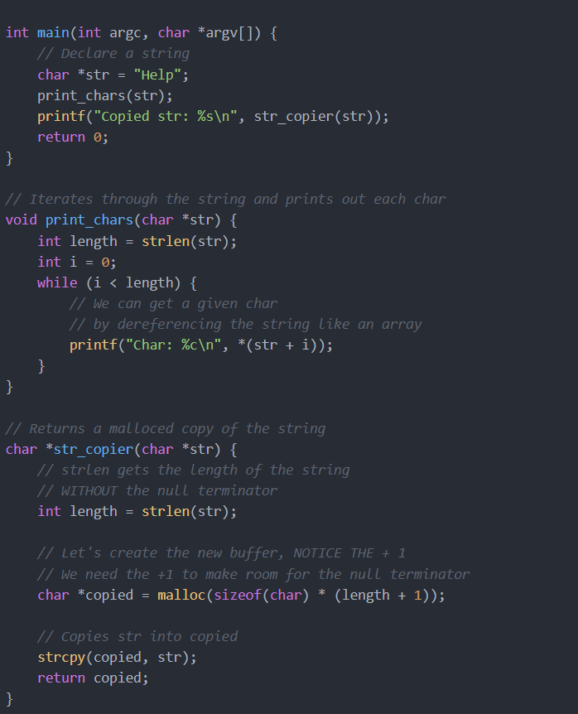
Strings
A string is an array of characters ending with a null terminator \0.
So, we can represent strings as a char * type (an array of chars).
Let's analyze the code
  We can declare a string as an array using either syntax, in this case we chose the pointer syntax.
  In print_chars, we can iterate through the string by using the same array dereferencing and pointer arithmetic method.
  In str_copier, notice that strlen returns the length of the string excluding the null terminator.
  If we didn't have the + 1 in our malloc call, then we wouldn't have enough space to fit both help and the \0

Slide 82
Review of strings
Sequence of zero or more characters, terminated by NUL (literally, the integer value '\0')
NUL terminates a string, but isn’t part of it
  important for strlen() – length doesn’t include the NUL
Strings are accessed through pointers/array names
string.h contains prototypes of many useful functions

Slide 83
String literals
Evaluating ″dog″ results in memory allocated for three characters
′d ′, ′ o ′, ′ g ′, plus terminating NUL
  char* m = "dog";
Note: If m is an array name, subtle difference:
  char m[10] = "dog";
This is not a string literal;
It’s an array initializer in disguise!
Equivalent to {′d′,′o′,′g′,′\0′}
10 bytes are allocated for this array

Slide 84
String manipulation functions
Read some “source” string(s), possibly write to some “destination” location
  char* strcpy(char* dst, char const* src);
  char* strcat(char* dst, char const* src);
Programmer’s responsibility to ensure that:
  destination region large enough to hold result
  source, destination regions don’t overlap
    “undefined” behavior in this case
    according to C spec, anything could happen!
  char m[10] = "dog";
  strcpy(m+1, m);
Assuming that the implementation of strcpy starts copying left-to-right without checking for the presence of a terminating NUL first, what will happen?

Slide 85
strlen() and size_t
  size_t strlen(char const* string);
  /* returns length of string */
size_t is an unsigned integer type, used to define sizes of strings and (other) memory blocks
  Reasonable to think of “size” as unsigned”...
  But beware! Expressions involving strlen() may be unsigned (perhaps unexpectedly)
if (strlen(x) – strlen(y) >= 0) ...
avoid by casting:
((int) (strlen(x) – strlen(y)) >= 0)
  Problem: what if x or y is a very large string?
a better alternative: (strlen(x) >= strlen(y))
always true!

Slide 86
strcmp() “string comparison”
int strcmp(char const* s1, char const* s2);
  returns a value less than zero if s1 precedes s2 in lexicographical order;
  returns zero if s1 and s2 are equal;
  returns a value greater than zero if s1 follows s2.
Source of a common mistake:
  seems reasonable to assume that strcmp returns “true” (nonzero) if s1 and s2 are equal; “false” (zero) otherwise
  In fact, exactly the opposite is the case!

Slide 87
Restricted vs. unrestricted string functions
Restricted versions: require an extra integer argument that bounds the operation
  char* strncpy(char* dst, char const* src, size_t len);
  char* strncat(char* dst, char const* src, size_t len);
int strncmp(char const* s1, char const* s2, size_t len);
  “safer” in that they avoid problems with missing NUL terminators
  safety concern with strncpy:
  If bound isn’t large enough, terminating NUL won’t be written
  Safe alternative:
  strncpy(buffer, name, BSIZE);
  buffer[BSIZE-1] = ′\0′;

Slide 88
String searching
char* strpbrk(char const* str, char const* group);
/* return a pointer to the first character in str
that matches *any* character in group;
return NULL if there is no match */
size_t* strspn(char const* str, char const* group);
/* return number of characters at beginning of str
that match *any* character in group */

Slide 89
strtok “string tokenizer”
char* strtok(char* s, char const* delim);
/* delim contains all possible ″tokens″:
characters that separate ″tokens″.
if delim non-NULL:
return ptr to beginning of first token in s,
and terminate token with NUL.
if delim is NULL:
use remainder of untokenized string from the
last call to strtok */

Slide 90
strtok in action
for (token = strtok(line, whitespace);
token != NULL;
token = strtok(NULL, whitespace))
printf("Next token is %s\n", token);
d
o
g
NUL
c
a
t
NUL
NUL
NUL
line
token

Slide 91
An implementation of strtok
old contains the remains
of an earlier s value
(note use of static)
char* strtok(char* s, const char* delim) {
static char *old = NULL;
char *token;
if (! s) { s = old; if (! s) return NULL; }
if (s) {
s += strspn(s, delim);
if (*s == 0) { old = NULL; return NULL; }
}
token = s;
s = strpbrk(s, delim);
if (s == NULL) old = NULL;
else { *s = 0; old = s + 1; }
return token;
}
NULL has been passed in for s,
so consult old
strspn returns number of delimiters
at beginning of s – skip past these characters
strpbrk gives the position of the next delimiter.
s is updated to this position, but token still points to the token to return.

Slide 92
Memory operations
Like string operations, work on sequences of bytes
  but do not terminate when NUL encountered
  void* memcpy(void* dst, void const* src, size_t length);
  void* memcmp(void const* a, void const* b, size_t length);
Note: memmove works like memcpy, but allows overlapping source, destination regions
Remember, these operations work on bytes
  If you want to copy N items of type T, get the length right:
  memcpy(to, from, N * sizeof(T))

Slide 93








