Slide 1
OS Fundamentals
Topic 1
Hartmut Kaiser
https://teaching.hkaiser.org/fall2025/csc7103/

Slide 2
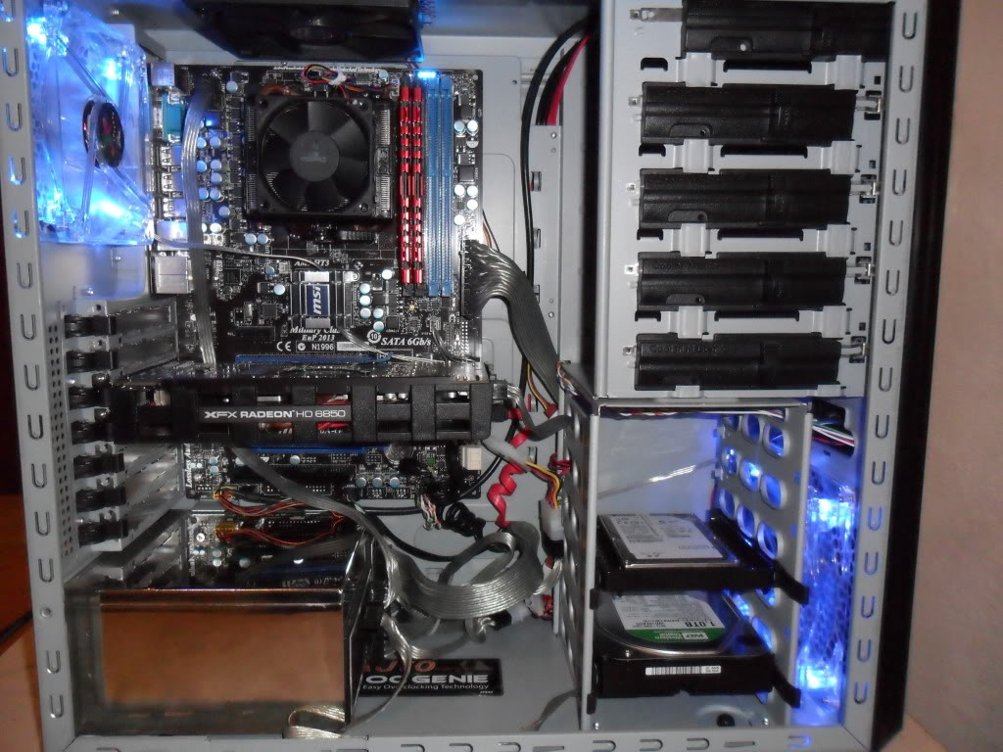
Computer System Structure
Computer system can be divided into four components:
  Hardware – provides basic computing resources (CSC 3501)
    CPU, memory, I/O devices, graphics card, storage
  Operating system
    Controls and coordinates use of hardware among various applications and users
  Application programs – define how the system resources are used to solve the computing problems of the users
    Database, web server, mail server
    Web browsers (Chrome), office apps
    Video games, iTunes
  Users
    People, machines, other computers

Slide 3
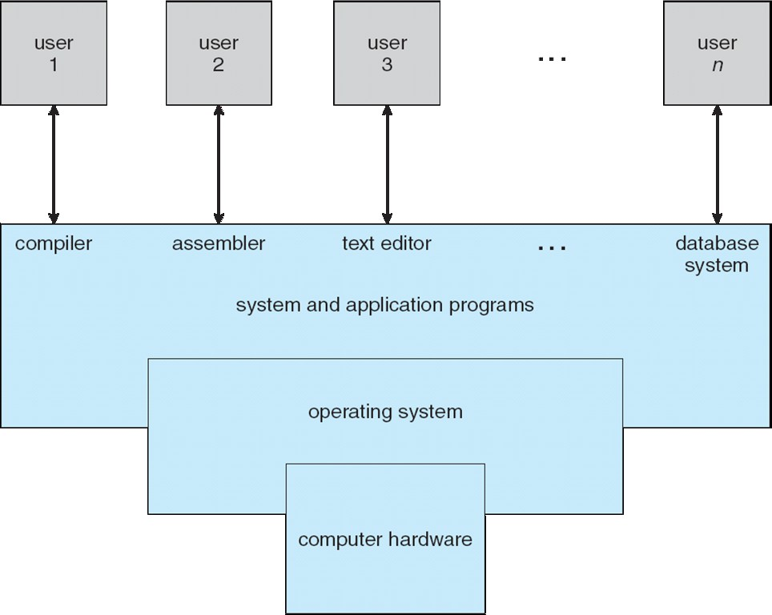
Four Components of a Computer System

Slide 4
What is an Operating System?
A program that acts as an intermediary between a user of a computer and the computer hardware
Operating system goals:
  Execute user programs and make solving user problems easier
  Make the computer system convenient to use
  Use the computer hardware in an efficient manner
User Programs
Operating Systems
Hardware

Slide 5
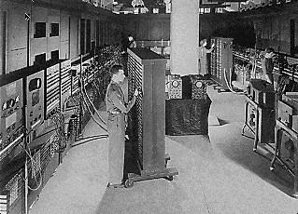
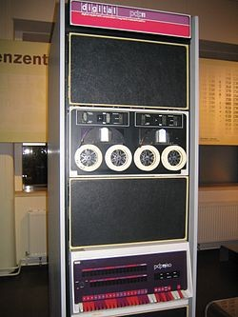
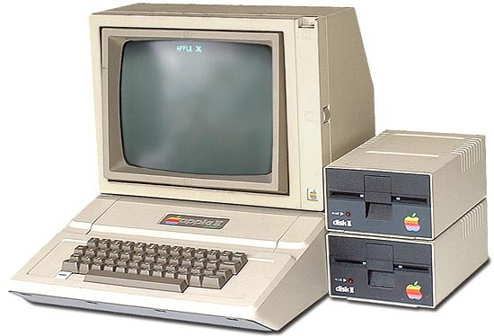
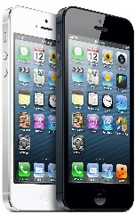
What Operating Systems Do
ENIAC (1946)
Depends on the point of view (requirements)
Users want convenience, ease of use and good performance
  Don't care about resource utilization
Shared computer such as mainframe or minicomputer must keep all users happy – fairness, utilization
Users of dedicate systems such as workstations have dedicated resources but frequently use shared resources from servers
Handheld computers are resource poor, optimized for usability and battery life – User experience (UX)
Some computers have little or no user interface, such as embedded computers in electronic devices and automobiles
PDP 11 (1970)
Apple II (1977)
iPhone (2007)

Slide 6



Operating System Definition
OS is a resource allocator (Referee)
  Manages all resources
  Decides between conflicting requests for efficient and fair
  resource use – it is all about tradeoff
OS is a control program (Illusionist)
  Controls execution of programs to prevent errors (reliability) and improper use (security) of the computer
Operating system is just like a “government” (Glue)
  It does not produce anything but provides an environment

Slide 7
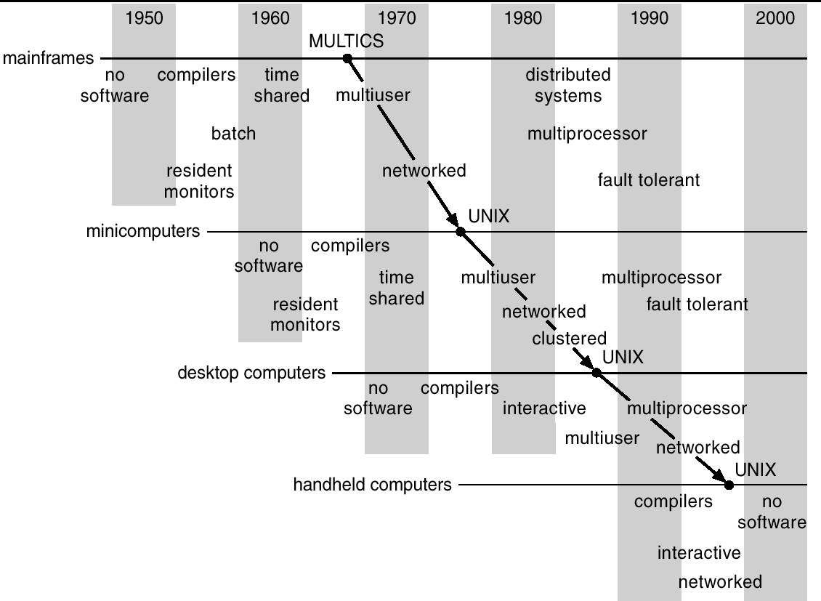
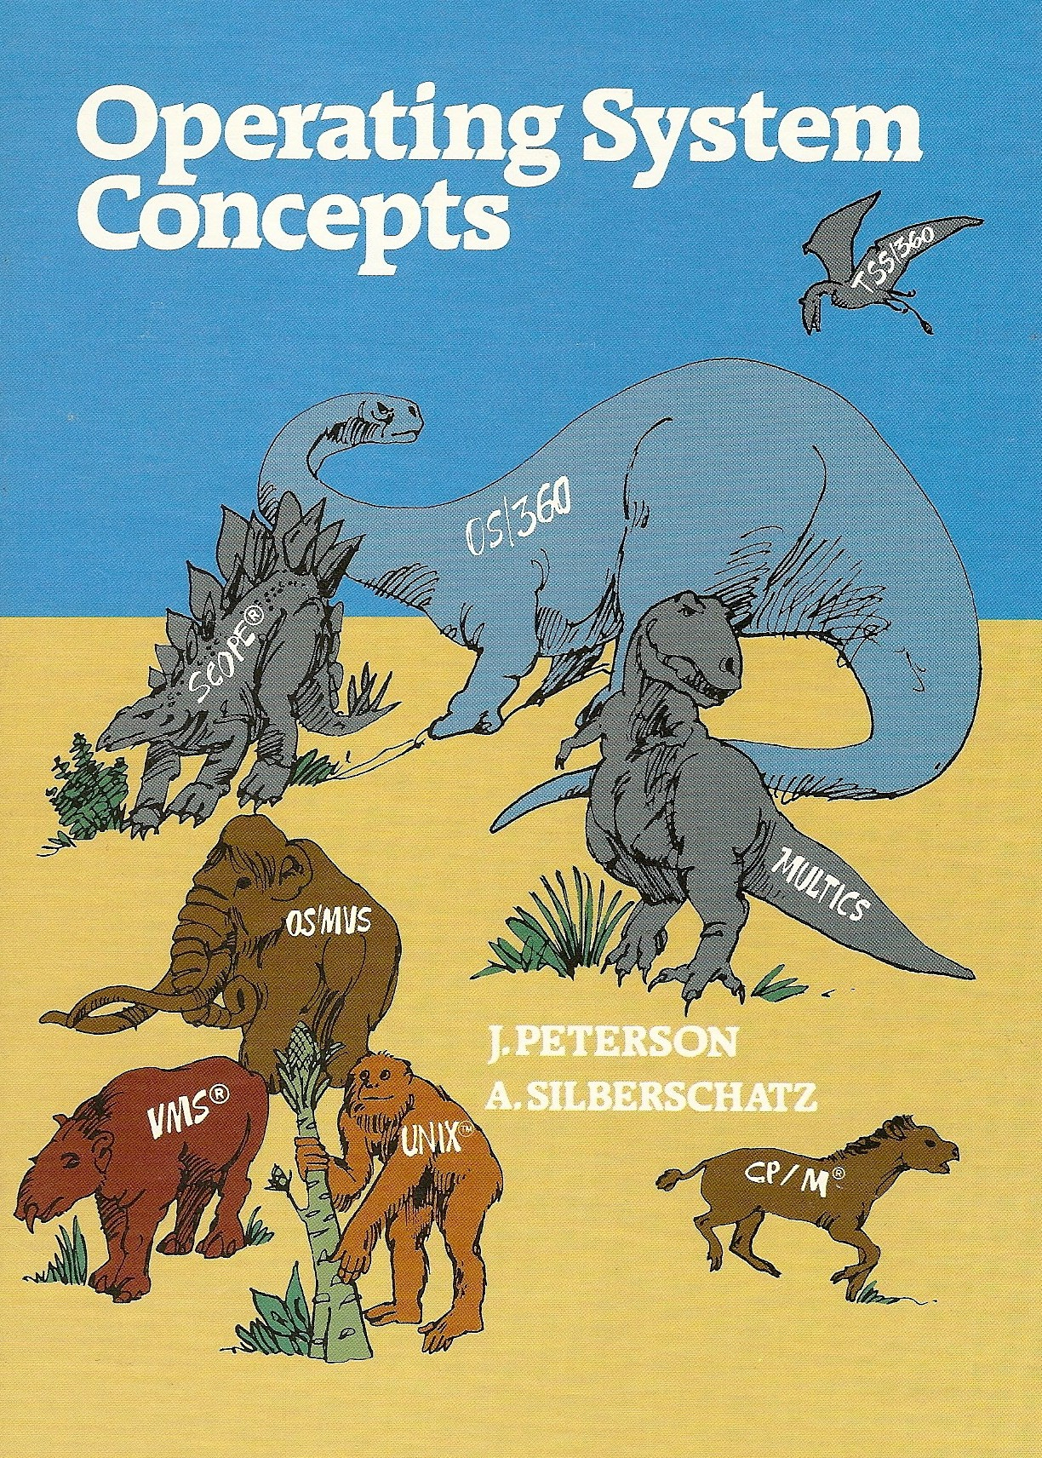
Operating Systems Evolve
UNIX
OSC 1st edition

Slide 8
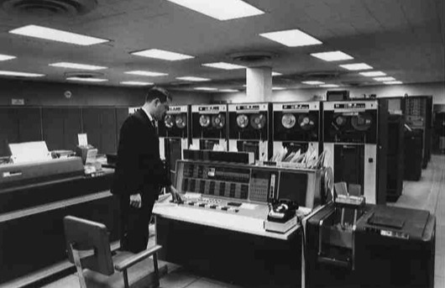
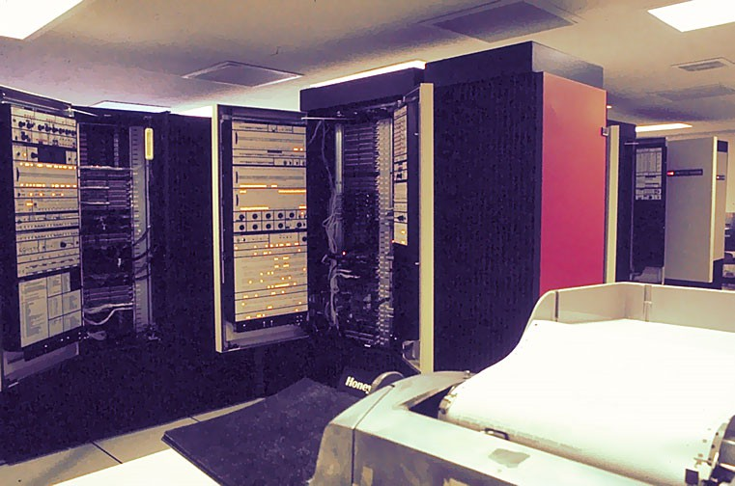
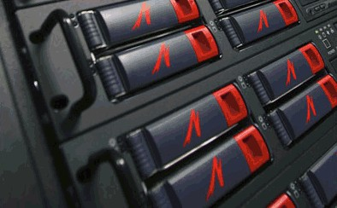
Mainframe Systems: OS Structures
Used to tackle scientific and commercial applications Batched, Multi-Programmed, Time-Shared Systems
ENIAC (1945), IBM 7094 (1965), Circa (1976), Supermike (2004)

Slide 9
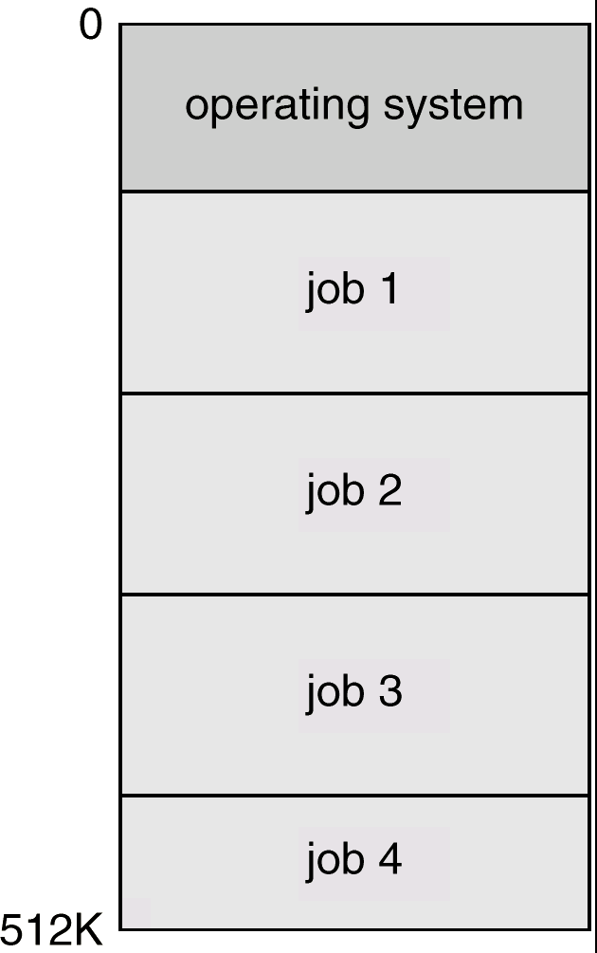
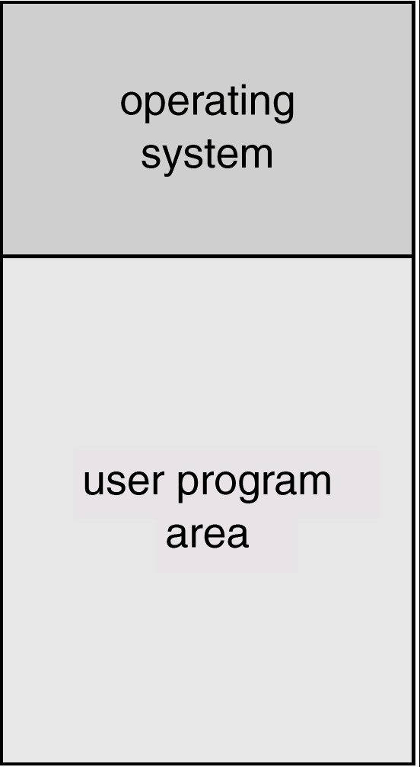
Batched versus Multiprogrammed Systems
Reduce setup time by batching similar jobs
Automatic job sequencing
When job completes control transfers back to monitor
Several jobs kept in the memory at the same time, and the CPU always has one job to execute
Main memory management
Job and CPU scheduling
U

Slide 10
Time-Sharing Systems
Interactive computing
CPU executes multiple jobs from different users as time evolves
  The users have concurrency transparency because they are not aware of the fact that the others are sharing the same system
  CPU scheduling and multiprogramming are important
A job swapped in and out of the main memory to the disk - swapping
On-line communication between the user and the system is provided
  Guarantee some acceptable (short) response time to each user

Slide 11
Single-Processor Systems: Desktops
Most systems use a single CPU – Not So true nowadays
Personal computer– computer system dedicated to a single user.
I/O devices – keyboards, mice, display screens, printers, networks
  Device-specific processors or controllers
User convenience and responsiveness
  No priority on resource utilization.
May run several different types of operating systems (Windows, Mac OS, UNIX, Linux)

Slide 12
Multiprocessor Systems
Multiprocessor systems grow in use and importance
  Also known as parallel systems or tightly coupled systems
More than one CPU or processor in close communication
  Share the clock, memory, computer bus, and peripheral devices
  Multicore chips – more than one computing core on a single processor
Advantages of parallel system:
  Increased throughput – Work can be done in parallel
  Economy of scale – cost less than multiple single-processor systems
  Increased reliability – jobs can fail over to the survived processors
Fault tolerance and graceful degradation is a hot research topic
1.13

Slide 13
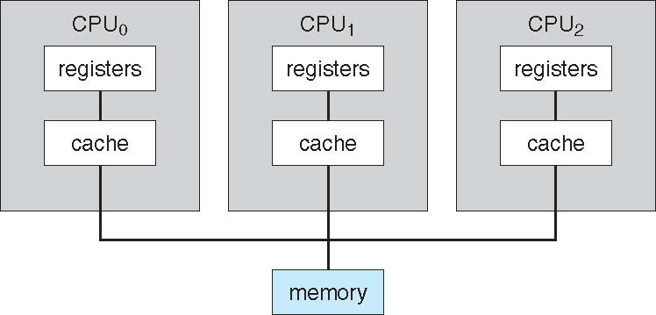
Multiprocessor Systems (Cont.)
Symmetric multiprocessing (SMP)
  Each processor runs an identical copy of the operating system
Asymmetric multiprocessing
  Each processor is assigned a specific task; master processor schedules and allocates work to slave processors.

Slide 14
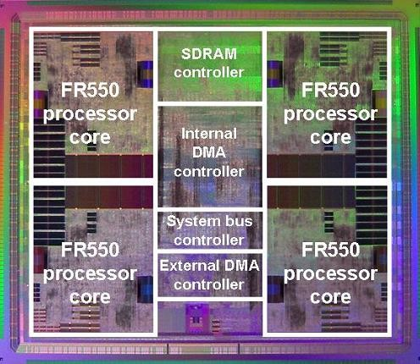
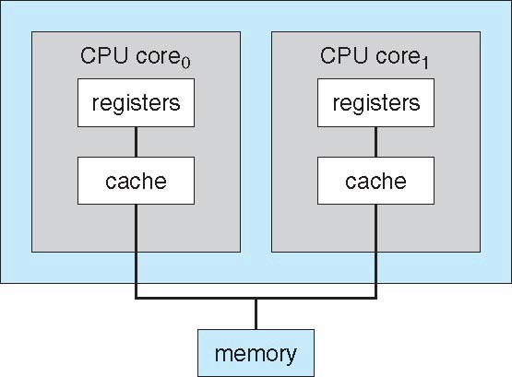
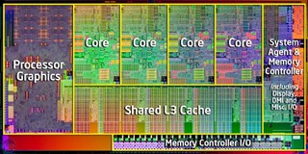
A Multi-Core Design
Fujistu Multi-core processor
Intel Sandy Bridget

Slide 15
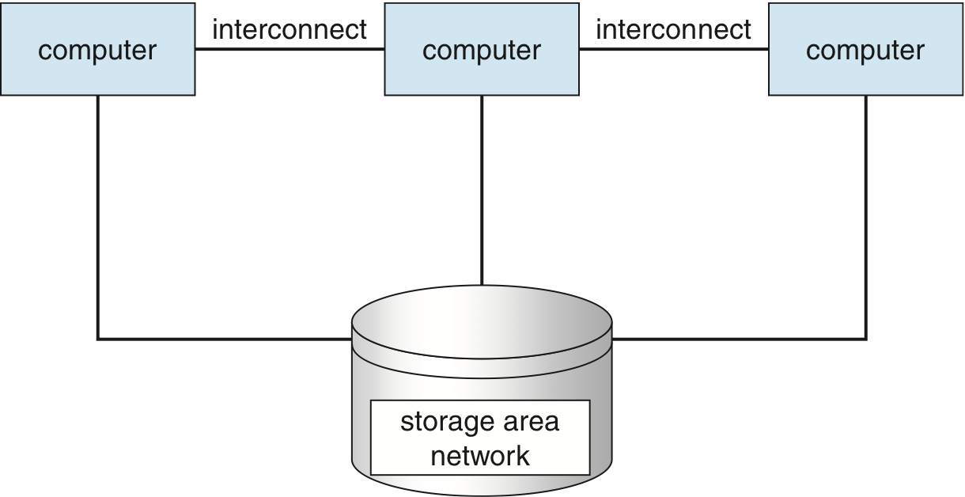
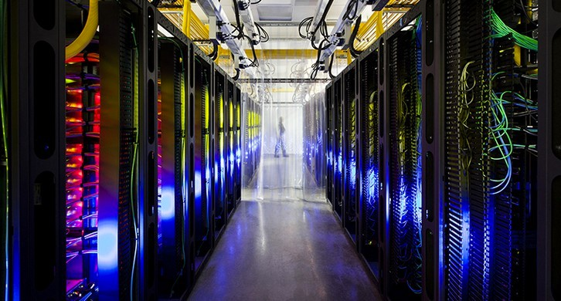
Clustered Systems
Like multiprocessor systems, but multiple systems (nodes) working together
  Usually sharing storage via a storage-area network (SAN)
  Provides a high-availability service which survives failures
    Asymmetric clustering has one machine in hot-standby mode
    Symmetric clustering has multiple nodes running applications, monitoring each other
  Some clusters are for high-performance computing (HPC)
    Applications must be written to use parallelization

Slide 16
Distributed Systems
A distributed system is a collection of physically separate, possibly heterogeneous computer systems that are networked to provide the users with access to the various resources that the system maintains
  Loosely coupled system – each processor has its own local memory and clock
  Processors communicate with one another through communication lines
Distributed systems require networking for their functionality:
  TCP/IP - the most common network protocol
  OS requires an interface device – a network adaptor
  Local-area network (LAN) or wide-area network (WAN)
  Notion of network operating system (file sharing, communication)
Advantages of distributed systems: resources sharing, computation speed up (load sharing), data availability, etc.
Distributed operating systems communicate closely enough to provide the illusion that only a single operating system controls the network

Slide 17
Real-Time Systems
Often used as a control device in a dedicated application:
  Embedded systems
Well-defined fixed-time constraints (e.g. flight control system)
Differ from time-sharing or batch systems which have flexibility with time
Variation in real-time systems:
  Hard real-time: guarantees that critical tasks be completed on time
  Soft real-time: critical task gets priority over other tasks, and retains that priority until it completes

Slide 18
Multimedia Systems
Incorporation of multimedia data into computer systems
  Audio, video and conventional files
Increasing number of applications:
  MP3 audio, DVD movies, video conferencing, video clips, live webcasts, live webcams
  Desktops and smaller devices
  Live or real-time streaming: Compress multimedia data and maintain frame rate

Slide 19
Handheld Systems
Examples:
  Personal Digital Assistants (PDAs)
  Cellular telephones
Issues:
  Limited memory
  Slow processors
  Small I/O devices
Network connectivity:
  Wireless access to e-mail, web browsing and different types of information sharing

Slide 20
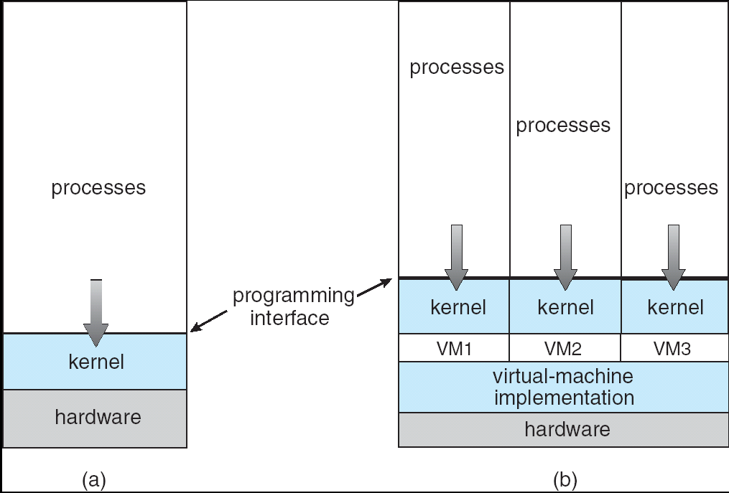
Virtual Machines
A virtual machine:
  Abstract the hardware of a single computer )the CPU, memory, disk drives, network interface cards, etc.)into several execution environments
  Application programs view everything under them as though the latter were a part of the machine itself
A virtual machine provides an interface identical to the underlying bare hardware
OS creates the illusion of multiple processes, each executing on their own private computers
Non-virtual Machine
Virtual Machine

Slide 21
Centralized OS vs Distributed OS
Normal centralized operating systems run on single or multiprocessor architectures
  Tightly coupled systems in that all resources are shared internally and the interprocess/interprocessor communication is achieved through either memory sharing or direct process interrupts
  Represent full-blown multiuser/multitasking systems
Distributed operating systems run on networked multiple-CPU systems which do not share the memory and clock
  Loosely coupled systems via LAN and WAN; high ratio of inter-processor communication time to intra-processor communication time
Distributed operating systems represent a centralized logical view of the software system that runs under a loosely coupled multiple computer system
  Transparency is a key property and goal of a distributed OS
  The users have a single-computer view of a multiple computer system. The existence of the underlying network and details of the implementation of the system are transparent to the user
  Concurrence transparency, location and access transparency, and performance transparency all are relevant in a distributed OS

Slide 22
Computer Organization

Slide 23
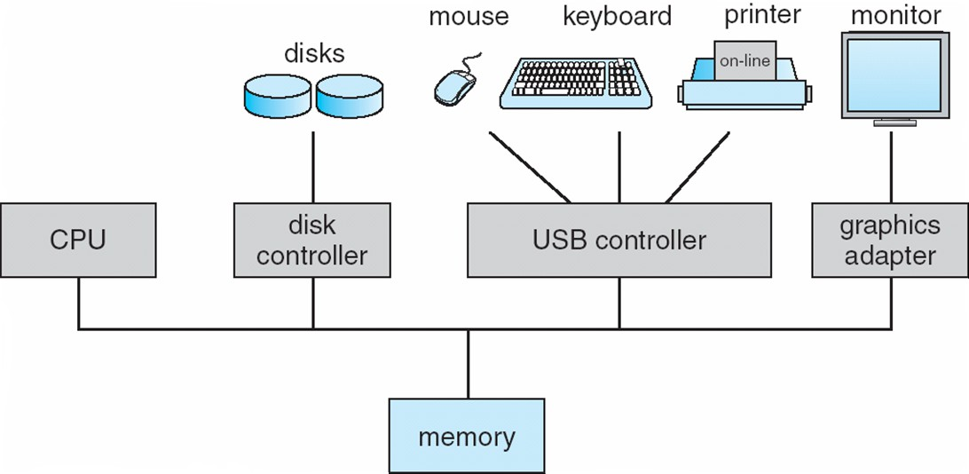
Modern Computer Organization
One or more CPUs, device controllers connect through common bus providing access to shared memory
Concurrent execution of CPUs and devices competing for memory cycles

Slide 24
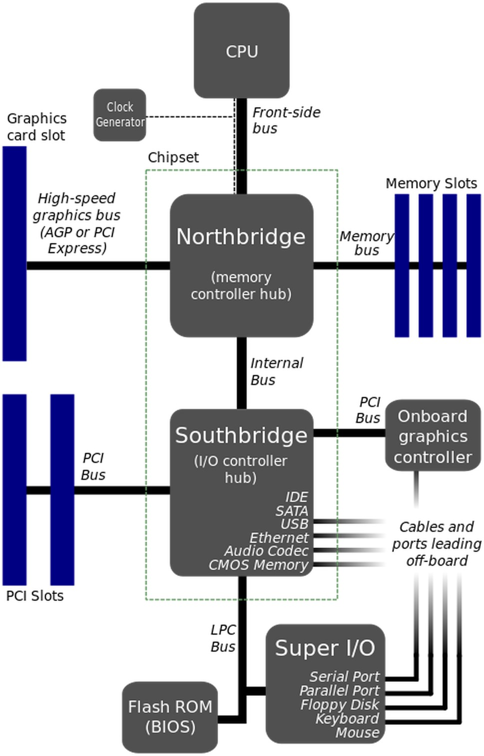
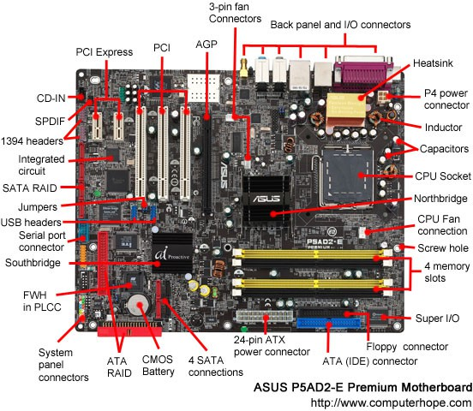
Computer System Organization
Logical organization
A computer motherboard

Slide 25
Computer Hardware Support
The hardware must provide appropriate mechanisms to ensure correct operation of the computer system and to prevent user programs from interfering with OS
Computer system operation
  System startup
  Interrupt-driven
Related hardware components and mechanisms
  I/O structure
  Storage structure and hierarchy
  Hardware protection
  Network structure

Slide 26
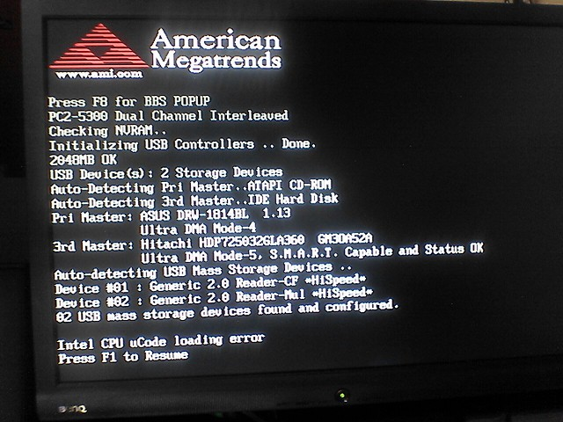
Computer Startup
The Bootstrap program is loaded at power-up or reboot
  Typically stored in ROM or EPROM, generally known as firmware
    Firmware – Software stored in chip, could be updated
  Initializes all aspects of the system from hardware to software
  Loads operating system kernel and starts execution

Slide 27
Computer System Operation
I/O devices and the CPU can execute concurrently
Each device controller is in charge of a particular device type
Each device controller has a local buffer
CPU moves data from/to main memory to/from local buffers
I/O is from the device to local buffer of controller
Device controller informs CPU that it has finished its operation by causing an interrupt

Slide 28
Interrupts
An operating system is interrupt driven
Interrupt transfers control to the interrupt service routine generally, through the interrupt vector, which contains the addresses of all the service routines
Interrupt architecture must save the address of the interrupted instruction (for returning back to the original position)
Incoming interrupts are disabled while another interrupt is being processed to prevent a lost interrupt
A trap or exception is a software-generated interrupt caused either by an error or a user request
int 0x80 – generate an interrupt with ID 0x80

Slide 29
Interrupts
An operating system is Interrupt Driven
  OS executes the first process (such as init) and waits for some event to occur.
  Occurrence of an event is signaled by an interrupt from either hardware (e.g., DVD drive) or software (e.g., trap).
Interrupt handling
  The operating system preserves the state of the CPU by storing registers and the program counter (PC)
  Interrupt transfers control to the interrupt service routine through the interrupt vector
  Interrupt architecture must save the address (PC) of the interrupted instruction.
  After servicing the interrupt, the state and return address are restored

Slide 30
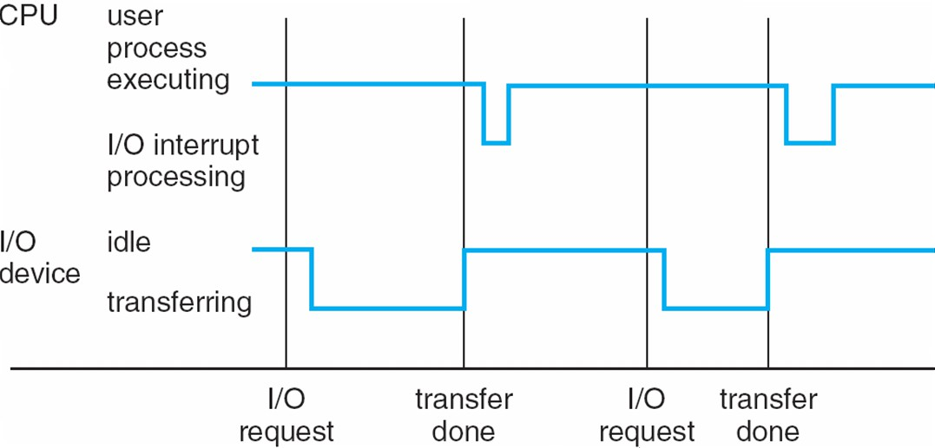
Interrupt Timeline
Work is done!
When the CPU is interrupted, it stops what it is doing and immediately transfers execution to the fixed location of the service routine.

Slide 31
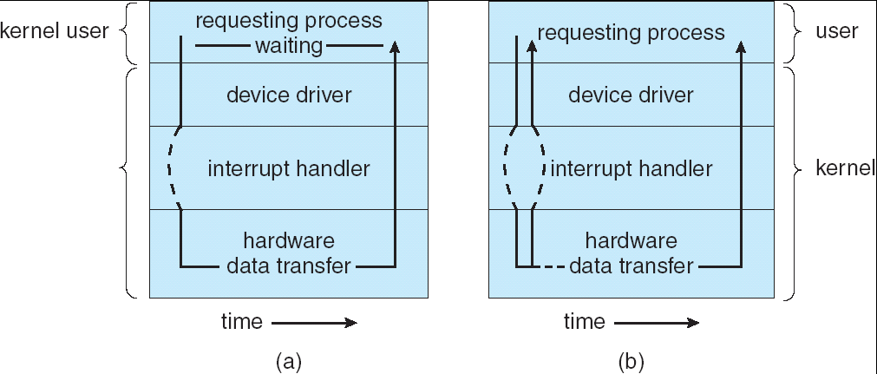
I/O Structure
Device controller informs CPU (through device driver) that it has finished its operation by causing an interrupt.
Synchronous I/O: Control returns to user program (or other OS code) only upon I/O completion.
  Wait instruction idles the CPU until the next interrupt.
Asynchronous I/O: Control returns to user program without waiting for I/O completion.

Slide 32
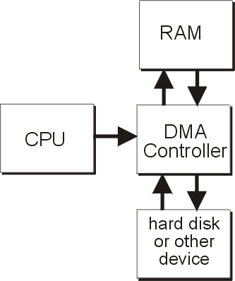
Direct Memory Access Structure
Too many interrupts slows down the entire system
DMA is used for high-speed I/O devices able to transmit information at close to memory speeds
Device controller transfers blocks of data from buffer storage directly to main memory without CPU intervention
Only one interrupt is generated per block, rather
than the one interrupt per byte

Slide 33
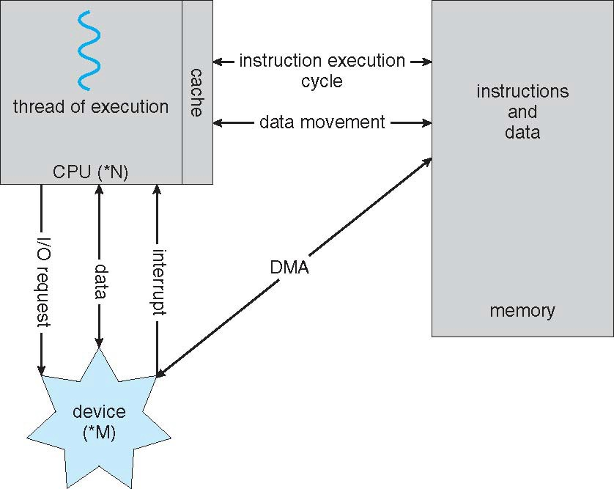
How a Modern Computer Works

Slide 34
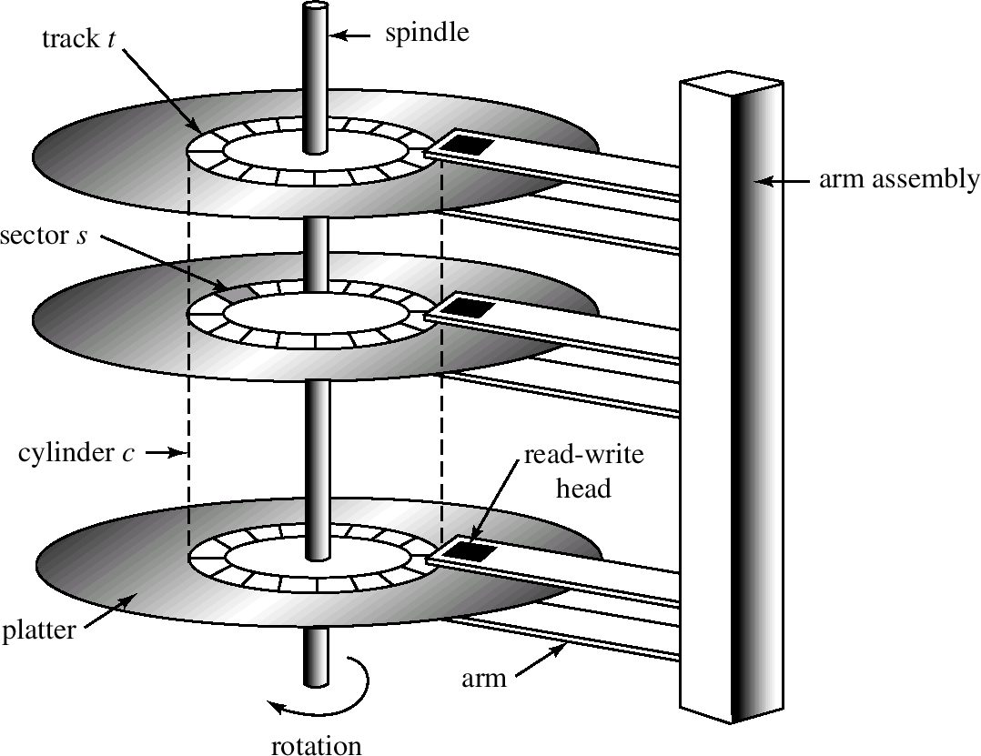

Storage Structure
Main memory – only large storage media that the CPU can access directly – random access, volatile, byte-addressable, fast, small
Secondary storage – extension of main memory that provides large storage capacity – block access, nonvolatile, slow, big
  Hard disks – rigid metal or glass platters covered with magnetic recording material
    Disk surface is logically divided into tracks, which are subdivided into sectors
    The disk controller determines the logical interaction between the device and the computer
  Solid-state disks – faster than hard disks, nonvolatile
    Various technologies
    Becoming more popular
Flash Memory
Hard disk

Slide 35
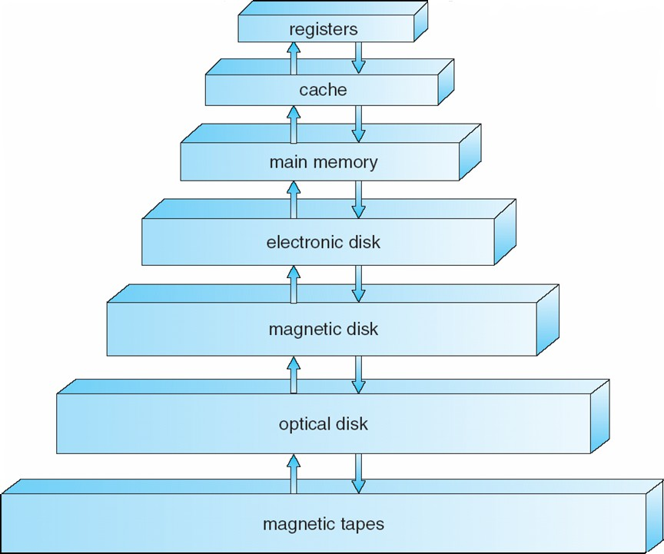
Storage Hierarchy
Storage systems organized in hierarchy
  Speed
  Cost
  Volatility
Caching – copying information into faster storage system; main memory can be viewed as a last cache for secondary storage

Slide 36
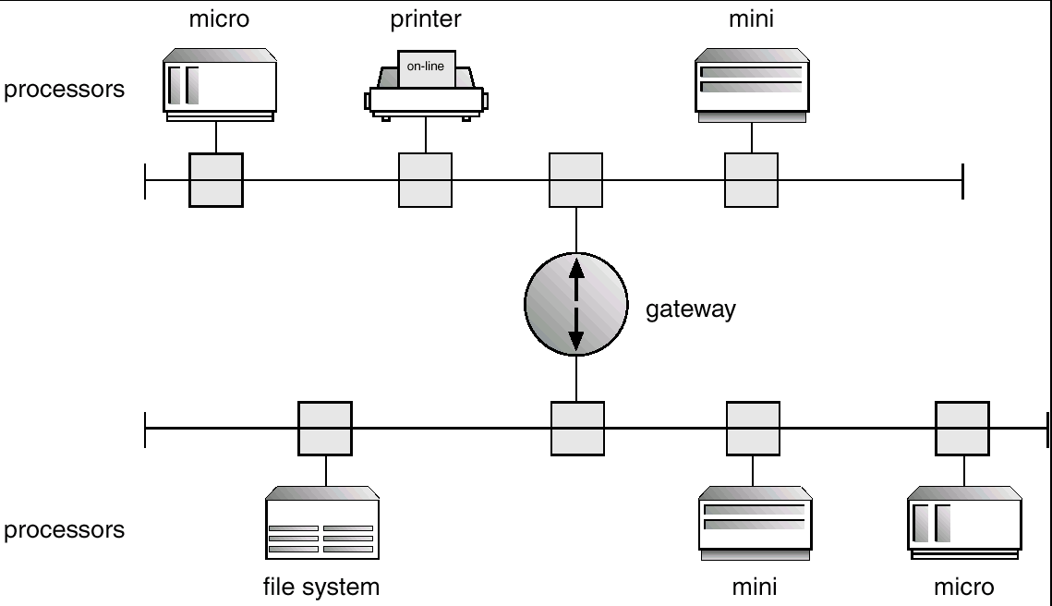
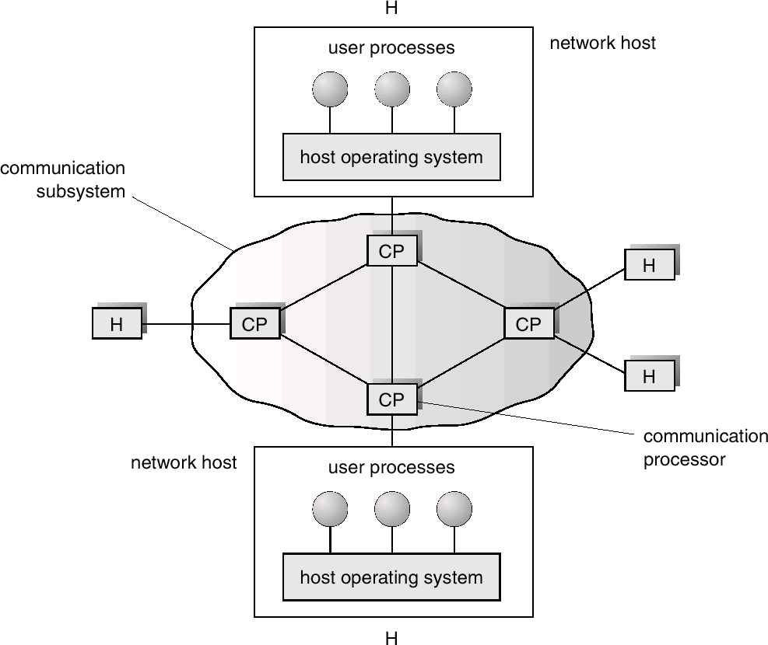
Network Structure
Two types of networks based on how they are geographically distributed:
Local Area Networks (LAN)
  Processors distributed over small geographical areas (such as single building or a number of adjacent buildings).
Wide Area Networks (WAN)
  Processors distributed over a large geographical area (such as the US).
Variations in speed and reliability communications
  LAN has a higher speed, lower error rate and more expensive connections

Slide 37
Operating System Structure

Slide 38
Operating System Structure
Multiprogramming needed for efficiency – Improvement over sequential execution
  Single user cannot keep CPU and I/O devices busy at all times
  Multiprogramming organizes jobs (code and data) so CPU always has one to execute
  A subset of total jobs in system is kept in memory – buffering
  One job selected and run via job scheduling
  When it has to wait (for I/O for example), OS switches to another job
Timesharing (multitasking) is logical extension in which CPU switches jobs so frequently that users can interact with each job while it is running, creating interactive computing
  Response time should be < 1 second
  Each user has at least one program executing in memory c:process
  If several jobs ready to run at the same time c: CPU scheduling
  If processes don’t fit in memory, swapping moves them in and out to run
  Virtual memory allows execution of processes not completely in memory

Slide 39
Hardware Protection
Errors can come from any malfunctioning program.
Protection of the OS against errors using hardware support:
  Hardware can detect the errors and it will trap to the OS thereby transferring control to the OS by interrupt.
Dual-Mode Operation
  User mode vs. Kernel mode; hardware support
I/O Protection
  OS must ensure user apps never gain control of hardware
  Using syscall interface; I/O operations are privileged operations
Memory Protection
  Users are not allowed to access OS or other programs’ memory
CPU Protection
  Prevent a user program stuck in an infinite loop; Timer interrupt

Slide 40
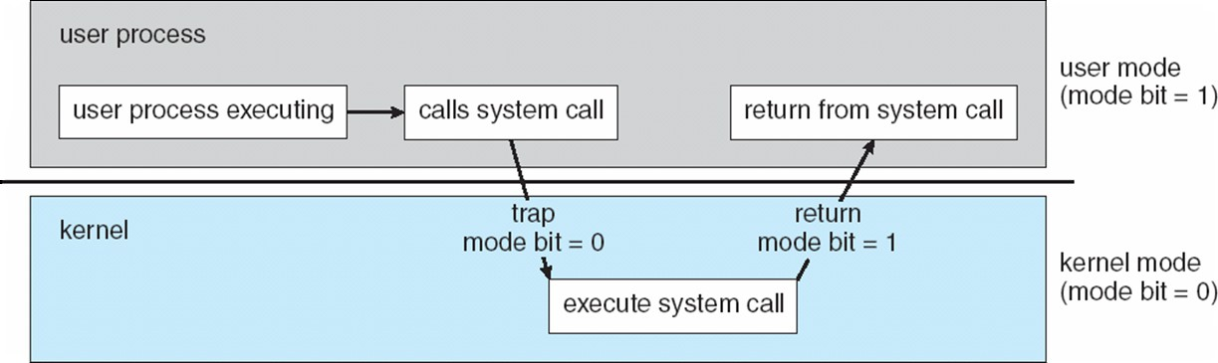
Operating-System Operations (cont.)
Dual-mode allows OS to protect itself and other system components
  User mode and kernel mode
  Mode bit provided by hardware
    Enables to distinguish when system is running user or kernel code
    Some instructions are privileged, only executable in kernel mode
    System call changes mode to kernel, return from call resets it to user
Increasingly CPUs support multi-mode operations
  i.e. virtual machine manager (VMM) mode for guest VMs

Slide 41
Process Management
A process is a program in execution. It is a unit of work within the system. Program is a passive entity, process is an active entity.
Process needs resources to accomplish its task
  CPU, memory, I/O, files
  Initialization data (e.g., opening a file needs a file name)
Process termination requires reclaim of any reusable resources
Single-threaded process has one program counter specifying location of next instruction to execute
  Process executes instructions sequentially, one at a time, until completion
Multi-threaded process has one program counter per thread
Typically system has many processes, some user, some operating system running concurrently on one or more CPUs
  Concurrency by multiplexing the CPUs among the processes / threads

Slide 42
Memory Management
To execute a program all (or part) of the instructions must be in memory
All (or part) of the data that is needed by the program must be in memory.
Memory management determines what is in memory and when
  Optimizing CPU utilization and computer response to users
Memory management activities
  Track which parts of memory are currently being used and by whom
  Deciding which processes (or parts thereof) and data to move into and out of memory
  Allocating and deallocating memory space as needed

Slide 43
File-System Management
Computers can store information in different physical media (e.g., disks, tapes)
OS provides a logical (an abstract) view of information storage, i.e., define a logical storage unit called the file
  OS maps files into physical media, and accesses these files via the storage devices such as disk drive
A file is a collection of related information (program or data) defined by its creator
OS is responsible for all file management activities:
  file creation and deletion
  directory creation and deletion
  support of primitives for manipulating files and directories
  mapping files onto secondary storage
  file backup on stable (nonvolatile) storage media

Slide 44
Storage Management
OS provides uniform, logical view of information storage
  Abstracts physical properties to logical storage unit - file
  Each medium is controlled by device (i.e., disk drive, tape drive)
    Varying properties include access speed, capacity, data-transfer rate, access method (sequential or random)
File-System management
  Files usually organized into directories
  Access control on most systems to determine who can access what
  OS activities include
    Creating and deleting files and directories
    Primitives to manipulate files and directories
    Mapping files onto secondary storage
    Backup files onto stable (non-volatile) storage media

Slide 45
Mass-Storage Management
Usually disks used to store data that does not fit in main memory or data that must be kept for a “long” period of time – large & persistent
  Proper management is of central importance
Entire speed of computer operation hinges on disk subsystem and its algorithms – very slow (milliseconds)
OS activities
  Free-space management
  Storage allocation
  Disk scheduling
Some storage need not be fast
  Tertiary storage includes optical storage, magnetic tape
  Still must be managed – by OS or applications
  Varies between WORM (write-once, read-many-times) and RW (read-write)

Slide 46
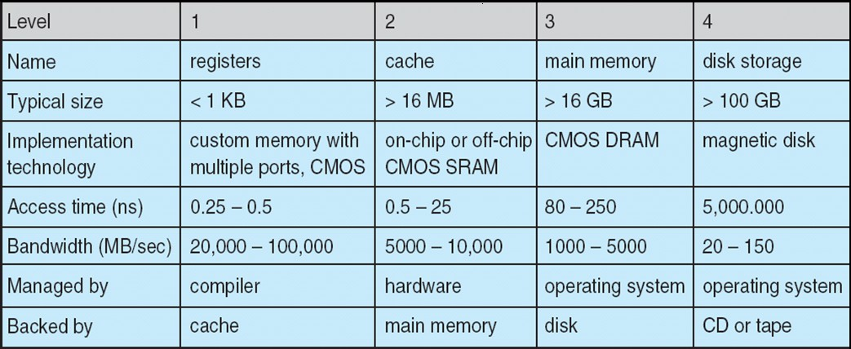
Performance of Various Levels of Storage
Movement between levels of storage hierarchy can be explicit or implicit
Faster, Smaller
Cheaper, bigger

Slide 47
Caching
Caching – Holding critical data in fast, expensive storage
  Important principle, performed at many levels in a computer (in hardware, operating system, software)
  Information in use copied from slower to faster storage temporarily
Faster storage (cache) checked first to determine if information is there
  If it is, information used directly from the cache (fast)
  If not, data copied to cache and used there
Cache smaller than storage being cached
  Cache management is an important design problem
  Cache size and replacement policy is crucial

Slide 48
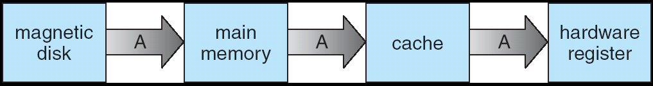
Migration of Data From Disk to Register
Cache consistency
  Data simultaneously stored in more than one level to be consistent.
  The copy of A appears in several places: on the magnetic disk, in main memory, in the cache and in an internal registers.
Cache coherency
  Update of a copy of A need to be in all caches where A resides (in a multiprocessor system with all CPUs having a local cache).
  Distributed environment situation is even more complex.

Slide 49
I/O Subsystem
One purpose of OS is to hide peculiarities of hardware devices from the user – only driver needs to know specific device details
I/O subsystem responsible for multiple things
  Memory management of I/O
    Buffering (storing data temporarily while it is being transferred)
    Caching (storing parts of data in faster storage for performance)
    Spooling (the overlapping of output of one job with input of other jobs)
  A general device-driver interface
  Drivers for specific hardware devices

Slide 50
Protection and Security
Protection – any mechanism for controlling access of processes or users to resources defined by the OS
Security – defense of the system against internal and external attacks
  Huge range, including denial-of-service, worms, viruses, identity theft, theft of service
Systems generally first distinguish among users, to determine who can do what
  User identities (user IDs, security IDs) include name and associated number, one per user
  User ID then associated with all files, processes of that user to determine access control
  Group identifier (group ID) allows set of users to be defined and controls managed, then also associated with each process, file
  Privilege escalation allows user to change to effective ID with more rights

Slide 51
OS Services
Provide certain services to programs and to the users of those programs:
User interface: command-line, batch interface, and GUI
Program execution: capability to load a program into memory and to run it
I/O operations: A running program may require I/O for file or device
File-system manipulation: capability to read, write, create, and delete files
Communications: exchange of information between processes via shared memory or message passing
Error detection: ensure correct operation by detecting errors in CPU and memory hardware, in I/O devices, or in user programs
Additional functions exist for ensuring efficient system operation:
  Resource allocation, accounting, and protection

Slide 52
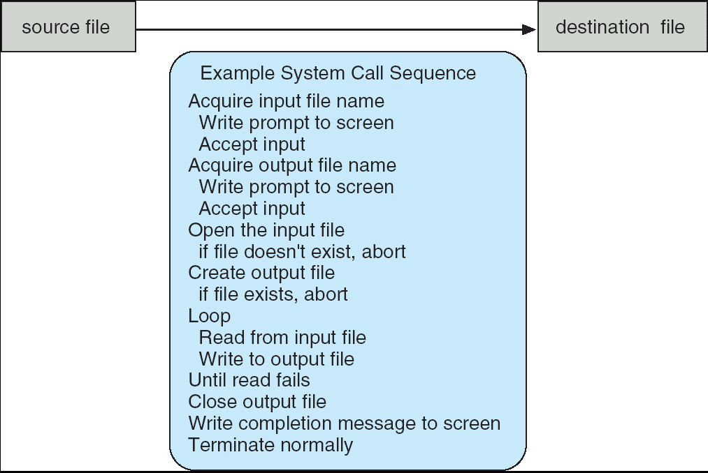
System Calls
System calls provide an interface between a process and the OS
Even simple programs make heavy use of OS but users never see this level of detail
System call sequence to copy the contents of one file to another file
Mostly accessed via a high- level application program interface rather than direct system call

Slide 53
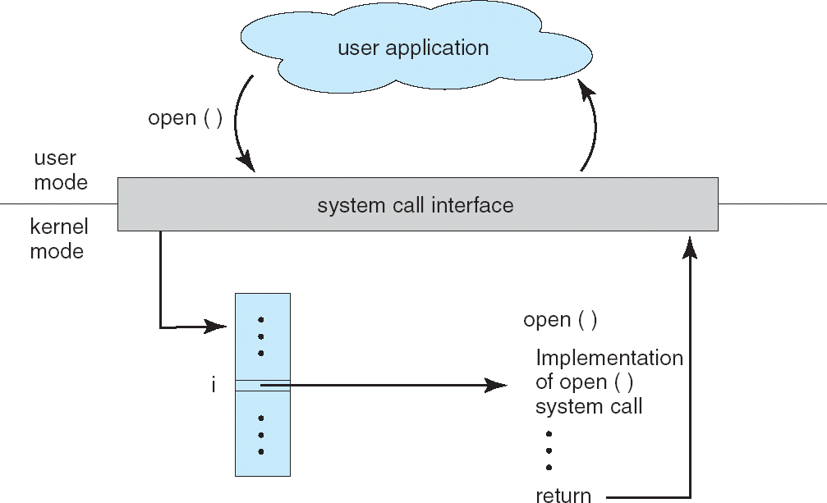
API - System Call - OS Relationship

Slide 54
Five Categories of System Calls
Process control: create_process, terminate_process, load, execute, end, abort
File management: create_file, delete_file, open, close, read, write
Device management: request_device, release_device, read, write, attach_or_detach_device
Information maintenance: get_time_or_date, set_time_or_date, get_system_data, set_system_data, get_process_attributes, set_process, attributes
Communication: create_or_delete_connection, send_or_receive_message, transfer_status_information

Slide 55
System Programs
System programs provide convenient environment for program development and execution:
  File management: Manipulate files and directories
  Status information: Date, disk space, number of users
  File modification: Text editors
  Programming language support: Compilers, assemblers, debuggers, etc.
  Program loading and execution: Loaders, linkage editors
  Communications: Connection, messages, remote login, data transfer
Most users' view of the operating system is defined by system programs, not the actual system calls
  System programs are actually user interfaces to system calls
Application programs or system utilities
  Web browsers, word processors, text formatters, spreadsheets, compilers, plotting, games

Slide 56
Operating System Design

Slide 57
Operating Systems Design
Organization of OS components to specify the privilege with which each component executes.
Four structures
  Monolithic – All components contained in the kernel
  Layered – Top-down approach to separate the functionality and features into components.
  Microkernel – Only essential components included in the kernel
  Modules – Object-oriented structure
Virtual Machines Run on the top of any OS
  VMware and the Java Virtual machine

Slide 58
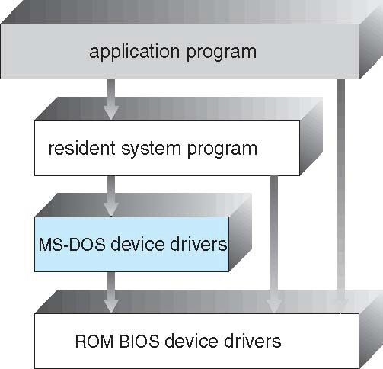
MS-DOS: Simple Structure
MS-DOS – written to provide the most functionality in the least space
  Not divided into modules
  Although MS-DOS has some structure, its interfaces and levels of functionality are not well separated

Slide 59
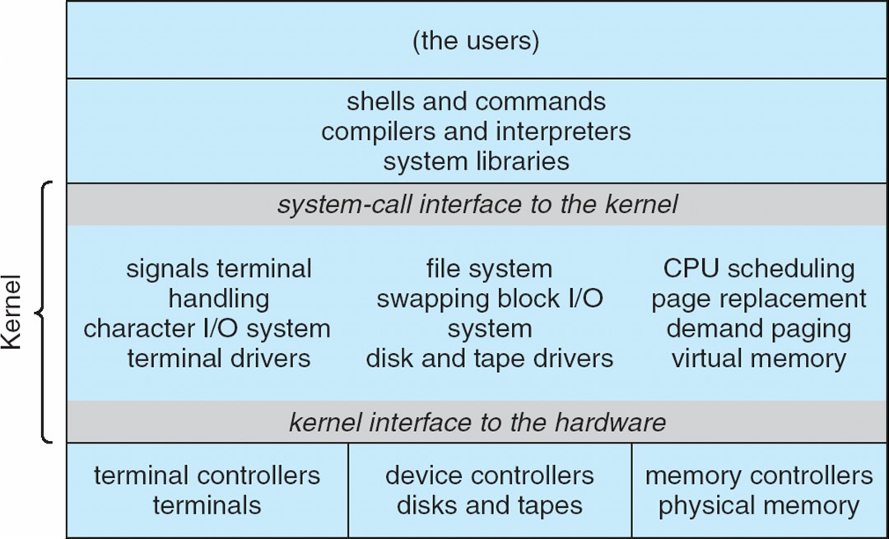
UNIX: Non-simple Structure
UNIX – limited by hardware functionality, the original UNIX operating system had limited structuring.
The UNIX OS has two separable parts
  Systems programs
  The UNIX kernel
    Everything between the system-call interface and the hardware
    Provides the file system, CPU scheduling, memory management, and other operating-system functions; a large number of functions for one level
UNIX: Beyond simple but not fully layered

Slide 60
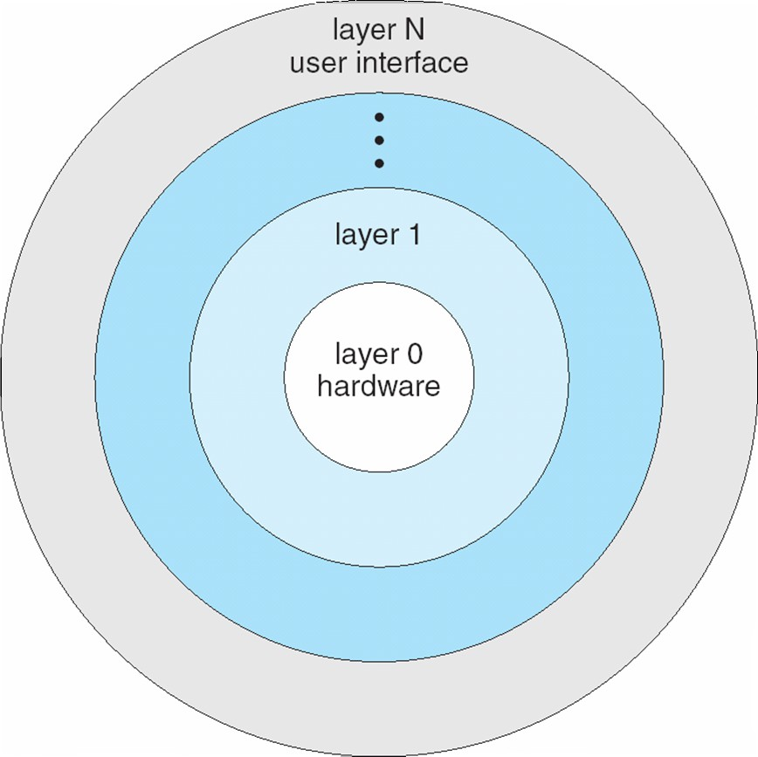
Layered Approach
The operating system is divided into a number of layers (levels), each built on top of lower layers. The bottom layer (layer 0), is the hardware; the highest (layer N) is the user interface.
With modularity, layers are selected such that each uses functions (operations) and services of only lower-level layers
Design and implementation of OS get simplified in the layered approach.

Slide 61
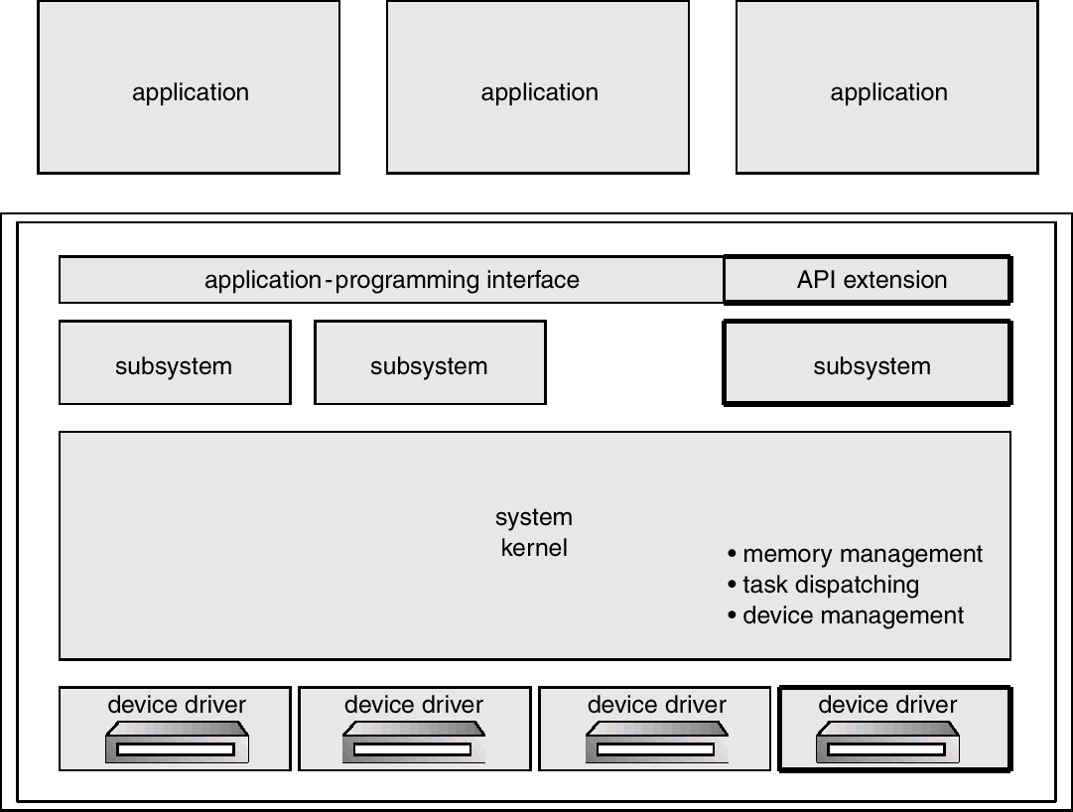
OS/2 – Layer Structure
A descendant of MS DOS with multitasking and dual-mode operation.

Slide 62
Microkernel System Structure
Moves as much from the kernel into user space
  Kernel maintains the minimum generic OS functions
Mach example of microkernel
  Mac OS X kernel (Darwin) partly based on Mach
Communication takes place between user modules using message passing
Benefits:
  Easier to extend a microkernel
  Easier to port the operating system to new architectures
  More reliable (less code is running in kernel mode)
  More secure
Detriments:
  Performance overhead of user space to kernel space communication

Slide 63
Microkernel System Structure
Application Program
Device Driver
File System
user mode
messages
messages
Interprocess Communication
memory managment
CPU
scheduling
kernel mode
microkernel
hardware

Slide 64
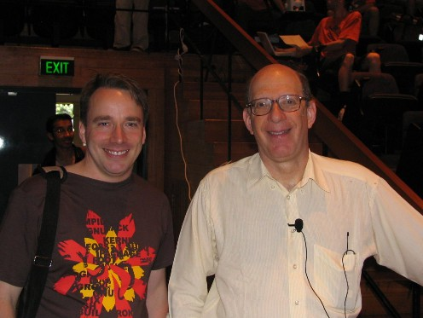
Microkernel vs. Monolithic Model
Tanenbaum-Torvalds Debate
  1992, Usernet discussion group comp.os.minix
  Andrew S. Tanenbaum – Minix
    Microkernel is better for portability
    Linux is too closely tied to expensive Intel 386
    x86 processors will be superseded
    Linux, as a monolithic kernel, is “a giant step back into 1970s”
  Linus Torvalds – Linux
    Linux API is more portable and simpler
    Choosing x86 is explicit design goal, rather than a design flaw
    Building for cheap hardware will have portability problems
http://oreilly.com/catalog/opensources/book/appa.html

Slide 65
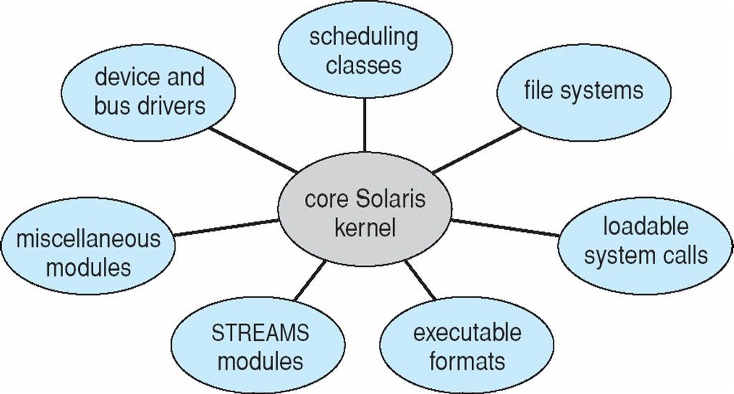
Modules
Many modern operating systems implement loadable kernel modules
  Uses object-oriented approach
  Each core component is separate
  Each talks to the others over known interfaces
  Each is loadable as needed within the kernel
Overall, similar to layers but with more
flexibility
  Linux, Solaris, etc.
Solaris Module Approach

Slide 66
Hybrid Systems
Most modern operating systems are actually not one pure model
  Hybrid combines multiple approaches to address performance, security, usability needs
Linux and Solaris kernels in kernel address space, so monolithic, plus modular for dynamic loading of functionality
Windows mostly monolithic, plus microkernel for different subsystem
Apple Mac OS X hybrid, layered, Aqua UI plus Cocoa programming environment
  Below is kernel consisting of Mach microkernel and BSD Unix parts, plus I/O kit and dynamically loadable modules (called kernel extensions)

Slide 67
Mac OS X Structure
graphical user interface
Aqua
application environments and services
Java Cocoa
Quicktime
BSD
kernel environment Mach | BSD
I/O kit |  | kernel extensions

Slide 68
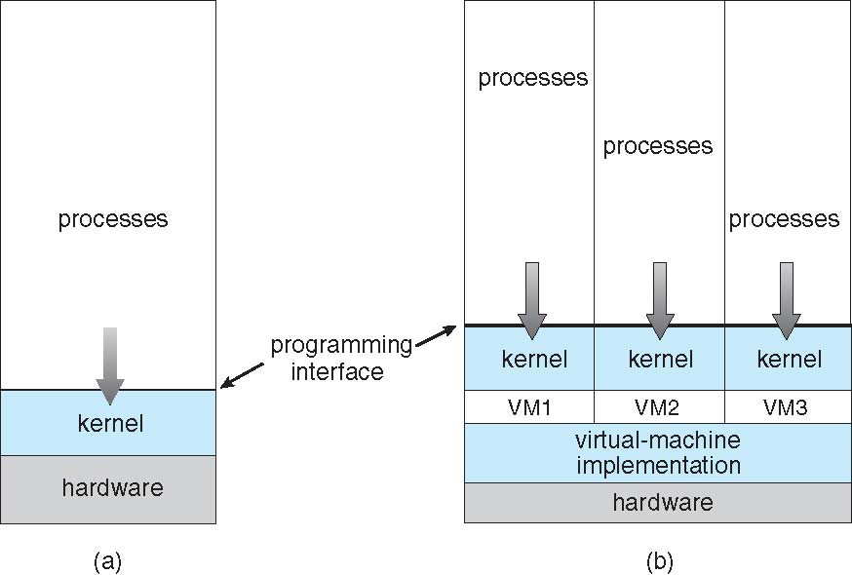
Virtual Machines
A virtual machine takes the layered approach to its logical conclusion. It treats hardware and OS kernel as all hardware.
A VM provides an interface to the underlying bare hardware.
The operating system host creates the illusion that a process has its own processor and (virtual memory).
Each guest provided with a (virtual) copy of underlying computer.
Non-virtualized machine
Virtualized machine
VMM or Hypervisor

Slide 69
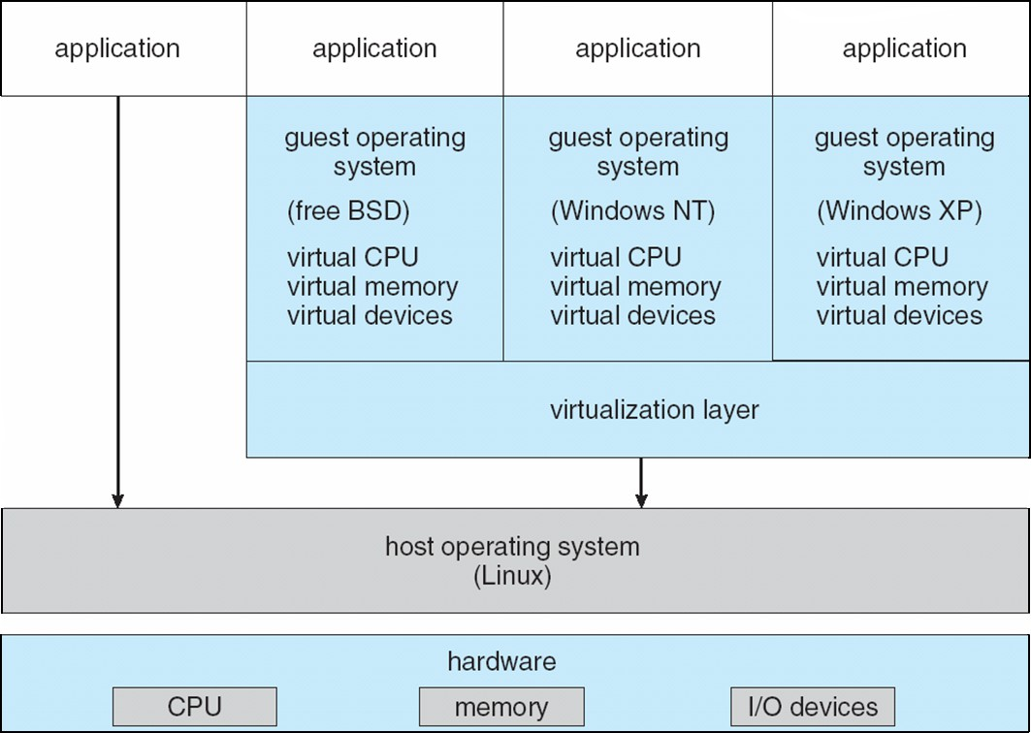
VMware
VM Architecture: Abstracts Intel 80X86 hardware into isolated virtual machines to run several guest operating systems as independently.

Slide 70
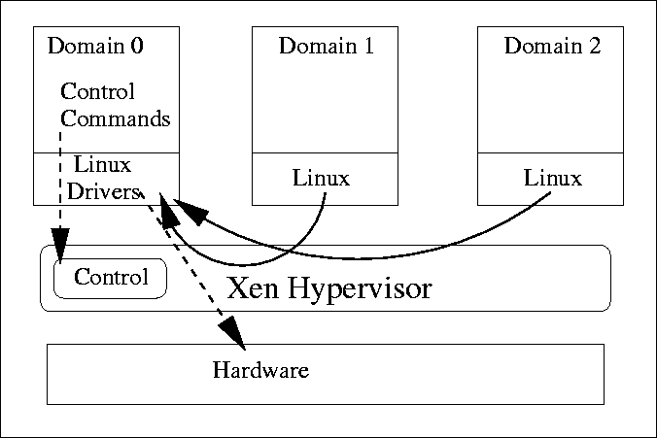
Para-virtualization
Presents guest with system similar but not identical to hardware
Guest OS must be modified to run on para-virtualized hardware
Guest can be an OS, or in the case of Solaris 10 applications running in containers

Slide 71
Open-Source Operating Systems
Operating systems made available in source-code format rather than just binary closed-source
Counter to the copy protection and Digital Rights Management (DRM) movement
Started by Free Software Foundation (FSF), which has “copyleft”
  GNU Public License (GPL)
Examples include GNU/Linux and BSD UNIX (including core of Mac OS X), and many more

Slide 72
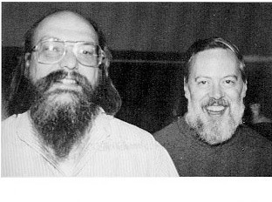
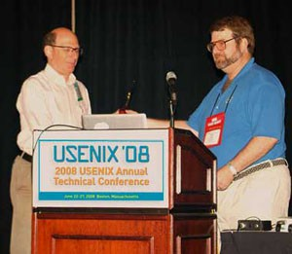
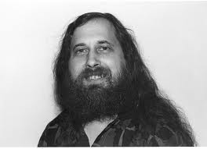
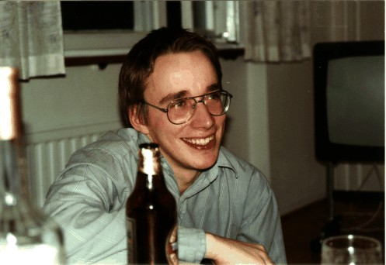
Open-Source Operating Systems (Cont’d)
Ken Thompson & Dennis Ritchie UNIX (1971)
Andrew Tanenbaum Minix (1987)
Richard Stallman GNU/GPL (1983)
Linus Torvalds Linux (1991)

Slide 73








