Slide 1
Distributed Process Scheduling
Topic 4
Hartmut Kaiser
https://teaching.hkaiser.org/fall2025/csc7103/

Slide 2
Scheduling Basics
Before execution/running, processes must be scheduled for CPUs and allocated with resources
Objectives of scheduling
  Enhance overall system performance metrics such as process completion (turnaround) time and processor (resource) utilization
  Achieve location and performance transparency
Several challenges:
  Multiple processing nodes are geographically distributed
    Dynamical behaviors of the system – underlying architecture
  Local and global scheduling
  Distributed processes execute on remote nodes and may migrate from node to node:
    Remote execution, process/task migration, data migration
  Non-negligible communication overhead

Slide 3
Process/CPU Scheduling
Scheduler selects from among the processes in ready queue, and allocates the available processor/CPU to one of them
Scheduling decision may take place
  When a process switches state (e.g., running to waiting)
  When a new process enters the system
  Whenever a scheduling condition is met
  When a process terminates
Preemptive vs. non-preemptive
  Scheduling can be non-preemptive (static) – once CPU is allocated to a process, the process keeps CPU until its execution finishes
  Scheduling can be preemptive – process is interrupted (suspended) for other process to be allocated to CPU
Dispatch latency – time the dispatcher takes to stop one process and start another running

Slide 4
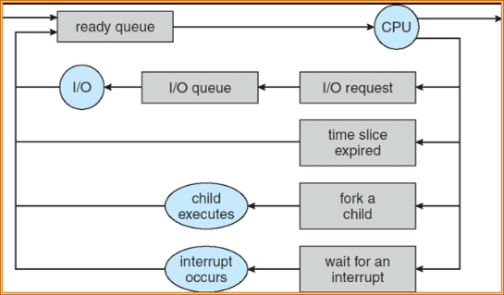
Representation of Process Scheduling
Useful formulation of scheduling: How is the scheduler to decide which of several tasks to take off a queue?

Slide 5
Common Scheduling Algorithms
Several scheduling algorithms exist for single processor computer system:
  First-Come, First Served (FCFS) scheduling
  Shortest-Job-First (SJF) scheduling
  Shortest-Remaining-Time-First (SRTF) scheduling (preemptive)
  Priority scheduling (preemptive/non-preemptive)
  Round Robin (RR) scheduling (preemptive)
  Multilevel Queue scheduling
  Multilevel Feedback Queue scheduling

Slide 6
First-Come, First-Served Scheduling (FCFS)
Also: “First In First Out” (FIFO)
Example: Process Burst Time
T1 24
T2 3
T3 3
Arrival Order: T1, T2, then T3 (all arrive at time 0)
T₁
T₂
T₃
0
24
27
30

Slide 7
First-Come, First-Served Scheduling (FCFS)
Response Times: T1 = 24, T2 = 27, T3 = 30
  Average Response Time = (24+27+30) / 3 = 27
Waiting times: T1 = 0, T2 = 24, T3 = 27
  Average Wait Time = (0 + 24 + 27) / 3 = 17
Convoy Effect: Short processes stuck behind long processes
  If T2, T3 arrive any time < 24, they must wait
T₁
T₂
T₃
0
24
27
30

Slide 8
Slightly Different Arrival Order?
T2 < T3 < T1
Response Time: T1 = 30, T2 = 3, T3 = 6
  Average Response Time = (30 + 3 + 6) / 3 = 13
  Versus 27 with T1 < T2 < T3
Waiting Time: T1 = 6, T2 = 0, T3 = 3
  Average Waiting Time = (6+0+3) / 3 = 3
  Versus 17 with T1 < T2 < T3
T₂
T₃
T₁
0
3
6
30

Slide 9
Optimization Criteria
Speedup – Increasing throughput (the number of completed processes per time unit)
Resource utilization – keeping processors as busy as possible
Makespan or completion time – decreasing turnaround time (waiting + execution + event)
Response time – reducing the time taken from request submission until the first response (important in time-sharing systems)
Load sharing and balancing – key in distributed and multiprocessor systems
Optimize the max or min values or average measure or variance

Slide 10
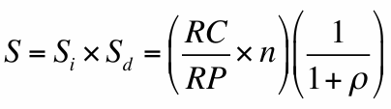
Speedup
The purpose of partitioning processes is for speeding up executions
  Speedup perhaps is the most important performance metric for distributed computing
Speedup factor (S) is a function of the parallel/distributed algorithm, system architecture, and scheduling
S_{i} = ideal speedup, S_{d} = degradation due to actual implementation
n = number of processors used
RC = relative concurrency: how far from optimal is the usage of the processors
RP = relative processing: how far from optimal is the speedup with a parallel algorithm compared to the ideal sequential algorithm
ρ = Efficiency loss: loss of parallelism when implemented on a real machine (ratio of overheads and optimal processing time)
S reflects the real-world speedup for parallelizing a sequential program

Slide 11
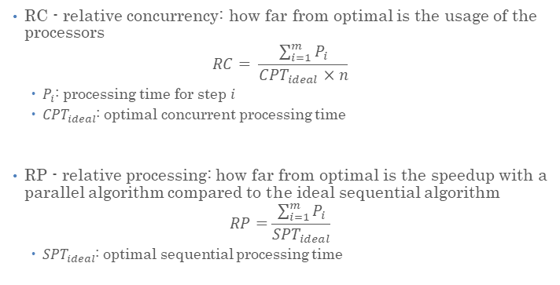
Speedup
RC - relative concurrency: how far from optimal is the usage of the processors
$$RC= \frac{\sum_{i=1}^{m}{P_{i}}}{{CPT}_{ideal}×n}$$
  $P_{i}$: processing time for step $i$
  ${CPT}_{ideal}$: optimal concurrent processing time
RP - relative processing: how far from optimal is the speedup with a parallel algorithm compared to the ideal sequential algorithm
$$RP=\frac{\sum_{i=1}^{m}{P_{i}}}{{SPT}_{ideal}}$$
  ${SPT}_{ideal}$: optimal sequential processing time

Slide 12
Multiple Processor Scheduling
Scheduling becomes more complex when multiple CPUs/processors are available – load sharing/balancing is important
Homogeneous (identical) processors within a multiprocessor system:
  Asymmetric multiprocessing
    One single processor (called master server like coordinator) does all scheduling including I/O processing
    Other processors execute only user codes
  Symmetric multiprocessing (SMP)
    Each processor is self-scheduling.
    Provide a separate queue for each processor
    Use a common ready queue (naturally self-balancing)
Distributed systems:
  Processors may not be identical (heterogeneous system)
  Communication overhead (heavy networking) is non-negligible
  Clock and memory are not shared

Slide 13
Scheduling Evaluation Methods
Deterministic modeling
  Takes a particular predetermined workload, and evaluate the performance metric for the workload
Queuing models
  Use statistical approaches
  X / Y / c queue with an arrival process X, a service time distribution of Y, and c servers (Kendall’s notation)
    e.g., Poisson distribution for arrival time, exponential distribution for service time, etc.
  Isolated workstation, processor pool, migration workstation
Simulations – program a model of the computer system (a simulator)
Implementation – code the algorithm, put in the real OS, and see how it works

Slide 14
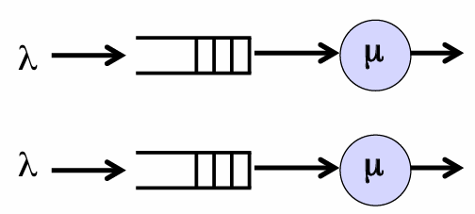
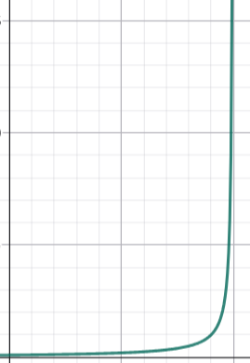
Isolated Workstation Model
Maintains a separate queue for each workstation – static scheduling
M/M/1 queue - no sharing of the workload is attempted
  Arrival process distribution M / service time distribution M / one server
  M represents a Markovian distribution
λ and μ are the arrival and service rates of each processing node (i.e., 1/λ: mean arrival time, 1/μ: mean service time)
Average turnaround
time:
t = 1/(μ - λ)
Turnaround time is the sum of service and queuing
times due to waiting of processes

Slide 15
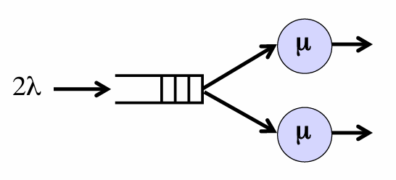
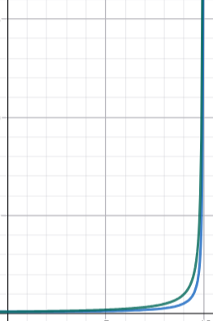
Processor Pool Model
A process is dispatched to an available processor and remains there statically throughout the entirety of its execution
M/M/2 queue – a waiting job can be serviced by either of two processors
  Two servers model a system
Average turnaround time:
t = μ / (μ + λ) (μ - λ)

Slide 16
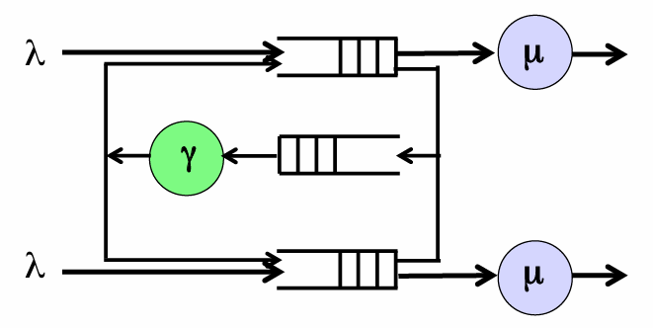
Migration Workstation Model
In migration workstation model, processes are allowed to move from one workstation to the other
Process migration incurs some communication overhead (modeled as an additional queue)
  γ : process migration rate
Average turnaround time lies between those of isolated workstation model and processor pool model (that is, better than M/M/1 but worse than M/M/2)

Slide 17
Distributed Scheduling

Slide 18
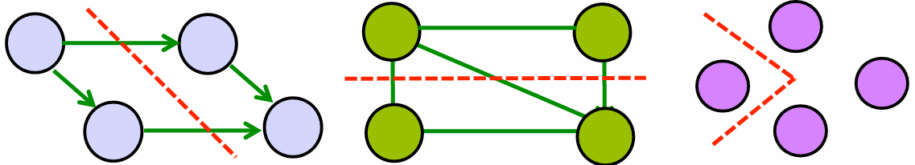
Process Interaction Models
Distributed scheduling algorithms represent sets of multiple processes governed by rules that regulate the interactions among processes
  Partitioning of processes and how to map processes to processors
Graph models describing process communication:
  Precedence process model – satisfy precedence relationships
  Communication process model – processes coexist and communicate asynchronously
  Disjoint process model – process can run independently
Precedence process model
Communication process model
Disjoint process model

Slide 19
Distributed Scheduling Algorithms
Static (or off-line) scheduling
Dynamic (or on-line) scheduling
  Load sharing – static workload distribution
  Load balancing – dynamic workload distribution
Real-time scheduling

Slide 20
Static Scheduling

Slide 21
Static Process Scheduling
Static process scheduling (deterministic scheduling theory) deals with a set of partially ordered tasks on a non-preemptive multiprocessor system
  System consisting of identical processors
  Goal of minimizing the overall finishing time – makespan
The general problem is NP-complete
  Scheduling to optimize makespan is NP-complete
  Only approximate or heuristic methods to obtain near optimal solution
In distributed systems, the problem becomes even more complicated because communication is not only non-negligible but is also a characteristic of the system. Moreover, processors are not identical

Slide 22
Static Process Scheduling (Cont.)
Find good but easy-to-implement heuristic approaches for scheduling processes in distributed systems
  Balance and overlap computation and communication
In static scheduling, the mapping of processes is determined before the execution of the processes
  Once a process is started, it stays at the processor until completion (static)
  Need good knowledge about process behavior: process execution time, precedence relationships and communication patterns between processes
  Scheduling decision is centralized and non-adaptive
  Impacted by communication: Communication process model versus communication system model
Static distributed process scheduling algorithms:
  Stone's algorithm
  Two heterogeneous processors, arbitrary communication process graph
  n-processor generalization

Slide 23
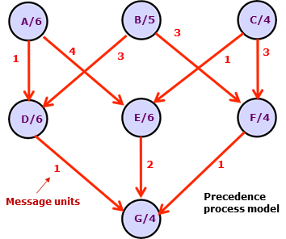
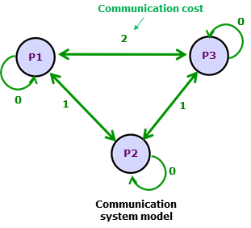
Using Precedence Process Model
Static multiprocessor scheduling based on precedence process model
  Minimizing overall makespan (overall finishing time)
Using the DAG of the program, a heuristic algorithm tries to find a good mapping of the process model to the system model
  Example: 7 tasks (A through G) with execution times and message units shown to be mapped on 3 processors (P1, P2 and P3) with non-negligible inter-processor communication costs/delays shown

Slide 24
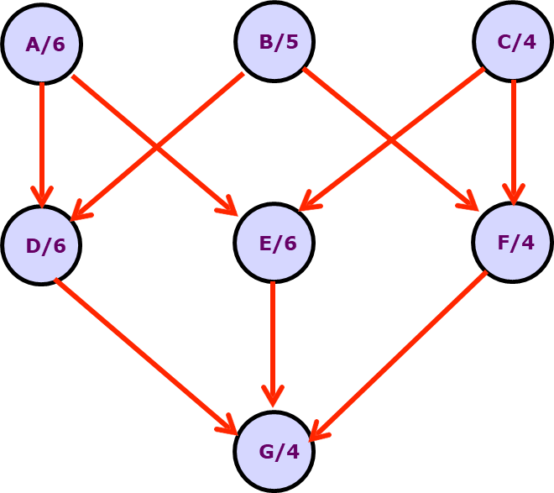
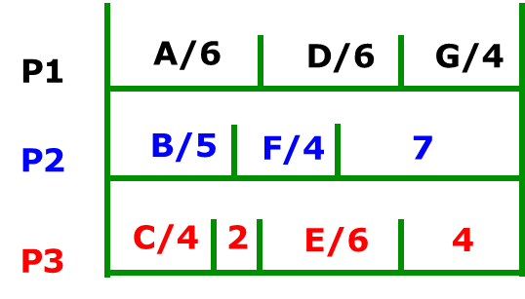
List Scheduling –
Ignore Communication Overhead
List Scheduling (LS): No processor remains idle if there are some tasks available that it could process
Critical path – the longest execution path in the DAG, which is a lower bound of makespan
  Critical path for the example is ADG or AEG of length = 6 + 6 + 4 = 16
Makespan = 16
Optimal result though the algorithm
is heuristic

Slide 25
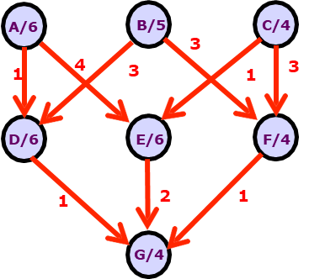
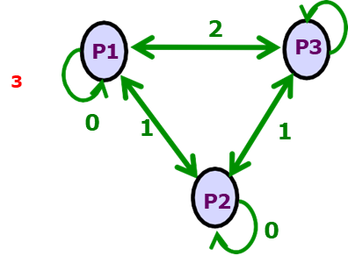

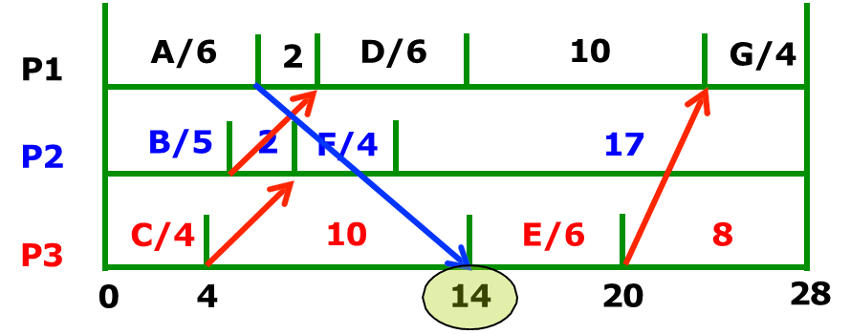
Extended List Scheduling – With Communication Overhead
Extended List Scheduling (ELS): First allocate tasks to processor by applying LS and then add the necessary communication delays
Communication delays are computed by multiplying the unit communication cost and message units
LS makespan = 16 units
Cross lines represent waiting for communication
ELS makespan = 28 units
Far from optimal
Comm. Cost = 6

Slide 26
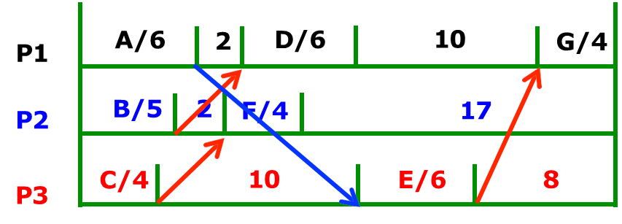
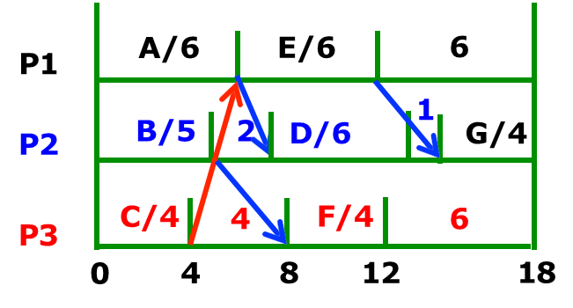
Earliest Task First Scheduling - Delaying Decision
Earliest Task First (ETF) – the earliest schedulable task is (delayed) scheduled first
  Communication costs are included in the calculation
ELS makespan = 28 units
Delay scheduling task F because task E will become schedulable first
ETF makespan = 18 units
Comm. Cost = 5

Slide 27
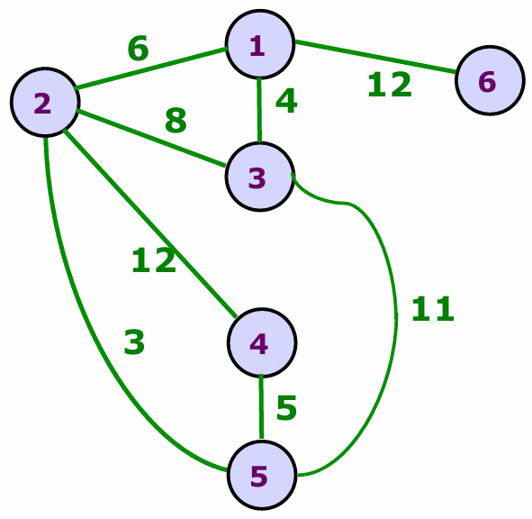
Using Communication Process Model
The primary objective of distributed process scheduling is to achieve maximal concurrency for task execution within a program
  Maximize resource utilization and minimize inter-process communication
If there are no precedence constraints except the need for communication among processes, the applications can be better modeled by the communication process model
  Using undirected graph:
  G = (V, E)
Communication process model
Six processes with communication links
and costs shown

Slide 28
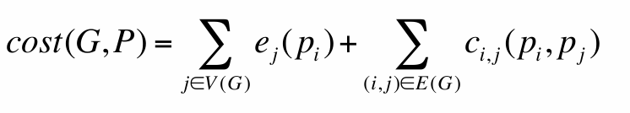
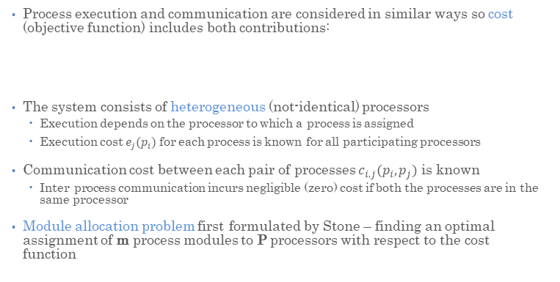
Stone’s Algorithm - Assumptions
Process execution and communication are considered in similar ways so cost (objective function) includes both contributions:
The system consists of heterogeneous (not-identical) processors
  Execution depends on the processor to which a process is assigned
  Execution cost $e_{j}(p_{i})$ for each process is known for all participating processors
Communication cost between each pair of processes $c_{i,j}(p_{i},p_{j})$ is known
  Inter-process communication incurs negligible (zero) cost if both the processes are in the same processor
Module allocation problem first formulated by Stone – finding an optimal assignment of m process modules to P processors with respect to the cost
function

Slide 29
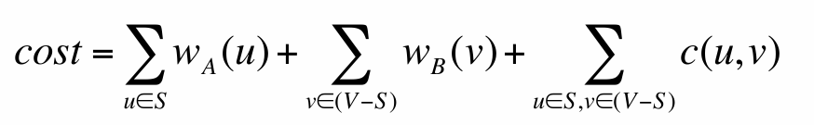
Stone’s Algorithm for Two Processors
Stone’s algorithm minimizes the total execution and communication
cost(G, P) by properly allocating the P processors among m processes
For P = 2, Stone suggested an efficient polynomial-time solution:
  G = (V,E) : communication process model
  A and B : two heterogeneous processors
  w_{A}(u) and w_{B}(u) : cost of executing process u on A and B, respectively
  c(u, v) : communication cost between processes u and v if they are allocated different processors
  S : set of processes to be executed on processor A
  V-S : set of process to be executed on processor B
Stone's algorithm computes S such that the cost function is minimized

Slide 30
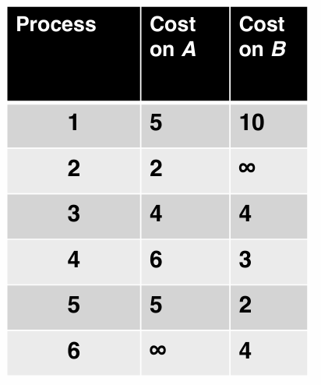
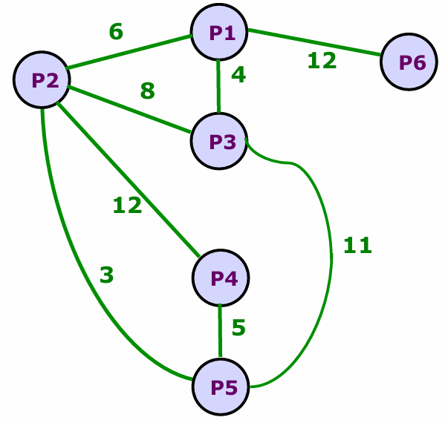
Communication Process Model Example
Computation cost communication cost
A program consisting of six processes (1 through 6) to be allocated on two (non- identical) processors A and B for minimizing the total computation and communication cost

Slide 31
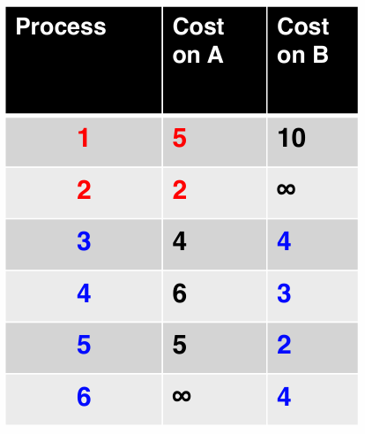
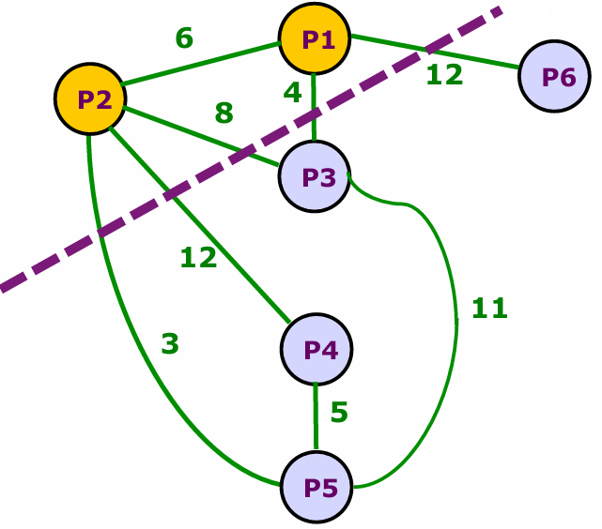
Partitioning Communication Graph
Partition the graph by drawing a line that cuts
through some edges. This results in two disjoint graphs, one for each processor
The set of edges removed by the cut is called a cut set. Its cost is the sum of weights of the edges, which represents the total interprocess communication cost between A and B
If processes are allocated to processor A and the rest to the processor B:
cost = (5+2) + (4+3+2+4) + (12+4+8+12+3) = 7 + 13 + 39 = 59
Compute cost on A Compute cost on B Comm. cost between A and B

Slide 32
Commodity Flow Problem
Stone’s algorithm reduces the scheduling problem to the commodity-flow problem described below:
Let G = (V, E) be a graph with two special nodes s (source) and d (destination/sink). Each edge has a maximum capacity to carry some commodity. What is the maximum amount of the commodity that can be carried from the source to the sink?
Let S be a subset of V such that the source is in S and the sink is in D (=V-S). A set of edges (say C) with one end in S and the other end in D is called a cut set and the sum of the capacities of the edges in C is called the weight of the cut set
  Cut is a node partition (S, D) such that s is in S and d is in D
  Cut set separates the source and destination in the graph
Given a commodity graph, the optimization problem is to find the maximum flow from source to destination. It can be shown that the maximum-flow is equal to the minimum possible cut-weight
  This is called max-flow, min-cut theorem

Slide 33
Minimum-cost Cut
Given communication process graph G = (V, E), construct a new graph
G'= (V',E') by adding two new nodes s (source, corresponding to processor A) and d (destination, corresponding to processor B). For every node u in G, add the edges (s, u) and (d, u) in G'. The weights (capacities) of the new edges will be w_{B}(u) and w_{A}(u), respectively
  w_{A}(u): execution/computation cost of process u on processor B
  w_{B}(u): execution/computation cost of process u on processor A
A cut in G' (through the dashed-lines edges) gives a processor allocation for the job/task
Only consider cuts that separate the processor nodes (A, B). The weight of the cut set is the sum of computation and communication costs
  Therefore, if we compute the max-flow on G', the corresponding min-cut gives the best processor allocation

Slide 34
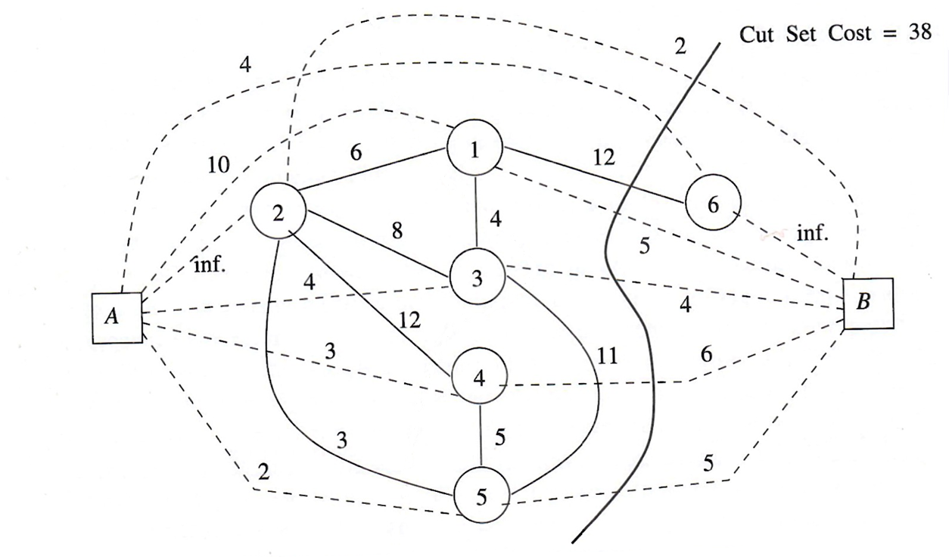
Commodity Flow Problem

Slide 35
Problem Generalization
To generalize the problem beyond two processors, use a repetitive approach using the two-processor algorithm to solve n-processor problem
Finding a module allocation of m processes to n processors:
  The max-flow min-cut algorithm can be applied to a processor p_{i} and an imaginary super processor P that consists of the remaining processors
  After some processes have been scheduled to p_{i} the same procedure is repeated iteratively on the super processor until all processes are assigned

Slide 36
Clustering Processes
The module allocation problem is complex, requiring heuristic solutions:
  Heuristic solutions make sense since we generally have approximate information about computation and communication costs
  Optimal static scheduling has high complexity
One heuristic approach is to separate the optimization of computation and communication in two independent phases
  If communication cost is relatively high, merge processes with higher inter-process interaction into clusters of processes
  The number of processes in a cluster can be constrained using a threshold on communication cost (C) and a threshold on total execution cost (X)

Slide 37
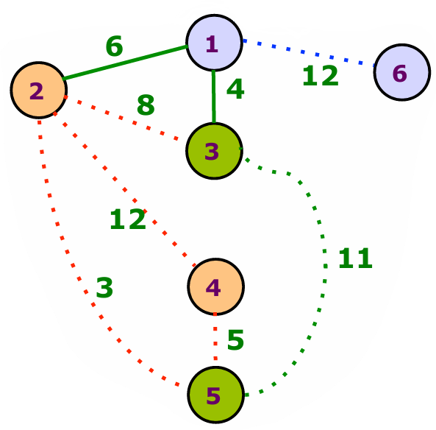
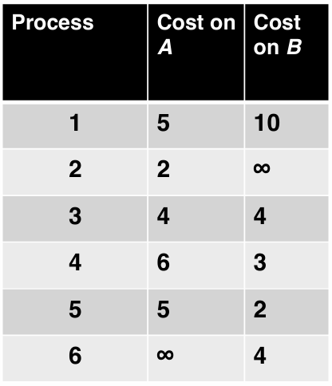
Clustering Example
With estimated average communication cost C = 9
as threshold, we find three clusters: (2,4), (1,6), (3,5) – 12, 11, and 12 are larger than 9
Must assign (2,4) to A whereas (1,6) to B. Cluster (3,5) can be mapped to either A or B.
  If assigned to A, total cost = computation cost of 17 on A + computation cost of 14 on B + communication cost of 10 between A and B (overall 41)
  If cluster (3,5) assigned to B, communication cost becomes too high (6+8+3+5 = 22)

Slide 38
Dynamic Scheduling

Slide 39

Dynamic Scheduling
Prior knowledge of processes (about their execution times and communication behaviors) is not realistic for most distributed applications
Need an ad hoc scheduling strategy that is adaptive (dynamic) and allows its assignment decision to be made locally (decentralized)
  Static scheduling is non-adaptive and tends to be centralized
Using disjoint process model:
  Ignoring the effect of the interdependency among processes as we do not know how these processes interact with each other
Objectives/goals:
  Maximize the utilization of the system – considering throughput and completion time
  Provide fairness to the user processes – giving priority to a user’s process if the user has a lesser share of the resources

Slide 40
Load Sharing and Balancing
Performance can be enhanced if processes are free to be redistributed or moved around among the processors/nodes/sites in the system
Distribute workloads among all available processors to avoid having idle processors as much as possible – load sharing
  An arriving (new) process can be assigned to the processor that has the shortest waiting queue to reduce processor idling
Distribute workloads among all nodes as evenly as possible to keep the workload balanced among all nodes of the system – load balancing
  Needs to move processes from heavily loaded nodes to idle or lightly loaded nodes dynamically
  Improves performance and achieves a sort of fairness in terms of equal workload for each process
  Reduces the overall averaging turnaround time of processes

Slide 41
Processor Affinity
A process has an affinity for the processor on which it is currently running – processor affinity
Processor affinity makes more sense in SMP (symmetric multiprocessing) systems because of cache memory (locality)
  If a running process migrates to another processor, the contents of the cache memory must be invalidated for the first processor, and the cache for second processor must be repopulated
  To avoid high overhead, SMP systems try to keep a process running on the same processor as much as possible
The process migration overhead is much worse in a distributed system
  Complete state information of migrating process must be passed to a remote site for its execution there
Processor affinity counteracts the benefits of load balancing

Slide 42
Centralized Approach
Designate a controller process that maintains the information about the queue size of each processor
  Processes arrive and depart from the system asynchronously
  Controller is responsible for transferring a process from one site to other site: Migrating process from a longer queue to a shorter queue dynamically
An arriving process makes a request to the coordinator for the assignment to a processor.
The controller schedules the process to the processor that has the shortest waiting queue
To update the queue size information, each processor must inform the controller whenever a process completes its execution – overhead
To remove the centralized controller, the process transfer must be initiated by either a sender or receiver or both

Slide 43
Sender-initiated Algorithms
A sender-initiated algorithm is activated by a sender process that wishes to off-load some of its computation (push model)
  Facilitates migration of process from a heavily loaded sender to a lightly loaded receiver
This process transfer procedure require three basic decisions
  Transfer policy: When does a node become the sender?
    When node’s queue length (SQ) becomes longer than a certain threshold (ST)
  Selection policy: How does the sender choose a process for transfer?
    A newly arrived process is a good candidate
  Location policy: Which node should be the target receiver?
    Randomly select a receiver node
    Probing receiver: poll a certain number of nodes (probe limit PL) to find an idle node or a node with the smallest queue length

Slide 44
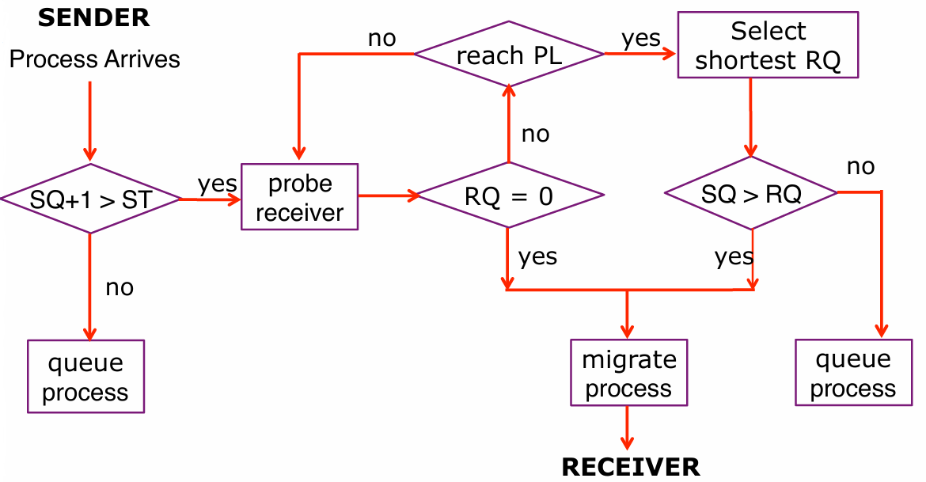
Flow Chart of Sender-initiated Algorithm
SQ, ST and PL are the sender’s queue length, threshold, and probe limit, respectively
RQ is the queue length of a polled receiver

Slide 45
Sender-initiated Algorithm (Cont.)
Sender-initiate load sharing algorithm is push model or push migration, where processes are pushed from one node to the others
  Pushing (or moving) processes from the overloaded to idle or less-busy nodes
A sender-initiated algorithm incurs additional communication overhead because of probing of receivers and migration of processes
In an already heavily loaded system, if many (or all) nodes initiate the algorithm simultaneously, a ping-pong effect among senders trying to off- load processes fruitlessly can occur
  The algorithm becomes unstable at heavy system load due to high communication overhead
The algorithm perform very well in a lightly loaded system since it is easy to find a receiver

Slide 46
Receiver-initiated Algorithms
A receiver-initiated algorithm is activated by a receiver process to pull a process from others to its site for execution – pull model or pull migration
  Pulling waiting process from a busy processor/node
Three similar basic decisions include
  Transfer policy – activate pull operation when the queue length (RQ) falls below a certain threshold (RT)
  Selection policy – require preemption since the processes at the sender site might have already been running
  Location policy – a probing strategy to identify a heavily loaded sender
Receiver-initiated algorithms are more stable than the sender-initiated ones
  More effective at higher system load because a sender can be found easily and migration communication overhead is low. At very high load, the algorithm becomes less active (so no unstable problem)

Slide 47
Sender/Receiver-initiated Approach
It makes sense to combine two algorithms into one so that a node can dynamically play the role of either a sender or a receiver
  Node can activate the sender-initiated algorithms when its queue size exceeds the threshold ST and can enable the receiver-initiated algorithms when its queue size falls below the threshold RT
The decision of which algorithm to use can be based on the estimated system load information – an adaptive approach
Senders rendezvous with receivers
  A registration service can be used to match a sender with a receiver --
  Can even serve as a trader for best matching based on some price (e.g., computational cost)

Slide 48
Distributed Process Implementation

Slide 49
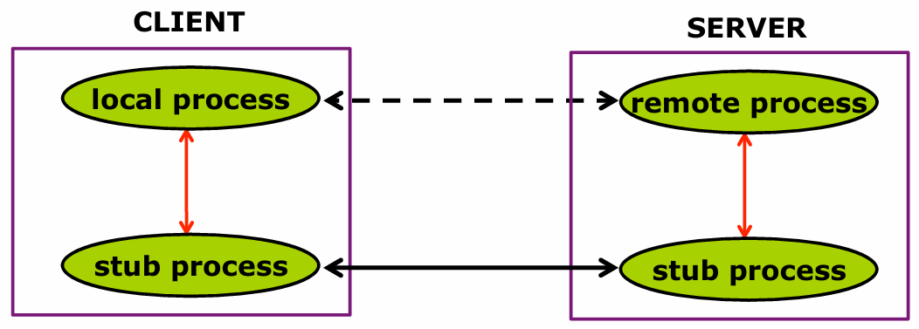
Distributed Process Implementation
Load sharing and balancing in distributed system require the activation of process execution at a remote site
Creating a remote process using the client/server model
  Front-end stub processes facilitate the creation and communication between processes on different machines
  Stub processes serve as a logical link between local and remote processes

Slide 50
Different Remote Applications
Based on how request messages are interpreted, different application scenarios can arise:
  Remote service: The message is interpreted as a request for a known service at the remote site
  Remote execution: The messages contain a program to be executed at the remote site
  Process migration: The messages represent a process being migrated to the remote site for continuing execution

Slide 51
Remote Service
The request message is interpreted as a request for a known service at the remote site
Primary application is resource sharing in distributed systems
  Sharing of file systems, peripherals, and processing capabilities
  Remote service views the computation environment as accessing remote resources
  Whereas remote execution and process migration views it as remote host
Request message can be generated at three different software levels:
  As remote procedure calls at the language level
  As remote commands at the operating system level
  As interpretive messages at the application level

Slide 52
Remote Execution
Remote execution (or dynamic task placement) is used for off-loading computation (load sharing):
  The message sent from a client to a server is a client program to be executed at the server
  In essence, it is the spawning of a process at a remote host
Remote execution is difficult to implement:
  Load sharing algorithm – process (or) servers are responsible for maintaining load distribution, negotiating remote host, invoking remote operation, and creating stub processes for linking clients and servers
  Location independence – each remote process is represented by an agent process at the originating host. Parent/child relationship is preserved
  System heterogeneity – need to recompile the program or use Java program execution or XDR data transfer
  Protection and security – a double-edge sword. A foreign code image can be a Trojan horse

Slide 53
Process Migration
Extend load-sharing model further to allow a remote execution to be preempted and moved to another remote host
  In effect, a process can migrate from host to host dynamically
A process migration facility needs to locate and negotiate a remote host, transfer the code image, and initialize the remote execution
Since the target process is preempted, its state information
  Computation state – information necessary to save and restore process at remote site, similar to conventional context switching
  Communication state – status of process communication links and the messages in transit, difficult to handle
Two key components of process migration procedure:
  Link redirection and message forwarding
  State and context transfer

Slide 54
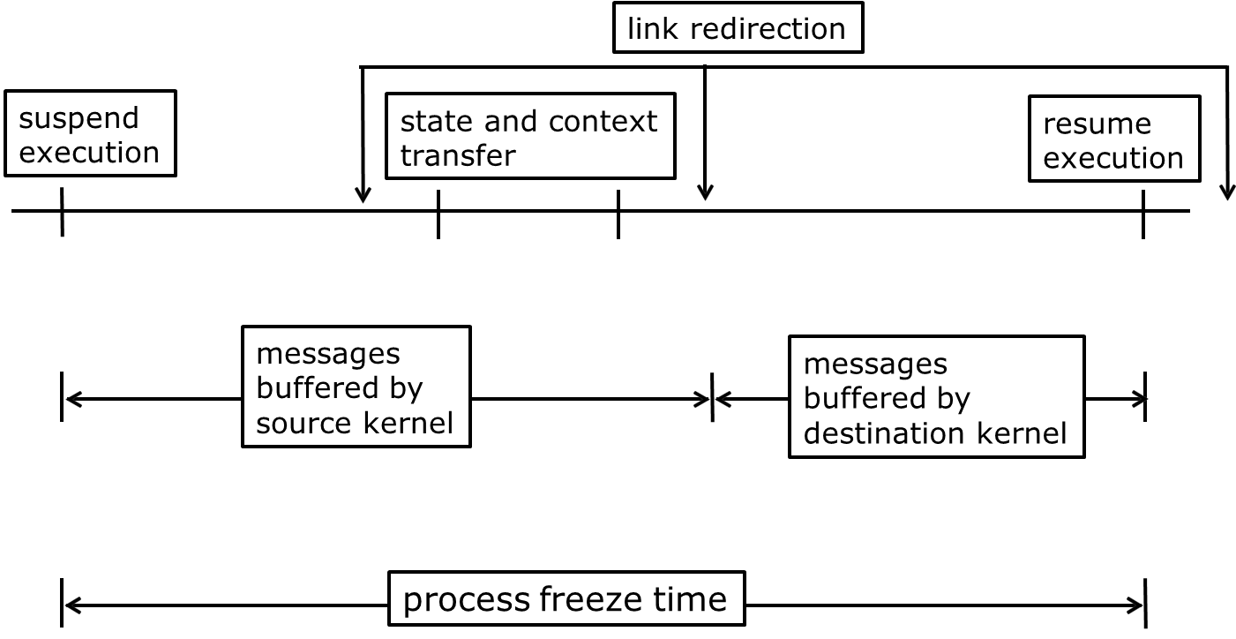
Handling Process Migration

Slide 55
Process Frozen Time
Freeze (suspend) migrating process after remote host identified
Transfer the state and context (code image) of the process to remote host
Perform link redirection at different stages of migration
  Explicit update requests for link tables of all communicating processes
  The time of link update affects how process’s received messages are forwarded
Early messages are buffered by source kernel and are transferred together with the context or forwarded later
Late messages (received after link update) are handled by destination kernel
Freeze time is process migration overhead
  Context transfer, link redirection, and message forwarding can proceed concurrently – some overlapping can reduce the overhead
  To start remote execution requires the transfer of the process’s computation state information and some initial codes (i.e., some blocks/pages needed)
  Link redirection and message forwarding can wait until remote execution begins

Slide 56








