Slide 1
Distributed File Systems
Topic 7
Hartmut Kaiser
https://teaching.hkaiser.org/fall2025/csc7103/

Slide 2
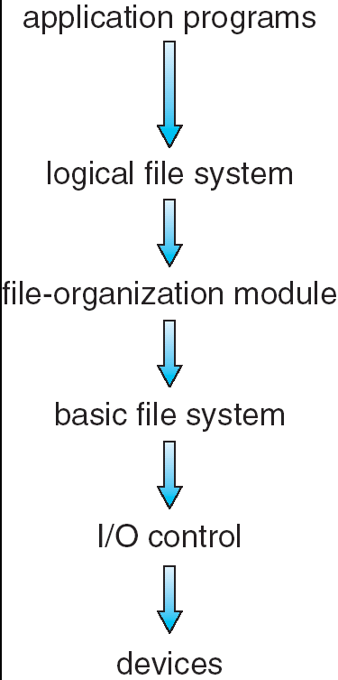
File System Basics
File system is a visible part of OS to users
  Uniform logical view of information/data storage
  Define a logical storage unit - the file
  OS maps files onto physical storage device
  File system resides on secondary storage (hard disk)
A file is a named collection of related information
  Named data objects are called files
  File attributes stored as FCB (file control block):
    Name, identifier, type, location size, protection, time, date,
    and user identification
Key design issues:
  How the file system should look to the user
  How to map the logical file system onto the secondary storage devices
  Layered structure

Slide 3
DFS Topics
Background
Naming and Transparency: Explain naming mechanism that provides location transparency and independence
Remote File Access: Describe various methods for accessing distributed files
Stateful versus Stateless Service: Contrast stateful and stateless distributed file servers
Transactions and Concurrency Control: Protocols to maintain ACID (atomicity, consistency, isolation, durability) semantics for concurrent transactions associated with file sharing
File Replication: How replication of files on different machines in a DFS is a useful redundancy for improving availability and performance
Example: Andrew file system (AFS)

Slide 4
Background
Distributed file system (DFS) – a distributed implementation of the classical time-sharing model of a file system, where multiple users share files and storage resources
  How to support the same kind of sharing when the files are physically dispersed among the sites of a distributed system
A DFS manages set of dispersed storage devices
  Overall storage space managed by a DFS is composed of different and remotely located smaller storage spaces
There is usually a correspondence between constituent storage spaces and sets of files
  A component unit is the smallest set of files that can be stored on a single machine
Two key characteristics of a DFS are the dispersion and multiplicity of users and files

Slide 5
DFS Structure
Service – software entity running on one or more machines and providing a particular type of function to a priori unknown clients
  Multiple services often needed in DFS: directory service, authorization service, file service, system service
Server – service software running on a single machine
  Multiple servers corresponding to multiple services
Client – process that can invoke a service using a set of operations that forms its client interface
  A client interface for a file service is formed by a set of primitive file operations (create, delete, read, write)
  Client interface of a DFS should be transparent, i.e., not distinguish between local and remote files
Sometimes lower level inter-machine interface need for actual cross- machine interaction

Slide 6
DFS Challenges
A file system provides file services to clients
  A DFS is a file system whose clients, servers, and storage devices are all dispersed
  The system has multiple and independent storage devices
DFS configuration and implementation can vary:
  Servers can run on dedicated machines or a machine can be both a server and a client
  Can be implemented as a part of a DOS or, alternatively, by a software layer managing the communication between conventional OS and file systems
Ideally, a DFS should appear to its client to be a conventional, centralized file system
  How to make the multiplicity and dispersion of its servers and storage devices invisible to the users – transparency
  How to make DFS’s performance comparable to that of a conventional OS
Total service time = disk-access time + CPU overhead + network time for processing request and response

Slide 7
Naming and Transparency
Naming – mapping between logical and physical objects
  User deals with logical data objects represented by file names, whereas the system manipulates physical blocks of data stored on disk tracks
  User refers to a file by a textual name
Multilevel mapping – abstraction of a file that hides the details of how and where on the disk the file is actually stored
A transparent DFS hides the location where in the network the file is stored
  Naming mapping includes the specific machine and then an address within a disk there
File replication – a file being replicated in several sites, the mapping returns a set of the locations of this file’s replicas
  This abstraction hides both the existence of multiple copies and their location

Slide 8
Naming Structures
Two related notions regarding name mappings in a DFS:
Location transparency – file name does not reveal the file’s physical storage location
  User-level textual names versus system-level numerical identifiers
Location independence – file name does not need to be changed when the file’s physical storage location changes
  A dynamic mapping that can map the same file name to different locations at two different times
  Supports file migration
In practice, most DFSs use a static, location-transparent mapping for user- level names
  Generally, no location independence and no file mobility
  Some support file migration, e.g., Hadoop

Slide 9
Naming Schemes
Three main approaches to naming schemes in a DFS
Simplest approach - files identified by combination of their host name and local name, e.g., host:local-name
  Guarantees a unique system-wide name
  Component units remain isolated, though the same file operations work for both local and remote files
File mounting approach - attach remote directories to local directories, giving the appearance of a coherent directory tree
  Integrate component units to support transparent sharing
  Provided by Sun’s network file system (NSF)
  Only previously mounted remote directories can be accessed transparently
  Auto-mounting allows mounting be done on demand
Third approach - total integration of the component file systems
  A single global name structure spans all the files in the system
  If a server is unavailable, some arbitrary set of directories on different machines also becomes unavailable

Slide 10
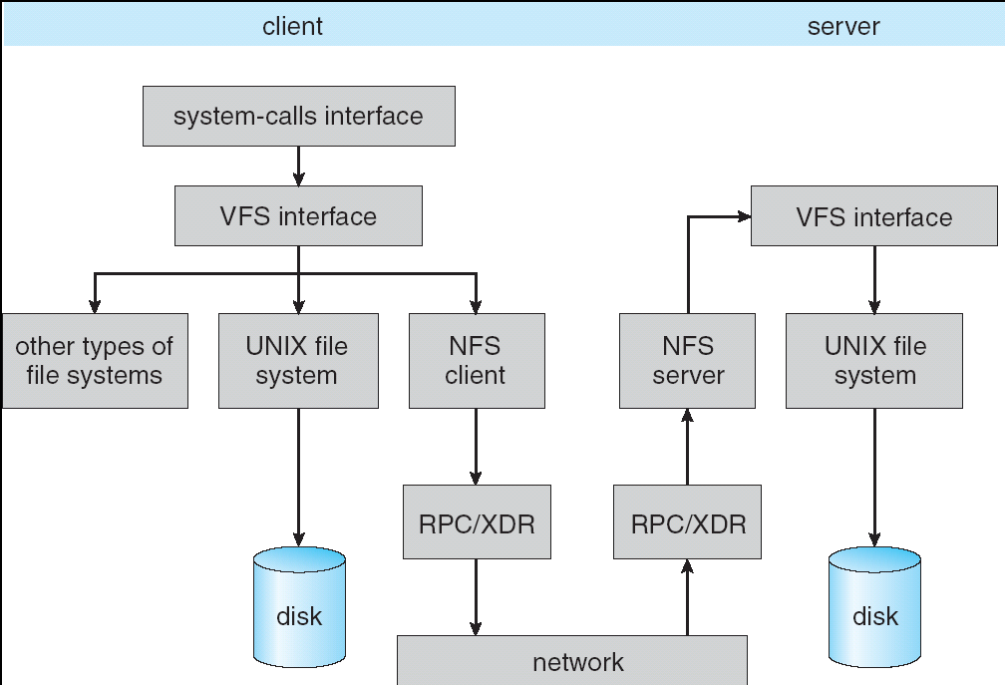
Schematic View of NFS Architecture

Slide 11
Remote File Access
Consider a user who requests access to a remote file:
  First, the server storing the file is located by the name scheme
  Then, the actual data transfer must take place
Remote-service mechanism is one transfer approach
  Requests for service are delivered to the server, which performs the accesses, and their results are then forwarded back to the user
  Implementation with RPC
DFS’s performance depends on both disk I/O and network traffic

Slide 12
Caching Scheme
Ensure reasonable performance of remote-service mechanism using a form of caching
  Retain recently accessed disk blocks in a cache, so that repeated accesses to the same information/data can be handled locally
  If needed data not already cached, a copy of data is brought from the server to the user
Accesses are performed on the cached copy
Files identified with one master copy residing at the server machine, but copies of (parts of) the file are scattered in different caches
  The granularity of caching varies from blocks of a file to an entire file
Cache-consistency problem – keeping the cached copies consistent with the master file
  Could be called network virtual memory – similar to demand-paged virtual memory

Slide 13
Cache Location
Where should the cached data be stored – on disk or in main memory?
Advantages of disk caches
  More reliable
  Cached data kept on disk are still there during recovery and don’t need to be fetched again
Advantages of main-memory caches:
  Permit workstations to be diskless
  Data can be accessed more quickly
  Performance speedup in bigger memories
  Permits a single caching mechanism for servers and users
    Server caches (used to speed up disk I/O) are in main memory regardless of where user caches are located; using main-memory caches on the user machine
Many remote-access implementations can be thought of as hybrids of caching and remote service

Slide 14
Cache Update Policy
Need to write modified data blocks back to the server’s master copy
  The policy can critically affect the system’s performance and reliability
Write-through policy – write data through to disk as soon as they are placed on any cache
  Reliable, but poor performance
  Caching is exploited only for read accesses
Delayed-write policy – modifications written to the cache and then written through to the server later
  Write accesses complete quickly; some data may be overwritten before they are written back, and so only the last update needs to be written
  Poor reliability; unwritten data will be lost whenever a user machine crashes
  Variation – scan cache at regular intervals and flush blocks (to the server) that have been modified since the last scan (periodic write-back)
  Variation – write-on-close, writes data back to the server when the file is closed. Best for files that are open for long periods and frequently modified.

Slide 15
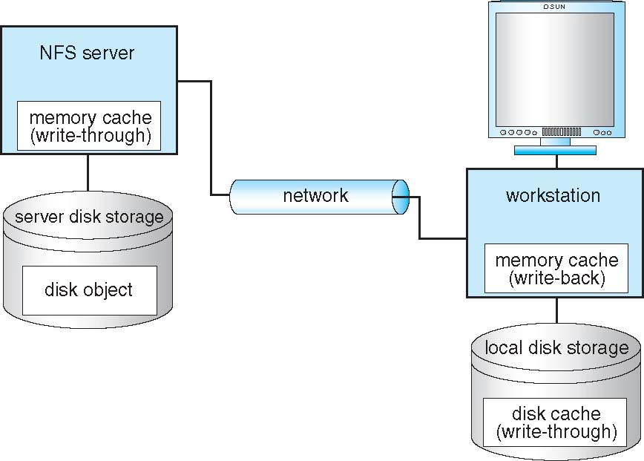
Cachefs
Cachefs file system – a client side caching option
  Once NFS client reads file blocks from the server, it caches them in memory as well as on the disk
  Reference disk cache if the memory copy is flushed, or even if the system reboots

Slide 16
Consistency
Is locally cached copy of the data consistent with the master copy?
  If yes, the cached data can be used
  Up-to-date copy of the data needs to be cached
Client-initiated approach
  Client initiates a validity check in which it contacts server and checks whether the local data are consistent with the master copy
  How often the validity checking is performed – a check before every access or a check only on first access to a file (open a file), or anything in between
Server-initiated approach
  Server records, for each client, the (parts of) files it caches. When server detects a potential inconsistency, it must react
  A potential inconsistency occurs when two different clients in conflicting modes cache a file. When server detects this situation, it disables caching for that file

Slide 17
Caching versus Remote Service
The choice between caching and remote service trades off potentially increased performance with decreased simplicity
In caching, many remote accesses handled efficiently by the local cache; most ‘remote’ accesses will be served as fast as local ones
  Servers are contacted only occasionally in caching (rather than for each access)
  Reduces server load and network traffic
  Enhances potential for scalability
Remote service method handles every remote access across the network; penalty in network traffic, server load, and performance
  Total network overhead in transmitting big chunks of data (caching) is lower than for transmitting series of responses to specific requests (remote-service)

Slide 18
Caching versus Remote Service (Cont.)
Caching is superior in access patterns with infrequent writes
  With frequent writes, substantial overhead incurred to overcome cache-consistency problem
  Benefit from caching when execution carried out on machines with either local disks or large main memories
Remote access on diskless, small-memory-capacity machines should be done through remote-service method
In caching, the lower inter-machine interface is different form the upper user interface
  Data are transferred in masses between the server and the client, rather than in response to the specific needs of a file operation
In remote-service, the inter-machine interface mirrors the local user-file- system interface

Slide 19
Stateful Versus Stateless Service
A session of file operations can be viewed as a connection used for a sequence of requests and responses between client and file server
  State information is associated with each file session (connection)
  Examples of state information: open files and their clients, file descriptors and file handles, current file position pointers, mounting information, lock status, session keys, caches or buffers
  State information of a file session may be distributed between client and server
How to provide server-side information when a client accesses remote files:
  First approach: server tracks each file being accessed by each client
    The service provided is stateful as the server maintains internally some of the state information
  Second approach: server simply sends blocks as they are requested by the client without knowledge of how those blocks are used
    Service is stateless as the server maintains no state information at all

Slide 20
Stateful File Service
Mechanism
  Client performs an open() operation on a file before accessing that file
  Server fetches information about the file from its disk, stores it in its memory, and gives the client a connection identifier unique to the client and the open file
  Identifier is used for subsequent accesses until the session ends
  Server must reclaim the main-memory space used by clients that are no longer active
Increased performance
  Fewer disk accesses
  Stateful server knows if a file was opened for sequential access and can thus read ahead the next blocks
Some environments require stateful service
  A server employing server-initiated cache validation cannot provide stateless service, since it maintains a record of which files are cached by which clients

Slide 21
Stateless File Server
Avoids state information by making each request self-contained
Each request identifies the file and position in the file in full
  Server does not need to keep a table of open files in main memory
No need to establish and terminate a connection by (remote) open() and close() operations
  They are redundant because each file operation stands on its own and is not considered as a part of a session
NFS v3 is stateless service

Slide 22
Comparing Stateful and Stateless Service
Failure recovery in a stateful service is more challenging
  A stateful server loses all its volatile state in a crash
  Restore state by recovery protocol based on a dialog with clients, or abort operations that were underway when the crash occurred
  Server needs to be aware of client failures in order to reclaim space allocated to record the state of crashed client processes
A stateless server is more fault-tolerant upon failure
  The effects of server failures and recovery are almost unnoticeable
  A newly reincarnated server can respond to a self-contained request without any difficulty
Penalty with stateless service includes longer request messages and slower processing of requests, some design issues:
  Implementation must address issues such as idempotency requirement, file locking mechanism, session key management, and cache consistency

Slide 23
Transactions and Consistency Control

Slide 24
Transactions and Concurrency Control
Applying transaction processing to distributed file system management
Clients at each distributed site issue their transaction service requests to the local transaction processing system, which consists of
  Transaction manager (TM) – work in concerts with other TMs to oversee the correct execution of both the local transactions and remote operations
  Scheduler (SCH) – schedule operations to data objects to avoid conflicts
  Object manager (OM) – maintain coherency of replicas and caches, and provide an interface to the file system
Distributed transaction services must address 3 atomicity requirements:
  The execution of the collection of operations in each transaction is all or none
  The execution of a transaction that is interleaved with the execution of other transactions appears to be indivisible
  The update of a replicated object is atomic
TM, SCH and OM are responsible for enforcing the atomicity requirements
  Using a two-phase commit protocol

Slide 25
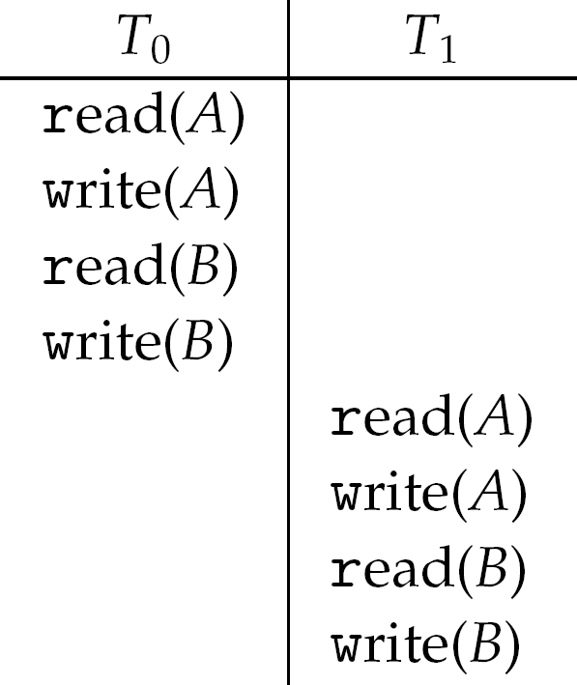
Serial Schedule
A serial schedule is a special legal schedule that is formed by a strict sequential execution (no interleaving operations) of the transactions in some atomically executed transaction order
  One after another, no interleaving
Consider two data items A and B and two transactions T₀ and T₁ on them
  Execute T₀, T₁ atomically (that is, execute all operations in each transaction together)
  Execution sequence (T₀, then T₁) called schedule, which is a serial schedule
  Another possible serial schedule: T₁, then T₀
For N transactions, there are N! valid serial schedules
Schedule 1: T₀ then T₁

Slide 26
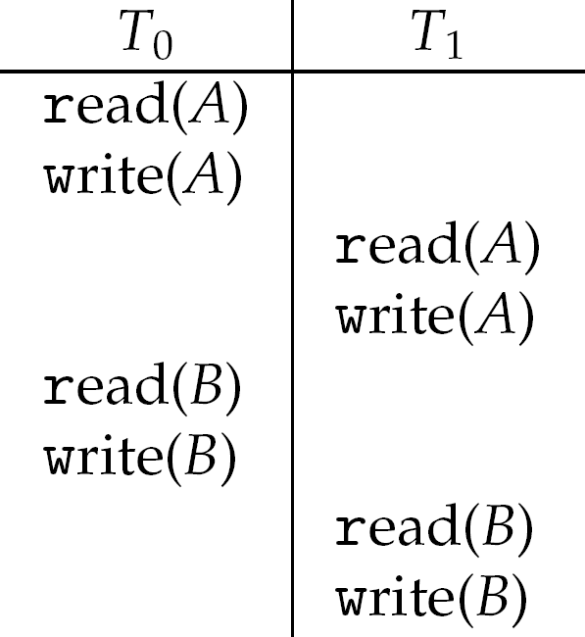
Nonserial Schedule
Non-serial schedule allows overlapped (i.e., interleaved) execution
  Resulting execution not necessarily incorrect
Consider schedule S. Operations O_{i} O_{j} conflict with each other if they access the same data item (object) with, at least, one write
  write-read, read-write, or write-write
If O_{i} O_{j} (consecutive operations of different transactions) don't conflict, then S' with swapped order O_{j} O_{i} is equivalent to S
If S can become S' via swapping of non-conflicting operations
  S is concurrent serializable
Schedule 2: Not a concurrent-serializable schedule

Slide 27
Serializability
A schedule is called serializable if the result of its execution is equivalent to that of a serial schedule
  Concurrent transactions must be equivalent to serial execution – serializability
  Ensure the consistency requirement, which must be enforced by transaction manager and scheduler
Necessary and sufficient conditions for a serializability:
  If the interleaved execution of transactions is to be equivalent to a serial execution in some order, then all conflicting operations in the interleaved serializable schedule must also be executed in the same order at all object sites
Concurrency-control protocols provide serializability:
  Two-phase locking (prevents inconsistencies)
  Timestamp ordering (avoids inconsistencies)
  Optimistic concurrency control (consistency validation)

Slide 28
Locking Protocol
A simple solution is to lock all data items before executing a transaction
Locking protocol ensures serializability by associating a lock with each data item
  Require every transaction on data item (object) Q acquire appropriate lock
  Data objects must be locked before being read from or written to
Two types of locks
  Shared – T_{i} has shared-mode lock on item Q, T_{i} can read Q but not write Q. Allows concurrent reading
  Exclusive – T_{i} has exclusive-mode lock on Q, T_{i} can read and write Q
If a lock is already held, new request may have to wait
  Similar to readers-writers algorithm
All locks must be released after the operations and before the end of transaction

Slide 29
Two-phase Locking Protocol
The two-phase locking protocol (2PL) imposes an additional requirement that a new lock cannot be acquired after the first release of a lock
A transaction is divided into two phases so each transaction issues lock and unlock requests in two phases
  Growing – obtaining locks
  Shrinking – releasing locks
Ensures sequential-serializability
Ignores sharing and concurrency
  2PL limits the number of acceptable schedules thereby sacrificing concurrency for serializability
Does not prevent deadlock

Slide 30
Timestamp Ordering
Select order among transactions in advance – timestamp-ordering
  Conflicting operations in interleaved transactions can be ordered by timestamps (TS)
  2PL protocol orders conflicting operations by the time a shared object is first locked
Transaction T_{i} is associated with timestamp TS(T_{i}) before it starts
  TS(T_{i}) < TS(T_{j}) if T_{i} entered system before T_{j}, TS can be generated from system clock or using logical clock (i.e., a counter incremented at each entry of transaction)
Timestamps determine serializability order
  If TS(T_{i}) < TS(T_{j}), system must ensure the produced schedule is equivalent to a serial schedule where T_{i} appears before T_{j}

Slide 31
Timestamp-based Protocol Implementation
Data object (item) O_{j} gets two timestamps
  WR_{j} – largest timestamp of any transaction that executed write(O_{j}) successfully
  RD_{j} – largest timestamp of successful read(O_{j})
  Timestamps are updated whenever read(O_{j}) or write(O_{j}) executed
  Also a list of tentative times (T_{S,j}, sorted in ascending order) for the pending transactions with a write operation to object O_{j}. Suppose T_{min,j} is the minimum of all these tentative times
Timestamp-ordering protocol assures any conflicting read and write executed in timestamp order
Any rolled back transaction t_{i} is assigned new timestamp and restarted
Algorithm ensures concurrent serializability and freedom from deadlock

Slide 32
Timestamp Ordering
Timestamp is recorded when an operation on a shared object is successfully executed (RD_{j ,} WR_{j})
Later a different transaction invokes a conflicting operation on the same object
  If the transaction’s timestamp is larger than the objects timestamp the operation can proceed
    The transaction is permitted to wait for execution at the object’s site (i.e. a implicit lock)
  If the transaction’s timestamp is smaller (older timestamp), we abort it
Older transactions die and restart when confronted with a younger transaction

Slide 33
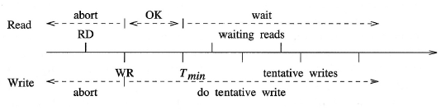
Timestamp-based Protocol
Read operation does not conflict with other reads
  Is aborted if its timestamp is smaller than that of a conflicting write
  Is allowed to proceed if the timestamp is larger than that of the write
Write operation conflicts with reads and other writes
  Is allowed to proceed only if its timestamp is larger than that of both, conflicting reads and writes

Slide 34
Read Operation
Suppose t_{i} executes read(O_{j}) with timestamp TS_{i}
  A read operation does not conflict with other reads (read-read)
If TS_{i} < WR_{j}, t_{i} would read a rewritten value of O_{j}
  read operation rejected and t_{i} rolled back
If TS_{i} ≥ WR_{j} and TS_{i} < T_{min,j}
  read executed, RD_{j} is set to max(RD_{j}, TR_{i}). The read result is put in the transaction manager’s work space and returned to the client
Object O_{j} may already have some tentative write operations pending (i.e., TS_{i} > T_{min,j}) so the read operation waits in the tentative list (the read is supposed to happen later than the pending write)

Slide 35
Write Operation
Suppose t_{i} executes write(O_{j}) with timestamp TS_{i}
  A write operation conflicts with both read and write
TS_{i} < RD_{j}, value O_{j} produced by t_{i} was needed previously and t_{i} assumed it would never be produced
  write operation rejected, t_{i} rolled back
If TS_{i} < WR_{j}, t_{i} attempting to write obsolete value of O_{j}
  write operation rejected and t_{i} rolled back
Otherwise, write executed
  write operation is allowed to proceed tentatively only if its timestamp is greater than both RD_{j} and WR_{j}

Slide 36
Abort and Commit Operations
Abort: Object manager (OM) simply discards the waiting read because an aborted read operation has no effect on other transactions. OM needs to remove an aborted write from the tentative list.
Commit: Only after successful completion of atomic commit phase in TM, a commit is issued:
  For committed transaction consisting of only read operations, OM records the larger of the transaction’s timestamp and the object’s RD as the new RD
  If the committed transaction has done a tentative write, SCH aborts all prior pending transactions, makes the update permanent, and removes it from the tentative list
  Removal of the transaction may allow a waiting read to proceed
  The permanent update calls a replication manager if replicas of the object exist

Slide 37
Optimistic Concurrency Control
Allows an entire transaction to complete and then validates the transaction before making its effects permanent
  The assumption is that conflicts are less likely and can be temporarily ignored – an optimistic approach
  A transaction is allowed to complete and then it is globally validated among all TMs and then the object is updated by each TM
Each transaction manager (TM) undergoes three phases:
  Execution
  Validation
  Update
Timing and other information used by the protocol:
  Each transaction t_{i} is assigned a timestamp TS_{j} at the start of the transaction and a timestamp TV_{i} at the beginning of its validation phase
  Every object O_{j} records RD_{j} and WR_{j}
  Read-set = R_{i}, write-set = W_{i}, objects accessed by t_{i} during its execution

Slide 38
Execution Phase
Execution phase begins at TM when it receives a begin transaction from a local client
  No consistency is checked during execution phase
A private work space is created for each transaction
The work space holds shadow copies of objects with their version numbers and allows local updates
  WR_{j} is also called the version number of object O_{j}
End transaction from the client signals the request for commit (otherwise simply delete transaction and its work space) and TM moves to validation phase

Slide 39
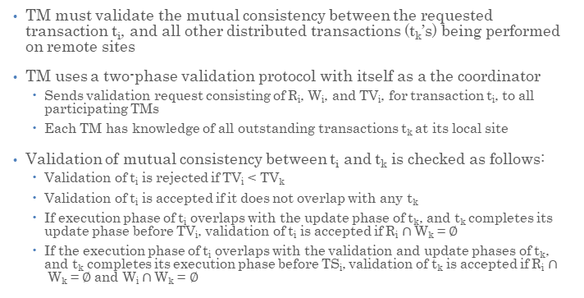
Validation Phase
TM must validate the mutual consistency between the requested transaction t_{i}, and all other distributed transactions (t_{k}’s) being performed on remote sites
TM uses a two-phase validation protocol with itself as a the coordinator
  Sends validation request consisting of R_{i}, W_{i}, and TV_{i}, for transaction t_{i}, to all participating TMs
  Each TM has knowledge of all outstanding transactions t_{k} at its local site
Validation of mutual consistency between t_{i} and t_{k} is checked as follows:
  Validation of t_{i} is rejected if TV_{i} < TV_{k}
  Validation of t_{i} is accepted if it does not overlap with any t_{k}
  If execution phase of t_{i} overlaps with the update phase of t_{k}, and t_{k} completes its update phase before TV_{i}, validation of t_{i} is accepted if R_{i} $∩$W_{k} = $∅$
  If the execution phase of t_{i} overlaps with the validation and update phases of t_{k}, and t_{k} completes its execution phase before TS_{i}, validation of t_{k} is accepted if R_{i} $∩$W_{k} = $∅$ and W_{i} $∩$W_{k} = $∅$

Slide 40
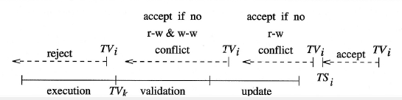
Optimistic Concurrency Control

Slide 41
Update Phase
An accepted validation means that updates must be committed for the corresponding transactions
Transactions are serialized with respect to the timestamps TV_{S} of the validated transactions
  Validated transactions are already ordered
Making shadow copies permanent
  Using a shared update manager which can be called to serialize the updates by all TMs

Slide 42
Data and File Replication

Slide 43
Data and File Replication
Data objects and files are replicated on multiple machines of a distributed system
  Replicas of the same file reside on failure-independent machines
Improve system performance and availability
  Allowing concurrent accesses to the replicas for higher performance
    Shorten service time by selecting a nearby replica
  Exploiting the redundancy of data objects for higher availability
    Availability of one replica is not affected by the availability of the rest of replicas
  Object managers are responsible for replica management

Slide 44
Transparency and Atomicity Requirements
Naming scheme maps a replicated file name to a particular replica hiding details of replication from users
Two related transparencies to be assured (in addition to parallelism and failure transparencies):
  Replication transparency – clients not aware of the existence of replicas (i.e., perceiving a single copy of objects)
    Existence of replicas should be invisible to higher levels
  Concurrency transparency - clients not aware of other sharing clients
Three relevant atomicity requirements:
  Execution of transactions should be all or none
  Concurrent execution of object sharing transactions should be equivalent to a serial execution of the transactions
  Additionally: Updates to all replicas must be atomic:
    Replicas of a file denote the same logical entity, and thus an update to any replica must be reflected to all other replicas

Slide 45
Updating Replicas
Atomic update is a generic management function for data replication in any file system
Unlike transactions, the consistency requirement may be less stringent for data replication
  Allow failures of replicas as long as at least one copy is available for client access
  No global coherency of replicas as long as client can read the most recently written data
Three atomicity situations due to group notion in distributed systems:
  Atomic multicast – delivering multicast messages reliably to all non-faulty group members satisfying a total ordering (main concern: order of message delivery)
  Atomic update – propagate and serialize updates to all replicated objects
  Atomic transaction – performing operations in every transaction on an all or none basis, executing conflicting operations among concurrent transactions in the same order
Management of replicated data/files can be tackled from either group multicast or transaction point of view

Slide 46
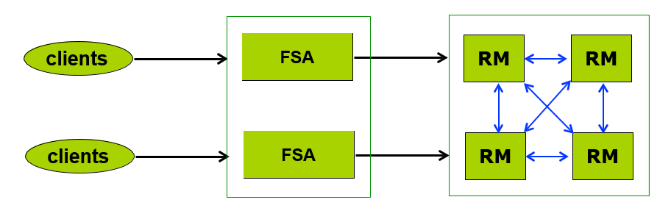
Replica Management
A generic system architecture for replica management:
  File service agents (FSAs): serve as front end to RMs
    Provide replication transparency for clients
  Replica managers (RMs) to handle actual reading and updating of data objects
    Provide concurrency transparency for clients
For accessing data objects, clients may choose one or more FSAs, and then each FSA may contact one or more RMs
  Two types of object access operations: read and update

Slide 47
Object Access Operations
Read operation - addressed by only one of replicas but need to ensure that data read is most recent by checking other replicas:
  Read-one-primary: only read from a primary RM to enforce consistency
  Read-one: may read from any RM to gain concurrency
  Read-quorum: read from a quorum of RMs to decide on the data being current
Write/update operation (overwrite or read-modify write) – addressed to all replicas atomically, and could be done in less restrictive manner:
  Write-one-primary: only write to primary replica (RM), which propagates the updates to all other secondary RMs
  Write-all: atomic updates to all RMs
  Write-all-available: atomic update only to available (non-faulty) RMs
  Write-quorum: atomic update only to a quorum of RMs
  Write-gossip: update directed to any RM and then lazily propagated to other neighboring RMs
Combinations of above operations are used for managing replicas

Slide 48
One-copy Serializability
Goal: one-copy serializability: Combined atomic transaction and atomic update property
  Execution of transactions on replicated objects is equivalent to execution of same transactions on non-replicated objects
Read-one-primary/write-one-primary: Both read and write operations are directed to the primary replica manager
  All operations can be serialized by the primary RM
  No concurrency at all but easy consistency
  Secondary RMs only supply redundancy in case of primary failures
Read-one/write-all: Allow read from any RM site and require atomic propagation of updates from primary RM to secondary RMs
  Provides concurrency
  Allows update to be initiated by any RM, preferably one closer to the client
  Assumption of write-all is not realistic – requiring all replicas to participate in atomic update contradicts the purpose of replication

Slide 49
One-copy Serializability Problem
Perform atomic update only on all of available (non-faulty) replicas but not to all RMs - read-one/write-all-available protocol
  Complicates one-copy serializability property because read operation may not always be from an updated replica
Consider an example of three transactions t₀, t₁ and t₂ on two data objects X and Y:
  Correct execution is when t₁ and t₂ are executed serially: t₁ t₂ or t₂ t₁
Suppose that you replicate X to X_{a} and X_{b}, and Y to Y_{c} and Y_{d}, and failures occur to X_{a} and Y_{d}. Two transactions become:
  Neither t₁ nor t₂ sees the object written by the other – so execution is not one- copy serializable
t₀ : bt t₁ : bt t₂ : bt
W(X) W(Y) et
R(X) W(Y) et
R(Y) W(X) et
t₁ : bt | R(X_{a}) (Y_{d} fails) W(Y_{c}) | et
t₂ : bt | R(Y_{d}) (X_{a} fails) W(X_{b}) | et

Slide 50
Quorum Voting
Read-quorum/write-quorum: requires that each read operation to replicated data object d must obtain read quorum R(d) of RMs to perform the read, and similarly each write operation needs write quorum W(d) to complete the write
Using two quorums, conflicts between access operations may be detected by an overlapping of the quorums. Let V(d) be the total number of copies (votes) of object d. The overlapping rules for read and write are:
  Write-write conflict: 2 * W(d) > V(d)
  Read-write conflict: R(d) + W(d) > V(d)
Once conflicts can be detected, 2PL locking or timestamp ordering protocol can be used to enforce one-copy serializability
A read operation queries all R(d) replicas, and the value in the replica with the highest version number is returned to the client
A write operation queries W(d) replicas and adds 1 to the highest version number found, which becomes the new version number for writing to all replicas

Slide 51
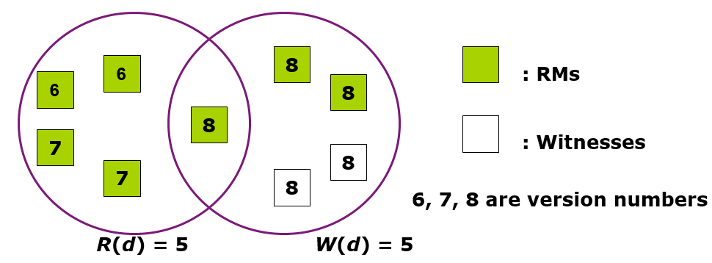
Quorum Voting Example
Since the read and write operations overlap with each other, a read is always returned with the most updated write
  R(d) = 1 and W(d) = V(d) for read-one/write-all protocol
  R(d) = 1 and W(d) < V(d) for read-one/write-all-available protocol (not feasible)
R(d) > 1 and W(d) < V(d) for read-quorum/write-quorum protocol
  Example: V(d) = 9, and both R(d) and W(d) set to 5
  Write quorum may also include witnesses (ghosts) that maintain only necessary information (but no replicated data) to participate in the quorum

Slide 52
Gossip Update Propagation
Many of applications of data replication do not need as strong consistency as the one-copy-serializability
  If updates are less frequent than reads and ordering of updates can be relaxed, updates can be propagated lazily among replicas
  Similar to dissemination of information by gossip in real life
Read-one/write-gossip approach called a gossip update propagation protocol
  Both read and update operations are directed by FSA to any RM
  RMs bring their data up to date by exchanging gossip information among themselves
  Useful in environments where failures of replica are likely and multicast of updates is unreliable
Two update options:
  Overwrite update
  Read-modify update: depends on current state of data object
    An update log L used to record the history of updates

Slide 53
Basic Gossip Protocol
Timing information used for overwrite updates: TS_{f} and TS_{i}
Read: TS_{f} of FSA is compared with TS_{i} of RM contacted
  If TS_{f} ≤ TS_{i}, RM has more recent data so its value is returned to FSA and TS_{f} is set to TS_{i}
  Otherwise, FSA waits until RM has been brought up to date through gossip or contacts other RMs
Update: FSA increments its TS_{f}
  If TS_{f} > TS_{i}, the update is executed, and TS_{i} is set to TS_{f}.
    RM can propagate the new knowledge at its own convenience by way of gossip
  If TS_{f} ≤ TS_{i}, the update has come too late or concurrent updates are being processed
    Simply perform overwrite or first read and then update to become more up to date, and then advance the timestamp
Gossip: A gossip message carrying a data value from RM_{j} to RM_{i} is accepted if TS_{j} > TS_{i}

Slide 54
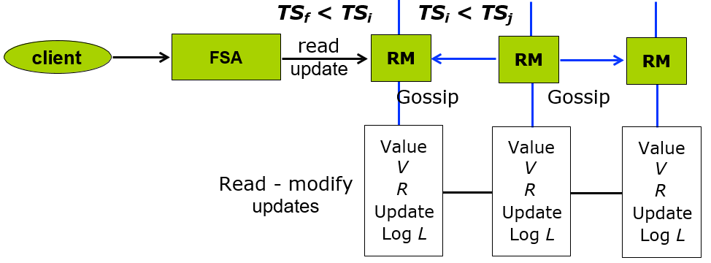
Gossip Architecture
Information maintained by each RM and each FSA for updates:
TS_{i} = timestamp representing the last update of data object by each RM
TS_{f} = timestamp of the last successful access operation by each FSA
V = timestamp of the current value of the object at RM
R = RM’s knowledge of update requests of all RMs (in a group)
L = update log = list of update records collected by RM, each record containing unique identifier r and update u

Slide 55
Using Vector Timestamps
If the group is definitive so that all RMs are known, vector timestamps can be used instead of single timestamps
Vector timestamp can be composed of sequence numbers (or version numbers) representing the number of updates executed at each RM site
  For example, TS_{i} = < 2, 3, 4 > means that two, three and four updates have occurred at RM₁, RM₂ and RM₃, respectively
  A read operation with TS_{f} = < 2, 2, 2 > pairwise and equal or less than TS_{i} is allowed to proceed
  Operation with TS_{f} of < 2, 5, 5 > needs to wait
Vector timestamps can be used to maintain causal order necessary for gossip propagation if updates are read-modify

Slide 56
Causal Order Gossip Protocol
Read: FSA assigns its vector timestamp TS_{f} to the query q and compares it with current vector timestamp V of the object
  If q ≤ V, RM returns the stable object value to FSA. Advance TS_{f} by merging q with V
  Otherwise, FSA either waits for the object to become up to date or contact other RMs
Update: FSA assigns its vector timestamp TS_{f} to the update u
  If u < V, RM rejects the update because it comes too late
  If u ≥ V or u is concurrent with V, the update is accepted
    RM_{i} increments the i^{th} component of R by 1
    Generate a unique identifier r and place with the update operation u in log L
  If u = V, the update operation is executed and V is advanced by merging with r
As a result, some records are ready to be executed
If more, their execution is performed in causal order imposed by vector
timestamps

Slide 57
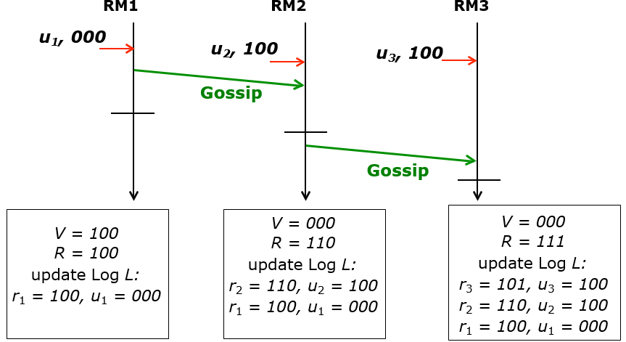
Gossip Protocol Example
Gossip: A gossip message from RM_{j} to RM_{i} carries RM_{j}’s vector timestamp R_{j} and log L_{j}
  R_{j} is merged with the vector timestamp R_{i} in RM_{i}
  L_{i} in RM_{i} is joined with L_{j} except for those update records with r ≤ V_{i}
  Aggregate of logs is true gossip in that it contains knowledge of many RMs

Slide 58
Andrew File System

Slide 59
An Example: AFS
AFS (Andrew file system) is a feature-rich DFS characterized by location independence and location transparency. It also imposes significant consistency semantics. Caching and replication are used to improve performance
A distributed computing environment (Andrew) under development since 1983 at Carnegie-Mellon University, purchased by IBM and released as Transarc DFS, now open sourced as OpenAFS
AFS tries to solve complex issues such as uniform name space, location-independent file sharing, client-side caching (with cache consistency), secure authentication (via Kerberos)
  Also includes server-side caching (via replicas), high availability
  Can span 5,000 workstations

Slide 60
Andrew FS (Cont.)
Clients are presented with a partitioned space of file names: a local name space and a shared name space
Dedicated servers, called Vice, present the shared name space to the clients as an homogeneous, identical, and location transparent file hierarchy
The local name space is the root file system of a workstation (client machine), from which the shared name space descends
Workstations run the Virtue protocol to communicate with Vice, and are required to have local disks where they store their local name space
Servers collectively are responsible for the storage and management of the shared name space

Slide 61
Andrew FS (Cont.)
Clients and servers are structured in clusters interconnected by a backbone LAN
A cluster consists of a collection of workstations and a cluster server and is connected to the backbone (WAN) by a router
A key mechanism selected for remote file operations is whole file caching
  Opening a file causes it to be cached, in its entirety, on the local disk

Slide 62
Andrew FS Shared Name Space
Andrew’s volumes are small component units associated with the files of a single client
A fid identifies a Vice file or directory - A fid is 96 bits long and has three equal-length components:
  volume number
  vnode number – index into an array containing the inodes of files in a single volume
  uniquifier – allows reuse of vnode numbers, thereby keeping certain data structures, compact
Fids are location transparent; therefore, file movements from server to server do not invalidate cached directory contents
Location information is kept on a volume basis, and the information is replicated on each server

Slide 63
Andrew FS File Operations
Andrew caches entire files form servers
  A client workstation interacts with Vice servers only during opening and closing of files
Venus – caches files from Vice when they are opened, and stores modified copies of files back when they are closed
Reading and writing bytes of a file are done by the kernel without Venus intervention on the cached copy
Venus caches contents of directories and symbolic links, for path- name translation
Exceptions to the caching policy are modifications to directories that are made directly on the server responsibility for that directory

Slide 64
Andrew FS Implementation
Client processes are interfaced to a UNIX kernel with the usual set of system calls
Venus carries out path-name translation component by component
The UNIX file system is used as a low-level storage system for both servers and clients
  The client cache is a local directory on the workstation’s disk
Both Venus and server processes access UNIX files directly by their inodes to avoid the expensive path name-to-inode translation routine

Slide 65
Andrew FS Implementation (Cont.)
Venus manages two separate caches:
  one for status
  one for data
LRU algorithm used to keep each of them bounded in size
The status cache is kept in virtual memory to allow rapid servicing of stat() (file status returning) system calls
The data cache is resident on the local disk, but the UNIX I/O buffering mechanism does some caching of the disk blocks in memory that are transparent to Venus

Slide 66








