Slide 1
Welcome and Introduction
Lecture 1
Hartmut Kaiser
https://teaching.hkaiser.org/fall2026/csc7103/

Slide 2

Administrativia

Slide 3

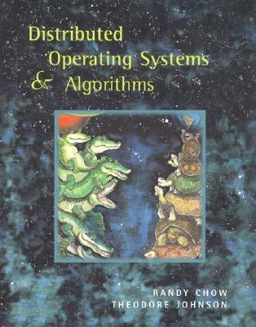
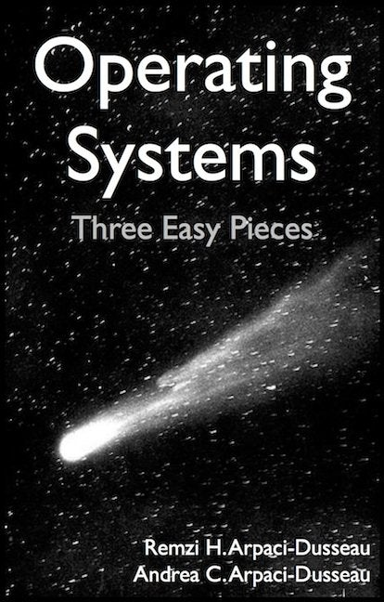
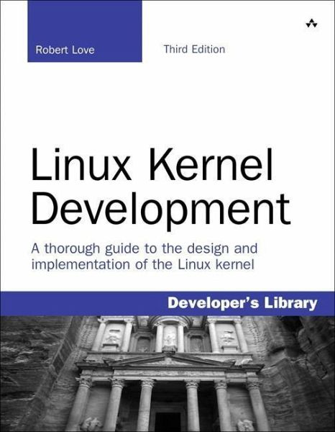
Infrastructure, Textbook & Readings
Infrastructure
  Website: https://teaching.hkaiser.org
  Discord: https://discord.gg/yN3gGfwpfE
Textbooks:
  Distributed Operating Systems & Algorithms, Chow and Johnson
    Not required, get a copy if you feel that lectures are not sufficient
    Suggested readings posted along with lectures
    Try to keep up with material in book as well as lectures
Supplementary Material
  Operating Systems: Principles and Practice (2nd Edition) Anderson and Dahlin
  Operating Systems: Three Easy Pieces, by Remzi and Andrea Arpaci-Dusseau, available for free online
  Linux Kernel Development, 3rd edition, by Robert Love
Homework, project, quizzes, grading, honesty
  Use Github/GradeScope/Moodle for assignments
  Use VSCode as a tool

Slide 4
Class Expectations
Lectures
  Come! Cannot guarantee content will be identical to previous years
  Will explain many things related to assignments not otherwise explained
  If you decide to come, please be on time
  Meet your fellow students, they are your future colleagues!
  Electronic devices used only for note taking
  Attendance not mandatory but highly advised
    I may take attendance
Office Hours
  Come and ask for help early. There are no stupid questions!
  We like teaching and want to meet you!
Communicate with course staff through Discord and Email.

Slide 5
This Course
This is a revised curriculum with new goals:
  Understanding and exploiting Distributed OS and services
  Foundation concepts and principles
  Common problems that have been solved in distributed OS
  Evolving directions in system architecture

Slide 6
Important Dates and Details
Lectures
  Tuesday and Thursday, 1:30pm to 2:50pm, 1236 PFT
Grading
  Assignments 20%
  Projects 50%
  Reading assignments 20%, presentations 10%
Exams
  There might be take-home examinations

Slide 7
Class Structure
Tuesdays will be lecture days
  Slides will be posted on web site
On Thursdays you present the papers you have read
  Weekly reading assignments are due at that lecture
  Will take attendance for these
Discussion notes may also be posted
Will sometimes cite papers
  Look up with search engine or ask us for more info
If you have questions on papers you read, email us by 9am on day of lecture
  I will try to address your questions in discussion
  Good questions may earn participation points

Slide 8
Class Structure
Lectures
  Discuss advanced topics
  Every week will have mandatory readings due on Thursday
    You are expected to have read those, submit written review for two of the papers
    Discuss readings, ask questions
Reading assignments
  Everyone reads the papers and submits (hardcopy) review for two of the papers every week
  Up to four students will present one of the papers each during lecture time
  Discussions will earn extra points
Assignments
  Programming against OS APIs
  Assignment0 is simple ‘readiness test’ for you, no submission, one question quiz on Sep 2
  Assignment1 is asking you to write a simple Linux command line tool
Projects
  PintOS, a toy OS
  Implement new features: threading, scheduling, memory management

Slide 9
Honesty
The LSU Code of Student Conduct defines plagiarism in Section 5.1.16:
  "Plagiarism is defined as the unacknowledged inclusion of someone else's words, structure, ideas, or data. When a student submits work as his/her own that includes the words, structure, ideas, or data of others, the source of this information must be acknowledged through complete, accurate, and specific references, and, if verbatim statements are included, through quotation marks as well. Failure to identify any source (including interviews, surveys, etc.), published in any medium (including on the internet) or unpublished, from which words, structure, ideas, or data have been taken, constitutes plagiarism;“
Plagiarism will not be tolerated and will be dealt with in accordance with and as outlined by the LSU Code of Student Conduct: https://www.lsu.edu/saa/students/codeofconduct.php

Slide 10
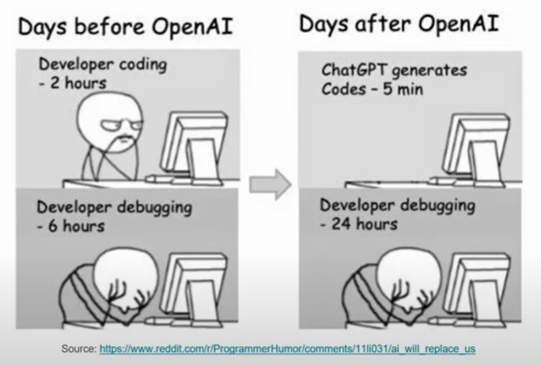
ChatGPT?

Slide 11
ChatGPT
The goal for this course is to train our brains, not ChatGPT
  So, do yourself a favor and don’t use it
  There are too many software ‘developers’ out there who copy & paste their way to the next paycheck
However, if you do use it:
  Never use anything without carefully reviewing it
    Assume what you got is wrong! Prove to yourself it is correct!
  The skill of reading (and understanding) code becomes more important than ever
  Cite and annotate the copied code
Whatever you do, remember:
  You are responsible for whatever you submit
  It’s plagiarism if you submit the same code as your neighbor
  No matter where you got it from, be it Google, ChatGPT, or your neighbors computer

Slide 12
Introduction to Operating Systems

Slide 13
Introduction to Operating Systems
Why study Operating Systems Research?
  Why care about OS/systems research?
  What are the fundamental problems?
Not really just about building OSes
  Any large code base converges on becoming an OS
  Manages memory, programming for space/performance, hardware details
  Database, JVM, browser, parallel/distributed systems, internet services
How to structure systems and deal with complexity
  Modularize and encapsulate
  Choose interfaces/abstractions carefully
Themes in this class
  Abstractions for managing/accessing resources: storage, replication, naming
  Correctness: concurrency and sharing
  Guarantees in real systems: security, fault tolerance, etc.

Slide 14
Prerequisites & Goal
We assume some familiarity with C
  There will be a lecture about ‘Refreshing C’, though
Some familiarity with Unix may help
An undergraduate “textbook” OS class (e.g., CSC4103)
  Familiar with concepts like Virtual Memory, processes, etc.
  Enough to read papers that employ these concepts
  Assignment 0 will give you a chance to catch up
Goals of class:
  Get to the point of being able to read and understand contemporary OS papers
  Provide background if you are interested in doing (distributed) OS research

Slide 15
Course Topics
Distributed aspects of:
  Concurrency & synchronization
  Scheduling
  Virtual memory
  Virtual machines
  File systems & storage
  Network stack implementation
  Storage systems
  Kernel architectures
  OS Security and reliability

Slide 16
Advanced Operating Systems

Slide 17
Why study Operating Systems?
Operating systems are a maturing field
  Most people use a handful of mature OSes
  Hard to get people to switch operating systems
  Hard to have impact with a new OS
High-performance of servers are an OS issue
  Face many of the same issues as OSes
Resource consumption is an OS issue
  Battery life, radio spectrum, etc.
Security is an OS issue
  Hard to achieve security without a solid foundation
New “smart” devices need new OSes

Slide 18
What is an Operating System?
Makes hardware useful to the programmer
Provides abstractions for applications
  Manages and hides details of hardware
  Accesses hardware through low/level interfaces unavailable to applications
Provides protection
  Prevents one process/user from clobbering another

Slide 19



Three Main Hats
Referee
  Manage protection, isolation, and sharing of resources
Illusionist
  Provide clean, easy-to-use abstractions of physical resources
Glue
Provides a set of common services

Slide 20
Referee:
What does this Program do?
laptop> gcc –o cpu cpu.c -Wall
laptop> ./cpu A
#include <stdio.h>
int main(int argc, char *argv[])
{
char *str = argv[1];
while (1) {
printf("%s\n", str);
}
return 0;
}
A
A
A
A
…
laptop> ./cpu A & ./cpu B & ./cpu C
a)
b)
A
B
C
A
B
C
…
c)
A
B
B
A
C
B
C
…
A
A
A
A
…
laptop> ./cpu ; ./cpu B
Segmentation Fault
B
…

Slide 21
Illusionist:
What does this Program do?
laptop> gcc –o memory memory.c -Wall
#include <stdio.h>
#include <stdlib.h>
#include <unistd.h>
int main(int argc, char *argv[])
{
int *p = malloc(sizeof(int));
printf("(%d) p: %p\n", getpid(), p);
*p = 0;
while (1) {
*p = *p + 1;
printf("(%d) p: %d\n", getpid(), *p);
}
return 0;
}
laptop> ./memory
(120) p: 0x200000
(120) p: 1
(120) p: 2
(120) p: 3
(120) p: 4
laptop> ./memory & ./memory
(120) p: 0x200000
(254) p: 0x200000
a)
(120) p: 1
(120) p: 2
(254) p: 1
(254) p: 2
(254) p: 3
(120) p: 3
…
b)
(120) p: 1
(254) p: 1
(120) p: 2
(254) p: 2
(120) p: 3
(254) p: 3
…

Slide 22
Glue:
Typical OS structure
Most software runs as user-level processes
OS kernel handles “privileged” operations
  Creating/deleting processes
  Access to hardware
P1
P2
P3
P4
user
kernel _{VM}
sockets scheduler
IPC
file system
TCP/IP
device driver
device driver
device driver
network console disk

Slide 23
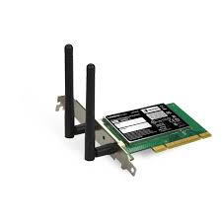
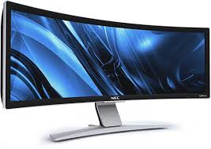

Putting it all together
Referee + Illusionist + Glue => Easy to use virtual machine
Program 1
Program 2
Program 1
Software
OS Hardware Virtualization
ISA
Infinite Processors
Infinite Memory
Hardware
Memory
Storage Mger
Network Mger
Processor
GUI
Ctrlr
Program 2
Storage
Networks
Displays
Infinite Processors
Infite Memory
Storage Mger
Network Mger
Inputs
GUI

Slide 24
*nix Architecture
User-level
Kernel “top half”
  System call, page fault handler, kernel-only process, etc.
Interrupts
  Software interrupt
  Device interrupt
  Timer interrupt
Context switch code

Slide 25
Transitions between Contexts
User → kernel: syscall, page fault
User/kernel → device/timer interrupt: hardware
Kernel → user/context switch: return
Kernel → context switch: sleep
Context switch → user/kernel
– p. 13/3

Slide 26
System Calls
Goal: invoke kernel from user-level code
  Like a library call, but into more privileged OS code
Applications request operations from kernel
Kernel supplies well-defined system call interface
  Applications set up syscall arguments and trap to kernel
  Kernel performs operation and returns result
Higher-level functions built on syscall interface
  printf, scanf, gets, etc. all user-level code

Slide 27
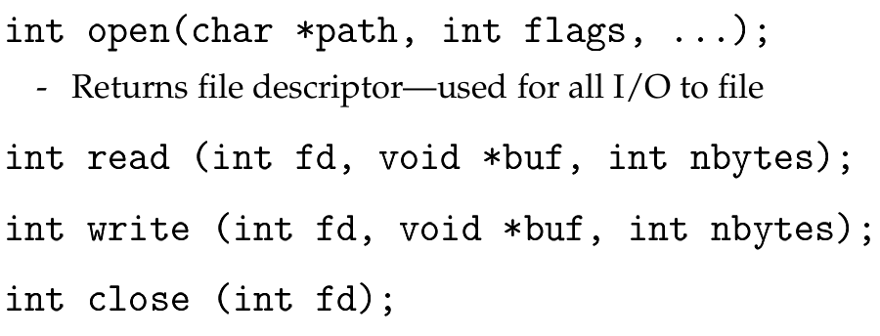
Example: POSIX/Unix interface
Applications “open” files/devices by name
  I/O happens through open files

Slide 28
System Interfaces
System call interface is interface to kernel
Historically also interface “most programmers” need
  But most programmers != all programmers
  Standard OSes support many types of application
No inherent reason for two interfaces to be the same
  Exokernel possibly most extreme example
Philosophy: provide protection in kernel, but abstraction only in user-level libraries

Slide 29
OS Research as a fundamental Discipline of Computer Science
What is Computer Science?
  Computer Science is the science of managing complexity
  Modularization and Encapsulation
  Building abstractions
What is OS Research?

Slide 30
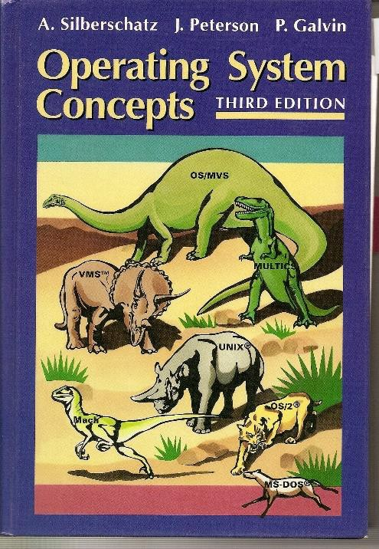
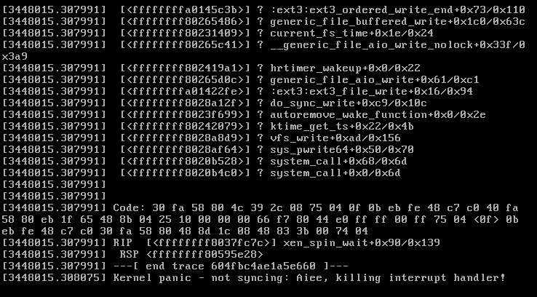

General Perception of OS Research

Slide 31
OS Research Actually
Not really just about building OSes
Any large code base converges on becoming an OS
  Manages memory, programming for space/performance, hardware details
  database, JVM, browser, parallel/distributed systems, internet services
How to structure systems and deal with complexity
  Modularize and encapsulate
  Choose interfaces/abstractions carefully
Themes in this class
  Abstractions for managing/accessing resources: storage, replication, naming
  Correctness: concurrency and sharing
  Guarantees in real systems: security, fault tolerance, etc.

Slide 32
What is OS Research?
New kernel architectures
  Typically <10% of papers in top OS conferences!
New kernel components
  E.g., new VM or network stack implementation, process or disk scheduling algorithm, buffer cache, file system, etc.
  Also only a small fraction of papers
User-level code running on an existing kernel
  Challenging applications often face OS issues
  Either hit your head against OS because it does the wrong thing
  Or have to re-implement OS-like abstractions (for better performance, distributed operation, etc.)

Slide 33
Today’s Readings

Slide 34
Today’s Readings: Motivation & Professional Development
Levin & Redell: “How (and How Not) to write a Good Systems Paper”
  Summary:
    Rules of thumb for writing good systems papers
    Most papers are limited
    A few researchers consistently publish at top conferences
    Learn from them or risk a second-rate career
    A good framework to use for thinking about the papers we read in this class
Haldane ’28: On being the right size
  Summary: scale and use case are determinants for the fitness of a system
Hamming: “You and Your Research”
  Summary:
    Stay open to people and ideas
    Research is both time-consuming and exciting
    Research inspiration comes from unexpected directions

Slide 35
How (and How Not) to write a Good Systems Paper (Levin & Redell)
Categories
  Real system
  Unimplemented system
  Theoretical topic
Most SOSP papers are about prototypes
  Some differences by field
    E.g. architecture: more simulation (why?)
Prototype is not enough
Why build a system?
  “The purpose of (scientific) computing is…
  insight, not numbers.” – Richard Hamming
Adapt old techniques to new technology
 |  | Effort | SOSP Accept | SOSP Reject
Real system | Used by others | Huge | Occasional | Occasional
Worked once | Benchmarks ran by deadline | Large | Common | Occasional
Simulated | Simulations run | Large/med | Occasional | Common
Paper design | Sounds good | minimal | Rare | Common

Slide 36
On being the Right Size (Haldane)
Why should we read this paper?
  Bold statements that are unusual in scientific literature
  Intellectual pursuits require breadth and depth
Incommensurate scaling: eye size, jumping height
  Hardware constraints influence system design: strength of femur limits height
Distribution of complexity and even basic assumptions change as a function of scale
  E.g. MapReduce algorithm is a handful of lines of code
  Apache Hadoop: 2,422,127 SLoC (as of 9/5/17)
What lessons relevant to computer systems?
  Systems are not becoming larger because they are more complicated but
  Systems become more complicated when becoming larger

Slide 37
Example: Video Server

Slide 38
Example: Video Server
Buy hardware with the following capabilities:
  40 MByte/sec SCSI disk (more for NVM, solid state disks)
  1 Gbit/sec Ethernet (could be more in modern data centers)
Application requirements:
  Serve 200 Kbit/sec video streams
  Many users spread around the Internet
  Access control
Maximum capacity: 500 clients???

Slide 39
Reality: Much lower Capacity
CPU bottleneck
  Software structure may impose many context switches
  Concurrency may introduce lock contention
Disk I/O limitations
  Multiple streams introduce disk seeks: E.g., 5ms/8K read = 1.6 MByte/sec
  Must pipeline disk requests—requires prefetching
  But then OS buffer cache may fill memory and induce paging
Network stack limitations
  OS may buffer stale data (dropped frames)
  Congestion control improperly prioritizes packets

Slide 40
Maximizing Throughput
Goal: Service maximum number of clients over time
Avoid letting resources stay idle
  Different resources: CPU, disk, network
  E.g., don’t leave disk idle while waiting for network
Key technique: Concurrency
  Concurrency ensures each resource can be utilized
Example: while waiting for a disk read for one client
  . . . can use CPU to compute data for another client
  . . . can transmit data to a third client over network

Slide 41
Impact of Disks

Slide 42
Disks
For many systems, disks are the limiting factor
Can limit throughput far below network capacity
  E.g., cut naïve video server throughput by factor of 7–8
Can also limit capacity of a system
Example: build a system to index CSC7103 lecture notes
  Scan all files, create index file
  Rely on kernel for low-level details of storage management
Example: build a system to index the web
  Can’t stuff enough disks in one computer to hold index
  Need a user-level distributed storage system

Slide 43
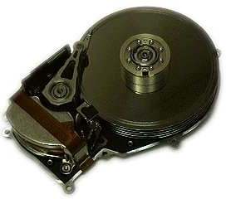
Anatomy of a Disk
Stack of magnetic platters
  Rotate together on a central spindle @3,600-15,000 RPM
  Drive speed drifts slowly over time
  Can’t predict rotational position after 100-200 revolutions
Disk arm assembly
  Arms rotate around pivot, all move together
  Pivot offers some resistance to linear shocks
  Arms contain disk heads–one for each recording surface
  Heads read and write data to platters

Slide 44
Disk Positioning System
Move head to specific track and keep it there
  Resist physical socks, imperfect tracks, etc.
A seek consists of up to four phases:
  speedup–accelerate arm to max speed or half way point
  coast–at max speed (for long seeks)
  slowdown–stops arm near destination
  settle–adjusts head to actual desired track
Very short seeks dominated by settle time (∼1 ms)
Short (200-400 cyl.) seeks dominated by speedup of arm
  Accelerations of 40g
– p. 25/3

Slide 45
Seek Details
Head switches comparable to short seeks
  May also require head adjustment
  Settles take longer for writes than reads
Disk keeps table of pivot motor power
  Maps seek distance to power and time
  Disk interpolates over entries in table
  Table set by periodic “thermal recalibration”
  500 ms recalibration every 25 min, bad for throughput
“Average seek time” quoted can be many things
  Time to seek 1/3 disk, 1/3 of time to seek whole disk,

Slide 46
What does this mean for Systems?
More concurrency can mean higher throughput
  If you have N requests, you can sort them
  Ask disk/controller to perform them in optimal order
  Can vastly reduce seek times, increase throughput
Cache data you will use again in faster memory
More efficient to access nearby data than far away data
  E.g., good idea to put related data close together (e.g., put file near metadata)
Larger requests mean higher throughput
  Sequential throughput much higher than random
Note: Last three may require bypassing the OS

Slide 47
Preview of Disk Techniques
Make many disks seem like one large disk (RAID)
Structure storage for large writes (Logs)
Expose information/control to applications
  What pages are in virtual memory
  What pages have been accessed
  How should OS manage cache
  What threads are blocked waiting for disk I/O

Slide 48
Impact of Network

Slide 49
Network
Many machines serve clients over the Internet
  Speed of light means typical round trip time (RTT) in 10’s of milliseconds
Often have to wait for client
  E.g., send back HTML page, wait for image requests
  Congestion control may require limiting send rate
Again, concurrency achieves good throughput
Also may care about space
  E.g., if it takes one second to service and requires 10 MByte of memory, memory will be limiting factor
Many kernels impose other limitations:
  Number of file descriptors or processes
  Size of hash table for TCP connections (mostly fixed today)

Slide 50
Achieving Concurrency
Can use OS processes
  Heavy weight (expensive to create) and memory intensive
Can use non-blocking I/O operations
  read/write, but return immediately if not possible
  Single process handles many clients
  Not good for disk concurrency
Can use threads implemented at user level
  Build on non-blocking I/O primitives
Can use kernel-level threads
  But more heavy weight than user-level threads
More on this later in the course. . .

Slide 51
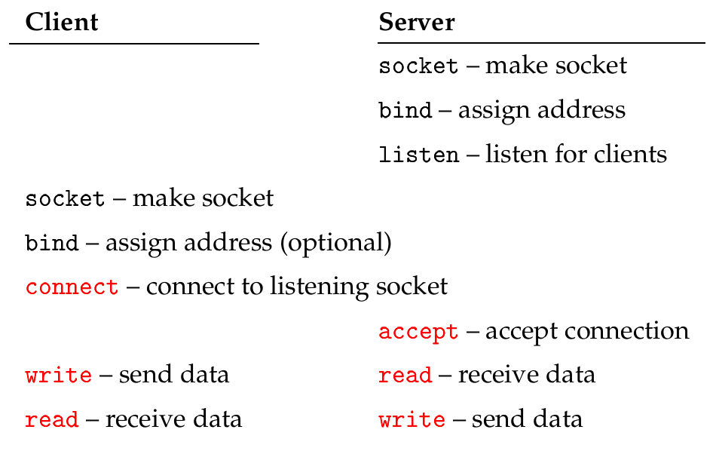
System calls for using TCP
Anything red might block, waiting for network
  Obviously bad for applications that need concurrency

Slide 52
Non-blocking I/O
Use fctnl to set O_NONBLOCK flag on descriptor
Non-blocking semantics of system calls:
  read immediately returns -1 with errno EAGAIN if no data
  write may not write all data, or may return EAGAIN
  connect may “fail” with EINPROGRESS (or may succeed, or may fail with real error such as a ECONNREFUSED)
  accept may fail with EAGAIN if no pending connections

Slide 53
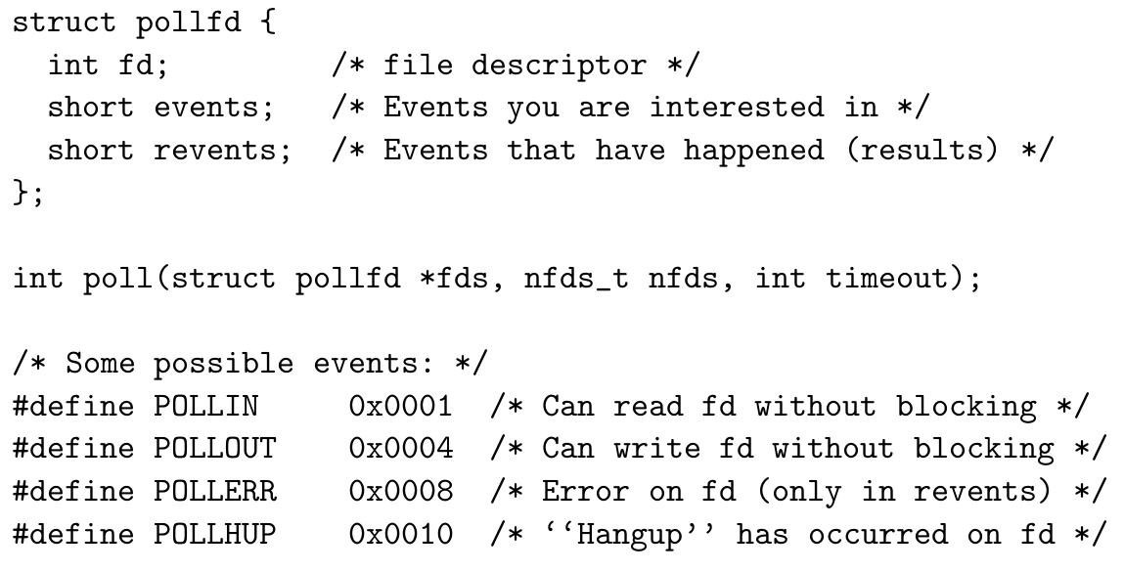
How to know when to read/write?
Note: BSD used select to achieve same thing
  Most OSes support both select and poll today

Slide 54
epoll
Newer Linux provides epoll
Interface allows more efficient implementation
  Register interest with epoll_create, epoll_ctl
  Wait with epoll_wait syscall
  Kernel doesn’t have to re-scan pollfd array on each wait
New option bits reduce calls to epoll_ctl
  EPOLLONESHOT – only wait for event once
  EPOLLET - “edge triggered” (as opposed to level triggered)
epoll is Linux specific
  But BSD has kqueue/kevent which is similar idea

Slide 55
epoll Interface
typedef union epoll_data { int fd;
/* ... */
} epoll_data_t;
struct epoll_event {
uint32_t events; epoll_data_t data;
};
/* Epoll events */
/* User data variable */
int epoll_create(int size);
int epoll_ctl(int epfd, int op, int fd,
struct epoll_event *event);
int epoll_wait(int epfd, struct epoll_event *events, int maxevents, int timeout);

Slide 56
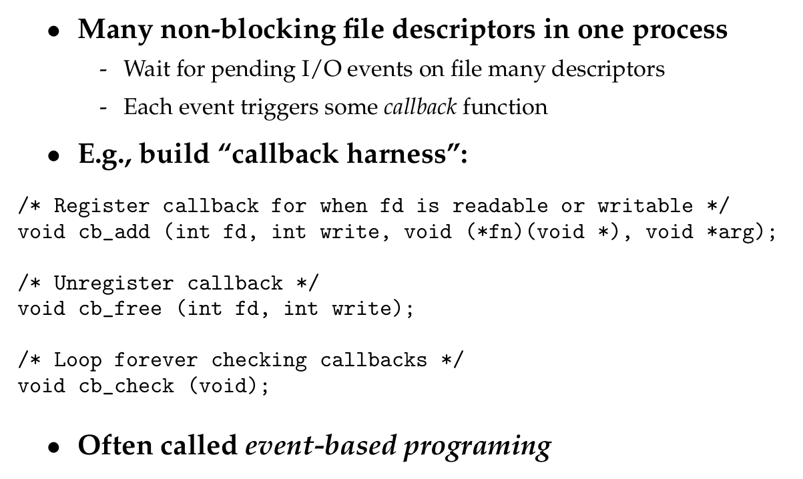
Asynchronous Programming Model

Slide 57
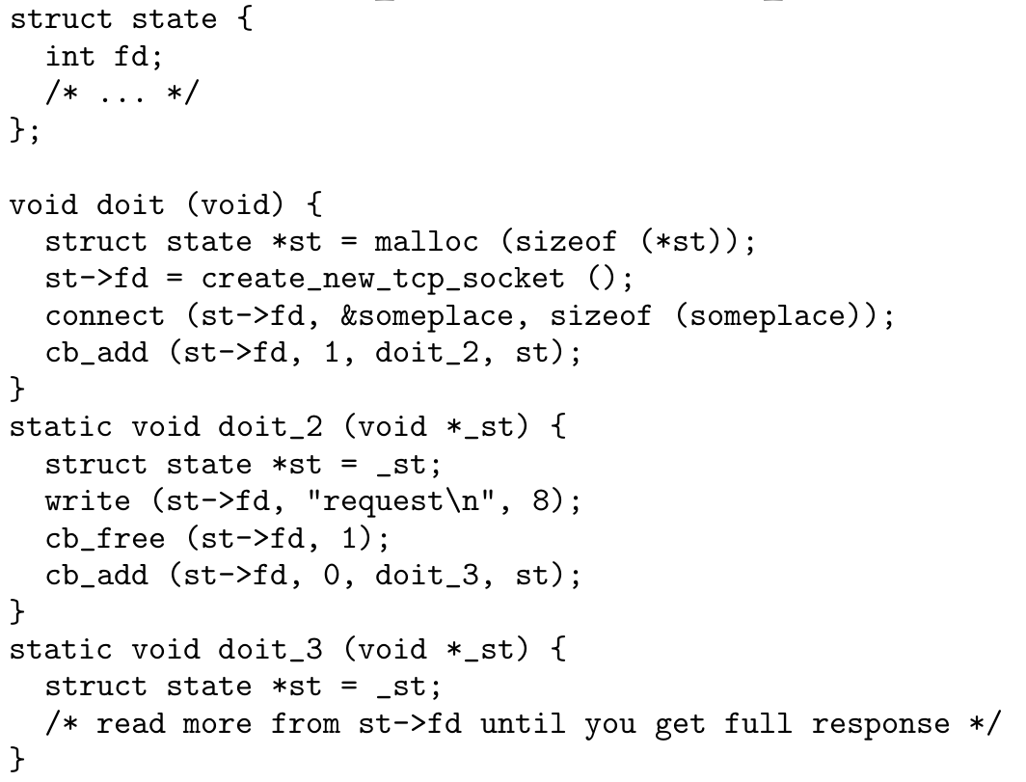
Simplified example

Slide 58
Pros & Cons of Event-based code
Advantages
  Fewer nasty bugs than threads (will discuss later)
  No locking, so no coarse- vs. fine-grained locking issues
  Works with legacy, non-reentrant code (e.g., strtok, getpwnam)
  Very efficient in terms of memory per client
  Callbacks usually more efficient than thread switches
Disadvantages
  “Stack ripping” makes code ugly
  Long running events make program unresponsive
  Harder to take advantage of multiprocessors
  Harder to do non-blocking disk I/O with existing OSes

Slide 59
