Slide 1
Interprocess Communication (IPC) and Coordination
Topic 3
Hartmut Kaiser
https://teaching.hkaiser.org/fall2026/csc7103/

Slide 2
Causality

Slide 3
Causality
The lack of a global system state – fundamental property of a distributed system
  Most of the time distributed systems are asynchronous
Distributed systems are causal – the cause precedes the effect
  The sending of a message precedes the receipt of a message
  The distributed system is composed of the set of processors and there are multiple sets of events that occur on these processors
    Events include message send, message receipt, user input receipt, signal raising, output creation, etc.
We define the ordering among different events:
  We write e₁ < e₂ if we know that event e₁ occurred before event e₂
In distributed systems, it is difficult to deduce which event came first
  Need to combine information from different sources to determine the ordering. If information source I tells us that e₁ occurred before e₂, we write e₁ <_{I} e₂

Slide 4
Causality Definitions
Event e₁ causally happened before event e₂ (that is, e₁ <_{H} e₂):
  Transitive closure of the processor orderings and the message orderings
Processor ordering: e₁ occurred before e₂ in the same process/processor p
e₁ <_{P} e₂
  Events that occur on the same processor are totally ordered
Message ordering: A message (m) sent by the process p_{i} after e₁ occurred is received by the process p_{j} before e₂ occurred
e₁ <_{m} e₂
  Simply, e₁ is the sending of message m and e₂ is the receipt of message m
Transitive closure property: if e₁ causally happened before e₂ and e₂ causally happened before e₃, then
e1 <_{C} e3

Slide 5
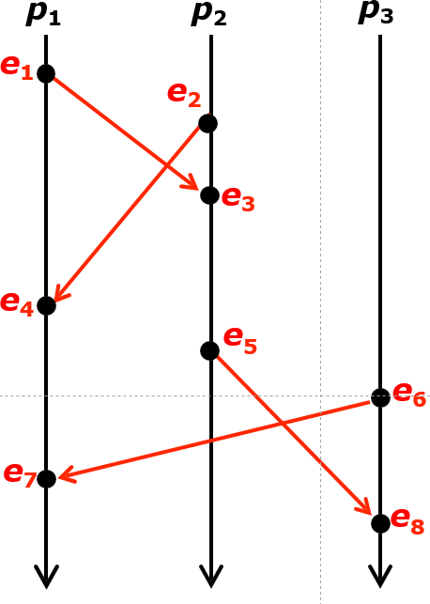

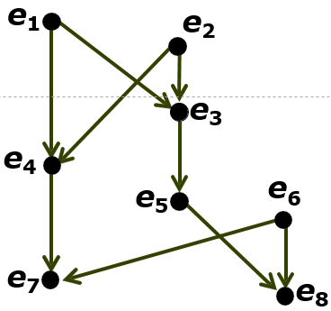
Happens-Before DAG
Causally ordered events:
Concurrent (disjoint) events
e₁ and e₆
DAG (directed acyclic graph)

Slide 6
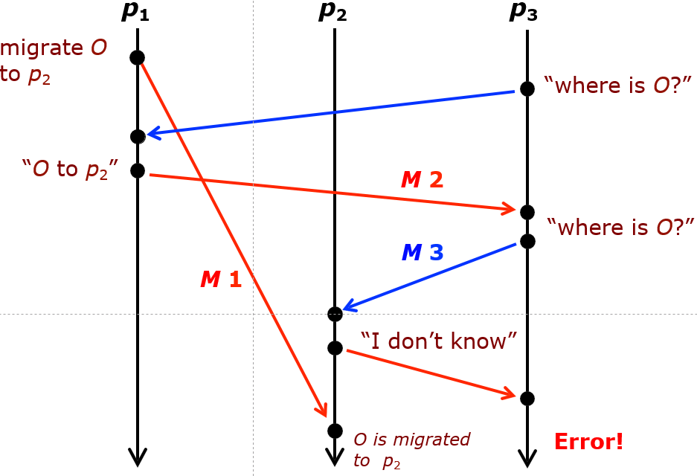
Example: Causality Violation

Slide 7
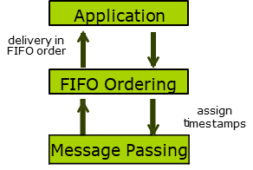
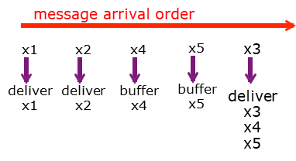
Causality Communication
Ensuring that processor never experiences a causal violation
Protocol for causal communication:
  A processor cannot choose the order in which messages arrive but it can change the order in which messages are delivered to the applications that consume them
  Revise delivery order by holding back messages that arrived “too soon”
  The source attaches timestamps on messages (to order messages), and the destination delays the delivery of out-of-order messages
Protocol for FIFO message delivery (TCP communication)

Slide 8
IPC and Synchronization

Slide 9
Mechanisms for Synchronization
How can the normal OS approaches be extended to the distributed OS?
Various synchronization mechanisms
  Shared-variable approaches: Semaphore, monitor, conditional critical region, serializer, path expression
  Message passing approaches: Communicating sequential processes, remote procedure call, rendezvous
A concurrent programming language supports:
  Specification of concurrent processing
  Synchronization of processes
  Interprocess communication
  Non-deterministic execution of processes

Slide 10
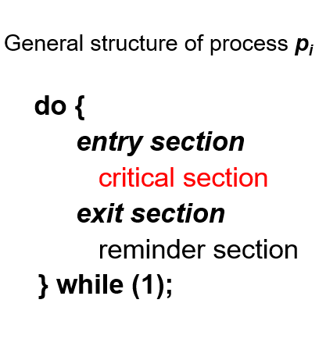
Critical Section Problem
Multiple processes are competing to use some shared data
Each process has a code segment, called critical section, in which the shared data is accessed
Problem – ensure that when one process is executing in its critical section, no other processes are executing in their critical sections
  Mutual exclusion should be enforced
Entry section implements a process’ request to enter its critical section which is followed by an exit section
  Processes may share some common variables to synchronize their actions (to have orderly execution of cooperating processes)

Slide 11
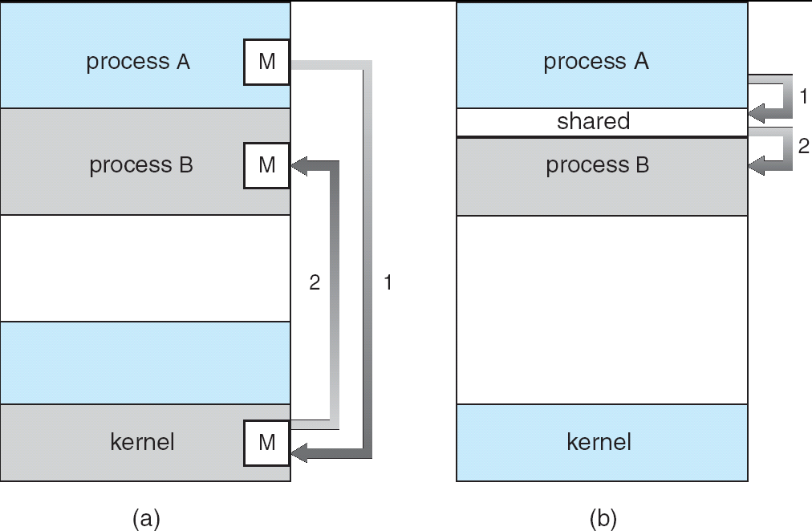
Interprocess Communication Models
Message passing – Useful for exchanging smaller amounts of data; easier to implement through system calls but slower
Shared memory – Allows maximum speed and convenience of communication; faster accesses to shared memory

Slide 12
Message-Passing Synchronization
A mechanism for cooperating processes to communicate and to synchronize their actions without sharing the same address space
  The only means of communication in distributed systems without shared memory
Message-passing facility provides two operations:
  send(message) – message size fixed or variable
  receive(message)
Two processes wishing to communicate need to establish a communication link between them and exchange messages via
send/receive
  Implementation of communication link physical (e.g., shared memory, hardware bus or network) or logical
Message can be asynchronous or synchronous

Slide 13
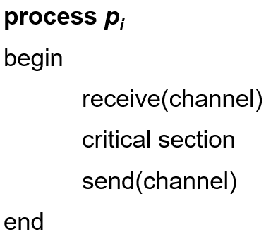
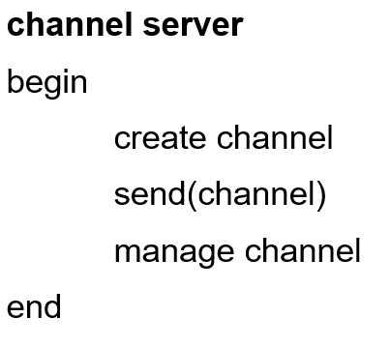
Asynchronous Message Passing
Assumes non-blocking send and blocking receive – channel with an unbounded buffer
  Equivalent to a semaphore (message content is not important)
Can be useful as semaphore if communication channel can be specified
  Blocking receive – (acquiring the lock), Non-blocking send – (releasing the lock)
Mutual exclusion solution using asynchronous message passing:

Slide 14
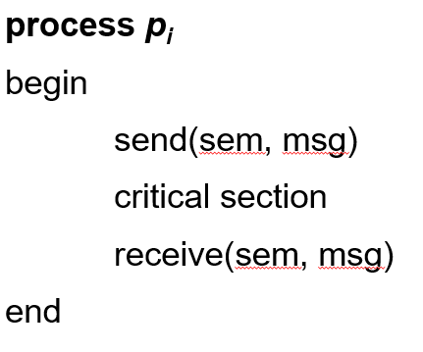
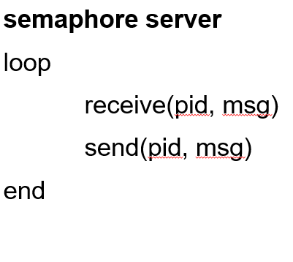
Synchronous Message Passing
Assumes blocking send and blocking receive – symmetrical waiting
Rendezvous between send and receive
  Allows two processes to join and exchange data at a synchronization point and continue their separate execution thereafter
Mutual exclusion solution using synchronous message passing:

Slide 15
Communication and Coordination

Slide 16
Communication and Coordination
Cooperating processes must interact with each other using some forms of communication model to coordinate their execution
Interprocess communication (IPC): Two approaches are message passing and shared memory
  Message passing - only method of exchanging data/information between processes in distributed systems
    All higher level models must be built on top of message passing
  Request/reply – based on the client/server concept
  Transactions – sequences of request/reply communications that require communication atomicity
In distributed systems, the only way to have (logically) shared memory (data objects) is to simulate it by message passing
Name service model: Locating the communication entities (objects)
Distributed process coordination:
  Classical problems: Distributed mutual exclusion and leader selection

Slide 17
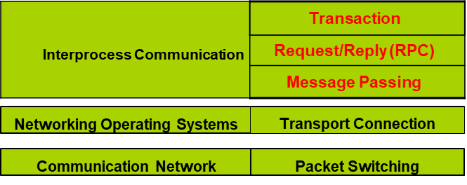
Different Levels of Communication
Five levels of communication abstraction
  Top three levels deal with the transfer of messages among distributed processes

Slide 18
Message Passing Communication
Communicating processes pass composed messages to the system transport service, which provides connectivity for message transfer in the network
  Basic communication primitives
  Message synchronization and buffering
  Pipe and socket APIs
  Remote Procedure Calls (RPCs)

Slide 19
Basic Message Passing Primitives
Two generic message passing primitives
  Send (destination, message)
  Receive (source, message)
The communication entities, source and destination, can be addressed in four different ways
  Process name (host+pid)
  Link
  Mailbox
  Ports
Message size can be fixed or variable

Slide 20



Source/Destination Identification
Process names or unique global process identifiers are required
  May be obtained by adding machine address to process id
  Symmetric/asymmetric addressing options
    Symmetric – sender and receiver need to explicitly name each other
    Asymmetric – only sender needs to indicate the receiver
Allows one logical communication path/link between a pair of sending and receiving processes
Process identifiers need to be known ahead of time
  Or there has to be a way to retrieve the process identifiers based on a known symbolic name
symmetric process name
asymmetric process name

Slide 21
Links
Identifying/specifying each path in the communication primitives as connection or link
Allows multiple data paths between processes
  Different links, each pointing to an actual communication path can be used
Direct communication between peer processes can be provided by using process names and link numbers
Two links using two different link numbers

Slide 22
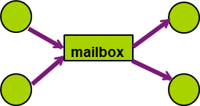
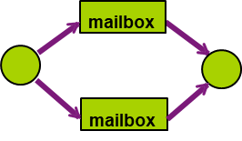
Mailboxes
Mailboxes are global data structures shared by some sender and some receiver processes
  Messages are sent to and received from mailboxes
Allow indirect communication between sender and receiver processes
Allow multipoint and multipath communication
multipoint communication
multipath communication

Slide 23
Ports
Port is an abstraction of a finite-size FIFO queue maintained by the kernel
  A special example of mailbox
  Messages can be appended to or removed from the queue by send and receive operations
  Ports are bidirectional and buffered, and support indirect communication
Created by user processes using system calls
  Referenced by port numbers
  User ports are mapped to transport ports and vice versa

Slide 24
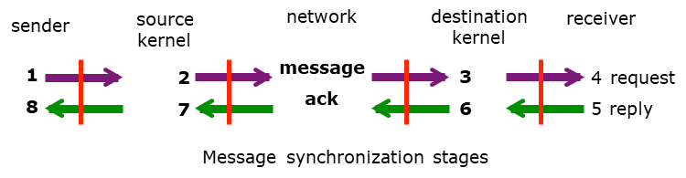
Message Synchronization
Message passing communication depends on synchronization at several points
  Between user process and system kernel
  Between kernel and kernel
  Between source and destination processes
Send/receive primitives may be blocking or non-blocking
  Blocking primitive means that the calling process needs to be blocked for the message delivery or receipt

Slide 25
Buffering
Common default: a non-blocking send and a blocking receive
  Non-blocking send also referred to as an asynchronous send (1 + 8)
Blocking send may be of different types:
  Ordinary blocking send (1 + 2 + 7 + 8)
  Reliable blocking send (1 + 2 + 3 + 6 + 7 + 8)
  Explicit blocking send (1 + 2 + 3 + 4 + 5 + 6 + 7 + 8)
  Request and reply – called client/server communication (1 – 4, service, 5 – 8)
Blocking receive implies that the process can not continue untill the message is received
Buffering is crucial in the synchronization:
  The sender puts messages in the buffer while the receiver removes the message from the buffer
  Sharable buffer spaces smooth out the asynchronous processing of messages
  Can be viewed as one big buffer by combining the buffers in the sender kernel, the receiver kernel and the communication network

Slide 26
Application Program Interface
User processes communicate using an API, independent of the underlying communication platform
  Shared communication channels are (logically) shared objects
  Internal details and implementation managed by the kernel are transparent to the users
Used in both Windows and Unix environments
  Pipes and socket APIs
  RPC APIs

Slide 27
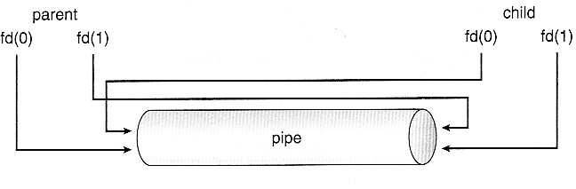
Pipes
Pipes are implemented with a finite-size, FIFO-byte stream buffer maintained by the kernel
  A pipe serves as an unidirectional communication link
  A pipe system call returns two pipe descriptors, one for reading and the other for writing: fd(0): read-end, fd(1): write end
Ordinary pipes: used only for related processes (pipe descriptors are shared by parent process and children)
Named pipes: FIFO files shared by unrelated (disjoint) processes across different machines with a common file system - limited to a single domain

Slide 28
Communication Between Processes
write(wfd, wbuf, wlen);
Process A
Process B
Intermediate Storage
n = read(rfd, rbuf, rmax);
Data written by A is held in memory until B reads it
Queue has a fixed capacity
  Writing to the queue blocks if the queue if full
  Reading from the queue blocks if the queue is empty
POSIX provides this abstraction in the form of pipes

Slide 29
Pipes
int pipe(int fileds[2]);
  Allocates two new file descriptors in the process
  Writes to fileds[1] read from fileds[0]
  Implemented as a fixed-size queue

Slide 30
Single-Process Pipe Example
  #include <unistd.h>
  int main(int argc, char *argv[]) {
  char *msg = "Message in a pipe.\n";
  char buf[BUFSIZE] = { '\0' };
  int pipe_fd[2];
  if (pipe(pipe_fd) == -1) {
  fprintf (stderr, "Pipe creation failed.\n"); return EXIT_FAILURE;
  }
  ssize_t writelen = write(pipe_fd[1], msg, strlen(msg)+1);
  printf("Sent: %s [%ld, %ld]\n", msg, strlen(msg)+1, writelen);
  ssize_t readlen = read(pipe_fd[0], buf, BUFSIZE);
  printf("Rcvd: %s [%ld]\n", buf, readlen);
  close(pipe_fd[1]); close(pipe_fd[0]);
  }

Slide 31
Inter-Process Communication (IPC)
  pid_t pid = fork();
  if (pid < 0) {
  fprintf (stderr, "Fork failed.\n");
  return EXIT_FAILURE;
  }
  if (pid != 0) {
  ssize_t writelen = write(pipe_fd[1], msg, msglen);
  printf("Parent: %s [%ld, %ld]\n", msg, msglen, writelen);
  close(pipe_fd[0]);
  close(pipe_fd[1]);
  } else {
  ssize_t readlen = read(pipe_fd[0], buf, BUFSIZE);
  printf("Child Rcvd: %s [%ld]\n", msg, readlen);
  close(pipe_fd[0]);
  close(pipe_fd[1]);
  }

Slide 32
Named Pipes
#include <unistd.h>
// create named pipe
if (mkfifo("/tmp/my_fifo", S_IRUSR|S_IWUSR) == -1) {
perror("mkfifo"); return EXIT_FAILURE;
}
// delete the named pipe
if (unlink("/tmp/my_fifo") == -1) {
perror("unlink"); return EXIT_FAILURE;
}

Slide 33
Named Pipes
// write to named pipe
int fd = open("/tmp/my_fifo", O_WRONLY);
if (fd == -1) {
perror("open"); return EXIT_FAILURE;
}
char *message = "Hello, Named Pipe!";
if (write(fd, message, strlen(message) + 1) == -1) {
perror("write"); return EXIT_FAILURE;
}
close(fd);

Slide 34
Named Pipes
// read from a named pipe
int fd = open("/tmp/my_fifo", O_RDONLY);
if (fd == -1) {
perror("open"); return EXIT_FAILURE;
}
char buffer[100];
ssize_t bytes_read = read(fd, buffer, sizeof(buffer));
if (bytes_read == -1) {
perror("read"); return EXIT_FAILURE;
}
buffer[bytes_read - 1] = '\0';
printf("Received message: %s\n", buffer);
close(fd);

Slide 35
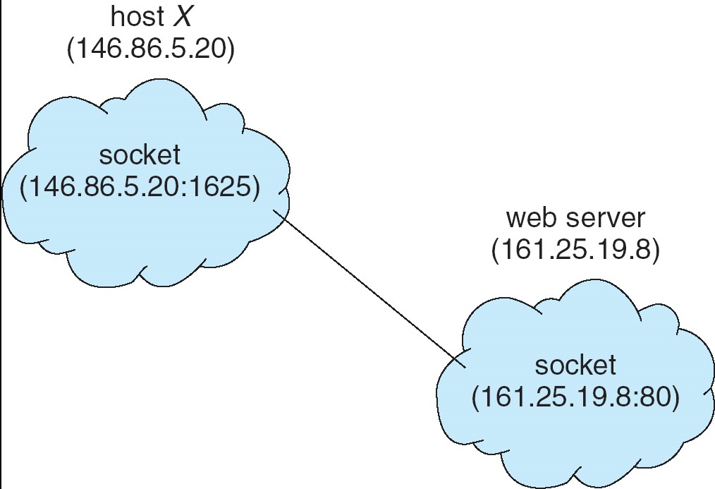
Sockets
Sockets provide two-way communication links shared by processes across heterogeneous domains
A socket is an endpoint for a communication link managed by the transport service
  A pair of processes communicating over a network employs a pair of sockets – one for each process
  Socket system call returns a socket descriptor (logical communication endpoint (local to a process), which must be associated with a physical communication endpoint – bind system call
A physical communication endpoint is specified
by a network host address and transport port pair
  Each socket is made up of an IP address
  concatenated with a port number:
  The socket 146.86.5.20:1625 refers to port 1625
  on host 146.86.5.20

Slide 36
Sockets in Schematic
Server
Client
Create Server Socket
Create Client Socket
Bind it to an Address
(host:port)
Connect it to server (host:port)
Listen for Connection
Accept syscall()
Connection Socket
Connection Socket
write request
read request
read response
write response
Close Client Socket
Close Connection Socket
Close Server Socket

Slide 37
Client Protocol
char* host_name = "www.lsu.edu";
char* port = "80";
// Create a socket
struct addrinfo *server = lookup_host(host_name, port);
int sock_fd = socket(server->ai_family, server->ai_socktype,
server->ai_protocol);
// Connect to specified host and port
connect(sock_fd, server->ai_addr, server->ai_addrlen);
// Carry out Client-Server protocol
run_client(sock_fd);
// Clean up on termination
close(sock_fd);

Slide 38
Server Protocol
// Create socket to listen for client connections
char *port = "80";
struct addrinfo *server = setup_address(port);
int server_socket = socket(server->ai_family, server->ai_socktype, server->ai_protocol);
// Bind socket to specific port
bind(server_socket, server->ai_addr, server->ai_addrlen);
// Start listening for new client connections
listen(server_socket, MAX_QUEUE);
while (1) { // Accept a new client connection, obtaining a new socket
int conn_socket = accept(server_socket, NULL, NULL);
serve_client(conn_socket);
close(conn_socket);
}
close(server_socket);

Slide 39
Client: Getting the Server Address
  struct addrinfo *lookup_host(char *host_name, char *port) {
  struct addrinfo *server;
  struct addrinfo hints;
  memset(&hints, 0, sizeof(hints));
  hints.ai_family = AF_UNSPEC;
  hints.ai_socktype = SOCK_STREAM;
  int rv = getaddrinfo(host_name, port, &hints, &server);
  if (rv != 0) {
  printf("getaddrinfo failed: %s\n", gai_strerror(rv));
  return NULL;
  }
  return server;
  }

Slide 40
Server Address: Itself
  struct addrinfo *setup_address(char *port) {
  struct addrinfo *server;
  struct addrinfo hints;
  memset(&hints, 0, sizeof(hints));
  hints.ai_family = AF_UNSPEC;
  hints.ai_socktype = SOCK_STREAM;
  hints.ai_flags = AI_PASSIVE;
  getaddrinfo(NULL, port, &hints, &server);
  return server;
  }
Accepts any connections on the specified port

Slide 41
SSL
Sockets are widely used and need communication security.
Secure socket layer (SSL) provides – Privacy, Integrity, Authenticity
Privacy and integrity are maintained by handshake protocol and cryptography
  Handshake protocol establishes communication session (write) keys and message authentication check, and validates the authenticity of clients and servers
    The server is verified with a certificate assuring client is talking to correct server
    Asymmetric cryptography used to establish a secure session key (for symmetric encryption later) for bulk of communication during session
    Communication between each computer then uses symmetric key cryptography
Layer protocol handles fragmentation, compression/decompression, encryption/decryption of messages (integrity)
Authentication is done by third-party certification authority

Slide 42
Request/Reply Communication
Service-oriented request/reply communication is above basic message passing – next level of communication
  The sender is blocked (or the message is considered not delivered) until it receives a reply
RPC – remote procedure call
  Is a language-level abstraction to support request/reply communication mechanism based on message passing
  Represents a pair of synchronization request (calling a remote procedure) and reply (waiting for results) communications
  Abstracts procedure calls between processes on networked systems, providing access transparency to remote operations
RPC is implemented by stub procedures at both the client end and the server end
  Client-side stub locates the server and marshals the parameters
  Server-side stub receives this message, unpacks the marshaled parameters, and performs the procedure on the server

Slide 43
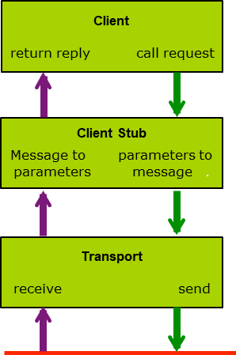
RPC Flow

Slide 44
RPC Implementation
Parameter passing and data conversion – parameter marshaling
  Parameters are passed by call-by-value and call-by-copy/restore
  Data typing, data representation, data transfer syntax problems can be solved using an universal language or canonical data representation
Binding between the client and the server – match maker
  Port mapper to provide the port number of the requested server to the client
  Directory server to locate the server machine if it is unknown
RPC Compilation - three major components:
  Interface specification file, RPC generator, run-time library
RPC exception and failure handling
Secure RPC

Slide 45
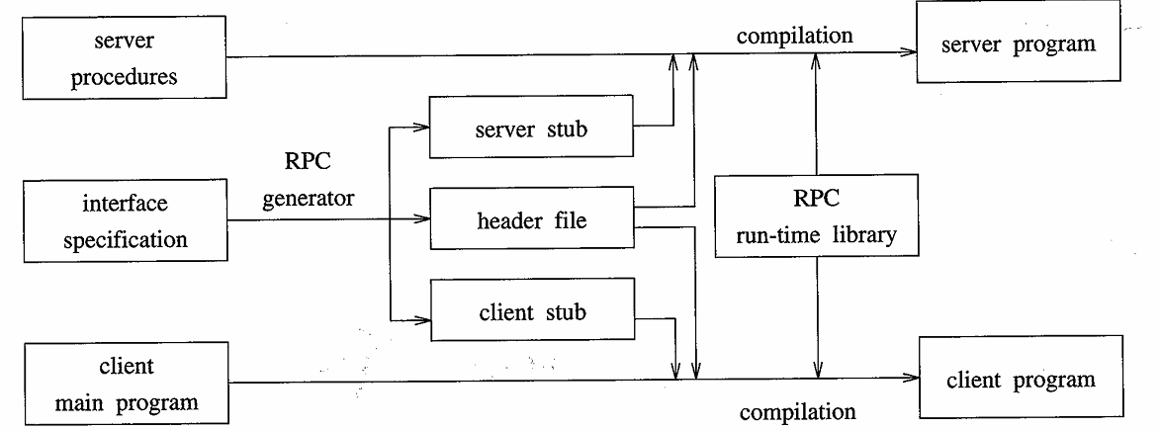
RPC Compilation

Slide 46
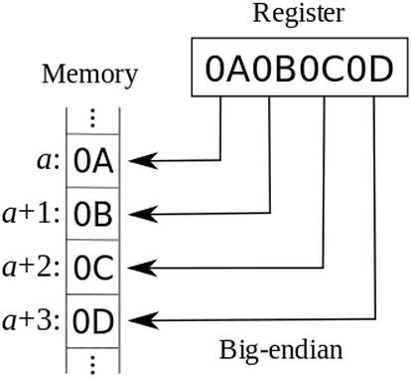
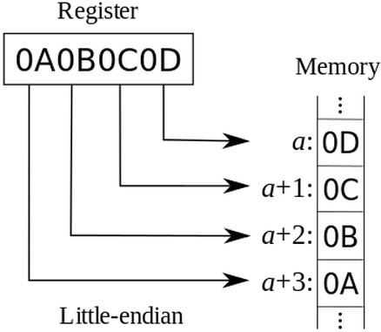
RPC Implementation (Cont’d)
Data representation handled via External Data Representation (XDL) format to cope with different architectures
  Big-endian (most significant byte first) and little-endian (least significant byte first)
Remote communication has more failure scenarios than local
OS typically provides a rendezvous (or matchmaker) service to connect client and server

Slide 47
RPC Exception and Failures Handling
Exception handling
  Overflow/underflow or protection violation in procedure execution
  In-band or out-of-band signaling for the exchange of status and control information
Failure handling
  Not locating the server, link failure, delayed or lost messages
  Idempotent services – a request can be repeatedly executed
  Detecting a duplicate or out-of-sequence request message – the client attaches a sequence number to each request
  Reliable transport layer (TCP connection, sockets)
Server crash and client crash
  Generally difficult to deal with
  Using a time-out or waiting for the failed server/client to come back

Slide 48
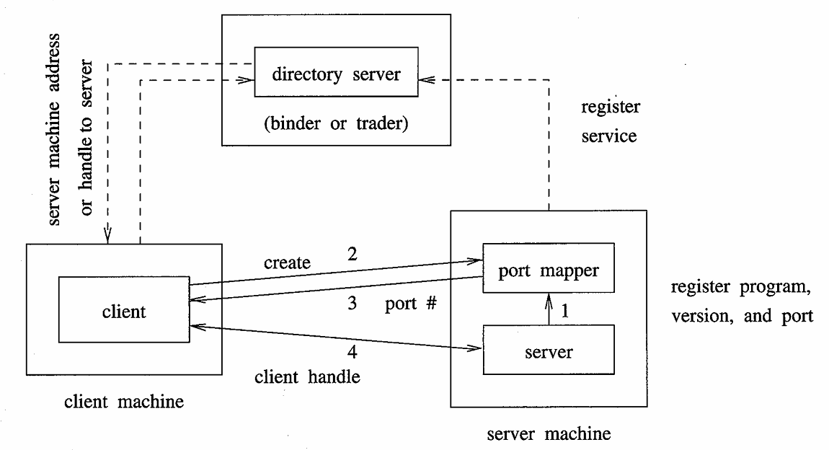
RPC Implementation

Slide 49
RPC Implementation
Interface description language (IDL), here XDR language
program KVSTORE {
version KVSTORE_V1 {
int EXAMPLE(int) = 1;
} = 1;
} = 0x20000001;
Use this to generate stubs:
rpcgen kv_store.x
  Generates client and server files

Slide 50
RPC Implementation
/* Generated client RPC stub. */
int *
example_1(int *argp, CLIENT *clnt)
{
static int clnt_res;
memset((char *)&clnt_res, 0, sizeof(clnt_res));
if (clnt_call (clnt, EXAMPLE,
(xdrproc_t) xdr_int, (caddr_t) argp,
(xdrproc_t) xdr_int, (caddr_t) &clnt_res,
TIMEOUT) != RPC_SUCCESS) {
return (NULL);
}
return (&clnt_res);
}
/* User supplied client RPC stub. */
int example(int input) {
CLIENT *clnt = clnt_connect(HOST);
int ret; int *result;
result = example_1(&input, clnt);
if (result == (int *)NULL) {
clnt_perror(clnt, "call failed");
exit(1);
}
ret = *result;
xdr_free((xdrproc_t)xdr_int, (char *)result);
clnt_destroy(clnt);
return ret;
}

Slide 51
RPC Implementation
/* Example server-side RPC implementation */
int *example_1_svc(int *argp, struct svc_req *rqstp) {
static int result;
result = *argp + 1; /* actual functionality */
return &result;
}

Slide 52
Secure RPC
Security is important for RPC
  RPC opens doors for attacks from unfriendly remote users
  RPC supports all types of client/server computations
The primary security issues are
  Authentication of client and server processes
  Authenticity and confidentiality of messages
  Access control authorization from client to server
Authentication protocol for RPC must establish:
  Mutual authentication for messages and communicating processes
  Message integrity, confidentiality, and originality
Designing secure authentication protocol is complex matter
  Example: Sun’s Secure RPC

Slide 53
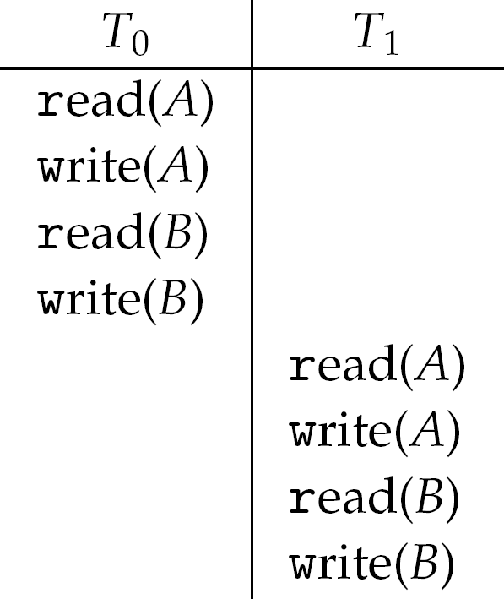
Transaction Communication
Transactions in communication are a set of asynchronous request/reply communications generally involving the multicast of the same message to replicated servers and different requests to partitioned servers
  Similar to fundamental unit of interaction between client and server processes in a database system
Transaction is collection of instructions or operations that performs single logical function
  A series of read and write operations
Example: Consider two data items A and B, and consider
two transactions T₀ and T₁
  Execute T₀, T₁ atomically
  Execution sequence called schedule
  Atomically executed transaction order
  called serial schedule

Slide 54
ACID Properties
Transaction communications must satisfy the ACID properties:
  Atomicity: all or nothing
  Consistency/serializability: interleaving results in serial execution in some order
  Isolation: partial results are not visible outside
  Durability: after committing, the results will be made permanent
Ensuring ACID properties requires that the participating processors coordinate their execution of a transaction
  Challenging in a distributed system because several sites may be participating; any site or link failure may result in erroneous computations
  Each site has its local transaction coordinator and maintains a log for recovery
  Name the processor which initiates the transaction the coordinator and name the remaining processors the participants

Slide 55
Two-Phase Commit Protocol
The two-phase commit (2PC) protocol is analogous to a real-life unanimous voting scheme
  One coordinator and multiple participants for a distributed transaction T
  Each of them have access to some stable storage to maintain its activity log
  T is committed only if all participants agree and ready to commit
Coordinator (initiator site):
  Prepare to commit the transaction T by writing every update in activity log
  Write a precommit record in activity log, and multicast a vote request to all participants asking whether they are ready to commit
  If all participants vote YES within a time-out period, multicast a commit message. Otherwise, multicast an abort message
Participant (other participating sites):
  Upon receiving the vote request, prepare to commit the transaction T by writing every update in activity log
  Write a precommit into the log and sends a YES reply to the coordinator. Otherwise, abort T and send a NO reply to the coordinator
  Wait for a commit message from the coordinator. If received, commit T. If abort message is received, abort T

Slide 56
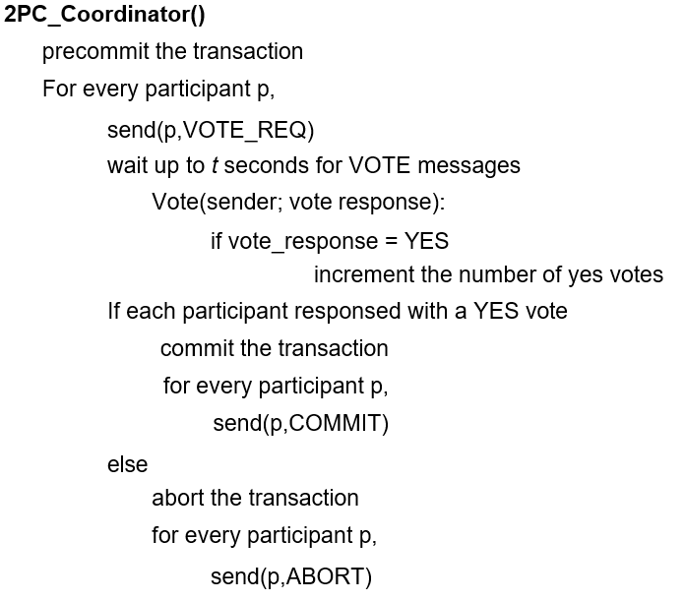
2PC Algorithm for Coordinator

Slide 57
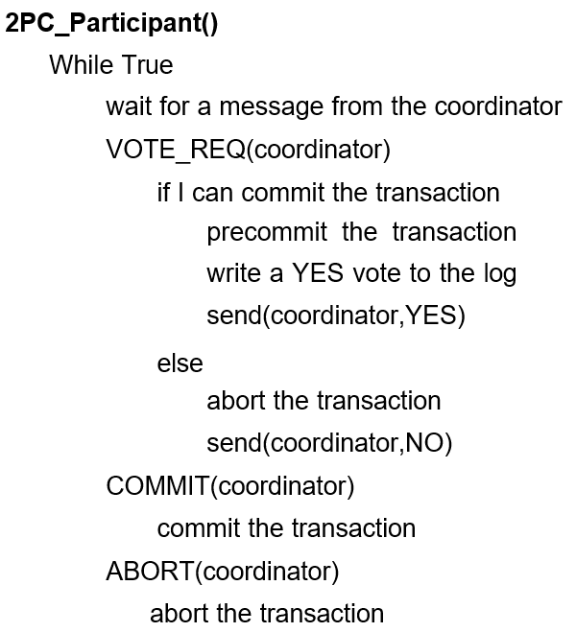
2PC Algorithm for Participant

Slide 58
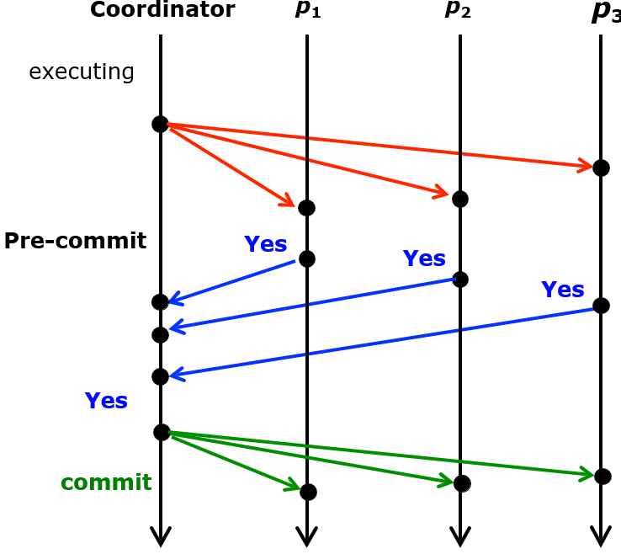
2PC Protocol - Example
First phase:
Obtain the votes
from all participants
Second phase:
Distribute the agreement to
commit
Find the stable property that every processor
voted Yes

Slide 59
2PC Protocol - Recovery
When used with an activity log in stable storage, 2PC protocol is highly resilient to processor failures
  The activity log can be replayed upon the recovery of a failure
  Note that every participant is required to vote, and once a processor votes it is not allowed to change its vote
Three types of failure and recovery actions:
  Failures before a precommit
    A processor (coordinator or participant) can simply abort the transition
  Failures after a precommit but before a commit
    Coordinator can abort the transaction or attempt to commit the transaction by re-multicasting (retake the vote)
    Participant recovery is complicated: needs to check with the coordinator or other participant about the transaction status
  Failures after a commit
    Coordinator resends the commit message to finish the transaction Participant simply makes the transaction’s updates permanent

Slide 60
Group and Multicast Communication
Besides point-to-point communication, multipoint group communication is naturally expected in distributed systems
  Notion of a group is essential for cooperative software
  Managing group of processes or objects needs multicast communication
Issues/complications of multicast communication implementation
  Reliability: Best effort vs. reliable
  Failures
  Delivery order
  Overlapping groups

Slide 61
Multicast Issues
Reliable delivery issue in multicast
  Two multicast application scenarios: Soliciting a service from any server or requesting a service from all servers in the group
  Best effort multicast – delivery to only reachable servers
  Reliable multicast – ensure the message delivered to all servers
Failures in the middle of an atomic multicast
  Failures of the recipient processes or the communication links:
    The message originator uses a time-out or acknowledgements, and also decides to abort the multicast or continue by excluding the failed members from the group
  Failure of the originator:
    One of recipients chosen as the new originator to decide whether to abort or complete the partially completed multicast

Slide 62
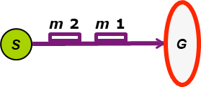
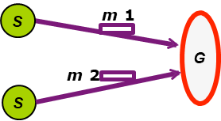
Message Delivery Ordering
Multiple messages multicast to the same group may arrive at different members (sites) of the group in different orders – need ordered delivery to the application processes
Multicast orderings in increasing order of strictness:
  FIFO, causal and total orders
FIFO order – Multicast messages from a single source are delivered in the order they were sent
  Assign message sequence numbers
  Communication handler can delay messages or reject duplicates
Causal order – Causally related messages from multiple sources are delivered in their causal order
Total order – All messages multicast to a group are delivered
to all members of the group in the same order

Slide 63
Delivery in Causal Order
Causal ordering of messages - two messages are causally related to each other if one message is generated after the receipt of the other
  This message order needs to be preserved at all sites
Birman-Schiper-Stephenson Protocol - similar to vector logical clock
  Each message is time-stamped by a sequence vector S where each entry is the number of messages received by the sender from that group member:
  S = (S₁, S₂, …, S_{n})
  Accept a message m from process i with vector T = (T₁, T₂, ….., T_{n}) if the member j has received all previous messages from i (that is, T_{i} = S_{i} + 1), and the member j has received all messages also seen by i, (that is, T_{k} ≤ S_{k} for all k ≠ i)
  Delay accepting the message m, otherwise: if T_{i} > S_{i} + 1 (another message from i is on the fly) or there exists a k ≠ i: T_{k} > S_{k} (this message is from the future)
  Reject any message if T_{i} ≤ S_{i} (duplicate message)

Slide 64
Two-Phase Total-Order Multicast
A reliable and total order multicast is called an atomic multicast
Two-phase total-order multicast protocol
  Combining the atomic and total order broadcasts
  First phase – originator broadcasts messages and collects acks with logical timestamps from all group member
  Second phase – after all acks received, the originator sends commitment message with the highest timestamp. Receiver decides if buffer or deliver msg.
Message originator
  Broadcasts messages, collect acknowledgments (ack) with logical timestamps from all group members
  Then sends a commitment message with the highest logical ack timestamp (taken as commitment timestamp)
Recipient
  Sends ack with the logical clock value as timestamp (local ack stamp)
  Do not deliver a message with commit timestamp t until the commit message for all messages with local ack stamp < t has been committed – commit messages in the commitment order
  Deliver messages in the order of the commit timestamp

Slide 65
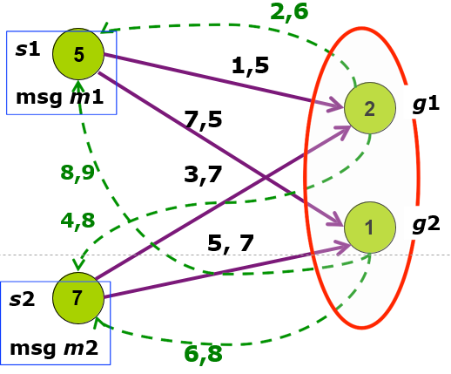
Two-Phase Total-Order Multicast Example
Two messages m₁ and m₂ broadcast between two sources (s₁, s₂) and two of the group members (g₁, g₂), with the initial logical clock times in circles
Multicast Message | Ack Time | Commit Time
m 0 | 2 | delivered
m 1 | 6 | 9
m 2 | 8 | 8
m 3 | 10 | pending
Multicast – solid lines
Acknowledgment – dashed lines
Buffer management in the communication handler of g1

Slide 66
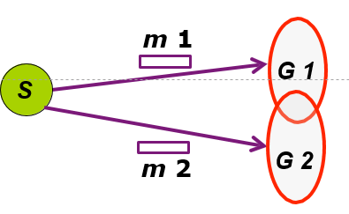
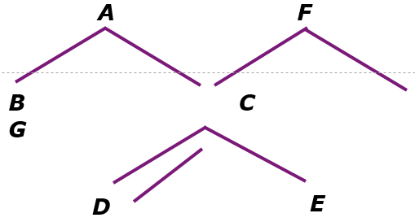
Overlapping Groups
Multicast to overlapped groups
  A process may belong to more than one group
Coordination among groups to maintain consistent ordering of messages:
  Impose some agreed upon structures (a spanning tree) for the groups and multicast messages using the structures
  A multicast message m is first sent to the group leader (root of a tree) and then to all group members by routing
Group 1
(A,B,C,D,E)
Group 2
(C,D,F,G)
Overlap set (C,D) appears
as a common subtree
Two overlapped groups

Slide 67








