Slide 1
Welcome and Getting Started
Lecture 1
Hartmut Kaiser
https://teaching.hkaiser.org/spring2024/csc3380/

Slide 2
Abstract
Today, we’ll outline the aims for this course and present a rough course plan. After some introduction, we’ll start reviewing C++ by looking at the simplest possible C++ program and outline how it can be made into running code.

Slide 3
What is Computer Science

Slide 4
Techniques for managing complexity
Black box abstraction
Primitive objects
Primitive procedures and primitive data
Means of combination
Procedure composition (functions) and compound data (types)
Means of abstraction
Procedure (function) definition - Algorithms
Data abstraction (types) – Data structures
Capturing common patterns
Higher order functions
Data as procedures, procedures as data

Slide 5
Techniques for managing complexity
Conventional Interfaces
Generic operations
Large scale structure and modularity
Object oriented programming
Operations on aggregates

Slide 6
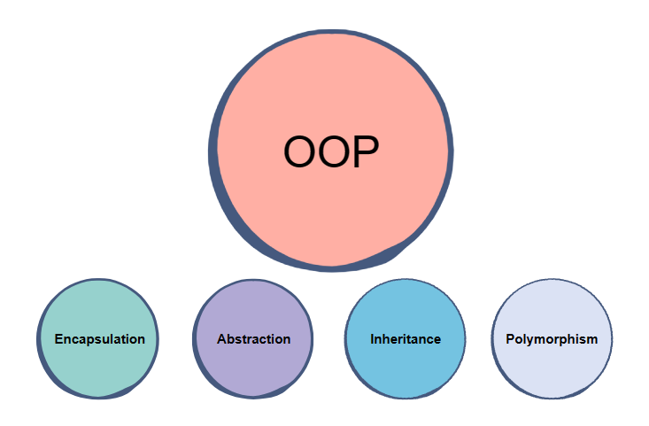
Object Oriented Programming
The four pillars of object-oriented programming are:
Encapsulation: containing information in an object, exposing only selected information
Abstraction: only exposing high-level public methods for accessing an object
Inheritance: child classes inherit data and behaviors from the parent class
Polymorphism: many methods can do the same task
See also: What is object-oriented programming? OOP explained in depth

Slide 7
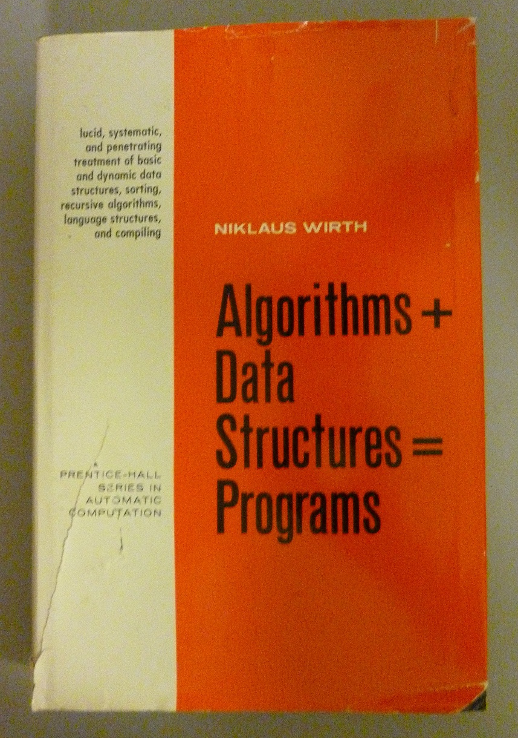
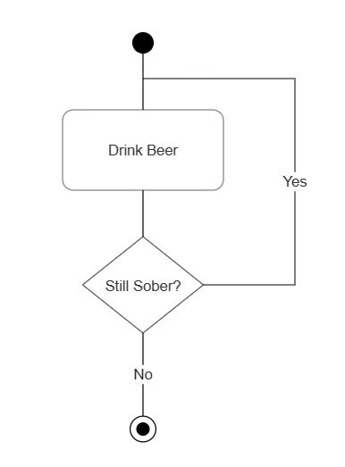
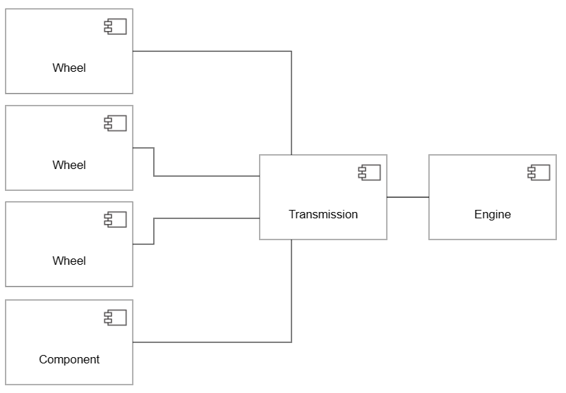
Course Overview
Programs == Algorithms + Data structures

Slide 8
Building Abstractions
Computer Science is a discipline that
Builds Abstractions
By managing complexity
With the goal of being able to write correct and performant code

Slide 9
Admin & Organizational

Slide 10
Admin & Organizational
Congrats
Why I like programming
Course:
Depth first introduction, C++ Standard Library, C++ Data structures and algorithms
https://teaching.hkaiser.org
hkaiser@cct.lsu.edu
Discord server: https://discord.gg/62U9ceEbN8
Reading:
Stepanov’s From Mathematics to Generic Programming
Koenig’s Accelerated C++
Stroustrup’s Programming - Principles and Practice Using C++
Homework, project, quizzes, grading, honesty
Use Github classroom for assignments
Use VSCode as a tool

Slide 11
Ground Rules
All information about the course: teaching.hkaiser.org
Following that site is expected and will positively impact overall grade
Lectures
Attendance is expected and will positively impact overall grade
Assignments
Up to five individual assignments focusing on writing code
Use of (standard C++) algorithms and (standard C++) data structures
Assignment 0 has been posted (due: January 29, 11:59 pm, no extension)
Project:
Collaborative project of six students per group
Start forming your group now, form groups, select leader, send email
Remaining students will be arbitrarily combined into teams by January 31
During project presentations attendance will be checked
All assignments and the project are hosted on GitHub (github.com) and managed through GitHub classroom (classroom.github.com)
You will need to create accounts on both

Slide 12
Honesty
The LSU Code of Student Conduct defines plagiarism in Section 5.1.16:
"Plagiarism is defined as the unacknowledged inclusion of someone else's words, structure, ideas, or data. When a student submits work as his/her own that includes the words, structure, ideas, or data of others, the source of this information must be acknowledged through complete, accurate, and specific references, and, if verbatim statements are included, through quotation marks as well. Failure to identify any source (including interviews, surveys, etc.), published in any medium (including on the internet) or unpublished, from which words, structure, ideas, or data have been taken, constitutes plagiarism;“
Plagiarism will not be tolerated and will be dealt with in accordance with and as outlined by the LSU Code of Student Conduct : https://www.lsu.edu/saa/students/codeofconduct.php

Slide 13
ChatGPT?

Slide 14
ChatGPT
The goal for this course is to train our brains, not ChatGPT
So, do yourself a favor and don’t use it
There are too many software ‘developers’ out there who copy & paste their way to the next paycheck
However, if you do use it:
Never use anything without carefully reviewing it
Assume what you got is wrong! Prove to yourself it is correct!
The skill of reading (and understanding) code becomes more important than ever
Whatever you do, remember:
It’s plagiarism if you submit the same code as your neighbor
No matter where you got it from, be it Google, ChatGPT, or your neighbors computer

Slide 15
Rough course outline
Books:
Alexander A. Stepanov and Daniel E. Rose: From Mathematics to Generic Programming, ISBN 978-0321942043
Andrew Koenig, Barbara Moo: Accelerated C++ - Practical Programming by Example, ISBN 0-201-70353-X
Bjarne Stroustrup: Programming – Principles and Practice using C++, ISBN 978032154372
Stanley Lippmann, Josée Lajoie, Barbara E. Moo: C++ Primer 5th Ed., ISBN 0321714113
Part I: The basics
Egyptian Multiplication
OOP and Generic Programming
Part II: Organizing Programs and Data, Overview of Standard Template Library
Sequential data containers
Using library algorithms
Associative data containers
Part III: Defining new types
Managing memory and low level data structures
Defining abstract data types
Part IV: Object oriented programming
Inheritance and dynamic binding
Automatic memory management

Slide 16
Rough course outline
Throughout
Program design and development techniques
Software development cycle, source code control system use
C++ language features
Background and related fields, topics, and languages

Slide 17
C++! But Why?

Slide 18
Why C++ ?
You can’t learn to program without a programming language
The purpose of a programming language is to allow you to express your ideas in code
C++ is the language that most directly allows you to express ideas from the largest number of application areas
C++ is the most widely used language in engineering areas
http://www.research.att.com/~bs/applications.html
Our society runs on software
Large parts of that software directly or indirectly rely on C/C++
Windows, Linux, Office Suite, Adobe Products, …
Self driving cars, industry equipment, …
Internet

Slide 19
Why C++ ?
C++ is precisely and comprehensively defined by an ISO standard
C++17! Now also C++23!
And that standard is almost universally accepted
C++ is available on almost all kinds of computers
Programming concepts that you learn using C++ can be used fairly directly in other languages
Including C, Java, C#, and (less directly) Fortran
Last but not least: C++ jobs are one of the best paid jobs available

Slide 20
A First C++ Program
// Our first C++ program
#include <iostream>
int main() // main() is where a C++ program starts
{
std::cout << "Hello, world!" << std::endl;
// output the 13 characters // Hello, world! followed by a new line
return 0; // return a value indicating success
}
// quotes delimit a string literal
// NOTE: “smart” quotes “ ” will cause compilation problems.
// so make sure your quotes are of the style " "
// \n is a notation for a new line

Slide 21
A deeper look
Expressions
Compute something, yields result, may have side effects
Operands and operators – types!
std::cout << "Hello, world!" << std::endl;
Scope
Part of the program in which a name has its meaning
Global scope
Namespace scope
Block scope

Slide 22
Details
Program structure
Free form except string literals, #include, comments
Types
Data structures and their operations
Built in and user defined
Functions
Code structure
Helps isolating (abstracting) sub-functionalities
Namespaces
Grouping related names

Slide 23
Details
Special character literals
\n newline character
\t horizontal tabulator
\b backspace character
\" same as " but does not terminate string
\' same as ' but does not terminate character literal
\\ same as \ but does not give special meaning to next character
Definitions and headers
The main() function
Braces and semicolons
Output

Slide 24
Hello, world!
“Hello world” is a very important program
Its purpose is to help you get used to your tools
Compiler
Program development environment
Program execution environment
Type in the program carefully
After you get it to work, please make a few mistakes to see how the tools respond; for example
Forget the header
Forget to terminate the string
Misspell return (e.g. retrun)
Forget a semicolon
Forget { or }
…

Slide 25
Hello world
It’s almost all “boiler plate”
Only std::cout << "Hello, world!\n" directly does anything
That’s normal
Most of our code, and most of the systems we use simply exist to make some other code elegant and/or efficient
“real world” non-software analogies abound
“Boiler plate,” that is, notation, libraries, and other support is what makes our code simple, comprehensible, trustworthy, and efficient.
Would you rather write 1,000,000 lines of machine code?
This implies that we should not just “get things done”; we should take great care that things are done elegantly, correctly, and in ways that ease the creation of more/other software:
Style Matters!

Slide 26
Number of Unique Elements
Let’s start with a sequence of integers:
int a[] = { 1, 3, 1, 4, 1, 5 };
How many unique integers do we have?
Simple solution:
#include <iostream>
#include <set>
int main() {
std::set<int> set_of_ints(a, a + 6);
std::cout << set_of_ints.size() << std::endl;
}
This solution is correct! But … very slow! Why?

Slide 27
Equality vs. Ordering
std::set is implemented using Red-Black-Trees, which according to textbooks is the best way of implementing it
Will do O(n log(n)) comparison operations, but with a large constant coefficient
Has to re-sort for each insertion without need
It might appear, that finding unique elements does not require ordering, it just requires equality
But, actually we need a search or find
Equality gives us linear search O(n), while sorting gives us binary search O(log(n)) so we can find much, much faster.
Correct solution is to use std::unique

Slide 28
Number of Unique Elements
Sequence must be sorted, however. std::unique eliminates equal elements and returns reference to first duplicated element:
#include <algorithm>
#include <iostream>
int main() {
std::sort(a, a + std::size(a));
std::cout << std::unique(a, a + std::size(a)) - a << std::endl;
}
For example:
1 2 2 2
^

Slide 29
Use the correct STL data structures
What container type should you use?
Whenever you can, use std::vector.
If you cannot, find a way so you can.
Avoid any data structures except arrays. “Well aren’t there exceptions?” No, not for you.
Typically advanced data structures are slower than simple data structures.
Data structures which appear to be alright when textbook writers wrote their books, are no longer all right now.
Computers changed so much. Things no longer work as taught 10 years ago.
Occasionally we will ask you to use other data structures
Mostly to make our point, though

Slide 30
A Word about Compilation

Slide 31
Compilation and Linking
C++ source code
You write C++ source code
Source code is (in principle) human readable
The compiler translates what you wrote into object code (sometimes called machine code)
Object code is simple enough for a computer to “understand”
The linker links your code to system code needed to execute
E.g. input/output libraries, operating system code, and windowing code
The result is an executable program
E.g. a .exe file on windows or an a.out file on Unix
C++ compiler
Library Object code
Object code
Linker
Executable program
See: Decoding C++ Compilation Process: From Source Code to Binary

Slide 32
CMake
CMake is a family of tools
Building software
Testing software
Packaging software
We will use it for building and testing
CMake generates build systems files (Makefiles and or workspaces)
Those can be used to automatically build and test your code
The user writes a single set of descriptive scripts
Define Targets and their inter-dependencies
CMake is well integrated with many IDEs

Slide 33
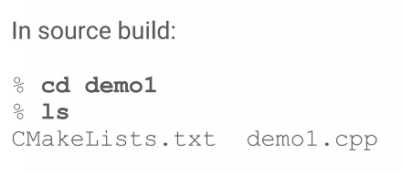
Simplest Example

Slide 34
Simplest Example

Slide 35
Homework and Projects
We will use Visual Studio Code as our development environment
Assignment 0 will ask you to install everything and make it work
We will use Github Classroom for managing your submission
Please go get a login on github.com, if you have none yet (this is part of assignment 0)
This will teach you the use of the Git source code control system along the lines
Special lecture will talk about development environment (git, cmake, etc.)
Project will be a collaborative assignment
Get a sense how collaborative software development works

Slide 36
What is Programming?

Slide 37
So what is Programming?
Conventional definitions
Telling a very fast moron exactly what to do
A plan for solving a problem on a computer
Specifying the order of a program execution
But modern programs often involve millions of lines of code
And manipulation of data is central
Definition from another domain (academia)
A … program is an organized and directed accumulation of resources to accomplish specific … objectives …
Good, but no mention of actually doing anything
The definition we’ll use
Specifying the structure and behavior of a program, and testing that the program performs its task correctly and with acceptable performance
Never forget to check that “it” works
Analysis, design, programming (coding), testing
Software == one or more programs

Slide 38
Programming
Programming is fundamentally simple
Just state what the machine is to do
So why is programming hard?
We want “the machine” to do complex things
And computers are nitpicking, unforgiving, dumb beasts
The world is more complex than we’d like to believe
So we don’t always know the implications of what we want
“Programming is understanding”
When you can program a task, you understand it
When you program, you spend significant time trying to understand the task you want to automate
Programming is part practical, part theory
If you are just practical, you produce non-scalable unmaintainable hacks
If you are just theoretical, you produce toys

Slide 39
