Slide 1
Working with Strings, the Type std::queue
Lecture 10
Hartmut Kaiser
https://teaching.hkaiser.org/spring2024/csc3380/

Slide 2
Software Development Notes

Slide 3
Data Centric vs Client/Server
In the data centric architecture, both clients and servers modify the same database
  Firebase apps use a data centric design
Using dynamic, table-driven logic, as opposed to logic embodied in previously compiled programs
Using stored procedures that run on database servers, as opposed to greater reliance on logic running in middle-tier application servers
Using a shared database as the basis for communicating between parallel processes in distributed computing applications
This is different than a client/server model
  In client/server, clients go through the server, and the server updates the database

Slide 4
Data Centric Benefits
Lower latency than client/server
Easy to scale number of servers (major benefit)
Database handles authentication and security

Slide 5
Data Centric Drawbacks
Some operations are too complicated to allow clients to manage
Breaks encapsulation
  adds coupling between client and data
Uglier communication interface
  Servers pull requests from database instead of API
Single point of failure
  Attractive target for DDoS attacks

Slide 6
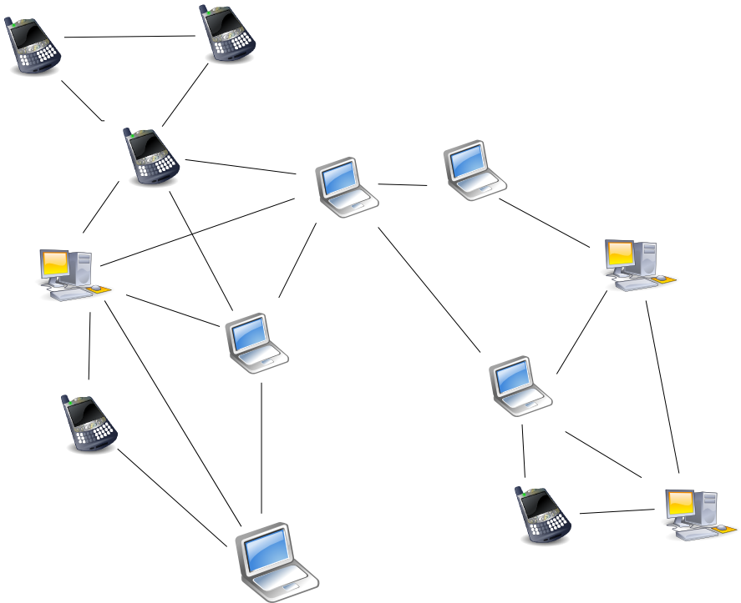
Peer to Peer Concept
No central server, peers broadcast directly to each other
Each client maintains private state
Needs to manage:
  Synchronization
  Dropout
  Security
  Flooding
Quite complicated

Slide 7
Peer to Peer Benefits
Robust: no single point of failure
Doesn’t require central infrastructure
Useful when communication range is limited (e.g., underwater drones)

Slide 8
Peer to Peer Drawbacks
Synchronization problems
  What time is it?
Consensus problems
  What is the state?
Byzantine attacks
  A node becomes infected and provides wrong information to other peers, creating an unstable network

Slide 9
Peer to Peer Examples
Cryptocurrency
Automotive networks
Internet of Things (IOT)
PC to PC local Wi-Fi hotspot

Slide 10
The Type std::string

Slide 11
Abstract
In this lecture we look at strings in C++: std::string
  Briefly introduce simple string manipulation
Create a user defined data type that represents an ‘image’
  A set of strings, that when printed resemble ASCII art
Develop a set of algorithms that can be used to manipulate those images
Briefly introduce std::queue<T>, a standard container adaptor modelling – well – queues.

Slide 12
Brief Overview

Slide 13
Framing a Name
Given the following interaction:
  Please enter your name: John
We would like to print:
  *******************
  * *
  * Hello John! *
  * *
  *******************

Slide 14
Framing a Name
// Ask a persons name, greet the person
#include <iostream>
#include <string>
int main()
{
std::cout << "Please enter your first name: "; // ask for the persons name
std::string first_name; // define 'first_name'
std::cin >> first_name; // read into 'first_name'
std::string const greeting = "Hello, " + first_name + "!"; // build the message we intend to write
std::string const spaces(greeting.size(), ' '); // build the second and fourth string
std::string const second = "* " + spaces + " *";
std::string const first(second.size(), '*'); // build the first and fifth lines
std::cout << first << std::endl; // write all
std::cout << second << std::endl;
std::cout << "* " + greeting + " *" << std::endl;
std::cout << second << std::endl;
std::cout << first << std::endl;
return 0;
}

Slide 15
Framing a Name
Variable definition
  Initialization
    Important!
  Use operator + for concatenation
    Custom operators do not change precedence, associativity, or number of arguments
  Constness (keyword const)
    Variable will not be changed
    Requires initialization
    May allows for more optimizations
    Expresses intention to the compiler

Slide 16
C++ std::string
Models a sequence of characters
std::string is defined as a class (user defined) type
Simple operations
  Member function size() returns number of chars
  operator[] to access individual characters
  C++ strings are mutable
Operators on strings
  operator= assigns, makes new copy
  Compare with relational operators: <, <=, ==, >=, >
    Lexicographical ordering
  operator+ concatenates (associative, but not commutative)
It’s a TotallyOrdered type

Slide 17
Framing a Name
Initializing using special constructor
  std::string spaces(greeting.size(), ' ');
  Number of characters and character literal (' ')
  Quoting similar to string literals ('\t', etc.)
Exercise: write a function to create a std::string consisting of N equal characters using the power algorithm.
Explain why power can be used.

Slide 18
C++ std::string
#include <iostream> // std::cout, std::endl
#include <string> // std::string
int main()
{
std::string s, t = "hello";
s = t; // s == "hello"
std::cout << "Length: " << s.size() << std::endl;
t[0] = 'j'; // t == "jello"
s = s + ' '; // s == "hello "
s += t;
std::cout << s << std::endl; // prints: 'hello jello'
return 0;
}

Slide 19
C++ std::string
#include <iostream> // std::cout, std::endl
#include <string> // std::string
#include <cctype> // std::toupper
#include <algorithm> // std::transform
int main()
{
std::string s;
s = "csc3380";
// converts to upper case
std::transform(std::begin(s), std::end(s), std::begin(s),
[](char c) { return std::toupper(c); });
std::cout << s << std::endl; // prints: CSC3380
return 0;
}

Slide 20
C++ std::string
#include <iostream> // std::cout, std::endl
#include <string> // std::string
#include <algorithm> // std::sort
int main()
{
std::string s;
s = "hello John";
// sort all characters of the string
std::sort(std::begin(s), std::end(s));
std::cout << s << std::endl; // prints: ' Jehhllnoo'
return 0;
}

Slide 21
C++ std::string member functions
Invoke member functions as: str.function(args)
Sample member functions:
  Return index after pos of first occurrence or std::string::npos
        int find(char c, int pos = 0);
        int find(std::string const& pattern, int pos = 0);
  Return new string, copies len characters starting at pos
        std::string substr(int pos, int len);
  Changes string, inserts txt at pos
        void insert(int pos, std::string const& txt);
  Changes string, removes len characters starting at pos
        void erase(int pos, int len);
  Changes string, removes len characters starting at pos, inserts txt
        void replace(int pos, int len, std::string const& txt);

Slide 22
More String Details
IO is using operator>> and operator<<
  os << s:
    output s to stream os without formatting changes
    evaluates to os
  is >> s:
    input s from stream is with whitespace handling (stops at whitespace!)
    evaluates to is
Ways to initialize:
    std::string hello = "hello";
    std::string stars(10, '*');
    std::string name;

Slide 23
C++ strings vs. C strings
C++ inherits legacy of old-style C string
  String literals are actually C strings (e.g. "C-string literal")
  (pointer to array of null terminated characters)
Converting C string to C++ string
  Happens automatically in most cases
  Can be forced: std::string("abc")
Converting C++ string to C string
  Using member function s.c_str()
  Critical when using: printf("%s", s.c_str());
Why do we care
  Some older functionality requires use of C strings
  C strings are not compatible with concatenation

Slide 24
C++ strings vs. C strings
Concatenation pitfalls
  If one operand is a C++ string, all is good
      std::string str = "Hello ";
      str = str + "John";
      str = str + '!';
  If both operands are C strings/characters, bad times
      "abc" + "def"; // won't compile
      "abc" + 'd'; // will compile, but does wrong thing
  Can force conversion if needed
      std::string("abc") + 'd';

Slide 25
The image Type

Slide 26
Putting Strings Together
Earlier we wrote a program to frame a string
  Never created the output in a string
  Rather printed the parts separately
So far we generated ‘images’ on the fly
  Let’s compose the image in memory
Let’s create a user defined type representing a ‘picture’ (ASCII art), each string is one line
Now, we will build a program framing such a picture
  Puts together the whole picture in a data structure before printing it

Slide 27
The image Type
Let’s make it a Regular type:
struct image
{
std::vector<std::string> data; // image data
image() = default; // default constructor (empty image)
~image() = default; // destructor
image(image const&) = default; // copy constructor
image& operator=(image const&) = default; // copy assignment
friend bool operator==(image const& lhs, image const& rhs)
{
return lhs.data == rhs.data;
}
friend bool operator!=(image const& lhs, image const& rhs)
{
return !(lhs == rhs);
}
};

Slide 28
The image Type: Constructors
// construct an 'image' from a single line
explicit image(std::string const& line)
: data(1, line)
{
}
// construct an 'image' from multiple lines
explicit image(std::vector<std::string> const& lines)
: data(lines)
{
}
// construct a 'space-filled' image of the given size
image(int width, int height)
: data(height, std::string(width, ' '))
{
}

Slide 29
The image Type: Constructors
// construct an 'image' from a single line
explicit image(std::string const& line)
: data(1, line)
{
}
// construct an 'image' from multiple lines
explicit image(std::vector<std::string> const& lines)
: data(lines)
{
}
// construct an optionally 'space-filled' image of the given size
image(int width, int height, char fill = ' ')
: data(height, std::string(width, fill))
{
}

Slide 30
The image Type
Add output support:
// print the 'image'
friend std::ostream& operator<<(std::ostream& os, image const& img)
{
for (auto const& line : img.data)
os << line << '\n';
return os;
}

Slide 31
Putting Strings Together
Store all strings in a std::vector<std::string> one line each and surround it by a border
For example, a framed image holding “this is an”, “example”, “to illustrate”, “framing” will result in:
      *****************
      * this is an *
      * example *
      * to illustrate *
      * framing *
      *****************

Slide 32
Putting Strings Together
Box is rectangular not ragged as single strings
Find the overall width and height of the image (i.e. the longest string and the number of strings):
      std::string::size_type image::width() const
      {
      std::string::size_type maxlen = 0;
      for (auto const& s: data)
      maxlen = std::max(maxlen, s.size());
      return maxlen;
      }
      std::string::size_type image::height() const
      {
      return data.size();
      }
Exercise: use standard algorithm (accumulate, or even better, max_element)

Slide 33
Framing Pictures
What should the interface look like?
Should it be based on member functions or (global) free functions?
  No clear criteria, what about
    Member function to apply the framing ‘in-place’
    Free function to create a new (now framed) image
Let’s create it as a global function:
  Algorithm frame() will take an image and should return a new image:
      image frame(image const& img, int gap = 1)
      {
      // extract width of right hand side image
      // create top line and append to result
      // append each line from img to result after adding '*'
      // create bottom line and append to result
      }
Exercise: create it as a member function

Slide 34
Framing Pictures
image frame(image const& img, int gap = 1)
{
image ret;
auto maxlen = img.width(); // find longest string
// create top line and append to result
std::string const border(maxlen + 2 + 2 * gap, '*');
ret.append(border);
// append each line from v to result after adding '*'
std::string const spaces(' ', gap);
for (auto const& s : img.data) {
ret.append("*" + spaces + s + std::string(maxlen - s.size(), ' ') + spaces + "*");
}
ret.append(border); // 'write' the bottom border
return ret;
}

Slide 35
More Image Functions
What else can we do to ‘images’?
  Concatenation! Vertical and horizontal
  Flipping and rotating images
The image type represents an ‘ascii’ picture
  Vertical concatenation is simple: just concatenate the two vectors
  ‘Pictures’ will line up along their left margin
  No predefined concatenation of vectors, let’s define one:
      image vcat(image const& top, image const& bottom, int gap = 0);
  Optional gap between images using the default argument
    If not specified, it will use the default value

Slide 36
Vertical Concatenation
// vertical concatenation
image vcat(image const& top, image const& bottom, int gap = 0)
{
// copy the top picture
image ret = top;
for (int i = 0; i < gap; ++i)
ret.append(std::string()); // insert empty string
// copy entire bottom picture
for (auto const& s : bottom) // <<-- unfortunately doesn’t work
ret.append(s);
return ret;
}

Slide 37
Expose Iterators from image
What is necessary for this to work?
  for (auto const& l : img) {...}
Type image needs to expose begin and end
  Those need to return an iterator
Our underlying vector exposes begin, end, which in turn expose iterators
  Simply re-expose those from our image type:
auto image::begin() const
{
return data.begin();
}
auto image::end() const
{
return data.end();
}

Slide 38
Vertical Concatenation
// vertical concatenation
image vcat(image const& top, image const& bottom, int gap = 0)
{
// copy the top picture
image ret = top;
for (int i = 0; i < gap; ++i)
ret.append(std::string()); // insert empty string
// append entire bottom picture, new member function!
ret.append(bottom);
return ret;
}

Slide 39
Horizontal Concatenation
For example:
    this is an **************
    example * this is an *
    to * example *
    illustrate * to *
    framing * illustrate *
    * framing *
    **************

Slide 40
Horizontal Concatenation
If left hand side picture is shorter than right hand side, we need padding
  Otherwise just copy the picture
Interface similar to vcat:
// horizontal concatenation
image hcat(image const& left, image const& right, int gap = 1)
{
image ret;
// get width of left, add 1 to leave a space between pictures
// handle all rows from both pictures, line by line
// copy a row from the left-hand side, if there is one
// pad the line to full width of left + 1
// copy row from the right-hand side, if there is one
// append overall line to result image
return ret;
}

Slide 41
Horizontal Concatenation
// horizontal concatenation
image hcat(image const& left, image const& right, int gap = 1)
{
image ret;
auto width1 = left.width() + gap; // add ‘gap’ to leave space between images
auto i = 0, j = 0;
while (i != left.height() || j != right.height()) {
std::string s; // construct new string to hold characters from both images
if (i != left.height()) s = left[i++]; // copy a row from the left-hand side, if there is one
s += std::string(width1 - s.size() + gap, ' '); // pad to full width, add gap
if (j != right.height()) s += right[j++]; // copy a row from the right-hand side, if there is one
ret.append(s); // add s to the picture
}
return ret;
}

Slide 42
Vertically Flip an image
For example:
    this is an flipping
    example illustrate
    to to
    illustrate example
    flipping this is an

Slide 43
Vertically Flip an image
Straight forward solution:
      image vflip(image const& v)
      {
      image ret;
      for (auto it = v.rbegin(); it != v.rend(); ++it)
      ret.append(*it);
      return ret;
      }
Using Standard algorithm:
      image vflip(image const& v)
      {
      image ret;
      std::reverse_copy(v.begin(), v.end(), std::back_inserter(ret.data));
      return ret;
      }

Slide 44
Left-rotate an image
For example:
    this is an n e
    example a t
    to an
    illustrate se ro
    rotation il ti
    p st
    sm ua
    ia lt
    hxolo
    tetir

Slide 45
Left-rotate an image
// left-rotate an image
image rotate_left(image const& img)
{
image ret;
// take a letter from each string, starting at the end of the line
for (auto i = img.width(); i != 0; --i)
{
std::string line; // new line
for (auto const& current: img) { // for all lines in the input image
if (current.size() < i) line += ' ';
else line += current[i-1];
}
ret.append(line); // store the new line in the result picture
}
return ret;
}

Slide 46
Generating Output On the Fly
int main()
{
std::vector<std::string> example = {
"this is an", "example", "to illustrate", "framing"};
image img(example);
std::cout << frame(img, 3); // creates vector just to discard it
return 0;
}

Slide 47
Generating Output On the Fly
If all we need is to generate the framed image
  No need to materialize the std::vector<std::string>
  It will be discarded right away
Anther application of the decorator pattern
Create special type framed_image
struct framed_image
{
image const& base; // underlying image to frame
int gap; // gap for spacing
};

Slide 48
Generating Output On the Fly
std::ostream& operator<<(std::ostream& os, framed_image const& img)
{
auto maxlen = img.base.width(); // find longest string
// create top line and append to result
std::string border(maxlen + 2 + 2 * img.gap, '*');
os << border << '\n';
// append each line from v to result after adding '*'
std::string spaces(img.gap, ' ');
for (auto const& s : img.base) {
os << "*" + spaces + s + std::string(maxlen - s.size(), ' ') + spaces + "*\n";
}
os << border << '\n'; // 'write' the bottom border
return os;
}

Slide 49
Generating Output On the Fly
int main()
{
std::vector<std::string> example = {
"this is an", "example", "to illustrate", "framing"};
image img(example);
std::cout << frame(img, 3); // creates vector just to discard it
std::cout << framed_image(img, 3); // generates output on the fly
return 0;
}

Slide 50
The Type std::queue

Slide 51
Introduction to Queue
A queue is a first-in-first-out (FIFO) data structure
Limited access vector (or list, or deque)
Main operations:
  Adding an item: queue.push(e)
    Referred to as pushing it onto the
    queue (enqueue an item, adding to
    the end)
  Removing an item: queue.pop()
    Referred to as popping it from the
    queue (dequeue an item, remove
    from the front)
  Access front item: auto e = q.front()
    Note that pop does not return the
    front item, it just removes it

Slide 52
Introduction to Queues
Definition:
  An ordered collection of data items
  Can be read at only one end (the front) and written to only at the other end (the back)
Operations:
  Construct a queue (usually empty)
  Check if it is empty
  push: add an element to the back
  front: retrieve the front element
  pop: remove the front element
  size: returns number of elements in queue

Slide 53
Introduction to Queues
Useful for
  All kind of simulations (traffic, supermarket, etc.)
  Computers use queues for scheduling
    Handling keyboard events
    Handling mouse events
    Scrolling the screen
    Printer spooler
  C++ I/O streams are queues
    Even if we only access one end, the other end is managed by the operating system

Slide 54
Example: Queue of Strings
    void manage_queue()
    {
    std::queue<std::string> waiting_strings; // queue of 'waiting' strings
    while (true) {
    std::cout << "?> "; // ask for next line of text
    std::string response;
    std::getline(std::cin, response);
    if (response.empty()) break;
    if (response == "next") { // try to dequeue
    if (waiting_strings.empty())
    std::cout << "No one waiting!" << std::endl;
    else {
    std::cout << waiting_strings.front() << std::endl;
    waiting_strings.pop();
    }
    }
    else { // enqueue the line read
    waiting_strings.push(response);
    }
    }
    }

Slide 55
