Slide 1
Using Sequential Containers
Lecture 11
Hartmut Kaiser
https://teaching.hkaiser.org/spring2024/csc3380/

Slide 2
Software Development Notes

Slide 3
Systems and Modeling
The use of modeling has a rich history in all engineering disciplines
The four basic principles of modeling
The choice of what models to create has a profound influence on how a problem is attacked and how a solution is shaped
Every model may be expressed at different levels of precision
The best models are connected to reality
No single model is sufficient. Every nontrivial system is best approached through a small set of nearly independent models
The Unified Modeling Language User Guide, by G. Booch, J. Rambaugh & I. Jacobson

Slide 4
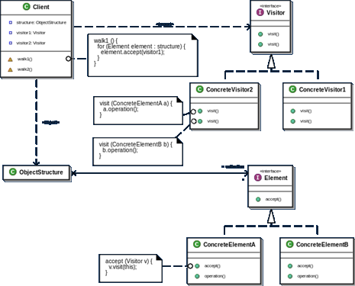
Unified Modeling Language (UML)
Unified Modeling Language (UML) is a graphical meta-language for visualizing, specifying, and documenting software systems

Slide 5
Unified Modeling Language (UML)
Developers (the 3 amigos)
Grady Booch (Rational Software Corp)
James Rumbaugh (General Electric)
Ivar Jacobson (Objectory)
Object Management Group (OMG)
An open membership, not-for-profit consortium that produces and maintains computer industry specifications for interoperable enterprise applications
UML Standards
UML 1.0 (1995)
UML 1.x (1995)
UML 2.0 (2005), currently most widely used
UML 2.x (2006-2015), minor revisions

Slide 6
The Component Model
The component model illustrates the software components that will be used to build the system
Components are high level aggregations of smaller software pieces, and provide a 'black box' building block approach to software construction
Typically a component is made up of many internal classes and packages of classes
It may be assembled from a collection of smaller components
https://sparxsystems.com/resources/tutorials/uml/component-model.html

Slide 7
The Component Model Component Notation
The component diagram shows the relationship between software components, their dependencies, communication, location and other conditions
The graphical representation of a component is a rectangle with tabs:
or
https://sparxsystems.com/resources/tutorials/uml/component-model.html

Slide 8
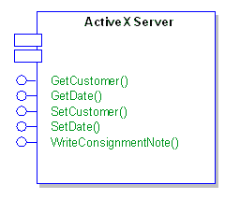
The Component Diagram Interfaces
Components may also expose interfaces
These are the visible entry points or services that a component is advertising and making available to other software components and classes
Modeled as lollypops
https://sparxsystems.com/resources/tutorials/uml/component-model.html

Slide 9
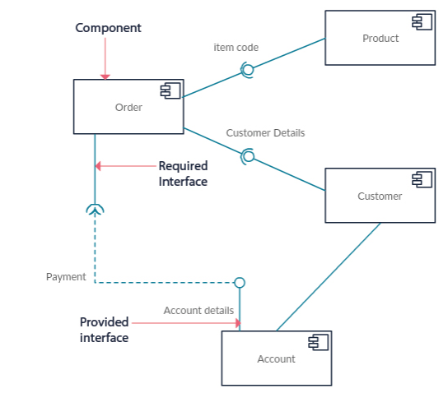
Component Diagram
Components communicate with each other using interfaces (lollypop: circle on a line)
The interfaces are linked using connectors (wine glass: half circle on a line)
The Unified Modeling Language User Guide, by G. Booch, J. Rambaugh & I. Jacobson
https://creately.com/blog/diagrams/uml-diagram-types-examples/

Slide 10
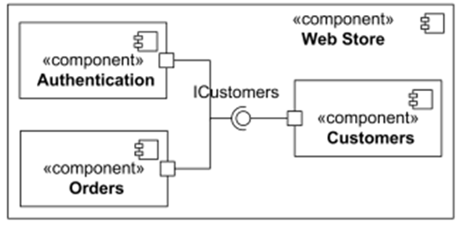
Sub-Components
https://www.uml-diagrams.org/component-diagrams-reference.html

Slide 11
Analyzing Student Grades

Slide 12
Abstract
We start looking beyond vector and string. We will focus on sequential containers and demonstrate a couple of problems we can solve when applying them.
The standard library’s architecture will start to get visible. That will help us to start understanding how to use all of the different containers in the standard library.

Slide 13
Organizing Data
Let’s write program analyzing student grades for a whole course (many students)
Read grades from a file:
Smith 93 91 47 90 92 73 100 87
Carpenter 75 90 87 92 93 60 0 98
i.e. Name Midterm Final Homework-Grades
We want to produce output (overall grade)
Carpenter 90.4
Smith 86.8
Alphabetical, formatting vertically lining up

Slide 14
Organizing Data
Need to store all student data
Sorted by name
Line up: find longest name
Let’s assume we can store all data about one student (student_info)
All students data: std::vector<student_info>
Should be Regular! Maybe TotallyOrdered, most likely StrictWeaklyOrdered
Set of auxiliary functions to work with that data
Solve the overall problem using those

Slide 15
Organizing Data
We need to hold all data items related to one student together:
// hold all information related to a single student
struct student_info
{
std::string name; // students name
double midterm, final; // midterm and final exam grades
std::vector<double> homework; // all homework grades
};
This is a new type holding four items (members)
We can use this type to define new objects of this type
We can store the information about all students in a
std::vector<student_info> students;

Slide 16
Reading Data for one Student
Very similar to what we already have seen:
// read all information related to one student
std::istream& operator>>(std::istream& in, student_info& s)
{
// read the students name, midterm, and final exam grades
in >> s.name >> s.midterm >> s.final;
// read all homework grades for this student
return read_hw(in, s.homework);
}
Any input error will cause all subsequent input to fail as well
Can be called repeatedly

Slide 17
Reading Data for one Student
std::istream& read_hw(std::istream& in, std::vector<double>& hw)
{
if (in) {
hw.clear(); // get rid of previous content
// read homework grades
double x;
while (in >> x)
hw.push_back(x);
// clear the stream so that input will work for
// the next student
in.clear();
}
return in;
}

Slide 18
Reading all Student Records
Invoke operator>> as long as we succeed:
std::vector<student_info> students; // all student records
std::string::size_type maxlen = 0; // length of longest name
// read and store all the records, find the length of the longest name
student_info record;
while (std::cin >> record) {
maxlen = std::max(maxlen, record.name.size());
students.push_back(record);
}
Function std::max() is peculiar
Both arguments need to have same type

Slide 19
Calculate Final Grade
Exercise: rewrite median() using std::nth_element.
Calculate grade based on data read:
// compute the median of a std::vector<double>
// note: calling this function copies the whole vector
double median(std::vector<double> vec)
{
auto size = vec.size();
if (size == 0) throw std::domain_error("vector is empty, median undefined");
std::sort(vec.begin(), vec.end());
auto mid = size / 2;
return size % 2 == 0 ? (vec[mid] + vec[mid-1]) / 2 : vec[mid];
}
// Calculate the final grade for one student
double grade(student_info const& s)
{
return 0.2 * s.midterm + 0.4 * s.final + 0.4 * median(s.homework);
}

Slide 20
Sort Student Data
We know that sorting can be done using sort():
std::vector<double> vec;
std::sort(vec.begin(), vec.end());
Let’s do the same for all students:
std::vector<student_info> students;
std::sort(students.begin(), students.end());
Not quite right, why?
What criteria to use for sorting?
What does it mean to sort the vector of students?
How to express the need to sort ‘by name’?

Slide 21
Sorting Student Data
Normally, sort() uses the operator< to determine order
Makes no sense for student_info’s!
We can teach sort() how to order by specifying a predicate
A function returning a bool taking two arguments of the type to be compared
Returns true if the first argument is smaller than the second (whatever that means)

Slide 22
Sorting Student Data
We can teach sort() how to order by specifying a predicate:
// compare two student_info instances, return whether 'x‘
// is smaller than 'y' based on comparing the stored names
// of the students
bool compare(student_info const& x, student_info const& y)
{
return x.name < y.name; // get_name(x) < get_name(y)
}
Now, we can use this function as:
std::vector<student_info> students;
std::sort(students.begin(), students.end(), compare);

Slide 23
Sorting Student Data
Alternatively, we could define an appropriate operator
// compare two student_info instances, return whether 'x‘
// is smaller than 'y' based on comparing the stored names
// of the students
bool operator<(student_info const& x, student_info const& y)
{
return x.name < y.name;
}
Now, we would be able to use this function as:
std::vector<student_info> students;
std::sort(students.begin(), students.end());
But is this what we really want?

Slide 24
Sorting Student Data
Alternative: lambda function:
// sorting the student data using a lambda function
sort(students.begin(), students.end(),
[](student_info const& x, student_info const& y)
{
return x.name < y.name;
}
);
Note: this lambda has no explicit return type
Although, it could be specified (-> bool)
Much nicer! Everything is in one place
This ordering is called StrictWeakOrdering
Weaker than TotallyOrdered as we might want to sort by grades, etc.

Slide 25
Sorting Student Data
A StrictWeakOrdering is a Binary Predicate that compares two objects, returning true if the first precedes the second
Applying TotalOrdering to equivalence classes
Invoke function on an element and totally order what it returns
StrictWeakOrdering
Partial ordering:
Irreflexivity: !f(x, x)
Antisymmetry: f(x, y) ⬄ !f(y, x)
Transitivity: f(x, y) && f(y, z) ⬄ f(x, z)
Transitivity of equivalence
if $x≅y$ and $y≅z$, then $x≅z$

Slide 26
Generating the Report
Now we’re ready to generate the report:
for (std::vector<student_info>::size_type i = 0; i != students.size(); ++i) {
// write the name, padded on the right side to maxlen + 1 characters
std::cout << students[i].name
<< std::string(maxlen + 1 - students[i].name.size(), ' ');
// compute and write the grade
try {
double final_grade = grade(students[i]);
std::streamsize prec = cout.precision();
std::cout << std::setprecision(3) << final_grade << std::setprecision(prec);
}
catch (std::domain_error e) {
std::cout << e.what();
}
std::cout << std::endl;
}

Slide 27
Generating the Report
Now we’re ready to generate the report:
for (student_info const& si: students)
{
// write the name, padded on the right side to maxlen + 1 characters
std::cout << si.name
<< std::string(maxlen + 1 - si.name.size(), ' ');
// compute and write the grade
try {
double final_grade = grade(si);
std::streamsize prec = cout.precision();
std::cout << std::setprecision(3) << final_grade << std::setprecision(prec);
}
catch (std::domain_error e) {
std::cout << e.what();
}
std::cout << std::endl;
}

Slide 28
Separating Students into Categories
Sort out failed students
Who failed?
Remove from our data
Create a new vector of student_data containing only students who succeeded:
// predicate to determine whether a student failed
bool fail_grade(student_info const& s)
{
return grade(s) < 60;
}
Push student data onto one of two containers based on this predicate

Slide 29
Separating Students into Categories
What’s wrong here? (Hint: what’s the memory consumption?)
// separate passing and failing student records: first try
std::vector<student_info> extract_fails(std::vector<student_info>& students)
{
std::vector<student_info> pass, fail;
for (std::vector<student_info>::size_type i = 0;
i != students.size(); ++i)
{
if (fail_grade(students[i]))
fail.push_back(students[i]);
else
pass.push_back(students[i]);
}
students = pass;
return fail;
}

Slide 30
Separating Students into Categories
Requires twice as much memory
Each record is held twice
Better to copy failed students, removing the data from original vector
How to remove elements from a vector?
Slow, too slow for larger amounts of data.
Why?
What happens if all students have failed?
This can be solved by either using a different data structure or by modifying the algorithm

Slide 31
Erasing Elements in Place
Slow, but direct solution (Why is it slow?)
// second try: correct but potentially slow
std::vector<student_info> extract_fails(std::vector<student_info>& students)
{
std::vector<student_info> fail;
std::vector<student_info>::size_type i = 0;
// invariant: elements [0, i) of students represent passing grades
while (i != students.size()) {
if (fail_grade(students[i])) {
fail.push_back(students[i]};
students.erase(students.begin() + i);
} else
++i;
}
return fail;
}

Slide 32
Erasing Elements in Place
The erase() function takes a special type ‘pointing’ (referring) to the element to erase, i.e. an iterator:
students.erase(students.begin() + i);
students.size() == n
Element i
Elements we’ve already seen
FAIL
Elements we haven’t processed
students.size() == n - 1
(These elements are copied)
Elements we’ve already seen
Elements we haven’t processed

Slide 33
Erasing Elements in Place
Caution: why will this fail?
// this code will fail because of misguided optimization
auto size = students.size();
while (i != size) {
if (fail_grade(students[i])) {
fail.push_back(students[i]);
students.erase(students.begin() + i);
} else
++i;
}

Slide 34
Sequential Versus Random Access
Both versions share a non-obvious property
The elements are accessed sequentially only
We used integer ‘i’ as an index, which hides that
Need to analyze every operation on ‘i’ to verify
We might access student data in arbitrary order
Every container type has its performance characteristics for certain operations
By knowing what access pattern we use we can utilize the ‘best’ container type

Slide 35
Sequential Versus Random Access
Let’s restrict our access to being sequential
The standard library exposes special types we can use to express this intent: Iterators
By choosing the right type of iterator we ‘tell’ the library what access pattern we need to support
Allows for optimal selection of the underlying algorithm implementation

Slide 36
Iterators

Slide 37
Iterators
Our code uses the index for
Access of an element
fail_grade(students[i])
Move to the next element (increment ‘i’)
while (i != students.size()) {
// work gets done here; but doesn't change the value of i
++i;
}
We use index for sequential access only!
But there is no way of telling the library about this

Slide 38
Iterators
Iterators are special types
Identify a container and an element in the container
Let us examine the value stored in that element
Provide operations for moving between elements in the container
Restrict the available operations in ways that correspond to what the container can handle efficiently

Slide 39
Iterators
Code using iterators is often analogous to index based code:
// code based on indicies
for (std::vector<student_info>::size_type i = 0;
i != students.size(); ++i)
{
std::cout << students[i].name << std::endl;
}
// code based on iterators
for (std::vector<student_info>::const_iterator iter = students.begin();
iter != students.end(); ++iter)
{
std::cout << (*iter).name << std::endl; // same as iter->name
}

Slide 40
Iterator Types
Every standard container, such as std::vector, defines two associated iterator types:
container_type::iterator
container_type::const_iterator
Where container_type is the container (std::vector<student_info>)
Use iterator to modify the element, const_iterator otherwise (read only access)
Note, that we don‘t actually see the actual type, we just know what we can do with it.
Abstraction is selective ignorance!

Slide 41
Iterators
Code using iterators is often analogous to index based code:
// code based on indicies
for (auto i = 0; i != students.size(); ++i)
{
cout << students[i].name << endl;
}
// code based on iterators, we don't care about the actual iterator type
for (auto iter = students.begin(); iter != students.end(); ++iter)
{
cout << (*iter).name << endl;
}
// code based on iterators, we don't care about the actual element type
for (auto const& s : students)
{
cout << s.name << endl;
}

Slide 42
Iterator Types
Every container_type::iterator is convertible to the corresponding container_type::const_iterator
students.begin() returns an iterator, but we assign it to a const_iterator
Opposite is not true! Why?

Slide 43
Iterator Operations
Containers do not only expose their (specific) iterator types, but also actual iterators:
students.begin(), students.end()
begin(): ‘points’ to the first element
end(): ‘points’ to the element after the last one
Iterators can be compared:
iter != students.end()
Tests, whether both iterators refer to the same element
Iterators can be incremented:
++iter
Make the iterator ‘point’ (refer) to the next element

Slide 44
Iterator Operations
Iterators can be dereferenced:
*iter
Evaluates to the element the iterator refers to
In order to access a member of the element the iterator refers to, we write:
(*iter).name
(why not: *iter.name ?)
Syntactic sugar, 100% equivalent:
iter->name

Slide 45
Iterator Operations
Some iterators can get a number added
students.erase(students.begin() + i);
Overloaded operator+, makes the iterator refer to the ‘i’ –s element after begin
Equivalent to invoking ++ ‘i’ times
Defined only for iterators from random access containers
std::vector, std::string are random access (indexing is possible)
Will result in compilation error for sequential (non-random access) containers

Slide 46
Erasing Elements in Place
Slow, but direct solution
// second try: correct but potentially slow
std::vector<student_info> extract_fails(std::vector<student_info>& students)
{
std::vector<student_info> fail;
std::vector<student_info>::size_type i = 0;
// invariant: elements [0, i) of students represent passing grades
while (i != students.size()) {
if (fail_grade(students[i])) {
fail.push_back(students[i]};
students.erase(students.begin() + i);
} else
++i;
}
return fail;
}

Slide 47
Erasing Elements in Place
Still slow, but without indexing:
// version 3: iterators but no indexing
std::vector<student_info> extract_fails(std::vector<student_info>& students)
{
std::vector<student_info> fail;
auto iter = students.begin();
while (iter != students.end()) {
if (fail_grade(*iter)) {
fail.push_back(*iter);
iter = students.erase(iter); // watch out! Why?
} else
++iter;
}
return fail;
}

Slide 48
Iterator Invalidation
What happens to an iterator if the element it refers to is deleted?
It is invalidated
Certain containers invalidate all iterators after the deleted element as well (vectors)
For that reason erase() returns the next (valid) iterator:
iter = students.erase(iter);

Slide 49
Same Problem as before
Why does this code fail:
// this code will fail because of misguided optimization
auto iter = students.begin();
auto end_iter = students.end();
while (iter != end_iter) {
// ... erase elements from students without updating end_iter
}
End iterator is invalidated as well when element is erased!

Slide 50
What’s the Problem with std::vector?
For small inputs, vector works just fine, larger inputs cause performance degradation
Vector is optimized for fast access to arbitrary elements and for fast addition to the end
Inserting or removing from the middle is slow.
All elements after the inserted/removed element need to be moved in order to preserve fast random access
Our algorithm has quadratic performance characteristics
Let’s utilize a different data structure:
Next lecture: The list type

Slide 51
