Slide 1
The List Type
Lecture 12
Hartmut Kaiser
https://teaching.hkaiser.org/spring2024/csc3380/

Slide 2
Software Development Notes

Slide 3
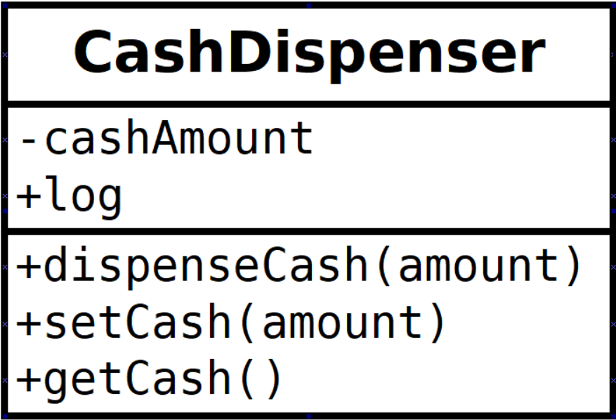
Class Diagrams
Class diagrams are the most commonly used of the UML diagrams
3 basic parts: Name, Fields (member variables), Methods
Visibility
+ public
- private
# protected
Visible to inherited classes, but not other classes
Datatypes can follow member variables, but are optional
For example: - cashAmount : double

Slide 4
Related classes
What if we have a separate class that logs activity of a class
We need to capture the relationship between the two classes

Slide 5
Association Relationship
Association (aka delegation) is the most common connection between classes
Represents one class object storing a reference to another
Represented by a solid line and a filled arrow
The source of the relationship (line) uses the target of the relationship (arrow)
For example, a CashDispenser uses a Log

Slide 6
Composition Relationship
When one class is “made” of another class, the relationship is called composition
Association vs. Composition
Composition is similar to association, but the relationship is stronger
If an object creates and “owns” an object, it is composed of that object
In other words, if object A cannot exist without object B, then object A is composed of object B
If an object is given to another object to use, they are merely associated (one delegates to the other)

Slide 7
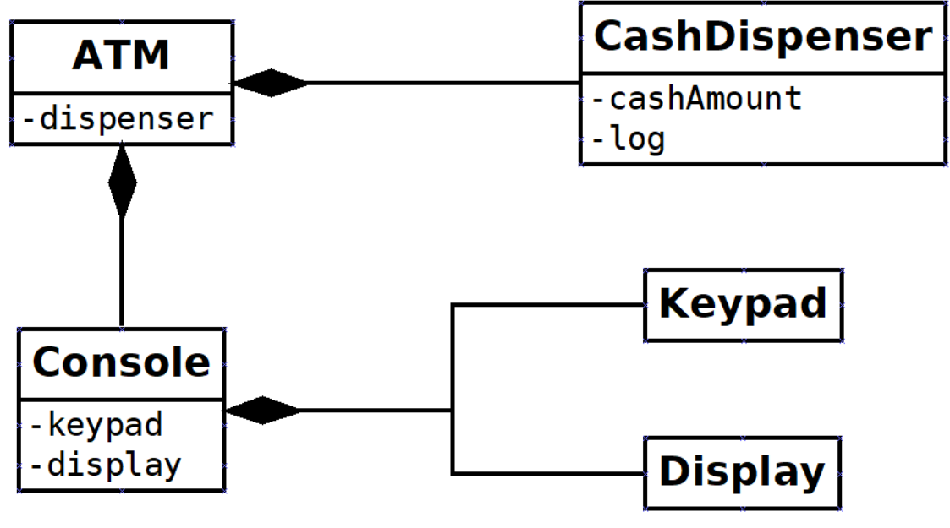
Composition Relationship
Represented by a solid line and a filled diamond
The target of the relationship (diamond) is composed of the source (line) of the relationship
For example, an ATM is composed of a CashDispenser and a Console; a Console is composed of a Keypad and a Display

Slide 8
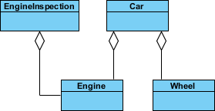
Aggregation Relationship
Aggregation is similar to composition, but not as strong
Aggregation implies a relationship where the child can exist independently of the parent
For example: Class (parent) and Student (child); delete the Class and the Students still exist
Represented by a solid line and an unfilled diamond
The target of the relationship (diamond) is an aggregation of the source (line) of the relationship
For example, a Car contains an Engine and a Wheel; EngineInspection contains an Engine
https://www.visual-paradigm.com/guide/uml-unified-modeling-language/uml-aggregation-vs-composition/

Slide 9
The Hollow Diamond
Aggregation is like composition:
An object is made up of other objects
But has an important difference:
An aggregating object does not own its members.
It’s not responsible for creating/destroying them
(although it has the option)
Fundamentally defined by destruction:
Composed objects go out of scope when their owner does
Aggregated objects do not (their life is independent)

Slide 10
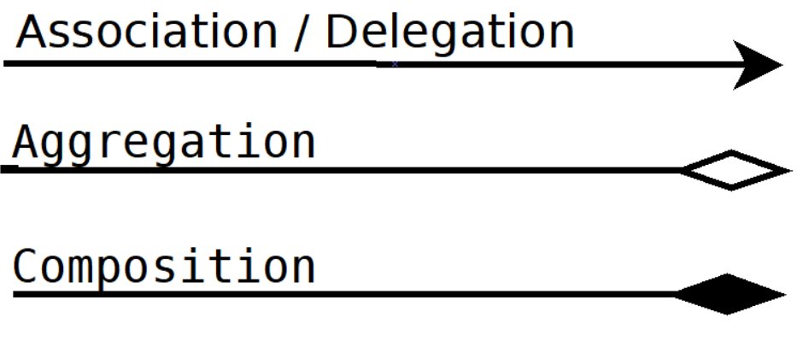
Association vs. Aggregation vs. Composition
Association
a very generic term used to represent when one class uses the functionalities provided by another class
Sibling-type relationship
Composition
one parent class object owns another child class object and that child class object cannot meaningfully exist without the parent class object
Whole/part-type relationship
Aggregation
If it can meaningfully exist without the parent class object
Container/contents-type relationship
https://www.visual-paradigm.com/guide/uml-unified-modeling-language/uml-aggregation-vs-composition/

Slide 11
Class Diagrams: Multiplicity
Number means how many instances of the class are contained/delegated to
The “..” establish a range:
2..5 means at least two, but up to five
1..* means at least one, but any number more
0..* or just * means any number, including none

Slide 12
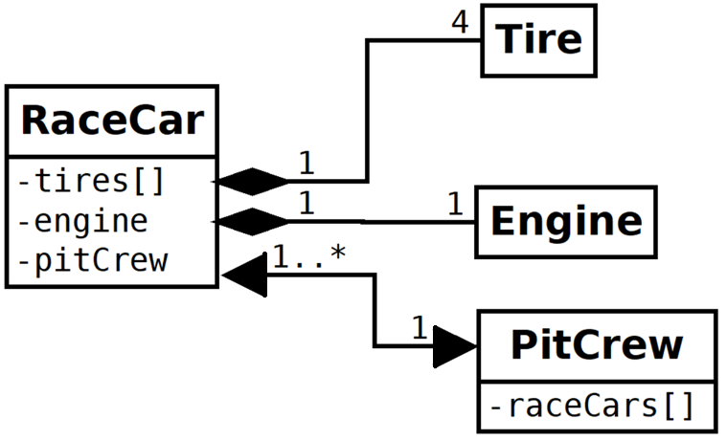
UML Cardinality/Multiplicity

Slide 13
Class Inheritance
Class inheritance is the is-a relationship between classes
Represented by a solid line and an unfilled closed arrow
The source of the relationship (line) is-a target (arrow) of the relationship
For example, a Savings Account is a Bank Account; a Credit Card Account is a Bank Account

Slide 14
The List Type

Slide 15
Abstract
Performance of our example is fine for small inputs, but quickly degrades for a larger number of students. Why?
Inserting/deleting records in the middle of vectors requires moving big chunks of memory to preserve the random access property.
Our program has a time complexity of O(N²).
Different data structure is required

Slide 16
Using Vector Type
// version 3: iterators but no indexing
std::vector<student_info> extract_fails(std::vector<student_info>& students)
{
std::vector<student_info> fail;
auto iter = students.begin();
while (iter != students.end()) {
if (fail_grade(*iter)) {
fail.push_back(*iter);
iter = students.erase(iter); // watch out!
} else
++iter;
}
return fail;
}

Slide 17
The List Type
We rewrote code to remove reliance on indices
Now: change data structure allowing to efficiently delete elements from the middle of the sequence
Common requirement, therefore: std::list<>
Vectors are optimized for fast random access
List are optimized for fast insert and delete at any point
Generally, slower than vectors
In heavy insertion and deletion scenarios, faster
Choose data structure depending on use case

Slide 18
The List Type
List and vector share many common ideas
Can store any data type
Share almost all operations
Converting our program to use lists is surprisingly simple
Main change is swapping container types
Lists do not support indexing operations
But using iterators allows to get away without those

Slide 19
Using List Type
// version 4: using lists
std::list<student_info> extract_fails(std::list<student_info>& students)
{
std::list<student_info> fail;
auto iter = students.begin();
while (iter != students.end()) {
if (fail_grade(*iter)) {
fail.push_back(*iter);
iter = students.erase(iter); // watch out!
} else
++iter;
}
return fail;
}

Slide 20
Iterator Invalidation
For vectors, any insert/remove operation potentially invalidated all iterators.
Reallocation, data movement
Watch out when storing iterators (i.e. end())!
For lists, no iterators are invalidated
Well, except for the one pointing to an erased element
But lists are not random access, that mean that iterators do not support random access operations

Slide 21
Sorting a List
Standard sort algorithm is usable for random access iterators only
std::sort not usable for lists:
std::list<student_info> students;
student.sort(compare);
Instead of:
std::vector<student_info> students;
std::sort(students.begin(), students.end(), compare);

Slide 22
Performance Data
File size [records] | List [s] | Vector [s]
700 | 0.1 | 0.1
7000 | 0.8 | 6.7
70000 | 8.8 | 597.1
‘Right’ data structure is not a once and for all decision
Performance might not even matter
But depending on use case, performance might have a profound influence

Slide 23
Doubly-Linked List
start
…
Given a pointer to a node in a doubly-linked list, we can remove the node in O(1) time.
This isn’t possible in a singly-linked list, since we must have a pointer to the node in front of the one we want to remove.

Slide 24
Doubly-Linked List
start
…
struct DLNode {
DataType info;
DLNodeIter next;
DLNodeIter back;
};
Each node is made from a struct that looks something like this.
info
next
back

Slide 25
Doubly-Linked List
start
…

Slide 26
Doubly-Linked List
start
ptr
…

Slide 27
Doubly-Linked List: Delete Node
start
ptr
…
ptr->back->next = ptr->next;
ptr->next->back = ptr->back;
delete ptr;

Slide 28
Doubly-Linked List: Delete Node
start
ptr
…
ptr->back->next = ptr->next;
ptr->next->back = ptr->back;
delete ptr;

Slide 29
Doubly-Linked List: Delete Node
start
ptr
…
ptr->back->next = ptr->next;
ptr->next->back = ptr->back;
delete ptr;

Slide 30
Doubly-Linked List: Delete Node
start
ptr
…
ptr->back->next = ptr->next;
ptr->next->back = ptr->back;
delete ptr;

Slide 31
Creating Our Own list Type

Slide 32
Creating Our Own list Type
Use std::vector whenever possible
If it’s not possible think again and make it possible
This is because of the architecture of modern computers
Working with data that is consecutive in memory is much faster than ‘chasing pointers’
Standard lists are implemented as interlinked nodes
Each element stored in a list is allocated separately
Nodes are not consecutive in memory, but may be randomly dispersed
start
…

Slide 33
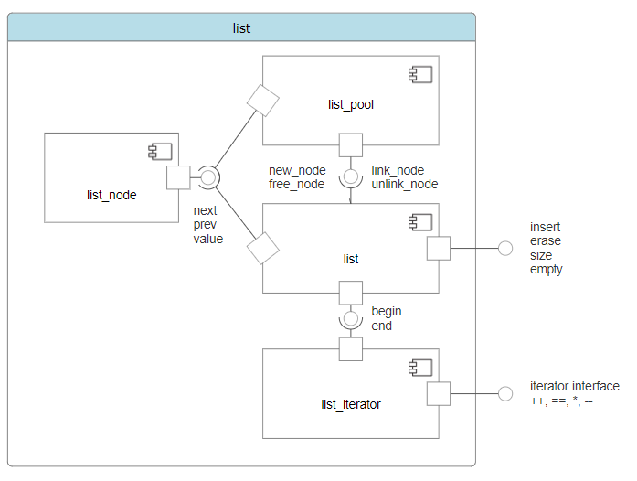
Our list Type, Component Diagram

Slide 34
Creating Our Own list Type
We will build an extremely fast list<T> implementation
Avoid spreading list nodes around in memory
Pooling all list nodes in one place (using std::vector)
Combine the best of two worlds
Fast insert/delete in the middle
Fast traversal as nodes are consecutive in memory
We will build a list_pool<T> user defined type that
Stores and recycles instances of a list_node<T> user defined type using a std::vector<list_node<T>>
Refers to the node instances by their index into the std::vector
Manages a free list of nodes that have been ‘erased’

Slide 35
Creating the list_node Type
A list_node<T> holds the node value and the indices of the next and previous nodes (or zero if there is none)
Both T and list_node<T> are SemiRegular

Slide 36
Creating the list_node Type
A list_node<T> holds the node value and the indices of the next and previous nodes (or zero if there is none)
Both T and list_node<T> are SemiRegular
template <std::semiregular T>
struct list_node
{
T value; // the node value
std::size_t prev = 0; // pool index of previous node
std::size_t next = 0; // pool index of next node
};

Slide 37
Creating the list_pool Type
A list pool is an object with many list nodes inside
Our lists will not be full STL containers
Simplified implementation to avoid having to talk about pointers
Elements in a container should go away when the container goes away (but they don’t)
Still a reasonable implementation
Elements in our list will exist until
Either the list goes out of scope
A list node is explicitly erased and then reused (a new value is added to the list)
The number of nodes allocated by the list_pool will never shrink, only grow

Slide 38
Creating a List Pool
A list_pool<T> holds the list of nodes and the starting index of the free list (or zero if it is empty)
The list_pool<T> is SemiRegular

Slide 39
Creating a List Pool
A list_pool<T> holds the list of nodes and the starting index of the free list (or zero if it is empty)
The list_pool<T> is SemiRegular
template <std::semiregular T>
struct list_pool
{
std::vector<list_node<T>> pool; // list of nodes
std::size_t free_list = 0; // index of first free (usable) node (if any)
list_node<T>& node(std::size_t pos) { return pool[pos - 1]; } // access given node
T& value(std::size_t pos) { return node(pos).value; } // access node value
std::size_t& next(std::size_t pos) { return node(pos).next; } // access next node
std::size_t& prev(std::size_t pos) { return node(pos).prev; } // access prev node
};

Slide 40
Creating a List Pool: deallocate
Deallocation simply adds the node to the free list
std::size_t deallocate(std::size_t pos) // list_pool member function
{
std::size_t n = next(pos);
prev(n) = 0; // remove backlink
next(pos) = free_list; // append current freelist
free_list = pos; // include deallocated node in freelist
return n; // return next node (or zero, if none)
}

Slide 41
Creating a List Pool: deallocate
deallocate(1); // returns 2
list_pool
v0, 2, 0
v1, 3, 1
v2, 0, 2
nodes
std::size_t
deallocate(std::size_t x) {
std::size_t n = next(x);
prev(n) = 0;
next(x) = free_list;
free_list = x;
return n;
}
free_list
0
list_pool
v0, 0, 0
v1, 3, 0
v2, 0, 2
nodes
free_list
1

Slide 42
Creating a List Pool: allocate
std::size_t allocate(T const& val) { // list_pool member function
std::size_t node;
if (free_list == 0) {
pool.push_back(list_node<T>()); // create new node
node = pool.size();
}
else {
node = free_list; // get node from free list
free_list = next(free_list);
}
value(node) = val;
next(node) = 0;
prev(node) = 0;
return node; // new node index
}

Slide 43
Creating a List Pool: allocate
allocate(v3); // returns 1
list_pool
v0, 0, 0
v1, 3, 0
v2, 0, 2
nodes
std::size_t
allocate(T const& val) {
std::size_t node = free_list;
free_list = next(free_list);
value(node) = val; // v3
next(node) = 0;
prev(node) = 0;
return node;
}
free_list
1
list_pool
v3, 0, 0
v1, 3, 0
v2, 0, 2
nodes
free_list
0

Slide 44
Creating a List Pool: link
Linking a new node into list:
std::size_t link(std::size_t pos, std::size_t new_node) {
prev(new_node) = pos;
if (pos != 0) {
next(new_node) = next(pos);
if (next(pos) != 0)
prev(next(pos)) = new_node;
next(pos) = new_node;
}
return new_node;
}
start
…

Slide 45
Creating a List Pool: unlink
Unlinking an existing node from list:
std::size_t unlink(std::size_t pos) {
if (prev(pos) != 0)
next(prev(pos)) = next(pos);
if (next(pos) != 0)
prev(next(pos)) = prev(pos);
return next(pos);
}
start
…

Slide 46
Creating a List Pool: insert and erase
std::size_t insert(T const& val, std::size_t pos)
{
return link(pos, allocate(val));
}
std::size_t erase(std::size_t pos)
{
std::size_t node = unlink(pos);
deallocate(pos);
return node;
}

Slide 47
Creating the list Type
With the existing facilities, implementing a list interface is straightforward

Slide 48
Creating the list Type
template <std::semiregular T>
class list {
list_pool<T> pool; // list_node’s are stored here
std::size_t front = 0; // index of first list node
std::size_t back = 0; // index of last list node
public:
void push_back(T const& val) {
back = pool.insert(val, back);
if (front == 0)
front = back;
}
list_iterator<T> erase(list_iterator<T> it);
list_iterator<T> begin();
list_iterator<T> end();
};

Slide 49
Creating the list_iterator Type
With the existing facilities, implementing a list interface is straightforward

Slide 50
Iterators
Iterators are special types
Identify a container and an element in the container
Let us examine the value stored in that element
Provide operations for moving between elements in the container
Restrict the available operations in ways that correspond to what the container can handle efficiently

Slide 51
Iterator Types
Every standard container, such as std::vector, defines two associated iterator types:
container_type::iterator
container_type::const_iterator
Where container_type is the container (std::vector<student_info>)
Use iterator to modify the element, const_iterator otherwise (read only access)
Note, that we don‘t actually see the actual type, we just know what we can do with it.
Abstraction is selective ignorance!

Slide 52
Iterator Types
Every container_type::iterator is convertible to the corresponding container_type::const_iterator
students.begin() returns an iterator, but we assign it to a const_iterator
Opposite is not true! Why?

Slide 53
Iterator Operations
Containers do not only expose their (specific) iterator types, but also actual iterators:
students.begin(), students.end()
begin(): ‘points’ to the first element
end(): ‘points’ to the element after the last one
Iterators can be compared:
iter != students.end()
Tests, whether both iterators refer to the same element
Iterators can be incremented:
++iter
Make the iterator ‘point’ (refer) to the next element

Slide 54
Iterator Operations
Iterators can be dereferenced:
*iter
Evaluates to the element the iterator refers to
In order to access a member of the element the iterator refers to, we write:
(*iter).name
(why not: *iter.name ?)
Syntactic sugar, 100% equivalent:
iter->name

Slide 55
Iterator Operations
Some iterators can get a number added
students.erase(students.begin() + i);
Overloaded operator+, makes the iterator refer to the ‘i’ –s element after begin
Equivalent to invoking ++ ‘i’ times
Defined only for iterators from random access containers
std::vector, std::string are random access (indexing is possible)
Will result in compilation error for sequential (non-random access) containers

Slide 56
Creating the list_iterator Type
With that knowledge, let’s implement list_iterator<T>
template <std::semiregular T>
class list_iterator {
list_pool<T>& pool;
std::size_t pos;
public:
list_iterator(list_pool<T>& p, std::size_t curr) : pool(p), pos(curr) {}
T& operator*() { return pool.value(pos); } // dereference
list_iterator& operator++() { pos = pool.next(pos); return *this; } // prefix++
list_iterator operator++(int) { // postfix++
auto prev_pos = pos;
pos = pool.next(pos);
return list_iterator(pool, prev_pos); }
};

Slide 57
Creating the list_iterator Type
With that knowledge, let’s implement list_iterator<T>:
friend bool operator==(
list_iterator const& lhs, list_iterator const& rhs)
{
return lhs.pos == rhs.pos;
}
friend bool operator!=(
list_iterator const& lhs, list_iterator const& rhs)
{
return !(lhs == rhs);
}

Slide 58
Using Our List Type
// version 5: using our lists
list<student_info> extract_fails(list<student_info>& students)
{
list<student_info> fail;
auto iter = students.begin();
while (iter != students.end()) {
if (fail_grade(*iter)) {
fail.push_back(*iter);
iter = students.erase(iter); // watch out!
} else
++iter;
}
return fail;
}

