Slide 1
Using Associative Containers
Lecture 13
Hartmut Kaiser
https://teaching.hkaiser.org/spring2024/csc3380/

Slide 2
Software Development Notes

Slide 3
Finite State Machine
A finite state machine is a mathematical construct
It is a type of state transition diagram
Others include cellular automaton, petri nets, and Turing machines
Entities change state upon the trigger of an event
Common uses
Discrete Event Simulations
Asynchronous Programming
UI Navigation

Slide 4
State Machine Diagram
A State Machine diagram is a control flow diagram
Shows discrete behavior of a part of a designed system through finite state transitions
How events change an object over its life

Slide 5
State Machine Diagram
A state machine is a behavior that specifies the sequences of states an object goes through during its lifetime
In response to events, together with its responses to those events.
A state is a condition or situation during the life of an object during which
It satisfies some condition
Performs some activity, or
Waits for some event.
An event is the specification of a significant occurrence that has a location in time and space.
An event is an occurrence of a stimulus that can trigger a state transition.

Slide 6
State Machine Diagram
A guard condition is evaluated after the trigger event for the transition occurs.
It is possible to have multiple transitions from the same source state and with the same event trigger, as long as the guard conditions don’t overlap.
A guard condition is evaluated just once for the transition at the time the event occurs.
A transition is a relationship between two states indicating that
An object in the first state will perform certain actions and
Enter the second state when a specified event occurs and specified conditions are satisfied.
An action is an executable atomic computation that results in a change in the state of the model or the return of a value.

Slide 7
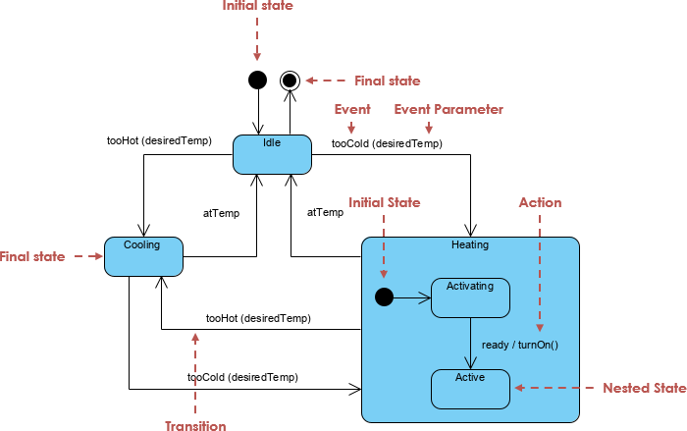
Finite State Machine

Slide 8
Key State Machine Elements
Simple State: rounded rectangle
State Transition, solid line with open arrow
Initial (Start) State, solid circle
Final (End) State, solid circle surrounded by solid line
https://www.uml-diagrams.org/state-machine-diagrams.html

Slide 9
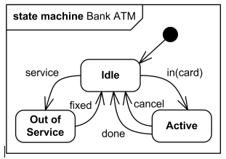
Example State Machine Diagram: Bank ATM
https://www.uml-diagrams.org/state-machine-diagrams.html

Slide 10
Associative Containers

Slide 11
Abstract
Associative containers arrange their elements in a certain sequence based on an ordering criteria for the elements themselves
They employ ordering to quicker find elements
Often they store key/value pairs, ordering the values based on the key
We will investigate these containers and use maps to write compact and efficient look-up-intensive programs.

Slide 12
Why Associative Containers?
Finding an element in sequential containers entails sequential search
Potentially slow if container has many elements
Alternative is to keep elements in sequential container in certain order
Devise a special search strategy, not easy
Potentially slow to insert as it might reorder elements
Another alternative is to use associative containers

Slide 13
Associative Containers
Associative containers automatically arrange their elements into a sequence that depends on the values of the elements themselves, rather than the sequence in which they were inserted
Allows to locate element with particular value quickly
The part which is used to locate an element is the key, which sometimes has an associated value

Slide 14
Counting Words

Slide 15
Counting Words
Almost trivial with associative containers:
int main()
{
std::string s;
std::map<std::string, int> counters; // store each word and an
// associated counter
// read the input, keeping track of each word and
// how often we see it
while (std::cin >> s) {
++counters[s];
}
// write the words and associated counts
for (std::map<std::string, int>::const_iterator it = counters.begin();
it != counters.end(); ++it) {
std::cout << it->first << "\t" << it->second << std::endl;
}
return 0;
}
Key type
Value type

Slide 16
Counting Words
As std::map holds key/value pairs, we need to specify both: std::map<string, int>
Holds values of type int (the word counters) with a key of type std::string (the counted words)
We call this a ‘map from std::string to int’
‘Associative array’, we use a string as the index (the key)
Very much like vectors, except that index can be any type, not just integers
The entries are kept ordered based on
operator<(Key, Key) (total ordering of keys)
Explicit comparison function (weak strict ordering of keys):
std::map<string, int, compare_func>

Slide 17
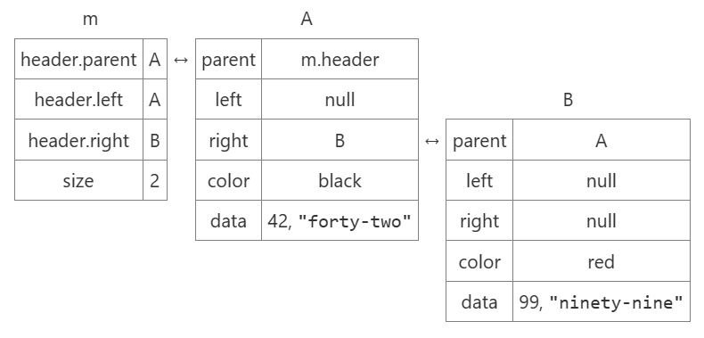
Associative Container: std::map
Usually implemented as a (self-)balanced red-black tree
Elements that compare less are left children, otherwise right children
Tree stores std::pair of key/values
Complexities of operations
Insert, delete, find: O(log N)

Slide 18
Counting Words
Necessary: #include <map>
while (std::cin >> s) ++counters[s];
Indexing operator[]: invoked with string ‘s’
Returns reference to integer value associated with string ‘s’
We increment this integer: counting words
If no entry representing string ‘s’ exists, new entry is created and value initialized (integer is set to zero)
std::cout << it->first << "\t" << it->second << endl;
Iterator ‘it’ refers to both, key and value
std::pair: pair of arbitrary types, stored in map
The parts are named: first, second

Slide 19
Counting Words
Almost trivial with associative containers:
int main()
{
std::string s;
std::map<std::string, int> counters; // store each word and an
// associated counter
// read the input, keeping track of each word and
// how often we see it
while (std::cin >> s) {
++counters[s];
}
// write the words and associated counts
for (auto const& [key, value] : counters) {
std::cout << key << "\t" << value << std::endl;
}
return 0;
}

Slide 20
An Input for the Word Counting Program
This lecture and the next presents the STL (the containers and algorithms part of the C++ standard library). It is an extensible framework dealing with data in a C++ program. First, I present the general ideal, then the fundamental concepts, and finally examples of containers and algorithms. The key notions of sequence and iterator used to tie containers (data) together with algorithms (processing) are presented. Function objects are used to parameterize algorithms with “policies”.

Slide 21
Output (Word Frequencies)
(data): 1
(processing): 1
(the: 1
C++: 2
First,: 1
Function: 1
Fundamental: 1
I: 1
It: 1
STL: 1
The: 1
This: 1
a: 1
algorithms: 3
algorithms.: 1
an: 1
and: 5
are: 2
concepts,: 1
containers: 3
data: 1
dealing: 1
examples: 1
extensible: 1
finally: 1
framework: 1
general: 1
ideal,: 1
in: 1
is: 1
iterator: 1
key: 1
lecture: 1
library).: 1
next: 1
notions: 1
objects: 1
of: 3
parameterize: 1
part: 1
present: 1
presented.: 1
presents: 1
program.: 1
sequence: 1
standard: 1
the: 5
then: 1
tie: 1
to: 2
…

Slide 22
Other Associative Containers
std::multimap<K, V>: Same as map, however doesn’t enforce uniqueness of keys
std::set<T>: Same as map, except no ‘values’, just ‘keys’
std::multiset<T>: Same as set, however doesn’t enforce uniqueness of keys
Starting C++23 (gcc/clang option --std=c++23, msvc option /std:c++23)
std::flat_map, std::flat_set, std::flat_multimap, std::flat_multiset
Same interface as containers above, just implemented on top of std::vector
Re-arrange (sort) elements after each insertion

Slide 23
Splitting a Line into Words

Slide 24
Splitting a Line into Words
We’ll write a function which takes a whole line of input and returns a vector of strings holding the single words of that line:
std::vector<std::string> split(std::string const& s);
Strings support indexing in the same way as vectors:
s[0]: refers to the first character in the string ‘s’
s[s.size()-1]: refers to the last character in a string
Our function will find indices ‘i’ and ‘j’ delimiting each of the words, where the range of characters [i, j) constitutes the word

Slide 25
Splitting a Line into Words
This looks like:
Words are split at whitespace characters
Very similar to the processing during stream input into a string
i
j
Some text read into a line

Slide 26
Splitting a Line into Words
std::vector<std::string> split(std::string const& s)
{
std::vector<std::string> words;
std::vector<std::string>::size_type i = 0;
// invariant: we have processed characters [original value of i, i)
while (i != s.size()) {
// ignore leading blanks, find begin of word
// find end of next word
// if we found some non-whitespace characters, store the word
}
return words;
}

Slide 27
Splitting a Line into Words
Ignore leading blanks
// invariant: characters in range [original i, current i)
// are all spaces
while (i != s.size() && std::isspace(s[i])) // short-circuiting
++i;
Find end of next word
// find end of next word
auto j = i;
// invariant: none of the characters in range
// [original j, current j) is a space
while (j != s.size() && !std::isspace(s[j])) // short-circuiting
++j;

Slide 28
Splitting a Line into Words
Store the word if any
// if we found some non-whitespace characters
if (i != j) {
// copy from s starting at i and having j – i characters
words.push_back(s.substr(i, j - i));
i = j;
}

Slide 29
Splitting a Line into Words
std::vector<std::string> split(std::string const& s)
{
std::vector<std::string> words;
std::vector<std::string>::size_type i = 0;
while (i != s.size()) {
while (i != s.size() && std::isspace(s[i])) ++i;
auto j = i;
while (j != s.size() && !std::isspace(s[j])) ++j;
if (i != j) {
words.push_back(s.substr(i, j - i));
i = j;
}
}
return words;
}

Slide 30
Splitting a Line into Words: Simplified
std::vector<std::string> split(std::string const& s)
{
std::stringstream str = s;
std::vector<std::string> words;
std::string word;
while (str >> word) {
words.push_back(word);
}
return words;
}

Slide 31
Generating a Cross-Reference

Slide 32
Generating a Cross-Reference Table
Write a program to generate a cross-reference table that indicates where (what line) each word occurs in the input
Read a line at a time, allowing to associate line numbers with words
Split line into words
Store more data in a map: all lines a particular word occurred on
std::map<std::string, std::vector<int>>

Slide 33
Generating a Cross-Reference Table
Find all the lines that refer to each word in the input:
std::map<std::string, std::vector<int>>
xref(std::istream& in,
std::vector<std::string> find_words(std::string const&) = split)
{
std::string line; // current line
int line_number = 0; // current line number
std::map<std::string, std::vector<int>> ret; // cross reference table
// read the next line
while (std::getline(in, line)) {
// store current line number for each word
// ...
}
return ret;
}

Slide 34
Generating a Cross-Reference Table
Default argument specification:
std::map<std::string, std::vector<int>>
xref(std::istream& in,
std::vector<std::string> find_words(std::string const &) = split);
Allows to leave out this argument at invocation:
// uses split() to find words in the input stream
... = xref(std::cin);
// uses the function named find_urls to find words
... = xref(std::cin, find_urls);

Slide 35
Generating a Cross-Reference Table
Store current line number for each word:
while (std::getline(in, line)) {
// adjust current line number
++line_number;
// break the input line into words
std::vector<std::string> words = find_words(line);
// remember that each word occurs on the current line
for (auto const& s: words)
{
ret[s].push_back(line_number); // see next slide
}
}

Slide 36
Generating a Cross-Reference Table
What is this doing here:
ret[s].push_back(line_number);
s: the current word
ret[s]: returns a reference to the value associated with the key ‘s’ yielding the vector of line numbers
If this is the first occurrence, an empty vector is put into the map
ret[s].push_back(): adds the current line number to the end of the vector

Slide 37
Printing the Cross-Reference
Print the generated map:
int main() {
// call xref using split by default
std::map<std::string, std::vector<int>> xrefmap = xref(std::cin);
// write the results
for (auto it = xrefmap.begin(); it != xrefmap.end(); ++it)
{
// write the word followed by one or more line numbers
std::cout << it->first << " occurs on line(s): ";
auto line_it = it->second.begin();
std::cout << *line_it++; // write the first line number
// write the rest of the line numbers, if any
std::for_each(line_it, it->second.end(), [](int line) { std::cout << ", " << line; });
std::cout << endl; // write a new line to separate each word from the next
}
return 0;
}

Slide 38
Printing the Cross-Reference
Whether I shall turn out to be the hero of my own life
or whether that station will be held by anybody else
these pages must show
^Z
I occurs on line(s): 1
Whether occurs on line(s): 1
anybody occurs on line(s): 2
be occurs on line(s): 1, 2
by occurs on line(s): 2
else occurs on line(s): 2
held occurs on line(s): 2
hero occurs on line(s): 1
...

Slide 39
Generating Sentences

Slide 40
Generating Sentences
Categories | Rules
<noun> | cat
<noun> | dog
<noun> | table
<noun-phrase> | <noun>
<noun-phrase> | <adjective> <noun-phrase>
<adjective> | large
<adjective> | brown
<adjective> | absurd
<verb> | jumps
<verb> | sits
<location> | on the stairs
<location> | under the sky
<location> | wherever it wants
<sentence> | the <noun-phrase> <verb> <location>
Example: the table jumps wherever it wants

Slide 41
Representing the Rules
Categories, rules, and ‘normal’ words
Categories: enclosed in angle brackets
Right hand side is a rule consisting out of a sequence of categories and words
How to represent/store categories?
Let’s use a std::map to associate the categories with the corresponding rules
Several rules for same category
using category = std::string;
using rule = std::vector<std::string>;
using rule_collection = std::vector<rule>;
using grammar = std::map<category, rule_collection>;

Slide 42
Reading the Grammar
// read a grammar from a given input stream
grammar read_grammar(std::istream& in)
{
grammar ret;
std::string line;
// read the input
while (std::getline(in, line)) {
// split the input into words
std::vector<std::string> entry = split(line);
if (!entry.empty()) {
// use the category to store the associated rule
ret[entry[0]].push_back(
rule(entry.begin() + 1, entry.end()));
}
}
return ret;
}

Slide 43
Generating the random Sentence
Start off with category <sentence>
Assemble the output in pieces from various rules
Result is a std::vector<std::string> holding the words of the generated sentence
std::vector<std::string> generate_sentence(grammar const& g)
{
std::vector<std::string> ret;
generate(g, "<sentence>", ret);
return ret;
}

Slide 44
Generating the random Sentence
Our algorithm generate() knows how to query the grammar and how to collect the words
Needs to decide whether a string is a category:
// return true if 's' represents a category
bool bracketed(std::string const& s)
{
return s.size() > 1 && s[0] == '<' && s[s.size() - 1] == '>';
}
If it’s a category, look up rule and expand it
If it’s not a category, copy word to output

Slide 45
Generating the random Sentence
void generate(grammar const& g, std::string const& word, std::vector<std::string>& ret)
{
if (!bracketed(word)) {
ret.push_back(word);
}
else {
// locate the rule that corresponds to word
auto it = g.find(word);
if (it == g.end()) throw std::logic_error("empty rule");
rule_collection const& c = it->second; // fetch the set of possible rules
rule const& r = c[nrand(c.size())]; // from which we select one at random
// recursively expand the selected rule
for (auto it = r.begin(); it != r.end(); ++it)
generate(g, *i, ret);
}
}

Slide 46
Selecting a Random Element
#include <random>
// return a random integer in the range [0, n)
int nrand(int n)
{
static std::mt19937 mt; // Mersenne Twister engine
std::uniform_int_distribution<int> dist(0, n - 1);
return dist(mt);
}

Slide 47
Function local statics
A function-local static variable
Is initialized once whenever the function is called first
Stays ‘alive’ even after the function execution has finished
Retains it’s state between function calls
Is visible only from inside the function

Slide 48
Pulling everything together
int main() {
// generate the sentence
std::vector<std::string> sentence = generate_sentence(read_grammar(std::cin));
// write the first word, if any
auto it = sentence.begin();
if (!sentence.empty())
std::cout << *it++;
// write the rest of the words, each preceded by a space
std::for_each(it, sentence.end(), [](std::string const& s) {
std::cout << " " << s;
});
std::cout << std::endl;
return 0;
}

Slide 49
Pulling everything together
int main() {
// generate the sentence
std::vector<std::string> sentence = generate_sentence(read_grammar(std::cin));
// write the words, separated by a space
bool first = true;
for(auto const& s : sentence) {
if (!first) {
std::cout << " ";
first = false;
}
std::cout << s;
}
std::cout << std::endl;
return 0;
}

Slide 50
Selecting a Random Element
Why does it print the same sentence whenever run?
Random number generators are not random
Generate a sequence of numbers with certain statistical properties
Each time they are used they generate the same sequence of numbers (by default)
Each generator can be initialized using a ‘seed’ causing it to generate different sequences of numbers
Let’s use a truly random number as the seed

Slide 51
Selecting a Random Element
#include <random>
// return a random integer in the range [0, n)
int nrand(int n)
{
static std::random_device rd; // truly random number generator
static std::mt19937 mt(rd()); // seeded Mersenne Twister engine
std::uniform_int_distribution<int> dist(0, n - 1);
return dist(mt);
}

Slide 52
Performance Considerations
Unlike to associative containers in other languages, std::map is not implemented as a hash table
For each key type those need a hash function
Performance is exquisitely sensitive to the details of this hash function.
There is usually no easy way to retrieve the elements of a hash table in a useful order.
C++ associative containers are hard to implement in terms of hash tables:
The key type needs only the < operator or equivalent comparison function
Associative-container elements are always kept sorted by key
C++ has std::unordered_map<>, std::unordered_set<>, etc.
Those are hash tables

Slide 53
