Slide 1
Ordering, Min, Max, and MinMax
Lecture 15
Hartmut Kaiser
https://teaching.hkaiser.org/fall2023/csc3380/

Slide 2
Software Development Notes

Slide 3
Agile Software Development
An approach to software development that emphasizes:
  Small, collaborative development teams
    Usually 4-6 members of the team
  Working closely with customers/stakeholders
    Have a user representative, that interfaces regularly with customers / users / stakeholders, on the team
  Developing software in an short iterative cycles
    requirements / code / testing / documentation
  Building working versions of code often
    Iterative Development
    Often employs Continuous Integration/Continuous Deployment (CI/CD)
    Test-driven development (TDD)

Slide 4
Agile Manifesto
“We are uncovering better ways of developing software by doing it and helping others do it. Through this work we have come to value:
  Individuals and interactions over processes and tools
  Working software over comprehensive documentation
  Customer collaboration over contract negotiation
  Responding to change over following a plan
That is, while there is value in the items on the right, we value the items on the left more.”
https://www.agilealliance.org/agile101/the-agile-manifesto/

Slide 5
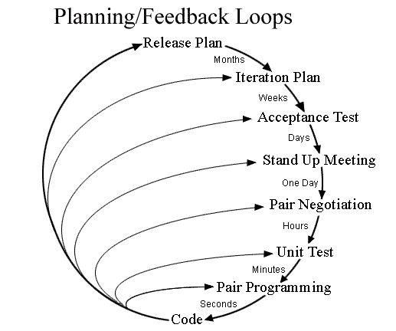
Agile Method: Extreme Programming
Characterized by feedback loops
On-site customer
Planning game (with customer)
Avoid features until needed
Pair programming
  Two programmers, one computer
  One person writes, the other dictates
  Typically writer is less skilled
This Photo by Alex86450 is licensed under CC BY-SA

Slide 6
Agile Method: SCRUM
Scrum is a simple set of roles, responsibilities, and meetings that never change
Time is divided into short work cadences, known as sprints, typically two to four weeks long
The product is kept in a potentially shippable (properly integrated and tested) state at all times
At the end of each sprint, stakeholders and team members meet to see a demonstrated potentially shippable product increment and plan its next steps
http://scrummethodology.com/

Slide 7
Scrum Roles
Product Owner
  The Product Owner should be a person with vision, authority, and availability
  The Product Owner is responsible for continuously communicating the vision and priorities to the development team
Scrum Master
  The Scrum Master acts as a facilitator for the Product Owner and the team
  The Scrum Master does not manage the team
  The Scrum Master works to remove any impediments that are obstructing the team from achieving its sprint goals
Team
  A Scrum development team contains about 3-9 fully dedicated members, ideally in one team room protected from outside distractions
  For software projects, a typical team includes a mix of software engineers, architects, programmers, analysts, QA experts, testers, and UI designers
http://scrummethodology.com/

Slide 8
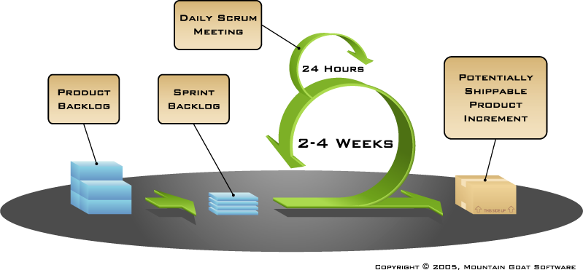
Scrum Phases/Steps
Product Backlog Creation
Sprints
  Sprint Planning and Sprint Backlog Creation
    Team commits to work to be accomplished in the Sprint
  Work on Sprint/Daily Scrum Meetings
    Development
    Testing
    Documentation
  Product Demonstration
  Retrospective

Slide 9
Agile Method: Kanban
Kanban is a method for managing the creation of products with an emphasis on continual delivery while not overburdening the development team
Kanban is based on 3 basic principles:
  Visualize what you do today (workflow): seeing all the items in context of each other can be very informative
  Limit the amount of work in progress (WIP): this helps balance the flow-based approach so teams don’t start and commit to too much work at once
  Enhance flow: when something is finished, the next highest priority thing from the backlog is pulled into play
https://www.versionone.com/what-is-kanban/

Slide 10
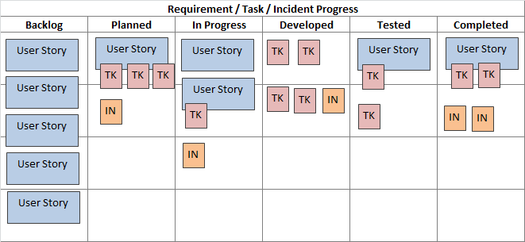
The Kanban Board
The Kanban process begins with a prioritized list of features, called a backlog
Agile team members work on the highest priority feature, based on their team role
Getting features to completion in priority order is the focus
There is no set timeframe to complete features
https://www.inflectra.com/methodologies/kanban.aspx

Slide 11
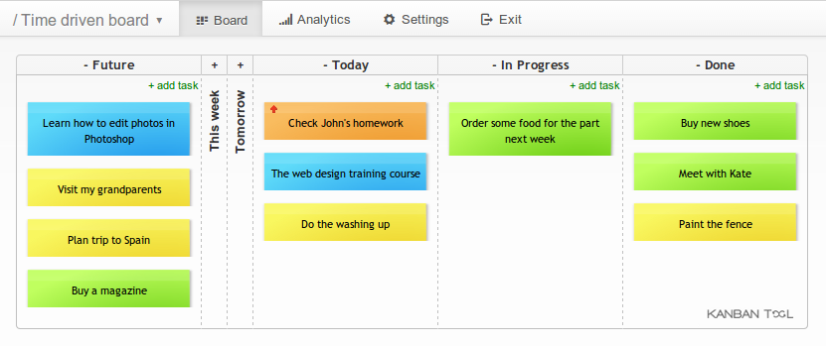
Online Kanban tool:
https://kanbantool.com/online-kanban-board

Slide 12
Ordering, Min, Max, and MinMax

Slide 13
Component Efficiency
What’s the criteria for a ‘good’ programming language?
  You can implement general-purpose components (algorithms, data structures) that are universally usable
  Without losing efficiency
Efficiency
  Relative efficiency
    A component is relatively efficient if when instantiated it’s as efficient as a non-generic written in the same language
  Absolute efficiency
    A component is absolutely efficient if when instantiated it is as efficient as anything which could be done on a given machine. Basically you know it’s as fast as assembly language.

Slide 14
Abstraction Penalty
The abstraction penalty is the ratio of runtime between a templated operation (say, find on a vector<int>) and the trivial nontemplated equivalent (say a loop over an array of int)
Modern compilers have an abstraction penalty of 1-2%
I still program in C++ because as far as I could ascertain it’s the only language which allows me
  Generality and absolute efficiency
  I can program as general as I like
  I can talk about things like monoids and semi-groups
  When it compiles I could look at assembly code and see it is good. It is absolutely efficient

Slide 15
Abstraction Penalty
Components that are sufficient to see if a language is efficient:
  swap: takes two things and swaps them
  min: takes two things and figures out which one is smaller
  linear search: goes through a bunch of stuff and finds the one you want
Are those too simple?
  How can you solve complicated things efficiently if you can’t solve those simple things?
  Even simple things can be exciting

Slide 16
Swap

Slide 17
Swap
Swap is a facility that – well swaps two values:
    int a = 42, b = 43;
    std::swap(a, b);
    std::cout << "a: " << a << ", b: " << b << "\n"; // a: 43, b: 42
Why is it important?
  Sorting sequences
  Reversing sequences
  Rotating sequences
  …
Group theory has shown, that any permutation of a sequence can be produced by a sequence of swaps

Slide 18
General swap
      template <std::semiregular T>
      void swap_copy(T& a, T& b)
      {
      T tmp(a);
      a = b;
      b = tmp;
      }
T must be semi-regular because of the copy construction
This will work for any (semi-regular) type, however unfortunately, this generic solution will be slow for some types. Why?

Slide 19
Slow for some Types
For instance, for std::vector<> this would be very slow
What we need is something like:
    template <std::semiregular T>
    void swap(std::vector<T>& a, std::vector<T>& b) {
    // swap headers of a and b
    // fix back pointers, if appropriate (for things like linked lists)
    }

Slide 20
Special case for (unsigned) integers
General swap requires additional memory location, can we do better?
      template <std::unsigned_integral T>
      void swap_xor(T& a, T& b)
      {
// if a is identical to b the result is always 0
      if (&a != &b) {
      a = a ^ b;
      b = a ^ b;
      a = a ^ b;
      }
      }
Why only unsigned integers?

Slide 21
Special case for (unsigned) integers
The ^ symbol is bitwise exclusive or. The expression a ^ b means a is true, or b is true, but not both. It is defined by the following truth table:
a | b | a ^ b
0 | 0 | 0
0 | 1 | 1
1 | 0 | 1
1 | 1 | 0

Slide 22

swap_xor: Proof
We need to use the fact that XOR is associative and commutative.
    1. $a = (a ^ b) b = b$ a = a ^ b;
    2. $a = (a ^ b) b = (a ^ b) ^ b$ b = a ^ b;
    $= a ^ (b ^ b)$
    $= a ^ 0$
    $= a$
    3. $a = (a ^ b) ^ a b = a$ a = a ^ b;
    $= b ^ (a ^ a)$
    $= b ^ 0$
    $a = b$

Slide 23
Really general swap
      template <std::semiregular T>
      void swap(T& a, T& b)
      {
      T tmp(std::move(a));
      a = std::move(b);
      b = std::move(tmp);
      }
C++11 introduced move semantics that are meant to do exactly what we need

Slide 24
Min & Max

Slide 25
Min & Max
min and max are two facilities that return the smaller (larger) of two values
C++ standard has both: std::min and std::max
Based on total ordering or strict weak ordering criteria

Slide 26
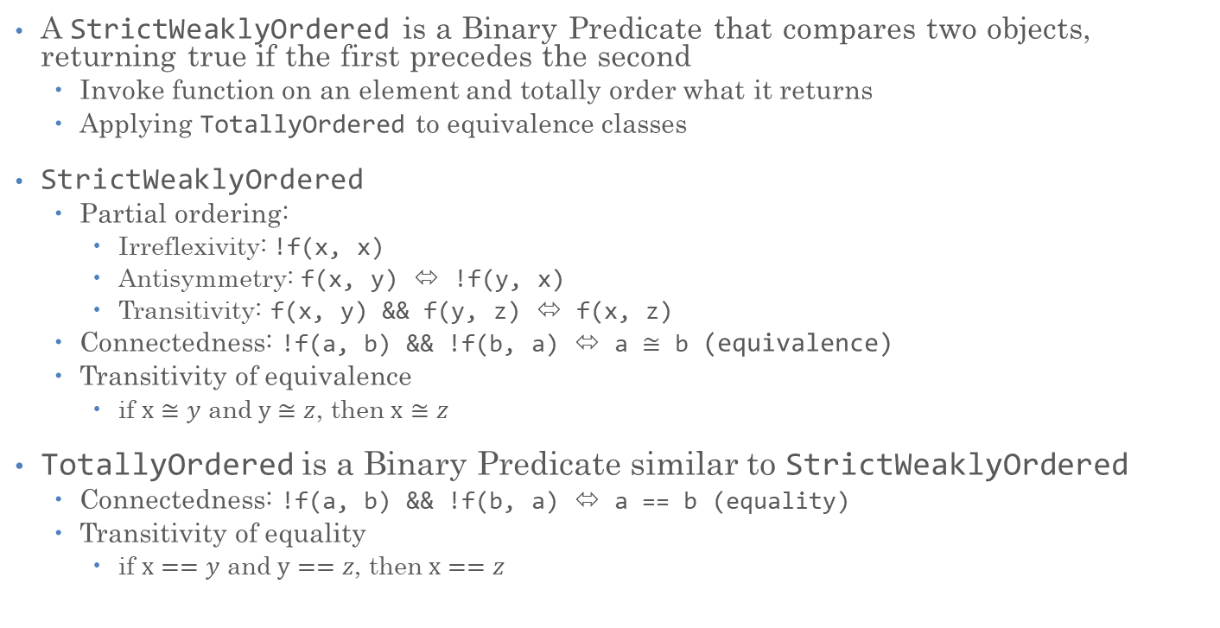
StrictWeak and Total Ordering
A StrictWeaklyOrdered is a Binary Predicate that compares two objects, returning true if the first precedes the second
  Invoke function on an element and totally order what it returns
  Applying TotallyOrdered to equivalence classes
StrictWeaklyOrdered
  Partial ordering:
    Irreflexivity: !f(x, x)
    Antisymmetry: f(x, y) ⬄ !f(y, x)
    Transitivity: f(x, y) && f(y, z) ⬄ f(x, z)
  Connectedness: !f(a, b) && !f(b, a) ⬄ a $≅$ b (equivalence)
  Transitivity of equivalence
    if $x≅y$ and $y≅z$, then $x≅z$
TotallyOrdered is a Binary Predicate similar to StrictWeaklyOrdered
  Connectedness: !f(a, b) && !f(b, a) ⬄ a == b (equality)
  Transitivity of equality
    if $x==y$ and $y==z$, then $x==z$

Slide 27
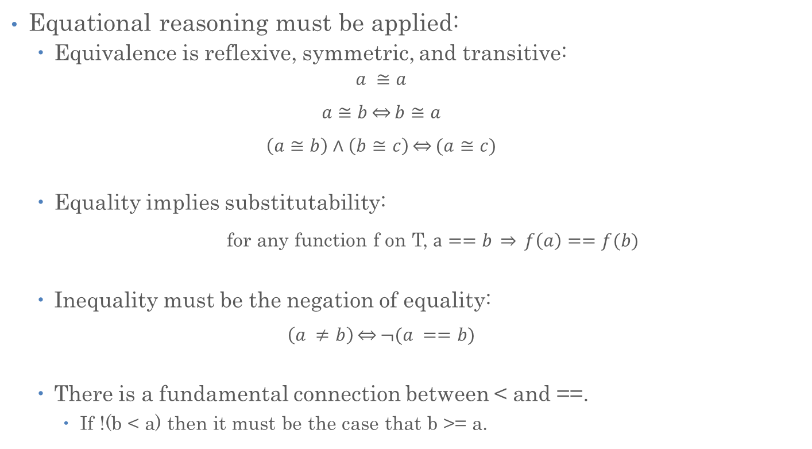
Equivalence vs. Equality
Equational reasoning must be applied:
  Equivalence is reflexive, symmetric, and transitive:
    $$a ≅a$$
    $$a≅b\underset{⇔}{}b≅a$$
    $$\left(a≅b\right)∧\left(b≅c\right)\underset{⇔}{}(a≅c)$$
  Equality implies substitutability:
    for any function f on T, $a==b \underset{⇒}{} f\left(a\right)==f(b)$
  Inequality must be the negation of equality:
    $$\left(a ≠b\right)\underset{⇔}{}¬(a ==b)$$
  There is a fundamental connection between < and ==.
    If !(b < a) then it must be the case that b >= a.

Slide 28
Min
We write an incorrect version and then fix it. We will start with TotallyOrdered because we are more familiar with it
    template <std::totally_ordered T>
    T const& min_flawed(T const& a, T const& b)
    {
    if (a < b) {
    return a;
    }
    else {
    return b;
    }
    }
We need to pass things by const reference
  Allow to invoke using constant objects while avoiding to copy things

Slide 29
Min, corrected version
What should min return if the arguments are equal?
  Does it matter?
When we sort a range which is already sorted, we should not do any operations. Nothing should be swapped
When we sort two things, the first guy should be the min afterwards and the second guy should be the max
Default ordering should be ascending (one, two, three, …)
We can conclude that min should return the first argument if both are equal

Slide 30
Sort2
We previously said that min, max, and sort should work together naturally.
  To see how they should all work, let’s write sort2, which sorts two things
    template <typename T, typename Compare>
    requires(std::strict_weak_order<Compare, T, T>)
    void sort2(T& a, T& b, Compare cmp)
    {
    if (cmp(b, a))
    {
    swap(a, b);
    }
    }
Sorting in-place is preferable
Order of comparison same as for min
  After calling sort2, a should be the minimum and b should be the maximum
  If a and b are equivalent, we don’t want to swap them

Slide 31
Min, corrected version
Let’s avoid swapping values unnecessarily
    template <std::totally_ordered T>
    T const& min(T const& a, T const& b)
    {
    if (b < a) {
    return b;
    }
    else {
    return a;
    }
    }

Slide 32
Min, corrected, final version
Let’s avoid swapping values unnecessarily
    template <typename T, typename Compare>
    requires(std::strict_weak_order<Compare, T, T>)
    T const& min(T const& a, T const& b, Compare cmp)
    {
    if (cmp(b, a)) {
    return b;
    }
    return a;
    }
Why do we pass cmp as a generic type argument instead of a function pointer?
  Functionality: allows for function objects
  Performance: compiler can optimize function call overhead

Slide 33
Min, back to TotallyOrdered
TotallyOrdered version, using std::less function object:
    template <std::totally_ordered T>
    T const& min(T const& a, T const& b)
    {
      return min(a, b, std::less<T>()); // std::less<T>() is an object
    }
Possible implementation of std::less:
    template <std::totally_ordered T>
    struct less
    {
    bool operator()(T const& a, T const& b) const
    {
    return a < b;
    }
    };

Slide 34
Max
Implementing max correctly is hard
  It seems to be just calling min using operator>()
    template <std::totally_ordered T>
    T const& max(T const& a, T const& b)
    {
      return min(a, b, std::greater<T>());
    }
  One couldn’t be more wrong about this! Why?

Slide 35
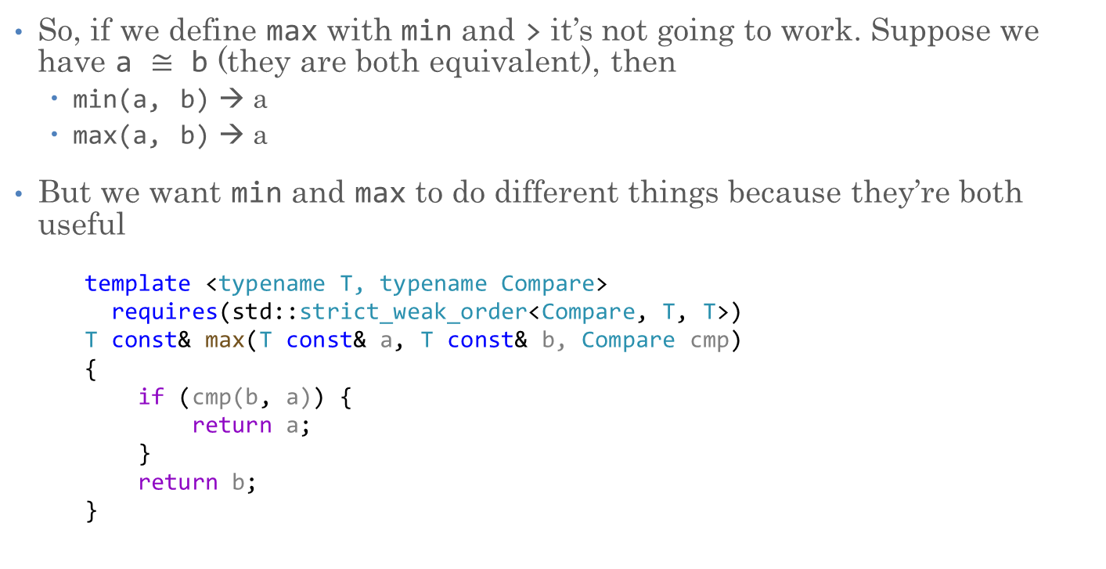
Max
So, if we define max with min and > it’s not going to work. Suppose we have a $≅$ b (they are both equivalent), then
  min(a, b) → a
  max(a, b) → a
But we want min and max to do different things because they’re both useful
    template <typename T, typename Compare>
    requires(std::strict_weak_order<Compare, T, T>)
    T const& max(T const& a, T const& b, Compare cmp)
    {
    if (cmp(b, a)) {
    return a;
    }
    return b;
    }

Slide 36
Max, TotallyOrdered
For the sake of completeness:
  TotallyOrdered version, using std::less function object:
    template <std::totally_ordered T>
    T const& max(T const& a, T const& b)
    {
      return max(a, b, std::less<T>()); // std::less<T>() is an object
    }

Slide 37
Min, Max, and MinMax

Slide 38
Min Element in a Range
Let’s find the min element in a range of values
  (Suppose we want to find an item with smallest price)
std::min_element: simple algorithm, but hidden details

Slide 39
Min Element in a Range
  template <std::forward_iterator I, typename Compare>
  requires(std::strict_weak_order<Compare, std::iter_value_t<I>, std::iter_value_t<I>>)
  I min_element(I first, I last, Compare cmp)
  {
  if (first == last)
  return last;
  I min_el = first;
  ++first;
  while (first != last) {
  if (cmp(*first, *min_el)) {
  min_el = first;
  }
  ++first;
  }
  return min_el;
  }

Slide 40
Min Element in a Range
Note: this returns an iterator referring to the min element. Why?
Because we probably want to update the value
  E.g. you want to find the worst performing employee and fire him
  You don’t need the person itself, you need a handle on him/her
  Often, you want to do things with what you found!
Because the sequence might be empty
  What would you return in that case?
  The algorithm returns the end iterator
Finds first of all minimal elements

Slide 41
Iterator Categories

Slide 42
Algorithms and Iterators
Library defines five iterator categories
  Each corresponds to a specific set of exposed container operations
  Each library algorithm states what iterator category is compatible
    Possible to understand what containers are usable with which algorithms
  Each category corresponds to an access strategy for elements, also limits usable algorithms
    For instance: single pass algorithms, or random access algorithms

Slide 43
Sequential Read-Only Access
std::find:
      template <std::input_iterator Iterator, typename T>
      Iterator find(Iterator first, Iterator last, T const& val)
      {
      for (/**/; first != last; ++first)
      if (*first == val)
      break;
      return first;
      }
Requires iterator operators: != (==), ++, * (for reading)
  Input iterators
Not possible to store a copy of the iterator ‘to go back’
All iterators we’ve seen so far are (at least) input iterators

Slide 44
Sequential Write-Only Access
std::copy
      template <std::input_iterator In, std::output_iterator Out>
      Out copy(In begin, In end, Out dest)
      {
      while (begin != end)
      *dest++ = *begin++;
      return dest;
      }
Required iterator operators: != (==), ++, * (for writing)
  Output Iterators, example: std::back_inserter
Implicit requirements:
  Do not execute ++it more than once between assignments to *it
  Do not assign a value to *it more than once without incrementing it
Not possible to store a copy of the iterator to overwrite output

Slide 45
Sequential Read-Write Access
std::replace
      template <std::forward_iterator Fwd, typename X>
      void replace(Fwd beg, Fwd end, X const& x, X const& y)
      {
      while (beg != end) {
      if (*beg == x)
      *beg = y;
      ++beg;
      }
      }
Required iterator operators: != (==), ++, * (for reading and writing), -> for member access
  Forward iterators
Storing copy of iterator possible! Very handy!

Slide 46
Reversible Access
std::reverse
      template <std::bidirectional_iterator BiDir>
      void reverse(BiDir begin, BiDir end)
      {
      while (begin != end) {
      --end;
      if (begin != end)
      swap(*begin++, *end);
      }
      }
Required iterator operators: !=, ==, ++, --, * (for reading and writing), -> for member access
  Bidirectional iterators
The standard-library container classes all support bidirectional iterators.
  Except std::forward_list (singly linked list)

Slide 47
Random Access
std::binary_search:
      template <std::random_access_iterator Ran, class X>
      bool binary_search(Ran begin, Ran end, X const& x)
      {
      while (begin < end) {
      Ran mid = begin + (end - begin) / 2; // find the midpoint of the range
      // see which part of the range contains x; keep looking only in that part
      if (x < *mid)
      end = mid;
      else if (*mid < x)
      begin = mid + 1;
      else // if we got here, then *mid == x so we're done
      return true;
      }
      return false;
      }

Slide 48
Random Access
Required iterator operators:
  != (==), ++, --, * (for reading and writing), -> for member access
  Let’s assume p, q are iterators, n is integer
    p + n, p - n, and n + p
    p - q
    p[n] (equivalent to *(p + n))
    p < q, p > q, p <= q, and p >= q
We’ve used std::sort
Containers: std::vector, std::string
  std::list is not random access (it’s bidirectional), why?

Slide 49
Iterator Ranges
Algorithms take pair of iterators
  c.begin() – refers to first element
  c.end() – refers to first element after last (‘one off’)
Allows simple handling of empty ranges, both iterators point to the one off element
Allows for comparing iterators for equality (!=/==), no need to define notion of iterators being larger/smaller than others
Allows to indicate ‘out of range’, see url_beg(), where we returned end (off by one) iterator if nothing was found
Only caveat for end iterators is that they can’t be dereferenced

Slide 50
Input/Output Iterators
Why are they separate from forward iterators?
  (no container exposes them)
One reason is
  Not all iterators come from containers
    std::back_inserter, usable with any container supporting push_back
    Iterators bound to streams: using iterator operations allowing to access std::istreams and std::ostreams

Slide 51
Input/Output Iterators
The input stream iterator is an input-iterator type named std::istream_iterator:
      // read ints from the standard input and append them to v
      std::vector<int> v;
      std::copy(
      std::istream_iterator<int>(cin), std::istream_iterator<int>(),
      std::back_inserter(v));
Stream iterators are templates!
  Need to specify type to read from input
  Same as for normal input operations, which are always typed as well
  Default constructed std::istream_iterator denotes end of input

Slide 52
Input/Output Iterators
The output stream iterator is an output-iterator type named std::ostream_iterator:
      // write the elements of v each separated from the other
      // by a space
      std::copy(
      v.begin(), v.end(),
      std::ostream_iterator<int>(std::cout, " "));
ostream_iterator is a template as well
  Need to specify type of required output
  Second argument is separator (defaults to no separation)

Slide 53
Min and max Element in a Range
How many comparisons do we need to find the min of five elements?
  Four.
In general why do we need n - 1 comparisons.
  Why no more?
    We don’t need to compare an element with itself.
  Why no fewer? Maybe we could do it in n - 2 with a clever algorithm?
    We need to look at all elements to know which one is the min
How many comparisons do we need to find min and max together?
  Obviously we could do 2n - 2, but what about fewer6?

Slide 54
Min and max Element in a Range
Instead of comparing each element of the sequence against running min and max
  Compare two (adjacent) elements amongst themselves
  Compare the smaller one against the running min
  Compare the larger one against the running max
How many operations?
  Three comparisons for every two elements: 3n/2

Slide 55
Min and max Element in a Range
  template <std::forward_iterator I, typename Compare>
  requires(std::strict_weak_order<Compare, std::iter_value_t<I>,
  std::iter_value_t<I>>)
  std::pair<I, I> minmax_element(I first, I last, Compare cmp)
  {
  // handle empty sequence
  // handle sequence with one element
  // initialize running min and max
  // loop over elements updating min and max
  while (first != last && next != last) {
  //...
  }
  // handle possible leftover element
  }

Slide 56
Min and max Element in a Range
Handle empty sequence
    template <std::forward_iterator I, typename Compare> requires(...)
    std::pair<I, I> minmax_element(I first, I last, Compare cmp)
    {
    // handle empty sequence
    if (first == last) {
    return std::make_pair(last, last);
    }
    // handle sequence with one element
    // initialize running min and max
    // loop over elements updating min and max
    while (first != last && next != last) {
    // ...
    }
    // handle possible leftover element
    }

Slide 57
Min and max Element in a Range
Handle sequence with one element
    template <std::forward_iterator I, typename Compare> requires(...)
    std::pair<I, I> minmax_element(I first, I last, Compare cmp)
    {
    // handle empty sequence
    // handle sequence with one element
    I min_el = first; // refers to current min
    ++first;
    if (first == last)
    return std::make_pair(min_el, min_el);
    // initialize running min and max
    // loop over elements updating min and max
    while (first != last && next != last) {
    // ...
    }
    // handle possible leftover element
    }

Slide 58
Min and max Element in a Range
Initialize running min and max
    template <std::forward_iterator I, typename Compare> requires(...)
    std::pair<I, I> minmax_element(I first, I last, Compare cmp)
    {
    I min_el = first; ++first; // refers to current min
    // initialize running min and max
    I max_el = first; // refers to current max
    I next = first; ++next; // first and next refer to pair to examine
    if (cmp(*max_el, *min_el))
    std::swap(min_el, max_el);
    // loop over elements updating min and max
    while (first != last && next != last) {
    // ...
    }
    // handle possible leftover element
    }

Slide 59
Min and max Element in a Range
Loop over elements, updating min and max
    template <std::forward_iterator I, typename Compare> requires(...)
    std::pair<I, I> minmax_element(I first, I last, Compare cmp)
    {
    I min_el = first; ++first; // refers to current min
    I max_el = first; // refers to current max
    I next = first; ++next; // first and next are pair to examine
    // loop over elements updating min and max
    while (first != last && next != last) {
    I potential_min = first, potential_max = next;
    if (cmp(*potential_max, *potential_min)) // potential_min refers to smaller of the two
    std::swap(potential_max, potential_min);
    if (cmp(*potential_min, *min_el)) // update current min
    min_el = potential_min;
    if (!cmp(*potential_max, *max_el)) // update current max
    max_el = potential_max;
    first = next; ++first; ++next; // go to next pair of elements
    }
    // handle possible leftover element
    }

Slide 60
Min and max Element in a Range
Handle possible leftover element
    template <std::forward_iterator I, typename Compare> requires(...)
    std::pair<I, I> minmax_element(I first, I last, Compare cmp)
    {
    I min_el = first; // refers to current min
    I max_el = first; // refers to current max
    I next = first; ++next; // first and next are pair to examine
    while (first != last && next != last) { ... }
    // handle possible leftover element
    if (first != last) { // odd elements, one left over
    if (cmp(*first, *min_el))
    min_el = first;
    else if (!cmp(*first, *max_el))
    max_el = first;
    }
    return std::make_pair(min_el, max_el);
    }

Slide 61
Min and max Element in a Range
This algorithm was invented by Ira Pohl of UC Santa Cruz, in the mid-seventies
  He also proved it was optimal
  std::minmax_element is part of the C++ standard since C++11

Slide 62
Min and max Element in a Range
Comparisons
per iteration
ns/iteration

Slide 63








