Slide 1
Graphics Classes
Lecture 17
Hartmut Kaiser
https://teaching.hkaiser.org/spring2024/csc3380/

Slide 2
Software Development Notes

Slide 3
What is Refactoring?
Changing the structure of code without changing behavior
Here’s the classic example:
Refactor
if (x)
{
return true;
}
else
{
return false;
}
To
return x;

Slide 4
Why?
Refactoring is designed to “clean up” code
It can become
Easier to read
Easier to debug
Easier to test
More efficient
Refactoring undoes “technical debt”

Slide 5
Technical Debt
Sometimes you take the “easy approach”
You duplicate code
You have a complicated base class
You hardcode values
You use inflexible data structures
You use singletons
You pay for these decisions later

Slide 6
Kinds of Refactoring
Large refactorings are broken down into micro-refactorings
Each is guaranteed to preserve semantics
If you refactor carefully, you won’t break your program
Run regression tests before refactoring
Make one small refactoring change
Run regression tests after refactoring

Slide 7
Kinds
Move Member Function or Data
Rename Member Function or Data
Pull-up/push-down
Extract class/method
Encapsulate field
Replacing code with patterns
Functional Refactoring

Slide 8
Move Member Function or Data
Why?
Each member/method belongs somewhere
Once-and-only-once means that we need to find the best place
Where?
Wherever it yields the least coupling (the least amount of other code uses it/depends on it)

Slide 9
Example
class Car
{
static int NUMBER_OF_WHEELS = 4;
};
class CarFactory
{
static int NUMBER_OF_WHEELS = 4;
};
Where does NUMBER_OF_WHEELS belong?

Slide 10
It Depends …
If Car often references the constant, it should have it
If other classes mainly use the constant, choose the owner who will result in the smallest number of coupled classes
Basically: if other classes depend on Car and want to use the constant, it should belong to Car, and vice versa

Slide 11
Rename Member Function or Data
Choose the name that most closely and specifically reflects what a method does
Specifically
Don’t be too vague
Don’t be too low level
This one is subjective
The most difficult task programmers solve is to come up with new names

Slide 12
Guidelines
Use the “Rename” function built into your IDE to also catch comments and strings
Remember: wrong comments are worse than no comments
Make names descriptive and accurate:
compute_height( ... ) { height = ... } is better than
get_height( ... ) { height = ... }
Because “get” implies that you’re returning something instead of setting something
Don’t be afraid to use longer names
Intellisense in modern IDEs helps avoiding to type those over and over again

Slide 13
Pull-up/push-down
Move a member function or data item from a sub-class to a base-class
The purpose is to avoid repetition
But…
Consider when you should refactor into a pattern
You may find that you don’t need inheritance after all (good!)

Slide 14
Pull-up/push-down applies to Hierarchies
Push state (data members) as far down (away from the base class) as you can
Why?
State changes will require the least amount propagation
You will end up with the least amount of coupling

Slide 15
Graphics Classes

Slide 16
Abstract
This lecture presents a display model (the output part of a GUI), giving examples of use and fundamental notions such as screen coordinates, lines, and color. Some examples of shapes are Lines, Polygons, Axis, and Text.

Slide 17
Overview
Graphing Classes
Model
Code organization
Interface classes
Point
Line
Lines
Grid
Open Polylines
Closed Polylines
Color
Text
Unnamed objects

Slide 18
Graphing Classes

Slide 19
The Display Model
Objects (such as graphs) are “attached to” (“placed in”) a window.
The “display engine” invokes display commands (such as “draw line from x to y”) for the objects in a window
Objects such as Rectangle add vectors of lines to the window to draw
Open_polyline
draw()
draw()
Display
Engine
attach()
“window”
attach()
Rectangle
draw()

Slide 20
Code Organization
FLTK headers
Point.h:
struct Point { … };
FLTK code
Graph.h:
Window.h:
GUI.h:
// Graphing interface:
struct Point { … };
…
// window interface:
class Window {…};
…
// GUI interface:
struct In_box { … };
…
Graph.cpp:
Window.cpp:
GUI.cpp:
Graph code
Window code
GUI code
#include "Graph.h"
#include "Window.h"
int main() { … }
demo.cpp:

Slide 21
Source files
Header: .h, .hpp
File that contains interface information (declarations)
#include in user and implementer
.cpp (“code file” / “implementation file”)
File that contains code implementing interfaces defined in headers and/or uses such interfaces
#includes headers
Read the Graph.h header
And later the Graph.cpp implementation file
Don’t read the Window.h header or the window.cpp implementation file
Naturally, some of you will take a peek
Beware: heavy use of yet unexplained C++ features

Slide 22
Design note
The ideal of program design is to represent concepts directly in code
We take this ideal very seriously
For example:
Window – a window as we see it on the screen
Will look different on different operating systems (not our business)
Point – a coordinate point
Line – a line as you see it in a window on the screen
Shape – what’s common to shapes
(imperfectly explained for now; all details in next lecture)
Color – as you see it on the screen

Slide 23
Point
namespace Graph_lib // our graphics interface is in Graph_lib
{
struct Point // a Point is simply a pair of ints (the coordinates)
{
int x, y;
};
bool operator==(Point rhs, Point lhs)
{
return rhs.x == lhs.x && rhs.y == lhs.y;
}
bool operator!=(Point rhs, Point lhs)
{
return !(rhs == lhs);
}
} // namespace Graph_lib

Slide 24
Line
struct Shape
{
// hold lines represented as sequence of points
// knows how to display lines
};
struct Line : Shape // a Line is a Shape defined by just two Points
{
Line(Point p1, Point p2);
};
Line::Line(Point p1, Point p2) // construct a line from p1 to p2
{
add(p1); // add p1 to this shape (add() is provided by Shape)
add(p2); // add p2 to this shape
}

Slide 25
Line example
// draw two lines:
using namespace Graph_lib;
Simple_window win(Point(100, 100), 600, 400, "Canvas"); // make a window
Line horizontal(Point(100, 100), Point(200, 100)); // make a horizontal line
horizontal.set_color(Color::black);
Line vertical(Point(150, 50), Point(150, 150)); // make a vertical line
vertical.set_color(Color::black);
win.attach(horizontal); // attach the lines to the window
win.attach(vertical);
win.wait_for_button(); // Display!

Slide 26
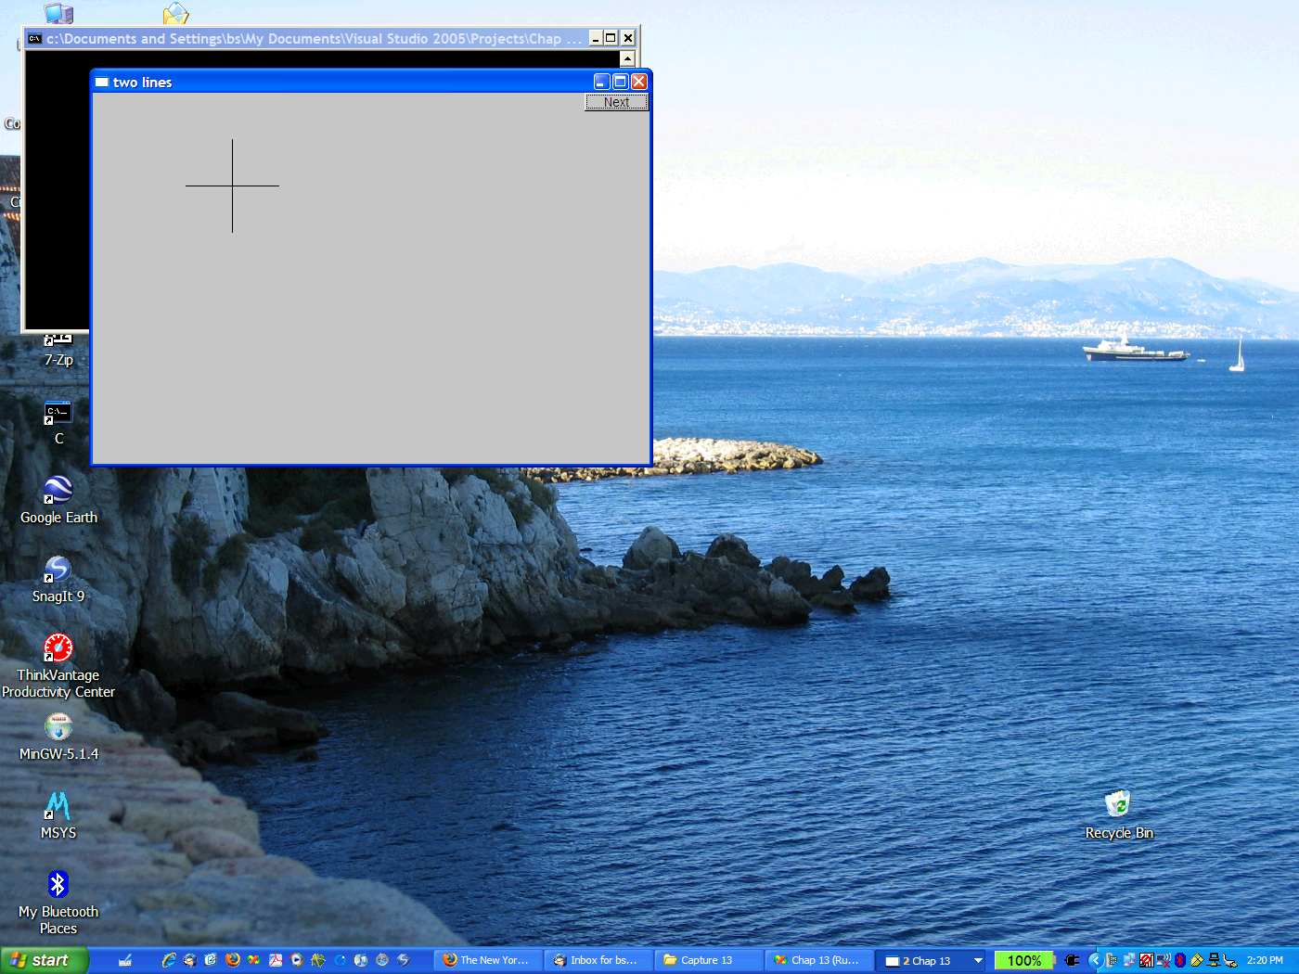
Line Example

Slide 27
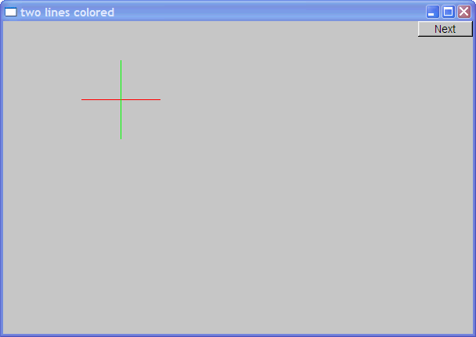
Line Example
Individual lines are independent:
horizontal.set_color(Color::red);
vertical.set_color(Color::green);

Slide 28
Lines
// a Lines object is a set of lines
// We use Lines when we want to manipulate
// all the lines as one shape, e.g. move them all
struct Lines : Shape
{
void add(Point p1, Point p2); // add line from p1 to p2
void draw_lines() const; // to be called by Window to draw Lines
};
Terminology:
Lines is “derived from” Shape
Lines “inherit from” Shape
Lines is “a kind of” Shape
Shape is “the base” of Lines
This is the key to what is called “object-oriented programming”
We’ll get back to this later

Slide 29
Lines Example
Simple_window win(Point(100, 100), 600, 400, "Canvas"); // make a window
Lines x;
x.add(Point(100, 100), Point(200, 100)); // horizontal line
x.add(Point(150, 50), Point(150, 150)); // vertical line
win.attach(x); // attach Lines x to Window win
win.wait_for_button(); // Draw!

Slide 30
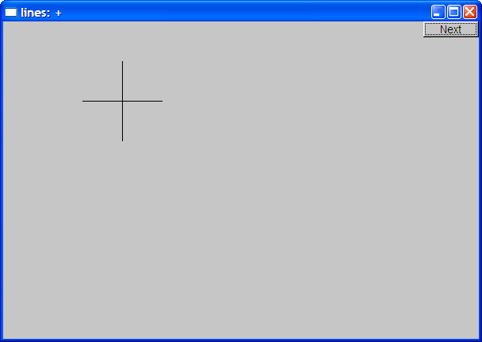
Lines example
Looks exactly like the two Lines example

Slide 31
Implementation: Lines
void Lines::add(Point p1, Point p2) // use Shape's add()
{
Shape::add(p1);
Shape::add(p2);
}
void Lines::draw_lines() const // to somehow be called from Shape
{
for (int i = 1; i < number_of_points(); i += 2)
fl_line(point(i - 1).x, point(i - 1).y, point(i).x, point(i).y);
}
Note
fl_line is a basic line drawing function from FLTK
FLTK is used in the implementation, not in the interface to our classes
We could replace FLTK with another graphics library

Slide 32
Draw Grid (Why bother with Lines when we have Line?)
// A Lines object may hold many related lines
// Here we construct a grid:
int x_size = win.x_max();
int y_size = win.y_max();
int x_grid = 80;
int y_grid = 40;
Lines grid;
for (int x = x_grid; x < x_size; x += x_grid) // vertical lines
grid.add(Point(x, 0), Point(x, y_size));
for (int y = y_grid; y < y_size; y += y_grid) // horizontal lines
grid.add(Point(0, y), Point(x_size, y));
win.attach(grid); // attach our grid to our window (note ‘grid’ is one object)

Slide 33
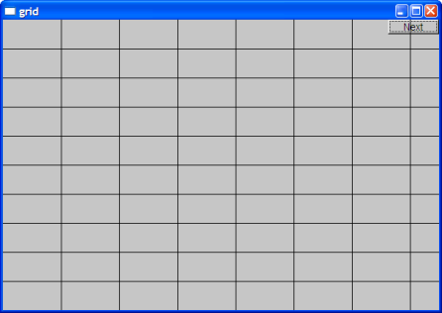
Grid

Slide 34
Color
struct Color {
enum Color_type { // Map FLTK colors and scope them
red = FL_RED, blue = FL_BLUE, /* ... */
};
Color(Color_type cc) : c(Fl_Color(cc)), v(visible) {}
Color(int cc) : c(Fl_Color(cc)), v(visible) {}
Color(Color_type cc, Transparency t) : c(Fl_Color(cc)), v(t) {}
int as_int() const { return c; }
private:
Fl_Color c; // FLTK type representing a color
bool v;
};

Slide 35
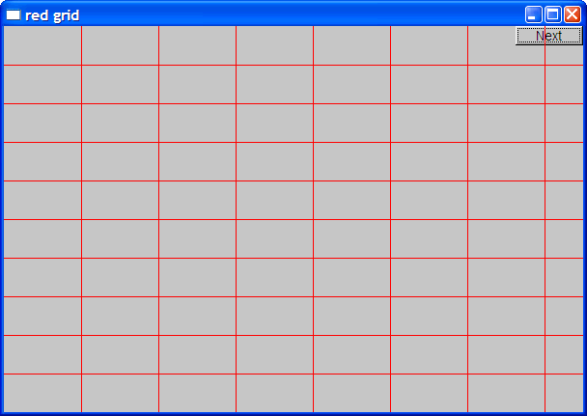
Draw red Rrid
grid.set_color(Color::red);

Slide 36
Line_style
struct Line_style {
enum Line_style_type {
solid = FL_SOLID, // -------
dash = FL_DASH, // - - - -
dot = FL_DOT, // .......
};
Line_style(Line_style_type lst) : s(lst), w(0) {}
Line_style(Line_style_type lst, int ww) : s(lst), w(ww) {}
Line_style(int ss) : s(ss), w(0) {}
int width() const { return w; }
int style() const { return s; }
private:
int s; int w;
};

Slide 37
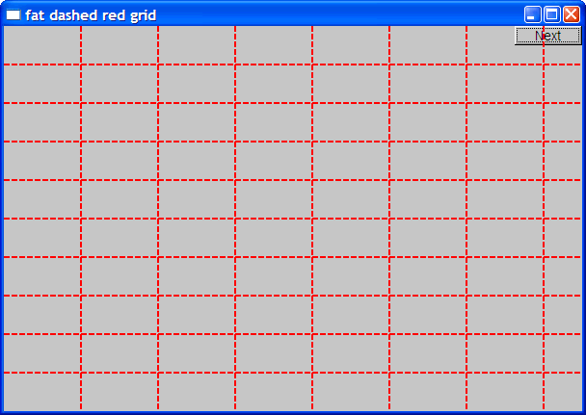
Example: colored fat dash grid
grid.set_style(Line_style(Line_style::dash, 2));

Slide 38
Polylines
// open sequence of lines
struct Open_polyline : Shape {
void add(Point p) { Shape::add(p); }
};
// closed sequence of lines
struct Closed_polyline : Open_polyline {
void draw_lines() const {
Open_polyline::draw_lines(); // draw lines (except the closing one)
// draw the closing line:
fl_line(point(number_of_points() - 1).x,
point(number_of_points() - 1).y, point(0).x, point(0).y);
}
void add(Point p) { Shape::add(p); }
};

Slide 39
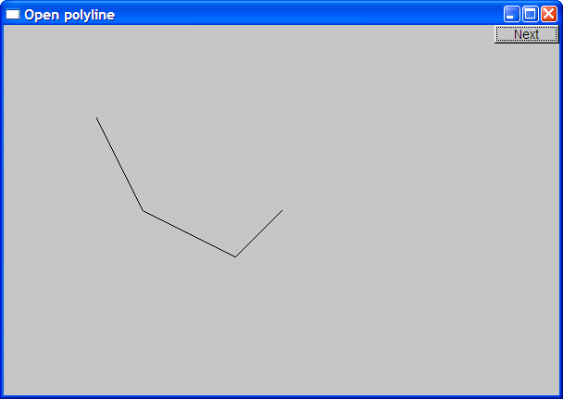
Open_polyline
Open_polyline opl;
opl.add(Point(100, 100));
opl.add(Point(150, 200));
opl.add(Point(250, 250));
opl.add(Point(300, 200));

Slide 40
Closed_polyline
Closed_polyline cpl;
cpl.add(Point(100, 100));
cpl.add(Point(150, 200));
cpl.add(Point(250, 250));
cpl.add(Point(300, 200));

Slide 41
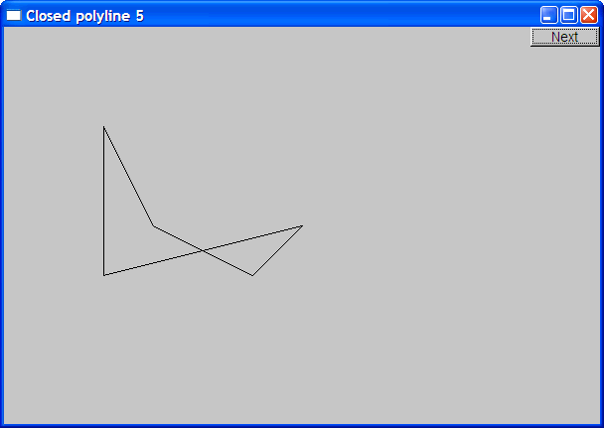
Closed_polyline
cpl.add(Point(100, 250));
A Closed_polyline is not a polygon
some closed_polylines look like polygons
A Polygon is a Closed_polyline where no lines cross
A Polygon has a stronger invariant than a Closed_polyline

Slide 42
Text
struct Text : Shape
{
// x is the bottom left of the first letter
Text(Point x, std::string const& s)
: lab(s)
, fnt(fl_font()) // default character font
, fnt_sz(fl_size()) // default character size
{
Shape::add(x); // store x in the Shape part of the Text
}
void draw_lines() const;
private:
std::string lab; // label
Font fnt; // character font of label
int fnt_sz; // size of characters
};

Slide 43
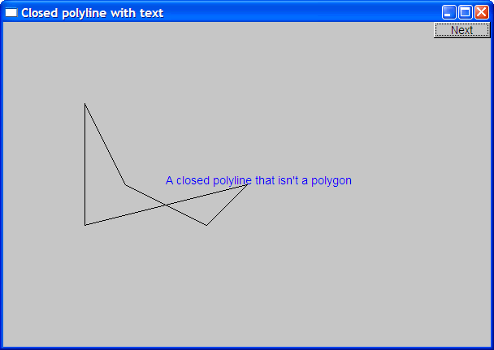
Add Text
Text t(Point(200, 200), "A closed polyline that isn't a polygon");
t.set_color(Color::blue);

Slide 44
Implementation: Text
void Text::draw_lines() const
{
fl_draw(lab.c_str(), point(0).x, point(0).y);
}
// fl_draw() is a basic text drawing function from FLTK

Slide 45
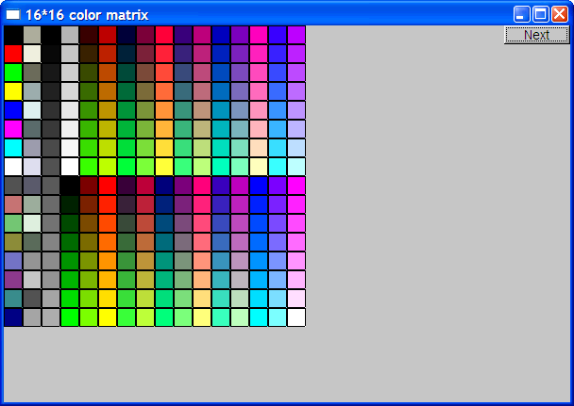
Color Matrix
Let’s draw a color matrix
To see some of the colors we have to work with
To see how messy two-dimensional addressing can be
To see how to avoid inventing names for hundreds of objects

Slide 46
Color Matrix (16*16)
Simple_window win(pt, 600, 400, "16*16 color matrix");
// normal vector
std::vector<Rectangle> v;
for (int i = 0; i < 16; ++i) // i is the horizontal coordinate
{
for (int j = 0; j < 16; ++j) // j is the vertical coordinate
{
v.push_back(Rectangle(Point(i * 20, j * 20), 20, 20);
v.back().set_fill_color(i * 16 + j);
win.attach(v.back());
}
}
// make_unique makes an object that you can give to a unique_ptr to hold
// unique_ptr behaves like a pointer, but manages memory for you

Slide 47
Color Matrix (16*16)
Simple_window win(pt, 600, 400, "16*16 color matrix");
// normal vector, but imagine that it holds references to objects
std::vector<std::unique_ptr<Shape>> v;
for (int i = 0; i < 16; ++i) // i is the horizontal coordinate
{
for (int j = 0; j < 16; ++j) // j is the vertical coordinate
{
v.push_back(std::make_unique<Rectangle>(Point(i * 20, j * 20), 20, 20));
v.back()->set_fill_color(i * 16 + j);
win.attach(*v.back());
}
}
// make_unique makes an object that you can give to a unique_ptr to hold
// unique_ptr behaves like a pointer, but manages memory for you

Slide 48
Color matrix (16*16)
More examples and graphics classes in the book*
*Stroustrup: Programming - Principles and Practice using C++

Slide 49
