Slide 1
Functions & Graphing
Lecture 19
Hartmut Kaiser
https://teaching.hkaiser.org/spring2024/csc3380/

Slide 2
Software Development Notes

Slide 3
Test Driven Development
Add requirements/stories
Write automated tests for each
Write code until it passes
Test pass % acts as progress bar to next release

Slide 4
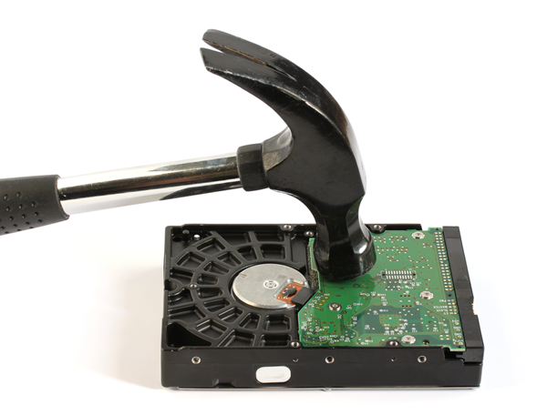
Manual Testing
The most basic form of testing
Run the program yourself
When an error occurs, write it down
Ensure that the error can be reproduced
Create issue on github
How to run? What input used?
What system run on?
Everything needed to reproduce
What result is expected? What result is seen?

Slide 5
Issues with Manual Testing
To be effective, bugs must be tracked
Bug reproduction steps must be carefully retained
Have to re-test after changes
Expensive and error-prone

Slide 6
Automated Testing
Manual testing is still necessary for sanity checks
But we can create automated tests to provide immediate feedback
Tests are automatically run for each change set (commit)
We receive a checklist afterwards seeing how many, and which, tests succeeded and failed

Slide 7
Unit Testing
The most common kind of automated testing is Unit Testing
Unit testing is a form of automated testing where you test a single class, module, or method
A unit is the smallest testable portion of an application:
Each unit test tests one thing
We can test every function of the unit, and every meaningful case of the function
Pay particular attention to testing boundary cases
Zero length strings
Check at minimum/maximum index bounds

Slide 8
Regressions
It is extremely common for a new update to fix old bugs, but introduce new ones
If a test used to pass, but after applying a change set it fails, this is called a regression
Automated testing provides a mechanism to quickly discover regressions
When fixing regressions always add a test verifying it has been fixed

Slide 9
Integration Tests
An integration test crosses unit boundaries
When more than one class is involved
Interactions with external systems
Simple examples:
Testing that a database works with a software system
Testing that a frontend works with a backend
Testing a system component works with another system component
Testing that the interface for an external data source works with a software system

Slide 10
Mutation Testing
Basic idea: test the tests
Take some code that passes all the tests
Mutate that code (an operation, a constant, etc.)
One of the tests should now fail
If not, you need more tests!

Slide 11
Test Coverage
Automated testing raises an interesting problem:
How do we know we’ve tested everything
How many tests do we actually need?
Tests take time to execute
There is no benefit to redundant tests
We might be missing an important test case

Slide 12
Test Coverage
Function coverage: has every function/method been called at least once?
Statement coverage: has every statement been executed once?
Branch coverage: has every branch been executed?
Condition coverage: has every Boolean expression been evaluated as both true and false.

Slide 13
Function Coverage
Every function called at least once
This is the absolute bare minimum level of coverage
Even still, it is surprisingly difficult

Slide 14
Statement Coverage
The most common “bare-minimum” level of testing observed in real software
Ensure that each statement is executed at least once

Slide 15
Statement Coverage: How to Calculate
(#tested statements) / (#statements)
That’s it
Shoot for 100%
Note: we care about the innermost statements
the ones inside the body of ifs and loops

Slide 16
Branch Coverage
Every branch must be covered
Often similar to statement coverage

Slide 17
Limits on Testing
Testing can find the presence of faults, not absence
Testing is difficult for certain domains (games, graphics, …)
Testing assumes that methods terminate (the halting problem)
If they don’t, testing must freeze or be occasionally wrong
Testing is not a substitute for code review

Slide 18
Zero-Defects Philosophy
Introduced by Philip Crosby at the Pershing Missile Program
The philosophy was introduced to reduce the failure rate of the Pershing Missile
Major failures happen when engineers tolerate mistakes because they know inspectors will detect them later
Getting it right the first time dramatically reduces errors

Slide 19
Zero-defects Software Development
Don’t write code you know to be bad, because your friends will catch the error in testing
Don’t build new code on defective code
Don’t add features if your tests aren’t passing
Create new features only if all existing tests pass successfully
Create new tests with each new feature

Slide 20
Functions & Graphing

Slide 21
Abstract
Here we present ways of graphing functions and data and some of the programming techniques needed to do so, notably scaling.

Slide 22
Note
This course is about programming
The examples – such as graphics – are simply examples of
Useful programming techniques
Useful tools for constructing real programs
Look for the way the examples are constructed
How are “big problems” broken down into little ones and solved separately?
How are classes defined and used
Do they have sensible data members?
Do they have useful member functions?
Use of variables
Are there too few?
Too many?
How would you have named them better?

Slide 23
Graphing functions
Start with something really simple
Always remember “Hello, World!”
We graph functions of one argument yielding a value
Plot (x, f(x)) for values of x in some range [r1,r2)
Let’s graph three simple functions
// y == 1
double one(double) { return 1; }
// y == x/2
double slope(double x) { return x / 2; }
// y == x*x
double square(double x) { return x * x; }

Slide 24
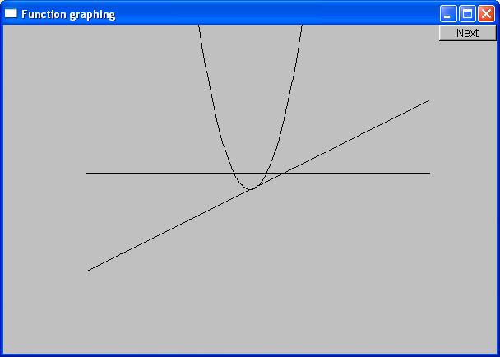
Functions
// y == 1
double one(double) { return 1; }
// y == x/2
double slope(double x) { return x / 2; }
// y == x*x
double square(double x) { return x * x; }

Slide 25
How do we write code to do this?
Function to be graphed
// make a window
Simple_window win(Point(100, 100), xmax, ymax, "Function graphing");
Function s(one, -10, 11, orig, n_points, x_scale, y_scale);
Function s2(slope, -10, 11, orig, n_points, x_scale, y_scale);
Function s3(square, -10, 11, orig, n_points, x_scale, y_scale);
win.attach(s); // attach Lines x to Window win
win.attach(s2); // attach Lines x to Window win
win.attach(s3); // attach Lines x to Window win
win.wait_for_button(); // Draw!
“stuff” to make the graph fit into the window
Range in which to graph

Slide 26
We need some Constants
const int xmax = 600; // window size
const int ymax = 400;
const int x_orig = xmax / 2;
const int y_orig = ymax / 2;
const Point orig(x_orig, y_orig); // position of (0, 0) in window
const int r_min = -10; // range [-10:11) == [-10:10] of x
const int r_max = 11;
const int n_points = 400; // number of points used in range
const int x_scale = 20; // scaling factors (one unit == 20 pixels)
const int y_scale = 20;
// Choosing a center (0, 0), scales, and number of points can be fiddly
// The range usually comes from the definition of what you are doing

Slide 27
Functions – but what does it mean?
What’s wrong with this?
No axes (no scale)
No labels

Slide 28
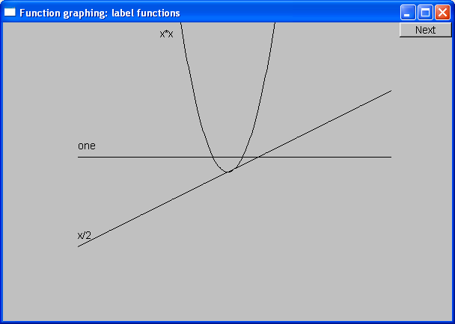
Label the Functions
Text ts(Point(100, y_orig - 30), "one");
Text ts2(Point(100, y_orig + y_orig / 2 - 10), "x/2");
Text ts3(Point(x_orig - 90, 20), "x*x");

Slide 29
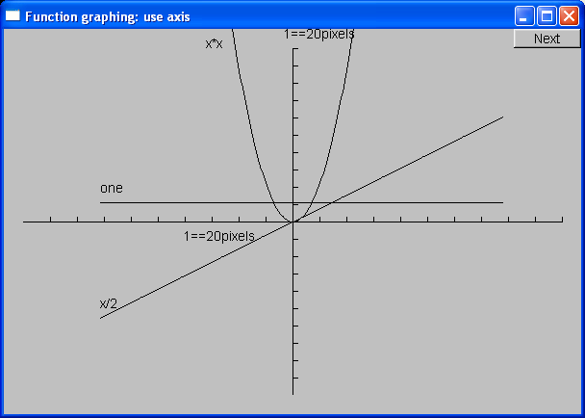
Add x-axis and y-axis
We can use axes to show (0,0) and the scale:
Axis x(Axis::x, Point(20, y_orig),
xlength, xlength / x_scale, "1 == 20 pixels");
Axis y(Axis::y, Point(x_orig, ymax - 20),
ylength, ylength / y_scale, "1 == 20 pixels");

Slide 30
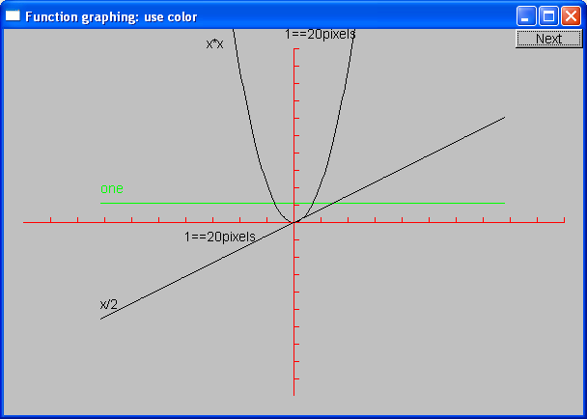
Use color (in moderation)
s.set_color(Graph_lib::Color::green);
ts.set_color(Graph_lib::Color::green);
x.set_color(Graph_lib::Color::red);
y.set_color(Graph_lib::Color::red);

Slide 31
The Implementation of Function
We need a type for the argument specifying the function to graph
using can be used to declare a new name for a type
using color = int; // now color means int
Define the type of our desired argument, Fct
using Fct = std::function<double(double)>; // now Fct means function
// taking a double argument
// and returning a double
Examples of functions of type double(double):
double one(double x) { return 1; } // y==1
double slope(double x) { return x / 2; } // y==x/2
double square(double x) { return x * x; } // y==x*x

Slide 32
Now Define “Function”
struct Function : Shape // Function is derived from Shape
{
// all it needs is a constructor:
Function(Fct f, // f is a Fct (takes a double, returns a double)
double r1, // the range of x values (arguments to f) [r1:r2)
double r2,
Point orig, // the screen location of (0, 0)
int count, // number of points used to draw the function
// (number of line segments used is count-1)
double xscale, // the location (x, f(x)) is (xscale*x, yscale*f(x))
double yscale);
};

Slide 33
Implementation of Function
Function::Function(Fct f, double r1, double r2,
Point xy, int count, double xscale, double yscale)
{
if (r2 - r1 <= 0)
throw std::runtime_error("bad graphing range");
if (count <= 0)
throw std::runtime_error("non-positive graphing count");
double dist = (r2 - r1) / count;
double r = r1;
for (int i = 0; i < count; ++i)
{
add(Point(xy.x + int(r * xscale), xy.y - int(f(r) * yscale)));
r += dist;
}
}

Slide 34
Default Arguments
Seven arguments are too many!
Many too many
We’re just asking for confusion and errors
Provide defaults for some (trailing) arguments
Default arguments are often useful for constructors
struct Function : Shape
{
Function(Fct f, double r1, double r2, Point xy, int count = 100,
double xscale = 25, double yscale = 25);
};
Function f1(sqrt, -10, 11, Point(0, 0), 100, 25, 25); // ok (obviously)
Function f2(sqrt, -10, 11, Point(0, 0), 100, 25); // ok: exactly the same as f1
Function f3(sqrt, -10, 11, Point(0, 0), 100); // ok: exactly the same as f1
Function f4(sqrt, -10, 11, Point(0, 0)); // ok: exactly the same as f1

Slide 35
Function
Is Function a “pretty class”?
No
Why not?
What could you do with all of those position and scaling arguments?
If you can’t do something genuinely clever, do something simple, so that the user can do anything needed
Such as adding parameters so that the caller can have control

Slide 36
Some more Functions
#include <cmath> // standard mathematical functions
// You can combine functions (e.g., by addition):
double sloping_cos(double x)
{
return std::cos(x) + slope(x);
}
Graph_lib::Function s4(std::cos, -10, 11, orig, 400, 20, 20);
s4.set_color(Graph_lib::Color::blue);
Graph_lib::Function s5(sloping_cos, -10, 11, orig, 400, 20, 20);

Slide 37
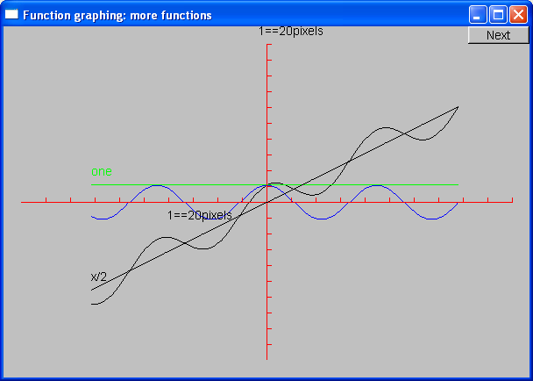
Cos and sloping-cos

Slide 38
Standard mathematical Functions (header <cmath>)
double abs(double); // absolute value
double ceil(double d); // smallest integer >= d
double floor(double d); // largest integer <= d
double sqrt(double d); // d must be non-negative
double cos(double);
double sin(double);
double tan(double);
double acos(double); // result is non-negative; “a” for “arc”
double asin(double); // result nearest to 0 returned
double atan(double);
double sinh(double); // “h” for “hyperbolic”
double cosh(double);
double tanh(double);

Slide 39
Standard mathematical functions (header <cmath>)
double exp(double); // base e
double log(double d); // natural logarithm (base e)
// d must be positive
double log10(double); // base 10 logarithm
double pow(double x, double y); // x to the power of y
double pow(double x, int y); // x to the power of y
double atan2(double x, double y); // atan(x/y)
// floating-point remainder, same sign as d % m
double fmod(double d, double m);
double ldexp(double d, int i); // d*pow(2,i)

Slide 40
Code for Axis
struct Axis : Shape {
enum Orientation { x, y, z };
Axis(Orientation d, Point xy, int length,
int number_of_notches = 0, // default: no notches
string label = ""); // default: no label
void draw_lines() const;
void move(int dx, int dy);
void set_color(Color); // in case we want to change the color
// of all parts at once
// line stored in (base) Shape
// orientation not stored (can be deduced from line)
Text label;
Lines notches;
};

Slide 41
Axis Implementation
Axis::Axis(Orientation d, Point xy, int length, int n, string lab) : label(Point(0, 0), lab)
{
if (length < 0) throw std::runtime_error("bad axis length");
switch (d) {
case Axis::x:
{
Shape::add(xy); // axis line begin
Shape::add(Point(xy.x + length, xy.y)); // axis line end
if (n > 1) {
int dist = length / n;
int x = xy.x + dist;
for (int i = 0; i < n; ++i) {
notches.add(Point(x, xy.y), Point(x, xy.y - 5));
x += dist;
}
}
label.move(length / 3, xy.y + 20); // put label under the line
break;
}

Slide 42
Axis Implementation
void Axis::draw_lines() const
{
Shape::draw_lines(); // the line
notches.draw(); // the notches may have a difference color from the line
label.draw(); // the label may have a different color from the line
}
void Axis::move(int dx, int dy)
{
Shape::move(dx, dy); // the line
notches.move(dx, dy);
label.move(dx, dy);
}
void Axis::set_color(Color c)
{
// ... the obvious three lines
}

Slide 43
Why Graphing?
Because you can see things in a graph that are not obvious from a set of numbers
How would you understand a sine curve if you couldn’t (ever) see one?
Visualization is
Key to understanding in many fields
Used in most research and business areas
Science, medicine, business, telecommunications, control of large systems

Slide 44
An example: $ex$
$e^{x}$ == $1$
+ $x$
+ $\frac{x2}{2!}$
+ $\frac{x3}{3!}$
+ $\frac{x4}{4!}$
+ $\frac{x5}{5!}$
+ $\frac{x6}{6!}$
+ $\frac{x7}{7!}$
+ …
Where ‘!’ Means factorial (e.g. 4! == 4*3*2*1)

Slide 45
Simple algorithm to approximate $ex$
double fac(int n) { // factorial
if (n == 1) return 1;
return fac(n - 1) * n;
}
double term(double x, int n) { // x^n/n!
return std::pow(x, n) / fac(n);
}
double expe(double x, int n) { // sum of n terms of x
double sum = 0;
for (int i = 0; i < n; ++i)
sum += term(x, i);
return sum;
}

Slide 46
Simple algorithm to approximate $ex$
But we can only graph functions of one arguments, so how can we get graph expr(x, n) for various n?
auto expN = [n](double x) { return expe(x, n); };
Equivalent to:
int expN_number_of_terms = 6; // nasty sneaky global argument to expN
double expN(double x)
{
return expe(x, expN_number_of_terms);
}

Slide 47
“Animate” approximations to $ex$
Simple_window win(Point(100, 100), xmax, ymax,
"Function graphing"); // make a window
Axis x(Axis::x, Point(20, y_orig), xlength,
xlength / x_scale, "1 == 20 pixels");
x.set_color(Color::red);
Axis y(Axis::y, Point(x_orig, ymax - 20),
ylength, ylength / y_scale, "1 == 20 pixels");
y.set_color(Color::red);
Function real_exp(std::exp, -15, 15, orig, 400, 20, 20);
real_exp.set_color(Color::blue);

Slide 48
“Animate” Approximations to $ex$
for (int n = 0; n < 40; ++n)
{
auto expN = [n](double x) { return expe(x, n); };
Graph_lib::Function f(expN, -15, 15, orig, 400, 20, 20);
f.set_color(Graph_lib::Color::black);
win.set_label("exp approximation, x == " + std::to_string(n));
win.attach(f);
win.wait_for_button(); // Draw!
win.detach(f);
}

Slide 49
Demo
The following screenshots are of the successive approximations of exp(x) using
auto expN = [n](double x) { return expe(x, n); };

Slide 50
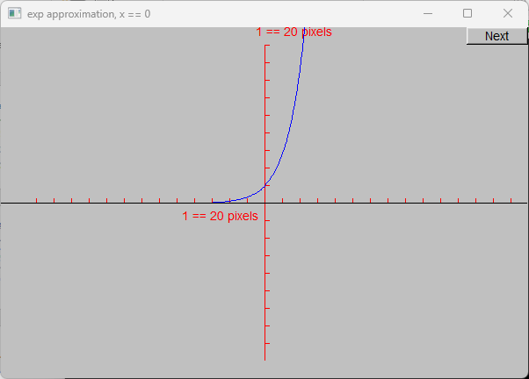
Demo n = 0

Slide 51
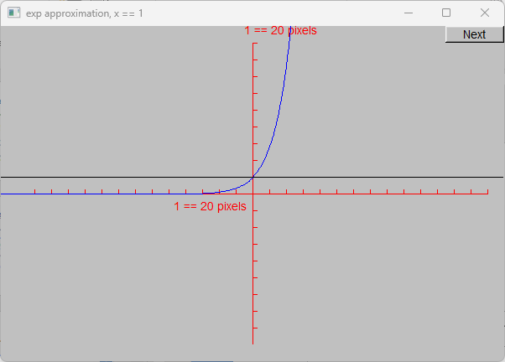
Demo n = 1

Slide 52
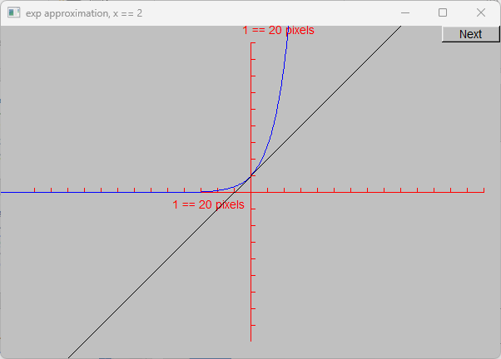
Demo n = 2

Slide 53
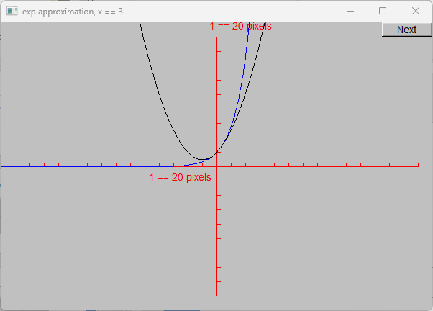
Demo n = 3

Slide 54
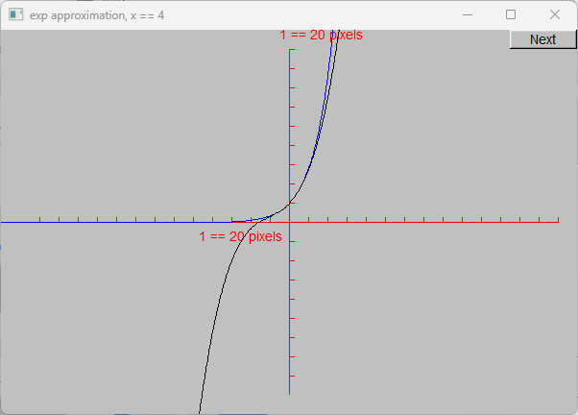
Demo n = 4

Slide 55
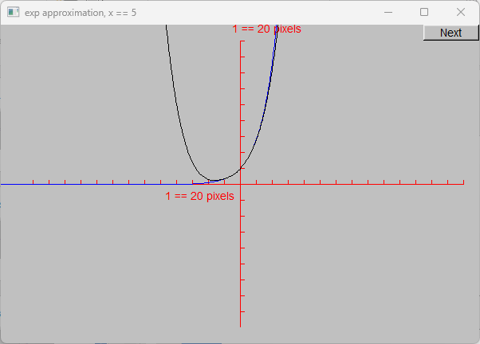
Demo n = 5

Slide 56
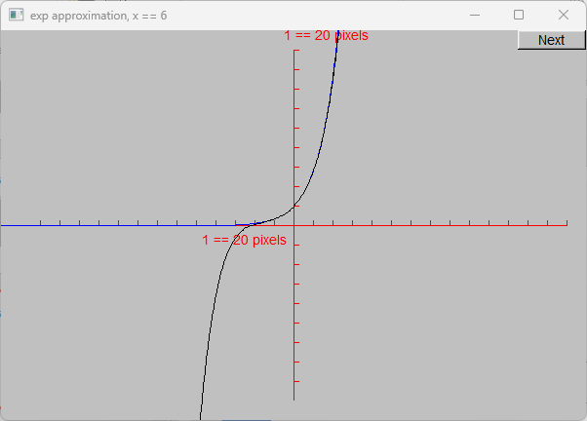
Demo n = 6

Slide 57
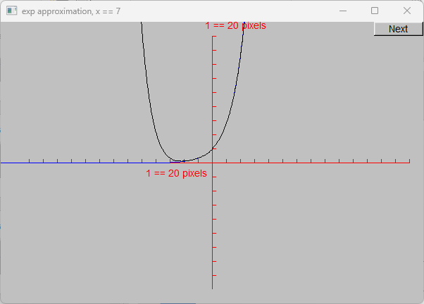
Demo n = 7

Slide 58
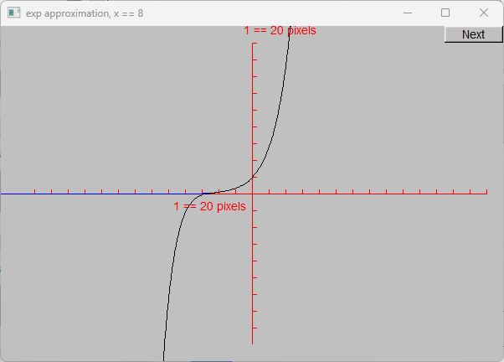
Demo n = 8

Slide 59
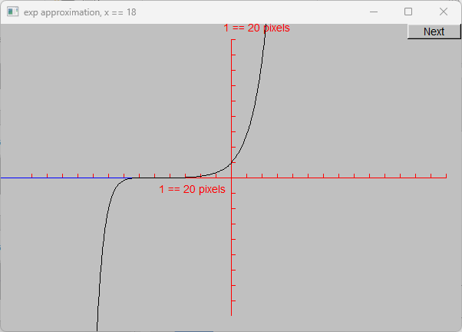
Demo n = 18

Slide 60
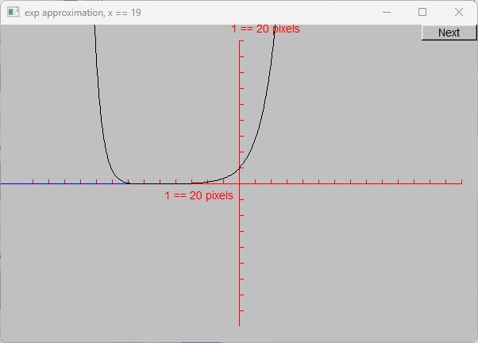
Demo n = 19

Slide 61
Demo n = 20

Slide 62
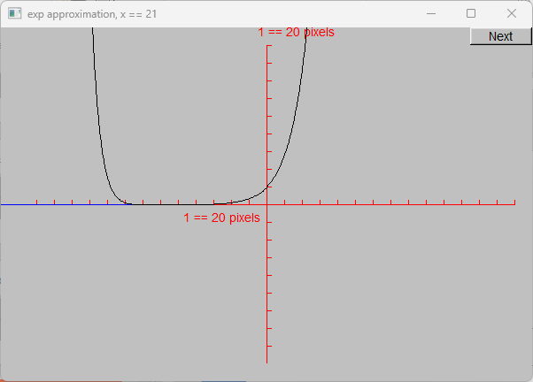
Demo n = 21

Slide 63
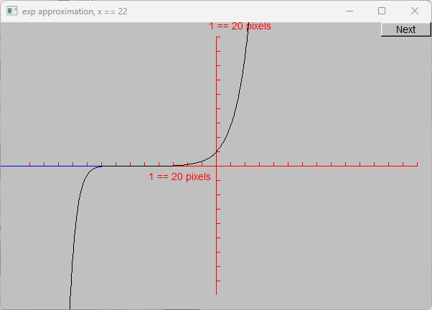
Demo n = 22

Slide 64
Demo n = 23

Slide 65
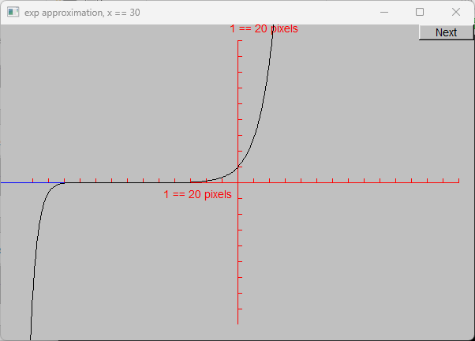
Demo n = 30

Slide 66
Next Lecture
Graphical user interfaces
Windows and Widgets
Buttons and dialog boxes

Slide 67
