Slide 1
The C++ Standard Library (1)
Lecture 3
Hartmut Kaiser
https://teaching.hkaiser.org/spring2024/csc3380/

Slide 2
Abstract
We will look at the C++ Standard Library
  A vast collection of extremely useful containers, algorithms, and supporting data structures
This will be a whirlwind overview over certain aspects and facilities
  Date/time computation
  Filesystem operations
  Revisiting I/O (input/output)
  Containers
    Array containers
      Vector, array
    Associative container
      Unordered map/set, map/set
    Specialized containers
      Lists, deque,
    Container adaptors

Slide 3
Git & Github
Managing Source Code Histories

Slide 4
Git and GitHub
Git and GitHub are common tools used in programming
  Help managing different versions of your code and collaborate with other developers
Git was developed in 2005 by Linus Torvalds
  Open source software for tracking changes in a distributed version control system
Git is made freely available for anyone to modify and use
  Available on all platforms, widely used
Git tracks changes via a distributed version control system
  Git can track the state of different versions of all files in your project
  It is distributed because you can access your code files from another computer – and so can other developers.

Slide 5
Git and Github
GitHub is a web-based platform where Git users build software together
GitHub is also an hosting provider and version control platform you can use to collaborate on open source projects and share files
When you're using GitHub, you're working with Git under the hood
Git is the (command-line) tool that manages the files
  VSCode (and many other IDEs) have a graphical user interface that sits on top of Git
Github is (one of the existing and free) web-platforms you can use to host your Git repositories

Slide 6
Git and Github
Millions of people all over the world use these tools, and the numbers just keep going up
  It is being used for any programming language
More companies are requiring new hires to know how to use Git and GitHub
  So if you're looking for a developer job, these are essential skills to have

Slide 7
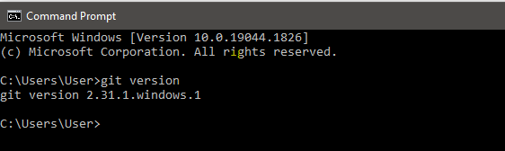
Setting Things Up
Install Git
  Comes preinstalled in some Macs and Linux-based systems
  Simple install for all platforms: https://git-scm.com/download
Create account on Github: https://github.com

Slide 8
Connect Git to Github
Set Git user name and email address (do this once)
  git config --global user.name "Hartmut Kaiser"
  git config --global user.email "hartmut.kaiser@gmail.com"
Use same email address as you used for registering on Github

Slide 9
Github Classroom
Website helping to manage assignments
Based on starter codes in a repository
  Manages clones (copies) of this repository for each student
  All repositories are hosted on Github
Enables automatic grading
Enables individual feedback to each student
Well integrated in VSCode

Slide 10
Software Development Notes

Slide 11

The “natural” development process
Get project requirements
Disappear and start coding immediately
Abruptly stop coding and start testing
Emerge from cave to demo project
Haphazardly fix bugs as they emerge

Slide 12
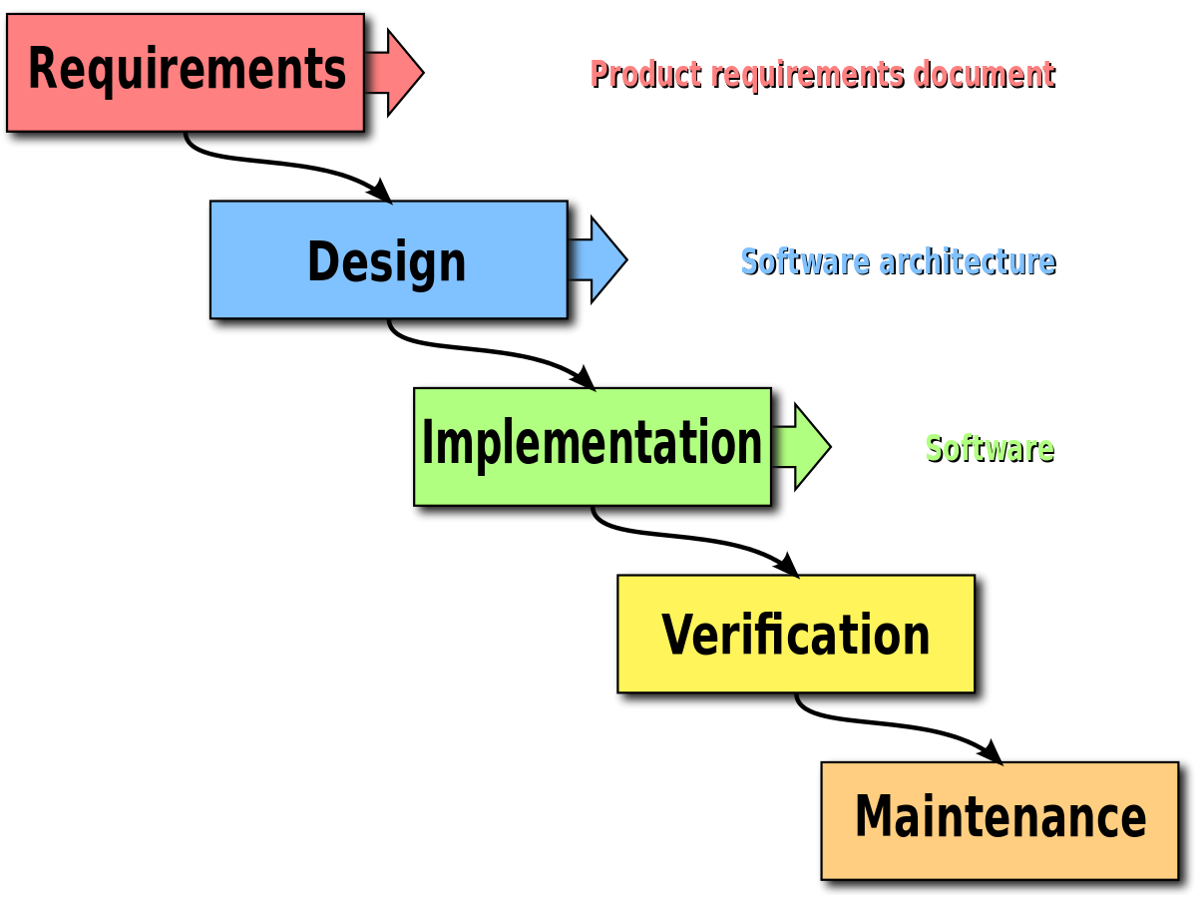
Waterfall:
A flawed Engineering Process
Supposedly:
  Simple to understand and manage
  Engineers can specify things completely
  Fixing problems in earlier phases is cheaper
Waterfall is a generic term for the one-way methods used by entirely too many of companies

Slide 13
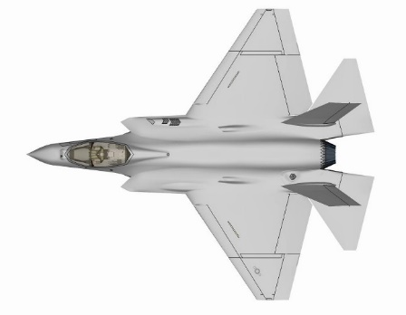


What’s Wrong?
Software engineering is not like other disciplines
Requirements specification is never complete (or unambiguous)
Stakeholders change their minds often
Nearly infinite complexity in software
Causing software that is:
  Heavily delayed
  Significantly over budget
  Does not meet the need

Slide 14
Alternative Lifecycle:
Modified Waterfall Lifecycle

Slide 15
Alternative Lifecycle:
Rapid Prototyping

Slide 16
Phased Development
Incremental
  Initial release has limited functionality
  Each release adds new subsystem
Iterative
  Each release delivers full system
  Subsystem changes with new release

Slide 17
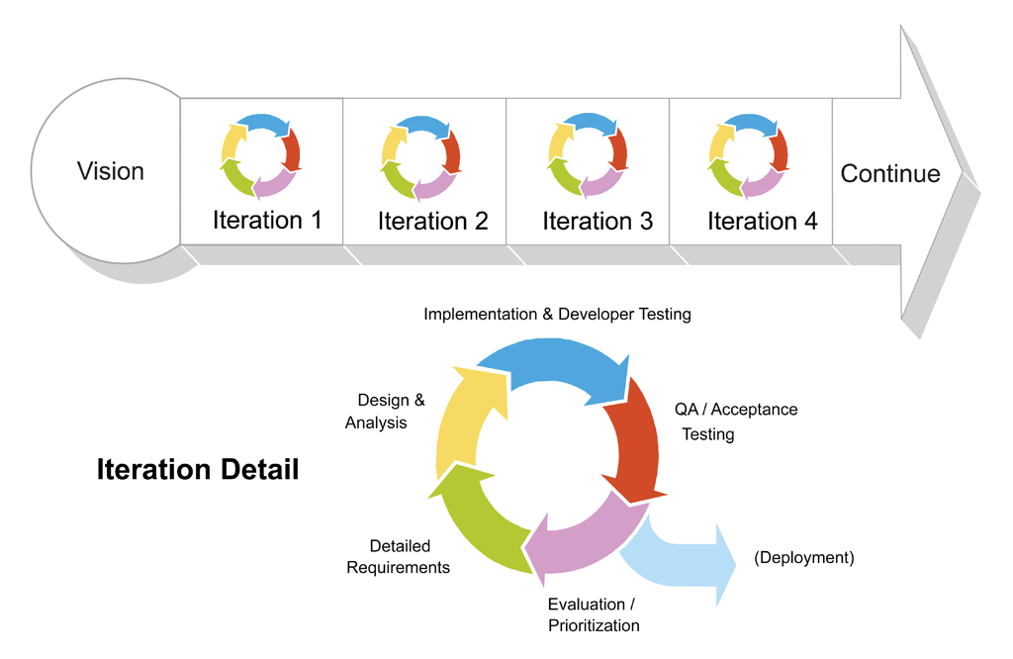
An Iterative Development Lifecycle
Vision is established
Development cycles through iterations
Frequent deployment
User-focus

Slide 18
The Standard C++ Library

Slide 19
Date and Time

Slide 20
Date and Time
C++ offers a full featured time and date manipulation library
  Fairly complex, so we will give a light overview
All date/time types are defined in namespace std::chrono
There are two primary clocks to consider for obtaining time
  The system clock (std::chrono::system_clock)
  The steady clock (std::chrono::steady_clock)
The system clock matches the system time and should be used when working with the actual time (UTC).
  Not guaranteed to be contiguous
  Use steady_clock for benchmarking

Slide 21
Date and Time
// Get current time from system_clock, returns a time point
auto tp1 = std::chrono::system_clock::now();
std::cout << "The current UTC time is: "
<< tp1 << "\n";
// The current UTC time is: 2023-06-22 20:51:41.278848 +0000
// Difference of two time points is a duration
auto tp2 = std::chrono::system_clock::now();
auto duration = tp2 - tp1;
std::cout << "Time elapsed between calls: "
<< duration << "\n";
// Time elapsed between calls: 21587 [1/10000000]s

Slide 22
The system and the steady clock
The system clock’s problem is that it can be externally adjusted (when synchronizing the system’s clock with time servers).
  This poses a problem when we try to make accurate measurements by capturing specific time points.
The steady clock is a monotonic clock that is not externally adjusted
  It is meant for measuring time periods, for example, performance metrics.
  It is unrelated to system time (it can be the time since the last system reboot).

Slide 23
The steady clock
// Bring in literals from std::chrono
using namespace std::literals;
// Same interface as system_clock:
auto tp1 = std::chrono::steady_clock::now();
std::this_thread::sleep_for(1ms); // millisecond literal
auto tp2 = std::chrono::steady_clock::now();
auto duration = tp2 - tp1;
std::cout << "Slept for " << duration << "\n";
std::cout << "Which is " << (duration - 1ms)
<< " more than the requested duration.\n";
// Slept for 8867900ns
// Which is 7867900ns more than the requested duration.

Slide 24
Timepoints and Durations
The supported arithmetic operations follow the expected semantics
Time literals represent durations
Durations can be added together or multiplied with scalars
Adding a duration to a time point produces a new time point with the desired offset
A difference of two time points is a duration
Negative durations are supported as well

Slide 25
Date Manipulations
// Day in a year can be specified using literals and operator/
std::cout << "Christmas 2024 is on a "
<< weekday(2024y / December / 24d) << "\n"; // Christmas 2024 is on a Tue
// Last day for February 2020
std::cout << "Leap day in 2020: "
<< year_month_day(2020y / February / last) << "\n"; // Leap day in 2020: 2020-02-29
// Last Sunday of 2024
year_month_weekday_last last_sunday = 2024y / December / Sunday[last];
std::cout << "Last Sunday in 2024: "
<< year_month_day(last_sunday) << "\n"; // Last Sunday in 2024: 2024-12-29
// US Thanksgiving in 2024
auto thanksgiving = November / Thursday[4];
std::cout << "Thanksgiving in 2024: "
<< year_month_day(thanksgiving / 2024y) << "\n"; // Thanksgiving in 2024: 2024-11-28

Slide 26
Timezones
// Monthly meeting each first Wednesday 15:00, as un-zoned time
auto meeting = local_days(2023y / June / Wednesday[1]) + 15h;
// local_time -> zoned_time: the time is local to this zone
auto prague = locate_zone("Europe/Prague");
auto new_york = locate_zone("America/New_York");
zoned_time<seconds> local(prague, meeting);
zoned_time<seconds> remote(new_york, local); // time zone conversion
std::cout << "Prague time: " << local << "\n"; // Prague time: 2023-06-07 15:00:00 GMT+2
std::cout << "New York time: " << remote << "\n"; // New York time: 2023-06-07 09:00:00 EDT
// Next week's meeting
zoned_time<seconds> next_local(prague, meeting + weeks(1));
zoned_time<seconds> next_remote(new_york, next_local);
std::cout << "Prague next time: " << next_local << "\n"; // Prague time: 2023-06-14 15:00:00 GMT+2
std::cout << "New York next time: " << next_remote << "\n"; // New York time: 2023-06-14 09:00:00 EDT

Slide 27
File System

Slide 28
Filesystem Operations
The std::filesystem library offers file-system exploration, manipulation and querying tools
Files and directories are identified by their paths, which are, by default, relative.
  The std::filesystem::absolute() function turn any relative path into an absolute one based on the current working directory
  The std::filesystem::canonical() function turn any relative path into an absolute one that has no dot, dot-dot elements, or symbolic links
  The std::filesystem::equivalent comparator can be used to check whether two paths refer to the same file-system entity
    Even taking into account symbolic links, etc.

Slide 29
Filesystem Operations
// Construct a path for the current directory
std::filesystem::path local(".");
std::cout << "local == " << local << "\n"; // local == "."
// Get the absolute path, i.e. a path from root
std::filesystem::path from_root = absolute(local);
std::cout << "from_root == " << from_root << "\n"; // from_root == "/some/path/."
// Get the canonical (normalized) full path
std::filesystem::path unique = canonical(local);
std::cout << "unique == " << from_root << "\n"; // unique == "/some/path"
bool eq1 = std::filesystem::equivalent(local, from_root);
bool eq2 = std::filesystem::equivalent(local, unique);
std::cout << std::boolalpha << "eq1 == " << eq1 << ", eq2 == " << eq2 << "\n";
// eq1 == true, eq2 == true

Slide 30
Filesystem Operations
Directory content can be enumerated using
directory_iterator or recursive_directory_iterator
std::filesystem::path local(".");
// iterate over entries in directory specified by path
for (auto const& entry : std::filesystem::directory_iterator(local))
{
print_file_size(entry);
}
// recursively iterate over entries in directory specified by path
for (auto const& entry : std::filesystem::recursive_directory_iterator(local))
{
print_file_size(entry);
}

Slide 31
Filesystem Operations
Print the size of a file
// process each std::filesystem::directory_entry
void print_file_size(std::filesystem::directory_entry const& entry)
{
if (entry.is_regular_file()) // Type of object
{
// Filename can be extracted from the path
auto filename = entry.path().filename();
std::cout << filename << ": " << file_size(entry) << "\n";
// size, permissions, etc...
}
}

Slide 32
Filesystem Operations
// Create a file with the content: "Current content\n"
std::filesystem::path file = "current_file";
{
// canonical path must exists, however, since we are just
// about to create the file, we need to use weakly_canonical
std::ofstream f(weakly_canonical(file));
f << "Current content\n";
}
// Create a directory if it doesn't exist
std::filesystem::path backup_folder = "./backup";
if (!exists(backup_folder))
create_directory(backup_folder);

Slide 33
Filesystem Operations
// Check for sufficient space
if (space(backup_folder).available < file_size(file))
throw std::runtime_error("Not enough space for backup.");
// Create a "unique" filename in the backup folder
std::filesystem::path backup_file = backup_folder / file.filename();
// Copy the file to backup
copy(file, backup_file);
// Update the symlink to point to this backup
std::filesystem::path symlink = file.parent_path() / "current_backup";
if (exists(symlink))
remove(symlink);
create_symlink(backup_file, symlink);

Slide 34
Revisiting I/O

Slide 35
Revisiting I/O
In the previous example, we used a new type of stream, std::ofstream. Similar to std::cin and std::cout, files are also represented by streams.
{
// Open for writing or create if file doesn't exist.
std::ofstream out("data.txt");
out << "Hello World!\n";
} // out closes
{
// Open for reading.
std::ifstream in("data.txt");
std::string line;
std::getline(in, line);
std::cout << "line == " << line << "\n"; // line == "Hello World!"
}

Slide 36
Revisiting I/O
It is also possible to use an output stream that fills a std::string
std::string line;
{
std::stringstream strm;
strm << "Hello world!";
line = strm.str();
}
std::cout << "line == " << line << "\n"; // line == "Hello World!"

Slide 37
I/O for your own Types
struct X
{
int64_t value;
};
std::ostream& operator<<(std::ostream& out, X const& el)
{
return out << el.value;
}
std::istream& operator>>(std::istream& in, X& el)
{
return in >> el.value;
}

Slide 38
I/O for your own Types
{
std::ofstream out("data.txt");
X a{42};
X b{7};
out << a << " " << b;
} // out closes
{
std::ifstream in("data.txt");
X a{0};
X b{0};
in >> a >> b;
std::cout << "a.value == " << a << ", b.value == " << b
<< "\n"; // a.value == 42, b.value == 7
}

Slide 39
Containers, Algorithms & Iterators

Slide 40
Containers, Algorithms & Iterators
The Standard Template Library is an extensible framework dealing with data in a C++ program.
First, I will present the general idea, then the fundamental concepts, and finally examples of containers and algorithms.
The key notions of sequence and iterator used to tie data together with algorithms (for general processing) are also presented.
We can (already) write programs that are very similar independent of the data type used
  Using an int isn’t that different from using a double
  Using a std::vector<int> isn’t that different from using a std:: vector<string>

Slide 41
Common Tasks
Collect data into containers
Organize data
  For printing
  For fast access
Retrieve data items
  By index (e.g., get the Nth element)
  By value (e.g., get the first element with the value "Chocolate")
  By properties (e.g., get the first elements where “age < 64”)
Add data
Remove data
Sorting and searching
Simple numeric operations

Slide 42
Ideals
We’d like to write common programming tasks so that we don’t have to re-do the work each time we find a new way of storing the data or a slightly different way of interpreting the data
  Finding a value in a std::vector isn’t all that different from finding a value in a std::list or an array
  Looking for a std::string ignoring case isn’t all that different from looking at a std::string not ignoring case
  Graphing experimental data with exact values isn’t all that different from graphing data with rounded values
  Copying a file isn’t all that different from copying a vector

Slide 43
Ideals (continued)
Code that’s
  Easy to read
  Easy to modify
  Regular
  Short
  Fast
Uniform access to data
  Independently of how it is stored
  Independently of its type
…

Slide 44
Ideals (continued)
…
Type-safe access to data
Easy traversal of data
Compact storage of data
Fast
  Retrieval of data
  Addition of data
  Deletion of data
Standard versions of the most common algorithms
  Copy, find, search, sort, sum, …

Slide 45
Examples
Sort a vector of strings
Find an number in a phone book, given a name
Find the highest temperature
Find all values larger than 800
Find the first occurrence of the value 17
Sort the telemetry records by unit number
Sort the telemetry records by time stamp
Find the first value larger than “Petersen”?
What is the largest amount seen?
Find the first difference between two sequences
Compute the pair wise product of the elements of two sequences
What’s the highest temperatures for each day in a month?
What’s the top 10 best-sellers?
What’s the entry for “C++” (say, in Google)?
What’s the sum of the elements?

Slide 46
Generic Programming
Generalize algorithms
  Sometimes called “lifting an algorithm”
The aim (for the end user) is
  Increased correctness
    Through better specification
  Greater range of uses
    Possibilities for re-use
  Better performance
    Through wider use of tuned libraries
    Unnecessarily slow code will eventually be thrown away
Go from the concrete to the more abstract
  The other way most often leads to bloat

Slide 47
Lifting example (concrete algorithms)
// one concrete algorithm (doubles in array)
double sum(double array[], int n) {
double s = 0;
for (int i = 0; i < n; ++i)
s = s + array[i];
return s;
}
struct Node {
Node* next; int data;
};
// another concrete algorithm (int’s in list)
int sum(Node* first) {
int s = 0;
while (first != 0)
{
s += first->data;
first = first->next;
}
return s;
}

Slide 48
Lifting Example
(abstract the Data Structure)
// somehow parameterize with the data structure
int sum(data)
{
int s = 0; // initialize
while (not-at-end)
{ // loop through all elements
s = s + get-value; // compute sum
get-to-next-data-element;
}
return s; // return result
}
We need three operations (on the data structure):
  not at end
  get value
  get to next data element

Slide 49
Lifting Example (STL version)
// Concrete STL-style code for a more general version of both algorithms
template <typename Iter, typename T>
T sum(Iter first, Iter last, T s) {
while (first != last) {
s = s + *first;
++first;
}
return s;
}
// 'Iter' should be an Input_iterator (supports ==, ++, *)
// 'T' should be something we can + and =, is the accumulator type
Let the user initialize the accumulator:
float a[] = {1, 2, 3, 4, 5, 6, 7, 8};
double d = sum(a, a + std::size(a), 0.0);

Slide 50
Lifting Example
Almost the standard library accumulate
  Simplified a bit for terseness
Works for
  C arrays
  std::vector’s
  std::lists’s
  std::istream’s
  …
Runs as fast as “hand-crafted” code
  Given decent inlining
The code’s requirements on its data has become explicit
  We understand the code better

Slide 51
Pattern: Iterator
Context:
  1. An object (which we’ll call the container) contains other objects (which we’ll call elements).
  2. Clients (that is, methods that use the container) need access to the elements.
  3. The container should not expose its internal structure.
  4. There may be multiple clients that need simultaneous access.
Solution:
  1. Define an iterator class that refers to one element at a time.
  2. Each iterator type needs to be able to keep track of the position of the previous and/or next element
  3. There are several variations of containers
    Each exposes its own iterator classes
    All iterators implement common interfaces
    The client only needs to know the interface, not the concrete classes.

Slide 52
