Slide 1
The C++ Standard Library (2)
Lecture 4
Hartmut Kaiser
https://teaching.hkaiser.org/spring2024/csc3380/

Slide 2
Version Control

Slide 3
What is Version Control?
A database that keeps track of all changes to files over time
Allows for collaborative development
Allows to track who made what changes and when
Allows to revert changes and go back to previous state

Slide 4
What is Git
Distributed version control system
Entire code and history is kept on user’s machine
Changes can be made without internet access
(Except pushing and pulling from a remote server)
One of many different version control systems
Subversion, Perforce, Mercurial
Git one of the most widely used ones

Slide 5
How does Git work?
Can be complicated at first, but it is based on a few key concepts
Based on Snapshots
All history is based on snapshots
Records what all files look like at a given point in time
User decides when to take snapshots and of what files
Can go back to any previous snapshot
Later snapshots are still available

Slide 6
How does Git work?
Key concept: Commit
The act of taking a snapshot
Verb: the user committed the code
Noun: the user made a new commit
Every project is made of many commits
List of commits defines the timeline of changes applied to files
Three pieces of information:
How did files changes from previous state
A reference of the commit that came before it
Parent commit
A unique hash code identifying the commit
Something like: c374f26626038f020dd12f842d4dc5d67d02f59d

Slide 7
How does Git work?
Key concept: Repositories
Often shortened to repo
A collection of all files and their history for a project
Consists of all commits
Place were all the work is stored
Can live on a local machine or on a remote server (Github)
Copying a remote repository to your local machine is called cloning
Allows for teams to work collaboratively
Downloading commits from remote repository: pulling changes
Adding local changes to a remote repository: pushing changes

Slide 8
How does Git work?
Key concept: Branches
All commits live on a branch
Each branch is a sequence of commits
There can be many branches
The main branch is often called main or master branch

Slide 9
Typical Structure of a Project

Slide 10
Typical Structure of a Project
HEAD: Reference to the most recent commit
MASTER: The main branch in a project
Sometimes called ‘main’
Key concept: branching off master branch
Start off a branch from a specific commit
Any changes to a project should start with a new branch

Slide 11
Branching off master

Slide 12
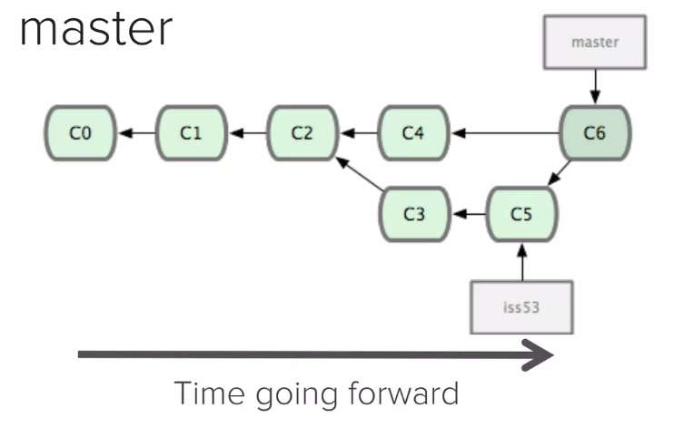
Typical Structure of a Project
Key concept: Merging
Once done with a feature the branch will be merged back to master

Slide 13
Making a Commit
Files can be a in a lot of states and places
Files are being edited in your local file system
The working directory
A file that is ready to be committed needs to be staged (added to the index)
Use 'git add ...' command to define the set of files that should be part of a commit
Use 'git commit ...' command to create actual commit

Slide 14
Making a Commit

Slide 15
Making a Commit

Slide 16
The Standard Template Library

Slide 17
Abstract
We will look at the C++ Standard Template Library
A vast collection of extremely useful containers, algorithms, and supporting data structures
This will be a whirlwind overview over certain aspects and facilities
Containers, Algorithms & Iterators

Slide 18
The STL (Standard Template Library)
Designed by Alex Stepanov
General aim: The most general, most efficient, most flexible representation of concepts (ideas, algorithms)
Represent separate concepts separately in code
Combine concepts freely wherever meaningful
General aim to make programming “like math”
or even “Good programming is math”
works for integers, for floating-point numbers, for polynomials, for …

Slide 19
Basic Model
Algorithms
sort, find, search, copy, …
Containers
vector, list, map, unordered_map, …
Separation of concerns
Algorithms manipulate data, but don’t know about containers
Containers store data, but don’t know about algorithms
Algorithms and containers interact through iterators
Each container has its own iterator types
Iterators know about internal container structure and data
Iterators expose uniform interface for algorithms
iterators

Slide 20
The STL
An ISO C++ standard framework of about a dozen containers and over 100 algorithms connected by iterators
Other organizations provide more containers and algorithms in the style of the STL
Boost.org, Microsoft, SGI, …
Probably the currently best known and most widely used example of generic programming

Slide 21
The STL
If you know the basic concepts and a few examples you can use the rest
Documentation
Cpp-Reference: https://en.cppreference.com
Draft C++ Standard: https://eel.is/c++draft/

Slide 22
Basic Model
A pair of iterators defines a sequence (a range)
The beginning (points to the first element – if any)
The end (points to the one-beyond-the-last element)
An iterator is a type that supports the “iterator operations”
++ Go to next element
* Get value of element
== Does this iterator point to the same element as that iterator?
Some iterators support more operations (e.g. --, +, and [ ])
begin:
end:
…

Slide 23
Pattern: Iterator
Context:
1. An object (which we’ll call the container) contains other objects (which we’ll call elements).
2. Algorithms (that is, methods that use the container) need access to the elements.
3. The container should not expose its internal structure.
4. There may be multiple algorithms that need simultaneous access.
Solution:
1. Define an iterator class that refers to one element at a time.
2. Each iterator type needs to be able to keep track of the position of the current element
3. Each iterator knows how to navigate the container to find next/previous element
4. There are several variations of containers
Each exposes its own iterator classes
All iterators implement common interfaces
The algorithm only needs to know the interface, not the concrete classes.

Slide 24
Containers

Slide 25
Containers
Containers are special data structures that help storing one or more items of the same type
Collections of items
Manages the storage space for its elements and provides functions to access them
Containers replicate structures very commonly used in programming:
Arrays: dynamic (std::vector), static (std::array)
Linked lists (std::list, std::forward_list)
Trees (std::set, std::multi_set, std::unordered_set)
Associative arrays (std::map, std::multi_map, std::unordered_map)
Various adaptors:
Queues (std::queue, std::priority_queue), stacks (std::stack)
Associative interfaces for arrays (std::flat_map, std::flat_set)

Slide 26
Containers (hold sequences in difference ways)
std::vector
std::list
std::set
0
1
2
3
0
1
2
4
1
8
0
2
7
5
6

Slide 27
Dynamic arrays (std::vector)
All containers are generic types (templates) so they can be used to store items of arbitrary types
Dynamic arrays are the first choice container type
Rule: use std::vector by default
If you can’t use std::vector, think again and change your approach such that you can use std::vector
Rely on contiguous memory
Makes them O(1) in terms of access time
Insertion and deletion is O(N), however (except at the end)

Slide 28
Dynamic arrays (std::vector)
// An array of integers, initialized with five elements:
std::vector<std::int64_t> data = {1, 2, 3, 4, 5};
// Elements can be accessed using the operator []
std::cout << "data[3] == " << data[3] << "\n"; // data[3] == 4
// An array of arrays of integers follows the same pattern
std::vector<std::vector<std::int64_t>> data2d = {{1, 2, 3}, {2, 3}, {4, 5, 6}, {7}};
// Same logic for accessing elements
std::cout << "data2d[1][0] == " << data2d[1][0] << "\n"; // data2d[1][0] == 2
std::cout << "data2d[2][2] == " << data2d[2][2] << "\n"; // data2d[2][2] == 6
// We can use element access to mutate the array
data2d[3] = {1, 2, 3, 4, 5};
std::cout << "data2d[3][2] == " << data2d[3][2] << "\n"; // data2d[3][2] == 3
data2d[1][0] = 42;
std::cout << "data2d[1][0] == " << data2d[1][0] << "\n"; // data2d[1][0] == 42

Slide 29
Dynamic arrays (std::vector)
Note that accessing nonexistent elements makes the program malformed
Always ensure the index is valid (is in range) when accessing elements by index (i.e. 0 <= index && index < size)
Various debugging tools help with identifying index-out-of range errors
Windows (msvc): standard library in debug builds
Linux, Mac (gcc, clang): address sanitizer, undefined behavior sanitizer
If you want to be sure, use at() instead operator[]()
at() performs index checking at runtime and throws an error if index is out of bounds

Slide 30
Algorithms and Iterators

Slide 31
The simplest Algorithm: std::find
// Find the first element that is equal to a value
template <typename In, typename T> requires(std::input_iterator<In> && ...)
In find(In first, In last, T const& val)
{
while (first != last && *first != val)
++first;
return first;
}
// find an int in a given vector
void f(std::vector<int> const& v, int x) {
auto p = std::find(v.begin(), v.end(), x);
if (p != v.end()) {
// we found x
std::cout << *p << "\n";
}
}
…
begin:
end:

Slide 32
std::find: Generic for both, element type and container type
// works for list of strings
void f(std::list<std::string> const& l, std::string x)
{
auto p = std::find(l.begin(), l.end(), x); // <-- here
if (p != l.end()) // did we find x?
{
std::cout << "Found x: " << *p << "\n";
}
}
// works of set of doubles
void f(std::set<double> const& s, double x)
{
auto p = std::find(s.begin(), s.end(), x); // <-- here
if (p != s.end()) // did we find x?
{
std::cout << "Found x: " << *p << "\n";
}
}

Slide 33
Algorithms and Iterators
An iterator points to (refers to, denotes) an element of a sequence
The end of the sequence is “one past the last element”
not “the last element”
That’s necessary to elegantly represent an empty sequence
One-past-the-last-element isn’t an element
You can compare an iterator pointing to it
You can’t dereference it (read its value)
Returning the end of the sequence is the standard idiom for “not found” or “unsuccessful”
An empty sequence:
some iterator:
the end:
0
1
2
3

Slide 34
Simple algorithm: find_if
Find the first element that matches a criteria (predicate)
Here, a predicate takes one argument and returns a bool
template <typename In, typename Pred>
In find_if(In first, In last, Pred pred) {
while (first != last && !pred(*first))
++first;
return first;
}
void f(std::vector<int> const& v) {
auto p = std::find_if(v.begin(), v.end(), odd);
if (p != v.end())
{
// we found an odd number
}
}

Slide 35
Predicates
A predicate (of one argument) is a function or a function object that takes an argument and returns a bool
A function:
bool odd(int i) { return i % 2; } // % is the remainder
odd(7); // call odd: is 7 odd?
A function object:
struct Odd {
bool operator()(int i) const { return i % 2; }
};
Odd odd; // make an object odd of type Odd
odd(7); // call odd: is 7 odd?
A lambda function:
auto odd = [](int i) { return i % 2; }
odd(7); // call odd: is 7 odd?

Slide 36
Function objects
A concrete example using state:
template <typename T>
struct less_than {
T val; // value to compare with
less_than(T x) : val(x) {}
bool operator()(T const& x) const {
return x < val;
}
};
// find x < 43 in std::vector<int>:
p = find_if(v.begin(), v.end(), less_than(43));
// find x < “perfection” in std::list<std::string>:
q = find_if(ls.begin(), ls.end(), less_than("perfection"));

Slide 37
Function objects
A very efficient technique
inlining very easy
and effective with current compilers
Faster than equivalent function
And sometimes you can’t write an equivalent function
The main method of policy parameterization in the STL
Key to emulating functional programming techniques in C++
‘Using code as data’

Slide 38
Lambda
A concrete example:
// find x < 43 in std::vector<int>:
p = std::find_if(v.begin(), v.end(), [](auto x) { return x < 43; });
// find x < “perfection” in std::list<std::string>:
q = std::find_if(ls.begin(), ls.end(), [](auto x) { return x < "perfection"; });

Slide 39
Policy Parameterization
Whenever you have a useful algorithm, you eventually want to parameterize it by a “policy”.
For example, we need to parameterize sort by the comparison criteria
struct record {
std::string name; // standard string for ease of use
char addr[24]; // old C-style string to match database layout
// ...
};
std::vector<record> vr = {
{"John Doe", "42 Main Street"},
{"Donald Duck", "123 3rd Avenue"},
};
std::sort(vr.begin(), vr.end(), cmp_by_name()); // sort by name
std::sort(vr.begin(), vr.end(), cmp_by_addr()); // sort by addr

Slide 40
Comparisons
// Different comparisons for record objects:
struct cmp_by_name {
bool operator()(record const& a, record const& b) const
{
return a.name < b.name; // look at the name field of Rec
}
};
struct cmp_by_addr {
bool operator()(record const& a, record const& b) const
{
return 0 < std::strncmp(a.addr, b.addr, 24); // correct?
}
};
// note how the comparison function objects are used to hide ugly
// and error-prone code

Slide 41
std::vector
template <typename T>
class vector {
T* elements;
public:
// ...
using iterator = ...; // the type of an iterator is implementation defined
// and it (usefully) varies (e.g. range checked iterators)
// a vector iterator could be a pointer to an element
using const_iterator = ...;
iterator begin(); // points to first element
const_iterator begin() const;
iterator end(); // points one beyond the last element
const_iterator end() const;
iterator erase(iterator p); // remove element pointed to by p
iterator insert(iterator p, T const& v); // insert a new element v before p
};

Slide 42
insert() into std::vector
std::vector<int>::iterator p = v.begin(); ++p; ++p; ++p;
std::vector<int>::iterator q = p; ++q;
p = v.insert(p, 99); // leaves p pointing at the inserted element
Note: q is invalid after the insert()
Note: Some elements moved; all elements could have moved
p:
q:
v:
6
0
1
2
3
4
5
p:
q:
v:
7
0
1
2
99
3
4
5

Slide 43
erase() from std::vector
// leaves p pointing at the element after the erased one
p = v.erase(p);
vector elements move when you insert() or erase()
Iterators into a vector are invalidated by insert() and erase()
p:
q:
v:
7
0
1
2
99
3
4
5
p:
q:
v:
6
0
1
2
3
4
5

Slide 44
std::list
Link:
T value
Link* pre
Link* post
template <typename T>
class list {
Link* elements;
public:
// ...
using iterator = ...; // the type of an iterator is implementation defined
// and it (usefully) varies (e.g. range checked iterators)
// a list iterator could be a pointer to a link node
using const_iterator = ...;
iterator begin(); // points to first element
const_iterator begin() const;
iterator end(); // points one beyond the last element
const_iterator end() const;
iterator erase(iterator p); // remove element pointed to by p
iterator insert(iterator p, const T& v); // insert a new element v before p
};

Slide 45
insert() into std::list
std::list<int>::iterator p = l.begin(); ++p; ++p; ++p;
std::list<int>::iterator q = p; ++q;
p = l.insert(p, 99); // leaves p pointing at the inserted element
Note: q is unaffected
Note: No elements moved around
l:
6
p:
q:
0
1
2
3
4
5
l:
7
p:
q:
0
1
2
3
4
5
99

Slide 46
erase() from std::list
// leaves p pointing at the element after the erased one
p = l.erase(p);
Note: list elements do not move when you insert() or erase()
l:
7
p:
q:
0
1
2
3
4
5
99
l:
6
p:
q:
0
1
2
3
4
5

Slide 47
std::array
template <typename T, size_t N>
class array {
T elements[N];
public:
// ...
using iterator = ...; // the type of an iterator is implementation defined
// and it (usefully) varies (e.g. range checked iterators)
// a vector iterator could be a pointer to an element
using const_iterator = ...;
iterator begin(); // points to first element
const_iterator begin() const;
iterator end(); // points one beyond the last element
const_iterator end() const;
// no erase
// no insert
};

Slide 48
Ways of traversing a container
for (int i = 0; i < v.size(); ++i) // why int?
// do something with v[i]
// longer but always correct
for (std::vector<int>::size_type i = 0; i < v.size(); ++i)
// do something with v[i]
for (std::vector<int>::iterator p = v.begin(); p != v.end(); ++p)
// do something with *p
for (auto p = v.begin(); p != v.end(); ++p)
// do something with *p
for (auto const& e : v)
// do something with e

Slide 50
Software Development Notes

Slide 51
Agile Software Development
An approach to software development that emphasizes:
Small, collaborative development teams
Usually 4-6 members of the team
Working closely with customers/stakeholders
Have a user representative, that interfaces regularly with customers / users / stakeholders, on the team
Developing software in an short iterative cycles
requirements / code / testing / documentation
Building working versions of code often
Iterative Development
Often employees Continuous Integration/Continuous Deployment (CI/CD)
Test-driven development (TDD)

Slide 52
Agile Manifesto
“We are uncovering better ways of developing software by doing it and helping others do it. Through this work we have come to value:
Individuals and interactions over processes and tools
Working software over comprehensive documentation
Customer collaboration over contract negotiation
Responding to change over following a plan
That is, while there is value in the items on the right, we value the items on the left more.”
https://www.agilealliance.org/agile101/the-agile-manifesto/

Slide 53
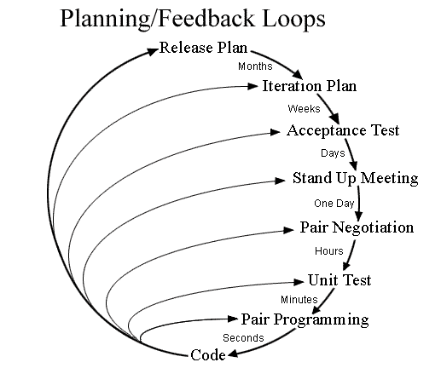
Agile Method: Extreme Programming
Characterized by feedback loops
On-site customer
Planning game (with customer)
Avoid features until needed
Pair programming
Two programmers, one computer
One person writes, the other dictates
Typically writer is less skilled
This Photo by Alex86450 is licensed under CC BY-SA

Slide 54
Agile Method: SCRUM
Scrum is a simple set of roles, responsibilities, and meetings that never change
Time is divided into short work cadences, known as sprints, typically two to four weeks long
The product is kept in a potentially shippable (properly integrated and tested) state at all times
At the end of each sprint, stakeholders and team members meet to see a demonstrated potentially shippable product increment and plan its next steps
http://scrummethodology.com/

Slide 55
Scrum Roles
Product Owner
The Product Owner should be a person with vision, authority, and availability
The Product Owner is responsible for continuously communicating the vision and priorities to the development team
Scrum Master
The Scrum Master acts as a facilitator for the Product Owner and the team
The Scrum Master does not manage the team
The Scrum Master works to remove any impediments that are obstructing the team from achieving its sprint goals
Team
A Scrum development team contains about 3-9 fully dedicated members, ideally in one team room protected from outside distractions
For software projects, a typical team includes a mix of software engineers, architects, programmers, analysts, QA experts, testers, and UI designers
http://scrummethodology.com/

Slide 56
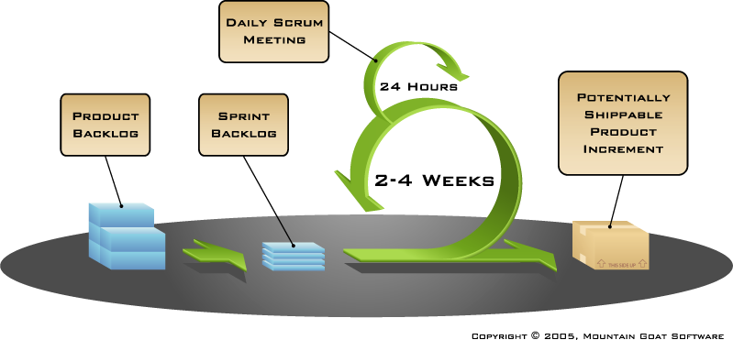
Scrum Phases/Steps
Product Backlog Creation
Sprints
Sprint Planning and Sprint Backlog Creation
Team commits to work to be accomplished in the Sprint
Work on Sprint/Daily Scrum Meetings
Development
Testing
Documentation
Product Demonstration
Retrospective

Slide 57
Agile Method: Kanban
Kanban is a method for managing the creation of products with an emphasis on continual delivery while not overburdening the development team
Kanban is based on 3 basic principles:
Visualize what you do today (workflow): seeing all the items in context of each other can be very informative
Limit the amount of work in progress (WIP): this helps balance the flow-based approach so teams don’t start and commit to too much work at once
Enhance flow: when something is finished, the next highest priority thing from the backlog is pulled into play
https://www.versionone.com/what-is-kanban/

Slide 58
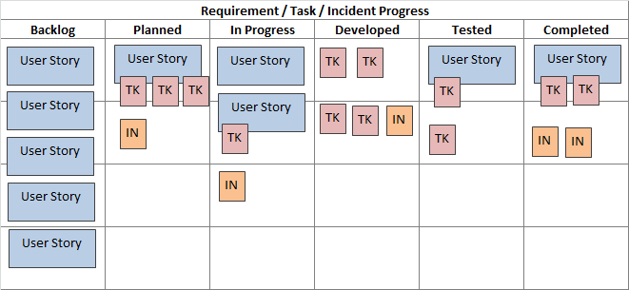
The Kanban Board
The Kanban process begins with a prioritized list of features, called a backlog
Agile team members work on the highest priority feature, based on their team role
Getting features to completion in priority order is the focus
There is no set timeframe to complete features
https://www.inflectra.com/methodologies/kanban.aspx

Slide 59
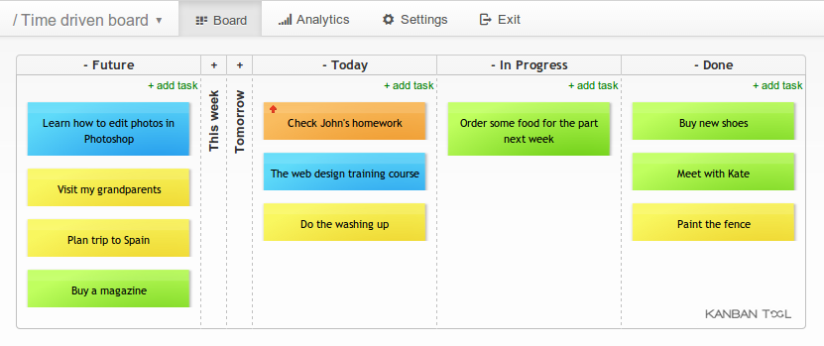
Online Kanban tool:
https://kanbantool.com/online-kanban-board

Slide 60
Agile for your Project?
You don’t have a design yet
You will probably have to change it
You don’t know all the features
Agile methods are good for you
Kanban is probably the most productive approach for a class project

Slide 61
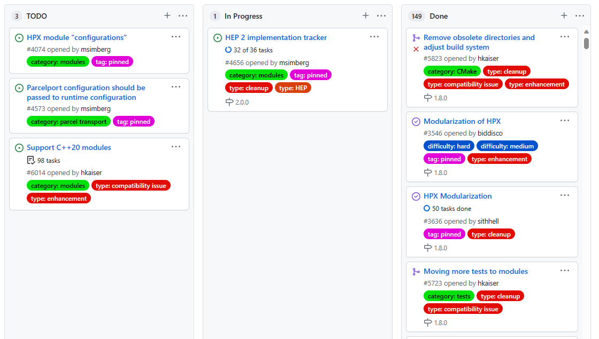
Use Github Projects
Github has a ‘Projects’ tab for every repository
Kanban style overview
Allows to track Issues and pull requests
Automatically updates on merges
Integrates well with code base
Use this for your project planning and management

