Slide 1
Errors
Lecture 5
Hartmut Kaiser
https://teaching.hkaiser.org/spring2024/csc3380/

Slide 2
Course Project

Slide 3
Course Project
Everybody should have received email with group number to join
Everybody must accept project using the link in email
Milestone 1: Proposal
Project portfolio template: in the project repository
System Requirements
Name
User stories
Core Features, viable features, stretch features
Management
Continuation of operation plan (COOP)
Communication, contingency,
Project Plan Proposal
Deadline for this: Friday, February 9, 11.59pm
Push edited document to repository

Slide 4
Software Development Notes

Slide 5
Manual Testing
The most basic form of testing
Run the program yourself
When an error occurs, write it down
Ensure that the error can be reproduced
Create issue on Github
How to run? What input used?
What system run on?
Everything needed to reproduce
What result is expected? What result is seen?

Slide 6
Issues with Manual Testing
To be effective, bugs must be tracked
Bug reproduction steps must be carefully retained
Have to re-test after changes
Expensive and error-prone

Slide 7
Automated Testing
Manual testing is still necessary for sanity checks
But we can create automated tests to provide immediate feedback
Tests are automatically run for each change set (commit)
We receive a checklist afterwards seeing how many, and which, tests succeeded and failed

Slide 8
Test Framework
Testing and the Catch2 framework:
https://teaching.hkaiser.org/resources/testing.html
Read this to learn everything!
Integrates well with VSCode
Run tests before pushing, make sure all tests pass
Integrates well with Github automated testing
Each push triggers the tests – immediate feedback
This is the basis for grading!

Slide 9
Unit Testing
The most common kind of automated testing is Unit Testing
Unit testing is a form of automated testing where you test a single class, module, or method
A unit is the smallest testable portion of an application:
Each unit test tests one thing
We can test every function of the unit, and every meaningful case of the function
Pay particular attention to testing boundary cases
Zero length strings
Check at minimum/maximum index bounds

Slide 10
Regressions
It is extremely common for a new update to fix old bugs, but introduce new ones
If a test used to pass, but after applying a change set it fails, this is called a regression
Automated testing provides a mechanism to quickly discover regressions
When fixing regressions always add a test verifying it has been fixed

Slide 11
Be Careful
The natural instinct is to rely on automated testing
It is NOT a replacement for manual testing
And manual testing is not a replacement for code review
In studies, code review catches more difficult-to-detect bugs than testing!
Juristo, N., & Vegas, S. (2003). Functional testing, structural testing and code reading: What fault type do they each detect?. In Empirical Methods and Studies in Software Engineering (pp. 208-232). Springer, Berlin, Heidelberg.

Slide 12
Normal Process
Add
1. Add requirements/stories
Start
2. Start writing code
Test
3. Test code
Fix
4. Fix code; goto 1

Slide 13
Guidelines
Use
Use the CHECK methods instead of plain assert for nicer error messages.
Allows to see why the test failed
Don’t cram
Don’t cram too much into one test
Don’t mix
Don’t mix tests for different classes in unit tests
This is a different kind of testing called “integration testing” which we’ll talk about later.
Avoid
Avoid making tests depend on one another. Don’t call tests from tests. Factor out common code into methods and call those.
Test one thing at a time

Slide 14
Errors and Error Handling

Slide 15
Abstract
When we program, we have to deal with errors. Our most basic aim is correctness, but we must deal with incomplete problem specifications, incomplete programs, and our own errors. Here, we’ll concentrate on a key area: how to deal with unexpected function arguments. We’ll also discuss techniques for finding errors in programs: debugging and testing.

Slide 16
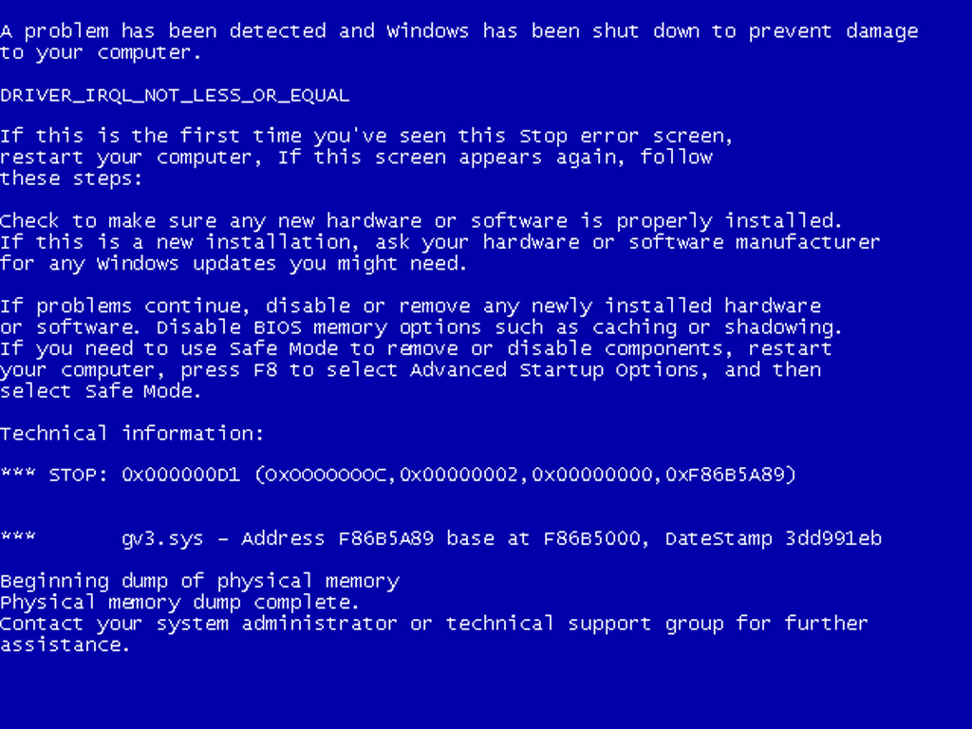
Overview
Kinds of errors
Argument checking
Error reporting
Error detection
Exceptions
Debugging
Testing

Slide 17
Errors
“ … I realized that from now on a large part of my life would be spent finding and correcting my own mistakes.”
Maurice Wilkes, 1949
When we write programs, errors are natural and unavoidable; the question is, how do we deal with them?
Organize software to minimize errors.
Eliminate most of the errors we made anyway.
Debugging
Testing
Make sure the remaining errors are not serious.
My guess is that avoiding, finding, and correcting errors is 95% or more of the effort for serious software development.
You can do much better for small programs.
or worse, if you’re sloppy

Slide 18
Your Program
Should produce the desired results for all legal inputs
Should give reasonable error messages for illegal inputs
Need not worry about misbehaving hardware
Need not worry about misbehaving system software
Is allowed to terminate after finding an error
3, 4, and 5 are true for beginner’s code; often, we have to worry about those in real software.

Slide 19
Sources of Errors
Poor specification
“What’s this supposed to do?”
Incomplete programs
“but I’ll not get around to doing that until tomorrow”
Unexpected arguments
“but sqrt() isn’t supposed to be called with -1 as its argument”
Unexpected input
“but the user was supposed to input an integer”
Code that simply doesn’t do what it was supposed to do
“so fix it!”

Slide 20
Kinds of Errors
Compile-time errors
Syntax errors
Type errors
Link-time errors
Undefined symbols
Non-existing libraries
Run-time errors
Detected by computer (crash)
Detected by library (exceptions)
Detected by user code
Logic errors
Detected by programmer (code runs, but produces incorrect output)

Slide 21
Check your Inputs
Before trying to use an input value, check that it meets your expectations/requirements
Function arguments
Data from input (istream)
Make sure the expectations of the algorithm (function) are met (preconditions)
Argument to sqrt is non-negative
Index used to access element of array is in range
Iterator is not equal to end iterator
Sequence passed to unique is actually sorted
Etc.

Slide 22
Bad Function Arguments
The compiler helps:
Number and types of arguments must match
int area(int length, int width)
{
return length*width;
}
int x1 = area(7); // error: wrong number of arguments
int x2 = area("seven", 2); // error: 1st argument has a wrong type
int x3 = area(7, 10); // ok
int x5 = area(7.5, 10); // ok, but dangerous: 7.5 truncated to 7;
// most compilers will warn you
int x = area(10, -7); // this is a difficult case:
// the types are correct,
// but the values make no sense

Slide 23
Bad Function Arguments
So, how about int x = area(10, -7);
Alternatives
Just don’t do that
Rarely a satisfactory answer
The caller should check
Hard to do systematically
The function should check
Return an “error value” (not general, problematic)
Set an error status indicator (not general, problematic – don’t do this)
Throw an exception
Note: sometimes we can’t change a function that handles errors in a way we do not like
Someone else wrote it and we can’t or don’t want to change their code

Slide 24
Bad Function Arguments
Why worry?
You want your programs to be correct
Typically the writer of a function has no control over how it is called
Writing “do it this way” in the manual (or in comments) is no solution – many people don’t read manuals
The beginning of a function is often a good place to check
Before the computation gets complicated
When to worry?
If it doesn’t make sense to test every function, test some

Slide 25
How to Report an Error
Return an “error value” (not general, problematic)
// return a negative value for bad input
int area(int length, int width)
{
if (length <= 0 || width <= 0) return -1;
return length*width;
}
So, “let the caller beware”
int z = area(x,y);
if (z < 0) error("bad area computation");
// …
Problems
What if I forget to check that return value?
For some functions there isn’t a “bad value” to return (e.g. max())

Slide 26
How to Report an Error
Set an error status indicator (not general, problematic, don’t!)
int errno = 0; // used to indicate errors
int area(int length, int width)
{
if (length <= 0 || width <= 0) errno = 7;
return length*width;
}
So, “let the caller check”
int z = area(x, y);
if (errno == 7) error("bad area computation");
// …
Problems
What if I forget to check errno?
How do I pick a value for errno that’s different from all others?
How do I deal with that error?

Slide 27
How to Report an Error
Report an error by throwing an exception
class bad_area : std::exception {}; // a class is a user defined type
// bad_area is a type to be used as an exception
int area(int length, int width)
{
if (length <= 0 || width <= 0) throw bad_area(); // note the ()
return length * width;
}
Catch and deal with the error (e.g., in main())
try {
int z = area(x,y); // if area() doesn’t throw an exception
} // make the assignment and proceed
catch (bad_area const&) { // if area() throws bad_area(), respond
cout << "oops! Bad area calculation – fix program\n";
}

Slide 28
How to Report an Error
int main()
{
std::cout << "Testing exceptions." << std::endl;
try {
throw runtime_error("Doh! Something went wrong!");
std::cout << "Here we are, still alive and kicking!" << std::endl;
}
catch (runtime_error e) {
std::cout << e.what() << std::endl;
}
std::cout << "Done testing exceptions." << std::endl;
return 0;
}
Testing exceptions.
Doh! Something went wrong!
Done testing exceptions.

Slide 29
Exceptions
Exception handling is general
You can’t forget about an exception: the program will terminate if someone doesn’t handle it (using a try … catch)
Just about every kind of error can be reported using exceptions
You still have to figure out what to do about an exception (every exception thrown in your program)
Error handling is never really simple

Slide 30
Out of range
Try this
vector<int> v(10); // a vector of 10 ints, each
// initialized to the default value,
// 0, referred to as v[0] .. v[9]
for (int i = 0; i != v.size(); ++i)
v[i] = i; // set values
for (int i = 0; i <= 10; ++i) // print 10 values (???)
cout << "v[" << i << "] == " << v.at(i) << endl;
vector’s operator[ ] (subscript operator) reports a bad index (its argument) by throwing a std::range_error if you compile in ‘Debug’ mode (MSVC only)
The default behavior can differ, use at() to guarantee checking

Slide 31
Exceptions – for now
For now, just use exceptions to terminate programs gracefully, like this
int main()
{
try {
// …
}
catch (std::out_of_range const&) { // out_of_range exceptions
std::cout << "oops – some vector index out of range\n";
}
catch (...) { // all other exceptions
std::cout << "oops – some exception\n";
}
}

Slide 32
Getting an Integer from an Input Stream
Read one integer from cin:
int get_int(std::string const& prompt)
{
std::cout << prompt;
int n = 0;
while (true)
{
if (std::cin >> n)
return n;
std::cout << "sorry, this was not a number, try again." << std::endl;
skip_to_int();
}
}

Slide 33
Getting an Integer from an Input Stream
Read one integer from cin, skip to next valid input character:
void skip_to_int()
{
if (!std::cin)
{
std::cin.clear();
char ch;
while (std::cin >> ch)
{
// throw away non-digits
if (std::isdigit(ch) || ch == '-')
{
std::cin.unget(ch); // put the digit back
return;
}
}
}
throw domain_error("no input");
}

Slide 34
How to Look for Errors
When you have written (drafted?) a program, it’ll have errors (commonly called “bugs”)
It’ll do something, but not what you expected
How do you find out what it actually does?
How do you correct it?
This process is usually called “debugging”

Slide 35
Debugging
How not to do it
// pseudo code
while (program doesn’t appear to work) {
Randomly look at the program for something
that “looks odd”.
Change it to “look better”
}
Key question:
How would I know if the program actually worked correctly?

Slide 36
Program structure
Make the program easy to read so that you have a chance of spotting the bugs
Comment
Explain design ideas
Use meaningful names
Indentation and formatting
Use a consistent layout
Your IDE tries to help (but it can’t do everything)
You are the one responsible
Break code into small functions
Try to avoid functions longer than a page
Avoid complicated code sequences
Try to avoid nested loops, nested if-statements, etc.
(But, obviously, you sometimes need those)
Use library facilities
Use consistent error handling

Slide 37
First Get the Program to Compile
Is every string literal terminated?
cout << "Hello, << name << '\n'; // oops!
Is every character literal terminated?
cout << "Hello, " << name << '\n; // oops!
Is every block terminated?
if (a > 0) { /* do something */
else { /* do something else */ } // oops!
Is every set of parentheses matched?
if (a // oops!
x = f(y);
The compiler generally reports this kind of error “late”
It doesn’t know you didn’t mean to close “it” later

Slide 38
First Get the Program to Compile
Is every name declared?
Did you include needed headers? (e.g., iostream, etc.)
Is every name declared before it’s used?
Did you spell all names correctly?
int count; /* … */ ++Count; // oops!
char ch; /* … */ Cin >> c; // double oops!
Did you terminate each expression statement with a semicolon?
x = sqrt(y) + 2 // oops!
z = x + 3;

Slide 39
Debugging
Carefully follow the program through the specified sequence of steps
Pretend you’re the computer executing the program
Does the output match your expectations?
If there isn’t enough output to help, add a few debug output statements
cout << "x == " << x << ", y == " << y << '\n';
Be very careful
See what the program specifies, not what you think it should say
That’s much harder to do than it sounds
for (int i = 0; 0 != month.size(); ++i) { // oops!
for (int i = 0; i <= max; ++j) { // oops! (twice)

Slide 40
Debugging
When you write the program, insert some checks (“sanity checks”) that variables have “reasonable values”
Function argument checks are prominent examples of this
if (number_of_elements < 0)
throw runtime_error("impossible: negative number of elements");
if (number_of_elements > largest_reasonable)
throw runtime_error("unexpectedly large number of elements");
if (x < y)
throw runtime_error("impossible: x < y");
Design these checks so that some can be left in the program even after you believe it to be correct
It’s almost always better for a program to stop than to give wrong results

Slide 41
Debugging
Pay special attention to “end cases” (beginnings and ends)
Did you initialize every variable?
To a reasonable value
Did the function get the right arguments?
Did the function return the right value?
Did you handle the first element correctly?
The last element?
Did you handle the empty case correctly?
No elements
No input
Did you open your files correctly?
more on this later
Did you actually read that input?
Write that output?

Slide 42
Debugging
“If you can’t see the bug, you’re looking in the wrong place”
It’s easy to be convinced that you know what the problem is and stubbornly keep looking in the wrong place
Don’t just guess, be guided by output
Work forward through the code from a place you know is right
so what happens next? Why?
Work backwards from some bad output
how could that possibly happen?
Once you have found “the bug” carefully consider if fixing it solves the whole problem
It’s common to introduce new bugs with a “quick fix”
“I found the last bug”
is a programmer’s joke

Slide 43
Note
Error handling is fundamentally more difficult and messy than “ordinary code”
There is basically just one way things can work right
There are many ways that things can go wrong
The more people use a program, the better the error handling must be
If you break your own code, that’s your own problem
And you’ll learn the hard way
If your code is used by your friends, uncaught errors can cause you to lose friends
If your code is used by strangers, uncaught errors can cause serious grief
And they may not have a way of recovering

Slide 44
Pre-conditions
What does a function require of its arguments?
Such a requirement is called a pre-condition
Sometimes, it’s a good idea to check it
// calculate area of a rectangle
int area(int length, int width)
{
// length and width must be positive
if (length <= 0 || width <= 0)
throw bad_area();
return length * width;
}

Slide 45
Post-conditions
What must be true when a function returns?
Such a requirement is called a post-condition
// calculate area of a rectangle
int area(int length, int width)
{
// length and width must be positive
if (length <= 0 || width <= 0)
throw bad_area();
// the result must be a positive int that is the area
int result = length * width;
if (result <= 0) // how could this happen anyways???
throw bad_area();
return result;
}

Slide 46
Pre- and post-conditions
Always think about them
If nothing else write them as comments
Check them “where reasonable”
Check a lot when you are looking for a bug
This can be tricky
How could the post-condition for area() fail after the pre-condition succeeded (held)?

Slide 47
Testing
How do we test a program?
Be systematic
“pecking at the keyboard” is okay for very small programs and for very initial tests, but is insufficient for real systems
Think of testing and correctness from the very start
When possible, test parts of a program in isolation
E.g., when you write a complicated function write a little program that simply calls it with a lot of arguments to see how it behaves in isolation before putting it into the real program
We’ll return to this question later

Slide 48
