Slide 1
Writing a Program
Lecture 6
Hartmut Kaiser
https://teaching.hkaiserorg/spring2024/csc3380/

Slide 2
STEM Careers at the NSA and Quantum Computing
Event Details:
Date: 02/08/2024 (today)
Time: 2:00 pm CST
Location: CCT-Digital Media Center (Theater)
Speaker: Sean Nemetz-MA
This talk is specially designed for students, professionals, and anyone interested in the cutting-edge developments in STEM. We will discuss opportunities for a STEM career at the agency. This will be followed by a more technical talk about quantum computing, its immediate application in public key cryptography, and the potential impact of quantum computing on the NSA's mission.

Slide 3
Software Development Notes

Slide 4
The Design Process
Software System Architect
Postulates a solution
Models it in a design framework
Establishes and maintains the vision for the solution
Evaluates design against original requirements
Primary responsibility of the Software System Architect
Specify a solution to a given problem (usually expressed as a functional specification)
Implementation independent

Slide 5
The Design Process
Software Designer
Designs the internal working of system components
Defines subsystems
Crafts process logic
Details data flow between and within system components and external sources and interfaces
Produces a specification of the design, detailed enough that
A programmer can implement it
A tester can test it
A technical writer can document it

Slide 6
Objectives of the Design Process
Primary responsibility of the Software Designer
Produce a set of specifications that describe the intended form of the implementation for the software system
The design specifications
Describe
The form (structure) of the solution
The way that the components are to fit together
Act as a set of “blueprints” that show how the system is to be constructed

Slide 7
Desirable Features…
Fitness for purpose
The system must work, and work correctly
It should
perform the required tasks
in the specified manner and
within the specified constraints
of the specified resources
Robustness
The design should be stable against changes such as file and data structures, user interface, etc.

Slide 8
Desirable Design Features
Simplicity
The design should be as simple as possible, but no simpler
Separation of concerns
The different concepts and components should be separated out (modular)
Information hiding
Information about the detailed form of objects such as data structures and device interfaces should
be kept local to a module or unit
Not be directly “visible” outside that unit

Slide 9
Undesirable Features
Having too much retained state information spread around the system
Using interfaces that are too complex
Containing excessively complex control structures
Involving needless replication

Slide 10
Design Strategies
Top-down
Functional decomposition
Stepwise refinement at the component level
Bottom up
Composition
Design pieces in isolation before deciding how they will fit together as a whole
Stylized
Pattern (re)use
Good solution already exists, in part or in whole
There is a place for all of these strategies in software and software system design
Start with top-down architecture design
Components are handed off to development team for bottom-up software design
Patterns are reused at both the architecture and software design levels, where appropriate

Slide 11
Building a Calculator

Slide 12
Building a program
Analysis
Refine our understanding of the problem
Think of the final use of our program
Design
Create an overall structure for the program
Implementation
Write code
Debug
Test
Go through these stages repeatedly

Slide 13
Writing a program: Strategy
What is the problem to be solved?
Is the problem statement clear?
Is the problem manageable, given the time, skills, and tools available?
Try breaking it into manageable parts
Do we know of any tools, libraries, etc. that might help?
Yes, even this early: iostreams, vector, etc.
Build a small, limited version solving a key part of the problem
To bring out problems in our understanding, ideas, or tools
Possibly change the details of the problem statement to make it manageable
If that doesn’t work
Throw away the first version and make another limited version
Keep doing that until we find a version that we’re happy with
Build a full scale solution
Ideally by using part of our initial version

Slide 14
Writing a program: Example
I’ll build a program in stages, making lot of “typical mistakes” along the way
Even experienced programmers make mistakes
Lots of mistakes; it’s a necessary part of learning
Designing a good program is genuinely difficult
It’s often faster to let the compiler detect gross mistakes than to try to get every detail right the first time
Concentrate on the important design choices
Building a simple, incomplete version allows us to experiment and get feedback
Good programs are “grown”

Slide 15
A simple calculator
Given expressions as input from the keyboard, evaluate them and write out the resulting value
For example
Expression: 2+2
Result: 4
Expression: 2+2*3
Result: 8
Expression: 2+3-25/5
Result: 0
Let’s refine this a bit more …

Slide 16
Pseudo Code
A first idea:
int main()
{
variables // pseudo code
while (get a line) { // what's a line?
analyze the expression // what does that mean?
evaluate the expression
print the result
}
}
How do we represent 45+5/7 as data?
How do we find 45 + 5 / and 7 in an input string?
How do we make sure that 45+5/7 means 45+(5/7) rather than (45+5)/7?
Should we allow floating-point numbers (sure!)
Can we have variables? v=7; m=9; v*m (later)

Slide 17
A simple Calculator
Wait!
We are just about to reinvent the wheel!
Read Chapter 6 for more examples of dead-end approaches¹
What would the experts do?
Computers have been evaluating expressions for 50+ years
There has to be a solution!
What did the experts do?
Reading is good for you
Asking more experienced friends/colleagues can be far more effective, pleasant, and time-effective than slogging along on your own
¹ Bjarne Stroustrup, Programming – Principles and Practice using C++

Slide 18
A side trip: Grammars
What’s a grammar?
A set of (syntax) rules for expressions.
The rules say how to analyze (“parse”) an expression.
Some seem hard-wired into our brains
Example, you know what this means:
2*3+4/2
“birds fly but fish swim”
You know that this is wrong:
2 * + 3 4/2
“fly birds fish but swim”
Why is it right/wrong?
How do we know?
How can we teach what we know to a computer?

Slide 19
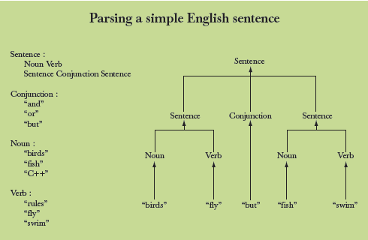
Grammars – “English”

Slide 20
Expression Grammar
This is what the experts usually do – write a grammar:
Expression :
Term
Expression ‘+’ Term e.g., 1+2, (1-2)+3, 2*3+1
Expression ‘-’ Term
Term :
Primary
Term ‘*’ Primary e.g., 1*2, (1-2)*3.5
Term ‘/’ Primary
Term ‘%’ Primary
Primary :
Number e.g., 1, 3.5
‘(‘ Expression ‘)’ e.g., (1+2*3)
Number :
floating-point literal e.g., 3.14, 0.274e1, or 42 – as defined for C++
An expression is built out of Tokens (e.g., numbers and operators).

Slide 21
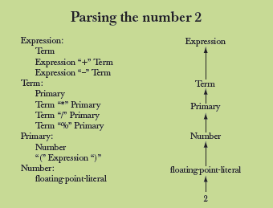
Grammars - Expression

Slide 22
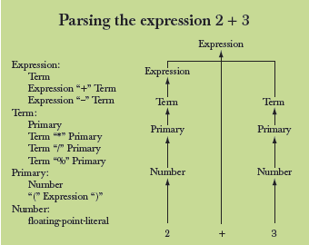
Grammars - Expression

Slide 23
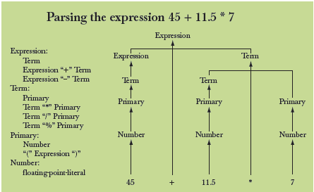
Grammars - Expression

Slide 24
Functions for Parsing
We need functions to match the grammar rules:
get() // read characters and compose tokens
// calls cin for input
expression() // deal with + and –
// calls term() and get()
term() // deal with *, /, and %
// calls primary() and get()
primary() // deal with numbers and parentheses
// calls expression() and get()
Note: each function deals with a specific part of an expression and leaves everything else to other functions – this radically simplifies each function.
Analogy: a group of people can deal with a complex problem by each person handling only problems in his/her own specialty, leaving the rest for colleagues.

Slide 25
Function Return Types
What should the parser functions return?
How about the result?
token get(); // read characters and compose tokens
double expression(); // deal with + and –
// return the sum (or difference)
double term(); // deal with *, /, and %
// return the product (or …)
double primary(); // deal with numbers and parentheses
// return the value
What is a ‘token’?

Slide 26
What is a token?
We want to see input as a stream of tokens
We read characters 1 + 4*(4.5-6) (That’s 13 characters incl. 2 spaces)
9 tokens in that expression: 1 + 4 * ( 4.5 - 6 )
6 kinds of tokens in that expression: number + * ( - )
We want each token to have two parts
A “kind”; e.g., number
A value; e.g., 4
We need a type to represent this “token” idea
We’ll build that later, but for now:
t = get() gives us the next token from input
t.kind gives us the kind of the token
t.value gives us the value of the token
number
+
4.5

Slide 27
Dealing with + and -
Expression :
Term
Expression ‘+’ Term e.g., 1+2, (1-2)+3, 2*3+1
Expression ‘-’ Term
// read and evaluate: 1, 1+2.5, 1+2+3.14 etc., return the sum (or difference)
double expression()
{
double left = term(); // get the Term
while (true)
{
token t = get(); // get the next token ...
switch (t.kind) { // ... and do the right thing with it
case '+': left += term(); break;
case '-': left -= term(); break;
default: return left; // return the value of the expression
}
}
}

Slide 28
Dealing with *, /, and %
Term :
Primary
Term ‘*’ Primary e.g., 1*2, (1-2)*3.5
Term ‘/’ Primary
Term ‘%’ Primary
// exactly like expression(), but for *, /, and %
double term()
{
double left = primary(); // get the Primary
while (true) {
token t = get(); // get the next Token ...
switch (t.kind) {
case '*': left *= primary(); break;
case '/': left /= primary(); break;
case '%': left %= primary(); break;
default: return left; // return the value
}
}
}
Oops: doesn’t compile
% isn’t defined for floating-point numbers

Slide 29
Dealing with * and /
Term :
Primary
Term ‘*’ Primary e.g., 1*2, (1-2)*3.5
Term ‘/’ Primary
// exactly like expression(), but for * and /
double term()
{
double left = primary(); // get the Primary
while (true) {
token t = get(); // get the next Token ...
switch (t.kind) {
case '*': left *= primary(); break;
case '/': left /= primary(); break;
default: return left; // return the value
}
}
}

Slide 30
Dealing with divide by 0
// exactly like expression(), but for * and /
double term()
{
double left = primary(); // get the Primary
while (true) {
token t = get(); // get the next Token ...
switch (t.kind) {
case '*': left *= primary(); break;
case '/': {
double d = primary();
if (d == 0) throw std::runtime_error("divide by zero");
left /= d;
break;
}
default: return left; // return the value
}
}
}

Slide 31
Dealing with numbers, ‘(‘and ‘)’
double primary() // Number or ‘(‘ Expression ‘)’
{
token t = get();
switch (t.kind) {
case '(': { // handle ‘(’ expression ‘)’
double d = expression();
t = get();
if (t.kind != ')') throw std::runtime_error("')' expected");
return d;
}
case '8': // we use ‘8’ to represent the “kind” of a number
return t.value; // return the number’s value
default:
throw std::runtime_error("primary expected");
}
}

Slide 32
Program Organization
Who calls who? (note the loop)
Token
get()
primary()
term()
istream
cin
>>
ostream
cout
<<
expression()
main()

Slide 33
The program
#include <iostream>
#include <string>
// Token stuff (explained in next lecture)
// declaration so that primary() can call expression()
double expression();
double primary() { /* … */ } // deal with numbers and parentheses
double term() { /* … */ } // deal with * and / (pity about %)
double expression() { /* … */ } // deal with + and –
int main() { /* … */ } // on next slide

Slide 34
The Program – main()
int main() {
try {
while (std::cin)
std::cout << expression() << '\n';
return 0;
}
catch (std::runtime_error& e) {
std::cerr << e.what() << std::endl;
return 1;
}
catch (...) {
std::cerr << "exception\n";
return 2;
}
}

Slide 35
A mystery
2
3
4
2 an answer
5+6
5 an answer
X
Bad token an answer (finally, an expected answer)

Slide 36
A mystery
1 2 3 4+5 6+7 8+9 10 11 12
1 an answer
4 an answer
6 an answer
8 an answer
10 an answer
Aha! Our program “eats” two out of three inputs
How come?
Let’s have a look at expression()

Slide 37
Dealing with + and -
Expression :
Term
Expression ‘+’ Term e.g., 1+2, (1-2)+3, 2*3+1
Expression ‘-’ Term
// read and evaluate: 1, 1+2.5, 1+2+3.14 etc., return the sum (or difference)
double expression()
{
double left = term(); // get the Term
while (true)
{
token t = get(); // get the next token ...
switch (t.kind) { // ... and do the right thing with it
case '+': left += term(); break;
case '-': left -= term(); break;
default: return left; // <<< doesn’t use “next token”, discards it
}
}
}

Slide 38
Dealing with + and -
So, we need a way to “put back” a token!
Back into what?
“the input,” of course; that is, we need an input stream of tokens
// read and evaluate: 1, 1+2.5, 1+2+3.14 etc., return the sum (or difference)
double expression()
{
double left = term(); // get the Term
while (true)
{
token t = ts.get(); // get the next token ...
switch (t.kind) { // ... and do the right thing with it
case '+': left += term(); break;
case '-': left -= term(); break;
default: ts.putback(t); // <<< put the unused token back into the token stream
return left;
}
}
}

Slide 39
Dealing with * and /
Now make the same change to term()
// exactly like expression(), but for * and /
double term()
{
double left = primary(); // get the Primary
while (true) {
token t = ts.get(); // get the next Token ...
switch (t.kind) {
case '*': left *= primary(); break;
case '/': left /= primary(); break;
default: ts.putback(t); // <<< put the unused token back
return left; // return the value
}
}
}

Slide 40
The program
It “sort of works”
That’s not bad for a first try
Well, second try
Well, really, the fourth try; see the book
But “sort of works” is not good enough
When the program “sort of works” is when the work (and fun) really start
Now we can get feedback!

Slide 41
Another mystery
2 3 4 2+3 2*3
2 an answer
3 an answer
4 an answer
5 an answer
What! No “6” ?
The program looks ahead one token
It’s waiting for the user
So, we introduce a “print result” command
While we’re at it, we also introduce a “quit” command

Slide 42
The main() program
int main()
{
double val = 0;
while (std::cin)
{
token t = ts.get();
if (t.kind == 'q')
break; // ‘q’ for “quit”
if (t.kind == ';') // ‘;’ for “print now”
std::cout << val << '\n'; // print result
else
ts.putback(t);
val = expression(); // evaluate
}
return 0;
}
// exception handling ...

Slide 43
Now the calculator is minimally useful
2;
2 an answer
2+3;
5 an answer
3+4*5;
23 an answer
q

Slide 44
Next Lecture
Completing a program
Tokens and token stream
Recovering from errors
Cleaning up the code
Code review
Testing

Slide 45
