Slide 1
Deriving a Generic Algorithm
Lecture 9
Hartmut Kaiser
https://teaching.hkaiser.org/spring2024/csc3380/

Slide 2
Software Development Notes

Slide 3
Client/Server
A network architecture in which each computer or process on the network is either a client or a server
  Servers are processes dedicated to managing resources, such as disk drives (file servers), printers (print servers), network traffic (network servers ), or computational services
    The server “guards” access to the important resources that it manages
  Clients are programs, which are run by users or specialized applications. Clients rely on servers for resources, such as files, devices, data, and computations (e.g., processing power)
    Clients connect to the server

Slide 4
Client Server Abstraction:
2-Tier Architecture

Slide 5
Client Server Abstraction:
3-tier Architecture
Process Management acts as a server to the User Interface client
It acts as a client to the Data Interface Server

Slide 6
Examples of Client/Server
Multiplayer videogames:
  Clients absolutely cannot be trusted to change game state directly
  Server validates actions and ensures rules are followed
  Doesn’t help with client side exploits
X11 windowing system
  Allows a windowing application to be separated from a “view”
  Streams drawing commands over network
  Allows low-latency screen sharing, but still being replaced
Modern single-page web applications
  Facebook, Twitter, Youtube, etc.
  Client runs in your browser, the server runs in the cloud

Slide 7
A Note on Using Web Servers
If you plan on developing a web app, don’t rewrite a webserver yourself
Consult your mentor TA on options
  The absolute easiest way to have a web-based server is for it to be a (fast) CGI application
  Install an http server on your host
    Nginx is good one
    Apache is widely supported
  Configure it to call your program
  Your server application will return either HTML or JSON

Slide 8
Fibonacci Numbers

Slide 9
Introduction
We will take the Egyptian Multiplication algorithm and generalize it in order to apply it to a wide variety of problems beyond simple arithmetic
Good piece of code requires (at least) two steps
  Write the algorithm
  Find out what type requirements the algorithm imposes on its arguments
Why generalize?
  Holy grail of programming is to reuse code
  You might not even know who is going to use your code for what application in the future

Slide 10
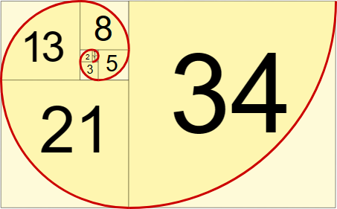

Fibonacci Sequence
Every next number is computed by adding the previous two
  0, 1, 1, 2, 3, 5, 8, 13, 21, 34, ...

Slide 11

Fibonacci Sequence

Slide 12
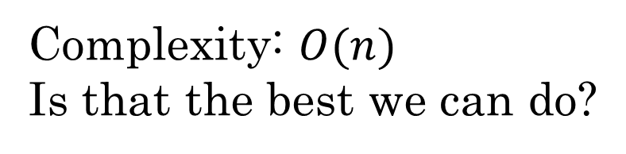
Fibonacci Sequence
Complexity: $O(n)$
Is that the best we can do?
int fib(int n)
{
if (n == 0) return 0;
std::pair<int, int> v = {0, 1};
for (int i = 0; i < n; ++i)
{
v = {v.second, v.first + v.second};
}
return v.first;
}
int main()
{
std::cout << fib(10) << "\n";
}

Slide 13
Egyptian Multiplication

Slide 14
Algorithm Requirements
This is where we stopped:
int mult_acc4(int r, int n, int a)
{
while (true) {
if (odd(n)) {
r = r + a;
if (n == 1) return r;
}
n = half(n);
a = a + a;
}
}

Slide 15
Algorithm Requirements
Note the operations on n and r are orthogonal and non-overlapping
The requirements on n and r are different and could be represented by different types
  So far we have been using the same type int for both
Let’s call type types N and A
  A must be ‘addable’ (support operator+())
  N must be checkable for odd-ness, compared with 1, and must support division by 2

Slide 16
Algorithm Requirements
This is where we stopped:
int mult_acc4(int r, int n, int a)
{
while (true) {
if (odd(n)) {
r = r + a;
if (n == 1) return r;
}
n = half(n);
a = a + a;
}
}
Type N
Type A

Slide 17
Algorithm Requirements
More generic form of the algorithm:
template <typename A, typename N>
A multiply_accumulate(A r, N n, A a)
{
while (true) {
if (odd(n)) {
r = r + a;
if (n == 1) return r;
}
n = half(n);
a = a + a;
}
}
Allows to figure out requirements for N and A separately

Slide 18
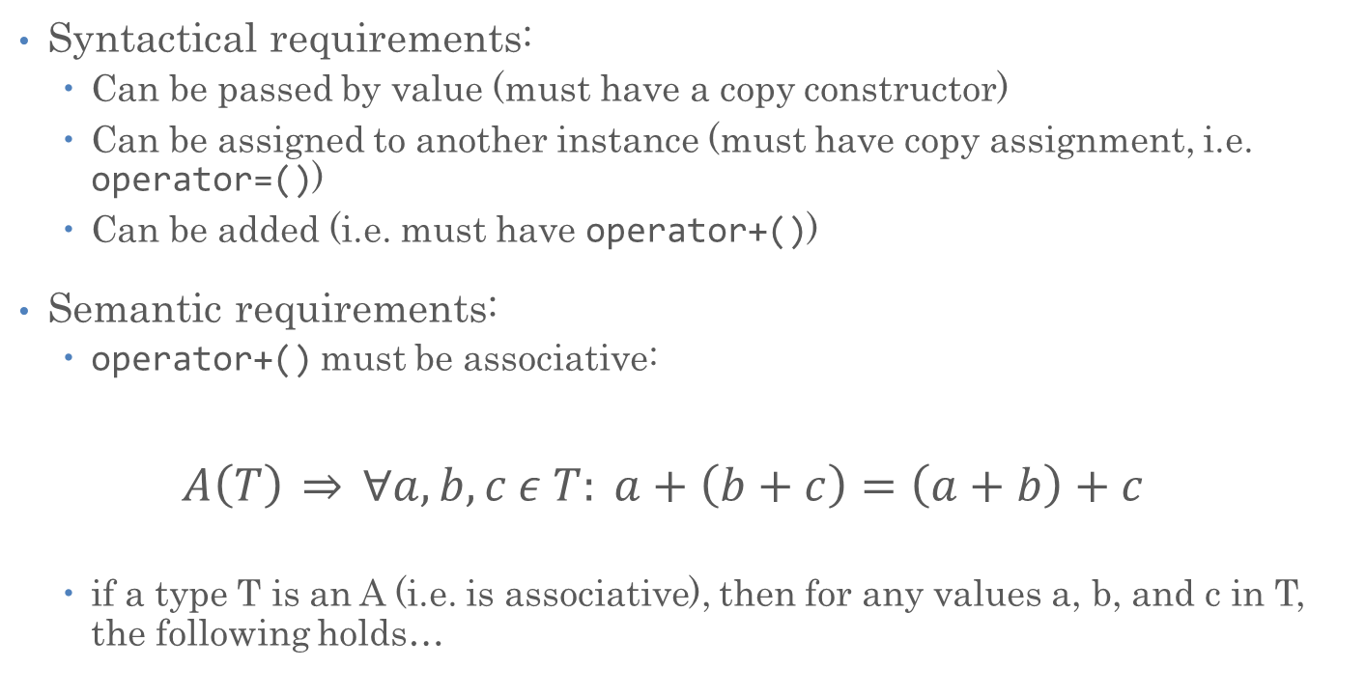
Requirements on A
Syntactical requirements:
  Can be passed by value (must have a copy constructor)
  Can be assigned to another instance (must have copy assignment, i.e. operator=())
  Can be added (i.e. must have operator+())
Semantic requirements:
  operator+() must be associative:
  $$A\left(T\right) \underset{⇒}{} ∀a, b, c ε T: a+\left(b+c\right)=\left(a+b\right)+c$$
  if a type T is an A (i.e. is associative), then for any values a, b, and c in T, the following holds…

Slide 19
Requirements on A: Clarification
While adding integers is associative in theory, on computers this might not be true
  Consider: (x + y) + z, for large x, y, and a negative z
    x + y might overflow
    Yields possibly different result from x + (y + z)
  operator+() on computers usually is a partial function
    A partial function’s domain of definition is a subset of the direct product of the types of its input
    It is defined only for a subset of all possible combinations of values of its input
Let’s clarify requirements:
  The requirement holds only in the domain of definition of the function, i.e. for the set of values for which the function is defined

Slide 20
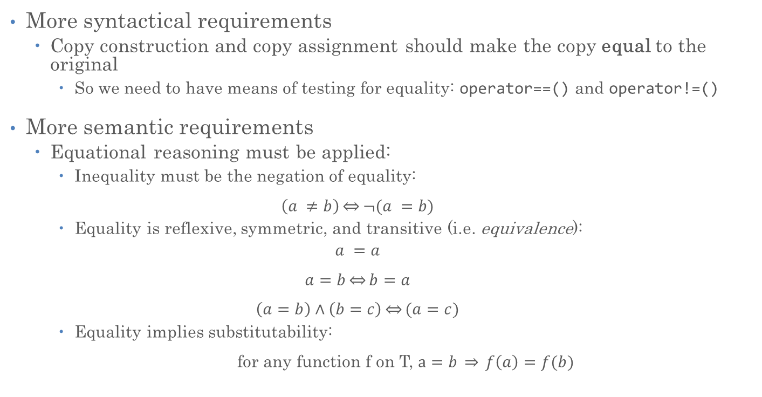
Requirements on A: regularity
More syntactical requirements
  Copy construction and copy assignment should make the copy equal to the original
    So we need to have means of testing for equality: operator==() and operator!=()
More semantic requirements
  Equational reasoning must be applied:
    Inequality must be the negation of equality:
    $$\left(a ≠b\right)\underset{⇔}{}¬(a =b)$$
    Equality is reflexive, symmetric, and transitive (i.e. equivalence):
    $$a =a$$
    $$a=b\underset{⇔}{}b=a$$
    $$\left(a=b\right)∧\left(b=c\right)\underset{⇔}{}(a=c)$$
    Equality implies substitutability:
    for any function f on T, $a=b \underset{⇒}{} f\left(a\right)=f(b)$

Slide 21
Requirements on A
Shorthand requirements description
  Must be regular type
  Must provide associative operator+()
Going back to math:
  A must be a non-commutative additive semigroup
Examples:
  Positive even integers
  Negative integers
  Real numbers
  Polynomials
  Planar (2D) vectors
  Boolean functions
  Line segments
  Etc.

Slide 22
Algorithm Requirements
Now we are able to write:
template <typename T>
concept Addable = requires(T a, T b) { a + b; }; // "a+b will compile"
template <typename T>
concept NoncommutativeAdditiveSemigroup = std::regular<T> && Addable<T>;
// there is no way to express associativity in a concept

Slide 23
Algorithm Requirements
Now we are able to write:
template <typename A, typename N>
requires(NoncommutativeAdditiveSemigroup<A>)
A multiply_accumulate(A r, N n, A a) {
while (true) {
if (odd(n)) {
r = r + a;
if (n == 1) return r;
}
n = half(n);
a = a + a;
}
}

Slide 24
Algorithm Requirements
Now we are able to write:
template <NoncommutativeAdditiveSemigroup A, typename N>
A multiply_accumulate(A r, N n, A a) {
while (true) {
if (odd(n)) {
r = r + a;
if (n == 1) return r;
}
n = half(n);
a = a + a;
}
}

Slide 25

Requirements on N
Syntactic requirements
  Has to be regular as well
  Must implement:
    half
    odd
    == 0
    == 1
Semantic requirements
  $even\left(n\right)\underset{⇒}{}half\left(n\right)+half\left(n\right)=n$
  $odd(n)\underset{⇒}{}even(n−1)$
  $odd(n)\underset{⇒}{}half(n−1)=half(n)$
  $n≤1 ∨ half\left(n\right)=1 ∨ half\left(half\left(n\right)\right)=1∨…$
uint8_t, int8_t, uint64_t, etc.
i.e. all integral types

Slide 26
Algorithm Requirements
Now finally we are able to write a fully generic algorithm:
template <typename T>
concept Addable = requires(T a, T b) { a + b; }; // "a+b will compile"
template <typename T>
concept NoncommutativeAdditiveSemigroup = std::regular<T> && Addable<T>;
template <typename T>
concept Integer = std::integral<T>;

Slide 27
Algorithm Requirements
Now finally we are able to write a fully generic algorithm:
template <NoncommutativeAdditiveSemigroup A, Integer N>
A multiply_accumulate_semigroup(A r, N n, A a) { // precondition: n >= 0
if (n == 0) return r;
while (true) {
if (odd(n)) {
r = r + a;
if (n == 1) return r;
}
n = half(n);
a = a + a;
}
}

Slide 28
Final multiply Algorithm
template <NoncommutativeAdditiveSemigroup A, Integer N>
A multiply_semigroup(N n, A a)
{
// precondition: n > 0
while (!odd(n)) {
a = a + a;
n = half(n);
}
if (n == 1) {
return a;
}
return multiply_accumulate_semigroup(a, half(n - 1), a + a);
}

Slide 29
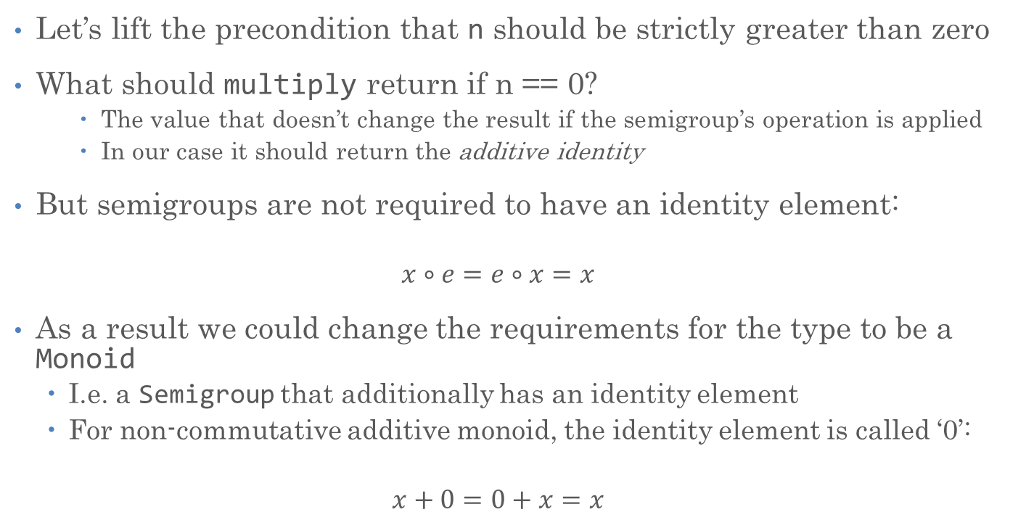
Further Generalization: Monoid
Let’s lift the precondition that n should be strictly greater than zero
What should multiply return if n == 0?
    The value that doesn’t change the result if the semigroup’s operation is applied
    In our case it should return the additive identity
But semigroups are not required to have an identity element:
  $$x∘e=e∘x=x$$
As a result we could change the requirements for the type to be a Monoid
  I.e. a Semigroup that additionally has an identity element
  For non-commutative additive monoid, the identity element is called ‘0’:
  $$x+0=0+x=x$$

Slide 30
Further Generalization: Monoid
template <typename T>
concept HasAdditiveIdentity = requires(T) { T(0); };
template <typename T>
concept NoncommutativeAdditiveMonoid =
NoncommutativeAdditiveSemigroup<T> && HasAdditiveIdentity<T>;

Slide 31
Further Generalization: Monoid
template <NoncommutativeAdditiveMonoid A, Integer N>
A multiply_monoid(N n, A a)
{
// precondition: n >= 0
if (n == 0) return A(0);
return multiply_semigroup(n, a);
}

Slide 32
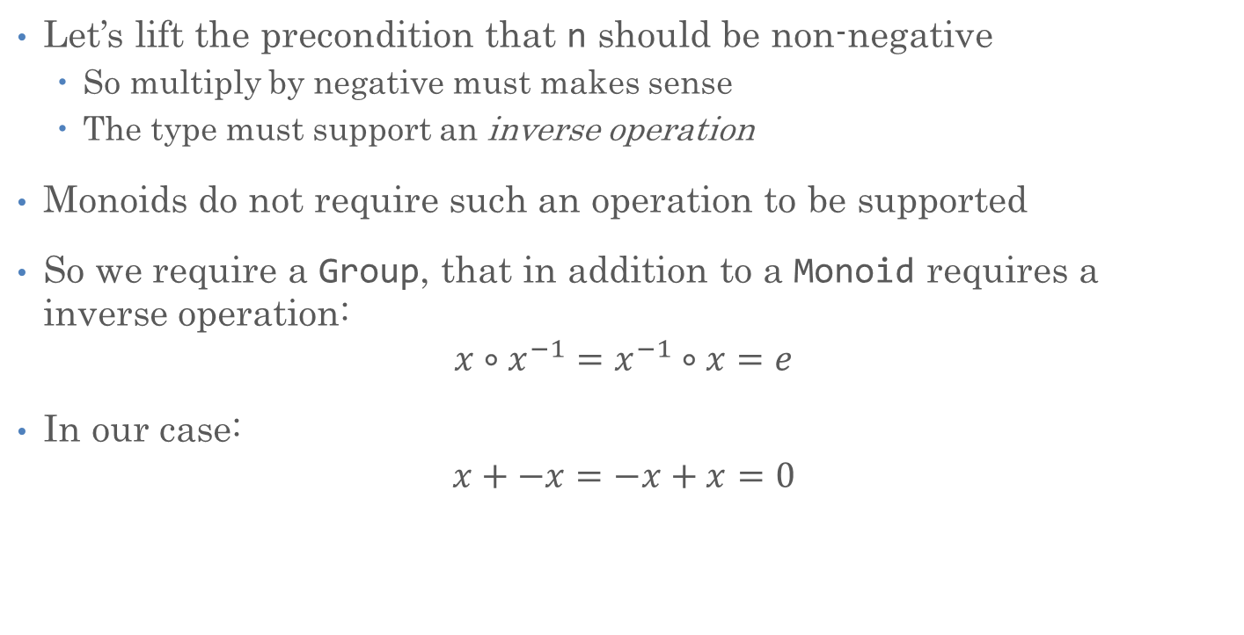
Further Generalization: Group
Let’s lift the precondition that n should be non-negative
  So multiply by negative must makes sense
  The type must support an inverse operation
Monoids do not require such an operation to be supported
So we require a Group, that in addition to a Monoid requires a inverse operation:
$$x∘x^{−1}=x^{−1}∘x=e$$
In our case:
$$x+−x=−x+x=0$$

Slide 33
Further Generalization: Monoid
template <typename T>
concept AdditiveIsInvertible = requires(T a) { -a; };
template <typename T>
concept NoncommutativeAdditiveGroup =
NoncommutativeAdditiveMonoid<T> && AdditiveIsInvertible<T>;

Slide 34
Further Generalization: Group
template <NoncommutativeAdditiveGroup A, Integer N>
A multiply_group(N n, A a)
{
// precondition: none
if (n < 0) {
n = -n;
a = -a;
}
return multiply_monoid(n, a);
}

Slide 35
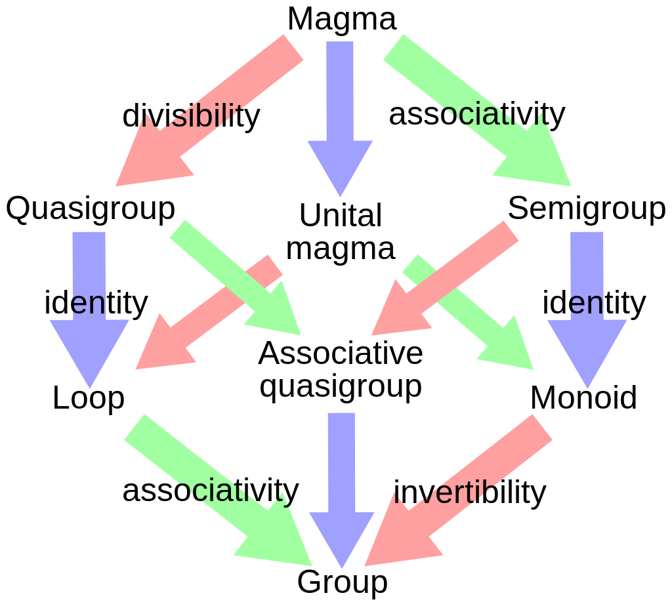
Algebraic Structures
Just FYI
  Various algebraic structures and their relation
We are here

Slide 36
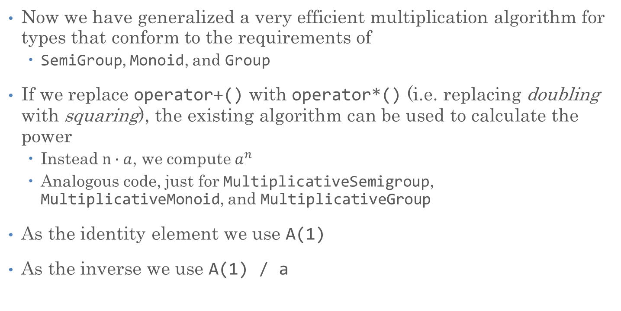
Turning Multiply into Power
Now we have generalized a very efficient multiplication algorithm for types that conform to the requirements of
  SemiGroup, Monoid, and Group
If we replace operator+() with operator*() (i.e. replacing doubling with squaring), the existing algorithm can be used to calculate the power
  Instead $n∙a$, we compute $a^{n}$
  Analogous code, just for MultiplicativeSemigroup, MultiplicativeMonoid, and MultiplicativeGroup
As the identity element we use A(1)
As the inverse we use A(1) / a

Slide 37
Generalizing the Operation
We have two versions of the code, both almost identical
There are many types that are semigroups, monoids, or groups
  Examples:
    Integer multiplication mod 7
    Matrix multiplication
Let’s avoid having to create yet another copy of almost the same code for each of those
Let’s pass the required operation as an additional argument

Slide 38
Generalizing the Operation
template <Regular A, Integer N, SemigroupOperation Op>
requires(Domain<Op, A>) // domain of Op must be A
A power_accumulate_semigroup(A r, A a, N n, Op op)
{
// precondition: n > 0
while (true) {
if (odd(n)) {
r = op(r, a); // was: r + a
if (n == 1) return r;
}
n = half(n);
a = op(a, a); // was: a + a
}
}

Slide 39
Generalizing the Operation
// check whether the domain of a given operation is the same as its argument
template <typename Op, typename A>
concept Domain = std::same_as<A, std::invoke_result_t<Op, A, A>>;
// we can't check whether Op is associative, assume true
template <typename Op>
concept SemigroupOperation = true;

Slide 40
Generalizing the Operation
For any SemiGroup we can now write:
template <Regular A, Integer N, SemigroupOperation Op>
requires(Domain<Op, A>)
A power_semigroup(A a, N n, Op op)
{
// precondition: n > 0
while (!odd(n)) {
a = op(a, a); // was: a + a
n = half(n);
}
if (n == 1) return a;
return power_accumulate_semigroup(a, op(a, a), half(n - 1), op);
}

Slide 41
Generalizing the Operation
template <typename Op>
concept OperationHasIdentityElement = requires(Op op) { identity_element(op); };
template <typename Op>
concept MonoidOperation =
SemigroupOperation<Op> && OperationHasIdentityElement<Op>;

Slide 42
Generalizing the Operation
For any Monoid we can now write:
template <Regular A, Integer N, MonoidOperation Op>
requires(Domain<Op, A>)
A power_monoid(A a, N n, Op op)
{
// precondition: n >= 0
if (n == 0)
return identity_element(op); // was: A(0)
return power_semigroup(a, n, op);
}
Note that we extract the identity element from the operation

Slide 43
Extracting the Identity Element
// The additive identity is zero
template <NoncommutativeAdditiveMonoid T>
T identity_element(std::plus<T>)
{
return T(0);
}
// The multiplicative identity is one
template <MultiplicativeMonoid T>
T identity_element(std::multiplies<T>)
{
return T(1);
}

Slide 44
Generalizing the Operation
template <typename Op>
concept OperationHasInverse = requires(Op op) { inverse_operation(op); };
template <typename Op>
concept GroupOperation = MonoidOperation<Op> && OperationHasInverse<Op>;

Slide 45
Generalizing the Operation
For any Group we can now write:
template <Regular A, Integer N, GroupOperation Op>
requires(Domain<Op, A>)
A power_group(A a, N n, Op op)
{
// precondition: none
if (n < 0) {
n = -n;
a = inverse_operation(op)(a); // was: -a
}
return power_monoid(a, n, op);
}
Note that the operation returned from inverse_operation is immediately invoked

Slide 46
Extracting the Inverse Operation
// The additive inverse operation is negate
template <NoncommutativeAdditiveGroup T>
auto inverse_operation(std::plus<T>)
{
return std::negate<T>(); // create new instance of negate operation
}
template <MultiplicativeGroup T>
struct reciprocal
{
T operator()(T x) const { return T(1) / x; }
};
// the multiplicative inverse is reciprocal
template <MultiplicativeGroup T>
auto inverse_operation(std::multiplies<T>)
{
return reciprocal<T>(); // create new instance of reciprocal operation
}

Slide 47
Fibonacci Numbers

Slide 48
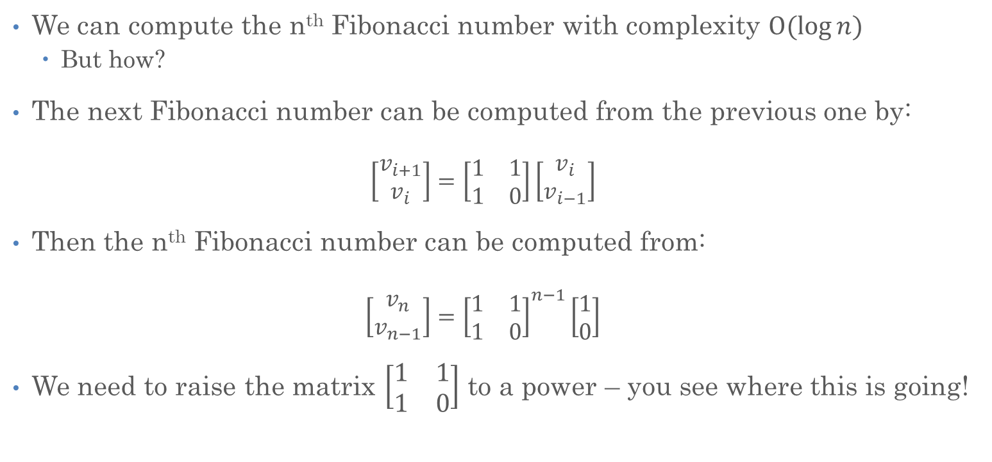
Fibonacci Sequence
We can compute the n^{th} Fibonacci number with complexity $O(log{n)}$
  But how?
The next Fibonacci number can be computed from the previous one by:
  $$\left[\begin{matrix}v_{i+1} \\ v_{i}\end{matrix}\right]=\left[\begin{matrix}1 & 1 \\ 1 & 0\end{matrix}\right]\left[\begin{matrix}v_{i} \\ v_{i−1}\end{matrix}\right]$$
Then the n^{th} Fibonacci number can be computed from:
  $$\left[\begin{matrix}v_{n} \\ v_{n−1}\end{matrix}\right]={\left[\begin{matrix}1 & 1 \\ 1 & 0\end{matrix}\right]}^{n−1}\left[\begin{matrix}1 \\ 0\end{matrix}\right]$$
We need to raise the matrix $\left[\begin{matrix}1 & 1 \\ 1 & 0\end{matrix}\right]$ to a power – you see where this is going!

Slide 49
Fibonacci Sequence
How can we be sure that we can use the power algorithm we developed?
It is known that
  Matrix multiplication is associative
  Square matrices form a multiplicative SemiGroup
We showed that our power algorithm is usable with any SemiGroup that defines an associative operation
We can be sure that our power algorithm gives correct results for raising matrices to a given integral power
q.e.d.

Slide 50
The matrix Type
Take singleton<T> and rename it, add members as needed:
template <typename T>
struct matrix
{
T x11, x12;
T x21, x22;
// ...
};

Slide 51
The matrix Type
Ensure that matrix<T> is Regular:
friend bool operator==(matrix const& lhs, matrix const& rhs)
{
return lhs.x11 == rhs.x11 &&
lhs.x12 == rhs.x12 &&
lhs.x21 == rhs.x21 &&
lhs.x22 == rhs.x22;
}
friend bool operator!=(matrix const& lhs, matrix const& rhs)
{
return !(lhs == rhs);
}

Slide 52
The matrix Type
Adding the required support for multiplication
friend matrix operator*(matrix const& lhs, matrix const& rhs)
{
return matrix{
lhs.x11 * rhs.x11 + lhs.x12 * rhs.x21,
lhs.x11 * rhs.x12 + lhs.x12 * rhs.x22,
lhs.x21 * rhs.x11 + lhs.x22 * rhs.x21,
lhs.x21 * rhs.x12 + lhs.x22 * rhs.x22
};
}

Slide 53
Final Fibonacci Code
int fib(int n)
{
if (n < 2)
return n;
auto result =
power_semigroup(matrix{1, 1, 1, 0}, n - 1, std::multiplies<matrix<int>>());
return result.x11;
}

Slide 54
Fibonacci Instrumented
long fib_sequential(int n)
{
if (n == 0)
return 0;
std::pair<instrumented<long>, instrumented<long>> v = {0, 1};
for (int i = 0; i < n - 1; i++)
{
v = {v.second, v.first + v.second};
}
return v.first.value;
}

Slide 55
Fibonacci Instrumented
long fib(int n)
{
if (n < 2)
return n;
auto result = power_semigroup(
matrix<instrumented<long>>{1, 1, 1, 0}, n - 1,
std::multiplies<matrix<instrumented<long>>>());
return result.x11.value;
}

Slide 56
Fibonacci Instrumented

Slide 57
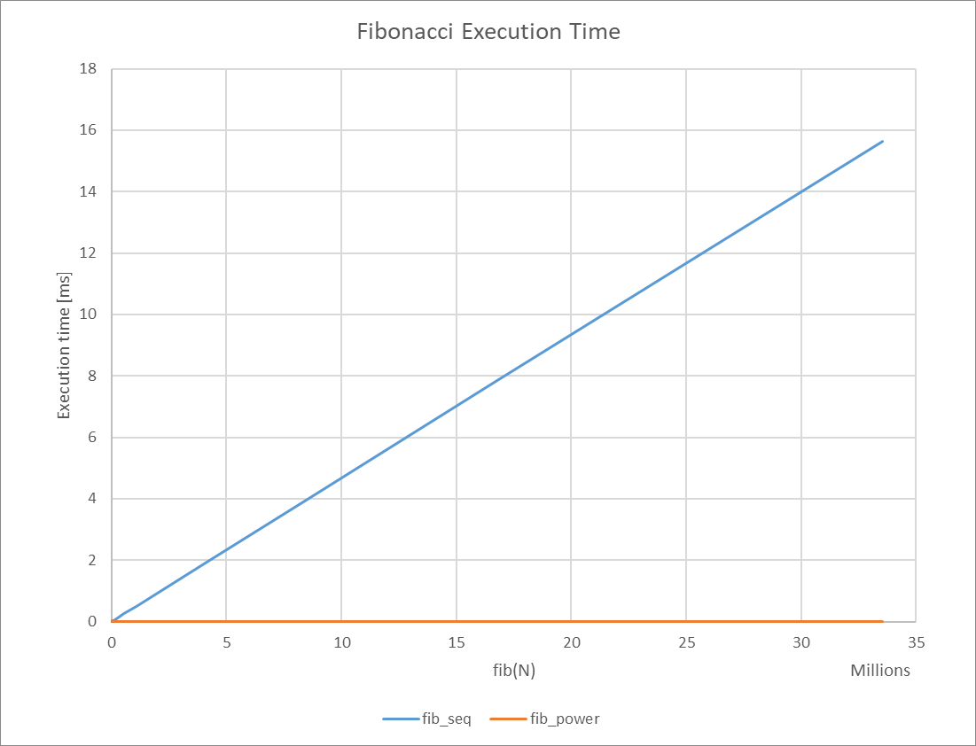
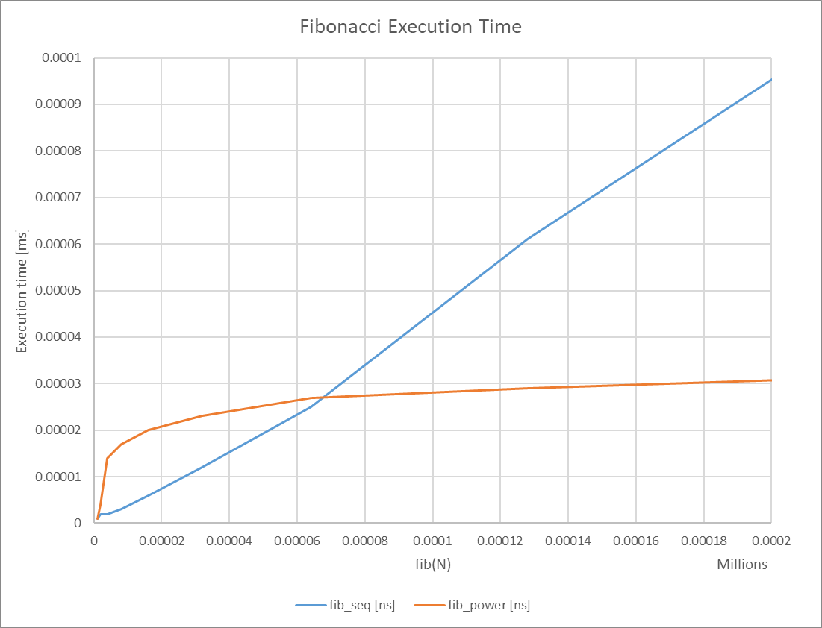
Fibonacci Benchmark

Slide 58
Conclusions
Doing more is sometimes faster than doing less
Understanding the Big-O complexity characteristics of algorithms is important
Understanding the type requirements for algorithms enables code reuse

Slide 59
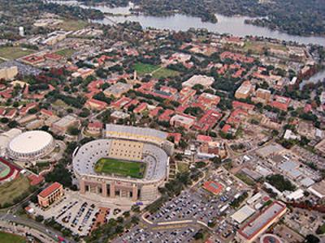







Slide 60
The matrix Type
Ensure that matrix<T> is TotallyOrdered (optional):
friend bool operator<(matrix const& lhs, matrix const& rhs)
{
return lhs.determinant() < rhs.determinant();
}
friend bool operator>(matrix const& x, matrix const& y)
{
return y < x;
}
friend bool operator<=(matrix const& x, matrix const& y)
{
return !(y < x);
}
friend bool operator>=(matrix const& x, matrix const& y)
{
return !(x < y);
}

Slide 61
The matrix Type
Ensure that matrix<T> is TotallyOrdered (optional):
T determinant() const
{
return x11 * x22 - x12 * x21;
}

Slide 62
Fibonacci Instrumented
long fib(int n)
{
if (n < 2)
return n;
auto result = power_semigroup(
instrumented<matrix<long>>{1, 1, 1, 0}, n - 1,
std::multiplies<instrumented<matrix<long>>>());
return result.x11.value;
}

