Slide 1
Midterm Review
Hartmut Kaiser
https://teaching.hkaiser.org/spring2024/csc3380/

Slide 2
Equivalence vs. Equality
Equational reasoning must be applied:
Equivalence is reflexive, symmetric, and transitive:
$$a ≅a$$
$$a≅b\underset{⇔}{}b≅a$$
$$\left(a≅b\right)∧\left(b≅c\right)\underset{⇔}{}(a≅c)$$
Equality implies substitutability:
for any function f on T, $a==b \underset{⇒}{} f\left(a\right)==f(b)$
Inequality must be the negation of equality:
$$\left(a ≠b\right)\underset{⇔}{}¬(a ==b)$$

Slide 3
StrictWeak and Total Ordering
A StrictWeakOrdering is a Binary Predicate that compares two objects, returning true if the first precedes the second
Applying TotalOrdering to equivalence classes
Invoke function on an element and totally order what it returns
StrictWeakOrdering
Partial ordering:
Irreflexivity: !f(x, x)
Antisymmetry: f(x, y) ⬄ !f(y, x)
Transitivity: f(x, y) && f(y, z) ⬄ f(x, z)
Transitivity of equivalence
if $x≅y$ and $y≅z$, then $x≅z$
TotallyOrdered
Additionally connectedness: !f(a, b) && !f(b, a) ⬄ a == b
Transitivity of equality
if $x==y$ and $y==z$, then $x==z$

Slide 4
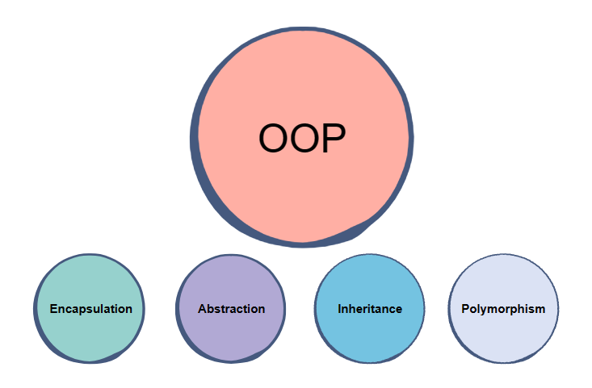
Object Oriented Programming
The four pillars of object-oriented programming are:
Encapsulation: containing information in an object, exposing only selected information
Abstraction: only exposing high-level public methods for accessing an object
Inheritance: child classes inherit data and behaviors from the parent class
Polymorphism: many methods can do the same task
See also: What is object-oriented programming? OOP explained in depth

Slide 5
What is a ‘type’?
A ‘type’ (of an object) defines the following things:
The amount of memory required to store all the data that is needed to support the operations valid for a type
The rules of how to interpret the bits in that memory as values in order to be able to make sense of the bit-salad
The set of values that are valid
The set of operations that are valid on those values
Examples of types:
int, double, float (built-in types)
token, token_stream, std::vector, etc. (user-defined types)

Slide 6
What is an ’object’?
An object is an instance of a type
Occupies memory
Has an optional name (is a variable)
Has a lifetime
Objects in C++ don’t change their type
C++ is a type-safe language
C++ checks types and type compatibility at compile time
Examples of objects:
int i = 0;
token t('+');
std::vector<int> v = {1, 2, 3, 4, 5};

Slide 7
