Slide 1
Scheduling 3: Deadlock
Lecture 11
Hartmut Kaiser
https://teaching.hkaiser.org/spring2025/csc4103/

Slide 2
Recall: Linux O(1) Scheduler
MLFQ-Like Scheduler with 140 Priority Levels
  40 for user tasks, 100 “realtime” tasks
  All algorithms O(1) complexity – low overhead
    Timeslices/priorities/interactivity credits all computed when job finishes time slice
Active and expired queues at each priority
  Once active is empty, swap them (pointers)
  Round Robin within each queue (varying quanta)
Timeslice depends on priority – linearly mapped onto timeslice range
Kernel/Realtime Tasks
User Tasks
0
100
139

Slide 3
Recall: Multi-Core Scheduling
Algorithmically, not a huge difference from single-core scheduling
Implementation-wise, helpful to have per-core scheduling data structures
  Cache coherence
Affinity scheduling: once a thread is scheduled on a CPU, OS tries to reschedule it on the same CPU
  Cache reuse

Slide 4
Recall: Real-Time Scheduling
Goal: Guaranteed Performance
  Meet deadlines even if it means being unfair or slow
  Limit how bad the worst case is
Hard real-time:
  Meet all deadlines (if possible)
  Ideally: determine in advance if this is possible
  Earliest Deadline First (EDF), Least Laxity First (LLF)
Soft real-time
  Attempt to meet deadlines with high probability
  Constant Bandwidth Server (CBS)

Slide 5
Recall: Earliest Deadline First (EDF)
Priority scheduling with preemption
Prefer task with earliest deadline
  Priority proportional to time until deadline
Example with periodic tasks:
0
5
10
15

Slide 6
Recall: Ensuring Progress
Starvation: thread fails to make progress for an indefinite period of time
Causes of starvation:
  Scheduling policy never runs a particular thread on the CPU
  Threads wait for each other or are spinning in a way that will never be resolved
Let’s explore what sorts of problems we might fall into and how to avoid them…

Slide 7
Recall: Schedulers Prone to Starvation
What kinds of schedulers are prone to starvation?
Of the scheduling policies we’ve studied, which are prone to starvation? And can we fix them?
How might we design scheduling policies that avoid starvation entirely?
  Arguably more relevant now than when CPU scheduling was first developed…

Slide 8
Recall: Priority Inversion
Where high priority task is blocked waiting on low priority task
Low priority one must run for high priority to make progress
Medium priority task can starve a high priority one
When else might priority lead to starvation or “live lock”?
High Priority
Low Priority
while (try_lock) {
…
}
lock.acquire(…)
…
lock.release(…)

Slide 9
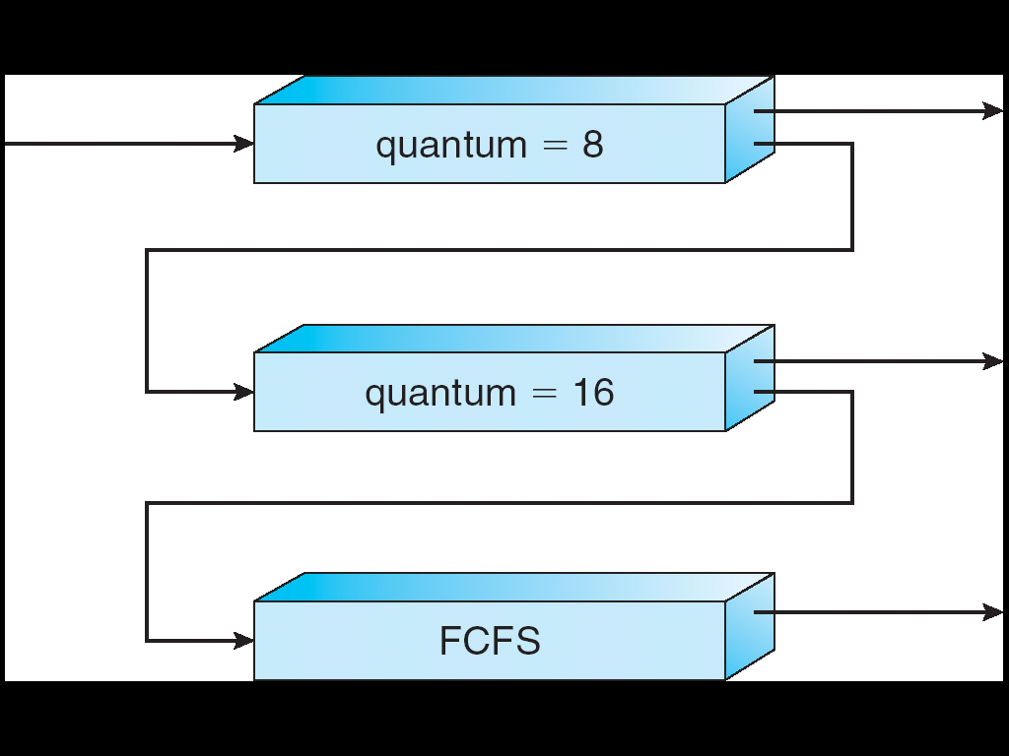
Recall: Are SRTF and MLFQ Prone to Starvation?
In SRTF, long jobs are starved in favor of short ones
  Same fundamental problem as priority scheduling
MLFQ is an approximation of SRTF, so it suffers from the same problem
Long-Running Compute
Tasks Demoted to
Low Priority

Slide 10
Recall: Evaluating Schedulers
Response Time (ideally low)
  What user sees: from keypress to character on screen
  Or completion time for non-interactive
Throughput (ideally high)
  Total operations (jobs) per second
  Overhead (e.g. context switching), artificial blocks
Fairness
  Fraction of resources provided to each
  May conflict with best avg. throughput, resp. time

Slide 11
Recall: Changing Landscape of Scheduling
Priority-based scheduling rooted in “time-sharing”
  Allocating precious, limited resources across a diverse workload
    CPU bound, vs interactive, vs I/O bound
80’s brought about personal computers, workstations, and servers on networks
  Different machines of different types for different purposes
  Shift to fairness and avoiding extremes (starvation)
90’s emergence of the web, rise of internet-based services, the data-center-is-the-computer
  Server consolidation, massive clustered services, huge flashcrowds
  It’s about predictability, 95th percentile performance guarantees

Slide 12
Recall: Proportional-Share Scheduling
The policies we’ve studied so far:
  Always prefer to give the CPU to a prioritized job
  Non-prioritized jobs may never get to run
Instead, we can share the CPU proportionally
  Give each job a share of the CPU according to its priority
  Low-priority jobs get to run less often
  But all jobs can at least make progress (no starvation)

Slide 13
Recall: Lottery Scheduling
Given a set of jobs (the mix), provide each with a share of a resource
  e.g., 50% of the CPU for Job A, 30% for Job B, and 20% for
Idea: Give out tickets according to the proportion each should receive,
Every quantum (tick): draw one at random, schedule that job (thread) to run
Q _{i}
Q _{i+1}
time
Job C

Slide 14
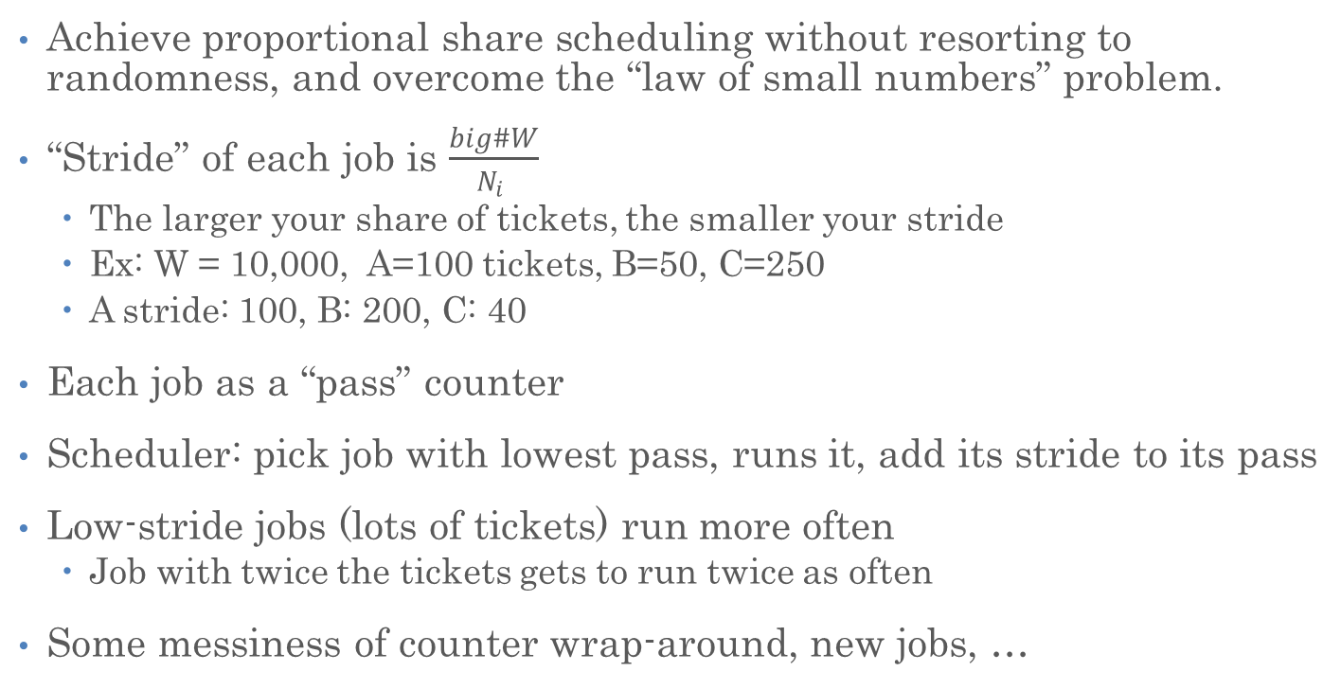
Stride Scheduling
Achieve proportional share scheduling without resorting to randomness, and overcome the “law of small numbers” problem.
“Stride” of each job is $\frac{big\#W}{N_{i} }$
  The larger your share of tickets, the smaller your stride
  Ex: W = 10,000, A=100 tickets, B=50, C=250
  A stride: 100, B: 200, C: 40
Each job as a “pass” counter
Scheduler: pick job with lowest pass, runs it, add its stride to its pass
Low-stride jobs (lots of tickets) run more often
  Job with twice the tickets gets to run twice as often
Some messiness of counter wrap-around, new jobs, …

Slide 15
Recall: Linux Completely Fair Scheduler (CFS)
Instead: track CPU time given to a thread so far
Scheduling Decision:
  “Repair” illusion of complete fairness
  Choose thread with minimum CPU time
Reset CPU time if thread goes to sleep and wakes back up
T₁
CPU
Time
t/N
T₃
T₂

Slide 16
Recall: Linux CFS, Responsiveness
In addition to fairness, we want low response time
Constraint 1: Target Latency
  Period of time over which every process gets service
  Quanta = Target_Latency / n
Target Latency: 20 ms, 4 Processes
  Each process gets 5ms time slice
Target Latency: 20 ms, 200 Processes
  Each process gets 0.1ms time slice (!!!)
  Recall Round-Robin: large context switching overhead if slice gets to small

Slide 17
Recall: Linux CFS, Throughput
Goal: Throughput
  Avoid excessive overhead
Constraint 2: Minimum Granularity
  Minimum length of any time slice
Target Latency 20 ms, Minimum Granularity 1 ms,
200 processes
  Each process gets 1 ms time slice

Slide 18
Recall: Linux CFS: Proportional Shares
Track a thread's virtual runtime rather than its true physical runtime
Higher weight: Virtual runtime increases more slowly
Lower weight: Virtual runtime increases more quickly
Virtual
CPU Time
B
A
Scheduler’s Decisions are based on Virtual CPU Time

Slide 19
Recall: Choosing the Right Scheduler
If You Care About: | Then Choose:
CPU Throughput | FCFS
Average Response Time | SRTF Approximation
I/O Throughput | SRTF Approximation
Fairness (CPU Time) | Linux CFS
Fairness (Wait Time to Get CPU) | Round Robin
Meeting Deadlines | EDF
Favoring Important Tasks | Priority

Slide 20
Deadlocks

Slide 21
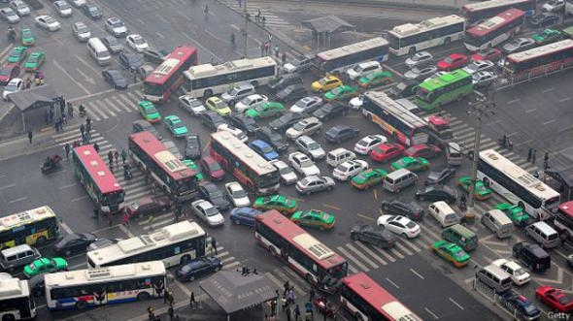

Slide 22
Ensuring Progress
Starvation: thread fails to make progress for an indefinite period of time
Causes of starvation:
  Scheduling policy never runs a particular thread on the CPU
  Threads wait for each other or are spinning in a way that will never be resolved
Let’s explore what sorts of problems we might fall into and how to avoid them…

Slide 23
Deadlock: A Type of Starvation
Starvation – thread fails to make progress for an indefinite period of time
Deadlock – starvation due to a cycle of waiting among a set of threads
  Each thread waits for some other thread in the cycle to take some action
Thread
A
Wait
For
Owned
By
Res 1
Res 2
Owned
By
Wait
For
Thread
B

Slide 24
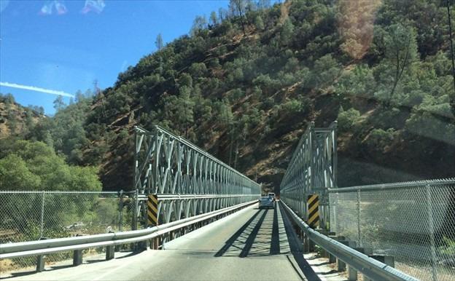
Example: Single-Lane Bridge Crossing
CA 140 to Yosemite National Park

Slide 25
Bridge Crossing Example
Each segment of road can be viewed as a resource
  Cars must own the segment under them
  Must acquire segment that they are moving into
Deadlock: Two cars in opposite directions meet in middle
Honk!

Slide 26
Deadlock with Locks
Thread A
x.Acquire();
y.Acquire();
…
y.Release();
x.Release();
Thread B
y.Acquire();
x.Acquire();
…
x.Release();
y.Release();
Thread
A
Owned
By
Wait
For
Lock x
Lock y
Nondeterministic Deadlock
Thread
B
Owned
By
Wait
For

Slide 27
Deadlock with Locks: Unlucky Case
Thread A
x.Acquire();
y.Acquire(); <stalled>
<unreachable>
…
y.Release();
x.Release();
Thread B
y.Acquire();
x.Acquire(); <stalled>
<unreachable>
…
x.Release();
y.Release();
Thread
A
Owned
By
Wait
For
Lock x
Lock y
Wait
For
Thread
B
Owned
By

Slide 28
Deadlock with Locks: “Lucky” Case
Thread A
x.Acquire();
y.Acquire();
…
y.Release();
x.Release();
Thread B
y.Acquire();
x.Acquire();
…
x.Release();
y.Release();
Thread
A
Owned
By
Wait
For
Lock x
Lock y
Wait
For
Thread
B
Owned
By
Sometimes, schedule won’t trigger deadlock

Slide 29
Other Types of Deadlock
Threads often block waiting for resources
  Locks
  Terminals
  Printers
  CD drives
  Memory
Threads often block waiting for other threads
  Pipes
  Sockets
You can deadlock on any of these!

Slide 30
Deadlock with Space
If only 2 MB of space, we get same deadlock situation
Thread A
AllocateOrWait(1 MB)
AllocateOrWait(1 MB)
Free(1 MB)
Free(1 MB)
Thread B
AllocateOrWait(1 MB)
AllocateOrWait(1 MB)
Free(1 MB)
Free(1 MB)

Slide 31
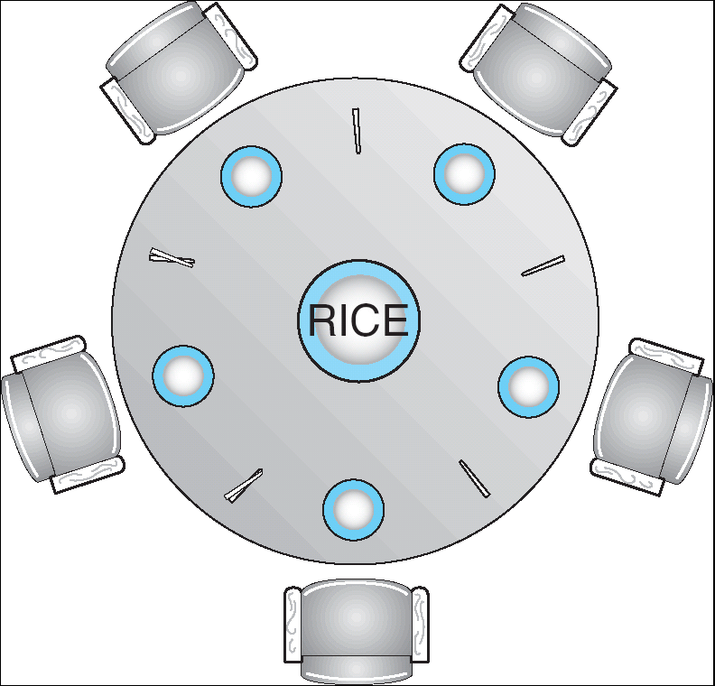
The Dining Philosophers Problem
Five chopsticks, five philosophers
  Goal: Grab two chopsticks to eat
Deadlock if they all grab chopstick to their right
How to fix deadlock?
  Make one of them give up a chopstick
How to prevent deadlock?
  Never take last chopstick if a hungry philosopher can’t have two afterward
  Alternatively, always take either two chopsticks or none

Slide 32
How to Detect Deadlock?

Slide 33
Resource-Allocation Graph
Symbols
System Model
  A set of Threads T₁, T₂, . . ., T_{n}
  Resource types R₁, R₂, . . ., R_{m}
    CPU cycles, memory space, I/O devices
  Each resource type R_{i} has W_{i} instances
  Each thread utilizes a resource as follows:
    Request() / Use() / Release()
Resource-Allocation Graph V:
  V is partitioned into two types:
    T = {T₁, T₂, . . ., T_{n}}, the set threads in the system.
    R = {R₁, R₂, . . ., R_{m}}, the set of resource types in system
  request edge – directed edge T_{i} → R_{j}
  assignment edge – directed edge R_{j} → T_{i}
T₁
T₂
R₁
R₂

Slide 34
Resource-Allocation Graph Examples
Model: Directed Graph
request edge
  T_{i} → R_{j}
assignment edge
  R_{j} → T_{i}
R₁
R₂
R₁
R₂
R₁
T₂
T₁
T₂
T₃
T₁
T₂
T₃
T₁
T₃
R₃
R₃
T₄
R₄
R₂
R₄
Simple Resource
Allocation Graph
Allocation Graph
With Deadlock
Allocation Graph
With Cycle, but
No Deadlock

Slide 35
Deadlock Detection Algorithm
Let [X] represent an m-ary vector of non-negative integers (quantities of resources of each type):
  [FreeResources]: Current free resources of each type
  [Request_{X}]: Current requests from thread X
  [Alloc_{X}]: Current resources held by thread X
See if tasks can eventually terminate on their own
  [Avail] = [FreeResources]
  Add all threads to UNFINISHED # tasks we have not resolved yet
  do {
  done = true
  Foreach thread in UNFINISHED {
  if ([Request_{thread}] <= [Avail]) { # if resources are available
  remove thread from UNFINISHED # task can terminate on its own
  [Avail] = [Avail] + [Alloc_{thread}] # free resources of this task
  done = false
  }
  }
  } until(done)
Nodes left in UNFINISHED ⇒ deadlocked (tasks that can terminate on their own have been removed)
R₁
T₂
T₁
T₃
T₄
R₂

Slide 36
How Should a System Deal With Deadlock?
Three different approaches:
  Deadlock avoidance: dynamically delay resource requests so deadlock doesn’t happen
  Deadlock prevention: write your code in a way that it isn’t prone to deadlock
  Deadlock recovery: let deadlock happen, and then figure out how to recover from it
Modern operating systems:
  Make sure the system isn’t involved in any deadlock
  Ignore deadlock in applications
    “Ostrich Algorithm” or deadlock denial

Slide 37
Deadlock Avoidance
Idea: When a thread requests a resource, OS checks if it would result in deadlock
  If not, it grants the resource right away
  If so, it waits for other threads to release resources
Example:
THIS DOES NOT WORK!!!!
Thread A
x.Acquire();
y.Acquire();
…
y.Release();
x.Release();
Thread B
y.Acquire();
x.Acquire();
…
x.Release();
y.Release();
Blocks…

Slide 38
Deadlock Avoidance: Three States
Safe state
  System can delay resource acquisition to prevent deadlock
Unsafe state
  No deadlock yet…
  But threads can request resources in a pattern that unavoidably leads to deadlock
Deadlocked state
  There exists a deadlock in the system
  Also considered “unsafe”
Deadlock avoidance: prevent system from reaching an unsafe state

Slide 39
Deadlock Avoidance
Idea: When a thread requests a resource, OS checks if it would result in an unsafe state
  If not, it grants the resource right away
  If so, it waits for other threads to release resources
Example:
Thread A
x.Acquire();
y.Acquire();
…
y.Release();
x.Release();
Thread B
y.Acquire();
x.Acquire();
…
x.Release();
y.Release();
Wait until Thread A releases the lock

Slide 40
Banker’s Algorithm for Avoiding Deadlock
Toward right idea:
  State maximum (max) resource needs in advance
  Allow particular thread to proceed if:
    (available resources - #requested) ≥ max remaining that might be needed by any thread
Banker’s algorithm:
  Allocate resources dynamically
    Evaluate each request and grant if some
    ordering of threads is still deadlock free afterward
    Technique: pretend each request is granted, then run deadlock detection algorithm, substituting
    ([Max_{thread}]-[Alloc_{thread}] <= [Avail]) for ([Request_{thread}] <= [Avail])
    Grant request if result is deadlock free (conservative!)

Slide 41
Banker’s Algorithm for Avoiding Deadlock
Toward right idea:
  State maximum (max) resource needs in advance
  Allow particular thread to proceed if:
    (available resources - #requested) ≥ max
    remaining that might be needed by any thread
Banker’s algorithm (less conservative):
  Allocate resources dynamically
    Evaluate each request and grant if some
    ordering of threads is still deadlock free afterward
    Technique: pretend each request is granted, then run deadlock detection algorithm, substituting
    ([Maxnode]-[Allocnode] <= [Avail]) for ([Requestnode] <= [Avail])
    Grant request if result is deadlock free (conservative!)
[Avail] = [FreeResources]
Add all threads to UNFINISHED
do {
done = true
Foreach thread in UNFINISHED {
if ([Max_{thread}]-[Alloc_{thread}] <= [Avail]) {
remove thread from UNFINISHED
[Avail] = [Avail] + [Alloc_{thread}]
done = false
}
}
} until(done)

Slide 42
Banker’s Algorithm for Avoiding Deadlock
Alternative view: Banker’s Algorithm checks whether all tasks finish if:
  Scheduler runs each task to completion one at a time, with no concurrency
    Most conservative thing the scheduler can do—it will avoid deadlock if it’s possible to do so
  Tasks allocate resources up to maximum and hold the resources simultaneously
    Most deadlock-prone thing the tasks can do
If under these circumstances all tasks can proceed, then the system will not enter an ‘unsafe’ state

Slide 43
Applying Banker’s Algorithm to the Dining Philosophers Problem
“Safe” (won’t cause deadlock) if when trying to grab chopstick either:
  Not last chopstick
  Is last chopstick but someone will have two afterwards (a hungry philosopher can’t have two afterward)
What if k-handed philosophers? Don’t allow if:
  It’s the last one, no one would have k
  It’s 2nd to last, and no one would have k-1
  It’s 3rd to last, and no one would have k-2
  …

Slide 44
How Should a System Deal With Deadlock?
Three different approaches:
  Deadlock avoidance: dynamically delay resource requests so deadlock doesn’t happen
  Deadlock prevention: write your code in a way that it isn’t prone to deadlock
  Deadlock recovery: let deadlock happen, and then figure out how to recover from it
Modern operating systems:
  Make sure the system isn’t involved in any deadlock
  Ignore deadlock in applications
    “Ostrich Algorithm” or deadlock denial

Slide 45
Deadlock Prevention
Structure code in a way that it isn’t prone to deadlock
First: What must be true about our code for deadlock to happen?

Slide 46
Four Requirements for Deadlock
Mutual exclusion
  Only one thread at a time can use a resource.
Hold and wait
  Thread holding at least one resource is waiting to acquire additional resources held by other threads
No preemption
  Resources are released only voluntarily by the thread holding the resource, after thread is finished with it
Circular wait
  There exists a set {T₁, …, T_{n}} of waiting threads
    T₁ is waiting for a resource that is held by T₂
    T₂ is waiting for a resource that is held by T₃
    …
    T_{n} is waiting for a resource that is held by T₁
To prevent deadlock, make sure at least one of these conditions does not hold

Slide 47
Deadlock Prevention (1/4)
Remove “Mutual Exclusion”
  Only one thread at a time can use a resource.
  Infinite resources
    Example: Virtual Memory
  Restructure program to avoid sharing

Slide 48
(Virtually) Infinite Resources
With virtual memory we have “infinite” space so everything will just succeed.
Thread A
AllocateOrWait(1 MB)
AllocateOrWait(1 MB)
Free(1 MB)
Free(1 MB)
Thread B
AllocateOrWait(1 MB)
AllocateOrWait(1 MB)
Free(1 MB)
Free(1 MB)

Slide 49
Deadlock Prevention (2/4)
Remove “Hold-and-Wait”
  Thread holding at least one resource is waiting to acquire additional resources held by other threads
  Back off and retry
    Removes deadlock but could still lead to starvation
  Request all resources up front
    Reduces concurrency (parallelism?)
    Example: Dining philosophers grab both chopsticks atomically

Slide 50
Request Resource Atomically
Thread A
x.Acquire();
y.Acquire();
…
y.Release();
x.Release();
Thread B
y.Acquire();
x.Acquire();
…
x.Release();
y.Release();
Consider instead:
Thread A
Acquire_both(x, y);
…
y.Release();
x.Release();
Thread B
Acquire_both(y, x);
…
x.Release();
y.Release();

Slide 51
Request Resource Atomically
Thread A
x.Acquire();
y.Acquire();
…
y.Release();
x.Release();
Thread B
y.Acquire();
x.Acquire();
…
x.Release();
y.Release();
Or consider this:
Thread A
z.Acquire();
x.Acquire();
y.Acquire();
z.Release();
…
y.Release();
x.Release();
Thread B
z.Acquire();
y.Acquire();
x.Acquire();
z.Release();
…
x.Release();
y.Release();

Slide 52
Deadlock Prevention (3/4)
Remove “No Preemption”
  Resources are released only voluntarily by the thread holding the resource, after thread is finished with it
  Allow OS to revoke resources it has granted
    Example: Preemptive scheduling
  Doesn’t always work with resource semantics

Slide 53
Preempting Resources
With virtual memory we have “infinite” space so everything will just succeed.
Alternative view: we are “pre-empting” memory when paging out to disk, and giving it back when paging back in
Thread A
AllocateOrWait(1 MB)
AllocateOrWait(1 MB)
Free(1 MB)
Free(1 MB)
Thread B
AllocateOrWait(1 MB)
AllocateOrWait(1 MB)
Free(1 MB)
Free(1 MB)

Slide 54
Deadlock Prevention (4/4)
Remove “Circular Wait”
  T₁ waits for T₂ and T₂ waits for T₁
  Acquire resources in a consistent order
  Acquire all resources atomically

Slide 55
Acquire Resources in a Consistent Order
Thread A
x.Acquire();
y.Acquire();
…
y.Release();
x.Release();
Thread B
y.Acquire();
x.Acquire();
…
x.Release();
y.Release();
Consider instead:
Thread A
x.Acquire();
y.Acquire();
…
y.Release();
x.Release();
Thread B
x.Acquire();
y.Acquire();
…
x.Release();
y.Release();
Does it matter in which order the locks are released?

Slide 56
How Should a System Deal With Deadlock?
Three different approaches:
  Deadlock avoidance: dynamically delay resource requests so deadlock doesn’t happen
  Deadlock prevention: write your code in a way that it isn’t prone to deadlock
  Deadlock recovery: let deadlock happen, and then figure out how to recover from it
Modern operating systems:
  Make sure the system isn’t involved in any deadlock
  Ignore deadlock in applications
    “Ostrich Algorithm” or deadlock denial

Slide 57
How to Deal with Deadlock?
Terminate thread, force it to give up resources
  Dining Philosophers Example: Remove a dining philosopher
  In AllocateOrWait example, OS kills a process to free up some memory
  Not always possible—killing a thread holding a lock leaves world inconsistent
Roll back actions of deadlocked threads
  Common techniques in databases (transactions)
  Of course, if you restart in exactly the same way, may enter deadlock again
Preempt resources without killing off thread
  Temporarily take resources away from a thread
  Doesn’t always fit with semantics of computation

Slide 58
Announcements
Assignment 2: due Monday, April 7
Project 1: deadline extended to Monday, April 7

Slide 59
The multi-oom Test (Project 1)
The multi-oom test is designed to stress your Project 1 implementation
Keeps creating processes until doing so fails
  Checks that you handle all failures properly (e.g., malloc failures)
Exits in unclean ways
  Checks that you properly handle exiting due to a fault, exiting with files open…
Checks whether all memory has been released when process exits
  Verify that every page_alloc has a page_free, every malloc has a corresponding free
It repeats the same thing 10 times, and checks that it can spawn the same number of processes each time
  To make sure there are no memory leaks

Slide 60
Conclusion
Starvation vs. Deadlock
  Starvation: Thread indefinitely unable to make progress
  Deadlock: Thread(s) unable to make progress due to circular wait
Four conditions for deadlock:
  Mutual exclusion
  Hold and wait
  No preemption
  Circular Wait
Three different approaches to address deadlock:
  Deadlock avoidance: dynamically delay resource requests so deadlock doesn’t happen
  Deadlock prevention: write your code in a way that it isn’t prone to deadlock
  Deadlock recovery: let deadlock happen, and then figure out how to recover from it
Or deadlock denial: ignore the possibility of deadlock in applications

Slide 61
