Slide 1
Memory 1: Address Translation
Lecture 13
Hartmut Kaiser
https://teaching.hkaiser.org/spring2025/csc4103/

Slide 2
Goals for Today
Finish up discussion of highly concurrent systems
Start exploring OS memory management (if time permits)

Slide 3
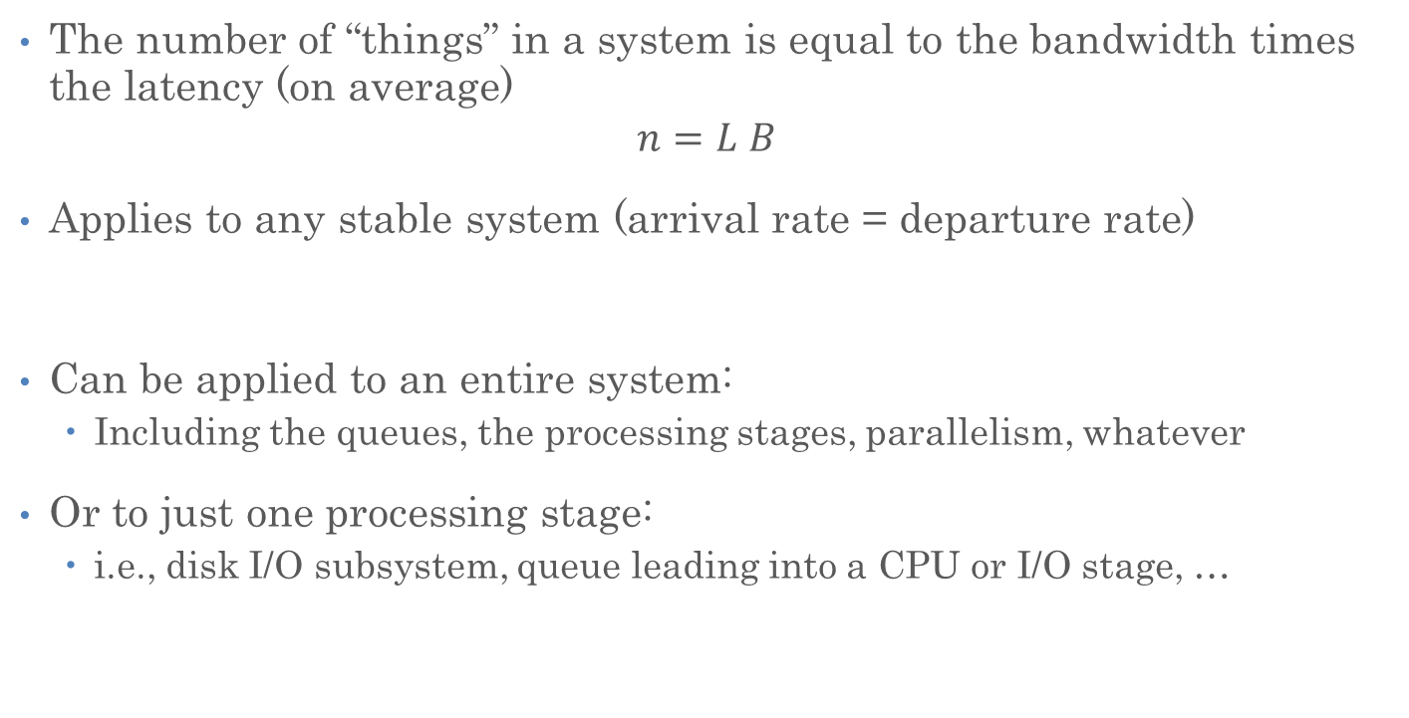
Recall: Little’s Law
The number of “things” in a system is equal to the bandwidth times the latency (on average)
$$n=L B$$
Applies to any stable system (arrival rate = departure rate)
Can be applied to an entire system:
  Including the queues, the processing stages, parallelism, whatever
Or to just one processing stage:
  i.e., disk I/O subsystem, queue leading into a CPU or I/O stage, …

Slide 4
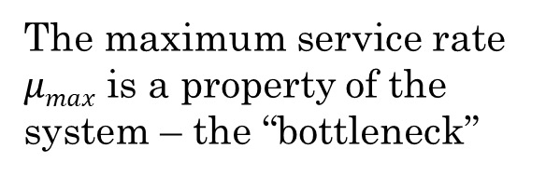





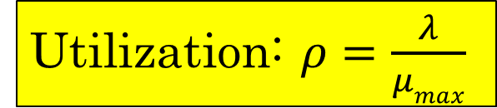
Recall: A Simple System Performance Model
Request Rate: $λ$
Latency ($L$)
Queuing delay: $d$
Operation Time: $t$
The maximum service rate $μmax$ is a property of the system – the “bottleneck”
Utilization: $ρ=\frac{λ}{μmax}$
Service Rate: $μ$

Slide 5



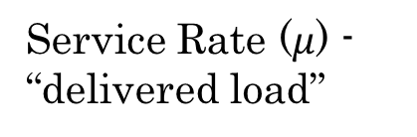
Recall: Ideal System Performance
How does $μ$ (service rate) vary with $λ$ (request rate)?
asymptotic peak rate
$$μmax$$
Service Rate ($μ$) - “delivered load”
$$μmax$$
Request Rate ($λ$ ) - “offered load”

Slide 6


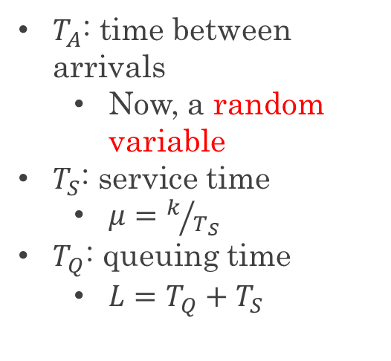
Recall: A Bursty World
Requests arrive in a burst, must queue up until served
Same average arrival time, but almost all of the requests experience large queue delays (even though average utilization is low)
$T_{A}$: time between arrivals
  Now, a random variable
$T_{S}$: service time
  $μ=k/{T_{S}}$
$T_{Q}$: queuing time
  $L=T_{Q}+T_{S}$
arrivals
Queue
Server
departures
$$T_{Q}$$
$$T_{S}$$
Arrivals
Q depth
Server

Slide 7


Recall: Little’s Law Applied to a Queue
Before, we had $n=LB$ (for a stable system):
  $B$: bandwidth
  $L$: latency
  $n$: number of operations in the system
When applied to a queue, we get:
Average Arrival Rate
$$L_{Q}=λT_{Q}$$
Average length of the queue
Average time “waiting”

Slide 8
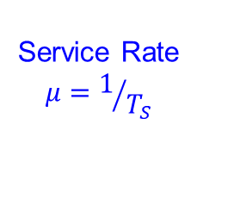

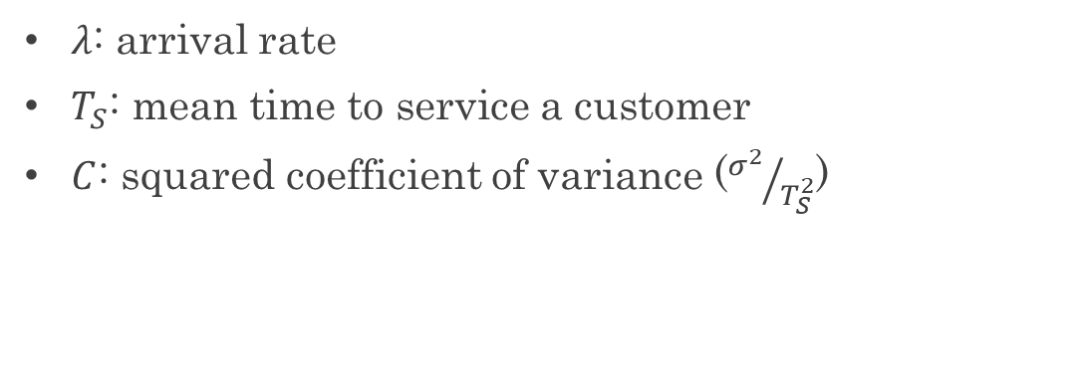
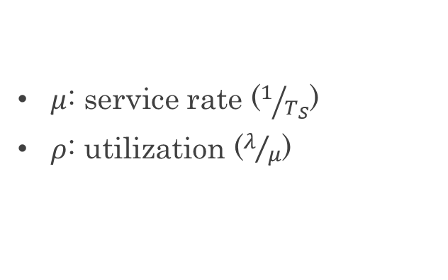
Recall: Some Results from Queuing Theory
Assumptions: system in equilibrium, no limit to the queue, time between successive arrivals is random and memoryless
Queue
Server
Arrival Rate
$$λ$$
Service Rate
$$μ=1/{T_{S}}$$
$λ$: arrival rate
$T_{S}$: mean time to service a customer
$C$: squared coefficient of variance (${σ^{2}}/{T_{S}^{2}}$)
$μ$: service rate ($1/{T_{S}}$)
$ρ$: utilization ($λ/μ$)

Slide 9

Recall: Some Results from Queuing Theory
Memoryless service distribution ($C=1)$ - an “M/M/1 queue”:
  $$T_{Q}=\frac{ρ}{1−ρ}⋅T_{S}$$
General service distribution (no restrictions) - an “M/G/1 queue”:
  $$T_{Q}=\frac{1+C}{2}⋅\frac{ρ}{1−ρ}⋅T_{S}$$
$λ$: arrival rate
$T_{S}$: mean time to service a customer
$C$: squared coefficient of variance (${σ^{2}}/{T_{S}^{2}}$)
$μ$: service rate ($1/{T_{S}}$)
$ρ$: utilization ($λ/μ$)

Slide 10

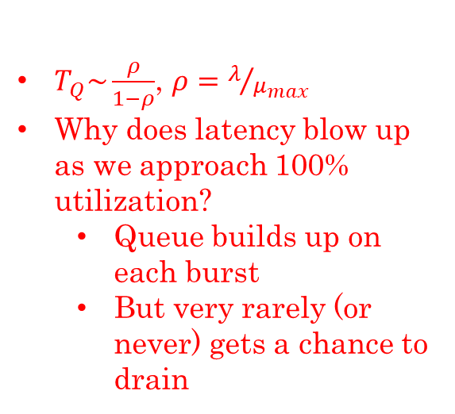




Recall: Ideal System Performance
$T_{Q}\sim \frac{ρ}{1−ρ}$, $ρ=λ/{μ_{max}}$
Why does latency blow up as we approach 100% utilization?
  Queue builds up on each burst
  But very rarely (or never) gets a chance to drain
Latency ($λ$)
Service Rate ($μ$) - “delivered load”
Time
$$μmax$$
Operation Time
$$μmax$$
Request Rate ($λ$ ) - “offered load”
“Half-Power Point”: load at which system delivers half of peak performance
Design and provision systems to operate roughly in this regime
Latency low and predictable, utilization good: ~50%

Slide 11




Do real systems really hit a wall as utilization approaches 100%?
$$μmax$$
server
Open System
$$λ$$
clients
$$μmax$$
server
$$λ$$
Closed System
clients

Slide 12
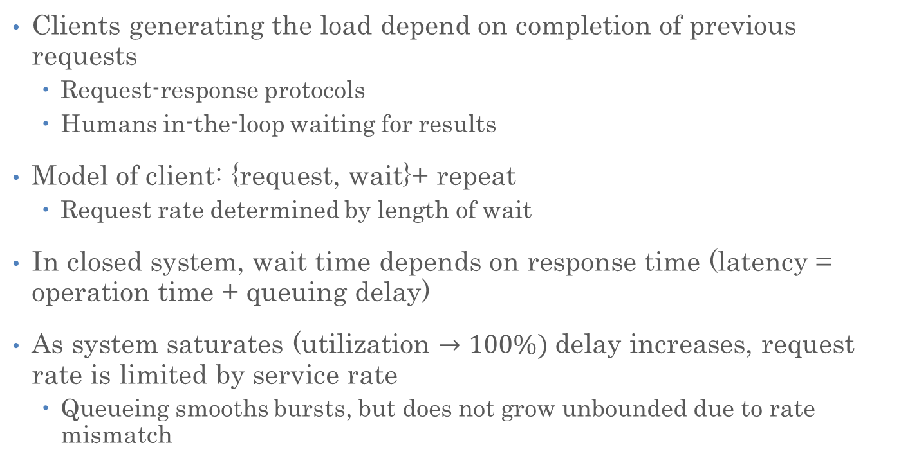
Closed System
Clients generating the load depend on completion of previous requests
  Request-response protocols
  Humans in-the-loop waiting for results
Model of client: {request, wait}+ repeat
  Request rate determined by length of wait
In closed system, wait time depends on response time (latency = operation time + queuing delay)
As system saturates (utilization $→100\%)$delay increases, request rate is limited by service rate
  Queueing smooths bursts, but does not grow unbounded due to rate mismatch

Slide 13
What Causes Systems to Close?
Protocols are designed to have self-limited behavior
  Request-response, bounded number of outstanding requests per client
Underlying system induces “back pressure” even if higher level services and applications don’t
  Bounded size queues (not just because of memory size)
  What happens when it fills up?

Slide 14
Queuing Theory Resources
Queuing theory resources are available on the “Resources” section of the course website

Slide 15
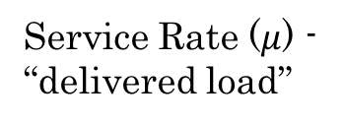



Recall: Well-Conditioned Systems
A system that behaves this way is well-conditioned
  Delivered load increases with offered load until pipeline saturates
  As offered load increases further, throughput remains high
asymptotic peak rate
$$μmax$$
Service Rate ($μ$) - “delivered load”
$$μmax$$
Request Rate ($λ$ ) - “offered load”

Slide 16
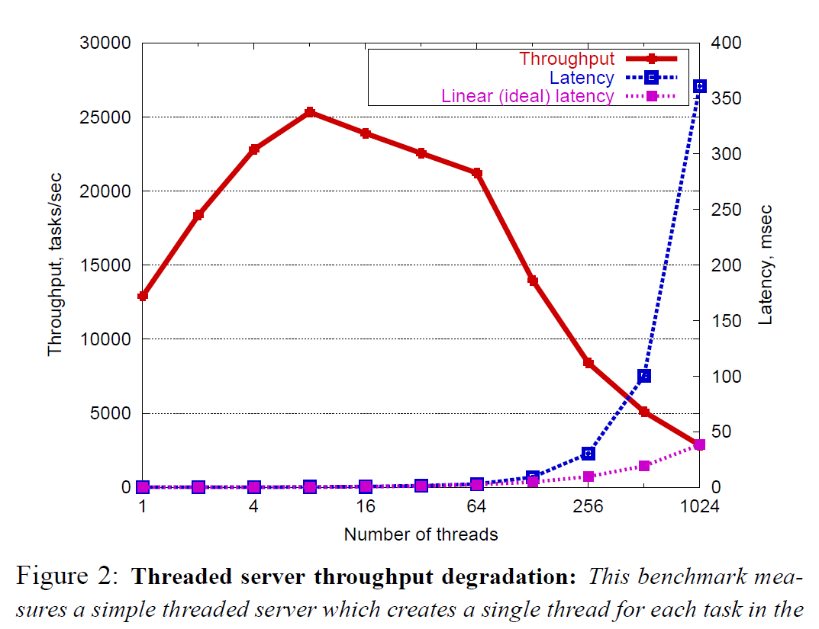
Recall: Non-Well-Conditioned Systems
A server that spawns a new pthread per request is not well-conditioned!
Figure from SEDA Section 2 reading (Welsh 2001)

Slide 17
Building Well-Conditioned Systems
Spawning a new thread or process for each request is not well-conditioned
Too many threads is bad
  Scheduling overhead becomes large
  Context switch overhead becomes large
    E.g., Poor cache performance
  Synchronization overhead becomes large
    E.g., Lock contention
Was our original (v1) server well-conditioned?
  The one that handles requests one at a time, with no concurrency?

Slide 18
System Performance and Highly Concurrent Systems
Part 2

Slide 19
Concurrent, Well-Conditioned Systems
Thread Pools
User-Mode Threads
Event-Driven Execution

Slide 20
Thread Pools
Key idea: limit the number of threads
  Before throughput starts to degrade
Instead, allocate a bounded “pool” of worker threads, representing the maximum level of multiprogramming
Master
Thread
queue
Thread Pool

Slide 21
Thread Pools
master() {
allocThreads(worker, queue);
while(TRUE) {
con = AcceptCon();
Enqueue(queue, con);
}
}
worker(queue) {
while(TRUE) {
// Blocks if empty
con = Dequeue(queue);
ServiceWebPage(con);
}
}
Master
Thread
queue
Thread Pool

Slide 22
Highly Concurrent Well-Conditioned Systems
Thread pools work well, but they somewhat limit concurrency
Is there a good alternative?

Slide 23
We’ve Looked At: Kernel-Supported Threads
Threads run and block (e.g., on I/O) independently
One process may have multiple threads waiting on different things
Two mode switches for every context switch (expensive)
Create threads with syscalls
Alternative: multiplex several streams of execution (at user level) on top of a single OS thread
  E.g., Java, Go, … (and many many user-level threads libraries before it)

Slide 24
Concurrent, Well-Conditioned Systems
Thread Pools
User-Mode Threads
Event-Driven Execution

Slide 25
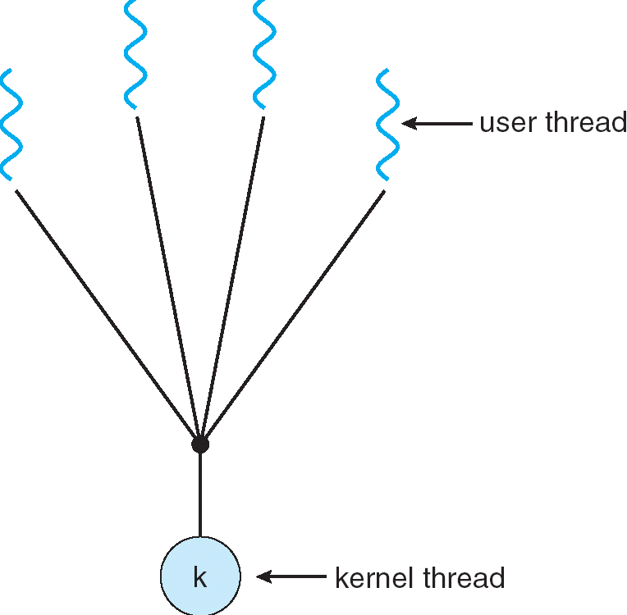
User-Mode Threads
User program contains its own
scheduler
Several user threads per kernel thread
User threads may be scheduled
non-preemptively
  Only switch on yield
Context switches cheaper
  Copy registers and jump (switch in userspace)

Slide 26
Thread Yield
Kernel-Supported Threads
User-Mode Threads
ComputePI
ComputePI
yield (syscall)
Library Function
Call (Cheap)
yield
Trap to OS
(Expensive)
kernel_yield
Stack growth
run_new_user_
thread
Stack growth
run_new_kernel_
thread
switch
switch

Slide 27
Thread I/O
Kernel-Supported Threads
User-Mode Threads
CopyFile
CopyFile
read
read
Trap to OS
Trap to OS
kernel_read
Stack growth
kernel_read
Stack growth
run_new_thread
run_new_thread
switch
switch
Selects a new kernel thread to run
Bypassing user-level scheduler

Slide 28
User-Mode Threads: Problems
One user-level thread blocks on I/O: they all do
  Kernel cannot adjust scheduling among threads it doesn’t know about
Multiple Cores?
Can’t completely avoid blocking (syscalls, page fault)
One Solution: Scheduler Activations
  Have kernel inform user-level scheduler when a thread blocks
  Evolving the contract between OS and application
Alternative Solution: Language Support?
  Make the scheduler aware of the blocking operation

Slide 29
Go Goroutines
Goroutines are lightweight, user-level threads
  Scheduling not preemptive (relies on goroutines to yield)
  Yield statements inserted by compiler
Advantages relative to regular threads (e.g., pthreads)
  More lightweight
  Faster context-switch time
Disadvantages
  Less sophisticated scheduling at the user-level
  OS is not aware of user-level threads

Slide 30
Go User-Level Scheduler
Why this approach?
1 OS (kernel-supported) thread per CPU core: allows Go program to achieve parallelism not just concurrency
  Fewer OS threads? Not utilizing all CPUs
  More OS threads? No additional benefit
    We’ll see one exception to this involving syscalls
Keep goroutine on same OS thread: affinity, nice for caching and performance

Slide 31
Go User-Level Thread Scheduler
Why not just have a single global run queue?
Global Run Queue
Newly created goroutines
Local Run Queue
Local Run Queue
Local Run Queue
OS Thread (M)
OS Thread (M)
OS Thread (M)
…
CPU Core
CPU Core
CPU Core

Slide 32
Dealing with Blocking Syscalls
What if a goroutine wants to make a blocking syscall?
  Example: File I/O
Local Run Queue
Running Go-rtn.
OS Thread (M1)
CPU Core

Slide 33
Dealing with Blocking Syscalls
What if a goroutine wants to make a blocking syscall?
  Example: File I/O
While syscall is blocking, allocate new OS thread (M2)
  M1 is blocked by kernel, M2 lets us continue using CPU
Local Run Queue
OS Thread (M2)
Blocking Go-rtn.
CPU Core
OS Thread
(M1)

Slide 34
Dealing with Blocking Syscalls
Syscall completes: Put invoking goroutine back on queue
Keep M1 around in a spare pool
Swap it with M2 upon next syscall, no need to pay thread creation cost
Local Run Queue
Running Go-rtn.
OS Thread (M2)
Ready Go-rtn.
CPU Core
OS Thread
(M1)

Slide 35
Recall: Motivation for Threads
Operating systems must handle multiple things at once (MTAO)
  Processes, interrupts, background system maintenance
Networked servers must handle MTAO
  Multiple connections handled simultaneously
Parallel programs must handle MTAO
  To achieve better performance
Programs with user interface often must handle MTAO
  To achieve user responsiveness while doing computation
Network and disk bound programs must handle MTAO
  To hide network/disk latency
  Sequence steps in access or communicatoin

Slide 36
Recall: Threads Allow Handling MTAO
Threads are a unit of concurrency provided by the OS
Each thread can represent one thing or one task

Slide 37
Concurrent, Well-Conditioned Systems
Thread Pools
User-Mode Threads
Event-Driven Execution

Slide 38
Event-Driven Execution
Allows a system to handle MTAO with a single thread
  Very lightweight
Key idea: juggle different tasks within a single thread
  All tasks’ CPU bursts execute within a single thread
  I/O bursts for each task happen in the background without a backing thread

Slide 39
Event-Driven Server Concept
  while (true) {
  int task_id = <wait for a task to become ready>
  <look up state for task_id>
  <execute next CPU burst for this task>
  if (task is done) {
  <forget state for task_id>
  continue;
  }
  <issue task’s next (I/O) operation>
  <update state for task_id>
  }

Slide 40
How to “Issue Task’s Next I/O Operation”?
So far, we’ve seen read and write, which block the calling thread
We can put file descriptors into non-blocking mode
  read: Just return whatever data is available
  write: Just write whatever the kernel can buffer in its memory for now
  So read/write calls may not read or write anything
How to wait for the next task to become ready to perform its I/O?

Slide 41
How to “Wait for Task to Become Ready”?
POSIX provides a way to wait for one of several files to have data available
  select/poll system calls
  Provide a list of file descriptors
  Blocks until at least one has “ready” data, then returns which ones do
  Mixes well with non-blocking I/O, especially sockets

Slide 42
Alternative Asynchronous I/O APIs
Unfortunately, non-blocking mode and select/poll don’t work well with regular files
Instead: there’s the asynchronous I/O interface
  io_submit issues a disk I/O
  io_getevents syscall reaps completion of disk I/Os issued with io_submit
Newer, better APIs still emerging (e.g., io_uring)

Slide 43
Event-Driven Server Concept
  while (true) {
  int task_id = <wait for a task to become ready>
  <look up state for task_id>
  <execute next CPU burst for this task>
  if (task is done) {
  <forget state for task_id>
  continue;
  }
  <issue task’s next (I/O) operation>
  <update state for task_id>
  }
This looks kind of like the OS thread scheduler…
But it runs in the user program!

Slide 44
User-Mode Scheduler Based on Event Loop
User-mode scheduler can be an event-loop
User threads use I/O library that issues async I/O operations
Now user-mode scheduler can properly suspend the thread…
But only works for I/O operations for which the kernel supports an asynchronous interface

Slide 45
User-Mode Scheduling vs. Event Loops
In user-mode scheduling:
  You’re still maintaining a separate stack for each thread
  Must save PC, stack, registers when switching
  Even if you use async I/O operations to properly suspend the user thread
In pure event-driven scheduling:
  All events execute in the same stack
  All state to resume each task (e.g., which stage we’re at) must be stored explicitly

Slide 46
Final Word on Scheduling
When do the details of the scheduling policy and fairness really matter?
When should you simply buy a faster computer?
  One approach: Buy it when it will pay
  for itself in improved response time
    Perhaps you’re paying for worse response
    time in reduced productivity, customer angst,
    etc…
    Might think that you should buy a faster X
    when X is utilized 100%, but usually, response
    time goes to infinity as utilization⇒100%
An interesting implication of this curve:
  Most scheduling algorithms work fine in the “linear” portion of the load curve, fail otherwise
  Argues for buying a faster X when hit “knee” of curve
Response
time
100%
Utilization

Slide 47
Announcements
Assignment 2, due Monday April 14
Project 1, due Monday April 21
Assignment 3 will be posted asap, due May 2
No further deadline extensions for any of those will be possible

Slide 48
Address Translation

Slide 49
Next Objective
Dive deeper into the concepts and mechanisms of memory sharing and address translation
Enabler of many key aspects of operating systems
  Protection
  Multi-programming
  Isolation
  Memory resource management
  I/O efficiency
  Sharing
  Inter-process communication
  Debugging
  Demand paging

Slide 50
Recall: Four Fundamental OS Concepts
Thread: Execution Context
  Program Counter, Registers, Execution Flags, Stack
Address Space (with Translation)
  Program’s view of memory is distinct from physical machine
Process: Instance of a Running Program
  Address space + one or more threads + …
Dual-Mode Operation and Protection
  Only the “system” can access certain resources
  Combined with translation, isolates programs from each other

Slide 51
Key OS Concept: Address Space
Program operates in an address space that is distinct from the physical memory space of the machine
0x000…
Processor
Translator
Memory
Registers
0xFFF…

Slide 52
Recall: Address Space
Definition: Set of accessible addresses and the state associated with them
  2³² = ~4 billion on a 32-bit machine
What happens when you read or write to an address?
  Perhaps acts like regular memory
  Perhaps causes I/O operation
    (Memory-mapped I/O)
  Causes program to abort (segfault)?
  Communicate with another program
  …
0x000…
Code
Static Data
Heap
Stack
0xFFF…

Slide 53
Recall: Typical Address Space Structure
0x000…
PC:
SP:
Code
Static Data
Processor
registers
Heap
Stack
0xFFF…

Slide 54
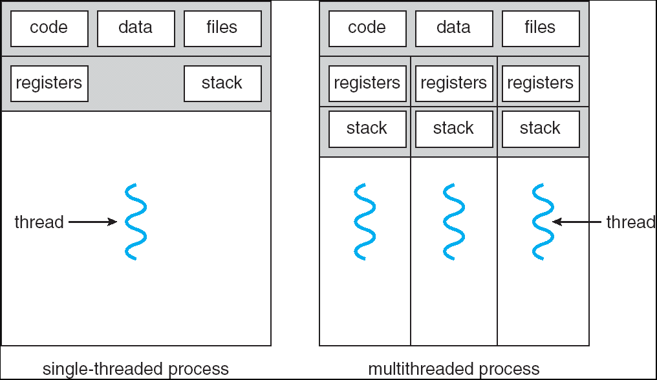
Recall: Single and Multithreaded Processes
Threads encapsulate concurrency
  “Active” component
Address space encapsulate protection:
  “Passive” component
  Keeps bugs from crashing the entire system
Why have multiple threads per address space?

Slide 55
Important Aspects of Memory Multiplexing
Protection
  Prevent access to private memory of other process or kernel
Translation
  Gives uniform view of memory to programs
  Allows for efficient “tricks”
    E.g., in implementation of fork()
Controlled Overlap
  Read-only data, execute-only shared libraries
  Inter-process communication

Slide 56
Alternative View: Interposing on Process Behavior
OS interposes on process’ I/O operations
  How? All I/O happens via syscalls.
OS interposes on process’ CPU usage
  How? Interrupt lets OS preempt current thread
Question: How can the OS interpose on process’ memory accesses?
  Too slow for the OS to interpose every memory access
  Translation: hardware support to accelerate the common case
  Page fault: uncommon cases trap to the OS to handle

Slide 57
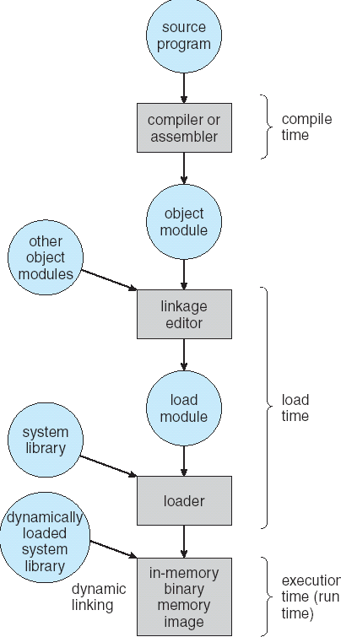
From Program to Process
Preparation of a program for execution involves components at:
  Compile time (i.e., “gcc”)
  Link/Load time (UNIX “ld” does link)
  Execution time (e.g., dynamic libs)
Addresses can be bound to final values anywhere in this path
  Depends on hardware support
  Also depends on operating system
Dynamic Libraries
  Linking postponed until execution
  Small piece of code (i.e. the stub), locates appropriate memory-resident library routine
  Stub replaces itself with the address of the routine, and executes routine

Slide 58

Uniprogramming: One Process at a Time
No Translation or Protection
  Application always runs at same place in physical memory since only one application at a time
  Application can access any physical address
  Application given illusion of dedicated machine by giving it reality of a dedicated machine
0xFFFFFFFF
Operating
System
Valid 32-bit
Addresses
Application
0x00000000

Slide 59

Primitive Multiprogramming
Multiprogramming without Translation or Protection
Use Loader/Linker: Adjust addresses while program loaded into memory (loads, stores, jumps)
  Everything adjusted to memory location where OS put program
  Translation done by a linker-loader (relocation)
No protection!
0xFFFFFFFF
Operating
System
Application2
0x00020000
Application1
0x00000000

Slide 60

Multiprogramming with Protection
Can we protect programs from each other without translation?
  Yes: Base and Bound!
  Used by, e.g., Cray-1 supercomputer
0xFFFFFFFF
Operating
System
LimitAddr=0x10000
BaseAddr=0x20000
Application2
0x00020000
Application1
0x00000000

Slide 61
Recall: Base and Bound (no Translation)
Requires relocation
Can the program touch OS?
Can it touch other programs?
0000…
Code
Static Data
Original Program
Heap
Base Address
0000…
1000…
Stack
code
≥
1000…
Static Data
0010…
Code
Program
address
1010…
heap
Static Data
Heap
stack
Bound
<
0100…
Stack
1100…
0100…
FFFF…

Slide 62
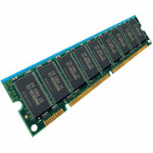
General Translation
Two views of memory:
  View from the CPU (what program sees, virtual memory)
  View from memory (physical memory)
  Hardware translator (Memory Management Unit or MMU) converts between the two views
With translation, every program can be linked/loaded into same region of user address space
CPU
Virtual Addresses
MMU
Physical Addresses

Slide 63
Recall: Base and Bound (with Translation)
0000…
Can the program touch OS?
Can it touch other programs?
Fragmentation still an issue!
Code
Static Data
Original Program
Heap
0000…
Stack
code
Base Address
1000…
Static Data
0010…
1000…
Code
Program
address
0010…
heap
Static Data
1010…
Heap
stack
Bound
<
0100…
Stack
1100…
0100…
FFFF…

Slide 64
Issues with Simple Base and Bound
process 6
Fragmentation problem over time
No support for sparse address space
Hard to do interprocess sharing
  E.g., to share code
process 6
process 6
process 6
process 5
process 5
process 5
process 9
process 9
process 11
process 2
process 10
OS
OS
OS
OS

Slide 65
Segmentation

Slide 66
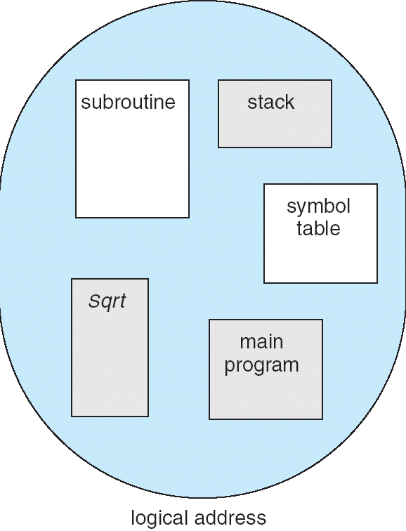
Segmentation
Program’s view of memory: multiple separate segments
Each segment is given a region of contiguous memory
  Has a base and limit
Memory address consists of segment ID and offset
1
1
1
4
2
3
2
2
4
3
user view of
memory space
physical
memory space

Slide 67
Hardware Support for Segmentation
offset
Segment map resides in
processor
  Segment number mapped to
  base/bound pair (for translation)
Each entry corresponds to a chunk
of physical memory
  Segment addressed by portion of virtual address
  However, could be included in instruction instead:
    x86 Example: mov [es:bx],ax.
What is “V/N” (valid / not valid)?
  Can mark segments as invalid; requires check as well
Virtual
Address
Seg #
Offset
>
Error
Base0
Limit0
V
Base1
Limit1
V
Base2
Limit2
V
Base2
Limit2
V
Physical
Address
Base3
Limit3
N
+
Base4
Limit4
V
Base5
Limit5
N
Base6
Limit6
N
Base7
Limit7
V
Check Valid
Access
Error

Slide 68
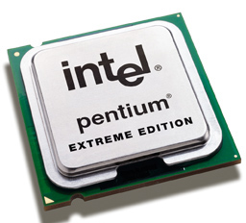
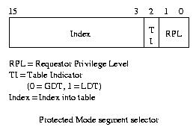
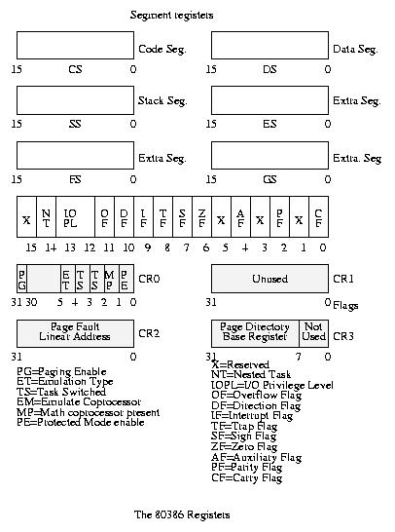
Intel x86 Special Registers
Segmentation can’t be just “turned off”
What if we just want to use paging?
  Set base and bound to all of memory, in all segments
80386 Special Registers

Slide 69
Example: Four Segments
Virtual Address Format:
Seg ID # | Base | Limit
0 (code) | 0x4000 | 0x0800
1 (data) | 0x4800 | 0x1400
2 (shared) | 0xF000 | 0x1000
3 (stack) | 0x0000 | 0x3000
Seg
Offset
15
14
13
0
SegID = 0
0x0000
0x0000
SegID = 1
0x4000
Might be shared
0x4000
0x4800
0x5C00
0x8000
Space for Other Apps
0xC000
0xF000
Shared with
Other Apps
Virtual Address Space
Physical Address Space

Slide 70
Observations about Segmentation
Translation on every instruction fetch, load or store
Virtual address space has holes
  Segmentation efficient for sparse address spaces
When it is OK to address outside valid range?
  This is how the stack (and heap?) is allowed to grow
  For instance, stack takes fault, system automatically increases size of stack
Need protection mode in segment table
  For example, code segment would be read-only
  Data and stack would be read-write (stores allowed)
What must be saved/restored on context switch?
  Segment table stored in CPU, not in memory (small)
  Might store all of processes memory onto disk when switched (called “swapping”)

Slide 71
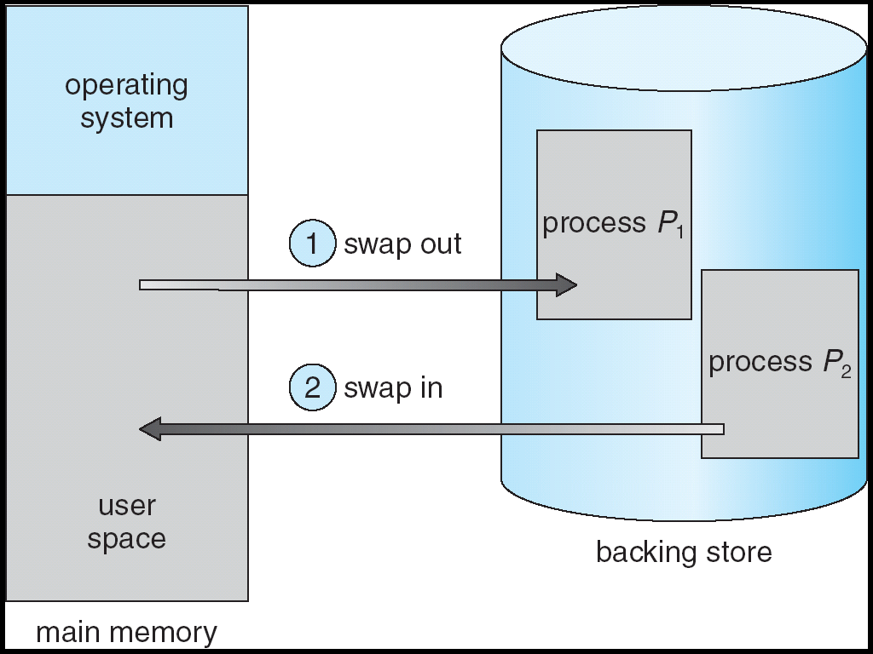
What if not all segments fit in memory?
Extreme form of Context Switch: Swapping
  In order to make room for next process, some or all of the previous process is moved to disk
    Likely need to send out complete segments
  This greatly increases the cost of context-switching
What might be a desirable alternative?
  Some way to keep only active portions of a process in memory at any one time
  Need finer granularity control over physical memory

Slide 72
Problems with Segmentation
Must fit variable-sized chunks into physical memory
May move processes multiple times to fit everything
Limited options for swapping to disk
Fragmentation: wasted space
  External: free gaps between allocated chunks
  Internal: don’t need all memory within allocated chunks

Slide 73
