Slide 1
Memory 2: Paging, Caching, and TLBs
Lecture 14
Hartmut Kaiser
https://teaching.hkaiser.org/spring2025/csc4103/

Slide 2
Recall: Address Space
Definition: Set of accessible addresses and the state associated with them
  2³² = ~4 billion on a 32-bit machine
What happens when you read or write to an address?
  Perhaps acts like regular memory
  Perhaps causes I/O operation
    (Memory-mapped I/O)
  Causes program to abort (segfault)?
  Communicate with another program
  …
0x000…
Code
Static Data
Heap
Stack
0xFFF…

Slide 3
Recall: Important Aspects of Memory Translation
Protection
  Prevent access to private memory of other process or kernel
Translation
  Gives uniform view of memory to programs
  Allows for efficient “tricks”
    E.g., in implementation of fork()
Controlled Overlap
  Read-only data, execute-only shared libraries
  Inter-process communication

Slide 4
Recall: Interposing on Process Behavior
OS interposes on process’ I/O operations
  How? All I/O happens via syscalls.
OS interposes on process’ CPU usage
  How? Interrupt lets OS preempt current thread
Question: How can the OS interpose on process’ memory accesses?
  Too slow for the OS to interpose every memory access
  Translation: hardware support to accelerate the common case
  Page fault: uncommon cases trap to the OS to handle

Slide 5

Recall: Uniprogramming
No Translation or Protection
  Application always runs at same place in physical memory since only one application at a time
  Application can access any physical address
  Application given illusion of dedicated machine by giving it reality of a dedicated machine
0xFFFFFFFF
Operating
System
Valid 32-bit
Addresses
Application
0x00000000

Slide 6
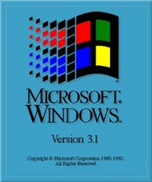
Recall: Primitive Multiprogramming
Multiprogramming without Translation or Protection
Use Loader/Linker: Adjust addresses while program loaded into memory (loads, stores, jumps)
  Everything adjusted to memory location where OS put program
  Translation done by a linker-loader (relocation)
No protection!
0xFFFFFFFF
Operating
System
Application2
0x00020000
Application1
0x00000000

Slide 7

Recall: Multiprogramming with Protection
Can we protect programs from each other without translation?
  Yes: Base and Bound!
  Used by, e.g., Cray-1 supercomputer
0xFFFFFFFF
Operating
System
LimitAddr=0x10000
BaseAddr=0x20000
Application2
0x00020000
Application1
0x00000000

Slide 8
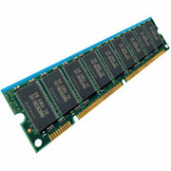
Recall: General Translation
Two views of memory:
  View from the CPU (what program sees, virtual memory)
  View from memory (physical memory)
  Hardware translator (Memory Management Unit or MMU) converts between the two views
With translation, every program can be linked/loaded into same region of user address space
CPU
Virtual Addresses
MMU
Physical Addresses

Slide 9
Recall: Issues with Simple Base and Bound
process 6
Fragmentation problem over time
No support for sparse address space
Hard to do interprocess sharing
  E.g., to share code
process 6
process 6
process 6
process 5
process 5
process 5
process 9
process 9
process 11
process 2
process 10
OS
OS
OS
OS

Slide 10
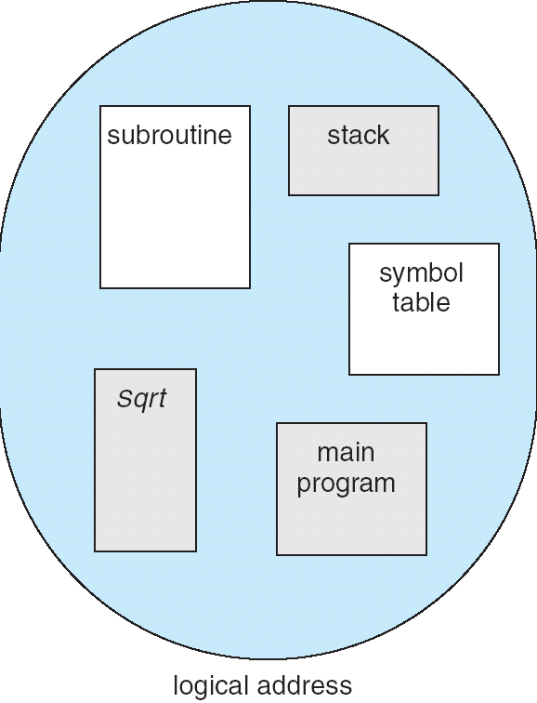
Recall: Segmentation
Program’s view of memory: multiple separate segments
Each segment is given a region of contiguous memory
  Has a base and limit
Memory address consists of segment ID and offset
1
1
1
4
2
3
2
2
4
3
user view of
memory space
physical
memory space

Slide 11
Recall: Problems with Segmentation
Must fit variable-sized chunks into physical memory
May move processes multiple times to fit everything
Limited options for swapping to disk
Fragmentation: wasted space
  External: free gaps between allocated chunks
  Internal: don’t need all memory within allocated chunks

Slide 12
Recall: General Address Translation
Code
Data
Heap
Stack
Data 2
(user process view of memory)
Code
Data
Heap
Stack
Stack 1
0x000…
Heap 1
Code 1
Code
Stack 2
Static Data
Prog 1
Virtual
Address
Space 1
Data 1
Prog 2
Virtual
Address
Space 2
Heap
Heap 2
Code 2
OS code
OS data
Stack
Translation Map 1
OS heap/
Stacks
Translation Map 2
Physical Address Space
0xFFF…

Slide 13
Paging: Fixed-Size Chunks of Memory
Divide up physical memory into equal-size chunks called page frames
Divide up virtual memory into equal-size chunks called pages
Key idea: each physical page frame can contain any page
No external fragmentation!
Should pages be as big as our previous segments?
  No: Can lead to lots of internal fragmentation
    Typically have small pages (1K-16K)
  Consequently: need multiple pages/segment

Slide 14
Hardware Support for Paging
Page Table (One per process)
  Contains physical page and permission for each virtual page
    Permissions include: Valid bits, Read, Write, etc.
Virtual address mapping
  Offset from Virtual address copied to Physical Address
  Virtual page # is the index into the page table
    Physical page # copied from table into physical address
Virtual Address:
Virtual
Page #
Offset
PageTablePtr
page #0
V,R
Physical
Page #
Offset
page #1
V,R
page #1
V,R
Physical Address
>
page #2
V,R,W
PageTableSize
page #3
V,R,W
Check Perm
Access Error
page #4
N
page #5
V,R,W
Access
Error

Slide 15
Simple Page Table Example
What is the physical address for
  Virtual address 0x06?
  Virtual address 0x09?
Example (4 byte pages)
0x00
0000 0000
0x00
a
b
c
d
0001 0000
0x04
0
4
i
j
k
l
0x04
0000 0100
1
0000 1100
0x05
e
f
g
h
3
2
1
0000 0100
0x08
0x06?
0x08
0000 1000
Page
Table
0x0C
i
j
k
l
e
f
g
h
0x09?
0x0E
0x10
Virtual
Memory
0000 0110
0000 1110
a
b
c
d
0000 1001
0000 0101
Physical Memory

Slide 16
What About Sharing?
Virtual Address
(Process A):
Virtual
Page #
Offset
PageTablePtrA
Where is page sharing used?
  Kernel data mapped into each process
  Different processes running the same binary
  User-level system libraries
  Shared pages as IPC
page #0
V,R
page #1
V,R
page #2
V,R,W
page #2
V,R,W
page #3
V,R,W
Shared
Page
page #4
N
page #5
V,R,W
PageTablePtrB
page #0
V,R
page #1
N
This physical page
appears in both
process’ address
spaces
page #2
V,R,W
page #3
N
page #4
V,R
page #4
V,R
Virtual Address
(Process B):
page #5
V,R,W
Virtual
Page #
Offset

Slide 17
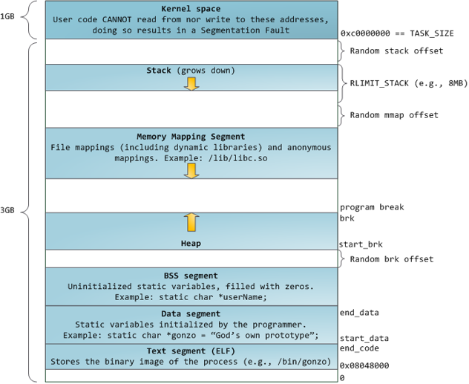
Example: Memory Layout for Linux 32-bit*
Diagram source: http://static.duartes.org/img/blogPosts/linuxFlexibleAddressSpaceLayout.png

Slide 18
Summary: Paging
Virtual memory view
Page Table
Physical memory view
1111 1111
11111 11101
11110 11100
11101 null
11100 null
11011 null
11010 null
11001 null
11000 null
10111 null
10110 null
10101 null
10100 null
10011 null
10010 10000
10001 01111
10000 01110
01111 null
01110 null
01101 null
01100 null
01011 01101
01010 01100
01001 01011
01000 01010
00111 null
00110 null
00101 null
00100 null
00011 00101
00010 00100
00001 00011
00000 00010
1110 1111
1111 0000
stack
stack
1110 0000
1100 0000
heap
1000 0000
heap
0111 000
data
data
0101 000
0100 0000
code
code
0001 0000
0000 0000
0000 0000
page #
offset

Slide 19
Summary: Paging
Virtual memory view
Page Table
Physical memory view
1111 1111
11111 11101
11110 11100
11101 null
11100 null
11011 null
11010 null
11001 null
11000 null
10111 null
10110 null
10101 null
10100 null
10011 null
10010 10000
10001 01111
10000 01110
01111 null
01110 null
01101 null
01100 null
01011 01101
01010 01100
01001 01011
01000 01010
00111 null
00110 null
00101 null
00100 null
00011 00101
00010 00100
00001 00011
00000 00010
1110 1111
1111 0000
stack
stack
1110 0000
1100 0000
What happens if stack grows to 1110 0000?
heap
1000 0000
heap
0111 000
data
data
0101 000
0100 0000
code
code
0001 0000
0000 0000
0000 0000
page #
page #
offset

Slide 20
Summary: Paging
Virtual memory view
Page Table
Physical memory view
1111 1111
11111 11101
11110 11100
11101 10111
11100 10110
11011 null
11010 null
11001 null
11000 null
10111 null
10110 null
10101 null
10100 null
10011 null
10010 10000
10001 01111
10000 01110
01111 null
01110 null
01101 null
01100 null
01011 01101
01010 01100
01001 01011
01000 01010
00111 null
00110 null
00101 null
00100 null
00011 00101
00010 00100
00001 00011
00000 00010
1110 1111
1111 0000
stack
stack
1110 0000
1100 0000
What happens if stack grows to 1110 0000?
stack
Allocate new pages where room!
heap
1000 0000
heap
0111 000
data
data
0101 000
0100 0000
code
code
0001 0000
0000 0000
0000 0000
page #
page #
offset

Slide 21
Summary: Paging
Virtual memory view
Page Table
Physical memory view
1111 1111
11111 11101
11110 11100
11101 10111
11100 10110
11011 null
11010 null
11001 null
11000 null
10111 null
10110 null
10101 null
10100 null
10011 null
10010 10000
10001 01111
10000 01110
01111 null
01110 null
01101 null
01100 null
01011 01101
01010 01100
01001 01011
01000 01010
00111 null
00110 null
00101 null
00100 null
00011 00101
00010 00100
00001 00011
00000 00010
1110 1111
1111 0000
stack
stack
1110 0000
1100 0000
What happens if stack grows to 1110 0000?
stack
Allocate new pages where room!
heap
1000 0000
heap
0111 000
data
data
0101 000
0100 0000
code
code
0001 0000
Challenge: Table size equal to # of pages in virtual memory!
0000 0000
0000 0000
page #
page #
offset

Slide 22
How Big is the Page Table?
Typical page size: 4 KiB
  How many bits of the address is that? (remember 2¹⁰ = 1024)
  Ans: 4KiB = 4×2¹⁰ = 2¹² ⇒ 12 bits of the address
So how big is the simple page table for each process?
  2³²/2¹² = 2²⁰ (that’s about a million entries) x 4 bytes each => 4 MiB
  When 32-bit machines got started (vax 11/780, intel 80386), this was a lot of memory
How big is a simple page table on a 64-bit processor (x86_64)?
  2⁶⁴/2¹² = 2⁵² (that’s 4.5×10¹⁵ or 4.5 exa-entries)×8 bytes each =
  36×10¹⁵ bytes or 36 exa-bytes!!!! This is a ridiculous amount of memory!
Mostly, the address space is sparse, i.e. has holes in it that are not mapped to physical memory
  So, most of this space is taken up by page tables mapped to nothing

Slide 23
Page Table Discussion
What provides protection here?
  Translation (per process) and dual-mode operation!
  Can’t let process alter its own page table!
Analysis
  Pros
    Simple memory allocation
    Easy to share
  Con: What if address space is sparse?
    E.g., on UNIX, code starts at 0, stack starts at (2³¹-1)
    With 4K pages, need 1 million page table entries (256 pages for the page table)!
  Con: What if table really big?
    Not all pages used all the time ⇒ would be nice to have working set of page table in memory
Simple Page table is way too big!
  Does it all need to be in memory?
  How about multi-level paging?
  or combining paging and segmentation

Slide 24
How to Structure a Page Table
Page Table is a map from VPN to PPN
Simple page table corresponds to a sparse array
  VPN is index into table, each entry contains PPN
What other map structures can you think of?
  Trees?
  Hash Tables?

Slide 25
Two-Level Page Table
Physical
Address:
Physical
Page #
Offset
10 bits
10 bits
12 bits
Virtual
Address:
Virtual
P1 index
Virtual
P2 index
Offset
Tree of Page Tables
Tables fixed size (1024 entries)
  On context-switch: save single PageTablePtr register
Valid bits on Page Table Entries
  Don’t need every 2nd-level table
  Even when exist, 2nd-level tables can reside on disk if not in use
4KB
PageTablePtr
4 bytes
4 bytes

Slide 26
Summary: Two-Level Paging
Virtual memory view
Page Table
(level 1)
Page Tables
(level 2)
Physical memory view
1111 1111
stack
11 11101
10 11100
01 10111
00 10110
stack
1110 0000
1111 0000
1100 0000
stack
111
110 null
101 null
100
011 null
010
001 null
000
11 null
10 10000
01 01111
00 01110
1001 0000
heap
1000 0000
heap
0111 000
11 01101
10 01100
01 01011
00 01010
data
data
0101 000
0100 0000
11 00101
10 00100
01 00011
00 00010
code
page2 #
code
0001 0000
0000 0000
0000 0000
page1 #
offset

Slide 27
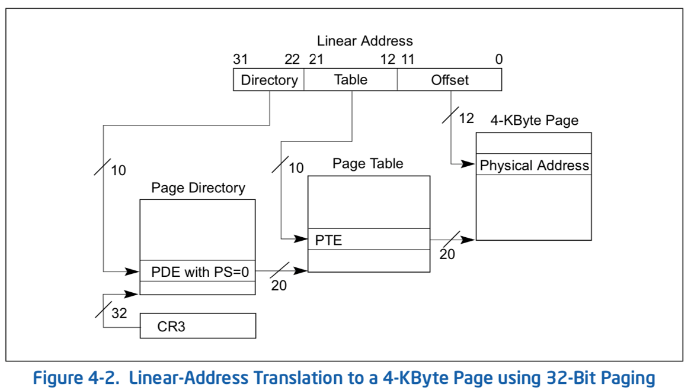
x86 Classic 32-bit Address Translation

Slide 28
x86-64: Four-Level Page Table!
9 bits
9 bits
9 bits
9 bits
12 bits
48-bit Virtual
Address:
Virtual
P1 index
Virtual
P2 index
Virtual
P3 index
Virtual
P4 index
Offset
PageTablePtr
8 bytes
4096-byte pages (12 bit offset)
Page tables also 4k bytes (pageable)
Physical
Address:
(40-50 bits)
Physical Page #
12bit Offset

Slide 29
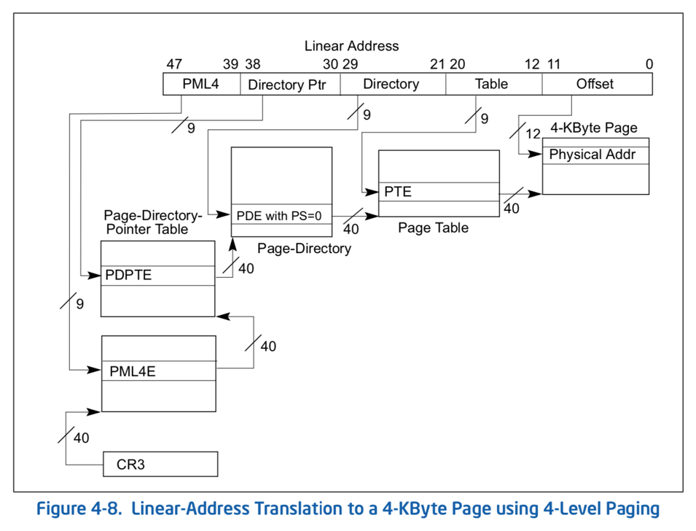
Large 64-bit Address Space
All current x86-64 processors support 64-bit operations
64-bit words but 48-bit addresses

Slide 30
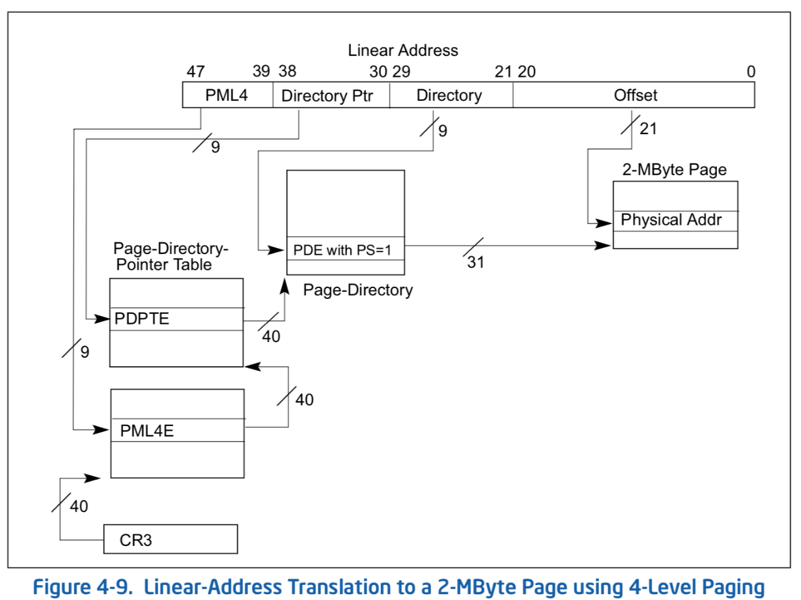
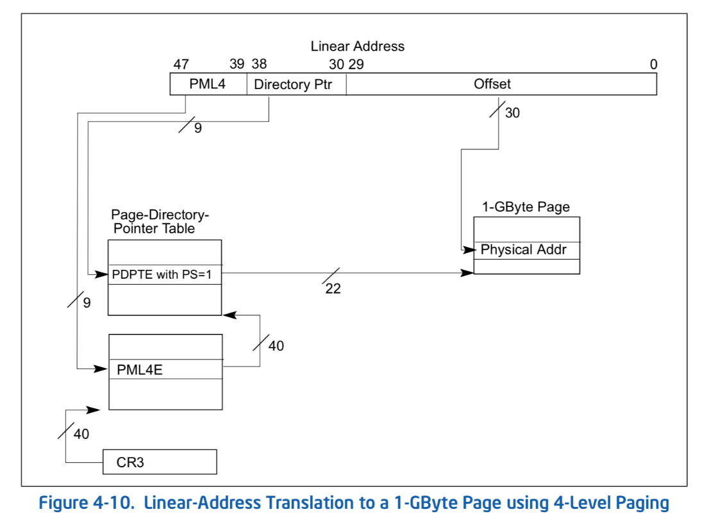
“Huge Pages” Supported as Well
Memory is now cheap…

Slide 31
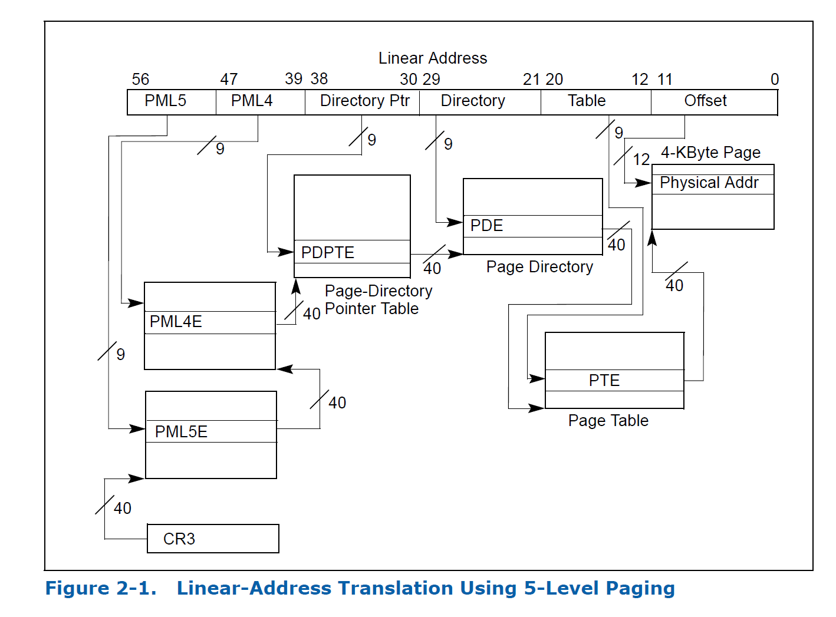
Intel Ice Lake (2019): One More Layer

Slide 32
Multi-Level Translation Analysis
Pros:
  Only need to allocate as many page table entries as we need for application
    In other words, sparse address spaces are easy
  Easy memory allocation
  Easy Sharing
    Share at segment or page level (need additional reference counting)
Cons:
  One pointer per page (typically 4K – 16K pages today)
  Page tables need to be contiguous
    However, previous example keeps tables to exactly one page in size
  Two (or more, if >2 levels) lookups per reference
    Seems very expensive!

Slide 33
Aside: Segments + Pages
Virtual
Address:
Virtual
Seg #
Virtual
Page #
Offset
page #0
V,R
page #1
V,R
Physical
Page #
Offset
Base0
Limit0
V
page #2
V,R,W
Base1
Limit1
V
page #2
V,R,W
Physical Address
Base2
Limit2
V
page #3
V,R,W
Base2
Limit2
V
Base3
Limit3
N
page #4
N
Base4
Limit4
V
page #5
V,R,W
Check Permissions
Base5
Limit5
N
Base6
Limit6
N
Base7
Limit7
V
>
Access
Error
Access
Error
What must be saved/restored on context switch?
  Contents of top-level segment registers (for this example)
  Pointer to top-level table (page table)

Slide 34
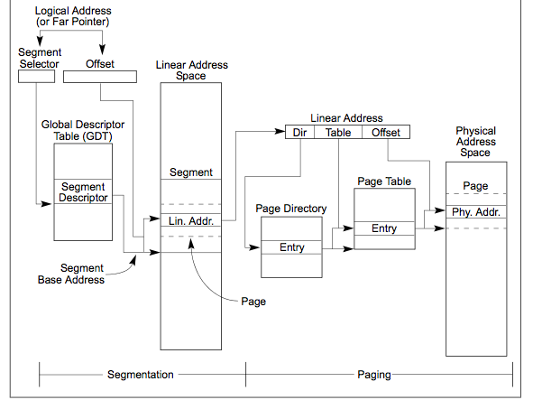
Aside: x86 Memory with Segmentation
Segment Selector from
instruction: mov eax, gs(0x0)
2-level page table
in 10-10-12 bit address
Second level
called “table”
Combined address
Is 32-bit “linear”
Virtual address
First level
called “directory”

Slide 35
IA-64: 64-bit Address: Six Levels???
64bit Virtual
Address:
7 bits
9 bits
9 bits
9 bits
9 bits
9 bits
12 bits
Virtual
P1 index
Virtual
P2 index
Virtual
P3 index
Virtual
P4 index
Virtual
P5 index
Virtual
P6 index
Offset
Too slow
Too many almost-empty tables

Slide 36
Alternative: Inverted Page Table
With all previous examples
(“Forward Page Tables”)
  Size of page table is at least proportional
  to amount of virtual memory allocated to
  processes
  Physical memory may be much less
    Much of process space may be out on disk or not in use
Answer: use a hash table
  Called an “Inverted Page Table”
  Size is independent of virtual address space
  Directly related to amount of physical memory
  Very attractive option for 64-bit address spaces
    PowerPC, UltraSPARC, IA64
Cons:
  Complexity of managing hash chains: Often in hardware!
  Poor cache locality of page table
Virtual
Page #
Offset
Hash
Table
Physical
Page #
Offset

Slide 37
Address Translation Comparison
 | Advantages | Disadvantages
Simple Segmentation | Fast context switching (segment map maintained by CPU) | External fragmentation
Paging (Single-Level) | No external fragmentation Fast and easy allocation | Large table size (~ virtual memory) Internal fragmentation
Paged Segmentation | Table size ~ # of pages in virtual memory Fast and easy allocation | Multiple memory references per page access
Multi-Level Paging
Inverted Page Table | Table size ~ # of pages in physical memory | Hash function more complex No cache locality of page table

Slide 38
Announcements
Assignment 2 (extended) deadline today
Project 1 (extended) deadline Monday, April 21
  Questionnaire for project 1 will be posted on Moodle soon
Assignment 3 deadline Friday May 2
No lectures next week (April 21 and April 23)

Slide 39
How to Translate Addresses Fast Enough?
The MMU must translate virtual address to physical address on:
  Every instruction fetch
  Every load
  Every store
More than one translation for EVERY instruction
  Each one requires a page table tree traversal (!)
  How to simplify this???
CPU
Virtual Addresses
MMU
Physical Addresses

Slide 40
Where and What is the MMU?
On every memory reference (I-fetch, Load, Store), MMU reads (multiple levels of) page table entries to get physical frame or FAULT
  Through the caches to the memory
  Then read/write the physical location
Read <Phys_Addr X>
Physical
Memory
Read <V_Addr m>
Processor
(core)
pgm data
MMU
Cache(s)
Cache Lines
PTBR
page tables
< data @ mem[VtoP(m)] >

Slide 41
Recall: Memory Hierarchy
Large memories are slow
Small memories are fast
Address Translation needs to occur here
Page table lives here (perhaps cached)
Processor
Secondary
Storage
(Disk)
Core
L2 Cache
Registers
L1 Cache
Secondary
Storage
(SSD)
Main
Memory
(DRAM)
Core
L3 Cache
(shared)
Registers
L1 Cache
L2 Cache
Speed (ns):
0.3
1
3
10-30
100
100,000
(0.1 ms)
10,000,000
(10 ms)
Size (bytes):
100Bs
10kBs
100kBs
MBs
GBs
100GBs
TBs

Slide 42
Recall: Caches
Cache: a repository for copies that can be accessed more quickly than the original
  Make frequent case fast and infrequent case less dominant
Caching underlies many techniques used to make computers fast
  Can cache: memory locations, address translations, pages, file blocks, file names, network routes, etc…
Key measure:
Average Access time =
(Hit Rate x Hit Time) + (Miss Rate x Miss Time)

Slide 43
Recall: Caching Memory
Main
Memory
(DRAM)
Average Memory Access Time (AMAT)
= (Hit Rate x HitTime) + (Miss Rate x MissTime)
Where: HitRate + MissRate = 1
HitRate = 90% => AMAT = (0.9 x 1) + (0.1 x (100+1)) = 11 ns
HitRate = 99% => AMAT = (0.99 x 1) + (0.01 x (100+1)) = 2 ns
MissTime_{L1} includes HitTime_{L1}+MissPenalty_{L1} ≡ HitTime_{L1} +AMAT_{L2}
Processor
Access time = 100ns
Main
Memory
(DRAM)
Cache
(SRAM)
Processor
1 ns
100ns

Slide 44
Why Does Caching Help? Locality!
Temporal Locality (Locality in Time)
  Keep recently accessed data items closer to processor
Spatial Locality (Locality in Space)
  Move contiguous blocks to the upper levels
Probability
of reference
0
Address Space
2^{n} - 1
Lower Level
Memory
To Processor
Upper Level
Memory
Blk X
From Processor
Blk Y

Slide 45
Recall: Working Set Model
As a program executes it transitions through a sequence of “working sets” consisting of varying sized subsets of the address space
Address
Time

Slide 46
Recall: Memory Hierarchy
Take advantage of the principle of locality to:
  Present as much memory in the cheapest technology
  Provide access at speed offered by the fastest technology
Processor
Secondary
Storage
(Disk)
Core
L2 Cache
Registers
L1 Cache
Secondary
Storage
(SSD)
Main
Memory
(DRAM)
Core
L3 Cache
(shared)
Registers
L1 Cache
L2 Cache
Speed (ns):
0.3
1
3
10-30
100
100,000
(0.1 ms)
10,000,000
(10 ms)
Size (bytes):
100Bs
10kBs
100kBs
MBs
GBs
100GBs
TBs

Slide 47
Making Address Translation Fast
Cache results of recent translations
  Separate from memory cache
  Cache PTEs using Virtual Page Number as the key
Read <Phys_Addr X>
Physical
Memory
Read <V_Addr m>
Processor
(core)
pgm data
MMU
Cache(s)
Cache Lines
PTBR
page tables
< data @ mem[VtoP(m)] >
V_Pg M₁ : <Phys_Frame #₁, V, …>
V_Pg M₂ : <Phys_Frame #₂, V, …>
V_Pg M_{k} : <Phys_Frame #_{k}, V, …>

Slide 48
Translation Lookaside Buffer (TLB)
Record recent Virtual Page # to Physical Frame # translations
If present in the TLB, translate address without reading page table
  Caches the end-to-end result, even if the translation involved multiple levels
  Was invented by Sir Maurice Wilkes – prior to caches
  People realized “if it’s good for page tables, why not the rest of the data in memory?”
On a TLB miss, the page tables may be cached, so only go to memory when both miss

Slide 49
Caching Applied to Address Translation
Virtual
Address
TLB
Physical
Memory
CPU
Physical
Address
This relies on locality of PTE accesses
  Instruction accesses spend a lot of time on the same page
  Stack accesses have locality
  Data accesses???
Cached?
Yes
No
Save
Result
Translate
(MMU)

Slide 50
The Big Picture
CPU
TLB
Cache
Memory
MMU traverses page table on miss
Page Fault trap on translation failure

Slide 51
How might organization of a TLB differ from that of a conventional instruction or data cache?
Let’s do some review…

Slide 52
What Kind of Cache for TLB?
Set Size (k) - Associativity
Remember all those cache design parameters and trade-offs?
Amount of Data = N * L * K
Write Policy (write-thru, write-back), Eviction Policy (LRU, …)
# of Sets (N)
. . .
. . .
tag
data
line size (L)

Slide 53
Sources of Cache Misses
Compulsory (cold start or first reference): first access to a block
  “Cold” fact of life: not a whole lot you can do about it
  Note: If you are going to run “billions” of instruction, Compulsory Misses are insignificant
Capacity:
  Cache cannot contain all blocks access by the program
  Solution: increase cache size
Conflict (collision):
  Multiple memory locations mapped to the same cache location
  Solution 1: increase cache size
  Solution 2: increase associativity
Coherence (Invalidation): other process (e.g., I/O) updates memory

Slide 54
Finding a Block in a Cache?
Block is minimum quantum of caching
  Data select field used to select data within block
  Many caching applications don’t have data select field
Index Used to Lookup Candidates in Cache
  Index identifies the set of possibilities (check tag)
Tag used to identify actual the block (what address?)
  If no candidates match, then declare cache miss
Block Address
Block
offset
Tag
Index
Data Select

Slide 55
Direct-Mapped Cache
Direct Mapped 2^{N} byte cache:
  The uppermost (32 - N) bits are always the Cache Tag
  The lowest M bits are the Byte Select (Block Size = 2^{M})
31
9
4
0
Example: 1 KB Direct Mapped Cache with 32B Blocks
  Index chooses potential block
  Tag checked to verify block
  Byte select chooses byte within block
Cache Tag
Cache Index
Byte Select
Ex: 0x50
Ex: 0x01
Ex: 0x00
Valid Bit
Cache Tag
Cache Data
Byte 31
:
Byte 1
Byte 0
0
0x50
Byte 63
:
Byte 33
Byte 32
1
2
3
:
:
:
Byte 1023
:
Byte 992
31

Slide 56
Fully Associative Cache
Fully Associative: Every block can hold any line
  Address does not include a cache index
  Compare tags of all cache entries in parallel
31
4
0
Cache Tag (27 bits long)
Byte Select
Example: Block Size=32B blocks
We need N²⁷-bit comparators
Still have byte select to choose from within block
Ex: 0x01
Cache Tag
Valid Bit
Cache Data
=
Byte 31
:
Byte 1
Byte 0
=
Byte 63
:
Byte 33
Byte 32
=
=
:
:
:
=

Slide 57
Set-Associative Cache
N-way set associative: N entries per Cache Index
  N direct mapped caches operate in parallel
31
8
4
0
Cache Tag
Cache Index
Byte Select
Valid
Cache Tag
Cache Data
Cache Data
Cache Tag
Valid
Example: Two-way set associative cache
  Cache Index selects a “set” from the cache
  Two tags in the set are compared to input in parallel
  Data is selected based on the tag result
Cache Block 0
Cache Block 0
:
:
:
:
:
:
Compare
Sel1
1
Mux
0
Sel0
Compare
OR
Hit
Cache Block

Slide 58
Where Does a Block Get Placed in a Cache?
32-Block Address Space:
Example: Block 12 placed in 8-block cache
  Address space has 32 blocks
Block
no.
1 1 1 1 1 1 1 1 1 1 2 2 2 2 2 2 2 2 2 2 3 3
0 1 2 3 4 5 6 7 8 9 0 1 2 3 4 5 6 7 8 9 0 1 2 3 4 5 6 7 8 9 0 1
Direct mapped:
block 12 can go only into block 4 (12 mod 8)
Set associative:
block 12 can go anywhere in set 0 (12 mod 4)
Fully associative:
block 12 can go anywhere
Block
no.
0 1 2 3 4 5 6 7
Block
no.
0 1 2 3 4 5 6 7
Block
no.
0 1 2 3 4 5 6 7
Set
0
Set
1
Set
2
Set
3

Slide 59
Which Block to Replace on a Miss?
Easy for Direct Mapped: Only one possibility
Set Associative or Fully Associative:
  Random
  LRU (Least Recently Used)
Miss rates for a workload:
 | 2-way |  | 4-way |  | 8-way
Size | LRU | Random | LRU | Random | LRU | Random
16 KB | 5.2% | 5.7% | 4.7% | 5.3% | 4.4% | 5.0%
64 KB | 1.9% | 2.0% | 1.5% | 1.7% | 1.4% | 1.5%
256 KB | 1.15% | 1.17% | 1.13% | 1.13% | 1.12% | 1.12%

Slide 60
Recall: What Happens on a Write?
Write through: The information is written to both the block in the cache and to the block in the lower-level memory
Write back: The information is written only to the block in the cache
  Modified cache block is written to main memory only when it is replaced
  Question is block clean or dirty?
Pros and Cons of each?
  WT:
    PRO: read misses cannot result in writes
    CON: Processor held up on writes unless writes buffered
  WB:
    PRO: repeated writes not sent to DRAM
    processor not held up on writes
    CON: More complex
    Read miss may require writeback of dirty data

Slide 61
What does our understanding of caches tell us about TLB design?

Slide 62
What TLB Organization Makes Sense?
Needs to be really fast
  Seems to argue for Direct Mapped or Low Associativity
However, needs to have very few conflicts!
  With TLB, the Miss Time extremely high! (PT traversal)
  Cost of Conflict (Miss Time) is high
  Hit Time – dictated by clock cycle
Thrashing: continuous conflicts between accesses
  What if use low order bits of page as index into TLB?
    First page of code, data, stack may map to same entry
    Need 3-way associativity at least?
  What if use high order bits as index?
    TLB mostly unused for small programs

Slide 63
TLB Organization: Include Protection
How big does TLB actually have to be?
  Usually fewer entries than the cache (why?)
  Not very big, can support higher associativity
Small TLBs usually organized as fully-associative cache
  Lookup is by Virtual Address
  Returns Physical Address + other info
What happens when fully-associative is too slow?
  Put a small (4-16 entry) direct-mapped cache in front
  Called a “TLB Slice”
Example for MIPS R3000:
Virtual Address Physical Address Dirty Ref Valid Access ASID
0xFA00 0x0003 Y N Y R/W 34
0x0040 0x0010 N Y Y R 0
0x0041 0x0011 N Y Y R 0

Slide 64
Example: R3000 Pipeline Includes TLB Stages
MIPS R3000 Pipeline
Inst Fetch
Dcd/ Reg
ALU / E.A
Memory
Write Reg
TLB I-Cache RF Operation WB
E.A. TLB D-Cache
TLB
  64 entry, on-chip, fully associative, software TLB fault handler
Virtual Address Space
ASID
V. Page Number
Offset
6
20
12
0xx User segment (caching based on PT/TLB entry)
100 Kernel physical space, cached
101 Kernel physical space, uncached
11x Kernel virtual space
Allows context switching among
64 user processes without TLB flush

Slide 65
Example: Pentium-M TLBs (2003)
Four different TLBs
  Instruction TLB for 4K pages
    128 entries, 4-way set associative
  Instruction TLB for large pages
    2 entries, fully associative
  Data TLB for 4K pages
    128 entries, 4-way set associative
  Data TLB for large pages
    8 entries, 4-way set associative
All TLBs use LRU replacement policy
Why different TLBs for instruction, data, and page sizes?

Slide 66
Example: Intel Nehalem (2008)
L1 DTLB
  64 entries for 4 K pages and
  32 entries for 2/4 M pages,
L1 ITLB
  128 entries for 4 K pages using 4-way associativity and
  14 fully associative entries for 2/4 MiB pages
unified 512-entry L2 TLB for 4 KiB pages, 4-way associative

Slide 67
Example: Skylake, Cascade Lake

Slide 68
Current Example: Memory Hierarchy
Caches (all 64 B line size)
  L1 I-Cache: 32 KB/core, 8-way set assoc.
  L1 D Cache: 32 KB/core, 8-way set assoc., 4-5 cycles load-to-use, Write-back policy
  L2 Cache: 1 MB/core, 16-way set assoc., Inclusive, Write-back policy, 14 cycles latency
  L3 Cache: 1.375 MB/core, 11-way set assoc., shared across cores, Non-inclusive victim cache, Write-back policy, 50-70 cycles latency
TLB
  L1 ITLB, 128 entries; 8-way set assoc. for 4 KB pages
    8 entries per thread; fully associative, for 2 MB / 4 MB page
  L1 DTLB 64 entries; 4-way set associative for 4 KB pages
    32 entries; 4-way set associative, 2 MB / 4 MB page translations
    4 entries; 4-way associative, 1G page translations
  L2 STLB: 1536 entries; 12-way set assoc. 4 KiB + 2 MB pages
    16 entries; 4-way set associative, 1 GB page translations

Slide 69
What Happens on a Context Switch?
Address Space just changed, so TLB entries no longer valid!
Options?
  Invalidate TLB (simple but expensive)
  Include ASID (address space identifier) in TLB
What if the OS changes the page table?
  Must invalidate TLB entry!
  Called “TLB Consistency”

Slide 70
Putting Everything Together
Physical
Memory:
Virtual Address:
Virtual
P1 index
Virtual
P2 index
Offset
Address Translation
PageTablePtr
Physical Address:
Physical
Page #
Offset
Page Table
(1st level)
Page Table
(2nd level)

Slide 71
Putting Everything Together
Physical
Memory:
Virtual Address:
Virtual
P1 index
Virtual
P2 index
Offset
TLB
PageTablePtr
Physical Address:
Physical
Page #
Offset
Page Table
(1st level)
Page Table
(2nd level)
TLB:
…

Slide 72
Putting Everything Together
Physical
Memory:
Virtual Address:
Virtual
P1 index
Virtual
P2 index
Offset
Cache
PageTablePtr
Physical Address:
Physical
Page #
Offset
Page Table
(1st level)
tag
index
byte
Cache:
Page Table
(2nd level)
tag:
block:
TLB:
…
…

Slide 73
Putting Everything Together
Physical
Memory:
Virtual Address:
Virtual
P1 index
Virtual
P2 index
Offset
PageTablePtr
Physical Address:
Physical
Page #
Offset
Page Table
(1st level)
tag
index
byte
Cache:
Page Table
(2nd level)
tag:
block:
TLB:
…
…

Slide 74
Putting Everything Together
Physical
Memory:
Virtual Address:
Virtual
P1 index
Virtual
P2 index
Offset
PageTablePtr
Physical Address:
Physical
Page #
Offset
Page Table
(1st level)
tag
index
byte
Cache:
Page Table
(2nd level)
tag:
block:
TLB:
…
…

Slide 75
Summary: Page Tables
Page Tables
  Memory divided into fixed-sized chunks of memory
  Virtual page number from virtual address mapped through page table to physical page number (base address of physical page)
  Offset of virtual address same as offset of physical address
  Large page tables can be placed into virtual memory
Multi-Level Tables
  Virtual address mapped to series of tables
  Permit sparse population of address space
Inverted Page Table
  Use of hash-table to hold translation entries
  Size of page table ~ size of physical memory rather than size of virtual memory

Slide 76
Summary: Caching
The Principle of Locality:
  Program likely to access a relatively small portion of the address space at any instant of time.
    Temporal Locality: Locality in Time
    Spatial Locality: Locality in Space
Three (+1) Major Categories of Cache Misses:
  Compulsory Misses: sad facts of life. Example: cold start misses.
  Conflict Misses: increase cache size and/or associativity
  Capacity Misses: increase cache size
  Coherence Misses: Caused by external processors or I/O devices
Cache Organizations:
  Direct Mapped: single block per set
  Set associative: more than one block per set
  Fully associative: all entries equivalent

Slide 77
Summary: TLBs
“Translation Lookaside Buffer” (TLB)
  Small number of PTEs and optional process IDs (< 512)
  Fully Associative (Since conflict misses expensive)
  On TLB miss, page table must be traversed and if located PTE is invalid, cause Page Fault
  On change in page table, TLB entries must be invalidated
  TLB is logically in front of cache (need to overlap with cache access)
On Page Fault, OS can take actions to resolve the situation
  Demand paging, automatic memory management
  Make copy of existing page for process
  On process start, don’t have to load much of executable into memory
  Rarely used code and data may never get paged in
Need to handle the exception carefully

Slide 78
