Slide 1
Memory 3: Virtual Memory
Lecture 15
Hartmut Kaiser
https://teaching.hkaiser.org/spring2025/csc4103/

Slide 2
Recall: Summary: Paging
Virtual memory view
Page Table
Physical memory view
1111 1111
11111 11101
11110 11100
11101 10111
11100 10110
11011 null
11010 null
11001 null
11000 null
10111 null
10110 null
10101 null
10100 null
10011 null
10010 10000
10001 01111
10000 01110
01111 null
01110 null
01101 null
01100 null
01011 01101
01010 01100
01001 01011
01000 01010
00111 null
00110 null
00101 null
00100 null
00011 00101
00010 00100
00001 00011
00000 00010
1110 1111
1111 0000
stack
stack
1110 0000
1100 0000
What happens if stack grows to 1110 0000?
stack
Allocate new pages where room!
heap
1000 0000
heap
0111 000
data
data
0101 000
0100 0000
code
code
0001 0000
Challenge: Table size equal to # of pages in virtual memory!
0000 0000
0000 0000
page #
offset

Slide 3
Recall: Two-Level Page Table
Physical
Address:
Physical
Page #
Offset
10 bits
10 bits
12 bits
Virtual
Address:
Virtual
P1 index
Virtual
P2 index
Offset
Tree of Page Tables
Tables fixed size (1024 entries)
  On context-switch: save single PageTablePtr register
Valid bits on Page Table Entries
  Don’t need every 2nd-level table
  Even when exist, 2nd-level tables can reside on disk if not in use
4KB
PageTablePtr
4 bytes
4 bytes

Slide 4
Recall: x86-64: Four-Level Page Table!
9 bits
9 bits
9 bits
9 bits
12 bits
48-bit Virtual
Address:
Virtual
P1 index
Virtual
P2 index
Virtual
P3 index
Virtual
P4 index
Offset
PageTablePtr
8 bytes
4096-byte pages (12 bit offset)
Page tables also 4k bytes (pageable)
Physical
Address:
(40-50 bits)
Physical Page #
12bit Offset

Slide 5
Address Translation Comparison
 | Advantages | Disadvantages
Simple Segmentation | Fast context switching (segment map maintained by CPU) | External fragmentation
Paging (Single-Level) | No external fragmentation Fast and easy allocation | Large table size (~ virtual memory) Internal fragmentation
Paged Segmentation | Table size ~ # of pages in virtual memory Fast and easy allocation | Multiple memory references per page access
Multi-Level Paging
Inverted Page Table | Table size ~ # of pages in physical memory | Hash function more complex No cache locality of page table

Slide 6
Making Address Translation Fast
Cache results of recent translations
  Separate from memory cache
  Cache PTEs using Virtual Page Number as the key
Read <Phys_Addr X>
Physical
Memory
Read <V_Addr m>
Processor
(core)
pgm data
MMU
Cache(s)
Cache Lines
PTBR
page tables
< data @ mem[VtoP(m)] >
V_Pg M₁ : <Phs_Frame #₁, V, … >
V_Pg M₂ : <Phs_Frame #₂, V, … >
V_Pg M_{k} : <Phs_Frame #_{k}, V, … >

Slide 7
The Big Picture
CPU
TLB
Cache
Memory
MMU traverses page table on miss
Page Fault trap on translation failure

Slide 8
Recall: TLB Organization: Include Protection
How big does TLB actually have to be?
  Usually fewer entries than the cache (why?)
  Not very big, can support higher associativity
Small TLBs usually organized as fully-associative cache
  Lookup is by Virtual Address
  Returns Physical Address + other info
What happens when fully-associative is too slow?
  Put a small (4-16 entry) direct-mapped cache in front
  Called a “TLB Slice”
Example for MIPS R3000:
Virtual Address Physical Address Dirty Ref Valid Access ASID
0xFA00 0x0003 Y N Y R/W 34
0x0040 0x0010 N Y Y R 0
0x0041 0x0011 N Y Y R 0

Slide 9
Recall: Current Example
Caches (all 64 B line size)
  L1 I-Cache: 32 KB/core, 8-way set assoc.
  L1 D Cache: 32 KB/core, 8-way set assoc., 4-5 cycles load-to-use, Write-back policy
  L2 Cache: 1 MB/core, 16-way set assoc., Inclusive, Write-back policy, 14 cycles latency
  L3 Cache: 1.375 MB/core, 11-way set assoc., shared across cores, Non-inclusive victim cache, Write-back policy, 50-70 cycles latency
TLB
  L1 ITLB, 128 entries; 8-way set assoc. for 4 KB pages
    8 entries per thread; fully associative, for 2 MB / 4 MB page
  L1 DTLB 64 entries; 4-way set associative for 4 KB pages
    32 entries; 4-way set associative, 2 MB / 4 MB page translations
    4 entries; 4-way associative, 1G page translations
  L2 STLB: 1536 entries; 12-way set assoc. 4 KiB + 2 MB pages
    16 entries; 4-way set associative, 1 GB page translations

Slide 10
Putting Everything Together
Physical
Memory:
Virtual Address:
Virtual
P1 index
Virtual
P2 index
Offset
PageTablePtr
Physical Address:
Physical
Page #
Offset
Page Table
(1st level)
tag
index
byte
Cache:
Page Table
(2nd level)
tag:
block:
TLB:
…
…

Slide 11
Page Faults

Slide 12
What’s in a Page Table Entry (PTE)?
What is in a Page Table Entry (or PTE)?
  “Pointer to” (address of) next-level page table or to actual page
  Permission bits: valid, read-only, read-write, write-only
Example: Intel x86 architecture PTE:
  P: Present (same as “valid” bit in other architectures)
  W: Writeable
  U: User accessible
  PWT: Page write transparent: external cache write-through
  PCD: Page cache disabled (page cannot be cached)
  A: Accessed: page has been accessed recently
  D: Dirty (PTE only): page has been modified recently
  L: L=1⇒4MB page (directory only).
  Bottom 12 bits of virtual address serve as offset
Page Frame Number
(Physical Page Number)
Free
(OS)
0
L
D
A
PCD
PWT
U
W
P
31-12
11-9
8
7
6
5
4
3
2
1
0

Slide 13
What to do if the Translation Fails?
Page Fault
  PTE marked invalid
  Priviledge level violation
  Access violation
  or does not exist
Causes a Fault / Trap, allowing the OS to run
  May occur on instruction fetch or data access

Slide 14
Recall: Interposing on Process Behavior
OS interposes on process’ I/O operations
  How? All I/O happens via syscalls.
OS interposes on process’ CPU usage
  How? Interrupt lets OS preempt current thread
Question: How can the OS interpose on process’ memory accesses?
  Too slow for the OS to interpose every memory access
  Translation: hardware support to accelerate the common case
  Page fault: uncommon cases trap to the OS to handle

Slide 15
What might the OS do on a page fault?
If the access is right below the stack…
  OS might allocate a new stack page and retry the instruction
If the access is a write to a page after fork()…
  OS might copy the page, mark as writable, and retry the instruction
If the access is one that the process has no good reason to make…
  OS typically terminates the process (segmentation fault)
  (e.g., for page marked kernel only)
If access is to a page whose contents are in secondary storage…
  OS brings in page from secondary storage to memory (demand paging) and retry the instruction

Slide 16
How to Use a PTE
Usage Example: Demand Paging
  Keep only active pages in memory
  Place others on disk and mark their PTEs invalid
Usage Example: Copy on Write
  UNIX fork gives copy of parent address space to child
    Address spaces disconnected after child created
  How to do this cheaply?
    Make copy of parent’s page tables (point at same memory)
    Mark entries in both sets of page tables as read-only
    Page fault on write creates two copies
Usage Example: Zero Fill On Demand
  New data pages must carry no information (be zeroed)
  Mark PTEs as invalid; page fault on use zeroes out page
  Often, OS creates zeroed pages in background

Slide 17
How does the OS know what to do?
A page fault could mean a variety of things…
OS keeps track of a memory map for each process
OS needs to store additional info about each page to know what to do
  Can use extra bits in the PTE
  Typically, OS keeps additional information about pages in a data structure called the supplemental page table, which it consults on page faults

Slide 18
Inversion of the Hardware/Software Boundary
For an instruction to complete the OS software must intervene
Receive the page fault, remedy the situation
  Load the page, create the page, copy-on-write, …
  Update the PTE entry so the translation will succeed
Restart (or resume) the instruction
  This is one of the huge simplifications in RISC instructions sets
  Can be very complex when instructions modify state (x86)

Slide 19
How to just “Restart” after a Page Fault?
Modern processors exploit Instruction-Level Parallelism
  Pipelining, out-of-order execution, etc.
At the time the hardware recognizes an instruction as a page fault:
  Prior instructions in that thread may not have been issued
  Future instructions in that thread may have been completed
  Some instructions may be partially done
How can the OS deal with this?

Slide 20
Precise Exceptions
Precise ⇒ state of the machine is preserved as if program executed up to the offending instruction
  All previous instructions completed
  Offending instruction and all following instructions act as if they have not even started
  Same system code will work on different implementations
  Difficult in the presence of pipelining, out-of-order execution, ...
Imprecise ⇒ system software has to figure out what is where and put it all back together
Modern techniques for out-of-order execution and branch prediction support precise interrupts
Architectural support for OS is hard
  Original M68000 had paging, but didn’t save fault address properly
  Original Sun Unix workstation used two PCs, running one-cycle apart!

Slide 21
Virtual Memory

Slide 22
Demand Paging
Modern programs require a lot of physical memory
  Memory per system growing faster than 25%-30%/year
But they don’t use all their memory all of the time
  90-10 rule: programs spend 90% of their time in 10% of their code
  Wasteful to require all of user’s code to be in memory
Solution: use main memory as “cache” for disk
Processor
paging
caching
Control
Tertiary
Storage
(Tape)
Second
Level
Cache
(SRAM)
Main
Memory
(DRAM)
Secondary
Storage
(Disk)
Datapath
On-Chip
Cache

Slide 23
Illusion of Infinite Memory
Principle: Transparent Level of Indirection (page table)
  Supports flexible placement of physical data
    Data could be on disk or somewhere across network
  Variable location of data transparent to user program
    Performance issue, not correctness issue
Secondary Storage is larger than physical memory ⇒
  In-use virtual memory can be bigger than physical memory
  More programs fit into memory, allowing more concurrency

Slide 24
Illusion of Infinite Memory
Principle: Transparent Level of Indirection (page table)
  Supports flexible placement of physical data
    Data could be on disk or somewhere across network
  Variable location of data transparent to user program
    Performance issue, not correctness issue
Secondary Storage is larger than physical memory ⇒
  In-use virtual memory can be bigger than physical memory
  More programs fit into memory, allowing more concurrency
∞
TLB
Page
Table
Physical
Memory
512 MB
Secondary Storage
500GB
Virtual
Memory
4 GB

Slide 25
Origins of Paging
Disks provide most of the storage
Keep most of the address space on disk
Actively swap pages to/from
Relatively small memory, for many processes
Keep memory full of the frequently accesses pages
P
Many clients on dumb terminals running different programs
. . .

Slide 26
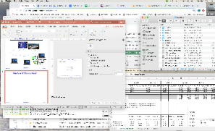
Very Different Situation Today
Powerful system
Huge memory
Huge disk
Single user

Slide 27
Classic: Loading an Executable into Memory
.exe
  lives on disk in the file system
  contains contents of code & data segments, relocation entries and symbols
  OS loads it into memory, initializes registers (and initial stack pointer)
disk (huge)
memory
info
data
code
exe

Slide 28
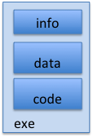
Create Virtual Address Space of the Process
Utilized pages in the VAS are backed by a page block on disk
  Called the backing store or swap file
  Typically in an optimized block store, but can think of it like a file
disk (huge)
process VAS
memory
kernel
user page
frames
stack
sbrk
user pagetable
heap
data
kernel code & data
code

Slide 29
Create Virtual Address Space of the Process
User Page table maps entire VAS, all the utilized regions are backed on disk, swapped into and out of memory as needed
disk (huge, TB)
process VAS (GBs)
memory
kernel
stack
user page
frames
stack
heap
heap
user pagetable
data
data
code
kernel code & data
code

Slide 30
Create Virtual Address Space of the Process
User Page table maps entire VAS
  Resident pages to the frame in memory they occupy
  The portion of it that the HW needs to access must be resident in memory
disk (huge, TB)
VAS (per process)
PT
memory
kernel
stack
user page
frames
stack
heap
heap
user pagetable
data
data
code
kernel code & data
code

Slide 31
Create Virtual Address Space of the Process
User Page table maps entire VAS, resident pages mapped to memory frames, for all other pages, OS must record where to find them on disk
disk (huge, TB)
VAS (per process)
PT
memory
kernel
stack
user page
frames
stack
heap
heap
user pagetable
data
data
code
kernel code & data
code

Slide 32
What Data Structure Maps Non-Resident Pages to Disk?
FindBlock(PID, page#) → disk_block
  Some OSs utilize spare space in PTE for paged blocks
  Like the PT, but purely software
Where to store it?
  Supplemental Page Table
  In memory – can be compact representation if swap storage is contiguous on disk
  Could use hash table (like Inverted PT)
May map code segment directly to on-disk image
  Saves a copy of code to swap file
May share code segment with multiple instances of the program

Slide 33
Provide Backing Store for VAS
disk (huge, TB)
VAS 1
PT 1
memory
kernel
stack
stack
stack
heap
user page
frames
heap
heap
data
VAS 2
PT 2
data
data
code
kernel
code
stack
kernel code & data
heap
data
code

Slide 34
On Page Fault…
disk (huge, TB)
VAS 1
PT 1
memory
kernel
stack
stack
stack
heap
user page
frames
heap
heap
data
VAS 2
PT 2
data
data
code
kernel
code
stack
kernel code & data
heap
data
active process & PT
code

Slide 35
On Page Fault… find page & start load
disk (huge, TB)
VAS 1
PT 1
memory
kernel
stack
stack
stack
heap
user page
frames
heap
heap
data
VAS 2
PT 2
data
data
code
kernel
code
stack
kernel code & data
heap
data
active process & PT
code

Slide 36
Schedule other Process or Thread
disk (huge, TB)
VAS 1
PT 1
memory
kernel
stack
stack
stack
heap
user page
frames
heap
heap
data
VAS 2
PT 2
data
data
code
kernel
code
stack
kernel code & data
heap
data
active process & PT
code

Slide 37
Update PTE
disk (huge, TB)
VAS 1
PT 1
memory
kernel
stack
stack
stack
heap
user page
frames
heap
heap
data
VAS 2
PT 2
data
data
code
kernel
code
stack
kernel code & data
heap
data
active process & PT
code

Slide 38
Eventually faulting thread is rescheduled
disk (huge, TB)
VAS 1
PT 1
memory
kernel
stack
stack
stack
heap
user page
frames
heap
heap
data
VAS 2
PT 2
data
data
code
kernel
code
stack
kernel code & data
heap
data
active process & PT
code

Slide 39
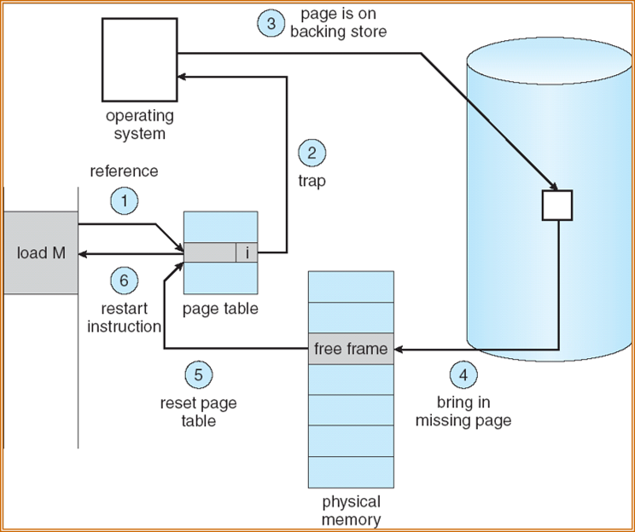
Steps in Handling a Page Fault (for Demand Paging)

Slide 40
Demand Paging Mechanisms
PTE helps us implement demand paging
  Valid ⇒ Page in memory, PTE points at physical page
  Not Valid ⇒ Page not in memory; use info in PTE (or other) to find it on disk
Suppose user references page with invalid PTE?
  Memory Management Unit (MMU) traps to OS
    Resulting trap is a “Page Fault”
  What does OS do on a Page Fault?:
    Choose an old page to replace
    If old page modified (“D=1”), write contents back to disk
    Change its PTE and any cached TLB to be invalid
    Load new page into memory from disk
    Update page table entry, invalidate TLB for new entry
    Continue thread from original faulting location
  TLB for new page will be loaded when thread is continued!
  While pulling pages off disk for one process, OS runs another process
    Suspended process sits on wait queue
Cache

Slide 41
Demand Paging as a Form of Caching
What is block size?
  1 page
What is organization of this cache (i.e. direct-mapped, set-associative, fully-associative)?
  Fully associative: arbitrary virtual→physical mapping
How do we find a page in the cache when look for it?
  First check TLB, then page-table traversal
What is page replacement policy? (i.e. LRU, Random…)
  This requires more explanation… (kinda LRU)
What happens on a miss?
  Go to lower level to fill miss (i.e. disk)
What happens on a write? (write-through, write back)
  Definitely write-back. Need dirty bit!

Slide 42
What’s in a Page Table Entry (PTE)?
What is in a Page Table Entry (or PTE)?
  “Pointer to” (address of) next-level page table or to actual page
  Permission bits: valid, read-only, read-write, write-only
Example: Intel x86 architecture PTE:
  P: Present (same as “valid” bit in other architectures)
  W: Writeable
  U: User accessible
  PWT: Page write transparent: external cache write-through
  PCD: Page cache disabled (page cannot be cached)
  A: Accessed: page has been accessed recently
  D: Dirty (PTE only): page has been modified recently
  L: L=1⇒4MB page (directory only).
  Bottom 22 bits of virtual address serve as offset
Page Frame Number
(Physical Page Number)
Free
(OS)
0
L
D
A
PCD
PWT
U
W
P
31-12
11-9
8
7
6
5
4
3
2
1
0

Slide 43
Caching in Operating Systems
Direct use of caching techniques
  TLB (cache of PTEs)
  Paged virtual memory (memory as cache for disk)
  File systems (cache disk blocks in memory)
  DNS (cache hostname => IP address translations)
  Web proxies (cache recently accessed pages)
Which pages to keep in memory?
  All-important “Policy” aspect of virtual memory

Slide 44
Recall: Working Set Model
As a program executes it transitions through a sequence of “working sets” consisting of varying sized subsets of the address space
Address
Time

Slide 45
Cache Behavior under Working Set Model
Amortized by fraction of time the Working Set is active
Transitions from one WS to the next
Applicable to memory caches and pages. Others ?
1
new working set fits
Hit Rate
0
Cache Size

Slide 46


Another Model of Locality: Zipf
$$\operatorname{Pr}\left[\text{access} \text{rank} r\right]∝\frac{1}{r}$$
Zipf: likelihood of accessing item of rank $r$ is $∝1/{r^{a}}$
  Here rank: how often is an item in cache requested (the higher the rank the less often)
Although rare to access items below the top few, there are so many that it yields a “heavy tailed” distribution
  Substantial value from even a tiny cache
  Substantial misses from even a very large cache

Slide 47
Demand Paging Cost Model
Demand Paging like caching, can compute average access time!
  AMAT = Hit Rate x Hit Time + Miss Rate x Miss Time
Example:
  Memory access time = 200 nanoseconds
  Average page-fault service time = 8 milliseconds
  Suppose p = Probability of miss, 1-p = Probably of hit
AMAT = 200ns + p x 8 ms
= 200ns + p x 8,000,000ns
If one access out of 1,000 causes a page fault, then AMAT = 8.2 μs:
  This is a slowdown by a factor of 40!
What if want slowdown by less than 10%?
  200ns x 1.1 < AMAT ⇒ p < 2.5 x 10-6
  This is about 1 page fault in 400,000!

Slide 48
Announcements
Project 1 (extended) deadline Monday, April 21
  Questionnaire for project 1 will be posted on Moodle soon
Assignment 3 deadline Friday May 2
No lectures next week (April 21 and April 23)

Slide 49
Page Replacement Policies

Slide 50
Recall: Sources of Cache Misses
Compulsory (cold start or first reference): first access to a block
  “Cold” fact of life: not a whole lot you can do about it
  Note: If you are going to run “billions” of instruction, Compulsory Misses are insignificant
Capacity:
  Cache cannot contain all blocks access by the program
  Solution: increase cache size
Conflict (collision):
  Multiple memory locations mapped to the same cache location
  Solution 1: increase cache size
  Solution 2: increase associativity
Coherence (Invalidation): other process (e.g., I/O) updates memory

Slide 51
Why might we miss in the Page Cache?
Compulsory Misses: Pages that have never been paged into memory before
  Prefetching: loading them into memory before needed
  Need to predict future somehow! More later
Capacity Misses: Not enough memory.
  One fix: Increase amount of DRAM (not quick fix!)
  Another option: If multiple processes in memory: adjust percentage of memory allocated to each one!
Conflict Misses:
  Technically, conflict misses don’t exist in virtual memory, since it is a “fully-associative” cache
Policy Misses:
  Caused when pages were in memory, but kicked out prematurely because of the replacement policy
  How to fix? Better replacement policy

Slide 52
Page Replacement Policies
Why do we care about Replacement Policy?
  Replacement is an issue with any cache, but particularly important with pages
    The cost of being wrong is high: must go to disk
    Must keep important pages in memory, not toss them out
FIFO (First In, First Out)
  Throw out oldest page. Be fair – let every page live in memory for about the same amount of time.
  Bad – throws out heavily used pages instead of infrequently used
RANDOM
  Pick random page for every replacement
  Typical solution for TLB’s. Simple hardware
  Pretty unpredictable – makes it hard to make real-time guarantees

Slide 53
Example: FIFO
Suppose we have 3 page frames, 4 virtual pages, and following reference stream:
  A B C A B D A D B C B
Consider FIFO Page replacement:
FIFO: 7 faults
When referencing D, replacing A is bad choice, since need A again right away
Ref:
Page:
A
B
C
A
B
D
A
D
B
C
B
1
A
D
C
2
B
A
3
C
B

Slide 54
Page Replacement Policy: MIN
MIN (Minimum):
  Replace page that won’t be used for the longest time
  Great (provably optimal), but can’t really know future…
    Clairvoyant algorithm
  Also called Belady’s Algorithm of Belady’s Theoretically Optimal Paging
But past is a good predictor of the future …

Slide 55
Page Replacement Policy: LRU
LRU (Least Recently Used):
  Replace page that hasn’t been used for the longest time
  Relies on temporal locality
How to implement LRU? Use a list!
Approximates MIN based on temporal locality
Page 6
Page 7
Page 1
Page 2
Head
Tail (LRU)

Slide 56
Example: MIN/LRU
Suppose we have the same reference stream:
  A B C A B D A D B C B
Consider MIN Page replacement:
MIN: 5 faults
What will LRU do?
  Same decisions as MIN here, but not true in general!
Ref:
Page:
A
B
C
A
B
D
A
D
B
C
B
1
A
C
2
B
3
C
D

Slide 57
Is LRU guaranteed to perform well?
Consider the following: A B C D A B C D A B C D
LRU Performs as follows (same as FIFO here):
  Every reference is a page fault!
Example of “Sequential Flooding”
Ref:
Page:
A
B
C
D
A
B
C
D
A
B
C
D
1
A
D
C
B
2
B
A
D
C
3
C
B
A
D

Slide 58
Is LRU guaranteed to perform well?
LRU Performs as follows (same as FIFO here):
MIN does much better!
Ref:
Page:
A
B
C
D
A
B
C
D
A
B
C
D
1
A
D
C
B
2
B
A
D
C
3
C
B
A
D
Ref:
Page:
A
B
C
D
A
B
C
D
A
B
C
D
1
A
B
2
B
C
3
C
D

Slide 59
Why LRU Often Works Well: Working Sets!
As a program executes it transitions through a sequence of “working sets” consisting of varying sized subsets of the address space
Address
Time

Slide 60
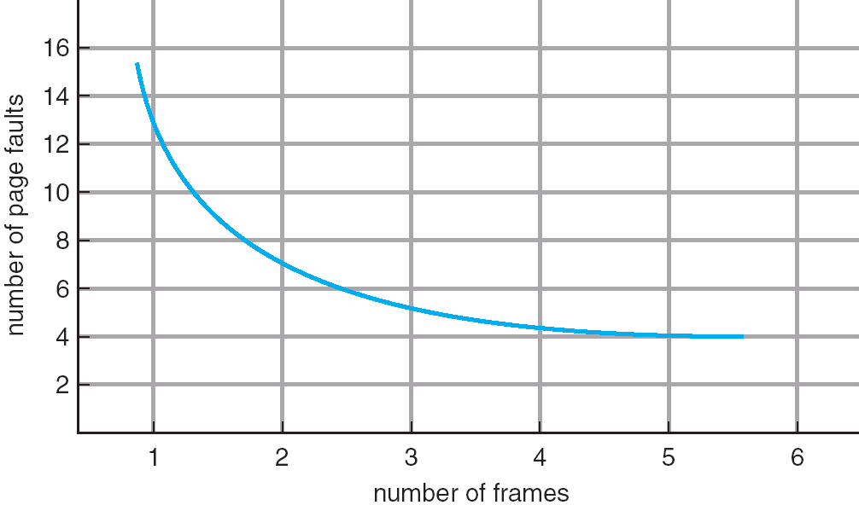
Increasing the Memory Size
One desirable property: When you add memory the miss rate drops
  Called the stack property
Surprisingly, certain replacement algorithms don’t have this property!
  Called Bélády’s Anomaly

Slide 61
Bélády’s Anomaly
FIFO example:
After adding memory:
  Resident pages could be totally different
  Number of page faults increases!
Ref:
Page:
A
B
C
D
A
B
E
A
B
C
D
E
1
A
D
E
2
B
A
C
3
C
B
D
Ref:
Page:
A
B
C
D
A
B
E
A
B
C
D
E
1
A
E
D
2
B
A
E
3
C
B
4
D
C

Slide 62
Problems with LRU
Not optimal (to be expected)
How to implement LRU?
  Requires mutating linked list on every memory access
  Trap to OS on every memory access?
    Way too slow
  Have hardware manipulate a linked list?
    Too complex
We will use hardware support to approximate LRU

Slide 63
What’s in a Page Table Entry (PTE)?
What is in a Page Table Entry (or PTE)?
  “Pointer to” (address of) next-level page table or to actual page
  Permission bits: valid, read-only, read-write, write-only
Example: Intel x86 architecture PTE:
  P: Present (same as “valid” bit in other architectures)
  W: Writeable
  U: User accessible
  PWT: Page write transparent: external cache write-through
  PCD: Page cache disabled (page cannot be cached)
  A: Accessed: page has been accessed recently
  D: Dirty (PTE only): page has been modified recently
  L: L=1⇒4MB page (directory only).
  Bottom 22 bits of virtual address serve as offset
Page Frame Number
(Physical Page Number)
Free
(OS)
0
L
D
A
PCD
PWT
U
W
P
31-12
11-9
8
7
6
5
4
3
2
1
0

Slide 64
Approximating LRU: Clock Algorithm
Clock Algorithm (NRU): Arrange physical pages in circle with single clock hand
  Approximate LRU (approximation to approximation to MIN)
  Replace an old page, not the oldest page
Details:
  Hardware sets “use” bit (“accessed” bit) in PTE on each reference
    Some hardware sets use bit in the TLB, with write-back to PTE
  On page fault:
    Advance clock hand (not real time)
    Check use bit:
      1→used recently; clear use bit and continue advancing clock hand
      0→not used recently; choose this page for replacement

Slide 65
Clock Algorithm: Not Recently Used
Set of all pages
in Memory
Single Clock Hand:
Advances only on page fault!
Check for pages not used recently
Mark pages as not used recently
What if hand moving slowly?
  Good sign or bad sign?
    Not many page faults
    Or find page quickly
What if hand is moving quickly?
  Lots of page faults and/or lots of reference bits set
One way to view clock algorithm:
  Crude partitioning of pages into two groups: young and old
  Why not partition into more than 2 groups?

Slide 66
Nth Chance Version of Clock Algorithm
Nth chance algorithm: Give page N chances
  OS keeps counter per page: # sweeps
  On page fault, OS checks use bit:
    1 → clear use and also set counter=N (used in last sweep)
    0 → decrement counter; if count=0, replace page
  Means that clock hand has to sweep by N times without page being used before page is replaced
How do we pick N?
  Why pick large N? Better approximation to LRU
  Why pick small N? More efficient
What about dirty pages?
  Takes extra overhead to replace a dirty page, so give dirty pages an extra chance before replacing?
  One approach:
    Clean pages, use N=1
    Dirty pages, use N=2 (and write back to disk when N=1)

Slide 67
Clock-Based Algorithms
Which bits of a PTE entry are useful to us?
  Use: Set when page is referenced; cleared by clock algorithm
  Modified: set when page is modified, cleared when page written to disk
  Valid: ok for program to reference this page
  Read-only: ok for program to read page, but not modify
    For example for catching modifications to code pages!
We rely on hardware support via the “use” bit and “modified” bits

Slide 68
Discussion: Hardware Support
Do we really need hardware support? No!
  Can emulate “use” and “modified” bits by marking all pages invalid and trapping to OS
  On use, set use bit and then mark page as “read-only”
  On write, set use/modified bits and then mark page as “read-write”
Given that, without hardware support, we have to take some extra page faults, is there a better approximation of LRU we can use?
  Second-Chance List
  Move pages that would otherwise be replaced onto a list (queue)
  Only if queue is full, start replacing pages in queue in FIFO order

Slide 69
Summary
Replacement policies
  FIFO: Place pages on queue, replace page at end
  MIN: Replace page that will be used farthest in future
  LRU: Replace page used farthest in past
Clock Algorithm (NRU): Approximation to LRU
  Arrange all pages in circular list
  Sweep through them, marking as not “in use”
  If page not “in use” for one pass, than it can be replaced
Nth-chance clock algorithm: Another approximate LRU
  Give pages multiple passes of clock hand before replacing
Second-Chance List algorithm: Yet another approximate LRU
  Divide pages into two groups, one of which is truly LRU and managed on page faults
Working Set:
  Set of pages touched by a process recently

Slide 70
