Slide 1
Four Fundamental OS Concepts
Lecture 2
Hartmut Kaiser
https://teaching.hkaiser.org/spring2025/csc4103/

Slide 2

Admistratrivia
This Photo by Unknown Author is licensed under CC BY-SA-NC

Slide 3
Homework and Early Drop Deadline
Assignment 0: due January 27th, 11:59pm
Project 0: due February 17th, 11:59pm
You should be working on both already!
  Get familiar with all the CSC4103 tools, set up environment, submitting to autograder via git
Early drop deadline: January 27th

Slide 4
Group Projects are Looming
Group Formation is due Wednesday January 29th
  Send email with preferences, each group will consist of four students (three students in exceptional cases)
  I will assign remaining students arbitrarily
Start working through Study Guide 0: C/x86
  Answer all questions!

Slide 5
Recall: What is an Operating System?
Special layer of software that provides application software access to hardware resources
  Convenient abstraction of complex hardware devices
  Protected access to shared resources
  Security and authentication
  Communication
appln
appln
appln
OS
Hardware

Slide 6
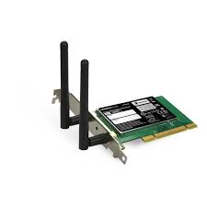
Recall: OS Abstracts the Underlying Hardware
Compiled Program
System Libs
Process: Execution environment with restricted rights provided by OS
Threads
Address Spaces
Files
Sockets
Operating System
ISA
Processor
PgTbl
& TLB
Storage
Networks
Memory
OS Mem
Hardware
I/O Ctrlr

Slide 7
Recall: OS Protects Processes and the Kernel
Segmentation fault (core dumped)
Compiled
Program 1
Compiled
Program 2
System Libs
System Libs
Process 1
Process 2
Threads
Address Spaces
Files
Sockets
Threads
Address Spaces
Files
Sockets
Operating System
ISA
Processor
PgTbl
& TLB
Storage
Networks
Memory
OS
Mem
Hardware
I/O Ctrlr

Slide 8



Recall: What is an Operating System?
Referee
  Manage protection, isolation, and sharing of resources
    Resource allocation and communication
Illusionist
  Provide clean, easy-to-use abstractions of physical resources
    Infinite memory, dedicated machine
    Higher level objects: files, users, messages
    Masking limitations, virtualization
Glue
  Common services
    Storage, Window system, Networking
    Sharing, Authorization
    Look and feel

Slide 9
Today: Four Fundamental OS Concepts
Thread: Execution Context
  Program Counter, Registers, Execution Flags, Stack
Address Space (with Translation)
  Program’s view of memory is distinct from physical machine
Process: Instance of a Running Program
  Address space + one or more threads + …
Dual-Mode Operation and Protection
  Only the “system” can access certain resources
  Combined with translation, isolates programs from each other

Slide 10

OS Bottom Line: Run Programs
0xFFF…
Program Source
Executable
OS
0xC00…
int main()
{ … ;
}
Editor
Compiler and Linker
data
stack
OS Loader
instructions
Memory
heap
foo.c
a.out
data
Create “PCB”, address space, stack and heap
Load instruction and data segments of executable file into memory
“Transfer control to program”
Provide services to program
While protecting OS and program
instructions
0x000…
PC:
registers
Processor

Slide 11
OS Bottom Line: Run Programs
0xFFF…
Program Source
Executable
OS
0xC00…
int main()
{ … ;
}
Editor
Compiler and Linker
data
stack
OS Loader
instructions
Memory
heap
foo.c
a.out
data
Create OS “PCB”, address space, stack and heap
Load instruction and data segments of executable file into memory
“Transfer control to program”
Provide services to program
While protecting OS and program
Creates a process from a program
instructions
0x000…
PC:
registers
Processor

Slide 12
Recall: CPU Instruction Cycle
Processor
next
Memory
PC:
Instruction fetch
instruction
Decode
decode
Registers
Execute
ALU
data

Slide 13
Review: How Programs Execute
Addr 2³²-1
Execution sequence:
  Fetch Instruction at PC
  Decode
  Execute (possibly using registers)
  Write results to registers/mem
  PC = Next Instruction(PC)
  Repeat
…
Data1
Data0
Inst237
Inst236
…
Inst4
Inst3
Inst2
Inst1
Inst0
R0
…
R31
F0
…
F30
PC
Fetch
Exec
PC
PC
PC
PC
Addr 0

Slide 14
Today: Four Fundamental OS Concepts
Thread: Execution Context
  Program Counter, Registers, Execution Flags, Stack
Address Space (with Translation)
  Program’s view of memory is distinct from physical machine
Process: Instance of a Running Program
  Address space + one or more threads + …
Dual-Mode Operation and Protection
  Only the “system” can access certain resources
  Combined with translation, isolates programs from each other

Slide 15
Key OS Concept: Thread
Definition: A single, unique execution context
  Program counter, registers, stack, execution state
A thread is the OS abstraction for a CPU core
  A “virtual CPU” of sorts
Registers hold the root state of the thread:
  Including program counter – pointer to the currently executing instruction
  The rest is “in memory”
Registers point to thread state in memory:
  Stack pointer to the top of the thread’s (own) stack

Slide 16
Illusion of Multiple Processors
Threads are virtual cores
Multiple threads: Multiplex hardware in time
A thread is executing on a processor when it is resident in that processor's registers
Each virtual core (thread) has PC, SP, Registers
Where is it?
  On the real (physical) core, or
  Saved in memory – called the Thread Control Block (TCB)
vCPU1
vCPU2
vCPU3
Shared Memory
On a single physical CPU:
vCPU1
vCPU2
vCPU3
vCPU1
vCPU2
Time

Slide 17
OS Object Representing a Thread
Traditional term: Thread Control Block (TCB)
Holds contents of registers when thread is not running…
… And other information the kernel needs to keep track of the thread and its state.

Slide 18
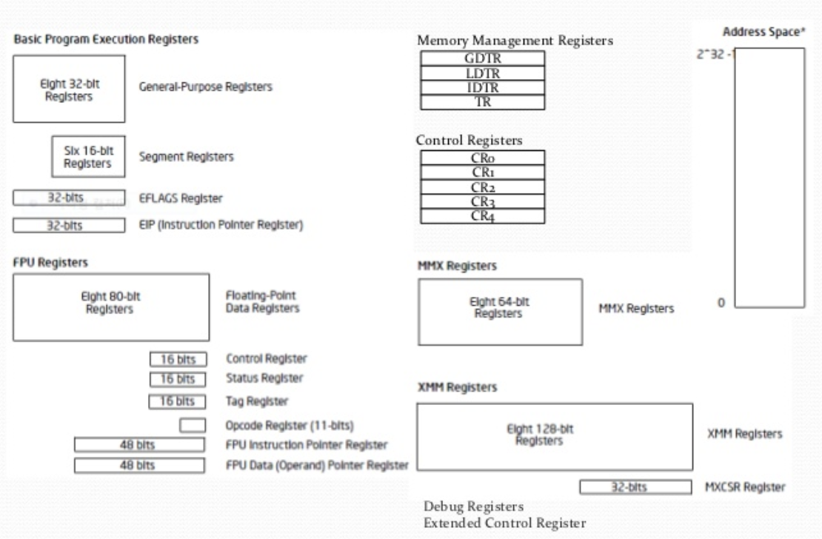
Registers: x86
Complex memory architecture with specialized registers and “segments”

Slide 19
Illusion of Multiple Processors
At T1: vCPU1 on real core
At T2: vCPU2 on real core
What happened?
  OS ran [how?]
  Saved PC, SP, … in vCPU1’s thread control block
  Loaded PC, SP, … from vCPU2’s thread control block
This is called context switch
vCPU1
vCPU2
vCPU3
Shared Memory
On a single physical CPU:
T1
T2
vCPU1
vCPU2
vCPU3
vCPU1
vCPU2
Time

Slide 20
Very Simple Multiprogramming
All vCPUs share non-CPU resources
  Memory, I/O Devices
Each thread can read/write memory
  Including data of others
  And the OS!
Unusable?
This approach is used in:
  Very early days of computing
  Embedded applications
  MacOS 1-9/Windows 3.1 (switch only with voluntary yield)
  Windows 95-ME

Slide 21
Today: Four Fundamental OS Concepts
Thread: Execution Context
  Program Counter, Registers, Execution Flags, Stack
Address Space (with Translation)
  Program’s view of memory is distinct from physical machine
Process: Instance of a Running Program
  Address space + one or more threads + …
Dual-Mode Operation and Protection
  Only the “system” can access certain resources
  Combined with translation, isolates programs from each other

Slide 22
Key OS Concept: Address Space
Program operates in an address space that is distinct from the physical memory space of the machine
0x000…
Processor
Translator
Memory
Registers
0xFFF…

Slide 23
Address Space
Definition: Set of accessible addresses and the state associated with them
  2³² = ~4 billion on a 32-bit machine
What happens when you read or write to an address?
  Perhaps acts like regular memory
  Perhaps causes I/O operation
    (Memory-mapped I/O)
  Causes program to abort (segfault)?
  Communicate with another program
  …
0x000…
Code
Static Data
Heap
Stack
0xFFF…

Slide 24
Typical Address Space Structure
0x000…
Code
PC:
SP:
Static Data
Heap
Processor
registers
Stack
0xFFF…

Slide 25
Address Space
What can the hardware do to help the OS protect itself from programs? And programs from each other?
  Prevent processes from reading or writing to physical addresses it should not have access to!
  Allow processes to read and write to physical addresses it should have access to!

Slide 26
Base and Bound (no Translation)
Can the program touch OS? Can it touch other programs?
Requires relocation, causes fragmentation
Stack and heap have unknown sizes
Memory sharing impossible
0000…
Code
Static Data
Original Program
Heap
0000…
Base Address
1000…
Stack
code
≥
1000…
Static Data
0010…
Code
Program
address
1010…
heap
Static Data
Heap
stack
<
0100…
Stack
1100…
Bound
0100…
FFFF…

Slide 27
Issues with Simple Base and Bound
process 6
Fragmentation problem over time
Hard to do interprocess sharing
  E.g., to share code
process 6
process 6
process 6
process 5
process 5
process 5
process 9
process 9
process 11
process 2
process 10
OS
OS
OS
OS

Slide 28
Base and Bound (with Translation)
0000…
Can the program touch OS? Can it touch other programs?
Fragmentation still an issue!
Still no sharing!
Stack and heaps are of variable size!
Code
Static Data
Heap
0000…
Stack
code
Base Address
1000…
Static Data
0010…
1000…
Code
Program
address
0010…
heap
Static Data
1010…
Heap
stack
Bound
<
0100…
Stack
1100…
0100…
FFFF…

Slide 29
Paged Virtual Address Space
What if we break the entire virtual address space into equally sized chunks (i.e., pages) and have a base and bound for each?
All pages are of the same size, so it’s easy to place each page in memory!
Hardware translates addresses using a page table
  Each page has a separate base
  The “bound” is the page size
  Special hardware register stores pointer to page table

Slide 30
Paged Virtual Address Space
Memory
Processor
Registers
<Page #>
Page Table
<Page Addr>
instruction
<Page Offset>
Page
(eg, 4 kb)
<Virtual Address> =
<Page #> <Page Offset>
PT Addr
Instructions operate on virtual addresses
Virtual addresses translated at runtime to physical addresses via a page table
Special register holds page table base address of current process’ page table

Slide 31
Today: Four Fundamental OS Concepts
Thread: Execution Context
  Program Counter, Registers, Execution Flags, Stack
Address Space (with Translation)
  Program’s view of memory is distinct from physical machine
Process: Instance of a Running Program
  Address space + one or more threads + …
Dual-Mode Operation and Protection
  Only the “system” can access certain resources
  Combined with translation, isolates programs from each other

Slide 32
Key OS Concept: Process
Definition: execution environment with restricted rights
  One or more threads executing in a single address space (own page table)
  Owns file descriptors, network connections, etc.
Instance of a running program
  When you run an executable, it runs in its own process
  Application: one or more processes working together
Protected from each other; OS protected from them
In modern OSes, anything that runs outside of the kernel runs in a process
  Even many of the OS services run in separate processes

Slide 33
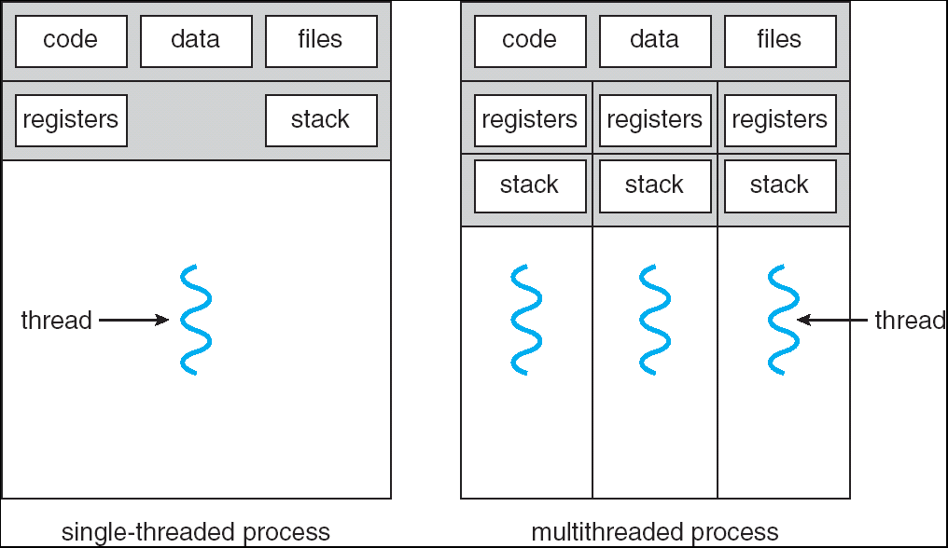
Single and Multithreaded Processes
Threads encapsulate concurrency
  “Active” component
Address space encapsulate protection:
  “Passive” component
  Keeps bugs from crashing the entire system
Why have multiple threads per address space?

Slide 34
Protection and Isolation
Why?
  Reliability: bugs can only overwrite memory of process they are in
  Security and privacy: malicious or compromised process can’t read or write other process’ data
  (to some degree) Fairness: enforce shares of disk, CPU
Mechanisms:
  Address translation: address space only contains its own data
BUT: why can’t a process change the page table pointer?
  Or use I/O instructions to bypass the system?
  Hardware must support privilege levels!

Slide 35
Today: Four Fundamental OS Concepts
Thread: Execution Context
  Program Counter, Registers, Execution Flags, Stack
Address Space (with Translation)
  Program’s view of memory is distinct from physical machine
Process: Instance of a Running Program
  Address space + one or more threads + …
Dual-Mode Operation and Protection
  Only the “system” can access certain resources
  Combined with translation, isolates programs from each other

Slide 36
Dual-Mode Operation
One bit of state: processor is either in user mode or kernel mode
  x86 has four privilege levels: rank 0 (kernel) … rank 3 (user)
Certain actions are only permitted in kernel mode (privileged instructions), e.g.
  Changing the page table pointer (memory protection)
  Certain entries in the page table
  Hardware I/O instructions
  Disable interrupts (timers)
State bit can’t be changed directly, is flipped only during execution of special transfer operations

Slide 37
Dual-Mode Operation
What hardware is needed to protect applications and users from one another?
Privileged instructions
  All potentially unsafe instructions are prohibited in user mode
Memory protection
  All memory accesses outside of a process’s valid memory region are prohibited when executing in user mode
Timer interrupts
  Regardless of what a process does, the kernel must have a way to potentially regain control from the current process

Slide 38
Dual-Mode Operation
Processes (i.e., programs you run) execute in user mode
  To perform privileged actions, processes request services from the OS kernel
  Carefully controlled transition from user to kernel mode
Kernel executes in kernel mode
  Performs privileged actions to support running processes
  … and configures hardware to properly protect them (e.g., address translation)
  Return to user mode through special instructions
    Return from interrupt

Slide 39
Three Types of User → Kernel Mode Transfer
System Call (“syscalls”)
  Process requests a system service (e.g., open a file)
  Like a function call, but “outside” the process
Interrupt
  External asynchronous event, independent of the process
  e.g., Timer, I/O device
Trap (exception)
  Internal synchronous event in process triggers context switch
  E.g., Divide by zero, bad memory access (segmentation fault)
CONTROL TRANSFER User -> Kernel mode
  System calls constitute PROGRAMMED control transfer
  Interrupts and traps are UNPROGRAMMED control transfer mechanisms
User process can’t jump to arbitrary instruction address in kernel!
  Why not?

Slide 40
Where do User → Kernel Mode Transfers Go?
Cannot let user programs specify the exact address!
Solution: Interrupt Vector
  OS kernel specifies a set of functions that are entry points to kernel mode
  Appropriate function is chosen depending on the type of transition
    Interrupt Number (i)
    Type of interrupt
    Type of trap
    OS may do additional dispatch
Interrupt vector
Address and properties of each interrupt handler
interrupt number (i)
intrpHandler_i () {
…
}

Slide 41
Example: Before Exception

Slide 42
Example: After Exception
Why don’t we just use the user stack?

Slide 43
Life of a Process
User Mode
interrupt
retn
exception
syscall
rfi
Kernel Mode
exit
exec
Limited HW access
Full HW access

Slide 44
Implementing Safe User → Kernel Mode Transfers
Carefully constructed kernel code packs up the user process state and sets it aside
Must handle weird/buggy/malicious user state
  Syscalls with null pointers
  Return instruction out of bounds
  User stack pointer out of bounds
Should be impossible for buggy or malicious user program to cause the kernel to corrupt itself
User program should not know that an interrupt has occurred
(transparency)

Slide 45
Kernel System Call Handler
Vector through well-defined syscall entry points!
  Table mapping system call number to handler
Locate arguments
  In registers or on user (!) stack
Copy arguments
  From user memory into kernel memory – carefully checking locations!
  Protect kernel from malicious code evading checks
Validate arguments
  Protect kernel from errors in user code
Copy results back
  Into user memory – carefully checking locations!

Slide 46
Kernel Stacks
Interrupt handlers want a stack
System call handlers want a stack
Can't just use the user stack [why?]
  More convenient to store execution state of kernel if additional interrupt is required (i.e. waiting for I/O operation, etc.)
  User-stack is in user-space
    Other user-threads could maliciously modify entries the kernel put on the stack of the interrupted thread
  Works regardless of state of user-process
    User data could be corrupt or compromised

Slide 47
Kernel Stacks
One Solution: two-stack model
  Each thread has user stack and a kernel stack
  Kernel stack stores user’s registers during an exception
  Kernel stack used to execute exception handler in the kernel

Slide 48
Hardware Support: Interrupt Control
Interrupt processing not visible to the user process:
  Occurs between instructions, restarted transparently
  No change to process state
  Happens transparently to the process—user program does not know it was interrupted
Interrupt Handler invoked with interrupts ‘disabled’
  Re-enabled upon completion
  Non-blocking (run to completion, no waits)
  Pack up in a queue and pass off to an OS thread for hard work
    wake up an existing OS thread

Slide 49
Hardware Support: Interrupt Control
Interrupt processing not visible to the user process:
  Occurs between instructions, restarted transparently
  No change to process state
  What can be observed even with perfect interrupt processing?
    Execution time!
Interrupt Handler invoked with interrupts ‘disabled’
  Re-enabled upon completion
  Non-blocking (run to completion, no waits)
  Pack up in a queue and pass off to an OS thread for hard work
    wake up an existing OS thread

Slide 50
How do we take Interrupts Safely?
Interrupt vector
  Limited number of entry points into kernel
Kernel interrupt stack
  Handler works regardless of state of user code
Interrupt masking
  Handler is non-blocking
Atomic transfer of control
  “Single instruction”-like to change:
    Program counter
    Stack pointer
    Memory protection
    Kernel/user mode
Transparent restartable execution
  User program does not know interrupt occurred

Slide 51
Kernel → User Mode Transfers
“Return from interrupt” instruction
  Drops mode from kernel to user privilege
  Restores user PC and stack
Transfer to user mode happens for:
  Creation of a new process
  Switching to a different process
  User-level upcalls (signal handling, etc.)

Slide 52
Today: Four Fundamental OS Concepts
Thread: Execution Context
  Program Counter, Registers, Execution Flags, Stack
Address Space (with Translation)
  Program’s view of memory is distinct from physical machine
Process: Instance of a Running Program
  Address space + one or more threads + …
Dual-Mode Operation and Protection
  Only the “system” can access certain resources
  Combined with translation, isolates programs from each other

Slide 53
Now, let’s put it all together!

Slide 54
Illusion of Multiple Processors
Scheduling
At T1: vCPU1 on real core
At T2: vCPU2 on real core
How did the OS get to run?
  Earlier, OS configured a hardware timer to periodically generate an interrupt
  On the interrupt, the hardware switches to kernel mode and the OS’s timer interrupt handler runs
  Timer interrupt handler decides whether to switch threads or not according to a policy
vCPU1
vCPU2
vCPU3
Shared Memory
On a single physical CPU:
T1
T2
vCPU1
vCPU2
vCPU3
vCPU1
vCPU2
Time

Slide 55
Scheduling
if ( readyProcesses(PCBs) ) {
nextPCB = selectProcess(PCBs);
run( nextPCB );
} else {
run_idle_process();
}
Scheduling: Mechanism for deciding which processes/threads receive the CPU
Lots of different scheduling policies provide …
  Fairness or
  Realtime guarantees or
  Latency optimization or …

Slide 56
What’s in a Process?
Process Control Block (PCB): Kernel representation of each process
  Process ID
  Thread control block(s)
    Program pointer, stack pointer, and registers for each thread
  Page table (information for address space translation)
  Necessary state to process system calls
    Which files are open and which network connections are accessible to the process
  All information that pertains to a process and has to be shared between all threads of said process
    User information
    File path of executable eon disk
    Current home directory of the process
    Process privileges
    Etc.

Slide 57
Mode Transfer and Translation
Mode transfer should change address translation mapping
Examples:
  Ignore base and bound in kernel mode
  Page tables:
    Either switch to kernel page table…
    Or mark some pages as only accessible in kernel mode

Slide 58
Base and Bound: OS Loads Process
0000…
Proc 1
Proc 2
Proc n
code
…
Static Data
OS
heap
stack
sysmode
1
1000…
code
Base
xxxx …
0000…
Static Data
Bound
xxxx…
FFFF…
heap
Stored User PC
xxxx…
stack
1100…
PC
code
3000…
regs
Static Data
…
heap
3080…
stack
FFFF…

Slide 59
Base and Bound: About to Switch
0000…
Proc 1
Proc 2
Proc n
code
…
Static Data
OS
heap
stack
sysmode
1
1000…
code
Base
1000 …
0000…
Static Data
Bound
1100 …
FFFF…
heap
Stored User PC
0011 …
stack
1100…
PC
OS runs in privileged mode, so it can set the special registers
“Return” to user
code
3000…
regs
Static Data
…
heap
3080…
stack
FFFF…

Slide 60
Base and Bound: User Code Running
0000…
Proc 1
Proc 2
Proc n
code
…
Static Data
OS
heap
stack
sysmode
0
1000…
code
Base
1000 …
Static Data
Bound
1100 …
heap
Stored User PC
xxxx …
stack
1100…
PC
code
3000…
regs
Static Data
…
heap
3080…
stack
FFFF…

Slide 61
Base and Bound: Handle Interrupt
0000…
Proc 1
Proc 2
Proc n
code
…
Static Data
OS
heap
stack
sysmode
1
1000…
code
Base
1000 …
0000…
Static Data
Bound
1100 …
FFFF…
heap
Stored User PC
0000 1234
stack
1100…
PC
IntrpVector[i]
code
3000…
regs
Static Data
Switch to kernel mode, set up interrupt handler
…
heap
3080…
stack
FFFF…

Slide 62
Base and Bound: Switch to Process 1
0000…
Proc 1
Proc 2
Proc n
code
RETI
…
Static Data
OS
heap
stack
sysmode
1
1000…
code
Base
3000 …
0000…
Static Data
Bound
0080 …
FFFF…
heap
Stored User PC
0000 0248
stack
1100…
Save registers of Process 2
Restore registers of Process 1
Then execute RETI
PC
0001 0124
code
3000…
regs
Static Data
…
heap
3080…
stack
FFFF…

Slide 63
Base and Bound: Switch to Process 1
0000…
Proc 1
Proc 2
Proc n
code
…
Static Data
OS
heap
stack
sysmode
1
1000…
code
Base
3000 …
Static Data
Bound
0080 …
heap
Stored User PC
xxxx …
stack
1100…
PC
0000 0248
code
3000…
regs
Static Data
…
heap
3080…
stack
FFFF…

Slide 64
Putting it all Together: Web Server
Server
4. parse request
9. format reply
request
buffer
reply
buffer
network
socket
read
3. kernel
copy
10. network
socket
write
5. file
read
8. kernel
copy
syscall
syscall
Kernel
wait
RTU
11. kernel copy
from user buffer
to network buffer
RTU
interrupt
interrupt
2. copy arriving
packet (DMA)
12. format outgoing
packet and DMA
6. disk
request
7. disk data
(DMA)
Hardware
Network
interface
Disk interface
Request
Reply

Slide 65
Conclusion: Four Fundamental OS Concepts
Thread: Execution Context
  Program Counter, Registers, Execution Flags, Stack
Address Space (with Translation)
  Program’s view of memory is distinct from physical machine
Process: Instance of a Running Program
  Address space + one or more threads + …
Dual-Mode Operation and Protection
  Only the “system” can access certain resources
  Combined with translation, isolates programs from each other

Slide 66
