Slide 1
Abstractions 1: Threads and Processes
Lecture 3
Hartmut Kaiser
https://teaching.hkaiser.org/spring2025/csc4103/

Slide 2
Recall: Four Fundamental OS Concepts
Thread: Execution Context
  Program Counter, Registers, Execution Flags, Stack
Address Space (with Translation)
  Program’s view of memory is distinct from physical machine
Process: Instance of a Running Program
  Address space + one or more threads + …
Dual-Mode Operation and Protection
  Only the “system” can access certain resources
  Combined with translation, isolates programs from each other

Slide 3
Recall: Thread
Definition: A single, unique execution context
  Program counter, registers, stack
A thread is the OS abstraction for a CPU core
  A “virtual CPU” of sorts
Registers hold the root state of the thread:
  Including program counter – pointer to the currently executing instruction
  The rest is “in memory”
Registers point to thread state in memory:
  Stack pointer to the top of the thread’s (own) stack

Slide 4
Recall: Illusion of Multiple Processors
Threads are virtual cores
Multiple threads: Multiplex hardware in time
A thread is executing on a processor when it is resident in that processor's registers
Each virtual core (thread) has PC, SP, Registers
Where is it?
  On the real (physical) core, or
  Saved in memory – called the Thread Control Block (TCB)
vCPU1
vCPU2
vCPU3
Shared Memory
On a single physical CPU:
vCPU1
vCPU2
vCPU3
vCPU1
vCPU2
Time

Slide 5
Recall: Address Space
Program operates in an address space that is distinct from the physical memory space of the machine
0x000…
Processor
Translator
Memory
Registers
0xFFF…

Slide 6
Recall: Process
Definition: execution environment with restricted rights
  One or more threads executing in a single address space
  Owns file descriptors, network connections
Instance of a running program
  When you run an executable, it runs in its own process
  Application: one or more processes working together
Protected from each other; OS protected from them
In modern OSes, anything that runs outside of the kernel runs in a process

Slide 7
Recall: Dual-Mode Operation
Processes (i.e., programs you run) execute in user mode
  To perform privileged actions, processes request services from the OS kernel
  Carefully controlled transition from user to kernel mode
Kernel executes in kernel mode
  Performs privileged actions to support running processes
  … and configures hardware to properly protect them (e.g., address translation)
Together, address translation and dual-mode operation allow the kernel to protect processes from each other and itself from processes

Slide 8
Today: The Thread Abstraction
What threads are
  And what they are not
Why threads are useful (motivation)
How to write a program using threads
Alternatives to using threads

Slide 9
Threads

Slide 10
What Threads Are
Definition from before: A single unique execution context
  Describes its representation
It provides the abstraction of: A single execution sequence that represents a separately schedulable task
  Also a valid definition!
Threads are a mechanism for concurrency
Protection is an orthogonal concept
  A protection domain can contain one thread or many

Slide 11
Motivation for Threads
Operating systems must handle multiple things at once (MTAO)
  Processes, interrupts, background system maintenance
Networked servers must handle MTAO
  Multiple connections handled simultaneously
Parallel programs must handle MTAO
  To achieve better performance
Programs with user interface often must handle MTAO
  To achieve user responsiveness while doing computation
Network and disk bound programs must handle MTAO
  To hide network/disk latency
  Sequence steps in access or communicatoin

Slide 12
Threads Allow Handling MTAO
Threads are a unit of concurrency provided by the OS
Each thread can represent one thing or one task

Slide 13
Concurrency is not Parallelism
Concurrency is about handling multiple things at once (MTAO)
Parallelism is about doing multiple independent things simultaneously
Example: Two threads on a single-core system...
  … execute concurrently …
  … but not in parallel
Each thread handles or manages a separate thing or task…
  But those tasks are not necessarily executing simultaneously!

Slide 14
Multiprocessing vs. Multiprogramming
Multiprocessing: Multiple cores
Multiprogramming: Multiple jobs/processes
Multithreading: Multiple threads/processes
What does it mean to run two threads concurrently?
  Scheduler is free to run threads in any order and interleaving
A
Multiprocessing
B
C
A
B
C
Multiprogramming
A
B
C
A
B
C
B

Slide 15
Silly Example for Threads
Imagine the following program:
    int main() {
    compute_pi("pi.txt");
    print_class_list("classlist.txt");
    }
What is the behavior here?
Program would never print out class list
Why? compute_pi would never finish

Slide 16
Adding Threads
Version of program with threads (loose syntax):
    int main() {
    create_thread(compute_pi, "pi.txt");
    create_thread(print_class_list, "classlist.txt");
    }
create_thread: Spawns a new thread running the given procedure
  Should behave as if another CPU is running the given procedure
Now, you would actually see the
class list
CPU1
CPU2
CPU1
CPU2
CPU1
CPU2
Time

Slide 17
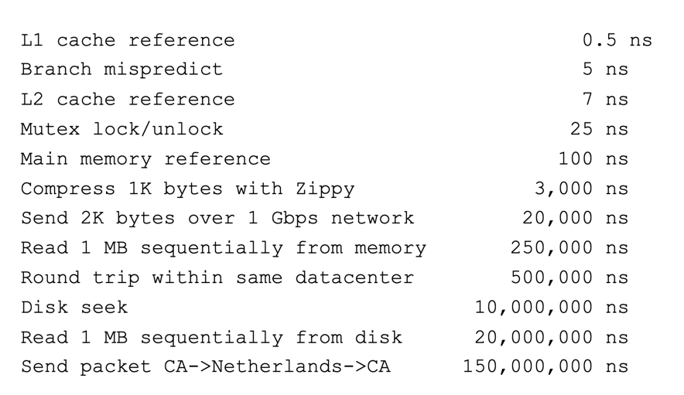
More Practical Motivation
Handle I/O in separate thread, avoid blocking other progress

Slide 18
Threads Mask I/O Latency
A thread is in one of the following three states:
  RUNNING – running
  READY – eligible to run, but not currently running
  BLOCKED – ineligible to run
If a thread is waiting for an I/O to finish, the OS marks it as BLOCKED
Once the I/O finally finishes, the OS marks it as READY
vCPU1
vCPU2
vCPU1
vCPU2
vCPU1
vCPU2
Time

Slide 19
Threads Mask I/O Latency
If no thread performs I/O:
vCPU1
vCPU2
vCPU1
vCPU2
vCPU1
vCPU2
Time
If thread 1 performs a blocking I/O operation:
vCPU1 starts I/O operation
I/O operation completes
vCPU1
vCPU2
vCPU1
vCPU2
Time

Slide 20
Little Better Example for Threads
Version of program with threads (loose syntax):
  main() {
  create_thread(read_large_file, "pi.txt");
  create_thread(render_user_interface);
  }
What is the behavior here?
  Still respond to user input
  While reading file in the background

Slide 21
Multithreaded Programs
You know how to compile a C program and run the executable
  This creates a process that is executing that program
Initially, this new process has one thread in its own address space
  With code, globals, etc. as specified in the executable
  This thread runs main()
Q: How can we make a multithreaded process?
A: Once the process starts, it issues system calls to create new threads
  These new threads are part of the process: they share its address space

Slide 22
System Calls (“Syscalls”)
Word Processing
Compilers
Web Browsers
“But, I’ve never seen a syscall!”
OS library issues system call
Language runtime uses OS library…
Email
Databases
Web Servers
Application / Service
Portable OS Library
OS
User
System Call
Interface
System
Portable OS Kernel
Software
Platform support, Device Drivers
Hardware
x86
PowerPC
ARM
PCI
Ethernet (1Gbs/10Gbs)
802.11 a/g/n/ac
SCSI
Graphics
Thunderbolt

Slide 23
OS Library Issues Syscalls
Proc 1
Proc 2
Proc n
…
OS
App
login
Window Manager
…
libc:
OS library
OS library
OS library
OS

Slide 24
OS Library API for Threads: pthreads
int pthread_create(pthread_t* thread,
pthread_attr_t const* attr,
void* (*start_routine)(void*), void* arg);
  thread is created executing start_routine with arg as its sole argument.
  Attributes attr are often NULL
void pthread_exit(void* value_ptr);
  terminates the thread and makes value_ptr available to any successful join
  Return of start_routine is implicit call to pthread_exit
int pthread_join(pthread_t thread, void** value_ptr);
  suspends execution of the calling thread until the target thread terminates.
  On return with a non-NULL value_ptr the value passed to pthread_exit
  by the terminating thread is made available in the location referenced by value_ptr.
https://pubs.opengroup.org/onlinepubs/7908799/xsh/pthread.h.html

Slide 25
Peeking Ahead: System Call Example
What happens when pthread_create(…) is called in a process?
Library:
int pthread_create(…) {
Do some work like a normal function…
asm code …
syscall # into %eax
put args into registers %ebx, …
special trap instruction
Kernel:
get args from registers dispatch
to system function
Do the work to spawn the new thread
Store return value in %eax
get return values from registers
Do some more work like a normal fn…
};

Slide 26
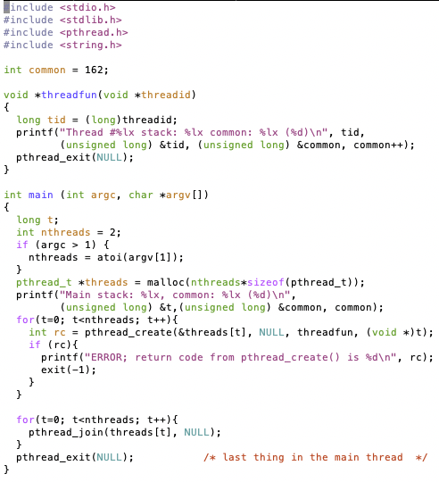

Threads Example
How many threads are in this program?
Does the main thread join with the threads in the same order that they were created?
Do the threads exit in the same order they were created?
If we run the program again, would the result change?

Slide 27
Fork-Join Pattern
Main thread creates (forks) collection of sub-threads passing them arguments to work on…
… and then joins with them, collecting results.
create
exit
join

Slide 28
Memory Layout with Two Threads
0xFFF…
Two sets of CPU registers
Two sets of Stacks
Issues:
  How do we position stacks relative to
  each other?
  What maximum size should we choose
  for the stacks?
  What happens if threads violate this?
  How might you catch violations?
Stack 1
Stack 2
Address Space
Heap
Global Data
Code
0x000…

Slide 29
Announcements
Project 0 is due Monday, February 17
  Attend next lecture for a walk through
  Work through Study Guide: x86
Assignment 1 was posted
  Due Monday, February 24
Project 1 will be posted soon
  Groups have been assigned

Slide 30
Interleaving and Nondeterminism

Slide 31
Thread Abstraction
Illusion: Infinite number of processors
Reality: Threads execute with variable “speed”
  Programs must be designed to work with any schedule

Slide 32
Programmer vs. Processor View

Slide 33
Possible Executions

Slide 34
Correctness with Concurrent Threads
Non-determinism:
  Scheduler can run threads in any order
  Scheduler can switch threads at any time
  This can make testing very difficult
Independent Threads
  No state shared with other threads
  Deterministic, reproducible conditions
Cooperating Threads
  Shared state between multiple threads
Goal: Correctness by Design

Slide 35
Race Conditions
What are the possible values of x below after all threads finish?
Initially x == 0 and y == 0
Must be 1. Thread B does not interfere.
Thread A
x = 1;
Thread B
y = 2;

Slide 36
Race Conditions
What are the possible values of x below?
Initially x == 0 and y == 0
1 or 3 or 5 (non-deterministic)
Race Condition: Thread A races against Thread B
Thread A
x = y + 1;
Thread B
y = 2;
y = y * 2;

Slide 37
Relevant Definitions
Synchronization: Coordination among threads, usually regarding shared data
Mutual Exclusion: Ensuring only one thread does a particular thing at a time (one thread excludes the others)
  Type of synchronization
Critical Section: Code exactly one thread can execute at once
  Result of mutual exclusion
Lock: An object only one thread can hold at a time
  Provides mutual exclusion
  Also called Mutex

Slide 38
Locks (Mutexes)
Locks provide two atomic operations:
  Lock.acquire() – wait until lock is free; then mark it as busy
    After this returns, we say the calling thread holds the lock
  Lock.release() – mark lock as free
    Should only be called by a thread that currently holds the lock
    After this returns, the calling thread no longer holds the lock
For now, don’t worry about how to implement locks!
  We’ll cover that in substantial depth later on in the class

Slide 39
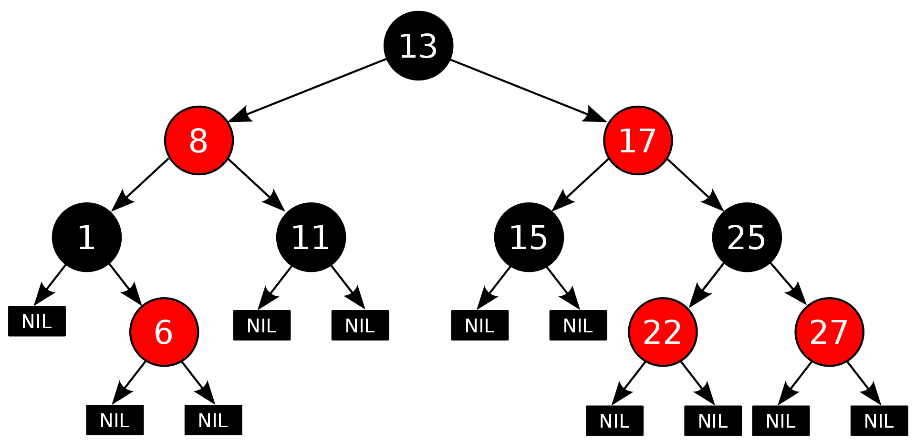
Example: Shared Data Structure
Thread A
Insert(3)
Thread B
Insert(4)
Get(6)
Tree-Based Set Data Structure

Slide 40
Example: Shared Data Structure
Thread A
Insert(3):
  Lock.acquire()
  Insert 3 into the data structure
  Lock.release()
Thread B
Insert(4):
  Lock.acquire()
  Insert 4 into the data structure
  Lock.release()
Get(6):
  Lock.acquire()
  Check for membership
  Lock.release()
Tree-Based Set Data Structure

Slide 41
OS Library Locks: pthreads
int pthread_mutex_init(
pthread_mutex_t* mutex,
pthread_mutexattr_t const* attr)
  Attributes are most of the time NULL
int pthread_mutex_lock(pthread_mutex_t* mutex);
int pthread_mutex_unlock(pthread_mutex_t* mutex);
You’ll get a chance to use these in Assignment 1

Slide 42
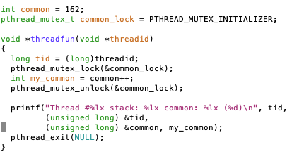
Our Example
Critical section
Note: pthread_mutex_init was called once in main thread

Slide 43
Semaphore
Semaphores are a kind of generalized lock
  First defined by Dijkstra in late 60s
  Main synchronization primitive used in original UNIX (& Pintos)
Definition: a Semaphore has an integer value and supports the following two operations:
  P() or down(): atomic operation that waits for semaphore to become positive, then decrements it by 1
  V() or up(): an atomic operation that increments the semaphore by 1, waking up a waiting P, if any
P() stands for “proberen” (to test) and V() stands for “verhogen” (to increment) in Dutch

Slide 44
Two Important Semaphore Patterns
Mutual Exclusion: (Like lock)
  Called a "binary semaphore“
    initial value of semaphore = 1;
    semaphore.down();
    // Critical section goes here
    semaphore.up();
Signaling other threads, e.g. ThreadJoin
    initial value of semaphore = 0
    ThreadJoin {
    semaphore.down();
    }
    ThreadFinish {
    semaphore.up();
    }

Slide 45
Processes

Slide 46
Recall: Process
Definition: execution environment with restricted rights
  One or more threads executing in a single address space
  Owns file descriptors, network connections
Instance of a running program
  When you run an executable, it runs in its own process
  Application: one or more processes working together
Protected from each other; OS protected from them
In modern OSes, anything that runs outside of the kernel runs in a process

Slide 47
Recall: Life of a Process
User Mode
interrupt
exception
syscall
rtn
rfi
Kernel Mode
exit
exec
Limited HW access
Full HW access

Slide 48
Processes
How to manage process state?
  How to create a process?
  How to exit from a process?
Remember: Everything outside of the kernel is running in a process!
  Including the shell! (Assignment 2)
Processes are created and managed… by processes!

Slide 49
Bootstrapping
If processes are created by other processes, how does the first process start?
First process is started by the kernel
  Often configured as an argument to the kernel before the kernel boots
After this, all processes on the system are created by other processes

Slide 50
Process Management API
exit – terminate a process
fork – copy the current process
wait – wait for a process to finish
exec – change the program being run by the current process
kill – send a signal (interrupt-like notification) to another process
sigaction – set handlers for signals

Slide 51
pid.c
Q: What if we let main return without ever calling exit?
The OS Library calls exit() for us!
The entrypoint of the executable is in the OS library
OS library calls main
If main returns, OS library calls exit
You’ll see this in Project 0: entry.c
#include <stdlib.h>
#include <stdio.h>
#include <string.h>
#include <unistd.h>
#include <sys/types.h>
int main(int argc, char *argv[])
{
/* get current processes PID */
pid_t pid = getpid();
printf("My pid: %d\n", pid);
exit(0);
}

Slide 52
Process Management API
exit – terminate a process
fork – copy the current process
wait – wait for a process to finish
exec – change the program being run by the current process
kill – send a signal (interrupt-like notification) to another process
sigaction – set handlers for signals

Slide 53
Creating Processes
pid_t fork() – copy the current process
  New process has different pid
  New process contains a single thread
State of original process duplicated in both Parent and Child!
  Address Space (Memory), File Descriptors (covered later), etc…
Return value from fork(): pid (like an integer)
  When > 0:
    Running in (original) Parent process
    return value is pid of new child
  When = 0:
    Running in new Child process
  When < 0:
    Error! Must handle somehow
    Running in original process

Slide 54
fork1.c
#include <stdlib.h>
#include <stdio.h>
#include <unistd.h>
#include <sys/types.h>
int main(int argc, char *argv[]) {
pid_t pid = getpid(); /* get current processes PID */
printf("Parent pid: %d\n", pid);
pid_t cpid = fork();
if (cpid > 0) { /* Parent Process */
printf("[%d] parent of [%d]\n", getpid(), cpid);
} else if (cpid == 0) { /* Child Process */
printf("[%d] child\n", getpid());
} else {
perror("Fork failed");
}
}

Slide 55
fork1.c
#include <stdlib.h>
#include <stdio.h>
#include <unistd.h>
#include <sys/types.h>
int main(int argc, char *argv[]) {
pid_t pid = getpid(); /* get current processes PID */
printf("Parent pid: %d\n", pid);
pid_t cpid = fork();
if (cpid > 0) { /* Parent Process */
printf("[%d] parent of [%d]\n", getpid(), cpid);
} else if (cpid == 0) { /* Child Process */
printf("[%d] child\n", getpid());
} else {
perror("Fork failed");
}
}
p

Slide 56
fork1.c
#include <stdlib.h>
#include <stdio.h>
#include <unistd.h>
#include <sys/types.h>
int main(int argc, char *argv[]) {
pid_t pid = getpid(); /* get current processes PID */
printf("Parent pid: %d\n", pid);
pid_t cpid = fork();
if (cpid > 0) { /* Parent Process */
printf("[%d] parent of [%d]\n", getpid(), cpid);
} else if (cpid == 0) { /* Child Process */
printf("[%d] child\n", getpid());
} else {
perror("Fork failed");
}
}
p
c

Slide 57
fork_race.c
int i;
pid_t cpid = fork();
if (cpid > 0) {
for (i = 0; i < 10; ++i) {
printf("Parent: %d\n", i);
// sleep(1);
}
} else if (cpid == 0) {
for (i = 0; i > -10; --i) {
printf("Child: %d\n", i);
// sleep(1);
}
}
What does this print?
Would adding the calls to sleep matter?
Recall: a process consists of one or more threads executing in an address space
In this case, each process has a single thread
These threads execute concurrently

Slide 58
Process Management API
exit – terminate a process
fork – copy the current process
wait – wait for a process to finish
exec – change the program being run by the current process
kill – send a signal (interrupt-like notification) to another process
sigaction – set handlers for signals

Slide 59
fork2.c – parent waits for child to finish
int status;
pid_t tcpid;
…
cpid = fork();
if (cpid > 0) { /* Parent Process */
mypid = getpid();
printf("[%d] parent of [%d]\n", mypid, cpid);
tcpid = wait(&status);
printf("[%d] bye %d(%d)\n", mypid, tcpid, status);
} else if (cpid == 0) { /* Child Process */
mypid = getpid();
printf("[%d] child\n", mypid);
}
…

Slide 60
Process Management API
exit – terminate a process
fork – copy the current process
wait – wait for a process to finish
exec – change the program being run by the current process
kill – send a signal (interrupt-like notification) to another process
sigaction – set handlers for signals

Slide 61
Running Another Program
With threads, we could call pthread_create to create a new thread executing a separate function
With processes, the equivalent would be spawning a new process executing a different program (i.e. fork and exec)
How can we do this?

Slide 62
fork3.c
  …
  cpid = fork();
  if (cpid > 0) { /* Parent Process */
  tcpid = wait(&status);
  } else if (cpid == 0) { /* Child Process */
  char *args[] = {"ls", "-l", NULL};
  execv("/bin/ls", args);
  /* execv doesn't return when it works.
  So, if we got here, it failed! */
  perror("execv failed");
  exit(1);
  }
  …

Slide 63
Process Management API
exit – terminate a process
fork – copy the current process
wait – wait for a process to finish
exec – change the program being run by the current process
kill – send a signal (interrupt-like notification) to another process
sigaction – set handlers for signals

Slide 64
inf_loop.c
#include <stdlib.h>
#include <stdio.h>
#include <sys/types.h>
#include <unistd.h>
#include <signal.h>
void signal_callback_handler(int signum) {
printf("Caught signal!\n");
exit(1);
}
int main() {
struct sigaction sa;
sa.sa_flags = 0;
sigemptyset(&sa.sa_mask);
sa.sa_handler = signal_callback_handler;
sigaction(SIGINT, &sa, NULL);
while (1) {}
}
Q: What would happen if the process receives a SIGINT signal, but does not register a signal handler?
A: The process dies!
For each signal, there is a default handler defined by the system

Slide 65
Common POSIX Signals
SIGINT – control-C
SIGTERM – default for kill shell command
SIGSTP – control-Z (default action: stop process)
SIGKILL, SIGSTOP – terminate/stop process
  Can’t be changed with sigaction
  Why?

Slide 66
Shell
A shell is a job control system
  Allows programmer to create and manage a set of programs to do some task
You will build your own shell in Assignment 2…
  … using fork and exec system calls to create new processes…
  … and the File I/O system calls we’ll see next time to link them together

Slide 67
Process vs. Thread APIs
Why have fork() and exec() system calls for processes, but just a pthread_create() function for threads?
  Convenient to fork without exec: put code for parent and child in one executable instead of multiple
  It will allow us to programmatically control child process’ state
    By executing code before calling exec() in the child
  We’ll see this in the case of File I/O next time
Windows uses CreateProcess() instead of fork()
  Also works, but a more complicated interface

Slide 68
Threads vs. Processes
If we have two tasks to run concurrently, do we run them in separate threads, or do we run them in separate processes?
Depends on how much isolation we want
  Threads are lighter weight [why?]
  Processes are more strongly isolated

Slide 69
Conclusion
Threads are the OS unit of concurrency
  Abstraction of a virtual CPU core
  Can use pthread_create, etc., to manage threads within a process
  They share data → need synchronization to avoid data races
Processes consist of one or more threads in an address space
  Abstraction of the machine: execution environment for a program
  Can use fork, exec, etc. to manage threads within a process
We saw the role of the OS library
  Provide API to programs
  Interface with the OS to request services

Slide 70
