Slide 1
Abstractions 2: Files
Lecture 4
Hartmut Kaiser
https://teaching.hkaiser.org/spring2025/csc4103/

Slide 2
Recall: Threads
Independently schedulable execution sequence that runs concurrently with other threads
  It can block waiting for something while others progress
  It can work in parallel with others
Has local state (its stack, registers) and shares static data and heap with other threads in the same process
In the absence of synchronization operations, arbitrary interleaving of threads may occur

Slide 3
Recall: Synchronization
Mutual Exclusion: Ensuring only one thread does a particular thing at a time (one thread excludes the others)
Critical Section: Code exactly one thread can execute at once
  Result of mutual exclusion
Lock: An object only one thread can hold at a time
  Provides mutual exclusion
  Offers two atomic operations:
    Lock.Acquire() – wait until lock is free; then grab
    Lock.Release() – Unlock, wake up waiters
Need other tools for “cooperation”
  e.g., semaphores

Slide 4
Recall: Processes
Definition: execution environment with restricted rights
  One or more threads executing in a single address space
  Owns file descriptors, network connections
Instance of a running program
  When you run an executable, it runs in its own process
  Application: one or more processes working together
Protected from each other; OS protected from them
In modern OSes, anything that runs outside of the kernel runs in a process

Slide 5
Recall: System Calls (“Syscalls”)
Word Processing
Compilers
Web Browsers
“But, I’ve never seen a syscall!”
OS library issues system call
Language runtime uses OS library…
Email
Databases
Web Servers
Application / Service
Portable OS Library
OS
User
System Call
Interface
System
Portable OS Kernel
Software
Platform support, Device Drivers
Hardware
x86
PowerPC
ARM
PCI
Ethernet (1Gbs/10Gbs)
802.11 a/g/n/ac
SCSI
Graphics
Thunderbolt

Slide 6
Recall: OS Library Issues Syscalls
Proc 1
Proc 2
Proc n
…
OS
App
login
Window Manager
…
libc:
OS library
OS library
OS library
OS

Slide 7
Putting it all Together: Web Server
Server
4. parse request
9. format reply
request
buffer
reply
buffer
network
socket
read
3. kernel
copy
10. network
socket
write
5. file
read
8. kernel
copy
syscall
syscall
Kernel
wait
RTU
11. kernel copy
from user buffer
to network buffer
RTU
interrupt
interrupt
2. copy arriving
packet (DMA)
12. format outgoing
packet and DMA
6. disk
request
7. disk data
(DMA)
Hardware
Network
interface
Disk interface
Request
Reply

Slide 8
What does pthread stand for?
pthread library: POSIX thread library
POSIX: Portable Operating System Interface (X?)
  Interface for application programmers (mostly)
  Defines the term “Unix,” derived from AT&T Unix
  Created to bring order to many Unix-derived OSes, so applications are portable
  Requires standard system call interface

Slide 9
Files

Slide 10
Unix/POSIX Idea:
Everything is a “File”
Identical interface for:
  Files on disk
  Devices (terminals, printers, etc.)
  Networking (sockets)
  Local inter-process communication (pipes, sockets)
Based on the system calls open(), read(), write(), and close()

Slide 11
The File System Abstraction
File
  Named collection of data in a file system
  POSIX File data: sequence of bytes
    Could be text, binary, serialized objects, …
  File Metadata: information about the file (in addition to its name)
    Size, Modification Time, Owner, Security info, Access control
Directory
  “Folder” containing files & directories
  Hierarchical (graphical) naming
    Path through the directory graph
    Uniquely identifies a file or directory
      /home/ff/csc4103/public_html/fa14/index.html
Links and Volumes (later)

Slide 12
Connecting Processes, File Systems, and Users
Every process has a current working directory
  Stored in the process control block (PCB)
Absolute paths
  /home/csc4103
Relative paths
  index.html, ./index.html
    Refers to index.html in current working directory
  ../index.html
    Refers to index.html in parent of current working directory
  ~/index.html, ~csc4103/index.html
    Refers to index.html in the home directory

Slide 13
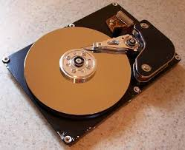
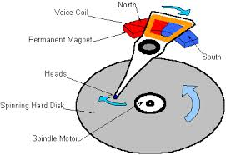
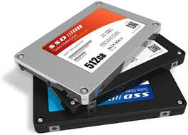

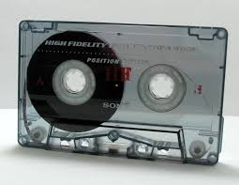
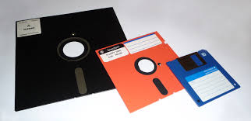
I/O and Storage Layers
Focus of today’s lecture
Application / Service
High Level I/O
Streams
Low Level I/O
File Descriptors
Syscall
open(), read(), write(), close(), …
Open File Descriptions
File System
Files/Directories/Indexes
I/O Driver
Commands and Data Transfers
Disks, Flash, Controllers, DMA

Slide 14
Today: The File Abstraction
High-Level File I/O: Streams
Low-Level File I/O: File Descriptors
How and Why of High-Level File I/O
Process State for File Descriptors
Common Pitfalls with OS Abstractions

Slide 15
C High-Level File API – Streams
Operates on “streams” – sequence of bytes, either text or data, with a position
#include <stdio.h>
FILE* fopen(char const* filename, char const* mode);
int fclose(FILE* fp);
Mode Text | Binary | Descriptions
"r" | "rb" | Open existing file for reading; fails if file doesn’t exist
"w" | "wb" | Open for writing; created if does not exist
"a" | "ab" | Open for appending; created if does not exist
"r+" | "rb+" | Open existing file for reading & writing; fails if file doesn’t exist
"w+" | "wb+" | Open for reading & writing; truncated to zero if exists, create otherwise
"a+" | "ab+" | Open for reading & writing. Created if does not exist. Read from beginning, write as append

Slide 16
C API Standard Streams – stdio.h
Three predefined streams are opened implicitly when the program is executed (by C standard library)
  FILE* stdin – normal source of input, can be redirected
  FILE* stdout – normal source of output, can be redirected too
  FILE* stderr – diagnostics and errors
STDIN / STDOUT enable composition in Unix
All can be redirected
  cat hello.txt | grep "World!"
  cat’s stdout goes to grep’s stdin

Slide 17
C High-Level File API
  // character oriented
  int fputc(int c, FILE* fp); // rtn c or EOF on err
  int fputs(char const* s, FILE* fp); // rtn > 0 or EOF
  int fgetc(FILE* fp);
  char *fgets(char* buf, int n, FILE* fp);
  // block oriented
  size_t fread(void* ptr, size_t size_of_elements,
  size_t number_of_elements, FILE* a_file);
  size_t fwrite(const void* ptr, size_t size_of_elements,
  size_t number_of_elements, FILE* a_file);
  // formatted
  int fprintf(FILE* stream, char const* format, ...);
  int fscanf(FILE* stream, char const* format, ... );

Slide 18
C Streams: Char-by-Char I/O
  int main(void) {
  FILE* input = fopen("input.txt", "r");
  FILE* output = fopen("output.txt", "w");
  int c;
  c = fgetc(input);
  while (c != EOF) {
  fputc(output, c);
  c = fgetc(input);
  }
  fclose(input);
  fclose(output);
  }

Slide 19
C High-Level File API
  // character oriented
  int fputc(int c, FILE* fp); // returns c or EOF on err
  int fputs(const char* s, FILE* fp); // returns > 0 or EOF
  int fgetc(FILE* fp );
  char *fgets(char* buf, int n, FILE* fp);
  // block oriented
  size_t fread(void* ptr, size_t size_of_elements,
  size_t number_of_elements, FILE* a_file);
  size_t fwrite(const void* ptr, size_t size_of_elements,
  size_t number_of_elements, FILE* a_file);
  // formatted
  int fprintf(FILE* stream, const char* format, ...);
  int fscanf(FILE* stream, const char* format, ... );

Slide 20
C Streams: Block-by-Block I/O
  #define BUFFER_SIZE 1024
  int main(void) {
  FILE* input = fopen("input.txt", "r");
  FILE* output = fopen("output.txt", "w");
  char buffer[BUFFER_SIZE];
  size_t length;
  length = fread(buffer, BUFFER_SIZE, sizeof(char), input);
  while (length > 0) {
  fwrite(buffer, length, sizeof(char), output);
  length = fread(buffer, BUFFER_SIZE, sizeof(char), input);
  }
  fclose(input);
  fclose(output);
  }

Slide 21
Aside: System Programming
Systems programmers are paranoid
We should really be writing things like:
    FILE* input = fopen("input.txt", "r");
    if (input == NULL) {
    // Prints our string and error msg.
    perror("Failed to open input file");
    }
Be thorough about checking return values
  Want failures to be systematically caught and dealt with

Slide 22
C High-Level File API: Positioning
int fseek(FILE* stream, long int offset, int whence);
long int ftell (FILE* stream)
void rewind (FILE* stream)
Preserves high level abstraction of a uniform stream of objects
offset (SEEK_SET)
offset (SEEK_END)
whence
offset (SEEK_CUR)

Slide 23
Today: The File Abstraction
High-Level File I/O: Streams
Low-Level File I/O: File Descriptors
How and Why of High-Level File I/O
Process State for File Descriptors
Common Pitfalls with OS Abstractions [if time]

Slide 24
Low-Level File I/O
Operations on file descriptors
  Integer that corresponds to an object in the kernel called an open file description
  Open file description object in the kernel represents an instance of an open file
  Why not just use a pointer?
#include <fcntl.h>
#include <unistd.h>
#include <sys/types.h>
int open (const char* filename, int flags [, mode_t mode])
int creat (const char* filename, mode_t mode)
int close (int filedes)
Bit vector of:
Access modes (Rd, Wr, …)
Open Flags (Create, …)
Operating modes (Appends, …)
Bit vector of Permission Bits:
User|Group|Other x R|W|X

Slide 25
C Low-Level Standard Descriptors
  #include <unistd.h>
  STDIN_FILENO - macro has value 0
  STDOUT_FILENO - macro has value 1
  STDERR_FILENO - macro has value 2
  int fileno (FILE* stream);
  FILE* fdopen (int fileno, const char* opentype);

Slide 26
Low-Level File API
ssize_t read (int filedesc, void* buffer, size_t maxsize)
  Reads up to maxsize bytes – might actually read less!
  Returns bytes read, 0 => EOF, -1 => error
ssize_t write (int filedesc, const void* buffer, size_t size)
  Returns bytes written
off_t lseek (int filedesc, off_t offset, int whence)
  Moves current position

Slide 27
Example: lowio.c
  int main() {
  char buf[1000];
  int fd = open("lowio.c", O_RDONLY | O_CREAT, S_IRUSR | S_IWUSR);
  ssize_t rd = read(fd, buf, sizeof(buf));
  int err = close(fd);
  ssize_t wr = write(STDOUT_FILENO, buf, rd);
  }
How many bytes does this program read?

Slide 28
POSIX I/O: Design Patterns
Open before use
  Access control check, setup happens here
Byte-oriented
  Least common denominator
  OS responsible for hiding the fact that real devices may not work this way (e.g. hard drive stores data in blocks)
Explicit close

Slide 29
POSIX I/O: Kernel Buffering
Reads are buffered
  Part of making everything byte-oriented
  Process is blocked while waiting for device
  Let other processes run while gathering result
Writes are buffered
  Complete in background (more later on)
  Return to user when data is “handed off” to kernel

Slide 30
Key Unix I/O Design Concepts
Uniformity – everything is a file
  file operations, device I/O, and interprocess communication through open, read/write, close
  Allows simple composition of programs
    find | grep | wc …
Open before use
  Provides opportunity for access control and arbitration
  Sets up the underlying machinery, i.e., data structures
Byte-oriented
  Even if blocks are transferred, addressing is in bytes
Kernel buffered reads
  Streaming and block devices look the same, reading blocks yields processor to other task
Kernel buffered writes
  Completion of out-going transfer decoupled from the application, allowing it to continue
Explicit close

Slide 31
Low-Level I/O: Other Operations
Operations specific to terminals, devices, networking, …
  e.g., ioctl
Duplicating descriptors
  int dup2(int old, int new);
  int dup(int old);
Pipes – channel
  int pipe(int pipefd[2]);
  Writes to pipefd[1] can be read from pipefd[0]
File Locking
Memory-Mapping Files
Asynchronous I/O

Slide 32
Announcements
Project 0 deadline is next Monday
Assignment 1 out, deadline February 24
  You should be working on this!

Slide 33
Today: The File Abstraction
High-Level File I/O: Streams
Low-Level File I/O: File Descriptors
How and Why of High-Level File I/O
Process State for File Descriptors
Some Pitfalls with OS Abstractions [if time]

Slide 34
High-Level vs. Low-Level File API
High-Level Operation:
Low-Level Operation:
size_t fread(…) {
Do some work like a normal fn…
asm code … syscall # into %eax
put args into registers %ebx, …
special trap instruction
ssize_t read(…) {
asm code … syscall # into %eax
put args into registers %ebx, …
special trap instruction
Kernel:
Kernel:
get args from regs
dispatch to system func
Do the work to read from the file
Store return value in %eax
get args from regs
dispatch to system func
Do the work to read from the file
Store return value in %eax
get return values from regs
Do some more work like a normal fn…
};
get return values from regs
};

Slide 35
High-Level vs. Low-Level File API
Streams are buffered in user memory:
printf("Beginning of line ");
sleep(10); // sleep for 10 seconds
printf("and end of line\n");
Prints out everything at once
Operations on file descriptors are visible immediately
write(STDOUT_FILENO, "Beginning of line ", 18);
sleep(10);
write(STDOUT_FILENO, "and end of line \n", 16);
Outputs "Beginning of line" 10 seconds earlier

Slide 36
What’s in a FILE*?
FILE instance lives in user space, fopen returns pointer to it
What’s in the FILE* returned by fopen?
  File descriptor (from call to open)
  Buffer (array)
  Lock (in case multiple threads use the FILE concurrently)
Of course there’s other stuff in a FILE too…
… but this is useful model to have

Slide 37
FILE Buffering
When you call fwrite, what happens to the data you provided?
  It gets written to the FILE’s buffer (in user space)
  If the FILE’s buffer is full, then it is flushed
    Which means it’s written to the underlying file descriptor
  The C standard library may flush the FILE more frequently
    e.g., if it sees a certain character in the stream
When you write code, make the weakest possible assumptions about how data is flushed from FILE buffers

Slide 38
Example
  What will x be after the following code execution?
  char x = 'c';
  FILE* f1 = fopen("file.txt", "w");
  fwrite("b", sizeof(char), 1, f1);
  FILE* f2 = fopen("file.txt", "r");
  fread(&x, sizeof(char), 1, f2);
The call to fread might see the latest write 'b'
Or it might miss it, seeing the end of file (in which case x will
remain 'c')

Slide 39
Example
  What will x be after the following code execution?
  char x = 'c';
  FILE* f1 = fopen("file.txt", "wb");
  fwrite("b", sizeof(char), 1, f1);
  fflush(f1);
  FILE* f2 = fopen("file.txt", "rb");
  fread(&x, sizeof(char), 1, f2);
Now, the call to fread will see the latest write 'b'

Slide 40
Writing Correct Code with FILE
Your code should behave correctly regardless of when/if C Standard Library flushes its buffer
  Add your own calls to fflush so that data is written when you need to
  Calls to fclose flush the buffer before deallocating memory and closing the file descriptor
With the low-level file API, we don’t have this problem
  After write completes, data is visible to any subsequent reads

Slide 41
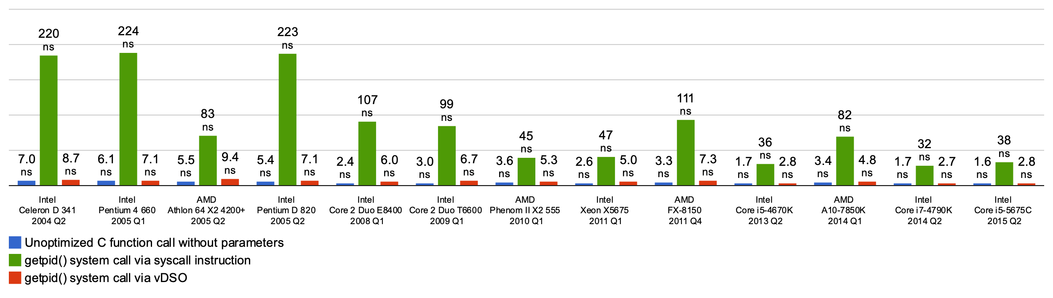
Why Buffer in Userspace?
Overhead!
Syscalls are 25x more expensive than function calls (~100 ns)
read/write a file byte by byte? Max throughput of ~10MB/second
With fgetc? Keeps up with your SSD

Slide 42
Why Buffer in Userspace? Functionality!
System call operations less capable
  Simplifies operating system
Example: No “read until new line” operation
  Solution: Make a big read syscall, find first new line in userspace

Slide 43
Today: The File Abstraction
High-Level File I/O: Streams
Low-Level File I/O: File Descriptors
How and Why of High-Level File I/O
Process State for File Descriptors
Some Pitfalls with OS Abstractions [if time]

Slide 44
I/O and Storage Layers
Focus of today’s lecture
Application / Service
High Level I/O
Streams
Low Level I/O
File Descriptors
Syscall
open(), read(), write(), close(), …
Open File Descriptions
File System
Files/Directories/Indexes
I/O Driver
Commands and Data Transfers
Disks, Flash, Controllers, DMA

Slide 45
Kernel Maintains State
  char buffer1[100];
  char buffer2[100];
  int fd = open("foo.txt", O_RDONLY);
  read(fd, buffer1, 100);
  read(fd, buffer2, 100);
  close(fd);
The kernel remembers that the int it receives (stored in fd) corresponds to foo.txt
The kernel picks up where it left off in the file

Slide 46
State Maintained by the Kernel
On a successful call to open():
  A file descriptor (int) is returned to the user
  An open file description is created in the kernel
For each process, the kernel maintains a mapping from a file descriptor to an open file description
On future system calls (e.g., read()), the kernel looks up the open file description corresponding to the provided file descriptor and uses it to service the system call
A call to close() removes the file descriptor mapping and deallocates the file description (if no other processes refer to it)

Slide 47
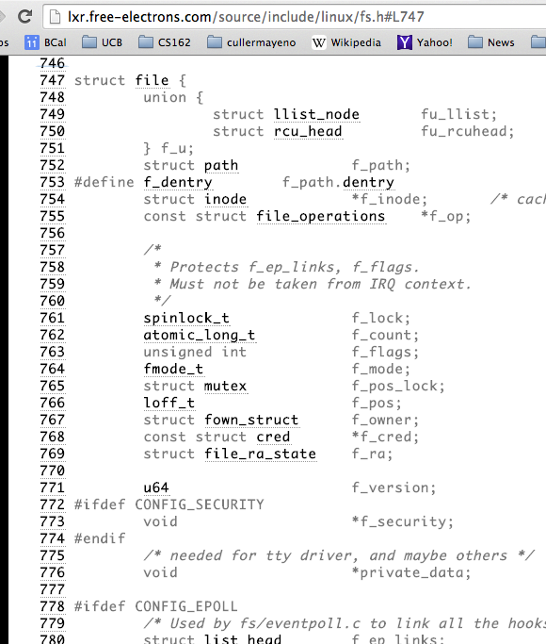
What’s in an Open File Description?
For our purposes, the two most important things are:
  Where to find the file data on disk
  The current position within the file

Slide 48
Abstract Representation of a Process
Process
Suppose that we execute
  open("foo.txt", ...)
and that the result is 3
Thread’s Regs
Address Space (Memory)
…
User Space
Kernel Space
File Descriptors
Open File Description
3
Not shown: Initially contains 0, 1, and 2 (stdin, stdout, stderr)
File: foo.txt
Position: 0

Slide 49
Abstract Representation of a Process
Process
Suppose that we execute
  open("foo.txt", ...)
and that the result is 3
Next, suppose that we execute
  read(3, buf, 100)
and that the result is 100
Thread’s Regs
Address Space (Memory)
…
User Space
Kernel Space
File Descriptors
Open File Description
3
Not shown: Initially contains 0, 1, and 2 (stdin, stdout, stderr)
File: foo.txt
Position: 0

Slide 50
Abstract Representation of a Process
Process
Suppose that we execute
  open("foo.txt", ...)
and that the result is 3
Next, suppose that we execute
  read(3, buf, 100)
and that the result is 100
Thread’s Regs
Address Space (Memory)
…
User Space
Kernel Space
File Descriptors
Open File Description
3
Not shown: Initially contains 0, 1, and 2 (stdin, stdout, stderr)
File: foo.txt
Position: 100

Slide 51
Abstract Representation of a Process
Process
Suppose that we execute
  open("foo.txt", ...)
and that the result is 3
Next, suppose that we execute
  read(3, buf, 100)
and that the result is 100
Finally, suppose that we execute
  close(3)
Thread’s Regs
Address Space (Memory)
…
User Space
Kernel Space
File Descriptors
Open File Description
3
Not shown: Initially contains 0, 1, and 2 (stdin, stdout, stderr)
File: foo.txt
Position: 100

Slide 52
Now, let’s fork()!
Process 1
Process 2
Thread’s Regs
Address Space (Memory)
File descriptor is copied
Open file description is aliased
Thread’s Regs
Address Space (Memory)
…
…
User Space
Kernel Space
File Descriptors
File Descriptors
Open File Description
3
3
Not shown: Initially contains 0, 1, and 2 (stdin, stdout, stderr)
File: foo.txt
Position: 100

Slide 53
Open File Description is Aliased
read(3, buf, 100)
Process 1
Process 2
Thread’s Regs
Address Space (Memory)
Thread’s Regs
Address Space (Memory)
…
…
User Space
Kernel Space
File Descriptors
File Descriptors
Open File Description
3
3
Not shown: Initially contains 0, 1, and 2 (stdin, stdout, stderr)
File: foo.txt
Position: 100

Slide 54
Open File Description is Aliased
read(3, buf, 100)
Process 1
Process 2
Thread’s Regs
Address Space (Memory)
Thread’s Regs
Address Space (Memory)
…
…
User Space
Kernel Space
File Descriptors
File Descriptors
Open File Description
3
3
Not shown: Initially contains 0, 1, and 2 (stdin, stdout, stderr)
File: foo.txt
Position: 200

Slide 55
Open File Description is Aliased
read(3, buf, 100)
Process 1
read(3, buf, 100)
Process 2
Thread’s Regs
Address Space (Memory)
Thread’s Regs
Address Space (Memory)
…
…
User Space
Kernel Space
File Descriptors
File Descriptors
Open File Description
3
3
Not shown: Initially contains 0, 1, and 2 (stdin, stdout, stderr)
File: foo.txt
Position: 200

Slide 56
Open File Description is Aliased
read(3, buf, 100)
Process 1
read(3, buf, 100)
Process 2
Thread’s Regs
Address Space (Memory)
Thread’s Regs
Address Space (Memory)
…
…
User Space
Kernel Space
File Descriptors
File Descriptors
Open File Description
3
3
Not shown: Initially contains 0, 1, and 2 (stdin, stdout, stderr)
File: foo.txt
Position: 300

Slide 57
File Descriptor is Copied
read(3, buf, 100)
close(3)
Process 1
read(3, buf, 100)
Process 2
Thread’s Regs
Address Space (Memory)
Thread’s Regs
Address Space (Memory)
…
…
User Space
Kernel Space
File Descriptors
File Descriptors
Open File Description
3
3
Not shown: Initially contains 0, 1, and 2 (stdin, stdout, stderr)
File: foo.txt
Position: 300

Slide 58
File Descriptor is Copied
read(3, buf, 100)
close(3)
Process 1
read(3, buf, 100)
Process 2
Thread’s Regs
Address Space (Memory)
Thread’s Regs
Address Space (Memory)
Open file description remains alive until no file descriptors in any process refer to it
…
…
User Space
Kernel Space
File Descriptors
File Descriptors
Open File Description
3
Not shown: Initially contains 0, 1, and 2 (stdin, stdout, stderr)
File: foo.txt
Position: 300

Slide 59
Why is Aliasing the Open File Description a Good Idea?
It allows for shared resources between processes

Slide 60
Recall: In POSIX, Everything is a “File”
Identical interface for:
  Files on disk
  Devices (terminals, printers, etc.)
  Regular files on disk
  Networking (sockets)
  Local interprocess communication (pipes, sockets)
Based on the system calls open(), read(), write(), and close()

Slide 61
Example: Shared Terminal Emulator
When you fork() a process, the parent’s and child’s printf outputs go to the same terminal

Slide 62
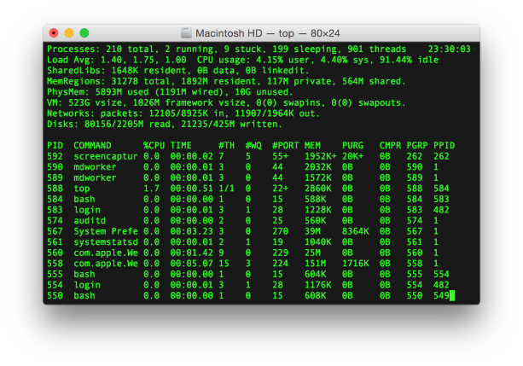
Example: Shared Terminal Emulator
Process 1
Process 2
Thread’s Regs
Address Space (Memory)
Thread’s Regs
Address Space (Memory)
…
…
User Space
Kernel Space
Terminal Emulator
File Descriptors
File Descriptors
0
1
2
0
1
2

Slide 63
Example: Shared Terminal Emulator
Process 1
Process 2
close(0)
Thread’s Regs
Address Space (Memory)
Thread’s Regs
Address Space (Memory)
…
…
User Space
Kernel Space
Terminal Emulator
File Descriptors
File Descriptors
0
1
2
0
1
2

Slide 64
Example: Shared Terminal Emulator
Process 1
Process 2
close(0)
Thread’s Regs
Address Space (Memory)
Thread’s Regs
Address Space (Memory)
If one process closes stdin (0), it remains open in other processes
…
…
User Space
Kernel Space
Terminal Emulator
File Descriptors
File Descriptors
0
1
2
0
1
2

Slide 65
Other Examples
Shared network connections after fork()
  Allows handling each connection in a separate process
  We’ll explore this next time
Shared access to pipes
  Useful for interprocess communication
  And in writing a shell (Assignment 2)

Slide 66
Other Syscalls: dup and dup2
They allow you to duplicate the file descriptor
But the open file description remains aliased

Slide 67
Other Syscalls: dup and dup2
Process
Suppose that we execute
  open("foo.txt")
and that the result is 3
Next, suppose that we execute
  read(3, buf, 100)
and that the result is 100
Next, suppose that we execute
  dup(3)
And that the result is 4
Finally, suppose that
we execute
  dup2(3, 4103)
Thread’s Regs
Address Space (Memory)
…
User Space
Kernel Space
File Descriptors
Open File Description
3
4
4103
Not shown: Initially contains 0, 1, and 2 (stdin, stdout, stderr)
File: foo.txt
Position: 100

Slide 68
Today: The File Abstraction
High-Level File I/O: Streams
Low-Level File I/O: File Descriptors
How and Why of High-Level File I/O
Process State for File Descriptors
Some Pitfalls with OS Abstractions [if time]

Slide 69
Don’t fork() in a process that already has multiple threads
Unless you plan to call exec() in the child process

Slide 70
fork() in Multithreaded Processes
The child process always has just a single thread
  The thread in which fork() returns
The other threads just vanish

Slide 71
fork() in a Multithreaded Processes
Process 1
Process 2
Thread 1 Regs
Address Space (Memory)
Only the thread that called fork() exists in the new process
Thread 1 Regs
Address Space (Memory)
Thread 2 Regs
…
User Space
…
Kernel Space
File Descriptors
File Descriptors
Open File Description
3
3
Not shown: Initially contains 0, 1, and 2 (stdin, stdout, stderr)
File: foo.txt
Position: 100

Slide 72
Possible Problems with Multithreaded fork()
When you call fork() in a multithreaded process, the other threads (the ones that didn’t call fork()) just vanish
  What if one of these threads was holding a lock?
  What if one of these threads was in the middle of modifying a data structure?
  No cleanup happens!
It’s safe if you call exec() in the child
  Replacing the entire address space

Slide 73
Don’t carelessly mix low-level and high-level file I/O

Slide 74
Avoid Mixing FILE* and File Descriptors
  What is the value has y after executing the following code?
  char x[10];
  char y[10];
  FILE* f = fopen("foo.txt", "rb");
  int fd = fileno(f);
  fread(x, 10, 1, f); // read 10 bytes from f
  read(fd, y, 10); // assumes that this returns 10
Bytes 0 to 9
Bytes 10 to 19
None of these?

Slide 75
Be careful with fork() and FILE*

Slide 76
Be Careful Using fork() with FILE*
  FILE* f = fopen("foo.txt", "w");
  fwrite("a", 1, 1, f);
  fork();
  fclose(f);
After all processes exit, what is in foo.txt?
  Could be either a or aa
Usually aa based on what I’ve observed in Linux…
Depends on whether this fwrite call flushes…

Slide 77
Be Careful Using fork() with FILE*
Process 1
Process 2
Thread’s Regs
Open File Description is aliased
But the FILE* buffer is copied!
Thread’s Regs
a
a
FILE* Buffer
FILE* Buffer
User Space
Kernel Space
File Descriptors
File Descriptors
Open File Description
3
3
Not shown: Initially contains 0, 1, and 2 (stdin, stdout, stderr)
File: foo.txt
Position: 0

Slide 78
Conclusion
Focus of today’s lecture
Application / Service
High Level I/O
Streams
Low Level I/O
File Descriptors
Syscall
open(), read(), write(), close(), …
Open File Descriptions
File System
Files/Directories/Indexes
I/O Driver
Commands and Data Transfers
Disks, Flash, Controllers, DMA

Slide 79
Conclusion
POSIX idea: “everything is a file”
All sorts of I/O managed by open/read/write/close
We added two new elements to the PCB:
  Mapping from file descriptor to open file description
  Current working directory

Slide 80
