Slide 1
Synchronization 2: Lock Implementation
Lecture 8
Hartmut Kaiser
https://teaching.hkaiser.org/spring2025/csc4103/

Slide 2
Recall: Producer-Consumer
Problem Definition
  Producers puts things into a shared buffer
  Consumers takes them out
Don’t want producers and consumers to have to work in lockstep, so put a buffer (bounded) between them
  Need synchronization to maintain integrity of the data structure and coordinate producers/consumers
  Producer needs to wait if buffer is full
  Consumer needs to wait if buffer is empty
Producer
Buffer
Consumer
Producer
Consumer
Consumer

Slide 3
Recall: Producer-Consumer (Semaphores)
  Semaphore usedSlots = 0; // No slots used
  Semaphore freeSlots = bufSize; // All slots free
  Lock mutex = <initially unlocked>; // Nobody in critical sec.
Producer(item) {
freeSlots.P();
mutex.acquire();
Enqueue(item);
mutex.release();
usedSlots.V();
}
Consumer() {
usedSlots.P();
mutex.acquire();
item = Dequeue();
mutex.release();
freeSlots.V();
return item;
}

Slide 4
Recall: Problems with Semaphores
More powerful (and primitive) than locks
Argument: Clearer to have separate constructs for
  Mutual Exclusion: One thread can do something at a time
  Waiting for a condition to become true
Need to make sure a thread calls P() for every V()
  Other tools are more flexible than this

Slide 5
Recall: Condition Variables
Queue of threads waiting inside a critical section
  Typically, waiting until a condition on some variables becomes true
  Variables typically are protected by a mutex
Operations:
  wait(&lock): Atomically release lock and go to sleep until condition variable is signaled. Re-acquire the lock before returning.
  signal(): Wake up one waiting thread (if there is one)
  broadcast(): Wake up all waiting threads
Rule: Hold lock when using a condition variable

Slide 6
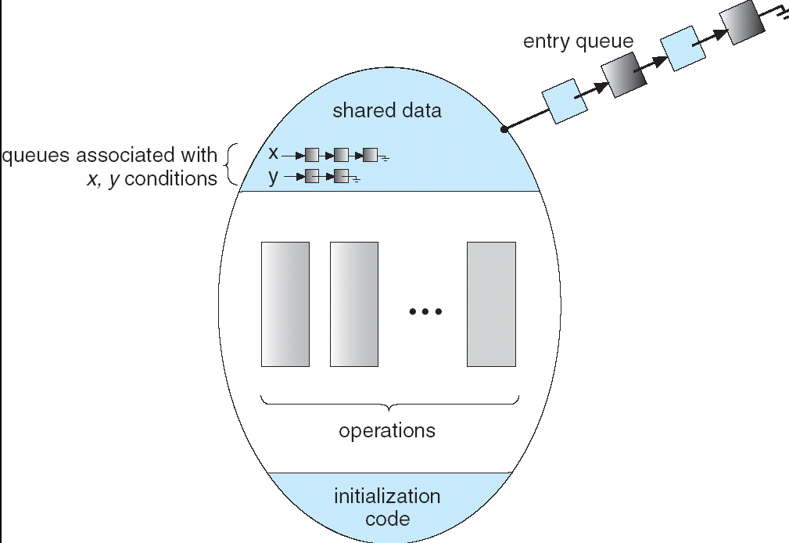
Recall: Monitors
A monitor consists of a lock and zero or more condition variables used for managing concurrent access to shared data
Lock: the lock provides mutual exclusion to shared data
Condition Variable: a queue of threads waiting for something inside a critical section
  Key idea: make it possible to go to sleep inside critical section by atomically releasing lock at time we go to sleep

Slide 7
Recall: Mesa Monitors vs. Hoare Monitors
Mesa Monitor
Hoare Monitor
  while (buffer empty) {
  cond_wait(&not_empty, &buf_lock);
  }
  if (buffer empty) {
  cond_wait(&not_empty, &buf_lock);
  }
In practice, almost all OSes implement Mesa monitors

Slide 8
Recall: Why the while Loop?
When a thread is woken up by signal(), it is simply marked as eligible to run
It may or may not reacquire the lock immediately!
  Another thread could be scheduled and “sneak in” make the condition it’s waiting for no longer true
  Need a loop to re-check condition on wakeup
This is called Mesa Scheduling (Mesa-style Monitors)
Most operating systems use Mesa-style Monitors!

Slide 9
Concurrency and Synchronization in C
Harder with more locks
  void Rtn() {
  lock1.acquire();
  …
  if (error) {
  lock1.release();
  return;
  }
  …
  lock2.acquire();
  …
  if (error) {
  lock2.release()
  lock1.release();
  return;
  }
  …
  lock2.release();
  lock1.release();
  }
Is goto a solution???
  void Rtn() {
  lock1.acquire();
  …
  if (error) {
  goto release_lock1_and_return;
  }
  …
  lock2.acquire();
  …
  if (error) {
  goto release_both_and_return;
  }
  …
  release_both_and_return:
  lock2.release();
  release_lock1_and_return:
  lock1.release();
  }

Slide 10
C++ Lock Guards
  #include <mutex>
  int global_i = 0;
  std::mutex global_mutex;
  void safe_increment() {
  std::lock_guard<std::mutex> lock(global_mutex);
  …
  ++global_i;
  // Mutex released when ‘lock’ goes out of scope
  }

Slide 11
Today: How to implement synchronization primitives?
For now, just consider locks inside the kernel.

Slide 12
Recall: Race Conditions
What are the possible values of x below?
Initially x == 0
1 or 2 (non-deterministic)
Thread A
x += 1;
Thread B
x += 1;
Thread A
ld r1, &x
add r1, r1, 1
st r1, &x
Thread B
ld r1, &x
add r1, r1, 1
st r1, &x

Slide 13
Recall: Race Conditions
What are the possible values of x below?
Initially x == 0
0x1 or 0x400 (non-deterministic)
  Note: on some architectures (ARM) we could see 0x401
Thread A
x = 0x1;
Thread B
x = 0x400;

Slide 14
Atomic Operations
To understand a concurrent program, we need to know what the underlying indivisible operations are!
Atomic Operation: an operation that always runs to completion or not at all
  It is indivisible: it cannot be stopped in the middle and state cannot be modified by someone else in the middle
  It is thread-safe by design
On most machines, memory references and assignments (i.e. loads and stores) of words are atomic
On other architectures (ARM!) load/store of a byte is atomic

Slide 15
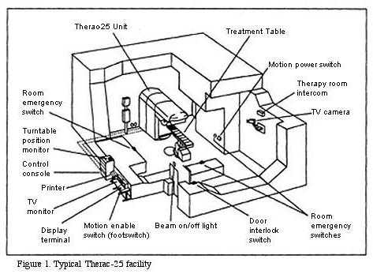
Concurrency is Hard!
Even for practicing engineers trying to write mission-critical, bulletproof code!
  Threaded programs must work for all inter-leavings of thread instruction sequences
  Cooperating threads inherently non-deterministic and non-reproducible
  Really hard to debug unless carefully designed!
Therac-25: Radiation Therapy Machine with Unintended Overdoses
Mars Pathfinder Priority Inversion (JPL Account)
Toyota Uncontrolled Acceleration (CMU Talk)
  256.6K Lines of C Code, ~9-11K global variables
  Inconsistent mutual exclusion on reads/writes

Slide 16
Motivating Example: “Too Much Milk”
Analogy between problems in OS and problems in real life
Example: People need to coordinate:
Time
Person A
Person B
3:00
Look in Fridge. Out of milk
3:05
Leave for store
3:10
Arrive at store
Look in Fridge. Out of milk
3:15
Buy milk
Leave for store
3:20
Arrive home, put milk away
Arrive at store
3:25
Buy milk
3:30
Arrive home, put milk away

Slide 17
Too Much Milk: Correctness
Safety: At most one person buys milk.
Liveness: If milk is needed, at least one person buys it.

Slide 18
Attempt #1
Leave a note
  Place on fridge before buying
  Remove after buying
  Don’t go to store if there’s already a note
Leaving/checking a note is atomic (word load/store)
    if (noMilk) {
    if (noNote) {
    leave Note;
    buy milk;
    remove Note;
    }
    }

Slide 19
Attempt #1 in Action
Thread A
Thread B
  if (noMilk) {
  if (noNote) {
  leave Note;
  buy milk;
  remove Note;
  }
  }
  if (noMilk) {
  if (noNote) {
  leave Note;
  buy milk;
  remove note;
  }
  }
Achieves liveness but not safety

Slide 20
Attempt #1.5
Idea: leave note, then check for milk
    leave Note;
    if (noMilk) {
    if (noNote) {
    buy milk;
    }
    }
    remove Note;
But there’s always a note – you just left one!

Slide 21
Attempt #2: Use Named Notes
Thread A
Thread B
  leave note A
  if (noMilk) {
  if (noNote B) {
  buy milk
  }
  }
  remove note A
  leave note B
  if (noMilk) {
  if (noNote A) {
  buy milk
  }
  }
  remove note B

Slide 22
Attempt #2 in Action
Thread A
Thread B
  leave note A
  if (noMilk) {
  if (noNote B) {
  buy milk
  }
  }
  remove note A
  leave note B
  if (noMilk) {
  if (noNote A) {
  buy milk
  }
  }
  remove note B
Achieves safety but not liveness

Slide 23
Attempt #3: Wait
Thread A
Thread B
  leave note A
  while (note B) {
  do nothing
  }
  if (noMilk) {
  buy milk
  }
  remove note A
  leave note B
  while (note A) {
  do nothing
  }
  if (noMilk) {
  buy milk
  }
  remove note B
This is a correct solution!

Slide 24
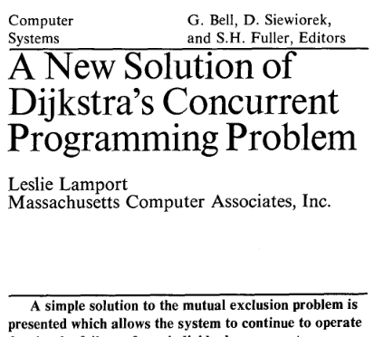

This Generalizes to $n$ Threads…
Leslie Lamport’s “Bakery Algorithm” (1974)
Allows one to protect a critical section like:
  if (noMilk) {
  buy milk;
  }

Slide 25
Solution #3 Discussion
Solution #3 works, but it’s not great
  Really complex – even for this simple example
    Hard to convince yourself that this really works
  While a thread is waiting, it is consuming CPU time
    This is called “busy-waiting”
There’s a better way
  Have hardware provide more primitives than simple atomic load & store
  Build even higher-level programming abstractions on this hardware support
    Make sure the OS scheduler never allows another thread to enter the critical section
    The other thread becomes blocked if it tries to enter

Slide 26
Where are we going with Synchronization?
Building an efficient, easy-to-use API
Programs
Shared Programs
Higher-level
API
Locks Semaphores Monitors Send/Receive
Hardware
Load/Store Disable Ints Test&Set Compare&Swap

Slide 27
Announcements
Project 1 design document due March 10
  You have started talking to the TA, hopefully
Assignment 2 now published, due April 7
Project 1 due March 24
Mid-term examination March 12, 5.00pm, 1200 PFT
  Mid-term review March 10

Slide 28
Implementing Locks: Single Core
How can we make lock.Acquire() and lock.Release() appear atomic to other threads?
Idea: A context switch can only happen (assuming threads don’t yield) if there’s an interrupt
“Solution”: Disable interrupts while holding lock
x86 has cli and sti instructions that only operate in system mode (PL=0)
  Interrupts enabled bit in FLAGS register

Slide 29
Naïve Interrupt Enable/Disable
Problem: can stall the entire system
    Lock.Acquire()
    While (1) {}
Problem: What if we want to do I/O?
    Lock.Acquire()
    Read from disk
    /* OS waits for (disabled) interrupt! */
Acquire() {
disable interrupts;
}
Release() {
enable interrupts;
}

Slide 30
Implementing Locks: Single Core
  int value = FREE;
  Acquire() {
  disable interrupts;
  if (value == BUSY) {
  put thread on wait queue;
  run_new_thread();
  // Enable interrupts?
  } else {
  value = BUSY;
  }
  enable interrupts;
  }
Key idea: maintain a lock variable (value) and disable interrupts only during operations on that variable
  Release() {
  disable interrupts;
  if (anyone on wait queue) {
  take thread off wait queue;
  Place on ready queue;
  }
  value = FREE;
  enable interrupts;
  }

Slide 31
Discussion
Why do we need to disable interrupts at all?
  Avoid interruption between checking and setting lock value
  Otherwise two threads could think that they both have lock
Unlike the naïve solution, interrupts are disabled for a short time only
Acquire() {
disable interrupts;
if (value == BUSY) {
put thread on wait queue;
run_new_thread();
// Enable interrupts?
} else {
value = BUSY;
}
enable interrupts;
}
Disabling interrupts prevents preemption
Locks disable interrupts to provide another critical section
Critical
Section

Slide 32
Implementing Locks: Single Core
  int value = FREE;
  Acquire() {
  disable interrupts;
  if (value == BUSY) {
  put thread on wait queue;
  run_new_thread();
  // Enable interrupts?
  } else {
  value = BUSY;
  }
  enable interrupts;
  }
Key idea: maintain a lock variable (value) and disable interrupts only during operations on that variable
  Release() {
  disable interrupts;
  if (anyone on wait queue) {
  take thread off wait queue;
  Place on ready queue;
  }
  value = FREE;
  enable interrupts;
  }

Slide 33
Re-enabling Interrupts when Waiting
Before on the queue?
  Release might not wake up this thread!
After putting the thread on the queue?
  Gets woken up, but immediately switches away
Acquire() {
disable interrupts;
if (value == BUSY) {
put thread on wait queue;
run_new_thread()
} else {
value = BUSY;
}
enable interrupts;
}
enable interrupts
enable interrupts

Slide 34
Re-enabling Interrupts when Waiting
Best solution: after the current thread suspends
How?
  run_new_thread() should do it!
  Part of returning from switch()
Acquire() {
disable interrupts;
if (value == BUSY) {
put thread on wait queue;
run_new_thread()
} else {
value = BUSY;
}
enable interrupts;
}
enable interrupts

Slide 35
How to Re-enable Interrupts when Waiting
In scheduler, since interrupts are disabled when switching threads:
  Responsibility of the next thread is to re-enable interrupts
  When the sleeping thread wakes up, returns and re-enables interrupts
  Thread A
  ...
  disable ints
  call run_new_thread
  run_new_thread returns
  enable ints
  ...
  Thread B
    run_new_thread returns
    enable ints
    ...
    disable ints
    call run_new_thread
context
switch
context
switch

Slide 36
Enabling Interrupts vs. Restoring Interrupts
99% of the time, you want to restore interrupts, not enable them
We used “enable interrupts” in this lecture since we were assuming interrupts are enabled when acquiring the lock
In PintOS:
  enum intr_level state = intr_disable();
  <code manipulating shared data>
  intr_set_level(state);

Slide 37
When does this Lock Implementation Work?
Answer: For threads in the kernel on a single-core machine.
What about multi-core machines?
What about user threads?

Slide 38
Multi-Core Machines
How to synchronize with threads executing in parallel on other cores?
  Disable interrupts on all cores?
  Prevent other cores from making progress?
Implement locks in hardware?
  What’s the interface between hardware lock and OS scheduler?
Solution: Use hardware support for atomic operations

Slide 39
Atomic Operations
Definition: An operation runs to completion or not at all
  Foundation for synchronization primitives
Example: Loading or storing a word (on most modern architectures)

Slide 40
Atomic Read-Modify-Write Instructions
These instructions read a value and write a new value atomically
Hardware is responsible for implementing this correctly
  On both uniprocessors (not too hard)
  And multiprocessors (requires help from cache coherence protocol)
Unlike disabling interrupts, can be used on both uniprocessors and multiprocessors
Natural extensions to user-level locking

Slide 41
Examples of Read-Modify Write
  test&set (&address) { /* most architectures */
  result = M[address]; // return result from “address” and
  M[address] = 1; // set value at “address” to 1
  return result;
  }
  swap (&address, register) { /* x86 */
  temp = M[address]; // swap register’s value to
  M[address] = register; // value at “address”
  register = temp;
  }

Slide 42
Examples of Read-Modify Write
  compare&swap (&address, reg1, reg2) { /* 68000, x86 */
  if (reg1 == M[address]) { // If memory still == reg1,
  M[address] = reg2; // then put reg2 => memory
  return success;
  } else { // Otherwise do not change memory
  return failure;
  }
  }
  load-linked&store-conditional(&address) { /* R4000, alpha */
  loop:
  ll r1, M[address];
  movi r2, 1; // Can do arbitrary computation
  sc r2, M[address];
  beqz r2, loop;
  }

Slide 43
Implementing Locks with test&set
Simple, but flawed, solution:
  int value = 0; // Free
  Acquire() {
  while (test&set(value)) {}; // spin while busy
  }
  Release() {
  value = 0; // atomic store
  }
Explanation:
  If lock is free, test&set reads 0 and sets value=1, so lock is now busy. It returns 0 so while exits.
  If lock is busy, test&set reads 1 and sets value=1 (no change). It returns 1, so while loop continues.
  When we set value = 0, someone else can get lock.
Busy-Waiting: thread consumes cycles while waiting
For multiprocessor cache coherence: every test&set() is a write, which makes value
ping-pong around in cache (using lots of memory BW)

Slide 44
This is Called a Spinlock
Spinlock implementation:
  int value = 0; // Free
  Acquire() {
  while (test&set(value)) {}; // spin while busy
  }
  Release() {
  value = 0; // atomic store
  }
Spinlock doesn’t put the calling thread to sleep --- it just busy waits

Slide 45
Problem: Busy-Waiting for Lock
Positives for this solution
  Machine can receive interrupts
  User code can use this lock (poorly)
  Works on a multiprocessor
Negatives
  Very inefficient: thread will consume cycles waiting
  Waiting thread takes cycles away from thread holding lock (no one wins!)
  Priority Inversion: If busy-waiting thread has higher priority than thread holding lock ⇒ no progress!
For semaphores (and monitors), waiting thread may wait for an arbitrary long time!
  Thus even if busy-waiting was OK for locks, definitely not OK for other primitives
  Homework/exam solutions should avoid busy-waiting!

Slide 46
Better Locks Using test&set
Can we build test&set locks without busy-waiting?
  Can’t entirely, but can minimize!
  Idea: only busy-wait to atomically check lock value
Note: sleep has to be sure to reset the guard variable
  Why can’t we do it just before or just after the sleep?
int guard = 0;
int value = FREE;
Acquire() {
// Short busy-wait time
while (test&set(guard)) /**/;
if (value == BUSY) {
put thread on wait queue;
run_new_thread() & guard = 0;
} else {
value = BUSY;
guard = 0;
}
}
Release() {
// Short busy-wait time
while (test&set(guard)) /**/;
if anyone on wait queue {
take thread off wait queue
Place on ready queue;
}
value = FREE;
guard = 0;
}

Slide 47
Alternative View: Bootstrapping a Spinlock
SpinLock guard = FREE;
int value = FREE;
Acquire() {
// Short busy-wait time
guard.Acquire();
if (value == BUSY) {
put thread on wait queue;
run_new_thread() & guard.Release();
} else {
value = BUSY;
guard.Release();
}
}
Release() {
// Short busy-wait time
guard.Acquire();
if anyone on wait queue {
take thread off wait queue
Place on ready queue;
}
value = FREE;
guard.Release();
}

Slide 48
Comparison to Disabling Interrupts
int value = FREE;
Acquire() {
// Short busy-wait time
disable interrupts;
if (value == BUSY) {
put thread on wait queue;
run_new_thread();
// scheduler enables interrupts
} else {
value = BUSY;
enable interrupts;
}
}
Release() {
disable interrupts;
if anyone on wait queue {
take thread off wait queue
Place on ready queue;
}
value = FREE;
enable interrupts;
We changed disable interrupts → spinlock.Acquire() [while (test&set(guard)]
We changed enable interrupts → spinlock.Release() [guard = 0]

Slide 49
Recap: Locks Using Interrupts
int value = 0;
Acquire() {
// Short busy-wait time
disable interrupts;
if (value == 1) {
put thread on wait-queue;
go to sleep() & disable interrupts;
} else {
value = 1;
guard = 0;
}
}
Acquire() {
disable interrupts;
}
lock.Acquire();
…
critical section;
…
lock.Release();
Release() {
enable interrupts;
}
Release() {
// Short busy-wait time
disable interrupts;
if anyone on wait queue {
take thread off wait-queue
Place on ready queue;
}
value = 0;
enable interrupts;
}
Threads waiting to enter critical section busy-wait

Slide 50
Recap: Locks Using test&set
int guard = 0;
int value = 0;
Acquire() {
// Short busy-wait time
while(test&set(guard));
if (value == 1) {
put thread on wait-queue;
go to sleep()& guard = 0;
} else {
value = 1;
guard = 0;
}
}
int value = 0;
Acquire() {
while(test&set(value));
}
lock.Acquire();
…
critical section;
…
lock.Release();
Release() {
value = 0;
}
Release() {
// Short busy-wait time
while (test&set(guard));
if anyone on wait queue {
take thread off wait-queue
Place on ready queue;
}
value = 0;
guard = 0;
}
Threads waiting to enter critical section busy-wait

Slide 51
Recall: Spinlock
Spinlock implementation:
  int value = 0; // Free
  Acquire() {
  while (test&set(value)) {}; // spin while busy
  }
  Release() {
  value = 0; // atomic store
  }
Spinlock doesn’t put the calling thread to sleep—it just busy waits
  When might this be preferable?
For multiprocessor cache coherence: every test&set() is a write, which makes value ping-pong around in cache (using lots of memory BW)

Slide 52
Better Spinlock: test&test&set
A better spinlock solution:
  int mylock = 0; // Free
  Acquire() {
  do {
  while(mylock) /**/; // Wait until might be free
  } while(test&set(&mylock)); // exit if get lock
  }
  Release() {
  mylock = 0;
  }
Explanation:
  Wait until lock might be free (only reading – stays in cache)
  Then, try to grab lock with test&set
  Repeat if fail to actually get lock
Busy-Waiting: no longer impacts other processors!

Slide 53
Locks in Userspace?
We’ve looked at locks in the kernel
  Uniprocessor case (disable interrupts)
  Multiprocessor case (test&set)
What about locks in userspace?
Spinlocks just work
Simple idea for non-busy-waiting lock:
  For each userspace lock, allocate a lock in the kernel
  Make a syscall for each acquire/release operation to acquire the lock in the kernel

Slide 54
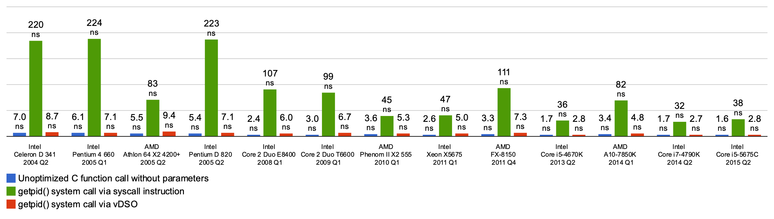
Recall: Overhead of Syscalls
Syscalls are 25x more expensive than function calls (~100 ns)
read/write a file byte by byte? Max throughput of ~10MB/second
With fgetc? Keeps up with your SSD

Slide 55
Userspace Locks: Syscall Overhead
Can we avoid syscall overhead when acquiring a non-busy-waiting lock in userspace?
  No: can’t put a thread to sleep (i.e., block the thread) without entering the kernel
What we can do: avoid system calls in the uncontended case (i.e., the case where we can acquire the lock without blocking)
  Helps both uniprocessor case and multiprocessor case

Slide 56
Linux futex: Fast Userspace Mutex
uaddr points to a 32-bit value in user space
futex_op
  FUTEX_WAIT – if val == *uaddr sleep till FUTEX_WAKE
    Atomic check that condition still holds
  FUTEX_WAKE – wake up at most val waiting threads
  FUTEX_FD, FUTEX_WAKE_OP, FUTEX_CMP_REQUEUE
timeout
  ptr to a timespec structure that specifies a timeout for the op
    NULL == wait forever
#include <linux/futex.h>
#include <sys/time.h>
int futex(int *uaddr, int futex_op, int val,
const struct timespec *timeout );

Slide 57
Linux futex: Fast Userspace Mutex
Idea: Userspace lock is syscall-free in the uncontended case
Lock has three states
  Free (no syscall when acquiring lock)
  Busy, no waiters (no syscall when releasing lock)
  Busy, possibly with some waiters
futex is not exposed in libc; it is used within the implementation of pthreads

Slide 58
Example: Userspace Locks with futex
This is syscall-free in the uncontended case
  Temporarily falls back to syscalls if multiple waiters, or concurrent acquire/release
But it can be considerably optimized!
  See “Futexes are Tricky” by Ulrich Drepper
int value = 0; // free
bool maybe_waiters = false;
Acquire() {
while (test&set(value)) {
maybe_waiters = true;
futex(&value, FUTEX_WAIT, 1);
// futex: sleep if lock is acquired
maybe_waiters = true;
}
}
Release() {
value = 0;
if (maybe_waiters) {
maybe_waiters = false;
futex(&value, FUTEX_WAKE, 1);
// futex: wake up a sleeping thread
}
}

Slide 59
Conclusion
Important concept: Atomic Operations
  An operation that runs to completion or not at all
  These are the primitives on which to construct various synchronization primitives
Talked about hardware atomicity primitives:
  Disabling of Interrupts, test&set, swap, compare&swap,
  load-locked & store-conditional
Showed several constructions of Locks
  Must be very careful not to waste/tie up machine resources
    Shouldn’t disable interrupts for long
    Shouldn’t spin wait for long
  Key idea: Separate lock variable, use hardware mechanisms to protect modifications of that variable

Slide 60
Bonus Slides (If Time)

Slide 61
Further Reducing Overhead
Make locks less contended [how?]
Move synchronization and scheduling into userspace

Slide 62
We’ve Looked At: Kernel-Supported Threads
Threads run and block (e.g., on I/O) independently
One process may have multiple threads waiting on different things
Two mode switches for every context switch (expensive)
Create threads with syscalls
Alternative: multiplex several streams of execution (at user level) on top of a single OS thread
  E.g., Java, Go, … (and many many user-level threads libraries before it)

Slide 63
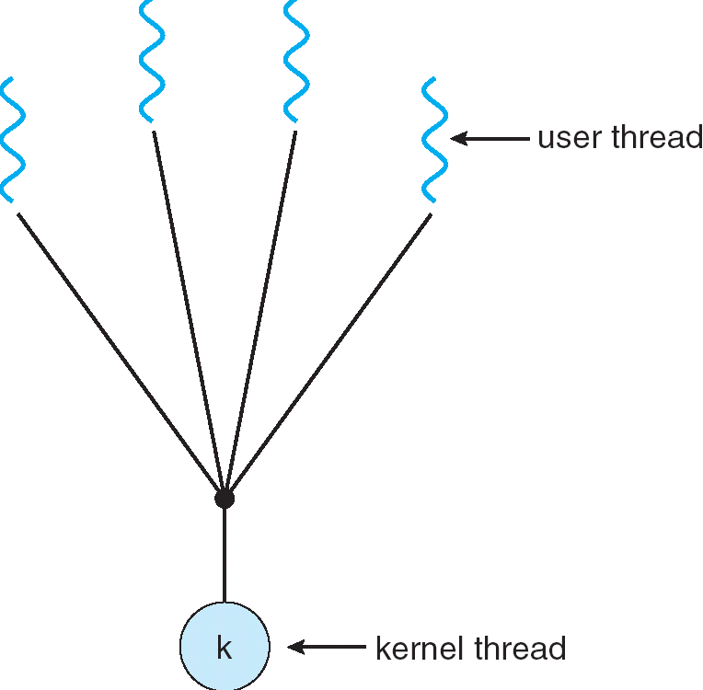
User-Mode Threads
User program contains its own
scheduler
Several user threads per kernel thread
User threads may be scheduled
non-preemptively
  Only switch on yield
Context switches cheaper
  Copy registers and jump (switch in userspace)

Slide 64
Thread Yield
Kernel-Supported Threads
User-Mode Threads
ComputePI
ComputePI
yield (syscall)
Library Function
Call (Cheap)
yield
Trap to OS
(Expensive)
kernel_yield
Stack growth
run_new_user_
thread
Stack growth
run_new_kernel_
thread
switch
switch

Slide 65
Thread I/O
Kernel-Supported Threads
User-Mode Threads
CopyFile
CopyFile
read
read
Trap to OS
Trap to OS
kernel_read
Stack growth
kernel_read
Stack growth
run_new_thread
run_new_thread
switch
switch
Selects a new kernel thread to run
Bypassing user-level scheduler

Slide 66
User-Mode Threads: Problems
One user-level thread blocks on I/O: they all do
  Kernel cannot adjust scheduling among threads it doesn’t know about
Multiple Cores?
Can’t completely avoid blocking (syscalls, page fault)
One Solution: Scheduler Activations
  Have kernel inform user-level scheduler when a thread blocks
  Evolving the contract between OS and application
Alternative Solution: Language Support?
  Make the scheduler aware of the blocking operation

Slide 67
Go Goroutines
Goroutines are lightweight, user-level threads
  Scheduling not preemptive (relies on goroutines to yield)
  Yield statements inserted by compiler
Advantages relative to regular threads (e.g., pthreads)
  More lightweight
  Faster context-switch time
Disadvantages
  Less sophisticated scheduling at the user-level
  OS is not aware of user-level threads

Slide 68
Go User-Level Scheduler
Why this approach?
1 OS (kernel-supported) thread per CPU core: allows go program to achieve parallelism not just concurrency
  Fewer OS threads? Not utilizing all CPUs
  More OS threads? No additional benefit
    We’ll see one exception to this involving syscalls
Keep goroutine on same OS thread: affinity, nice for caching and performance

Slide 69
Go User-Level Thread Scheduler
Why not just have a single global run queue?
Global Run Queue
Newly created goroutines
Local Run Queue
Local Run Queue
Local Run Queue
OS Thread (M)
OS Thread (M)
OS Thread (M)
…
CPU Core
CPU Core
CPU Core

Slide 70
Dealing with Blocking Syscalls
Local Run Queue
What if a goroutine wants to make a blocking syscall?
  Example: File I/O
Running Grtn.
OS Thread (M1)
CPU Core

Slide 71
Dealing with Blocking Syscalls
Local Run Queue
What if a goroutine wants to make a blocking syscall?
  Example: File I/O
While syscall is blocking, allocate new OS thread (M2)
  M1 is blocked by kernel, M2 lets us continue using CPU
OS Thread (M2)
Blocking Grtn.
CPU Core
OS Thread
(M1)

Slide 72
Dealing with Blocking Syscalls
Local Run Queue
Syscall completes: Put invoking goroutine back on queue
Keep M1 around in a spare pool
Swap it with M2 upon next syscall, no need to pay thread creation cost
Running Grtn.
OS Thread (M2)
Ready Grtn.
CPU Core
OS Thread
(M1)

Slide 73








