Slide 1
Scheduling 1: Concepts and Classic Policies
Lecture 9
Hartmut Kaiser
https://teaching.hkaiser.org/spring2025/csc4103/

Slide 2
Recall: “Too Much Milk”
Analogy between problems in OS and problems in real life
Example: People need to coordinate:
Time
Person A
Person B
3:00
Look in Fridge. Out of milk
3:05
Leave for store
3:10
Arrive at store
Look in Fridge. Out of milk
3:15
Buy milk
Leave for store
3:20
Arrive home, put milk away
Arrive at store
3:25
Buy milk
3:30
Arrive home, put milk away

Slide 3
Recall: Single-Core Lock Implementation
  int value = FREE;
  Acquire() {
  disable interrupts;
  if (value == BUSY) {
  put thread on wait queue;
  run_new_thread();
  // Enable interrupts?
  } else {
  value = BUSY;
  }
  enable interrupts;
  }
Key idea: maintain a lock variable (value) and disable interrupts only during operations on that variable
  Release() {
  disable interrupts;
  if (anyone on wait queue) {
  take thread off wait queue;
  Place on ready queue;
  } else {
  value = FREE;
  }
  enable interrupts;
  }

Slide 4
Recall: Re-enable Interrupts when Waiting
In scheduler, since interrupts are disabled when switching threads:
  Responsibility of the next thread is to re-enable interrupts
  When the sleeping thread wakes up, returns to acquire and
  re-enables interrupts
  Thread A
  ...
  disable ints
  call run_new_thread
  run_new_thread return
  enable ints
  ...
  Thread B
    run_new_thread return
    enable ints
    ...
    disable int
    call run_new_thread
context
switch
context
switch

Slide 5
Recall: Spinlock
Spinlock implementation:
  int value = 0; // Free
  Acquire() {
  while (test&set(value)) {}; // spin while busy
  }
  Release() {
  value = 0; // atomic store
  }
Spinlock doesn’t put the calling thread to sleep—it just busy waits
  When might this be preferable?

Slide 6
Recall: Multi-Core Lock Implementation
Can we build test&set locks without busy-waiting?
  Can’t entirely, but can minimize!
  Idea: only busy-wait to atomically check lock value
Note: sleep has to be sure to reset the guard variable
  Why can’t we do it just before or just after the sleep?
int guard = 0;
int value = FREE;
Acquire() {
// Short busy-wait time
while (test&set(guard)) /**/;
if (value == BUSY) {
put thread on wait queue;
run_new_thread() & guard = 0;
} else {
value = BUSY;
guard = 0;
}
}
Release() {
// Short busy-wait time
while (test&set(guard)) /**/;
if anyone on wait queue {
take thread off wait queue
Place on ready queue;
} else {
value = FREE;
}
guard = 0;
}

Slide 7
Recall: test&test&set
A better spinlock solution:
  int mylock = 0; // Free
  Acquire() {
  do {
  while(mylock) /**/; // Wait until might be free
  } while(test&set(&mylock)); // exit if get lock
  }
  Release() {
  mylock = 0;
  }
Explanation:
  Wait until lock might be free (only reading – stays in cache)
  Then, try to grab lock with test&set
  Repeat if fail to actually get lock
Busy-Waiting: no longer impacts other processors!

Slide 8
Recall: Linux futex: Fast Userspace Mutex
uaddr points to a 32-bit value in user space
futex_op
  FUTEX_WAIT – if val == *uaddr sleep till FUTEX_WAIT
    Atomic check that condition still holds
  FUTEX_WAKE – wake up at most val waiting threads
  FUTEX_FD, FUTEX_WAKE_OP, FUTEX_CMP_REQUEUE
timeout
  ptr to a timespec structure that specifies a timeout for the op
#include <linux/futex.h>
#include <sys/time.h>
int futex(int *uaddr, int futex_op, int val,
const struct timespec *timeout );

Slide 9
Recall: Userspace Locks with futex
This is syscall-free in the uncontended case
  Temporarily falls back to syscalls if multiple waiters, or concurrent acquire/release
But it can be considerably optimized!
  See “Futexes are Tricky” by Ulrich Drepper
int value = 0; // free
bool maybe_waiters = false;
Acquire() {
while (test&set(value)) {
maybe_waiters = true;
futex(&value, FUTEX_WAIT, 1);
// futex: sleep if lock is acquired
maybe_waiters = true;
}
}
Release() {
value = 0;
if (maybe_waiters) {
maybe_waiters = false;
futex(&value, FUTEX_WAKE, 1);
// futex: wake up a sleeping thread
}
}

Slide 10
Scheduling

Slide 11
Today: Scheduling
if ( readyProcesses(PCBs) ) {
nextPCB = selectProcess(PCBs);
run( nextPCB );
} else {
run_idle_process();
}
Scheduling: Mechanism for deciding which processes/threads receive the CPU
Lots of different scheduling policies provide …
  Fairness or
  Realtime guarantees or
  Latency optimization or …

Slide 12
Scheduling Opportunities
Every “yield”
Every timer tick (interrupt)
But also:
  Every syscall
  Every interrupt (even if not due to timer)
Whenever you enter the kernel, for any reason…
The kernel could switch the running thread at any of these times!

Slide 13
Broader Take on Scheduling
Scheduling: deciding which threads are given access to resources from moment to moment
  Often, we think in terms of CPU time, but could also think about access to resources like network BW or disk access

Slide 14
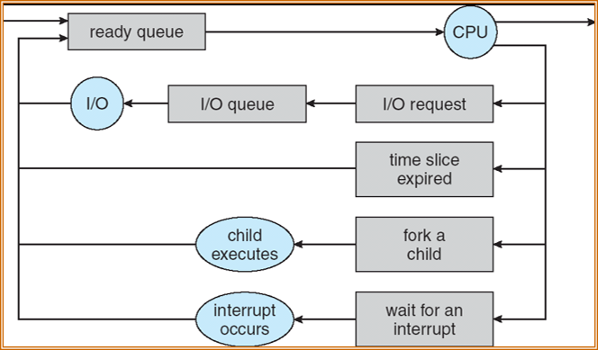
Scheduling: All About Queues
Useful formulation of scheduling: How is the OS to decide which of several tasks to take off a queue?

Slide 15
Scheduling: All About Trade-Offs
Individuals care about getting their task done quickly
System cares about overall efficiency
  Utilize multiple HW resources well, low overhead, …
Huge variation in job characteristics
Fairness???
What is our utility function?

Slide 16
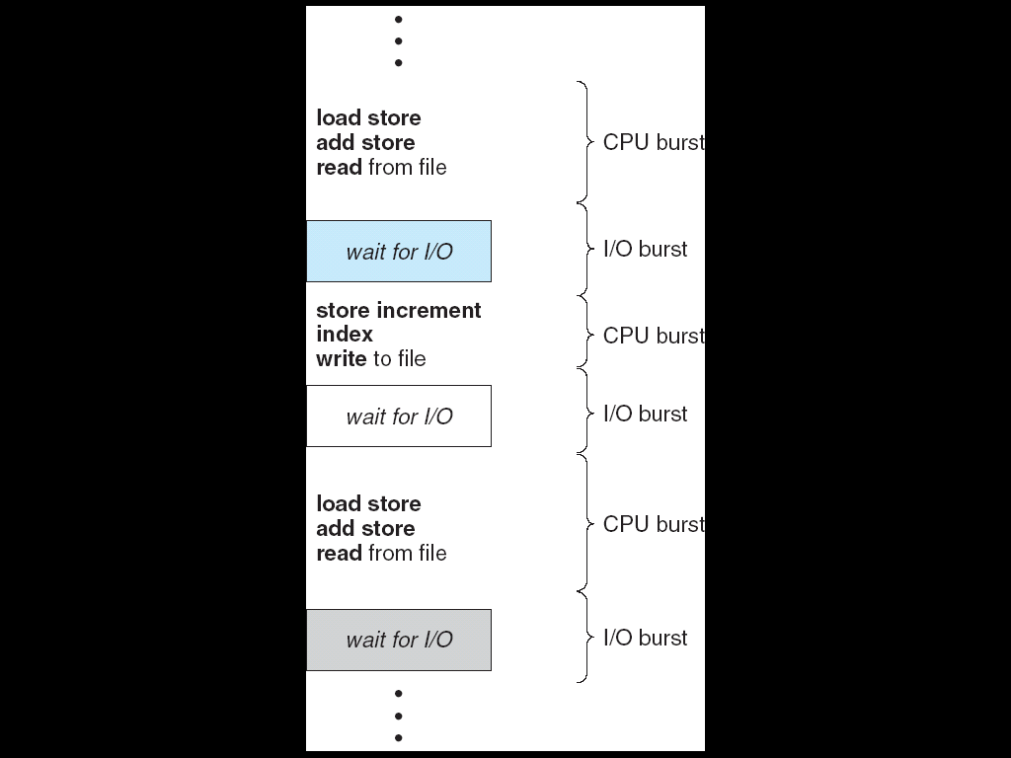
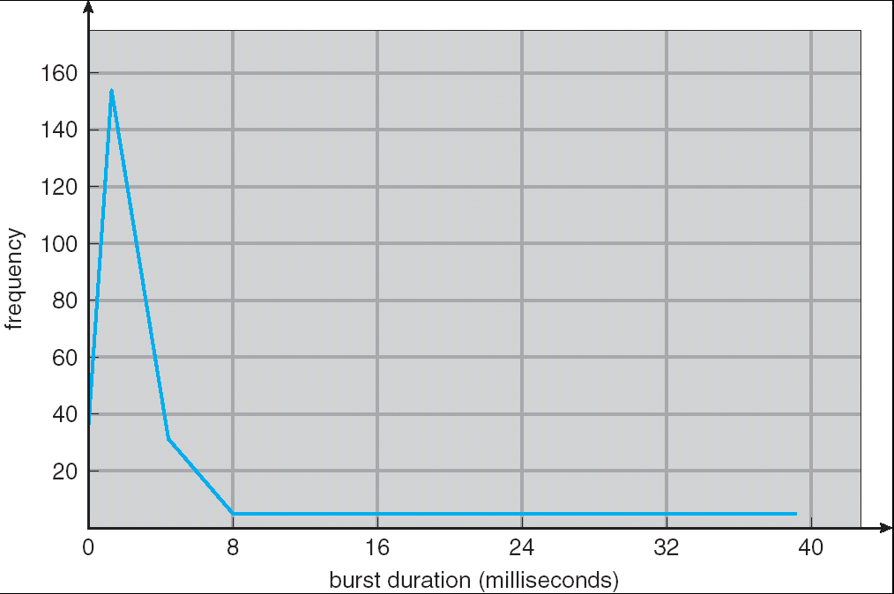
CPU and I/O Bursts
Programs alternate between bursts of CPU and I/O activity
Scheduler: Which thread (CPU burst) to run next?
Interactive programs vs. Compute Bound vs. Streaming

Slide 17
Evaluating Schedulers
Response Time (ideally low)
  What user sees: from keypress to character on screen
  Or completion time for non-interactive
Throughput (ideally high)
  Total operations (jobs) per second
  Overhead (e.g. context switching), artificial blocks
Fairness
  Fraction of resources provided to each
  May conflict with best average throughput or response time

Slide 18
Discussion: Scheduling Assumptions
Equal or variable job length?
Run to completion vs. preemption?
Arrival time (at once vs varied)?
Resources: CPU(s), I/O, Network, …?
Advanced Knowledge of Job characteristics or needs
  Off-line scheduling is given the entire collection of tasks and computes a schedule
  On-line scheduling makes decisions as tasks arrive

Slide 19
Scheduling Assumptions
Many implicit assumptions needed to make the problem solvable
For instance: is “fair” about fairness among users or programs?
  If I run one compilation job and you run five, you get five times as much CPU on many operating systems
The high-level goal: Dole out CPU time to optimize some desired parameters of system
USER 1
USER 2
USER 3
USER 1
USER 2
Time

Slide 20
First-Come, First-Served Scheduling (FCFS)
Also: “First In First Out” (FIFO)
Example: Process Burst Time
T1 24
T2 3
T3 3
Arrival Order: T1, T2, then T3 (all arrive at time 0)
T₁
T₂
T₃
0
24
27
30

Slide 21
First-Come, First-Served Scheduling (FCFS)
Response Times: T1 = 24, T2 = 27, T3 = 30
  Average Response Time = (24+27+30) / 3 = 27
Waiting times: T1 = 0, T2 = 24, T3 = 27
  Average Wait Time = (0 + 24 + 27) / 3 = 17
Convoy Effect: Short processes stuck behind long processes
  If T2, T3 arrive any time < 24, they must wait
T₁
T₂
T₃
0
24
27
30

Slide 22
Slightly Different Arrival Order?
T2 < T3 < T1
Response Time: T1 = 30, T2 = 3, T3 = 6
  Average Response Time = (30 + 3 + 6) / 3 = 13
  Versus 27 with T1 < T2 < T3
Waiting Time: T1 = 6, T2 = 0, T3 = 3
  Average Waiting Time = (6+0+3) / 3 = 3
  Versus 17 with T1 < T2 < T3
T₂
T₃
T₁
0
3
6
30

Slide 23
How to Implement FCFS in the Kernel?
Comes down to scheduling queue data structure
  FIFO
  E.g., push_front, pop_back

Slide 24
Convoy Effect
Scheduled Task (process, thread)
time
arrivals
Scheduling Queue
With FCFS non-preemptive scheduling, convoys of small tasks tend to build up when a large one is running.

Slide 25
First-Come, First-Serve Scheduling
FCFS Scheme: Potentially bad for short jobs!
  Depends on submit order
  If you are first in line at supermarket with milk only, you don’t care who is behind you, on the other hand…
Idea: What if we preempted long-running jobs to give shorter jobs a chance to run?

Slide 26
Announcements
Project 1 due next Monday, March 24
  Let me know if you need an extension
Assignment 2 due Monday, April 7
Midterm 1 is still being graded – apologies!
  Expect grades to be available by the weekend

Slide 27
Round-Robin Scheduling (RR)
Give out small units of CPU time ("time quantum")
  Typically 10 – 100 milliseconds
When quantum expires, preempt, and schedule
  Round Robin: add to end of the queue
Each of N processes gets ~1/N of CPU (in window)
  With quantum length Q ms, process waits at most
  (N-1)*Q ms to run again
Downside: More context switches

Slide 28

Example From Earlier ($Q=10$)
Regardless of arrival order, short jobs gets a chance early
Much less sensitive to arrival order
How much context switch overhead?
T₁
T₂
T₃
T₁
0
10
13
16
30

Slide 29

Another Example ($Q=20$)
Task Burst Time
T1 53
T2 8
T3 68
T4 24
Avg. response time = (125+28+153+112) / 4 = 104.5
Waiting times:
  T1 = (68-20)+(112-88) = 72
  T2 = (20-0) = 20
  T3 = (28-0)+(88-48)+(125-108) = 85
  T4 = (48-0)+(108-68) = 88
Average waiting time = (72+20+85+88) / 4 = 66.25
And don't forget context switch overhead!
T₁
T₂
T₃
T₄
T₁
T₃
T₄
T₁
T₃
T₃
0
20
28
48
68
88
108
112
125
145
153

Slide 30
Round-Robin Quantum
Assume that context switch overhead is 0
What happens when we decrease Q?
Avg. response time always decreases or stays the same?
Avg. response time always increases or stays the same?
Avg. response time can increase, decrease, or stays the same?

Slide 31
Decrease Response Time
T1: Burst Length 10
T2: Burst Length 1
Q = 10
Average Response Time = (10 + 11)/2 = 10.5
Q = 5
Average Response Time = (6 + 11)/2 = 8.5
T₁
T₂
0
10
11
T₁
T₂
T₁
0
5
6
11

Slide 32
Same Response Time
T1: Burst Length 1
T2: Burst Length 1
Q = 10
Average Response Time = (1 + 2)/2 = 1.5
Q = 1
Average Response Time = (1 + 2)/2 = 1.5
T₁
T₂
0
1
2
T₁
T₂
0
1
2

Slide 33
Increase Response Time
T1: Burst Length 1
T2: Burst Length 1
Q = 1
Average Response Time = (1 + 2)/2 = 1.5
Q = 0.5
Average Response Time = (1.5 + 2)/2 = 1.75
T₁
T₂
0
1
2
0
2

Slide 34
How to Implement RR in the Kernel?
Round Robin – what is it?
FIFO Queue, as in FCFS
But preempt job after quantum expires, and send it to the back of the queue
  How? Timer interrupt!
  And, of course, careful synchronization
Project 2: Scheduling

Slide 35
Discussion: Round-Robin Scheduling
How to choose the time quantum?
  Too big? RR approaches FCFS
  Too small? Throughput suffers (due to context switches)
Actual choices of timeslice:
  Initially, in UNIX timeslice was one second:
    Worked ok when UNIX was used by one or two people.
    When might this perform poorly?
  Need to balance short-job performance and long-job throughput:
    Typical time slice today is between 10ms – 100ms
    Typical context-switching overhead is 0.1ms – 1ms
    Roughly 1% overhead due to context-switching

Slide 36
Priority
Interactive vs. compute bound

Slide 37
Priority Scheduler
Something gives jobs (processes) priority
  Usually the user sets it explicitly, perhaps based on $ rate
Always run the ready thread with highest priority
  Low priority thread might never run!
  Starvation
Priority 3
Job 1
Job 2
Job 3
Priority 2
Job 4
Priority 1
Priority 0
Job 5
Job 6
Job 7

Slide 38
How to Implement Priority Scheduling in the Kernel?
Scheduling queue data structure determines next thread of those in the ready queue(s)
  Kernel prefers threads with more urgent priority
Why might a thread not be in the ready queue?
  Waiting on I/O
  Locks?

Slide 39
Adaptive Scheduling
Modern schedulers use knowledge about program to make better scheduling decisions
Provided by the user (servers vs. background)
Estimate future based on the past

Slide 40
Policy Based on Priority Scheduling
Systems may try to set priorities according to some policy goal
Example: Give interactive higher priority than long calculation
  Prefer jobs waiting on I/O to those consuming lots of CPU
Try to achieve fairness: elevate priority of threads that don’t get CPU time (ad-hoc, bad if system overload)
Priority 3
Job 1
Job 2
Job 3
Priority 2
Job 4
Priority 1
Priority 0
Job 5
Job 6
Job 7

Slide 41
Adaptive Scheduling
How can we adapt the scheduling algorithm based on threads’ past behavior?
Two steps:
  Based on past observations, predict what threads will do in the future.
  Make scheduling decisions based on those predictions.
Start with the second step. Suppose we knew the workload in advance. What should the scheduler do?

Slide 42
What if we knew how long each CPU burst will be, in advance?
Key Idea: remove convoy effect
  Short jobs always stay ahead of long ones
Non-preemptive: Shortest Job First
  Like FCFS if we always chose the best possible ordering
Preemptive Version: Shortest Remaining Time First
  If a job arrives and has shorter time to completion than current job, immediately preempt CPU
  Sometimes called “Shortest Remaining Time to Completion First”

Slide 43
SRTF Example
(Shortest Remaining Time First)
Three jobs in system
  A and B are CPU calculations that take a week to run
  C: Continuous loop of 1ms CPU time, 9ms of I/O time
FCFS? A or B starve C
  I/O throughput problem: lose opportunity to do work for C while CPU runs A or B
A or B
C
C’s
I/O
C’s
I/O
C’s
I/O

Slide 44
SRTF Example
(Shortest Remaining Time First)
C
A
B
C
Disk Utilization:
9/201 ~ 4.5%
C’s
I/O
RR 100 ms time slice
C’s
I/O
CABAB…
C
Disk Utilization:
~90% but lots of wakeups!
RR 1ms time slice
C’s
I/O
C’s
I/O
C
A
A
A
Disk Utilization:
90%
SRTF
C’s
I/O
C’s
I/O

Slide 45
Discussion: SJF and SRTF
Provably Optimal with respect to Response Time
But Starvation is possible
  What if new short jobs keep arriving?
But: Need to predict the future!
  Ask the user when they submit the job? How to prevent cheating?
  SRTF useful as a benchmark to measure other policies?

Slide 46
Adaptive Scheduling
How can we adapt the scheduling algorithm based on threads’ past behavior?
Two steps:
  Based on past observations, predict what threads will do in the future.
  Make scheduling decisions based on those predictions.
Now, let’s look at the first step. How can we predict future behavior from past behavior?

Slide 47
Predicting Future Behavior
Consider Round-Robin Scheduling
If process exhausts quantum, it has to be preempted
  Consuming all of the CPU time it can: “CPU-Bound”
  Likely to remain CPU-Bound
If process blocks on I/O before quantum exhausted
  Short CPU bursts, just to initiate I/O: “I/O-Bound”
  Often interactive tasks
  Likely to remain I/O-Bound and/or Interactive

Slide 48
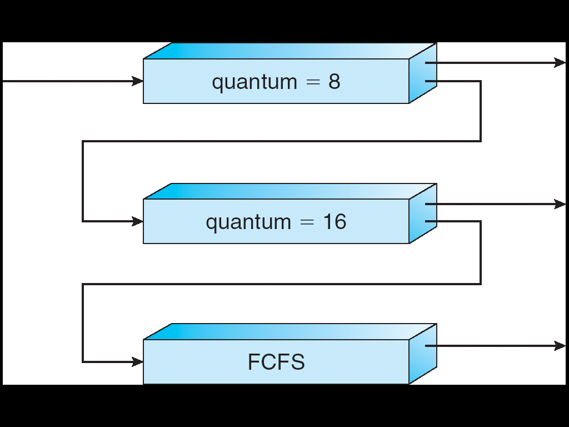
Multi-Level Feedback Queue (MLFQ)
Multiple queues, each of different priority
  Round Robin within each queue
  Different quantum length for each queue
Favor I/O-bound jobs for interactivity
  Get click or kick off I/O transfer
Low overhead for CPU bound
Long-Running Compute
Tasks Demoted to
Low Priority

Slide 49
Multi-Level Feedback Queue (MLFQ)
Intuition: approximate SRTF by setting priority level proportional to burst length
Job Exceeds Quantum: Drop to lower queue
Job Doesn't Exceed Quantum: Raise to higher queue
Long-Running Compute
Tasks Demoted to
Low Priority

Slide 50
Multi-Level Feedback Queue
Approximates Shortest Remaining Time First
  CPU-bound have lowest priority (run last)
  I/O-bound (short CPU bursts) have highest priority
  (run first)
Low overhead
  Easy to update priority of a job
  Easy to find next ready task to run
Can a process cheat?
  Yes, add meaningless I/O operations (but has a cost)

Slide 51
How to Implement MLFQ in the Kernel?
We could explicitly build the queue data structures
Or, we can leverage priority-based scheduling!

Slide 52
Recall: Policy Based on Priority Scheduling
Systems may try to set priorities according to some policy goal
Example: Give interactive higher priority than long calculation
  Prefer jobs waiting on I/O to those consuming lots of CPU
Try to achieve fairness: elevate priority of threads that don’t get CPU time (ad-hoc, bad if system overload)
Priority 3
Job 1
Job 2
Job 3
Priority 2
Job 4
Priority 1
Priority 0
Job 5
Job 6
Job 7

Slide 53
Conclusion
First-Come First-Served: Simple, vulnerable to convoy effect
Round-Robin: Fixed CPU time quantum, cycle between ready threads
Priority: Respect differences in importance
Shortest Job/Remaining Time First: Optimal for average response time, but unrealistic
Multi-Level Feedback Queue: Use past behavior to approximate SRTF and mitigate overhead

Slide 54
