Slide 1
Interlude – C++
Lecture 2
Hartmut Kaiser
https://teaching.hkaiser.org/spring2025/csc4700/

Slide 2
Write A Program in C++
High performance
Measure and Tune program
Run program
Compile program
Write program

Slide 3
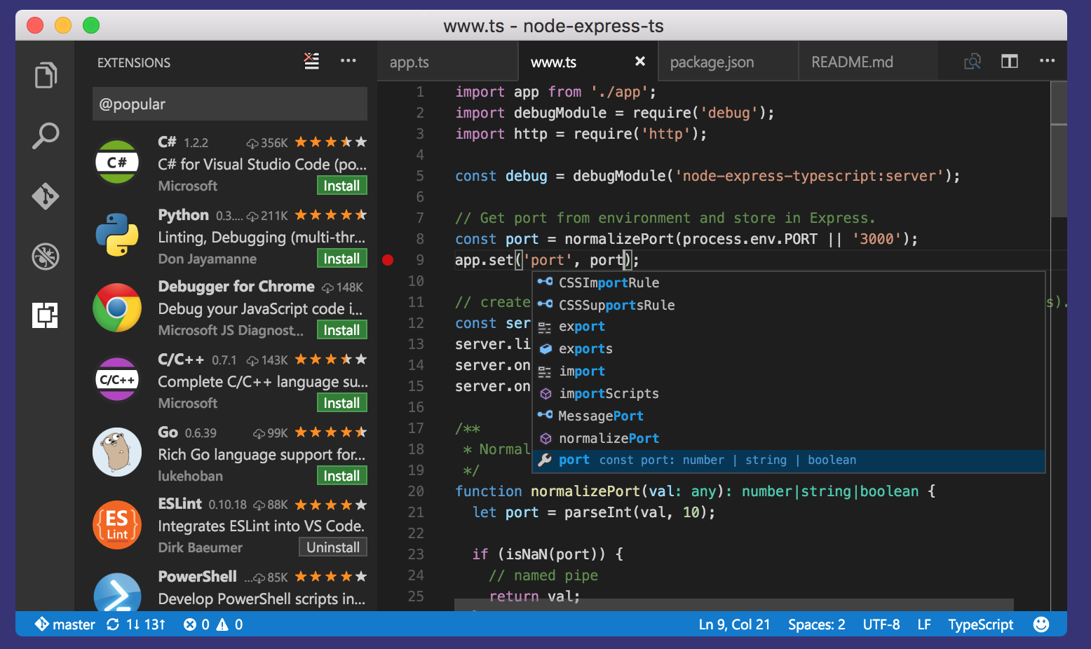
Developing your Code
A computer should be a labor saving device
  That includes (especially) mental labor
Use productivity tools
VS code (recommended)
  Many others exist: Atom, Eclipse …

Slide 4
The CSC470 Development Environment
Windows and Mac OS X can be made to approximate Linux
  Uniform docker environment for everyone
  Alternatively, use Github codespaces
How-to documentation in assignment instructions online
Notes:
PS1

Slide 5
Linux shells
sh: “Bourne shell” (Stephen Bourne, Bell Labs c.1977)
ksh: Korn shell (David Korn, Bell Labs, c. 1983)
csh: C shell (Bill Joy, UC Berkeley, 70s)
  and cousin tcsh
bash (Brian Fox, 1989)
  Who knows what this stands for (without searching)?
All are Linux (Unix) processes with read-eval-print loops
But also complete systems scripting language for dealing with Unix
  Unix philosophy: data in text format, small programs using text I/O

Slide 6
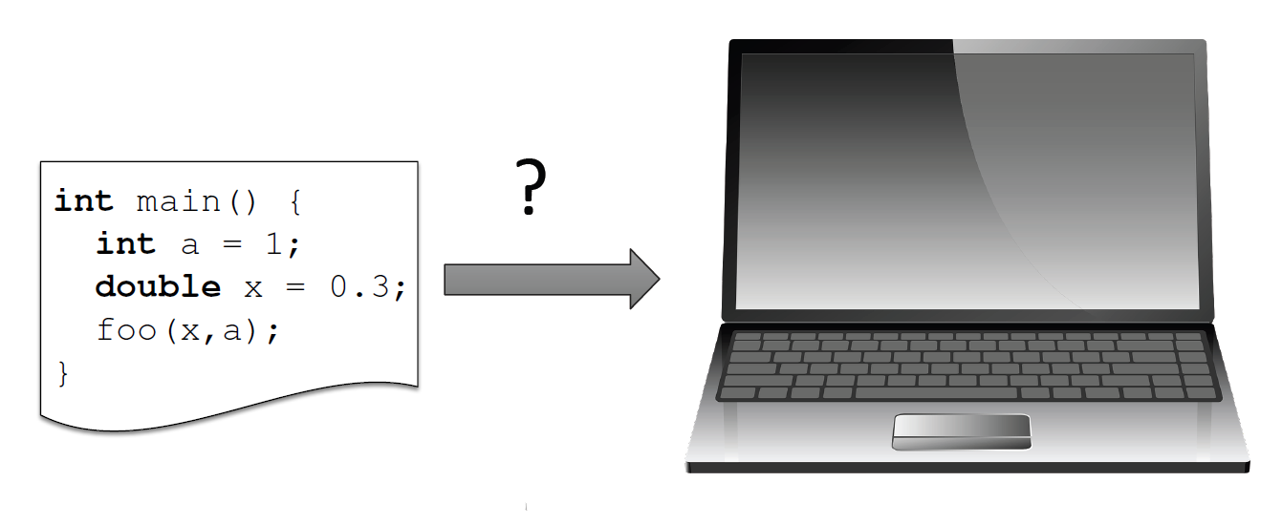
Programs and Programming

Slide 7
Programs and Programming
© S. Harris

Slide 8
Interpreted Language (Python)
import math
a = 3.14
b = math.sqrt(a)
print(b)

Slide 9
Compiled Language (C++)

Slide 10
Interpreted vs. Compiled Language
#include <cmath>
#include <print>
int main()
{
double a = 3.14;
double b = std::sqrt(a);
print("{}", b);
return 0;
}
import math
a = 3.14
b = math.sqrt(a)
print(b)

Slide 11
Compilation
You can’t run (directly execute) this code
It needs to be turned into code that can run
  An executable
Multi-step process
  Compile to object file
    Bits just for this code
  Then link in libraries for sqrt and IO
#include <cmath>
#include <print>
int main()
{
double a = 3.14;
double b = std::sqrt(a);
std::print("{}", b);
return 0;
}

Slide 12
Compiling
To compile one source file to an executable
  $ c++ filename.cpp
  (What is the name of the executable?)
To compile multiple source files to an executable
  $ c++ one.cpp two.cpp three.cpp
To create an object file
  $ c++ -c one.cpp –o one.o
To create an executable from multiple object files
  $ c++ one.o two.o three.o –o myexecutable

Slide 13
Compilation and Linking
C++ source code
You write C++ source code
  Source code is (in principle) human readable
The compiler translates what you wrote into object code (sometimes called machine code)
  Object code is simple enough for a computer to “understand”
The linker links your code to system code needed to execute
  E.g. input/output libraries, operating system code, and windowing code
The result is an executable program
  E.g. a .exe file on windows or an a.out file on Unix
C++ compiler
Library Object code
Object code
Linker
Executable program
See: Decoding C++ Compilation Process: From Source Code to Binary

Slide 14
CMake
CMake is a family of tools
  Building software
  Testing software
  Packaging software
We will use it for building and testing
CMake generates build system files (Makefiles and or workspaces)
  Those can be used to automatically build and test your code
The user writes a single set of descriptive scripts
  Define Targets and their inter-dependencies
CMake is well integrated with many IDEs (also VSCode)

Slide 15
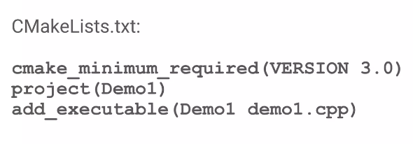
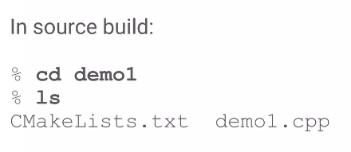
Simplest Example

Slide 16
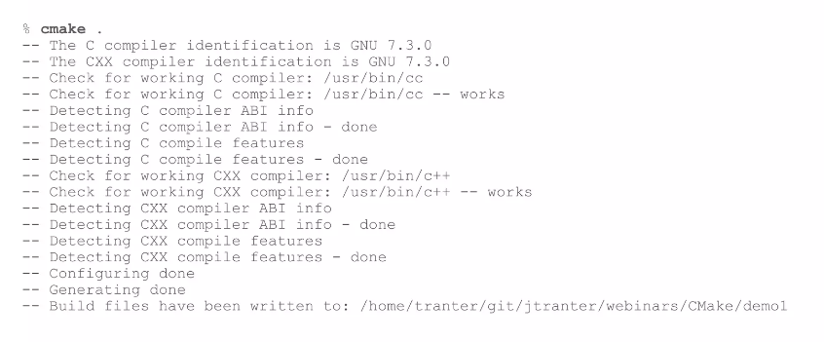
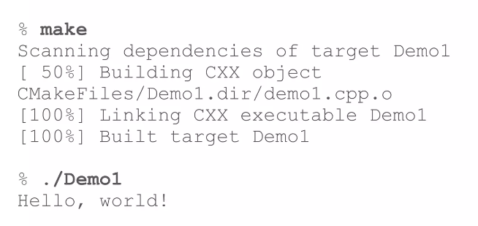
Simplest Example

Slide 17
Slice of C++
C++11 (C++14, C++17, C++20, C++23) are quite modern languages
But C++11 (et. Al.) and libraries are huge
We will use a focused slice of C++23
Use some modern features
Avoid legacy features (such as pointers)
Avoid modern features (OO)
#include <cmath>
#include <print>
int main()
{
double a = 3.14;
double b = std::sqrt(a);
std::print("{}", b);
return 0;
}

Slide 18
Hello World!
#include statement
Function definition, here:
  Takes no arguments
  Returns an int (integer)
Code block – scoping!
  std namespace
  Character string
  Returns 0 (zero, for main it means success)
Comments use ‘//’ or ‘/*...*/’
#include <print>
// This is a minimal example
int main()
{
std::print("Hello World!");
return 0;
}

Slide 19
Types
Variable definition
C++ has many built-in types: int, double, char, etc.
Other types are defined for libraries (accessed via #include)
Almost always class definitions

Slide 20
Declaring and Initializing Variables
Now they can be defined anywhere
in the block
In the old days variables were
declared at the beginning of a block
Best practice: Don’t declare variables before they are needed and always initialize if possible

Slide 21
Namespaces
Provides a scope to the identifiers (the names of types, functions, variables, etc.) inside it
Organize code into logical groups
Prevent name collisions that can occur especially when your code base includes multiple libraries

Slide 22
Namespaces
To print the value pi
  The compiler needs to resolve (find) the symbol (variable)
#include <cmath>
#include <print>
double pi = 3.14;
int main()
{
std::print("The value of pi is: {}", pi);
return 0;
}

Slide 23
Namespaces
To print the value pi
  The compiler needs to resolve (find) the symbol (variable)
Here pi is defined in a namespace csc4700
  We need to tell the compiler where to look
#include <cmath>
#include <print>
namespace csc4700 {
double pi = 3.14;
}
int main()
{
std::print("The value of pi is: {}", csc4700::pi);
return 0;
}

Slide 24
Namespaces
To print the value pi
  The compiler needs to resolve (find) the symbol (variable)
Here pi is defined in a namespace csc4700
  We need to tell the compiler where to look
  We can also hoist everything from one namespace into the current
#include <cmath>
#include <print>
namespace csc4700 {
double pi = 3.14;
}
int main()
{
using namespace csc4700;
std::print("The value of pi is: {}", pi);
return 0;
}

Slide 25
Namespaces
To print the value pi
  The compiler needs to resolve (find) the symbol (variable)
Here pi is defined in a namespace csc4700 and csc4700_1
  Requires disambiguation
namespace csc4700 {
double pi = 3.14;
}
namespace csc4700_1 {
double pi = 3.14;
}
int main()
{
using namespace csc4700;
std::print("The value of pi is: {}", pi);
return 0;
}

Slide 26
Organizing your Programs
Software development is difficult
How do humans attack complex problems?
  Abstract details
  Modular / reusable
  Well defined interfaces and functionality
  Understandable
Apply the same principles to software

Slide 27
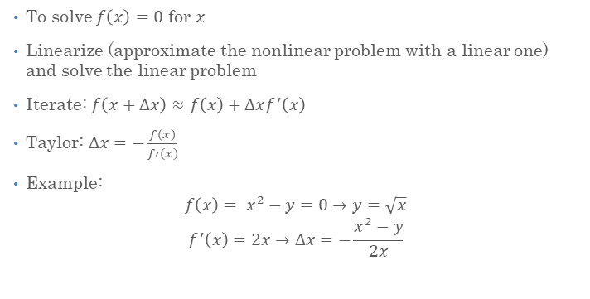
Newton’s Method for Square Root
To solve $f\left(x\right)=0$ for $x$
Linearize (approximate the nonlinear problem with a linear one) and solve the linear problem
Iterate: $f\left(x+∆x\right)≈f\left(x\right)+∆xf^{′}\left(x\right)$
Taylor: $∆x=−\frac{f(x)}{f′(x)}$
Example:
$$f\left(x\right)= x^{2}−y=0→y=\sqrt{x}$$
$$f^{′}\left(x\right)=2x→∆x=−\frac{x^{2}−y}{2x}$$

Slide 28
Compute Square Root of 2
#include <cmath>
#include <print>
int main()
{
double x = 1.0;
for (size_t i = 0; i != 32; ++i)
{
double dx = - (x*x - 2.0) / 2.0 * x;
x += dx;
if (std::abs(dx) <= 1.e-9)
break;
}
std::print("The square root of 2 is: {}", x);
}

Slide 29
Compute Square Root of 3
#include <cmath>
#include <print>
int main()
{
double x = 1.0;
for (size_t i = 0; i != 32; ++i)
{
double dx = - (x*x - 3.0) / 2.0 * x;
x += dx;
if (std::abs(dx) <= 1.e-9)
break;
}
std::print("The square root of 2 is: {}", x);
}

Slide 30
Compute Square Root of Anything
namespace csc4700 {
double sqrt(double y) {
double x = 1.0;
for (size_t i = 0; i != 32; ++i) {
double dx = - (x*x - y) / 2.0 * x;
x += dx;
if (std::abs(dx) <= 1.e-9)
break;
}
return x;
}
}
int main() {
std::print("The square root of 2 is: {}",
csc4700::sqrt(2.0));
}

Slide 31
Experiment: what will it print?
namespace csc4700 {
double sqrt(double y) {
double x = 1.0;
for (size_t i = 0; i != 32; ++i) {
double dx = - (sqr(x) - 2.0) / 2.0 * x;
x += dx;
if (std::abs(dx) <= 1.e-9) break;
}
y = x; // change value of argument
return x;
}
}
int main() {
double y = 2.0;
std::print("sqrt(2) is: {}", csc4700::sqrt(y));
std::print("y is: {}", y);
}

Slide 32
Parameter Passing in C++
The argument y was passed by value
  The function will operate on a copy of the original argument
  Only the copy is changed, not the original
C++ has “pass by value” semantics
Just to be clear, the parameter can have any name (don’t confuse with y declared in main)

Slide 33
Experiment: what will it print?
namespace csc4700 {
double sqrt(double& y) { // <-- added ‘&’
double x = 1.0;
for (size_t i = 0; i != 32; ++i) {
double dx = - (sqr(x) - 2.0) / 2.0 * x;
x += dx;
if (std::abs(dx) <= 1.e-9) break;
}
y = x; // change value of argument
return x;
}
}
int main() {
double y = 2.0;
std::print("sqrt(2) is: {}", csc4700::sqrt(y));
std::print("y is: {}", y);
}

Slide 34
Parameter Passing in C++
The argument y was now passed by reference
  The function will operate on the original argument
Both variables refer to the same instance of the double!
Why would we want to pass a reference?
  “Out parameters”
  Efficiency (no copy)
Pass by const reference is used to promise not to change the original argument:
  double sqrt(double const& y) {}
  Still gives the benefit of efficiency, if needed

Slide 35
C++ Core Guidelines: Functions
F.2: A function should perform a single logical operation
F.3: Keep functions short and simple
F.16: For “in” parameters, pass cheaply-copied types by value and others by reference to const
F.17: For “in-out” parameters, pass by reference to non-const
F.20: For “out” output values, prefer return values to output parameters

Slide 36
