Slide 1
Welcome and Introduction
Lecture 1
Hartmut Kaiser
https://teaching.hkaiser.org/spring2025/csc4700/

Slide 2
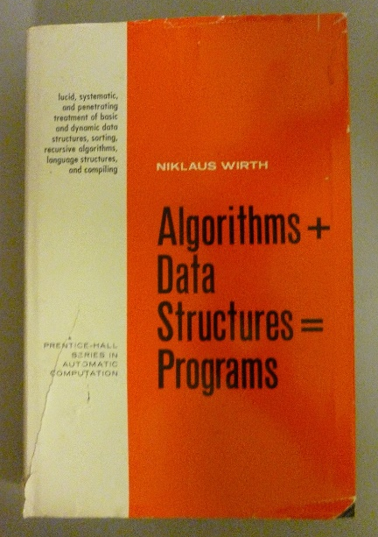
Course Overview
Programs == Algorithms + Data structures
Selecting the right data structure
  Selecting containers: trivial
  Selecting data types: type properties
Selecting and developing algorithms
  Algorithmic thinking
  Parallelization almost an afterthought

Slide 3

Administrativia

Slide 4
Admin & Organizational
Course:
  Depth first introduction, C++ Standard Library, C++ Data structures and algorithms, parallel algorithms, scientific applications, architectures, parallel programming models…
  https://teaching.hkaiser.org
  hkaiser@cct.lsu.edu
  Discord server: https://discord.gg/Q32sGfKqMS
Reading:
  Diehl’s Parallel C++
  Stepanov’s From Mathematics to Generic Programming
  Koenig’s Accelerated C++
  Stroustrup’s Programming - Principles and Practice Using C++
Homework, project, quizzes, grading, honesty
  Use Github classroom for assignments
  Use VSCode as a tool

Slide 5
Important Dates
Lectures
  Tuesday and Thursday, 10:30 to 11:50, 1212 PFT
Grading
  Homework 50%
  Project 25%
  Midterm exam 10%
  Final exam 15%
Exams
  Midterm exam: March 6
  Final exam: May 8, 5:30pm - 7:30pm

Slide 6
Ground Rules
All information about the course: teaching.hkaiser.org
  Following that site is expected and will positively impact overall grade
Lectures
  Attendance is expected and will positively impact overall grade
Assignments
  Up to five individual assignments focusing on writing code
    Use of (standard C++) algorithms and (standard C++) data structures
    Use of various parallel programming models
  Assignment 0 has been posted (due: January 27, 11:59 pm)
All assignments and the project are hosted on GitHub (github.com) and managed through GitHub classroom (classroom.github.com)
  You will need to create an account on Github

Slide 7
Honesty
The LSU Code of Student Conduct defines plagiarism in Section 5.1.16:
  "Plagiarism is defined as the unacknowledged inclusion of someone else's words, structure, ideas, or data. When a student submits work as his/her own that includes the words, structure, ideas, or data of others, the source of this information must be acknowledged through complete, accurate, and specific references, and, if verbatim statements are included, through quotation marks as well. Failure to identify any source (including interviews, surveys, etc.), published in any medium (including on the internet) or unpublished, from which words, structure, ideas, or data have been taken, constitutes plagiarism;“
Plagiarism will not be tolerated and will be dealt with in accordance with and as outlined by the LSU Code of Student Conduct: https://www.lsu.edu/saa/students/codeofconduct.php

Slide 8
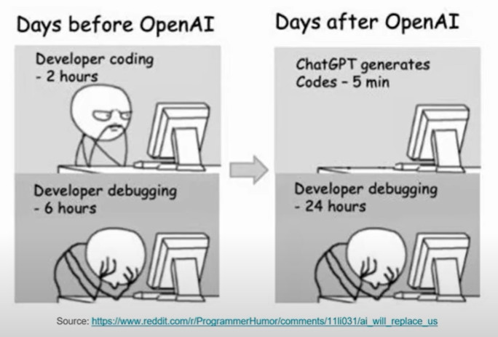
ChatGPT?

Slide 9
ChatGPT
The goal for this course is to train our brains, not ChatGPT
  So, do yourself a favor and don’t use it
  There are too many software ‘developers’ out there who copy & paste their way to the next paycheck
However, if you do use it:
  Never use anything without carefully reviewing it
    Assume what you got is wrong! Prove to yourself it is correct!
  The skill of reading (and understanding) code becomes more important than ever
  Cite and annotate the copied code
Whatever you do, remember:
  It’s plagiarism if you submit the same code as your neighbor
  No matter where you got it from, be it Google, ChatGPT, or your neighbors computer

Slide 10
How to Learn
Ask yourself at the beginning of this semester
  What scientific problem you want to solve?
  What do you want to learn from this course that can prepare you?
  Can you write a sequential program to solve it?
  What is the performance of it?
  …
Ask yourself at the end of this semester
  Did you master the skillset to solve your scientific problem?
  Can you write a high-performance program to solve it?
  What is the performance of it?
  What is the speedup?
    Compare your sequential program with your high-performance program

Slide 11
Tour of the Course
Basic CPU machine model
  Hierarchical memory (registers, cache, virtual memory)
  Instruction level parallelism
  Multicore processors
Scientific computing
  Linearization of physics model
Shared memory parallelism
GPU
Distributed memory parallelism
Use running examples to explain concepts and APIs

Slide 12
Tour of the Course
Elements of C++
Elements of software organization
Elements of software practice
Elements of performance measurement and
optimization

Slide 13
What This Course is About
How algorithms, data, software, and hardware interact to affect performance (and how to orchestrate them to get high performance)
At the completion of this course, you will be able to
  Write software that fully utilizes hardware performance features
  Describe the principal architecture mechanisms for high performance and algorithmic and software techniques to take advantage of them
  Recognize opportunities for performance improvement in extant code
  Describe a strategy for tuning HPC code
Today and years from now
Notes:
What is any course about?
Especially in computing it isn’t about facts. Today’s hardware will be obsolete in just a few years.
Any course, in any topic, any discipline really, is about a way of thinking about the world, about solving problems
We are going to be talking about high performance computing in the context of scientific computing and how to solve Really Big Problems
But using resources efficiently applies in all situations – especially today, with IoT and mobile

Slide 14

Computing is Indispensable to Science and Engineering
The 3rd (and 4th?) pillar(s)
Can carry out investigations where physical experiments would be too fast, too slow, too hot, too cold, too costly, too dangerous, etc.
Examples: Weather, climate, fusion, crash testing, etc.
HPC means more and better scientific discovery
Better world, survival of the planet
Notes:
Science in some sense started with the ancient Greeks, but the scientific method was really recognized per se in the 1500s during the renaissance. From that time there were two recognized branches of science, theory and experiment. Today even, you can ask a physicist, what kind of physicist are you – and they will say experimentalist or theoretician. But, in the last 70 years, computing has become the “3rd pillar” of science.
4th pillar: data-driven discovery
5th pillar: machine learning

Slide 15
The HPC Canon (as of 2025)
Technology | Paradigm | Hammer
CPU (single core) | Sequential | C compiler
SIMD/Vector (single core) | Data parallel | Intrinsics (asm)
Multicore | Threads | pthreads (C) library
NUMA shared memory | Threads | pthreads (C) library
GPU | GPU | CUDA
Clusters | Message passing | MPI (C) library

Slide 16
Scaling progression of CPUs
Simplest model
CPU fetches and executes instructions
Many cycles per instruction

Slide 17
Pipelining
Instructions are fetched in a stream
Pipelining
A long trip from memory

Slide 18
Hierarchical Memory
Use special, fast memory to keep data and instructions close

Slide 19
Multicore CPUs
Replicate 2X
Cores share slower memory
Caches need to be kept coherent

Slide 20
Even more Cores
Replicate 4X
Cores share slower memory
Include super-slow DRAM
Caches need to be kept coherent

Slide 21
Symmetric Multi-Processor (SMP)
Multiple CPU chips
Memory may be uniformly shared among sockets
AKA “sockets”
Caches still need to be kept (somewhat) coherent
Uniform memory access (UMA)

Slide 22
Asymmetric Multi-Processor
Multiple CPU chips
Memory may be non- uniformly shared among sockets
AKA “sockets”
Caches still need to be kept (somewhat) coherent: CC-NUMA
Non-uniform memory access (NUMA – most common)

Slide 23
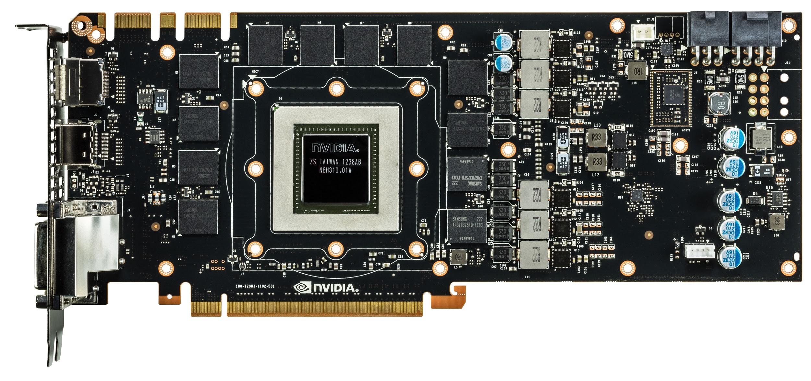
GPU
Notes:
Everything we’ve been talking about is the GPU core. These are made by Nvidia and are the “interesting” part of the GPU.
The global memory is not part of the GPU core, and is in this case manufactured by Samsung. Its RAM similar to what is already in your computer.
Note that not being located on the same silicon generally hurts performance. This is true for accessing global memory from the GPU, and is also (very) true for moving data to GPU over PCI-E.
Light travels about 1 foot each ns (in vacuum).

Slide 24
The Next Step
Put sockets on a blade
Put blades in a chassis
Put chassis in a rack
Put racks in a center
Put centers in the cloud

Slide 25
Then you have a Supercomputer
But how do you use it?

Slide 26
The HPC Canon (as of 2025)
Technology | Paradigm | Hammer
CPU (single core) | Sequential | C compiler
SIMD/Vector (single core) | Data parallel | Intrinsic
Multicore | Threads | pthreads library
NUMA shared memory | Threads | pthreads library
GPU | GPU | CUDA
Clusters | Message passing | MPI
This semester
C++

Slide 27
Editorial Comment
The most exciting phrase to hear in science, the one that heralds new discoveries, is not “Eureka!” (I found it) but “That’s funny”
  Attributed to Isaac Asimov (and others)

Slide 28
Uses of HPC (a Sample)
Cosmology
Earthquake
Weather
Climate modeling
Automobile crash testing
Aircraft design
Jet engine design
Stockpile stewardship
Nuclear fusion
Protein folding
Modeling the brain
Modeling bloodstream
Epidemiology
Rendering (CGI)
Sigint
Block chains
Gene sequencing
Etc

Slide 29
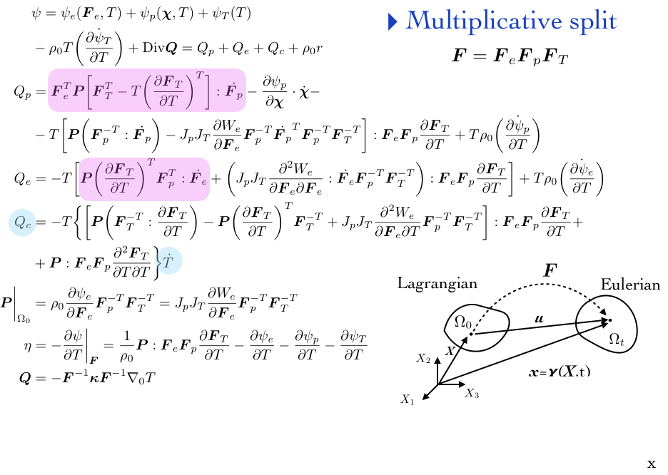
Multiphysics Solver

Slide 30
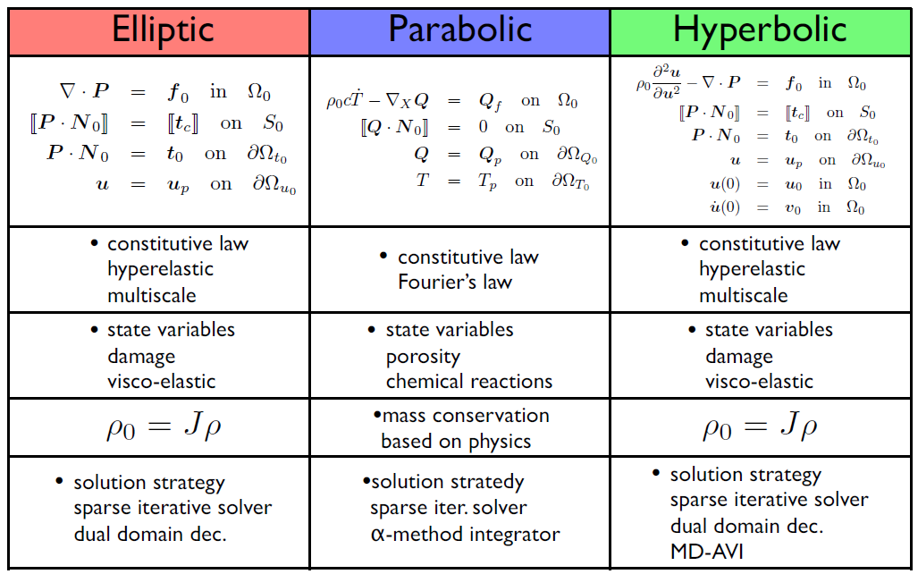
Physics: Systems of Partial Differential Equations (PDEs)
Courtesy Karel Matous, U. Notre Dame
Notes:
Now, we saw many many examples of how scientific computing is used to solve problems. How can we even scratch the surface? Well, it turns out that in one sense, all these problems boil down to the same thing. Solving systems of PDEs. And, solving systems of PDEs boils down to one thing: solving linear systems.

Slide 31
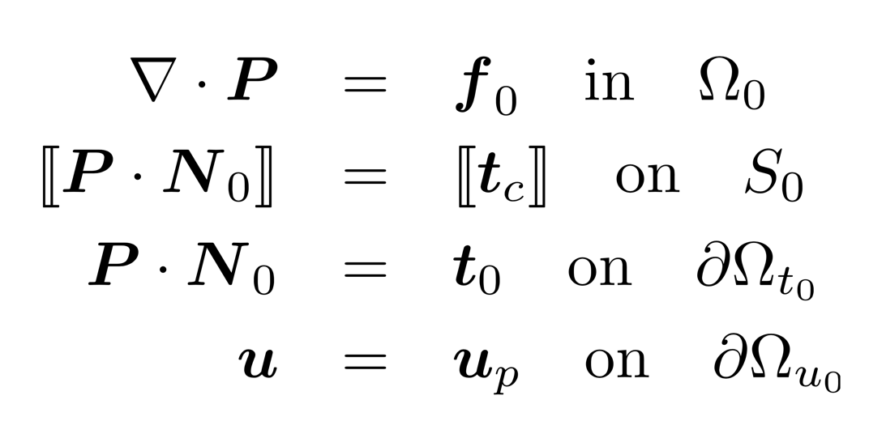
Computational Science
System of Partial Differential Eqns
System of Nonlinear Eqns
discretize
System of Linear Eqns
linearize
All scientific computing is this

Slide 32
C++! But Why?

Slide 33
Why C++ ?
You can’t learn to program without a programming language
The purpose of a programming language is to allow you to express your ideas in code
C++ is the language that most directly allows you to express ideas from the largest number of application areas
C++ is the most widely used language in engineering areas
  http://www.research.att.com/~bs/applications.html
Our society runs on software
  Large parts of that software directly or indirectly rely on C/C++
    Windows, Linux, Office Suite, Adobe Products, …
    Self driving cars, industry equipment, …
    Internet

Slide 34
Why C++ ?
C++ is precisely and comprehensively defined by an ISO standard
  C++17! Now also C++23!
  And that standard is almost universally accepted
C++ is available on almost all kinds of computers
Programming concepts that you learn using C++ can be used fairly directly in other languages
  Including C, Java, C#, and (less directly) Fortran
Last but not least: C++ jobs are one of the best paid jobs available

Slide 35
A First C++ Program
// Our first C++ program
#include <algorithm>
#include <print>
#include <vector>
int main() // main() is where a C++ program starts
{
std::vector<double> data = { 1.0, 2.0, 3.0, 4.0, 5.0, 6.0 };
auto sum = std::reduce(data.begin(), data.end());
std::print(std::stdout, "Sum of all values: {}\n", sum);
return 0;
}

Slide 36
A deeper Look
Expressions
  Compute something, yields result, may have side effects
  Operands and operators – types!
Scope
  Part of the program in which a name has its meaning
    Global scope
    Namespace scope
    Block scope
Algorithms
    auto sum = std::reduce(data.begin(), data.end());
    std::println(std::stdout, "Sum of all values: {}", sum);

Slide 37
Details
Program structure
  Free form except string literals, #include, comments
Types
  Data structures and their operations
  Built in and user defined
Functions
  Code structure
  Helps isolating (abstracting) sub-functionalities
Namespaces
  Grouping related names

Slide 38
Details
Special character literals
  \n newline character
  \t horizontal tabulator
  \b backspace character
  \" same as " but does not terminate string
  \' same as ' but does not terminate character literal
  \\ same as \ but does not give special meaning to next character
Definitions and headers
The main() function
Braces and semicolons
Output

Slide 39
Why Parallel C++?
Modern computers have more than one core
  Often many more
  Many programs require to do many things at once (MTAO)
Scientific computing requires a lot of number crunching
  Parallelization required to reduce required execution times
C++ offers
  Parallel algorithms
    Divide a loop into subtasks, which are processed simultaneously
  Task and Data parallelism
    Focuses on distributing tasks across cores
    Divides data arrays into smaller chunks and processes them in parallel
  Asynchronous execution

Slide 40
Motivation for Parallelism
Operating systems must handle multiple things at once (MTAO)
  Processes, interrupts, background system maintenance
Networked servers must handle MTAO
  Multiple connections handled simultaneously
Parallel programs must handle MTAO
  To achieve better performance
Programs with user interface often must handle MTAO
  To achieve user responsiveness while doing computation
Network and disk bound programs must handle MTAO
  To hide network/disk latency
  Sequence steps in access or communicatoin

Slide 41
A First Parallel C++ Program
// Our first parallel C++ program
#include <algorithm>
#include <execution>
#include <print>
#include <vector>
int main() // main() is where a C++ program starts
{
std::vector<double> data = { 1.0, 2.0, 3.0, 4.0, 5.0, 6.0 };
auto sum = std::reduce(std::execution::par, data.begin(), data.end());
std::println("Sum of all values: {}", sum);
return 0;
}

Slide 42
A deeper Look
Parallel algorithms
  std::execution::par: execution policy tells library that it is ok to execute out of order
    auto sum = reduce(std::execution::par, data.begin(), data.end());
This is a hint to the library
  Implementation is free to decide what to do
  No real control over how things are being executed

Slide 43
A First Parallel HPX Program
// Our first parallel HPX program
#include <hpx/algorithm.hpp>
#include <hpx/execution.hpp>
#include <print>
#include <vector>
int main() // main() is where a C++ program starts
{
std::vector<double> data = { 1.0, 2.0, 3.0, 4.0, 5.0, 6.0 };
hpx::execution::experimental::num_cores nc(2);
auto sum = hpx::reduce(hpx::execution::par.with(nc), data.begin(), data.end());
std::println("Sum of all values: {}", sum);
return 0;
}

Slide 44
A deeper Look
Parallel algorithms
  hpx::execution::par: execution policy tells library that it is ok to execute out of order
  hpx::execution::experimental::num_cores encapsulates a way to control number of cores to be used
  .with(nc): associates this with the execution policy
    hpx::execution::experimental::num_cores nc(2);
    auto sum = hpx::reduce(
    hpx::execution::par.with(nc), data.begin(), data.end());
This makes sure that the algorithm runs on 2 cores only

Slide 45
Hello, world!
“Hello world” is a very important program
  Its purpose is to help you get used to your tools
    Compiler
    Program development environment
    Program execution environment
  Type in the program carefully
    After you get it to work, please make a few mistakes to see how the tools respond; for example
      Forget the header
      Forget to terminate the string
      Misspell return (e.g. retrun)
      Forget a semicolon
      Forget { or }
      …

Slide 46
Number of Unique Elements
Let’s start with a sequence of integers:
int a[] = { 1, 3, 1, 4, 1, 5 };
How many unique integers do we have?
  Simple solution:
  #include <iostream>
  #include <set>
  int main() {
  std::set<int> set_of_ints(a, a + 6);
  std::println("{}", set_of_ints.size());
  }
This solution is correct! But … very slow! Why?

Slide 47
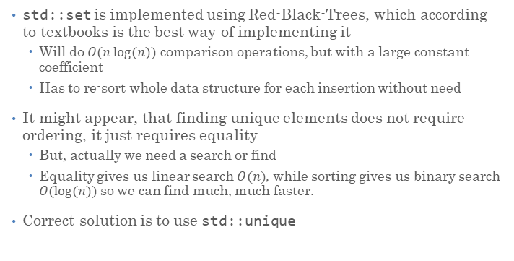
Equality vs. Ordering
std::set is implemented using Red-Black-Trees, which according to textbooks is the best way of implementing it
  Will do $O(n log⁡(n))$ comparison operations, but with a large constant coefficient
  Has to re-sort whole data structure for each insertion without need
It might appear, that finding unique elements does not require ordering, it just requires equality
  But, actually we need a search or find
  Equality gives us linear search $O(n)$, while sorting gives us binary search $O(log⁡(n))$ so we can find much, much faster.
Correct solution is to use std::unique

Slide 48
Number of Unique Elements
Sequence must be sorted, however. std::unique eliminates equal elements and returns reference to first duplicated element:
  #include <algorithm>
  #include <iostream>
  int main() {
  std::sort(a, a + std::size(a));
  std::println("{}", std::unique(a, a + std::size(a)) – a);
  }
For example:
1 2 2 2
^

Slide 49
Use the correct STL Data Structures
What container type should you use?
  Whenever you can, use std::vector.
  If you cannot, find a way so you can.
Avoid any data structures except arrays. “Well aren’t there exceptions?” No, not for you.
  Typically advanced data structures are slower than simple data structures.
  Data structures which appear to be alright when textbook writers wrote their books, are no longer all right now.
  Computers changed so much. Things no longer work as taught 10 years ago.
Occasionally we will ask you to use other data structures
  Mostly to make our point, though

Slide 50
A Word about Compilation

Slide 51
Compilation and Linking
C++ source code
You write C++ source code
  Source code is (in principle) human readable
The compiler translates what you wrote into object code (sometimes called machine code)
  Object code is simple enough for a computer to “understand”
The linker links your code to system code needed to execute
  E.g. input/output libraries, operating system code, and windowing code
The result is an executable program
  E.g. a .exe file on windows or an a.out file on Unix
C++ compiler
Library Object code
Object code
Linker
Executable program
See: Decoding C++ Compilation Process: From Source Code to Binary

Slide 52
CMake
CMake is a family of tools
  Building software
  Testing software
  Packaging software
We will use it for building and testing
CMake generates build systems files (Makefiles and or workspaces)
  Those can be used to automatically build and test your code
The user writes a single set of descriptive scripts
  Define Targets and their inter-dependencies
CMake is well integrated with many IDEs

Slide 53
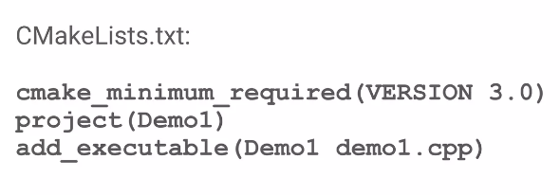
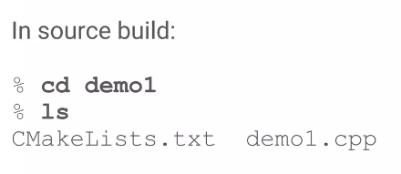
Simplest Example

Slide 54
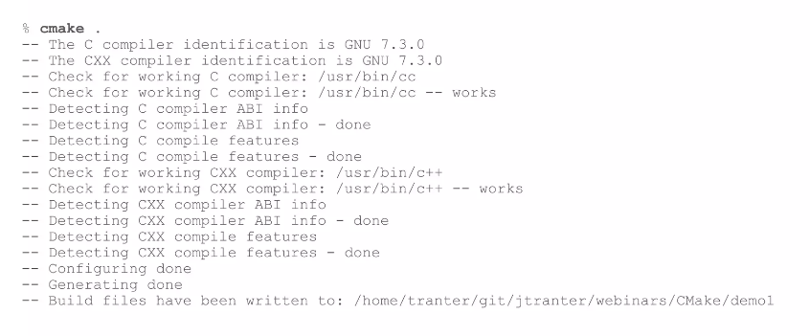
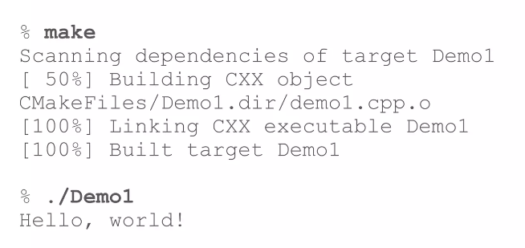
Simplest Example

Slide 55
Homework and Projects
We will use Visual Studio Code as our development environment
  Assignment 0 will ask you to install everything and make it work
  Alternatively use Github Codespaces (development fully online)
We will use Github Classroom for managing your submission
  Please go get a login on github.com, if you have none yet (this is part of assignment 0)
  This will teach you the use of the Git source code control system along the lines
  Special lecture will talk about development environment (git, cmake, etc.)

Slide 56
Summary
Today, single-thread-of-control performance is improving very slowly
  To run programs significantly faster, programs must utilize multiple processing elements or specialized processing hardware
  Which means you need to know how to reason about and write parallel and efficient code
Writing parallel programs can be challenging
  Requires problem partitioning, communication, synchronization
  Knowledge of machine characteristics is important
  In particular, understanding data movement!
I suspect you will find that modern computers have tremendously more processing power than you might realize, if you just use it efficiently!

Slide 57
