Slide 1
Introduction to Parallelism
Lecture 10
Hartmut Kaiser
https://teaching.hkaiser.org/spring2025/csc4700/

Slide 2
Multicore for HPC
How do multicore chips operate (how does the hardware work)?
How do they get high performance?
How does the software exploit the hardware (how do we write our software to exploit the hardware)?
What are the abstractions that we need to use to reason about multicore systems?
What are the programming abstractions and mechanisms?
Terminology: Program, process, thread
More terminology: Parallel, concurrent, asynchronous

Slide 3
Multicore Architecture
Any CPU in the last 4-5 years
Core is a FDREW + regs
Each runs its own sequence of instructions
Each can access its own data
Each has memory hierarchy
But memory might be shared

Slide 4
Parallelism and Concurrency
Parallelism may be defined as performing two (or more) activities at the same time
These activities may be related in some manner or not
Usually, these activities are not instantaneous: each takes a finite time
Two related activities are said to be concurrent if there is no predetermined order between them
They may or may not overlap in time when they do occur
In certain situations, concurrency is not desirable and a relative order is imposed
When such an order is enforced on two activities, they clearly cannot be executed in parallel

Slide 5
Why Parallelism?
Natural processes are inherently parallel, whether they be molecular and nuclear behavior, weather and geological phenomena, or biological and genetic manifestation
Modelling such processes require highly complex computations
For example, a nanosecond-long molecular dynamics simulation of barely a million atoms can take more than 10¹⁷ steps (a billion billion steps)
Highly detailed week-long weather modeling requires even higher orders of magnitude
Modern CPUs are able to complete ‘only’ a few billion sequential steps in a second
Without parallelism, many useful computations would literally take a lifetime

Slide 6
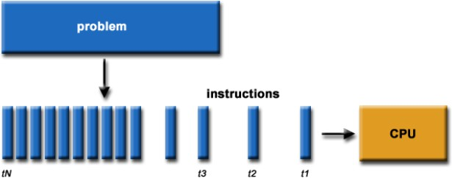
Sequential Computation
Traditionally software has been written for sequential computations
To be run on a single computer having a single Central Processing Unit (CPU)
A problem is broken into a discrete set of instructions
Instructions are executed one after another
Only one instruction can be executed at any moment in time

Slide 7
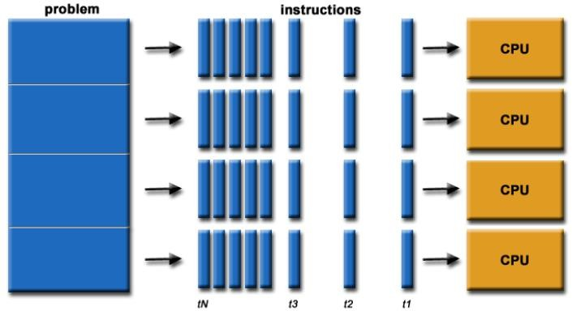
Parallel Computing
In the simplest sense, parallel computing is the simultaneous use of multiple compute resources to solve a computational problem
To be run using multiple CPUs concurrently
A problem is broken into discrete parts that can be solved concurrently
Each part is further broken down to a series of instructions
Instructions from each part execute simultaneously on different CPUs

Slide 8
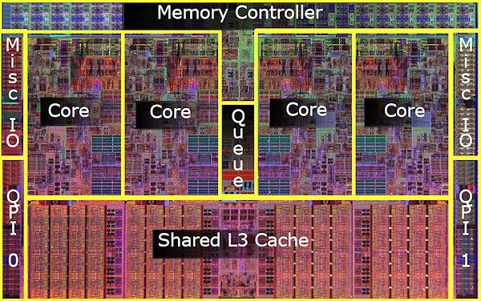
Parallel Computers
Virtually all stand-alone computers today are parallel from a hardware perspective
Multiple functional units (floating point, integer, GPU, etc.)
Multiple execution units / cores
Multiple hardware threads
Intel Core i7 CPU and its major components

Slide 9
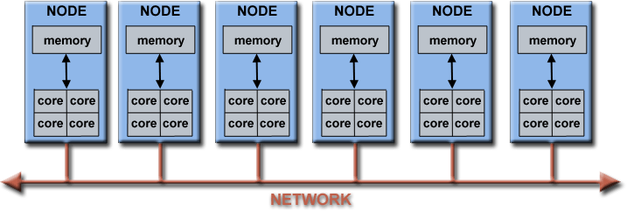
Parallel Computers (HPC)
Networks connect multiple stand-alone computers (nodes) to create larger parallel computer clusters
Each compute node is a multi-processor parallel computer in itself
Multiple compute nodes are networked together with a high-bandwidth, low-latency network (e.g., InfiniBand )
Special purpose nodes, also multi-processor, are used for other purposes

Slide 10
Why Use HPC?
Major reasons
Save time and/or money: In theory, throwing more resources at a task will shorten its time to completion, with potential cost savings. Parallel clusters can be built from cheap, commodity components
Solve larger problems: Many problems are so large and/or complex that it is impractical or impossible to solve them on a single computer, especially given limited computer memory
Provide concurrency: A single compute resource can only do one thing at a time. Multiple computing resources can be doing many things simultaneously
Use of non-local resources: Using compute resources on a wide area network, or even the Internet when local compute resources are scarce

Slide 11
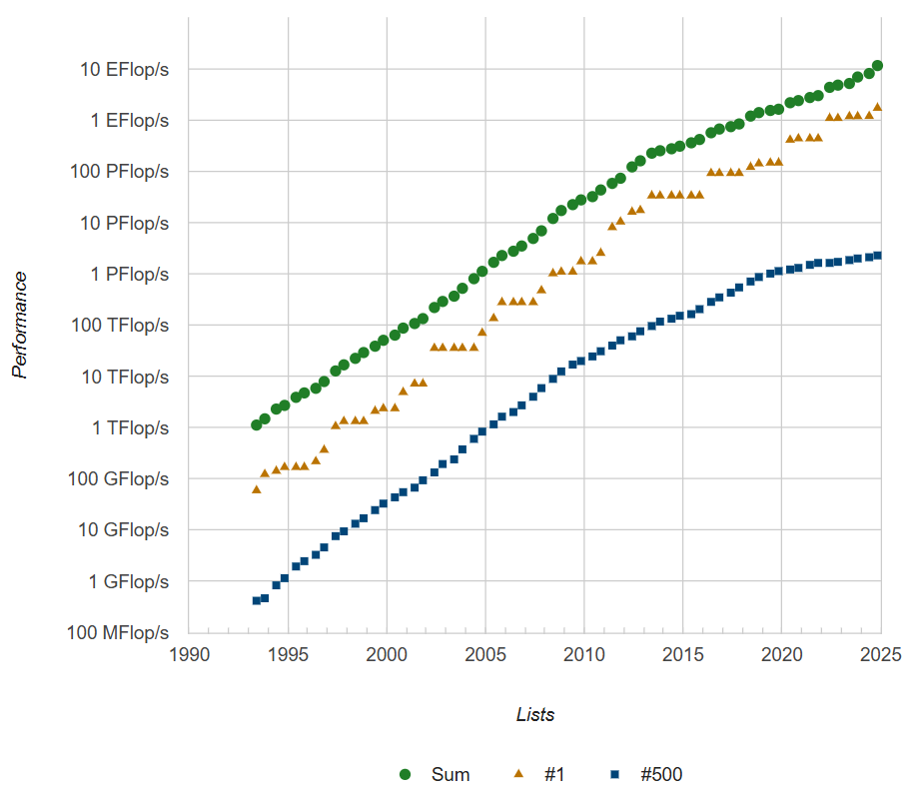
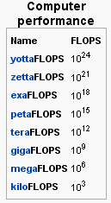
Future Trends
Source: Top500.org

Slide 12
HPC Terminology
Supercomputing / High-Performance Computing (HPC)
Flop/s – Floating point operation per second
Node – a stand alone computer
CPU / Core – a modern CPU usually has several cores (individual processing units)
Task – a logically discrete section from the computational work
Communication – data exchange between parallel tasks
Speedup – time of serial execution / time of parallel execution
Massively Parallel – refer to hardware of parallel systems with many processors (“many” = hundreds of thousands)
Embarrassingly Parallel – solving many similar but independent tasks simultaneously. Requires very little communication
Scalability – a proportionate increase in parallel speedup with the addition of more processors

Slide 13
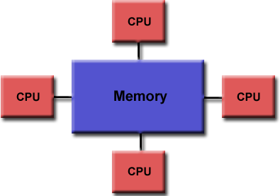
Parallel Computer Memory Architectures
Shared Memory
Multiple processors can operate independently, but share the same memory resources
Changes in a memory location caused by one CPU are visible to all processors
Advantages
Global address space provides a user-friendly programming perspective to memory
Fast and uniform data sharing due to proximity of memory to CPUs
Disadvantages
Lack of scalability between memory and CPUs. Adding more CPUs increases traffic on the shared memory-CPU path
Programmer responsibility for “correct” access to shared memory

Slide 14
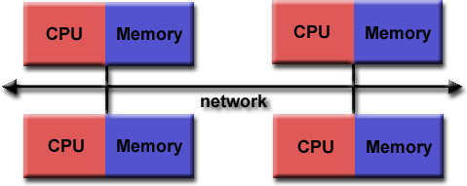
Parallel Computer Memory Architectures
Distributed Memory
Requires a communication network to connect inter-processor memory
Processors have their own local memory. Changes made by one CPU have no effect on others
Requires communication to exchange data among processors
Advantages:
Memory is scalable with the number of CPUs
Each CPU can rapidly access its own memory without overhead incurred by trying to maintain global cache coherency
Disadvantages:
Programmer is responsible for many of the details associated with data communication between processors
It is usually difficult to map existing data structures to this memory organization, based on global memory

Slide 15
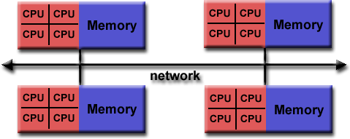
Parallel Computer Memory Architectures
Hybrid Distributed-Shared Memory
The largest and fastest computers in the world today employ both shared and distributed memory architectures.
Shared memory component can be a shared memory machine and/or GPU
Processors on a compute node share same memory space
Requires communication to exchange data between compute nodes
Advantages and Disadvantages
Whatever is common to both shared and distributed memory architectures
Increased scalability is an important advantage
Increased programming complexity is a major disadvantage
15

Slide 16
Parallel Programming Models

Slide 17
Parallel Programming Models
Parallel Programming Models exist as an abstraction on top of hardware and memory architectures
Uniform Memory (without threads)
Shared Threads Models (Pthreads, OpenMP, HPX)
GPU programming (CUDA, HIP, SYCL, etc.)
Distributed Memory (HPX) / Message Passing (MPI)
Data Parallel (HPX)
Hybrid (HPX, MPI+OpenMP)
Single Program Multiple Data (SPMD)
Multiple Program Multiple Data (MPMD)

Slide 18
Shared Threads Models
POSIX Threads
Library based, requires parallel coding
C Language only; Interfaces for Perl, Python and others exist
Commonly referred to as Pthreads
Most hardware vendors now offer Pthreads in addition to their proprietary threads implementations
Very explicit parallelism; requires significant programmer attention to detail
OpenMP
Compiler directive based (#pragma directives); can use serial code
Jointly defined and endorsed by a group of major computer hardware and software vendors
Portable / multi-platform, including Unix and Windows platforms
Available in C/C++ and Fortran implementations
Can be very easy and simple to use - provides for "incremental” parallelism

Slide 19
Shared Threads Models
Pthreads are the underlying threading implementation on almost all platforms
Too low level for daily use
OpenMP does not integrate with C++ very well
Is based on #pragma’s that don’t know anything about C++ types
Very verbose if fine tuning is needed
We will use higher level standard C++ facilities
Later we will use HPX, which provides extensions to the standard C++ APIs

Slide 20
Distributed Memory / Message Passing Models
A set of processes that use their own local memory during computation
Multiple tasks can reside on the same physical machine and/or across an arbitrary number of machines
Processes exchange data through communications by sending and receiving messages
Data transfer usually requires cooperative operations to be performed by each process
For example, a send operation must have a matching receive operation
Message Passing Interface (MPI) is the "de facto" industry standard for message passing
MPI implementations exist for virtually all popular parallel computing platforms
Distributed task-based systems like HPX combine benefits of both, one sided and tw0-sided communication

Slide 21
Data Parallel Model
Data Parallel on shared memory systems
SIMD registers and arithmetic operations
Is applicable semantically to distributed computing as well (SPMD/MPMD)
Relies on systems that expose a Global Address Space
UPC/UPC++: Partitioned Global Address Space (PGAS) (compiler dependent)
Coarray Fortran: A small set of extension to Fortran 95 (compiler dependent)
HPX: Active Global Address Space (AGAS) (pure library implementation)
Display these characteristics:
Address space is treated globally
Parallel work focuses on performing operations on a data set
Tasks work on different portions from the same data structure
Tasks may perform different operations concurrently
19

Slide 22
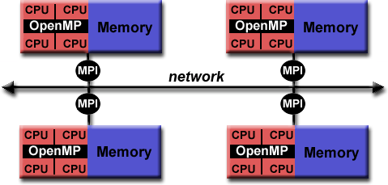
Hybrid Parallel Programming Models
Currently, a common example of a hybrid model is the combination of the message passing model (MPI) with the threads model (OpenMP)
Threads perform computationally intensive kernels using local, on-node data
Communications between processes on different nodes occurs over the network using MPI
This hybrid model lends itself well to the increasingly common hardware environment of clustered multi/many-core machines
HPX: a C++ library solution combining
Distributed tasks
Seamless local threading
Higher-level APIs uniform for local and remote operation

Slide 23
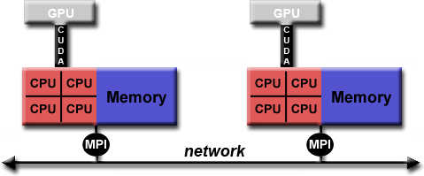
Hybrid Parallel Programming Models:
Another similar and increasingly popular example of a hybrid model is using MPI with GPU (Graphics Processing Unit) programming
GPUs perform computationally intensive kernels using local, on-node data
Communications between processes on different nodes occurs over the network using MPI
HPX allows to unify the programming interfaces for
Shared memory parallelism
Distributed parallelism
GPU based computation

Slide 24
Can my Code be parallelized?
Does it have large loops that repeat the same operations?
Does your code do multiple tasks that are not dependent on one another? If there are dependencies, are those weak?
Can any dependencies or information sharing be overlapped with computation? If not, is the amount of communications small?
Do multiple tasks depend on the same data?
Does the order of operations matter? If so how strict does it have to be?

Slide 25
Basic Guidance for efficient Parallelization
Is it even worth parallelizing my code?
Does your code take an intractably long amount of time to complete?
Do you run a single large model or do statistics on multiple small runs?
Would the amount of time it takes to parallelize your code be worth the gain in speed?
Parallelizing established code vs. starting from scratch
Established code: Maybe easier / faster to parallelize, but may not give good performance or scaling
Start from scratch: Takes longer, but will give better performance, accuracy, and gives the opportunity to turn a “black box” into a code you understand

Slide 26
Basic Guidance for efficient Parallelization
Increase the fraction of your program that can be parallelized
Identify the most time consuming parts of your program and parallelize them
This could require modifying your intrinsic algorithm and code’s organization
Balance parallel workload
Minimize time spent in communication
Partition data. Distribute arrays and matrices – allocate specific memory for each process on a separate node

Slide 27
Considerations about Parallelization
You parallelize your program to run faster, and to solve larger and more complex problems
How much faster will the program run?
$T (1)$: Time to complete the job on one process
$T (n)$: Time to complete the job on n processes
Speedup:
Efficiency:
T (1)
S(n) =
E(n) = ^{S(n)}
T (n)
n
Tells you how efficiently you parallelize your code

Slide 28
Oversimplified Example
$p$ $→$ fraction of program that can be parallelized
$1 − p$ $→$ fraction of program that cannot be parallelized
$n$ $→$number of processors
Then the time of running the parallel program will be $1 – p + p/n$ of the time for running the serial program
Example: if 80% can be parallelized and 20 % cannot be parallelized
$n = 4$
$1 − 0.8 + 0.8 / 4 = 0.4$ i.e., 40% of the time for running the serial code
You get 2.5 speed up although you run on 4 cores since only 80% of your code can be parallelized (assuming that all parts in the code can complete in equal time)

Slide 29
Oversimplified Example, continued
80%
Serial
Parallel
Process 1
20%
Process 2
Process 3
parallelized
Process 4
Not parallelized

Slide 30
More realistic Example
80%
Serial
Parallel
Process 1
20%
parallelized
Process 2
Not parallelized
Process 3
Overheads
Process 4
Load imbalance

Slide 31
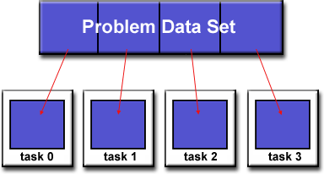
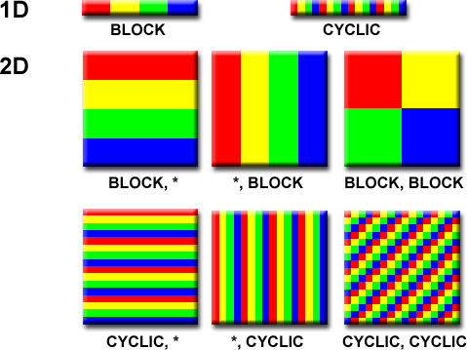
Designing parallel Programs - Partitioning
One of the first steps in designing a parallel program is to break the problem into discrete “chunks” that can be distributed to multiple parallel tasks
Domain Decomposition
Data associated with a problem is partitioned
Each parallel task works on a portion of the data
There are different ways to partition the data

Slide 32
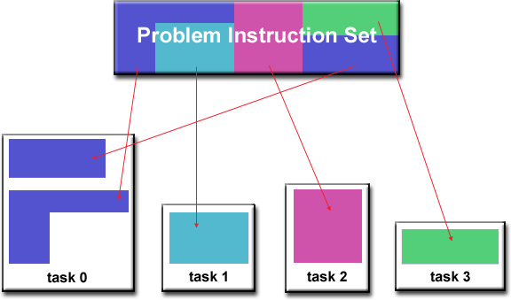
Designing parallel Programs - Partitioning
One of the first steps in designing a parallel program is to break the problem into discrete “chunks” that can be distributed to multiple parallel tasks
Functional Decomposition
Problem is decomposed according to the work that must be done. Each parallel task performs a fraction of the total computation

Slide 33
Designing parallel Programs - Communication
Most parallel applications require tasks to share data with each other
Cost of communication: Computational resources are used to package and transmit data
Requires frequently synchronization – some tasks will wait instead of doing work
Could saturate network bandwidth
Latency vs. Bandwidth
Latency is the time it takes to send a minimal message between two tasks
Bandwidth is the amount of data that can be communicated per unit of time
Sending many small messages can cause latency to dominate communication overhead

Slide 34
Designing parallel Programs - Communication
Most parallel applications require tasks to share data with each other
Synchronous vs. Asynchronous communication
Synchronous communication is referred to as blocking communication – other work stops until the communication is completed
Asynchronous communication is referred to as non-blocking since other work can be done while communication is taking place

Slide 35
Designing parallel Programs - Communication
Most parallel applications require tasks to share data with each other
Scope of communication
Point-to-point communication – data transmission between tasks.
Collective communication
Involves all tasks (in a communication group)

Slide 36
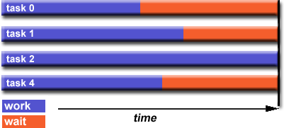
Designing parallel Programs - Load Balancing
Load balancing is the practice of distributing approximately equal amount of work so that all compute resources are kept busy all the time
How to Achieve Load Balance?
Equally partition the work given to each task
For array/matrix operations equally distribute the data set among parallel tasks
For loop iterations where the work done for each iteration is equal, evenly distribute iterations among tasks
Use dynamic work assignment
Certain class problems result in load imbalance even if data is distributed evenly among tasks (sparse matrices, adaptive grid methods, many body simulations, etc.).
Use scheduler – task pool approach. As each task finishes, it queues to get a new piece of work. Modify your algorithm to handle imbalances dynamically.

Slide 37
Scalability

Slide 38
Name This Famous Person
"Validity of the single processor approach to achieving large-scale computing capabilities,” AFIPS Conference Proceedings (30): 483–485, 1967.
Gene Amdahl (1922-2015)
Amdahl’s Law
Notes:
Michael Flynn, "Very high-speed computing systems," Proceedings of the IEEE , vol.54, no.12, pp.1901,1909, Dec. 1966.
Gene Amdahl, "Validity of the single processor approach to achieving large-scale computing capabilities,” AFIPS Conference Proceedings (30): 483–485, 1967.

Slide 39
Amdahl’s Law
Serial time on 1 processor: $T_{s}=T_{ser}+T_{par}$
Parallel time on $N$ processors: $T_{P}=T_{ser}+\frac{T_{par}}{N}+T_{pov}(N)$
Parallel overhead: $T_{pov}\left(N\right)=T_{ov}\left(N\right)+T_{comm}\left(N\right)+T_{sync}(N)$
Best case: $T_{pov}\left(N\right)=0$
$$S=\frac{T_{ser}+T_{par}}{T_{ser}+\frac{T_{par}}{N}}$$
$$=\frac{\left(1−P\right)+P}{\left(1−P\right)+\frac{P}{N}}$$
$$=\frac{1}{\left(1−P\right)+\frac{P}{N}}$$
$P$: Proportion of parallel code

Slide 40
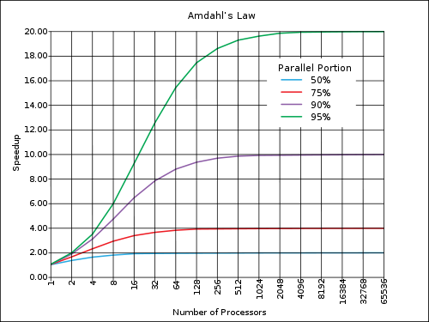
Amdahl’s Law (Strong Scaling)
$S$: Speedup
$P$: Proportion of parallel code
$N$: Number of processors
$$S=\frac{1}{\left(1−P\right)+ \frac{P}{N}}$$
Figure courtesy of Wikipedia (http://en.wikipedia.org/wiki/Amdahl's_law)

Slide 41
A simple Example
Consider a two-step computation on a N x N image
Step 1: multiply brightness of all pixels by two (independent computation on each pixel)
Step 2: compute average of all pixel values
Sequential implementation of program
Both steps take ~ N² time, so total time is ~ 2N²
N
Parallelism
_{N}2
_{N}2
N
1
Execution time

Slide 42
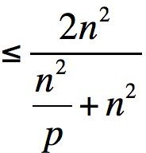
First attempt at Parallelism (P Processors)
Strategy:
Step 1: execute in parallel
time for phase 1: $N2/P$
Step 2: execute sequentially
time for phase 2: $N2$
Overall performance:
Speedup
Speedup ≤ 2
P
Parallelism
Sequential program
_{N}2
_{N}2
1
Execution time
N²/P
P
Parallelism
Parallel program
_{N}2
1
Execution time

Slide 43
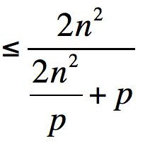
Parallelizing Step 2
Strategy:
Step 1: execute in parallel
time for phase 1: $N2/P$
Step 2: compute partial sums in parallel, combine results sequentially
time for phase 2: $N2/P + P$
Overall performance:
Speedup
Overhead of parallel algorithm: combining the partial sums
N²/P
N²/P P
P
Parallelism
Parallel program
Note: speedup → P when N >> P
1
Execution time

Slide 44
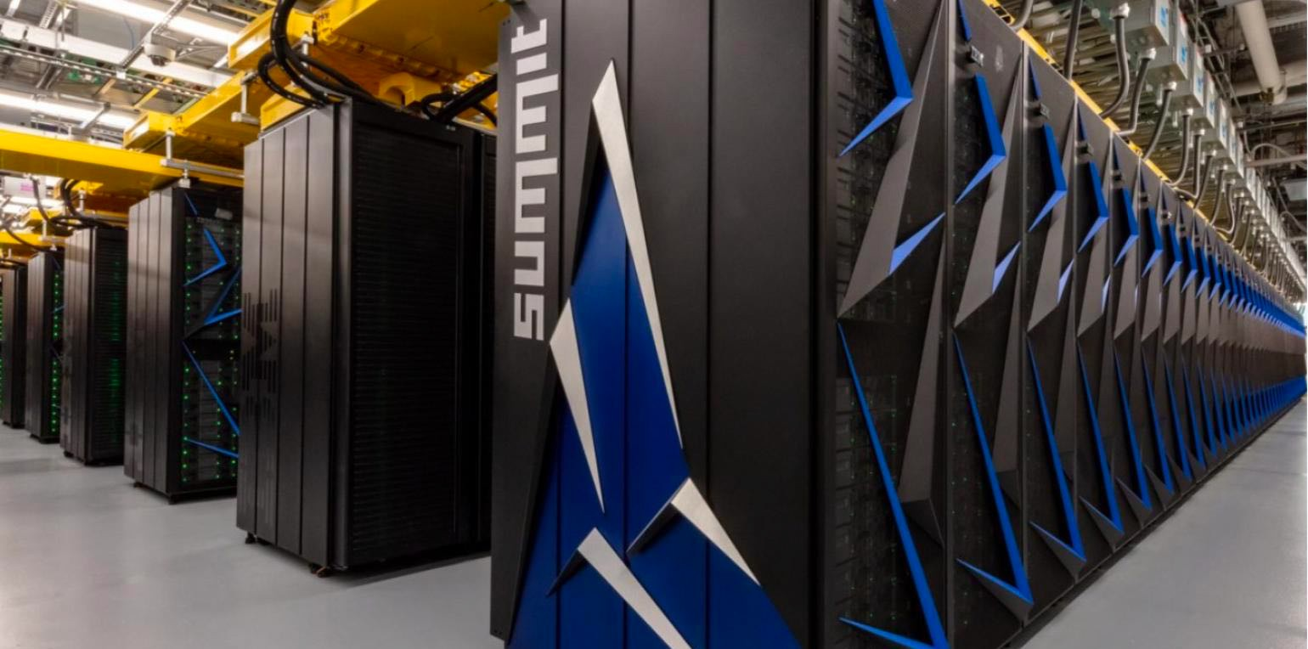
Amdahl’s Law
A small serial region can limit speedup on a large parallel machine
Summit supercomputer:
27,648 GPUs x (5,376 ALUs/GPU) = 148,635,648 ALUs
Machine can perform 148 million single precision operations in parallel
What is max speedup if 0.1% of application is serial?

Slide 45
Rule 1
Parallelize Applications as Much as Humanly Possible

Slide 46
The 4 Horsemen of the Apocalypse

Slide 47
Additional Factors that limit Scalability
Starvation
Insufficient concurrent work to maintain high utilization of resources
Latencies
Time-distance delay of remote resource access and services
Overheads
Work for management of parallel actions and resources on critical path which are not necessary in sequential variant
Waiting for Contention resolution
Delays due to lack of availability of oversubscribed shared resources

Slide 48
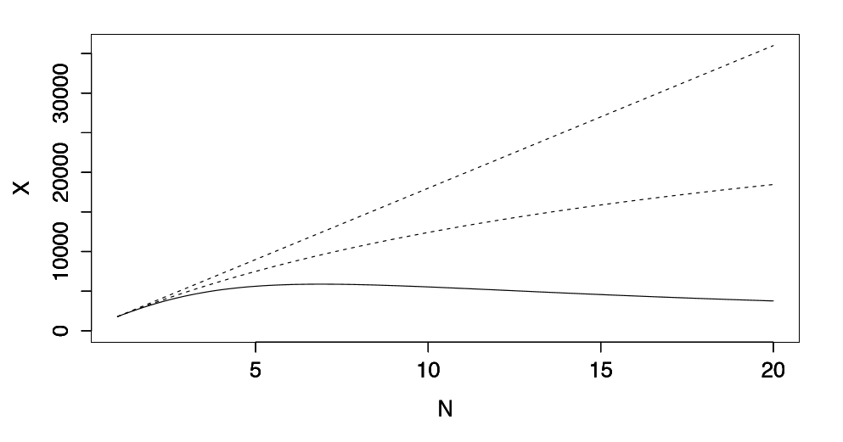
Universal Scalability Law
λ: Scaling efficiency
δ: Contention
κ: Latencies (‘Crosstalk’)
N: Number of processors

Slide 49
Real-world Problems
Even standard algorithms added to C++17 enforce fork-join semantics

Slide 50
Fork/Join Parallelism

Slide 51
Rule 2
Use a Programming Environment that Embraces SLOW

Slide 52
Name This Famous Person
"Reevaluating Amdahl's Law". Communications of the ACM. 31 (5): 532–3, May 1988
Recipient of the inaugural Gordon Bell Prize in 1998
John Gustafson
Gustafson’s Law

Slide 53
Oversimplified Example, again:
Parallel
Process 1
$$1−T_{p}$$
$$T_{p}$$
parallelized
Process 2
Not parallelized
Process 3
$T_{p}$: Time spent running parallel code
Process 4
$$S=\frac{\left(1−T_{p}\right)+T_{p}∙N}{\left(1−T_{p}\right)+T_{p}}$$
$$=\frac{\left(1−T_{p}\right)+T_{p}∙N}{1}$$
Serial

Slide 54
Gustafson’s Law (Weak Scaling)
Doing the same problem faster and faster is not how we use parallel computers
Rather, we solve bigger and more difficult problems
I.e., the amount of parallelizable work grows
$$S=\left(1−P\right)+P∙N$$
$S$: Speedup
$P$: Portion of parallelized code
N: Number of processors

Slide 55
Parallel Scaling & Efficiency
Two kinds of scaling used:
Strong scaling: fixed problem size
$S_{Sp}=\frac{T_{s}}{T_{p}}$, sometimes calculated as $S_{Sp}(P)=\frac{T_{p}(1)}{T_{p}(P)}$
Ideally scales linearly, sometimes super-linearly
Parallel efficiency: $E=\frac{S}{P}$ (in %)
Weak scaling: problem size $W$ proportional to $P$
Keeps effective problem size per processor constant
$S_{Wp}(P)=\frac{T_{p}(PW,P)}{T_{s}(W)}$
Ideally a flat line close to 1
Parallel efficiency: $E=\frac{1}{S}$

Slide 56
Overheads: Thought-Experiment

Slide 57
Overheads: The Worst of All?
Even relatively small amounts of work can benefit from being split into smaller tasks
Possibly huge amount of ‘threads’
In the previous thought-experiment we ended up considering up to 10 million threads
Best possible scaling is predicted to be reached when using 10000 threads (for 1 second worth of work)
Several problems
Impossible to work with that many kernel threads (p-threads)
Impossible to reason about this amount of tasks
Requires abstraction mechanism

Slide 60
Rule 3
Allow for your Grainsize to be Variable

Slide 61
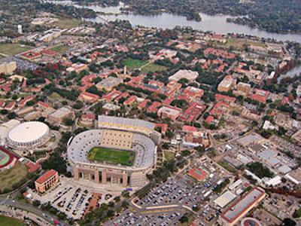

Slide 62
Efficiency Metrics
Efficiency(N) = Speedup(N)/ N = T_{S}/(N * T_{P})
Processor efficiency: figure of merit that indicates how well a parallel program uses available processors
For ideal executions without overhead, 1/N <= Efficiency(N) <= 1
Half-performance metric
$N_{1/2}$: input size that achieves Efficiency(N) = 0.5 for a given $P$
Figure of merit that indicates how large an input size is needed to obtain efficient parallelism
A larger value of $N_{1/2}$ indicates that the problem is harder to parallelize efficiently

Slide 63
Complexity Measures
We'll say that a cost function $Cost(n)$ is “order $f(n)$”, or simply “$O(f (n))$”, read as “Big-O of $f(n)$”
Cost-X(n) < $factor$ * f (n), for sufficiently large n, for some constant $factor$
Examples:
$CostA(n)=2∗n^{3} +n^{2}+ 1$ $CostA is O(n^{3})$
$CostB(n)=3∗n^{2}+ 10$ $CostB is O(n^{3})$
$CostC\left(n\right)=2^{n}$ $CostC is O(2^{n})$

Slide 64
Famous Complexity Classes
$O(1)$ constant-time (head, tail)
$O(log⁡n)$ logarithmic (binary search)
$O(n)$ linear (vector multiplication)
$O(n∗log⁡n)$ "n logn" (sorting)
$O(n^{2})$ quadratic (matrix addition)
$O(n^{3})$ cubic (matrix multiplication)
$n^{O(1)}$ polynomial (…many! …)
$2^{O(n)}$ exponential (guess password)

Slide 65
Complexity Measures
Focus on key metric of interest in your algorithm
Don’t count operations that are incidental to your algorithm
They can be important implementation considerations, but may not contribute to understanding your algorithm
Since big-O analysis does not care about differences within a constant factor, you can just use a unit cost as a stand-in for a constant number of operations

