Slide 1
Threads & Synchronization
Lecture 11
Hartmut Kaiser
https://teaching.hkaiser.org/spring2025/csc4400/

Slide 2
Finding π by Numerical Integration

Slide 3
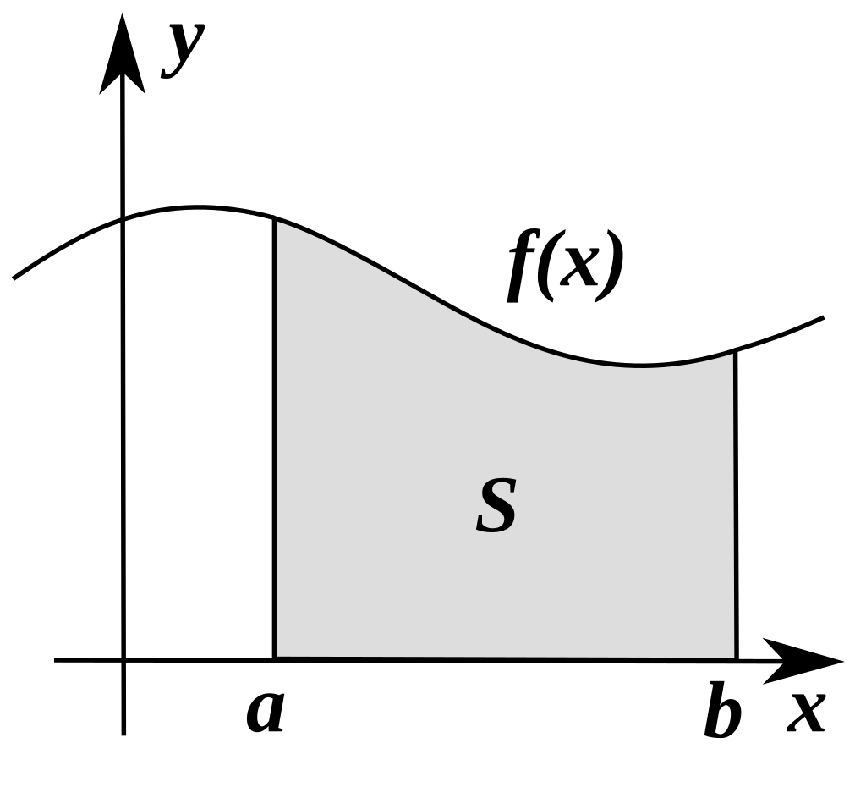
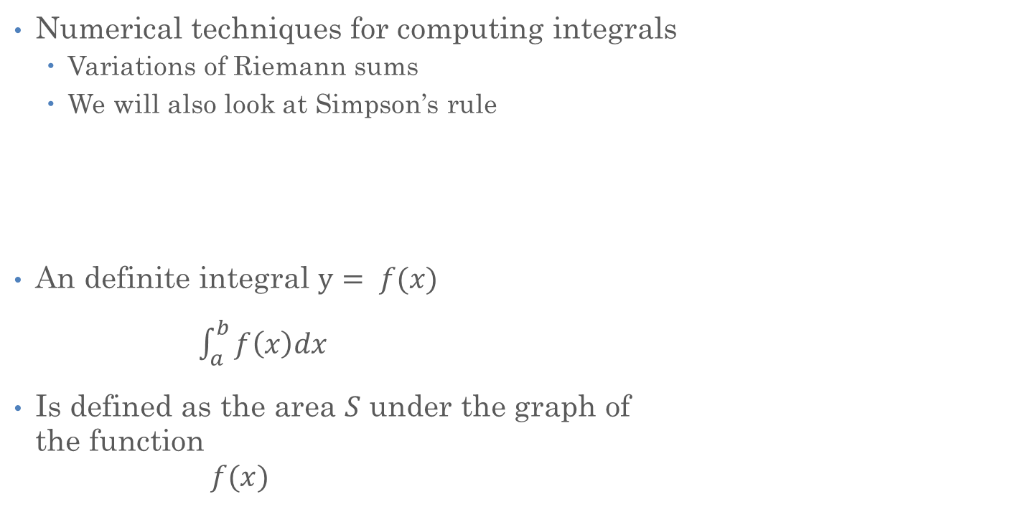
Numerical Integration
Numerical techniques for computing integrals
  Variations of Riemann sums
  We will also look at Simpson’s rule
An definite integral $y= f(x)$
$\int_{a}^{b}{f\left(x\right)dx}$
Is defined as the area $S$ under the graph of
the function
            $$f(x)$$

Slide 4
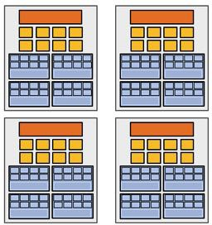
Problem to solve
Discretization/Decomposition
Subproblems (a.k.a.
“tasks”, “work to do”)
Assignment
Parallel Threads ** (“workers”)
Parallel program (communicating threads)
Orchestration
Mapping
Execution on parallel machine

Slide 5
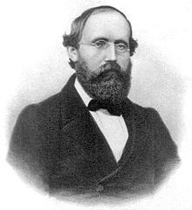
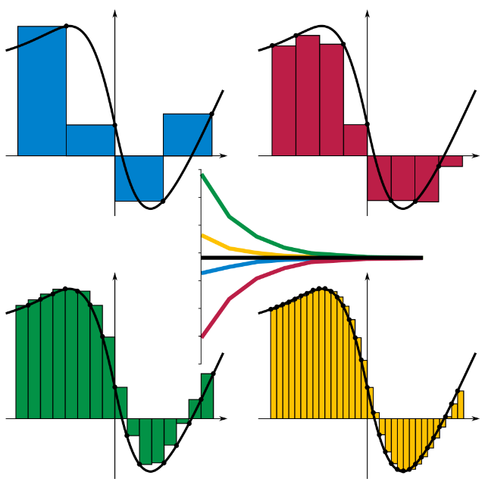
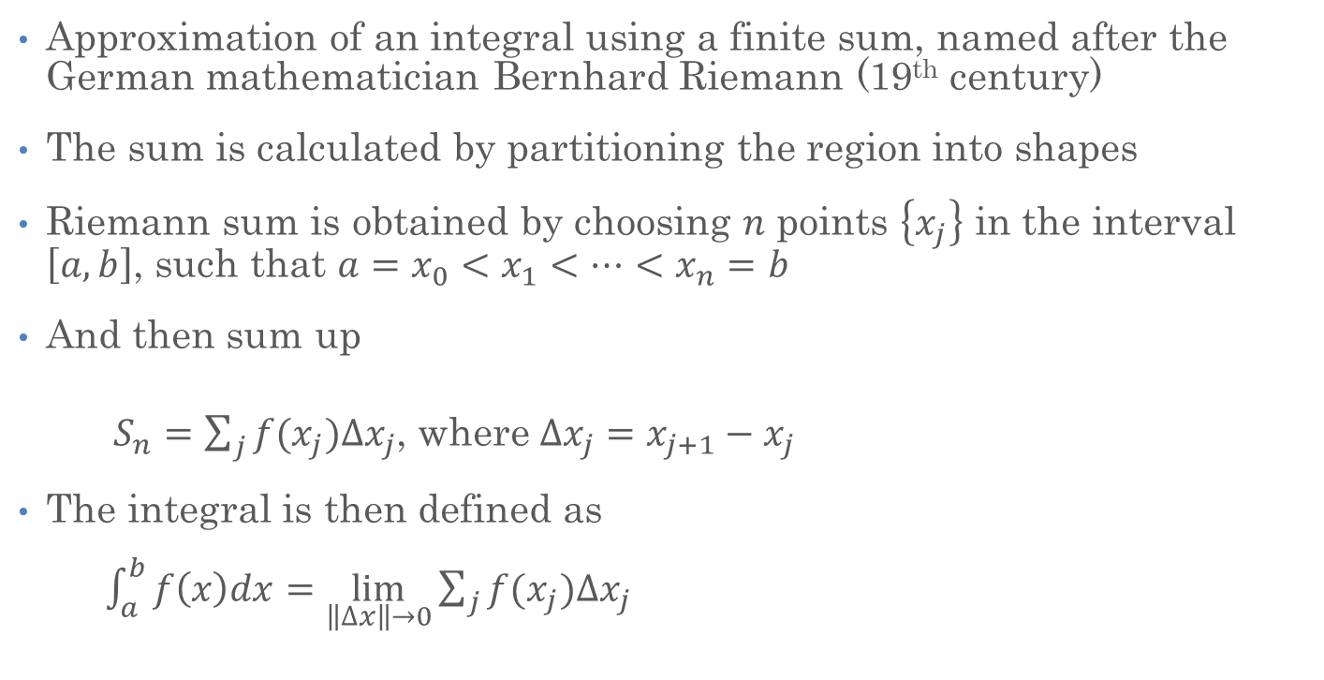
Riemann Sums (Discretization)
Approximation of an integral using a finite sum, named after the German mathematician Bernhard Riemann (19th century)
The sum is calculated by partitioning the region into shapes
Riemann sum is obtained by choosing $n$ points $\left\{x_{j}\right\}$ in the interval $\left[a, b\right]$, such that $a=x_{0}<x_{1}<…<x_{n}=b$
And then sum up
  $S_{n}=\sum_{j}{f(x_{j})∆x_{j}}$, where $∆x_{j}=x_{j+1}−x_{j}$
The integral is then defined as
$\int_{a}^{b}{f\left(x\right)dx}=\lim_{\left\|∆x\right\|→0}{\sum_{j}{f(x_{j})∆x_{j}}}$

Slide 6
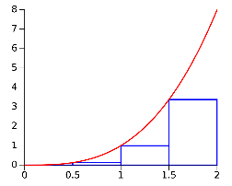
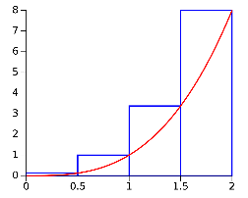
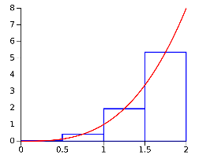
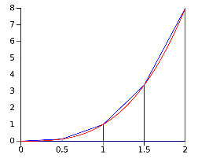
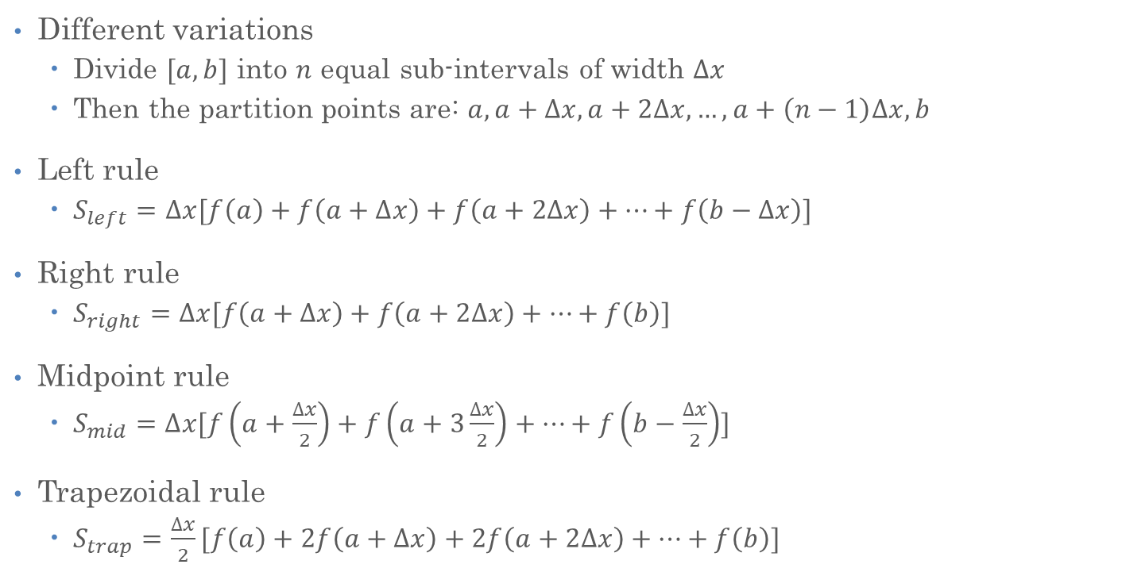
Riemann Sums (Discretization)
Different variations
  Divide $[a, b]$ into $n$ equal sub-intervals of width $∆x$
  Then the partition points are: $a, a+∆x, a+2∆x,…,a+\left(n−1\right)∆x, b$
Left rule
  $S_{left}=∆x[f\left(a\right)+f\left(a+∆x\right)+f\left(a+2∆x\right)+…+f\left(b−∆x\right)]$
Right rule
  $S_{right}=∆x[f\left(a+∆x\right)+f\left(a+2∆x\right)+…+f\left(b\right)]$
Midpoint rule
  $S_{mid}=∆x[f\left(a+\frac{∆x}{2}\right)+f\left(a+3\frac{∆x}{2}\right)+…+f\left(b−\frac{∆x}{2}\right)]$
Trapezoidal rule
  $S_{trap}=\frac{∆x}{2}[f\left(a\right)+2f\left(a+∆x\right)+2f\left(a+2∆x\right)+…+f\left(b\right)]$

Slide 7
Multi-Dimensional Integrals
Compute the volume under a given N-dimensional function is similar, except that now the sub-intervals are N-dimensional as well
The idea is to "break-up" the domain via a partition into pieces
  then multiply the "size" of each piece by some value the function takes on that piece,
  and sum all these products.
This can be generalized to allow Riemann sums for functions over domains of more than one dimension

Slide 8
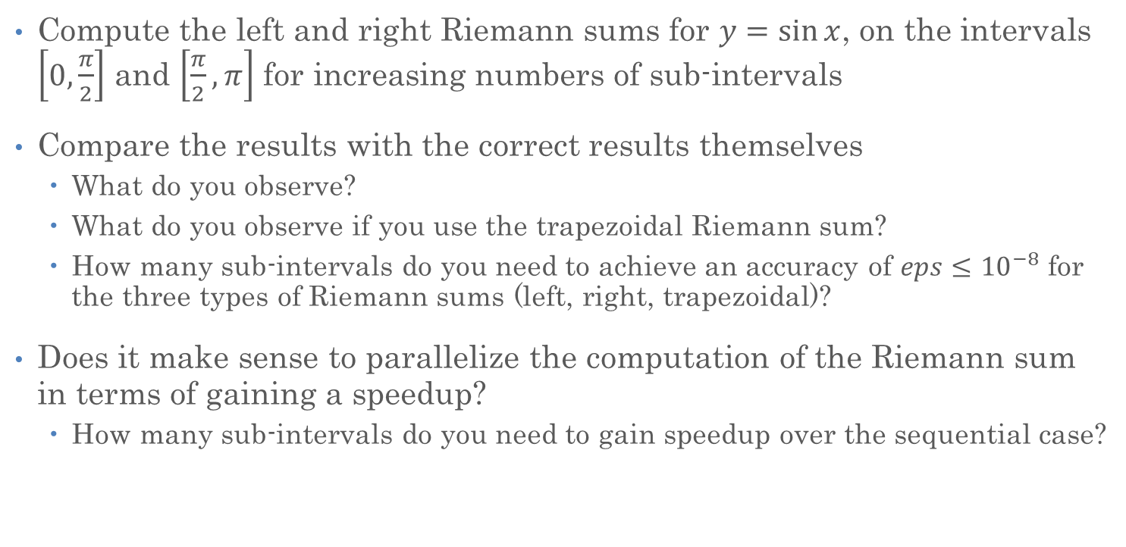
Exercise
Compute the left and right Riemann sums for $y=\sin{x}$, on the intervals $\left[0, \frac{π}{2}\right]$ and $\left[\frac{π}{2}, π\right]$ for increasing numbers of sub-intervals
Compare the results with the correct results themselves
  What do you observe?
  What do you observe if you use the trapezoidal Riemann sum?
  How many sub-intervals do you need to achieve an accuracy of $eps≤{10}^{−8}$ for the three types of Riemann sums (left, right, trapezoidal)?
Does it make sense to parallelize the computation of the Riemann sum in terms of gaining a speedup?
  How many sub-intervals do you need to gain speedup over the sequential case?

Slide 9

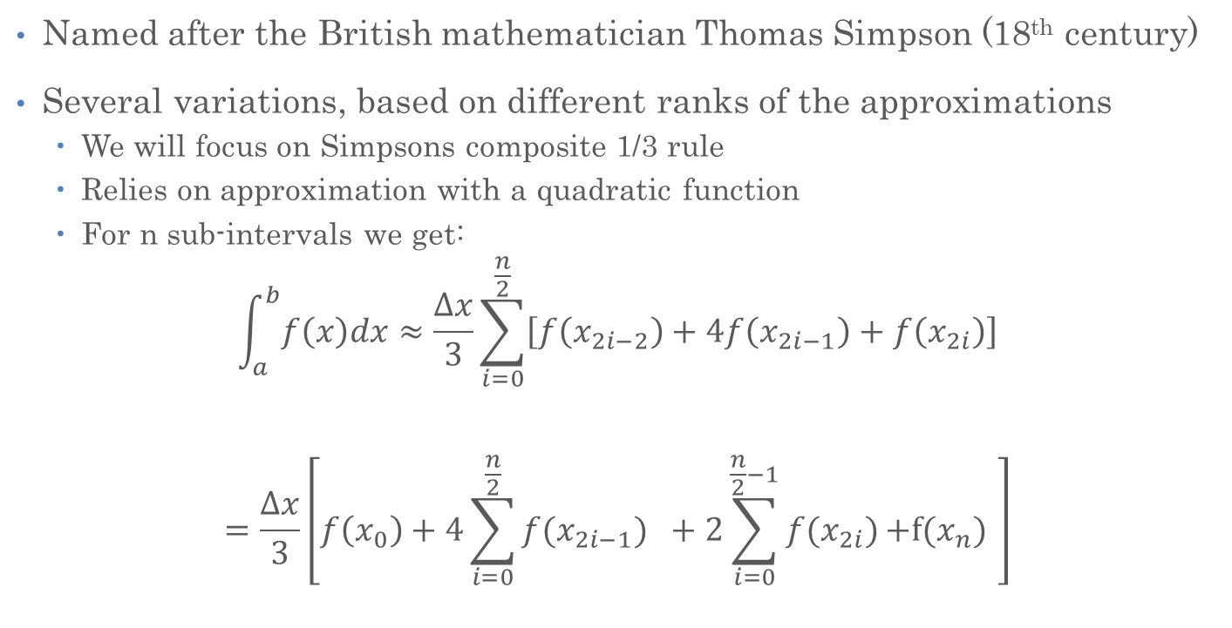
Simpson Rule
Named after the British mathematician Thomas Simpson (18th century)
Several variations, based on different ranks of the approximations
  We will focus on Simpsons composite 1/3 rule
  Relies on approximation with a quadratic function
  For n sub-intervals we get:
$$\int_{a}^{b}{f\left(x\right)dx}≈\frac{∆x}{3}\sum_{i=0}^{\frac{n}{2}}{\left[f\left(x_{2i−2}\right)+4f\left(x_{2i−1}\right)+f\left(x_{2i}\right)\right]}$$
$$=\frac{∆x}{3}\left[f\left(x_{0}\right)+4\sum_{i=0}^{\frac{n}{2}}{f(x_{2i−1})} +2\sum_{i=0}^{\frac{n}{2}−1}{f(x_{2i})}\text{+}\text{f}\text{(}x_{n}\text{)} \right]$$

Slide 10
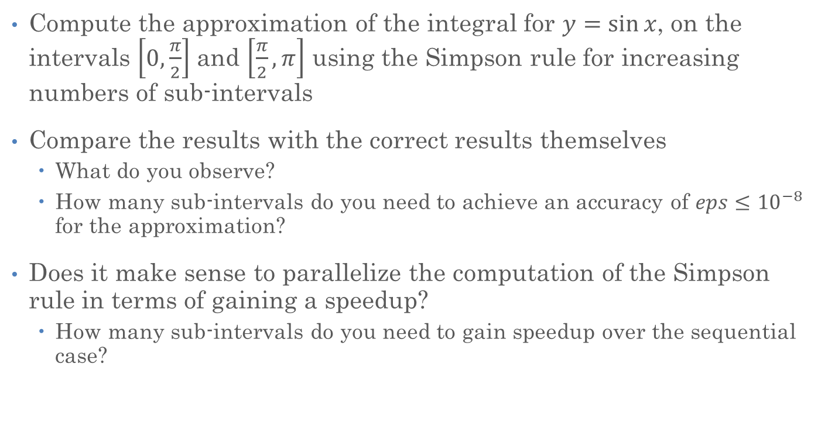
Exercise
Compute the approximation of the integral for $y=\sin{x}$, on the intervals $\left[0, \frac{π}{2}\right]$ and $\left[\frac{π}{2}, π\right]$ using the Simpson rule for increasing numbers of sub-intervals
Compare the results with the correct results themselves
  What do you observe?
  How many sub-intervals do you need to achieve an accuracy of $eps≤{10}^{−8}$ for the approximation?
Does it make sense to parallelize the computation of the Simpson rule in terms of gaining a speedup?
  How many sub-intervals do you need to gain speedup over the sequential case?

Slide 11

Finding π
Find the value of
$$π$$
Using formula
$π=\int_{0}^{1}{\frac{4}{1+x^{2}}dx}$

Slide 12

Numerical Integration
$$A=h \frac{4}{1+{(ih)}^{2}}$$

Slide 13
Numerical Integration

Slide 14
Numerical Integration (Sequential)
double pi = 0;
for (int i = 0; i < N; ++i)
pi += h * 4.0 / (1.0 + sqr(i * h));

Slide 15
Finding Concurrency (Decomposition)
Partial sums are all independent
Can be computed concurrently
k = 0
k = M-1

Slide 16
Sequentially Finding π
(Two Nested Loops)
double calculate_pi()
{
double h = 1.0 / (double) num_intervals; // Decomposition
double pi = 0.0;
// For each set of discretized points
for (int k = 0; k < num_intervals; ++k) {
double partial_pi = 0.0; // Compute partial sum
for (int i = k; i < (k + blocksize); ++i)
partial_pi += 4.0 / (1.0 + sqr(i * h));
pi += partial_pi; // Accumulate final sum
}
return pi;
}

Slide 17
Finding Concurrency (Decomposition)

Slide 18
Finding Concurrency (Decomposition)

Slide 19
Finding Concurrency (Decomposition)

Slide 20
Finding Concurrency (Decomposition)
double pi = 0;
for (int i = 0; i != N/4; ++i)
pi += h * 4.0 / (1 + sqr(i * h));
double pi = 0;
for (int i = N/4; i != N/2; ++i)
pi += h * 4.0 / (1 + sqr(i * h));
double pi = 0;
for (int i = N/2; i != 3*N/4; ++i)
pi += h * 4.0 / (1 + sqr(i * h));
double pi = 0;
for (int i = 3*N/4; i != N; ++i)
pi += h * 4.0 / (1 + sqr(i * h));

Slide 21
Finding Concurrency (Decomposition)
int main()
{
int const N = 1'000'000;
double pi = 0;
for (int i = 0; i != N/4; ++i)
pi += h * 4.0 / (1 + sqr(i * h));
for (int i = N/4; i != N/2; ++i)
pi += h * 4.0 / (1 + sqr(i * h));
for (int i = N/2; i != 3*N/4; ++i)
pi += h * 4.0 / (1 + sqr(i * h));
for (int i = 3*N/4; i != N; ++i)
pi += h * 4.0 / (1 + sqr(i * h));
std::println("pi: {}", pi);
}

Slide 22
Finding Concurrency (Decomposition)
int main()
{
int const N = 1'000'000;
double pi = 0;
for (int i = 0; i != N/4; ++i)
pi += h * 4.0 / (1 + sqr(i * h));
for (int i = N/4; i != N/2; ++i)
pi += h * 4.0 / (1 + sqr(i * h));
for (int i = N/2; i != 3*N/4; ++i)
pi += h * 4.0 / (1 + sqr(i * h));
for (int i = 3*N/4; i != N; ++i)
pi += h * 4.0 / (1 + sqr(i * h));
std::println("pi: {}", pi);
}

Slide 23
Aside:
Threads in C++

Slide 24
What’s a ‘Thread’?
C++ Standard defines it as follows:
  Thread of execution: “single flow of control within a program” ([intro.multithread.general])
  std::thread: is specified as a component “that can be used to create and manage threads" (see [thread.threads.general]), where “thread" explicitly refers to the definition of ”threads of execution” (see [thread.thread.class.general])
    Note: ”These threads are intended to map one-to-one with operating system threads”
  Execution agent: In [thread.req.lockable.general], an execution agent is defined as “an entity such as a thread that may perform work in parallel with other execution agents”.

Slide 25
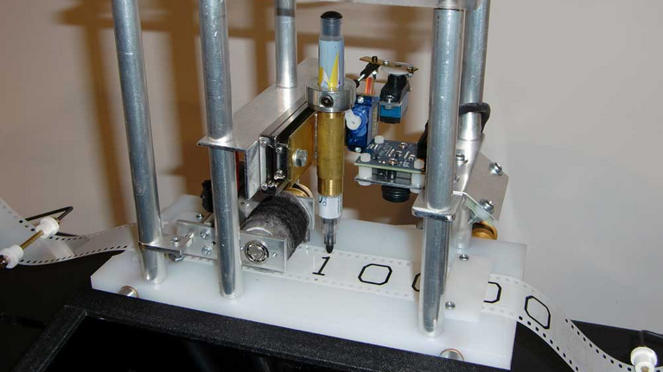
What’s a ‘Thread’?
An entity which exposes 4 properties:
  A single flow of control (sequence of op-codes)
  A program counter marking what’s currently being executed
  An associated execution context (stack, register set, static and dynamic memory, thread local variables, etc.)
  A state (initialized, pending, suspended, terminated, etc.)

Slide 26
Library API for Threads
template <typename F, typename... Args>
std::thread t(F f, Args... args)
  t is a new instance representing a thread executing f with args as its arguments
  Return of f is implicitly exiting (terminating) thread
template <typename F, typename... Args>
std::jthread t(F f, Args... args)
  t is a new instance representing a thread executing f with args as its arguments
  Return of f is implicitly exiting (terminating) thread
  Destructor of thread object t joins implicitly
void (j)thread::join();
  Suspends execution of the calling thread until the target thread terminates
  Does nothing if target thread has already finished running

Slide 27
Threads Example
  int shared_int = 4700;
  void thread_func(int num_thread) {
  std::println("Thread {}, stack {}, shared {} ({})", num_thread,
  &num_thread, &shared_int, ++shared_int);
  }
  int main(int argc, char* argv[]) {
  std::jthread t1(thread_func, 0));
  std::jthread t2(thread_func, 1));
  std::jthread t3(thread_func, 2));
  std::jthread t4(thread_func, 3));
  return 0; // destructors of threads will join implicitly
  }
Thread 3, stack 0x59c01ffae0, shared 0x7ff606ee8000 (4701)
Thread 0, stack 0x59bfeff840, shared 0x7ff606ee8000 (4703)
Thread 2, stack 0x59c00ff700, shared 0x7ff606ee8000 (4702)
Thread 1, stack 0x59bffffb10, shared 0x7ff606ee8000 (4704)

Slide 28
Threads Example
How many threads are in this program?
Does the main thread join with the threads in the same order that they were created?
Do the threads exit in the same order they were created?
If we run the program again, would the result change?

Slide 29
Threads vs. Tasks
// Task
void say_hello(int thread_num) {
std::println("Hello World. I am thread {}", thread_num);
}
int main()
{
std::thread tid[16];
for (int i = 0; i < 16; ++i) // Launch threads ('fork')
tid[i] = std::thread(say_hello, i);
for (int i = 0; i < 16; ++i) // Wait for tasks to finish
tid[i].join();
}

Slide 30
Threads vs. Tasks
// Task
void say_hello(int thread_num) {
std::println("Hello World. I am thread {}", thread_num);
}
int main()
{
std::jthread tid[16];
for (int i = 0; i < 16; ++i) // Launch threads ('fork')
tid[i] = std::jthread(say_hello, i);
} // implicitly join in destructor of thread objects

Slide 31
Threads
// Note: thread functions return void
void calculate_partial_pi(long begin, long end) {
double partial_pi = 0.0;
for (long i = begin; i < end; ++i)
partial_pi += 4.0 / (1.0 + sqr(i * h));
return partial_pi; // oops!
}
int main() {
double h = 1.0 / (double) num_intervals; // Decomposition
double pi = 0.0;
for (int k = 0; k < num_intervals; k += blocksize) {
// how do we get the partial sums here?
pi += h * partial_pi;
}
std::println("pi is approximately {}", pi);
}

Slide 32
Threads
void calculate_partial_pi(long begin, long end, double h, double& pi) {
double partial_pi = 0.0;
for (long i = begin; i < end; ++i)
partial_pi += 4.0 / (1.0 + sqr(i * h));
pi += partial_pi;
}
int main() {
double h = 1.0 / (double) num_intervals; // Decomposition
double pi = 0.0;
std::vector<std::thread> threads;
for (int k = 0; k < num_blocks; ++k) {
threads.push_back(
std::thread(calculate_partial_pi,
k * block_size, (k + 1) * block_size, h, std::ref(pi));
}
for (auto& t : threads) t.join(); // Wait for tasks to finish
std::println("pi is approximately {}", pi);
}
Needs explicit reference!

Slide 33
Threads
double partial_pi: local variable
double& pi: shared variable
pi += partial_pi: update shared variable!
void calculate_partial_pi(long begin, long end, double h, double& pi) {
double partial_pi = 0.0;
for (long i = begin; i < end; ++i)
partial_pi += 4.0 / (1.0 + sqr(i * h));
pi += partial_pi;
}

Slide 34
Finding Concurrency (Decomposition)
void pi_helper(int begin, int end, double h, double& pi) {
for (int i = begin; i != end; ++i)
pi += h * 4.0 / (1 + sqr(i * h));
}
int main() {
int const N = 1'000'000;
double h = 1.0 / N;
std::thread t0 (pi_helper, 0, N/4, h, std::ref(pi));
std::thread t1 (pi_helper, N/4, N/2, h, std::ref(pi)));
std::thread t2 (pi_helper, N/2, 3*N/4, h, std::ref(pi)));
std::thread t3 (pi_helper, 3*N/4, N, h, std::ref(pi)));
t0.joint(); t1.join();
t2.join(); t3.join();
std::println("pi: {}", pi);
}

Slide 35
Threads
void pi_helper(int begin, int end, double h, double& pi) {
for (int i = begin; i != end; ++i)
pi += h * 4.0 / (1 + sqr(i * h));
}
int main() {
int const N = 1'000'000;
double h = 1.0 / N;
std::thread t0 (pi_helper, 0, N/4, h, std::ref(pi));
std::thread t1 (pi_helper, N/4, N/2, h, std::ref(pi)));
std::thread t2 (pi_helper, N/2, 3*N/4, h, std::ref(pi)));
std::thread t3 (pi_helper, 3*N/4, N, h, std::ref(pi)));
t0.joint(); t1.join();
t2.join(); t3.join();
std::println("pi: {}", pi);
}

Slide 36
Race Condition

Slide 37
Synchronization, Mutual Exclusion
std::mutex
  Lock and unlock
  Prone to deadlock
RAII -> std::lock_guard (Resource Acquisition Is Initialization or RAII)
  When created, attempt to take ownership of the mutex it is given
  When control leaves the scope, release the mutex
std::lock
  use a deadlock avoidance algorithm to avoid deadlock
  Can lock multiple std::mutex objects

Slide 38
Mutex
  double pi = 0.0;
  std::mutex mtx;
  void pi_helper(int begin, int end, double h) {
  for (int i = begin; i != end; ++i) {
  mtx.lock();
  pi += h * 4.0 / (1 + sqr(i * h));
  mtx.unlock();
  }
  }
Mutual exclusion region

Slide 39
Mutex
Locking and unlocking at every trip in inner loop
  double pi = 0.0;
  std::mutex mtx;
  void pi_helper(int begin, int end, double h) {
  for (int i = begin; i != end; ++i) {
  mtx.lock();
  pi += h * 4.0 / (1 + sqr(i * h));
  mtx.unlock();
  }
  }
Without mutex
  Fast, but wrong: pi: 0.7194140023700201, time: 53 [ms]
With mutex
  Slow, but correct: pi: 3.141592663590465, time: 3422 [ms]

Slide 40
Mutex
Locking and unlocking at every function call
double pi = 0.0;
std::mutex mtx;
void pi_helper(int begin, int end, double h) {
mtx.lock();
for (int i = begin; i != end; ++i) {
pi += h * 4.0 / (1 + sqr(i * h));
}
mtx.unlock();
}
Without mutex
  Fast, but wrong: pi: 0.7194140023700201, time: 53 [ms]
With mutex
  Correct, but faster: pi: 3.141592663588645, time: 143 [ms]

Slide 41
Mutex
Locking and unlocking at every function call
double pi = 0.0;
std::mutex mtx;
int const N = 1'000'000'000; // really large number
void pi_helper(int begin, int end, double h) {
mtx.lock();
for (int i = begin; i != end; ++i) {
pi += h * 4.0 / (1 + sqr(i * h));
}
mtx.unlock();
}
With mutex:
  Not Correct! pi: 12.221553216452001, time: 5953 [ms]

Slide 42
Aside: Integers
Equivalent type | Width in bits by data model
 | C++ standard | LP32 | ILP32 | LLP64 | LP64
short | at least 16 | 16 | 16 | 16 | 16
unsigned short
int | at least 16 | 16 | 32 | 32 | 32
unsigned int
long | at least 32 | 32 | 32 | 32 | 64
unsigned long
long long | at least 64 | 64 | 64 | 64 | 64
unsigned long long

Slide 43
Aside: Types
template <typename T>
void output_info() {
std::println("{}\t{}\t{}\t{}\t{}", typeid(T).name(), sizeof(T),
8 * sizeof(T), std::numeric_limits<T>::min(), std::numeric_limits<T>::max());
}
int main() {
std::println("Type\tBytes\tBits\tMin\tMax");
output_info<bool>();
output_info<short>();
output_info<unsigned short>();
output_info<int>();
output_info<unsigned int>();
output_info<long>();
output_info<unsigned long>();
output_info<long long>();
output_info<unsigned long long>();
output_info<float>();
output_info<double>();
}
Type Bytes Bits Min Max
bool 1 8 false true
short 2 16 -32768 32767
unsigned short 2 16 0 65535
int 4 32 -2147483648 2147483647
unsigned int 4 32 0 4294967295
long 4 32 -2147483648 2147483647
unsigned long 4 32 0 4294967295
int64 8 64 -9223372036854775808 9223372036854775807
unsigned int64 8 64 0 18446744073709551615
float 4 32 1.1754944e-38 3.4028235e+38
double 8 64 2.2250738585072014e-308 1.7976931348623157e+308

Slide 44
Mutex
Locking and unlocking at every function call
double pi = 0.0;
std::mutex mtx;
int64_t const N = 1'000'000'000; // really large number
void pi_helper(int64_t begin, int64_t end, double h) {
mtx.lock();
for (int64_t i = begin; i != end; ++i) {
pi += h * 4.0 / (1 + sqr(i * h));
}
mtx.unlock();
}
With mutex:
  Correct and fast(er)! pi: 3.1415926545899198, time: 1408 [ms]

Slide 45
Mutex
Locking and unlocking at every function call
double pi = 0.0;
std::mutex mtx;
int64_t const N = 1'000'000'000; // really large number
void pi_helper(int64_t begin, int64_t end, double h) {
mtx.lock();
for (int64_t i = begin; i != end; ++i) {
pi += h * 4.0 / (1 + sqr(i * h));
}
mtx.unlock();
}
With mutex (4 threads):
  Correct and fast! pi: 3.1415926545899198, time: 1408 [ms]
With mutex (1 thread):
  Correct and fast, but does not scale! pi: 3.1415926545899198, time: 1683 [ms]
Mutual exclusion region

Slide 46
Back Where We Started
What happened?
We found concurrency (partitioned the integration)
We had a race because shared (global) variable pi
Protected each update
Too slow
Protected each helper
No longer concurrent
int main()
{
int const N = 1'000'000;
double pi = 0;
for (int i = 0; i != N/4; ++i)
pi += h * 4.0 / (1 + sqr(i * h));
for (int i = N/4; i != N/2; ++i)
pi += h * 4.0 / (1 + sqr(i * h));
for (int i = N/2; i != 3*N/4; ++i)
pi += h * 4.0 / (1 + sqr(i * h));
for (int i = 3*N/4; i != N; ++i)
pi += h * 4.0 / (1 + sqr(i * h));
std::println("pi: {}", pi);
}

Slide 47
Mutex - done right
Locking and unlocking at every function call
  double pi = 0.0;
  std::mutex mtx;
  void pi_helper(int64_t begin, int64_t end, double h)
  {
  double local_pi = 0.0;
  for (int64_t i = begin; i != end; ++i)
  local_pi += h * 4.0 / (1 + sqr(i * h));
  mtx.lock();
  pi += local_pi;
  mtx.unlock();
  }
Very short mutual exclusion region
Mutual exclusion region

Slide 48
Control Number of Threads
Make number of threads configurable:
    std::vector<std::thread> threads;
    int64_t block_size = N / num_blocks;
    for (int n = 0; n != num_blocks; ++n) {
    threads.push_back(
    std::thread(pi_helper, n * block_size, (n + 1) * block_size, h));
    }
    for (int n = 0; n != num_blocks; ++n) {
    threads[n].join();
    }

Slide 49
Results
pi_threads 1000000000 1
pi: 3.1415926545900716, time: 1147 [ms]
pi_threads 1000000000 2
pi: 3.1415926545897657, time: 642 [ms]
pi_threads 1000000000 4
pi: 3.1415926545898416, time: 416 [ms]
pi_threads 1000000000 6
pi: 3.1415926465898822, time: 340 [ms]
pi_threads 1000000000 8
pi: 3.1415926545897808, time: 302 [ms]
Sequential
2 threads, speedup of ~2
4 threads, speedup of ~3
6 threads, speedup of ~4
8 threads, speedup of ~4

Slide 50
Aside: Safe Locking
What we ended up with:
  double pi = 0.0;
  std::mutex mtx;
  void pi_helper(long long begin, long long end, double h) {
  double local_pi = 0.0;
  for (long long i = begin; i != end; ++i)
  local_pi += h * 4.0 / (1 + sqr(i * h));
  mtx.lock();
  pi += local_pi;
  mtx.unlock();
  }
But what if we returned without calling unlock()?
  We wouldn’t be able to acquire the mutex anymore – causing a deadlock

Slide 51
Aside: Safe Locking
C++ allows to guarantee unlocking by introducing types like std::lock_guard:
  double pi = 0.0;
  std::mutex mtx;
  void pi_helper(long long begin, long long end, double h) {
  double local_pi = 0.0;
  for (long long i = begin; i != end; ++i)
  local_pi += h * 4.0 / (1 + sqr(i * h));
        std::lock_guard l(mtx);
  pi += local_pi;
  }
  This type calls lock() in it’s constructor and calls unlock() in it’s destructor
    Destructor is always called when the lock_guard goes out of scope

Slide 52
BTW: Our Example
Protect access to shared variable and printing
    std::mutex mtx;
    void thread_func(int num_thread)
    {
    std::lock_guard l(mtx);
    ++shared_int;
    std::println("Thread {}, stack {}, shared: {} ({})",
    num_thread, static_cast<void*>(&num_thread),
    static_cast<void*>(&shared_int), shared_int);
    }
Critical
section

Slide 53
Parallelize Loops

Slide 54
Parallelize Loops
Sequence of elements:
0
1
2
3
…
N-1
N
  std::vector<int> d = {...};
  std::for_each(d.begin(), d.end(), [](int val) {...});
  template <typename Iterator, typename F>
  void for_each(Iterator b, Iterator e, F f)
  {
  while (b != e)
  f(*b++);
  }

Slide 55
Execution Policies
Standard introduces: std::execution::seq, std:: execution::par, std:: execution::unseq (C++20), std:: execution::par_unseq
  Passed as additional first argument to algorithm
Convey guarantees/requirements imposed by loop body
  seq: execute in-order (sequenced) on current thread
  unseq: allow out-of-order (unsequenced) execution on current thread - vectorization
  par: allow parallel execution on different threads
  par_unseq: allow parallel out-of-order (vectorized) execution on different threads
Proposed for standardization (P0350: Integrating simd with parallel algorithms): std::execution::simd
  Enable explicit vectorization that relies on special C++ types representing vector registers (std::experimental::simd, see: Parallelism TS V2, latest draft: N5001)
HPX introduces:
  Asynchronous policies, e.g. par(task): allow asynchronous operation
  Explicit parallelized vectorization: par_simd
  Executors: attached to execution policies using .on()
See: wg21.link/p0350, wg21.link/n5001

Slide 56
Parallelize Loops
Sequence of elements:
0
1
Core 1
Core 0
2
3
…
N-1
Core M
N
  std::vector<int> d = {...};
  std::for_each(std::execution::par, d.begin(), d.end(), [](int val) {...});
  template <typename Iterator, typename F>
  void for_each(std::execution::parallel_policy, Iterator b, Iterator e, F f) {
  auto size = std::distance(b, e); // Iterator should be random access
  std::vector<std::jthread> v;
  for (size_t chunk = 0; chunk != NUM_CHUNKS; ++chunk) { // assume: cleanly divisible
  v.push_back(std::jthread([&]() { // launch new thread
  auto begin = std::next(b, (chunk * size) / NUM_CHUNKS);
  std::for_each(begin, std::next(begin, size / NUM_CHUNKS), f); // sequential for_each()
  }));
  }
  } // join threads implicitly

Slide 57
Parallelize Loops: Observations
Parallelization concurrently runs sequential operations on parts of the input
  At least for CPU based implementations
  GPU based algorithms are usually different
Iterators should be random access
  Otherwise performance might be bad
NUM_CHUNKS is a magic number!
  How should we select it?
  What are the criteria for best performance?
NUM_CORES is another magic number
AFFINITIES are important too (NUMA awareness!), control task placement

Slide 58
Inter-thread Communication

Slide 59
Condition Variables
Synchronization primitive that is used to notify the other threads in a multithreading environment that the shared resource is free to access
  Defined in #include <condition_variable>
Used in cases where one thread has to wait for another thread execution to continue the work
  For example, the producer-consumer relationship, sender-receiver relationship, etc.
The condition variable makes the calling thread wait until it is notified by the other thread
  It is used with a mutex to block access to the shared resource when one thread is working on it

Slide 60
Condition Variables
wait(lock, pred)
  Causes the current thread to block until the condition variable is notified and as long as the given predicate function returns false
notify_one()
  If any threads are waiting on this condition_variable, calling notify_one unblocks one of the waiting threads
notify_all()
  Unblocks all threads currently waiting for this condition_variable

Slide 61
Condition Variables
    // mutex to block threads
    std::mutex mtx;
    std::condition_variable cv;
    bool data_ready = false;
    int data = 0;
    void producer();
    void consumer();
    int main() {
    std::thread consumer_thread(consumer);
    std::thread producer_thread(producer);
    consumer_thread.join();
    producer_thread.join();
    return 0;
    }

Slide 62
Condition Variables
Consumer waits for producer to call notify_one() after having provided the data:
    void consumer()
    {
    // locking
    std::unique_lock lock(mtx);
    // waiting
    cv.wait(lock, []() { return data_ready; });
    std::println("Data received: {}!", data);
    }

Slide 63
Condition Variables
Producer sets data and then calls notify_all()/notify_one():
    void producer()
    {
    // lock release
    std::lock_guard lock(mtx);
    data = 42; // set data
    data_ready = true; // variable to avoid spurious wakeup
    // logging notification to console
    std::println("Data sent: {}!", data);
    // notify consumer when done
    cv.notify_one();
    }

Slide 64
Creating a Threadpool

Slide 65
Threadpool Declaration
class thread_pool { // Class that represents a simple thread pool
public:
// Constructor to create a thread pool with given number of threads
thread_pool(size_t num_threads = std::thread::hardware_concurrency());
~thread_pool(); // Destructor to stop the thread pool
void enqueue(std::function<void()> task); // Enqueue task for execution by the pool
private:
std::vector<std::jthread> threads_; // Vector to store worker threads
std::queue<std::function<void()>> tasks_; // Queue of tasks
// Condition variable to signal changes in the state of the task queue
std::condition_variable cv_;
std::mutex queue_mutex_; // Mutex to synchronize access to shared data
bool stop_ = false; // Flag to indicate whether the thread pool should stop or not
};

Slide 66
Threadpool Definition
// Constructor to create a thread pool with given number of threads
thread_pool(size_t num_threads) {
// Function that is executed by each of the threads in the pool
auto thread_func = [this]() {
while (true) {
// pull tasks from queue and execute them
// ...
}
};
// Create worker threads
for (size_t i = 0; i < num_threads; ++i)
threads_.push_back(std::jthread(thread_func));
}

Slide 67
Threadpool Definition
// Function that is executed by each of the threads in the pool
auto thread_func = [this]() {
while (true) {
std::function<void()> task;
{
// Locking the queue so that data can be shared safely
std::unique_lock lock(queue_mutex_);
// Wait until there is a task to execute or the pool is stopped
cv_.wait(lock, [this] { return !tasks_.empty() || stop_; });
// exit the thread in case the pool is stopped and there are no tasks
if (stop_ && tasks_.empty()) return;
task = tasks_.front(); tasks_.pop(); // Get the next task from the queue
}
task(); // execute the task
}
};

Slide 68
Threadpool Definition
// Enqueue task for execution by the thread pool
void enqueue(std::function<void()> task)
{
{
std::unique_lock lock(queue_mutex_);
tasks_.push_back(task);
}
cv_.notify_one();
}

Slide 69
Threadpool Definition
// Destructor to stop the thread pool
~thread_pool()
{
{
// Lock the queue to update the stop flag safely
std::unique_lock lock(queue_mutex_);
stop_ = true;
}
// Notify all threads
cv_.notify_all();
}

Slide 70
Threadpool Example
int main() {
// Create a thread pool with 4 (OS-) threads
thread_pool pool(4);
// Enqueue tasks for execution
for (int i = 0; i < 50; ++i) {
pool.enqueue([i]() {
std::println("Task {} is running on thread {}",
i, std::this_thread::get_id());
// Simulate some work
std::this_thread::sleep_for(std::chrono::milliseconds(100));
});
}
return 0;
}

Slide 71
Parallelize Loops (Threadpool)
Sequence of elements:
0
1
Core 1
Core 0
2
3
…
N-1
Core M
N
  std::vector<int> d = {...};
  for_each(thread_pool(4), d.begin(), d.end(), [](int val) {...});
  template <typename Iterator, typename F>
  void for_each(thread_pool pool, Iterator b, Iterator e, F f) {
  auto size = std::distance(b, e); // Iterator should be random access
  for (size_t chunk = 0; chunk != NUM_CHUNKS; ++chunk) { // assume: cleanly divisible
  pool.enqueue([&]() { // launch tasks
  auto begin = std::next(b, (chunk * size) / NUM_CHUNKS);
  std::for_each(begin, std::next(begin, size / NUM_CHUNKS), f); // sequential for_each()
  });
  }
  pool.wait(); // join tasks explicitly
  }

Slide 72
Conclusion
Threads are the OS unit of concurrency
  Abstraction of a virtual CPU core
  Can use std::jthread, etc., to manage threads within a process
  They share data → need synchronization to avoid data races
Synchronization can be achieved using different primitives
  std::mutex
  std::condition_variable
  std::counting_semaphore, std::binary_semaphore
  ...

Slide 73
