Slide 1
Data Parallelism (1)
Lecture 12
Hartmut Kaiser
https://teaching.hkaiser.org/spring2025/csc4700/

Slide 2
Today’s Theme
You are now accustomed to thinking about parallel programming in terms of “what workers do” and “assigning work to workers”
Today I would like you to think about describing algorithms in terms of operations on sequences of data
map
filter
fold / reduce
scan / segmented scan
Main idea: high-performance parallel implementations of these operations exist
So programs written in terms of these primitives can often run efficiently on a parallel machine (if you can avoid being bandwidth bound)
sort
group_by
join
partition / flatten

Slide 3
Motivation
Why must an application expose large amounts of parallelism?
Utilize large numbers of cores
High-core count machines
Many machines (e.g., cluster of machines in the cloud)
SIMD processing + multi-threaded cores require even more parallelism
GPU architectures require very large amounts of parallelism

Slide 4
Understanding Dependencies is Key
Key part of parallel programming is understanding when dependencies exist between operation
Lack of dependencies implies potential for parallel execution
a b
+
7
*
x = a + b;
y = b * 7;
z = (x-y) * (x+y);
-
+
*
z

Slide 5
Data-Parallel Model
Organize computation as operations on sequences of elements
e.g., perform same function on all elements of a sequence
Helps decoupling steps in computation
Data parallelism is parallelization across multiple processors in parallel computing environments
It focuses on distributing the data across different computational units, which operate on the data in parallel
A well-known modern example:
Numpy: C = A + B (A, B, and C are vectors of same length)
We will look at various algorithms that work on ranges of elements
Many common problems can be solved by applying some of these algorithms

Slide 6
Data-Parallel Model
Data parallelism | Task parallelism
Same operations are performed on different subsets of same data | Different operations are performed on the same or different data
Synchronous computation | Asynchronous computation
Speedup is more as there is only one type of execution thread operating on all sets of data | Speedup is less as each processor will execute a different thread or process on the same or different set of data
Amount of parallelization is proportional to the input data size | Amount of parallelization is proportional to the number of independent tasks to be performed
Designed for optimum load balance on multi processor system | Load balancing depends on the availability of the hardware and scheduling algorithms like static and dynamic scheduling

Slide 7
Key Data Type: Sequences
Collection of elements
In C++: vector<T> (actually any C++ container)
Similar constructs exist in other programming languages:
Scala lists: List[T]
Python: Pandas Dataframes, Numpy arrays
In a functional language (like Haskell): seq T
Etc.
Important: data-parallel programs only access elements of a sequence through specific operations, not direct element access
C++: Iterators

Slide 8
Map
3
8
4
6
3
9
2
8
Higher order function (function that takes a function as an argument)
Applies side-effect free unary function f :: a -> b to all elements of input sequence, producing an output sequence of the same length
In a functional language (e.g., Haskell):
map :: (a -> b) -> seq a -> seq b
In C++:
template <typename InputIt, typename OutputIt,
typename UnaryOp>
OutputIt transform(
InputIt first1, InputIt last1,
OutputIt d_first, UnaryOp unary_op);
map f
13 18 14 16 13 19 12 18
3 8 4 6 3 9 2 8
f f f f f f f f
C++
int f(int x) { return x + 10; }
13
18
14
16
13
19
12
18
int a[] = {3, 8, 4, 6, 3, 9, 2, 8};
int b[8];
std::transform(a, a+8, b, f);
Produces:
{13, 18, 14, 16, 13, 19, 12, 18};
Output start iterator
Input end iterator Input start iterator

Slide 9
Parallelizing Map
Since f :: a -> b is a side-effect free function, applying f to all elements of the sequence can be performed
In any order without changing the output of the program
Therefore, the implementation of map has the flexibility to reorder/parallelize processing of elements of the sequence however it sees fit
Side-effect free → no multi-threading issues!
map f s =
partition sequence s into P smaller subsequences s_i
for each subsequence s_i (in parallel)
out_i = map f s_i
out = concatenate out_i’s

Slide 10
Parallelizing Map
Sequence of elements:
0
1
Core 1
Core 0
2
3
…
N-1
Core M
N
std::vector<int> d = {...}, target(size);
std::transform(std::execution::par, d.begin(), d.end(), target.begin(), [](int val) {...});
template <typename InIter, typename OutIter, typename F>
void transform(std::execution::parallel_policy, InIter b, InIter e, OutIter dest, F f)
{
auto size = std::distance(b, e); // Iterator should be random access
std::vector<std::jthread> v;
for (size_t chunk = 0; chunk != NUM_CHUNKS; ++chunk) { // assume: cleanly divisible
v.push_back(std::jthread([=]() { // launch new thread for each chunk
auto begin = std::next(b, (chunk * size) / NUM_CHUNKS);
std::transform(begin, std::next(begin, size / NUM_CHUNKS),
std::next(dest, (chunk * size) / NUM_CHUNKS), f); // sequential transform()
}));
}
} // join threads implicitly

Slide 11
Fold (fold left)
Apply binary operation op to each element and an accumulated value
Seeded by initial value T init
template <typename InputIt, typename T, typename BinaryOp>
T reduce(InputIt first, InputIt last, T init, BinaryOp op);
std::vector<int> numbers = {3, 8, 4, 6, 3, 9, 2, 8};
int sum = std::ranges::reduce(numbers, 10);
std::println("Sum: {}", sum); // Outputs: Sum: 53

Slide 12
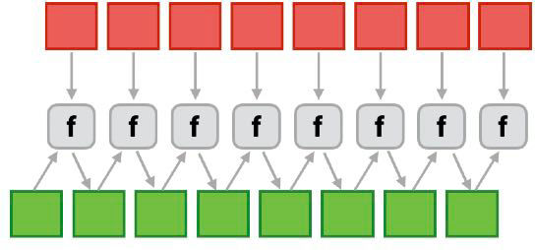
Parallel Fold (fold left)
Apply f to each element and an accumulated value
In addition to binary function f, also need an additional binary “combiner” function (no need for comb if f is an associative function)
Seeded by initial value of type b (must be identity for f and comb)
in
in
in
in
comb
comb
comb

Slide 13
Parallel Fold (fold left)
In C++:
template <typename ExecutionPolicy, typename ForwardIt, typename T>
T reduce(ExecutionPolicy&& policy,
ForwardIt first, ForwardIt last, T init); // uses std::plus<T>
template <typename ExecutionPolicy, typename ForwardIt, typename T,
typename BinaryOp>
T reduce(ExecutionPolicy&& policy,
ForwardIt first, ForwardIt last, T init, BinaryOp op);
std::vector<int> numbers = {3, 8, 4, 6, 3, 9, 2, 8};
int sum = std::reduce(std::execution::par, numbers.begin(), numbers.end(), 10);
std::println("Sum: {}", sum); // Outputs: Sum: 53

Slide 14
Scan
3
8
4
6
3
9
2
8
Given input, produce output where:
$output[i] = input[0]⊕input[1]⊕…⊕input[i]$
Where $⊕$: associative operator (not necessarily commutative)
Running totals: $y_{0}=x_{0}$, $y_{1}=y_{0}+x_{1}$, $y_{2}=y_{1}+x_{2}$, …
Example (using operator +):
Input: [6 4 16 10 16 14 2 8]
Output: [6 10 26 36 52 66 68 76]
Sequential scan:
inclusive_scan(float in[], float out[], int N) {
out[0] = in[0];
for (i = 1; i < N; ++i) out[i] = out[i-1] + in[i];
}
Does not seem parallelizable
Work: $O\left(n\right)$ - total operations performed
Span: $O(n)$ - longest chain of sequential steps
This algorithm is sequential, but a different algorithm has Work: $O(n)$, Span: $O(log⁡n)$
inclusive_scan +
3
11
15
21
24
33
35
43

Slide 15
Inclusive Scan
float op(float a, float b) { … }
inclusive_scan(float in[], float out[], int N) {
out[0] = in[0];
for (i = 1; i < N; ++i)
out[i] = op(out[i-1], in[i]);
}
In C++:
template <typename InputIt, typename OutputIt, typename BinaryOp>
OutputIt inclusive_scan(InputIt first, InputIt last,
OutputIt d_first, BinaryOp op); // op defaults to std::plus<>
template <typename InputIt, typename OutputIt, typename BinaryOp, typename T>
OutputIt inclusive_scan(InputIt first, InputIt last,
OutputIt d_first, BinaryOp op, T init);

Slide 16
Exclusive Scan
Alternative form: “exclusive scan”: out[i] is the scan result for all elements up to, but excluding, in[i]:
Running totals: $y_{0}=0$, $y_{1}={y_{0}+x}_{0}$, $y_{2}=y_{1}+x_{1}$, …
float op(float a, float b) { … }
exclusive_scan(float in[], float out[], int N, float init) {
out[0] = init;
for (i = 1; i < N; ++i)
out[i] = op(out[i-1], in[i-1]);
}
In C++:
template <typename InputIt, typename OutputIt, typename T, typename BinaryOp>
OutputIt exclusive_scan (InputIt first, InputIt last,
OutputIt d_first, T init, BinaryOp op);

Slide 17
Scan
Scan is a pattern that arises in many, many problems
Examples:
Running minimum or maximum of all elements to the left of i^{th}
Is there an element to the left of i^{th} element satisfying some property?
Count of elements to the left of i^{th} element satisfying some property
This last one is perfect for an efficient parallel pack (filter)…
Perfect for building on top of the “parallel prefix trick”
Generating row-indices for CSR/CSC matrix format
Find the number of subarrays with a specific sum
… and many other interview questions can be handled by applying a (variation) of a scan algorithm

Slide 18
Parallel Scan

Slide 19
Data-Parallel Scan
let $A = [a0, a1, a2, …, an]$
let $⊕$ be an associative binary operator with identity element $I$
$$inclusive_scan(⊕, A) = [a0, a0 ⊕ a1, a0 ⊕ a1 ⊕a2, … ]$$
$$exclusive_scan(⊕, A) = [I, a0, a0 ⊕ a1, … ]$$
If operator is $+$, then $inclusive_scan(+,A)$ is called “a prefix sum”:
$$prefix_sum(A) =[a0, a0+a1, a0 +a1 +a2, … ]$$

Slide 20
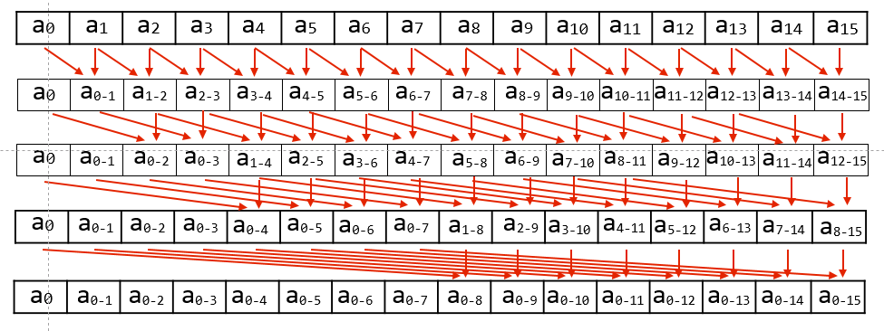
Data-Parallel Inclusive Scan
Inefficient compared to sequential algorithm:
Total operations performed: $O(N log⁡N)$
Longest chain of sequential steps: $O(log⁡N)$

Slide 21
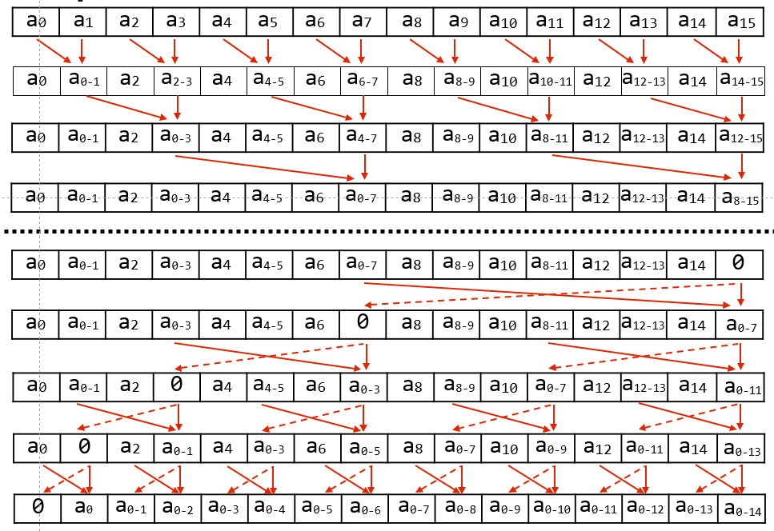
Work-efficient Parallel Exclusive Scan ($O(N)$ work, $O(LogN)$ span)

Slide 22
Work efficient exclusive Scan Algorithm
Up-sweep:
for d=0 to (log₂n - 1) do
forall k=0 to n-1 by 2^{d+1} do
a[k + 2^{d+1} - 1] = a[k + 2^{d-1}] + a[k + 2^{d+1} - 1]
Down-sweep:
x[n-1] = 0
for d=(log₂n - 1) down to 0 do forall k=0 to n-1 by 2^{d+1} do
tmp = a[k + 2^{d} - 1]
a[k + 2^{d} - 1] = a[k + 2^{d+1} - 1]
a[k + 2^{d+1} - 1] = tmp + a[k + 2^{d+1} - 1]
(with ⊕ = “+”)
Work: $O(N)$
Span: $O(log⁡N)$
Locality: ??

Slide 23
Now consider Scan Implementation on just two Cores
P1
P2

Slide 24
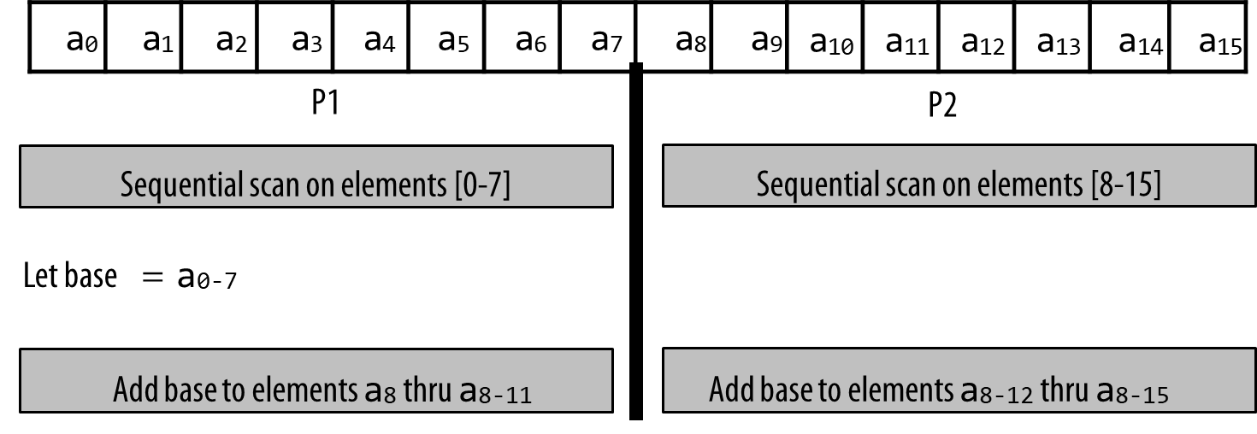
Scan: Two Processor Implementation
Work: $O(N)$ (but constant is now only 1.5)
Data-access:
Very high spatial locality (contiguous memory access)
P1’s access to a₈ through a₈₋₁₁ may be more costly on large core count system with non-uniform memory access costs, but on small-scale
On multi-core system the access cost is likely almost the same as from P2

Slide 25
Scan Implementation
Parallelism
Scan algorithm features $O(N)$ parallel work
But efficient implementations only leverage as much parallelism as required to make good utilization of the machine
Goal is to reduce work and reduce communication/synchronization
Locality
Multi-level implementation to match memory hierarchy
(CUDA example: per-block implementation carried out in local memory)
Heterogeneity in algorithm
Different strategy for performing scan at different levels of the machine
CUDA example: different algorithm for intra-warp scan than inter-thread scan
Low-core count CPU example: based largely on sequential scan

Slide 26
Parallel Segmented Scan

Slide 27
Segmented Scan
Common problem: operating on a sequence of sequences
Examples:
For each vertex v in a graph
For each edge e connected to v
For each particle p in a simulation
For each particle within distance D of p
For each document d in a collection
For each word in d
There are two levels of parallelism in the problem that a programmer might want to exploit
But it is irregular: the size of edge lists, particle neighbor lists, words per document, etc,
May be very different from vertex to vertex (or particle to particle)
Parallelization over subsequences may not scale well

Slide 28
Segmented Scan
Generalization of scan
Simultaneously perform scans on contiguous partitions of input sequence
let $A = [\left[1, 2\right],\left[6\right],[1,2,3,4]]$
let $⊕$ be +
$$segmented_exclusive_scan(⊕, A) = [[0,1], [0], [0,1,3,6]]$$
Assume a simple “start-flag” representation of nested sequences:
Consider nested sequence: $A = [[1, 2, 3],[4, 5, 6, 7, 8]]$
Flag: 1 0 0 1 0 0 0 0
Data: 1 2 3 4 5 6 7 8

Slide 29
Segmented Scan
Instead of applying $⊕$ to data $A$:
$exclusive_scan(⊕, A) = [I, a0, a0 ⊕ a1, … ]$
Apply $⊕$ to pairs of input (data $A$ and flag $F$):
$exclusive_scan(⊕, \left\langle \begin{matrix}A \\ F\end{matrix}\right\rangle ) = [I,\left\langle \begin{matrix}a0 \\ f_{0}\end{matrix}\right\rangle ,\left\langle \begin{matrix}a0 \\ f_{0}\end{matrix}\right\rangle ⊕\left\langle \begin{matrix}a_{1} \\ f_{1}\end{matrix}\right\rangle , … ]$
Where: $\left\langle \begin{matrix}a_{i} \\ f_{i}\end{matrix}\right\rangle ⊕\left\langle \begin{matrix}a_{k} \\ f_{k}\end{matrix}\right\rangle =\left\langle \begin{matrix}a_{i}×\overline{f_{i}}⊕a_{k} \\ f_{i}∨f_{k}\end{matrix}\right\rangle$ $\overline{{ f}_{i}}$: ‘not’ $f_{i}$
If flag is zero: inner element, i.e. do normal scan operation
If flag is non-zero: start a new scan operation
Then the upper row of result will represent segmented scan result

Slide 30
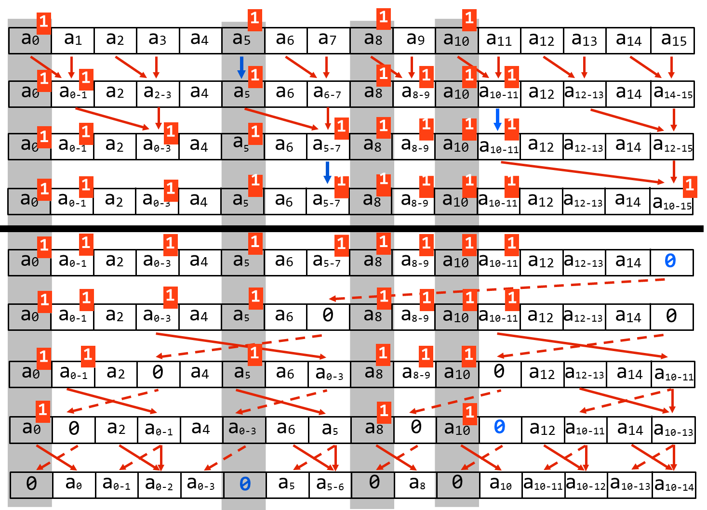
Segmented Scan (exclusive)

Slide 31
Work-efficient segmented Scan
Up-sweep:
for d=0 to (log₂n - 1) do:
forall k=0 to n-1 by 2^{d+1} do:
if flag[k + 2^{d+1} - 1] == 0:
data[k + 2^{d+1} - 1] = data[k + 2^{d} - 1] + data[k + 2^{d+1} - 1]
flag[k + 2^{d+1} - 1] = flag[k + 2^{d} - 1] || flag[k + 2^{d+1} - 1]
(with ⊕ = “+”)
Down-sweep:
data[n-1] = 0
for d=(log₂n - 1) down to 0 do:
forall k=0 to n-1 by 2^{d+1} do:
tmp = data[k + 2^{d} - 1]
data[k + 2^{d} - 1] = data[k + 2^{d+1} - 1]
if flag_original[k + 2^{d}] == 1: # must maintain copy of original flags
data[k + 2^{d+1} - 1] = 0 # start of segment
else if flag[k + 2^{d} - 1] == 1:
data[k + 2^{d+1} - 1] = tmp
else:
data[k + 2^{d+1} - 1] = tmp + data[k + 2^{d+1} - 1]
flag[k + 2^{d} - 1] = 0

Slide 32
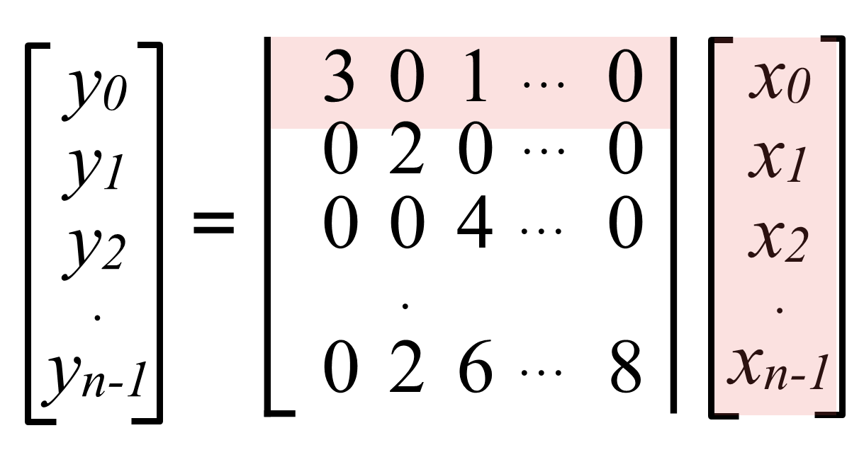
Sparse Matrix Multiplication
Most values in matrix are zero
Note: easy parallelization by parallelizing the different per-row dot products
But different amounts of work per row (complicates wide SIMD execution)
Example sparse storage format: compressed sparse row
$values = [ [3, 1], [2], [4], …, [2, 6, 8] ]$
$cols = [ [0, 2], [1], [2], …., ]$
$row_starts = [0, 2, 3, 4, … ]$

Slide 33
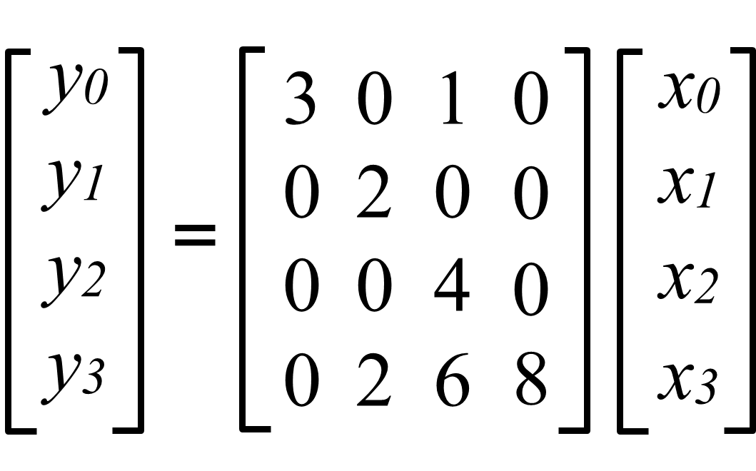
Sparse Matrix Multiplication with Scan
Example:
$x = [x0,x1,x2,x3]$
$values = [ [3, 1], [2], [4], [2, 6, 8] ]$
$cols = [ [0,2], [1], [2], [1,2,3] ]$
$row_starts = [0, 2, 3, 4]$
Map over all non-zero values: $products[i] =values[i]∗x[cols[i]]$
products = [3$x0$, $x2$, 2$x1$, 4$x2$, 2$x1$, 6$x2$, 8$x3$]
Create flags vector from $row_starts$: $flags=[1, 0, 1, 1, 1, 0, 0]$
Perform inclusive segmented-scan on (products, flags) using addition operator
$[3x0, 3x0+x2, 2x1, 4x2, 2x1, 2x1+6x2, 2x1+6x2+8x3]$
Take last element in each segment:
$y = [3x0+x2, 2x1, 4x2 , 2x1+6x2+8x3]$
gather(x, cols)

Slide 34
