Slide 1
Data Parallelism (2)
Lecture 13
Hartmut Kaiser
https://teaching.hkaiser.org/spring2025/csc4700/

Slide 2
Today’s Theme (cont.)
You are now accustomed to thinking about parallel programming in terms of “what workers do” and “assigning work to workers”
Today I would like you to think about describing algorithms in terms of operations on sequences of data
map
filter
fold / reduce
scan / segmented scan
Main idea: high-performance parallel implementations of these operations exist
So programs written in terms of these primitives can often run efficiently on a parallel machine (if you can avoid being bandwidth bound)
sort
group_by
join
partition / flatten

Slide 3
Key Data Type: Sequences
Collection of elements
In C++: vector<T> (actually any C++ container)
Similar constructs exist in other programming languages:
Scala lists: List[T]
Python: Pandas Dataframes, Numpy arrays
In a functional language (like Haskell): seq T
Etc.
Important: data-parallel programs only access elements of a sequence through specific operations, not direct element access
C++: Iterators

Slide 4
Other Key Data-parallel Operations
gather(index, input, output)
output[i] = input[index[i]]
scatter(index, input, output)
output[index[i]] = input[i]

Slide 5
Key Data-Parallel Operations
output_seq = gather(index_seq, data_seq)
“Gather data from data_seq according to indices in index_seq”

Slide 6
Gather Operation
void gather()
{
std::vector<double> elements = {1., 2., 3., 4., 5., 6., 7., 8.};
std::vector<int> indices = {1, 0, 3, 5, 4, 6};
std::vector<double> gathered;
std::ranges::transform(
indices, std::back_inserter(gathered),
[&](int idx) { return elements[idx]; });
// gathered: {2., 1., 4., 6., 5., 7.}
return 0;
}

Slide 7
Key Data-Parallel Operations
output_seq = scatter(index_seq, data_seq)
“Scatter data from data_seq according to indices in index_seq”

Slide 8
Aside: Zip Iterator
The zip_iterator allows to iterate over more than one sequence at the same time
It is initialized from a list of iterators, one for each of the sequences to combine
When incremented, it increments all iterators it refers to
When decremented, it decrements all iterators it refers to
When compared with another zip_iterator, it compares all iterators it refers to pair-wise with the iterators of the other zip_iterator
When dereferenced, it dereferences all iterators it refers to an returns a tuple of those results.
Iteration will stop once the first iterator reaches the end of its sequence

Slide 9
Aside: Zip Iterator
A C++ zip iterator allows you to iterate over multiple ranges simultaneously:
template <typename R1, typename R2, typename... Rs>
auto zip(R1&& r1, R2&& r2, Rs&&... rs) {
return iterator_range(
zip_iterator(r1.begin(), r2.begin(), rs.begin()...),
zip_iterator(r1.end(), r2.end(), rs.end()...));
}
int main() {
std::vector<char> vec1{'r', 'n', 'e'};
std::vector<char> vec2{'a', 'g', 's'};
// Example usage of zip_iterator
for (auto [ch1, ch2] : zip(vec1, vec2))
std::println("({}, {})", ch1, ch2);
}

Slide 10
Aside: Zip Iterator (Simplified)
template <typename It1, typename It2>
struct zip_iterator
{
zip_iterator(It1 iter1, It2 iter2) : it1(iter1), it2(iter2) {}
friend bool operator==(zip_iterator const& lhs, zip_iterator const& rhs)
{
return lhs.it1 == rhs.it1 || lhs.it2 == rhs.it2;
}
auto operator*() { return std::make_tuple(*it1, *it2); } // dereference
zip_iterator& operator++() { ++it1; ++it2; return *this; } // pre-increment
zip_iterator operator++(int) { // post-increment
zip_iterator tmp = *this;
++it1; ++it2;
return tmp;
}
It1 it1; It2 it2;
};

Slide 11
Scatter Operation
void scatter()
{
std::vector<double> elements = {1., 2., 3., 4., 5., 6., 7., 8.};
std::vector<int> indices = {1, 0, 7, 2};
std::vector<double> scattered(elements.size(), 0.0);
std::ranges::for_each(
zip(indices, elements),
[&](std::tuple<int, double> val) {
scattered[std::get<0>(val)] = std::get<1>(val);
});
// scattered: {2., 1., 4., 0., 0., 0., 0., 3.}
return 0;
}

Slide 12
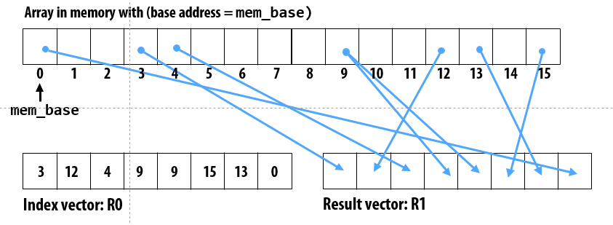
Scatter/Gather Machine Instructions
gather(R1, R0, mem_base);
“Gather from buffer mem_base into R1 according to indices specified by R0.”
Gather/scatter SIMD instruction exist in AVX512
Hardware supported gather/scatter exists on GPUs.

Slide 13
More Sequence Operations: Sort
Sort
Sort elements in sequence based on given ordering criteria
In C++:
template <typename RandomIt, typename Compare>
void sort (RandomIt first, RandomIt last, Compare comp); // defaults to std::less<>
template <typename RandomIt, typename Compare>
void stable_sort (RandomIt first, RandomIt last, Compare comp);
C++ also has parallel (stable-)sort:
template <typename ExPolicy, typename RandomIt>
void sort (ExPolicy policy, RandomIt first, RandomIt last);

Slide 14
Turning a Scatter into Sort/Gather
Special case:
assume elements of index are unique and
all elements are referenced in index (scatter is a permutation)
For each index element: output[index[i]] = input[i]
scatter(index, input, output) {
output = sort input sequence by values in index sequence
}
index: input:
0 2 1 4 3 6 7 5
3 8 4 6 3 9 2 8
input (sorted by index):
3 4 8 3 6 8 9 2

Slide 15
Turning a Scatter into Sort/Gather
template <typename Range1, typename Range2, typename Iter>
void scatter_sort(Range2 const& index, Range2 const& input, Iter output)
{
std::ranges::copy(input, output);
std::ranges::sort(
zip(index, output),
[](auto const& l, auto const& r) {
return get<0>(l) < get<0>(r);
});
}
May be faster than naïve implementation because of spatial locality

Slide 16
More Sequence Operations: Filter
Filter
Produce a sequence of elements that match predicate
In C++:
template <typename ForwardIt, typename UnaryPred>
ForwardIt copy_if (ForwardIt first, ForwardIt last, UnaryPred p);
remove_copy_if does the opposite, otherwise equivalent
3
8
4
6
3
9
2
8
filter f
8
4
6
2
8
Assume f() filters elements whose value is odd

Slide 17
Filter
Given an array input, produce an array output containing only elements such that f(element) is true
Example:
Input: [17, 4, 6, 8, 11, 5, 13, 19, 0, 24]
f: “element > 10”
Output: [17, 11, 13, 19, 24]
Standard algorithm copy_if:
template <typename ForwardIt, typename OutIt, typename UnaryPred>
ForwardIt copy_if(ForwardIt first, ForwardIt last, OutIt dest, UnaryPred p) {
for (ForwardIt i = first; i != last; ++i) {
if (p(*i)) // retain elements that do match predicate
*dest++ = *i;
}
return dest;
}

Slide 18
Parallel Filter
Parallelizable?
Determining whether an element belongs in the output is easy
But determining where an element belongs in the output is hard; seems to depend on previous results….
Solution:
Step 1: parallel map to compute a bit-vector for true elements:
Input: [17, 4, 6, 8, 11, 5, 13, 19, 0, 24]
Bits: [ 1, 0, 0, 0, 1, 0, 1, 1, 0, 1]
Step 2: parallel scan on the bit-vector (gives desired position in output):
Bitsum: [ 1, 1, 1, 1, 2, 2, 3, 4, 4, 5]
Step 3: parallel map to produce the output:
Output: [17, 11, 13, 19, 24]

Slide 19
Parallel Filter
void data_parallel_copy_if()
{
std::vector<double> elements = {1., 2., 3., 4., 5., 6., 7., 8.};
// map to compute a bit-vector for elements not matching predicate
std::vector<char> flags(elements.size());
std::transform(
first, last, flags.begin(), [](double val) { return val > 3.; });
// scan on the bit-vector (gives desired position in output)
std::vector<char> bitsum(elements.size());
std::inclusive_scan(flags.begin(), flags.end(), bitsum.begin());
// map to produce the output (gather)
std::vector<double> output(bitsum.back());
std::ranges::for_each(zip(bitsum, elements),
[&](auto curr) { output[std::get<0>(curr) - 1] = std::get<1>(curr); });
}

Slide 20
Parallel Filter
First two steps can be combined into one pass
Just using a different base case for the scan
No effect on asymptotic complexity
Can also combine third step into the down pass of the scan
Again no effect on asymptotic complexity
Analysis: $O(N)$ work
2 or 3 passes, but 3 is a constant

Slide 21
Implementing scatterOp with atomic sort/map/segmented-scan
Now, assume elements in index are not unique, so synchronization is required for atomicity!
Example: $index = [1, 1, 0, 2, 0, 0]$
Step 1: Sort input sequence according to values in index sequence
Sorted index: $[0, 0, 0, 1, 1, 2]$
Input sorted by index: $[input[2], input[4], input[5], input[0], input[1], input[3]]$
Step 2: Compute starts of each range of values with the same index number
starts: [1, 0, 0, 1, 0, 1]
Step 3: Segmented scan (using ‘op’) on each range
$[op(op(input[2], input[4]), input[5]), op(input[0], input[1]), input[3])]$
for all elements in sequence
output[index[i]] = atomic_op(output[index[i]], input[i])
Example: atomicAdd(output[index[i]], input[i])

Slide 22
More Sequence Operations: Exercise
Group by key
Creates a sequence of sequences containing elements with the same key
Reduce by key
Creates pairs of values consisting of key and reduced result for corresponding values
Sort by key
As group by key, but the sequences are sorted
Etc.
1,3
2,8
2,4
1,6
3,3
1,9
1,2
2,8
group by key
1,
2,
3,
3
6
9
2
8
4
8
3

Slide 23
Scan/Segmented Scan Summary
Scan
Parallel implementation of (intuitively sequential application)
Theory: parallelism in problem is linear in number of elements
Practice: exploit locality, use only as much parallelism as necessary to fill the machine’s execution resources
Great example of applying different strategies at different levels of the machine
Segmented scan
Express computation and operate on irregular data structures (e.g., list of lists) in a regular, data parallel way

Slide 24
Examples
Grid of Particles

Slide 25
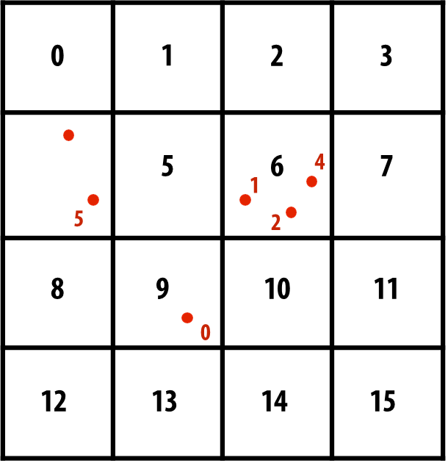
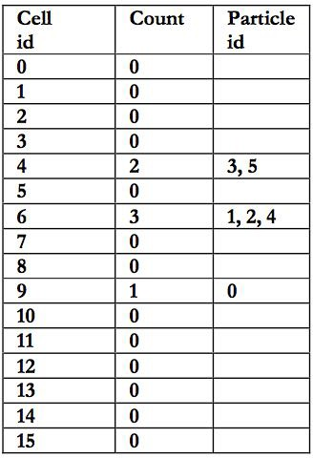
Example: Create Grid of Particles Data Structure
Problem: place 1M point particles in a 16-cell uniform grid based on 2D position
Parallel data structure manipulation problem: build a 2D array of lists

Slide 26
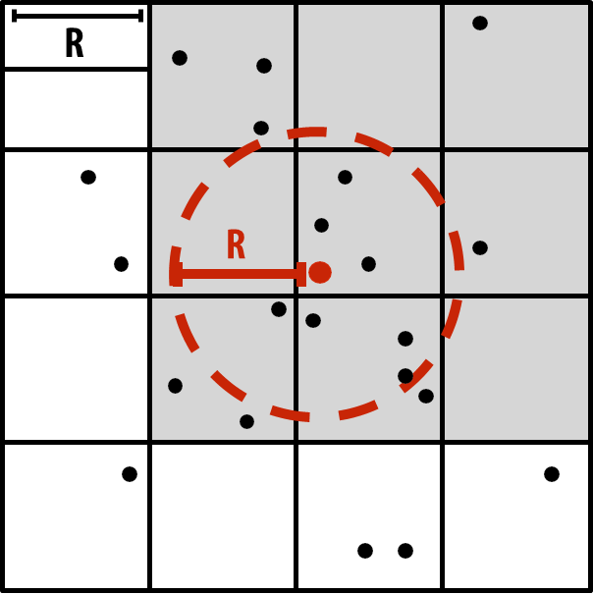
Common use of this Structure: N-Body Problems
A common operation is to compute interactions with neighboring particles
Example: given a particle, find all particles within radius R
Organize particles by placing them in grid with cells of size R
Only need to inspect particles in surrounding grid cells
N-Body problems require to compute pairwise forces between each pair of points
Creating a mesh of points allows to reduce amount of required coputations

Slide 27
Create Grid of Particles Data Structure
// one particle
struct point
{
double x;
double y;
};
// a cell containing particles struct cell
{ point upper_left;
point lower_right;
std::vector<point> points;
};
// the whole mesh (list of cells)
struct mesh
{
size_t size_x = 0;
size_t size_y = 0;
std::vector<cell> cells;
};
// calculate the index of the cell for pt
size_t find_cell_index(
point const& pt, mesh const& m)
{
size_t pos_x = size_t(pt.x * m.size_x);
size_t pos_y = size_t(pt.y * m.size_y);
return pos_y * size_x + pos_x;
}

Slide 28
Sequential Implementation
double fill_mesh_sequentially(
std::vector<point> const& points, size_t num_cells_x, size_t num_cells_y)
{
mesh m(num_cells_x, num_cells_y);
timer t;
t.start();
for (point const& p : points)
{
size_t idx = find_cell_index(p, m);
m.cells[idx].points.push_back(p);
}
t.stop();
return t.elapsed();
}

Slide 29
Solution 1: Parallelize over Particles
One answer: assign one particle to each thread. Each thread computes cell containing particle, then atomically updates per cell list.
Massive contention: thousands of threads contending for access to update single shared data structure
list cell_list[16]; lock cell_list_lock;
// 2D array of lists
for each particle p // in parallel c = compute cell containing p lock(cell_list_lock)
append p to cell_list[c] unlock(cell_list_lock)

Slide 30
Solution 1: Parallelize over Particles
double fill_mesh_parallel_v1(
std::vector<point> const& points, size_t num_cells_x, size_t num_cells_y)
{
mesh m(num_cells_x, num_cells_x); timer t; t.start();
hpx::mutex mtx;
hpx::ranges::for_each(hpx::execution::par, points, [&](point const& p) {
size_t idx = find_cell_index(p, m);
std::lock_guard l(mtx);
m.cells[idx].points.push_back(p);
});
t.stop(); return t.elapsed();
}

Slide 31
Solution 2: Use finer-granularity Locks
Alleviate contention for single global lock by using per-cell locks
Assuming uniform distribution of particles in 2D space... ~16x less contention than previous solution
list cell_list[16]; // 2D array of lists lock cell_list_lock[16];
for each particle p // in parallel c = compute cell containing p lock(cell_list_lock[c])
append p to cell_list[c] unlock(cell_list_lock[c])

Slide 32
Solution 2: Use finer-granularity Locks
Alleviate contention for single global lock by using per-cell locks
// a cell containing particles, now with a mutex struct cell
{
std::mutex mtx; point upper_left;
point lower_right;
std::vector<point> points;
};

Slide 33
Solution 2: Use finer-granularity Locks
double fill_mesh_parallel_v2(
std::vector<point> const& points, size_t num_cells_x, size_t num_cells_y)
{
mesh m(num_cells_x, num_cells_y); timer t; t.start();
std::ranges::for_each(std::execution::par, points,
[&](point const& p) {
size_t idx = find_cell_index(p, m);
cell& c = m.cells[idx];
std::lock_guard l(c.mtx);
c.points.push_back(p);
});
t.stop(); return t.elapsed();
}

Slide 34
Solution 3: Parallelize over Cells
Decompose work by cells: for each cell, independently compute what particles are within it
(eliminates contention because no synchronization is required)
Work inefficient: performs 16 times more particle-in-cell computations than sequential algorithm
Possibly insufficient parallelism: only 16 parallel tasks, but need thousands of independent tasks to efficiently utilize GPU)
list cell_lists[16]; // 2D array of lists
for each cell c // in parallel for each particle p // sequentially
if (p is within c)
append p to cell_lists[c]

Slide 35
Solution 3: Parallelize over Cells
double fill_mesh_parallel_v3(
std::vector<point> const& points, size_t num_cells_x, size_t num_cells_y)
{
mesh m(num_cells_x, num_cells_y);
timer t; t.start();
std::ranges::for_each(std::execution::par, m.cells,
[&](cell& c) {
std::ranges::for_each(points,
[&](point const& p) {
size_t idx = find_cell_index(p, m);
if (c.idx == idx) c.points.push_back(p);
});
});
t.stop(); return t.elapsed();
}

Slide 36
Solution 3.1: Parallelize over Cells
double fill_mesh_parallel_v3(
std::vector<point> const& points, size_t num_cells_x, size_t num_cells_y)
{
mesh m(num_cells_x, num_cells_y);
timer t; t.start();
std::ranges::for_each(std::execution::par, m.cells,
[&](cell& c) {
std::ranges::copy_if(
points, std::back_inserter(c.points),
[idx = c.idx, &m](point const& p) {
return idx == find_cell_index(p, m);
});
});
t.stop(); return t.elapsed();
}

Slide 37
Solution 4: Compute partial Results & Merge
Yet another answer: generate N “partial” grids in parallel, then combine results
Example: create N threads per thread block (one thread block per core)
Every thread in thread block updates same grid
Enables faster synchronization: contention reduced by factor of N and cost of synchronization is lower because it is performed on block-local variables
Requires extra work: merging the N grids at the end of the computation
Requires extra memory footprint: stores N grids of lists, rather than just one

Slide 38
Solution 4: Compute partial Results & Merge
double fill_mesh_parallel_v4(
std::vector<point> const& points, size_t num_cells_x, size_t num_cells_x)
{
mesh m(num_cells_x, num_cells_y);
timer t; t.start();
hpx::experimental::for_loop(hpx::execution::par, size_t(0), points.size(),
hpx::experimental::reduction(m, combine_meshes),
[&](size_t i, mesh& local_m) {
point const& p = points[i];
size_t idx = find_cell_index(p, local_m);
local_m.cells[idx].points.push_back(p);
});
t.stop(); return t.elapsed();
}

Slide 39
Solution 4: Compute partial Results & Merge
// Merge partial Results
mesh& combine_meshes(mesh& acc, mesh const& curr)
{
for (size_t i = 0; i != acc.cells.size(); ++i)
{
auto& dest_points = acc.cells[i].points;
auto const& src_points = curr.cells[i].points;
dest_points.insert(
dest_points.end(), src_points.begin(), src_points.end());
}
return acc;
}

Slide 40
Solution 4: Compute partial Results & Merge
// Merge partial Results
mesh& combine_meshes_v2(mesh& acc, mesh const& curr)
{
std::ranges::for_each(zip(acc.cells, curr.cells),
[](auto& curr) {
std::ranges::copy(std::get<1>(curr).points,
std::back_inserter(std::get<0>(curr).points));
});
return acc;
}

Slide 41
Solution 5: Data-parallel Approach
Step 1: map
Compute cell containing each particle (parallel over input particles)
Step 2: sort results by cell (notice that the particle index array is permuted based on sort)
Step 3: find start/end of each cell (over particle_index elements)
This solution maintains a large amount of parallelism and removes the need for fine-grained synchronization…
At the cost of a sort and extra passes over the data (extra BW)!

Slide 42
Solution 5: Data-parallel Approach
// Compute cell containing each particle
std::ranges::transform(std::execution::par, points, indices.begin(),
[&](point const& p) { return find_cell_index(p, m); });
// Sort results by cell index
std::ranges::sort(std::execution::par, zip(points, indices),
[](auto const& l, auto const& r) { // args: std::tuple<point&, size_t&>
return hpx::get<1>(l) < hpx::get<1>(r);
});
// find start/end of each cell, associate points with cells
std::ranges::for_each(std::execution::par, m.cells, [&](cell& c) {
auto [b, e] = std::ranges::equal_range(indices, c.idx);
c.points.insert(c.points.end(),
points.begin() + (b - indices.begin()),
points.begin() + (e - indices.begin()));
});

Slide 43
Create Grid of Particles Data Structure: Results
Mesh: 4x4
seq: 764 [ms]
par v1: 59593 [ms]
par v2: 6491 [ms]
par v3: 707 [ms]
par v4: 936 [ms]
par v5: 918 [ms]
Mesh: 8x8
seq: 1686 [ms]
par v1: 57192 [ms]
par v2: 2785 [ms]
par v3: 1229 [ms]
par v4: 1159 [ms]
par v5: 876 [ms]
Mesh: 16x16
seq: 1800 [ms]
par v1: 59531 [ms]
par v2: 1561 [ms]
par v3: 5366 [ms]
par v4: 3339 [ms]
par v5: 897 [ms]
Mesh: 32x32
seq: 2331 [ms]
par v1: 63897 [ms]
par v2: 1215 [ms]
par v3: 17834 [ms]
par v4: 14490 [ms]
par v5: 984 [ms]

Slide 44
Examples
Generate a Histogram

Slide 45
Another Example: Parallel Histogram
Consider computing a histogram for a sequence of values
// maps array values to histogram bin id's for float input[N];
int find_bin_index(float value);
// bins are initialized to 0
std::vector<int> histogram_bins(NUM_BINS, 0);
for (int i = 0; i < N; ++i)
++histogram_bins[find_bin_index(input[i])];
Challenge: Create a parallel implementation of histogram given only map and sort on sequences

Slide 46
Data-parallel Histogram Construction (Version 1)
// map find_bin_index onto input sequence to get bin ids of all elements
hpx::ranges::transform(hpx::execution::par, input, bin_ids.begin(),
[](float val) { return find_bin_index(val); });
// find starting point of each bin in sorted list
hpx::ranges::sort(hpx::execution::par, bin_ids);
std::vector<int> bin_starts(NUM_BINS, -1);
bin_starts[bin_ids[0]] = 0; // first bin starts with first element
hpx::experimental::for_loop(
hpx::execution::par, 1, bin_ids.size(), [&](size_t idx) {
// store first index of input for every bin
if (bin_ids[idx] != bin_ids[idx - 1])
bin_starts[bin_ids[idx]] = idx;
});
// compute bin sizes sequentially (see next slide)
hpx::experimental::for_loop(0, NUM_BINS,
[&](size_t idx) { adjust_bin_size(idx, bin_starts, histogram_bins); });

Slide 47
Data-parallel Histogram Construction (Version 1)
void adjust_bin_size(size_t idx, std::vector<int> const& bin_starts,
std::vector<int>& histogram_bins)
{
if (bin_starts[idx] == -1) {
histogram_bins[idx] = 0; // no items in this histogram bin
return;
}
// find start of next bin in order to determine size of current bin
auto next_idx = std::find_if(bin_starts.begin() + idx + 1, bin_starts.end(),
[](size_t v) { return v != -1; });
if (next_idx != bin_starts.end())
histogram_bins[idx] = *next_idx - bin_starts[idx];
else
histogram_bins[idx] = NUM_BINS - bin_starts[idx];
}

Slide 48
Data-parallel Histogram Construction (Version 2)
std::vector<int>& combine_histograms(
std::vector<int>& acc, std::vector<int> const& rhs)
{
std::ranges::transform(acc, rhs, acc.begin(), std::plus{});
return acc;
}
using namespace hpx::experimental;
std::vector<float> input = {...};
std::vector<int> histogram_bins(NUM_BINS, 0);
for_loop(hpx::execution::par, 0, input.size(),
reduction(histogram_bins, combine_histograms),
[&](size_t idx, std::vector<int>& local_histogram_bins) {
++local_histogram_bins[find_bin_index(input[idx])];
});

Slide 49
Summary
Data parallel thinking
Implementing algorithms in terms of simple (often widely parallelizable, efficiently implemented) operations on large data collections
Turn irregular parallelism into regular parallelism
Turn fine-grained synchronization into coarse synchronization
But most solutions require multiple passes over data - bandwidth hungry!

Slide 50
