Slide 1
Tasks & Concurrency (2)
Lecture 15
Hartmut Kaiser
https://teaching.hkaiser.org/spring2025/csc4400/

Slide 2
Task-Parallel Model
Focuses on distributing tasks concurrently performed by processes or threads across different processors
Task parallelism is distinguished by running many different tasks at the same time
  On the same data
  On different, even unrelated data
A common type is pipelining
  Consists of moving a single set of data through a series of separate tasks
  Where each task can execute independently of the others
Explicitly relies on dependencies between tasks
  Represented by intermediate results computed

Slide 3
Task-Parallel Model
Data parallelism | Task parallelism
Same operations are performed on different subsets of same data | Different operations are performed on the same or different data
Synchronous computation | Asynchronous computation
Speedup is more as there is only one type of execution thread operating on all sets of data | Speedup is less as each processor will execute a different thread or process on the same or different set of data
Amount of parallelization is proportional to the input data size | Amount of parallelization is proportional to the number of independent tasks to be performed
Designed for optimum load balance on multi processor system | Load balancing depends on the availability of the hardware and scheduling algorithms like static and dynamic scheduling

Slide 4
Where are we at?
The only thing we can do with the std facilities is
  To use std::async and (immediately) call get() on all futures
  This limits us to pure fork/join solution
While fork/join is widely used as easy to conceptualize
  It exposes a list of limitations, in particular it’s prone to workload imbalances
C++ has limited set of higher-level parallelization constructs
  Limited to fork/join as well (parallel algorithms)
We will introduce extensions to the standard facilities in HPX

Slide 5

HPX
C++ standard library for concurrency and parallelism

Slide 6
HPX
C++ Application Program Interface (API) used to explicitly direct multi-threaded, shared memory (and distributed) parallelism
Fully compatible with the C++ standard
  If you know the C++ standard library you can immediately use HPX
HPX is:
  Set of APIs
  Runtime library routines
Requires minimal code changes in order to parallelize your code
Supports a variety of programming models in shared and distributed memory
  Fork-Join parallelism
  Task based parallelism
  GPU based parallelism
Is preinstalled in Docker files you use for assignments
  https://github.com/STEllAR-GROUP/hpx

Slide 7
Hello HPX
Simplest HPX program
    #include <print>
    #include <hpx/hpx_main.hpp>
    int main(int argc, char* argv[])
    {
    std::println("Hello HPX!");
    return 0;
    }

Slide 8
Hello HPX
At startup HPX creates a set of threads, usually one per available core
int main() {} is executed by one of those threads
#include <hpx/hpx_main.hpp> makes this happen automatically

Slide 9
Programming with HPX
How do we start a parallel region?
How do we end a parallel region?
What can we do within a parallel region?
Do we need to worry about race conditions? And if so, what do we do about them?
How do we optimize?
Do we really not need to change our code?
What else can we do with HPX?
Examples

Slide 10
CMake Build System Support
Building an HPX application is straightforward:
  project(spring2025-csc4700-hello-hpx)
  # make HPX available
  find_package(HPX REQUIRED)
  # hello_hpx is an executable built from code/hello_hpx.cpp
  add_executable(hello_hpx code/hello_hpx.cpp)
  # hello_hpx depends on HPX
  target_link_libraries(hello_hpx HPX::hpx HPX::wrap_main)

Slide 11
Querying Environment
    #include <print>
    #include <hpx/hpx_main.hpp>
    #include <hpx/hpx.hpp>
    int main(int argc, char* argv[])
    {
    auto num_threads = hpx::get_num_worker_threads();
    std::println("Number of threads: {}", num_threads);
    auto num_localities = hpx::get_num_localities(hpx::launch::sync);
    std::println("Number of localities: {}", num_localities);
    auto this_thread = hpx::get_worker_thread_num();
    std::println("Sequence number of current thread: {}", this_thread);
    return 0;
    }
./build/query_environment
Number of threads: 8
Number of localities: 1
Sequence number of current thread: 4
Current thread is random

Slide 12
Querying Environment
Do NOT confuse these two
  Notice the difference between them
std::size_t hpx::get_worker_thread_num()
  Returns the thread number of the calling thread
std::size_t hpx::get_num_worker_threads()
  Returns the number of threads

Slide 13
Set Environment
./build/query_environment --hpx:threads=6
Number of threads: 6
Number of localities: 1
Sequence number of current thread: 3
Don’t specify more threads than you have cores
--hpx:threads=all (which is the default) will use as many threads as you have cores
Environment variable: HPX_NUM_WORKER_THREADS has the same effect
./build/query_environment --hpx:threads=4
Number of threads: 4
Number of localities: 1
Sequence number of current thread: 4

Slide 14
Extending std::future

Slide 15
Extending std::future
HPX implements all of the shown facilities
  hpx::future, hpx::promise, hpx::packaged_task, hpx::async
Unfortunately, these are insufficient to be widely useful
  Extension for std::future
    Create ‘ready’ futures
    Compositional facilities
      Parallel composition
      Sequential composition
  Extended async semantics: dataflow
  Asynchronous (parallel) Algorithms
  Parallel Task Regions

Slide 16
Make a ready Future
Create a future which is ready at construction
  Directly supply the value that will be returned by the future
  Useful in contexts where a function returns a future, but under certain conditions you already know the value to return
Also allows to create hpx::future<void>
Create a future that will become ready after/at a certain time
  Directly supply the value that eventually will be returned by the future
  Allows to create simple timers

Slide 17
Make a ready Future
hpx::future<int> compute(int x)
{
if (x < 0)
return hpx::make_ready_future(-1);
if (x == 0)
return hpx::make_ready_future(0);
return hpx::async(
[](int param) { return do_work(param); },
x);
}

Slide 18
Make a ready Future
Create a simple timer function that makes the future ready at a given time:
int main() {
hpx::future<int> f = hpx::make_ready_future_after(
std::chrono::seconds(1), 42);
std::println("After 1 second: {}", f.get());
return 0;
}
int main()
{
hpx::future<int> f = hpx::make_ready_future_at(
std::chrono::now() + std::chrono::seconds(1), 42);
std::println("After 1 second: {}", f.get());
return 0;
}

Slide 19
Compositional Facilities
Sequential composition of futures
  future.then: attach a ‘continuation’ function that will be invoked when the future becomes ready
  Enables code that will not block on a given future
  The continuation function receives the future it was attached to
  future.then returns another future that will eventually provide whatever the continuation function returns

Slide 20
Compositional Facilities
void test_then()
{
hpx::future<int> f1 = hpx::async([]() -> int { return 123; });
hpx::future<std::string> f2 = // encapsulates result of continuation
f1.then(
[](hpx::future<int> f) -> string {
return std::to_string(f.get()); // here .get() won't block
}
);
std::println("Chained result: {}", f2.get()); // prints "123"
}

Slide 21
Compositional Facilities
Parallel composition of futures
  hpx::when_all: returns a future that will become ready whenever all futures that are passed as arguments have become ready
  hpx::when_any: returns a future that will become ready whenever one or more futures that are passed as arguments have become ready
  hpx::when_some: returns a future that will become ready whenever oat least the given number of futures that are passed as arguments have become ready

Slide 22
Compositional Facilities
void test_when_all()
{
hpx::future<int> f1 = hpx::async([]() -> int { return 125; });
hpx::future<std::string> f2 =
hpx::async([]() { return std::string("hi"); });
hpx::future<hpx::tuple<future<int>, hpx::future<std::string>>> all_f =
hpx::when_all(f1, f2); // also: when_any, when_some, etc.
hpx::future<int> result =
all_f.then([](auto f) -> int { return do_work(f.get()); });
std::println("Chained result: {}", result.get());
}

Slide 23
Extending async: dataflow
What if one or more arguments to ’async’ are futures themselves?
Normal behavior: pass futures through to invoked function
  Calling .get inside the function spawned by async may suspend
Extended behavior: wait for futures to become ready before invoking the function:
template <typename F, typename... Args>
hpx::future<std::invoke_result_t<F, Args...>>
hpx::dataflow(F&& f, Args&&... arg);
The returned future becomes ready with the result produced by the invoked function
If one of the arguments is a future, then the invocation of f will be delayed
  Non-future arguments are passed through
Semantically equivalent to using when_all(…).then(…)

Slide 24
Extending async: dataflow
void test_dataflow()
{
hpx::future<int> f1 = hpx::async([]() -> int { return 125; });
hpx::future<std::string> f2 =
hpx::async([]() { return std::string("hi"); });
hpx::future<int> result = hpx::dataflow(
[](hpx::future<int> fut1, hpx::future<std::string> fut2) -> int {
return do_work(fut1.get(), fut2.get()); // here .get() won't block
},
f1, f2
);
std::println("Chained result: {}", result.get());
}

Slide 25
Parallel Algorithms

Slide 26
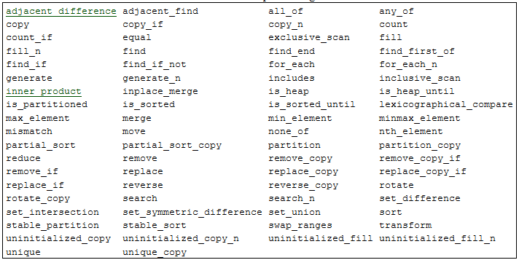
Parallel Algorithms (C++17)

Slide 27
Parallel Algorithms (C++17)
Add Execution Policy as first argument
Execution policies have associated default executor and default executor parameters
  execution::parallel_policy, generated with par
    parallel executor, static chunk size
  execution::sequenced_policy, generated with seq
    sequential executor, no chunking
// add execution policy
std::fill(
std::execution::par,
begin(d), end(d), 0.0);

Slide 28
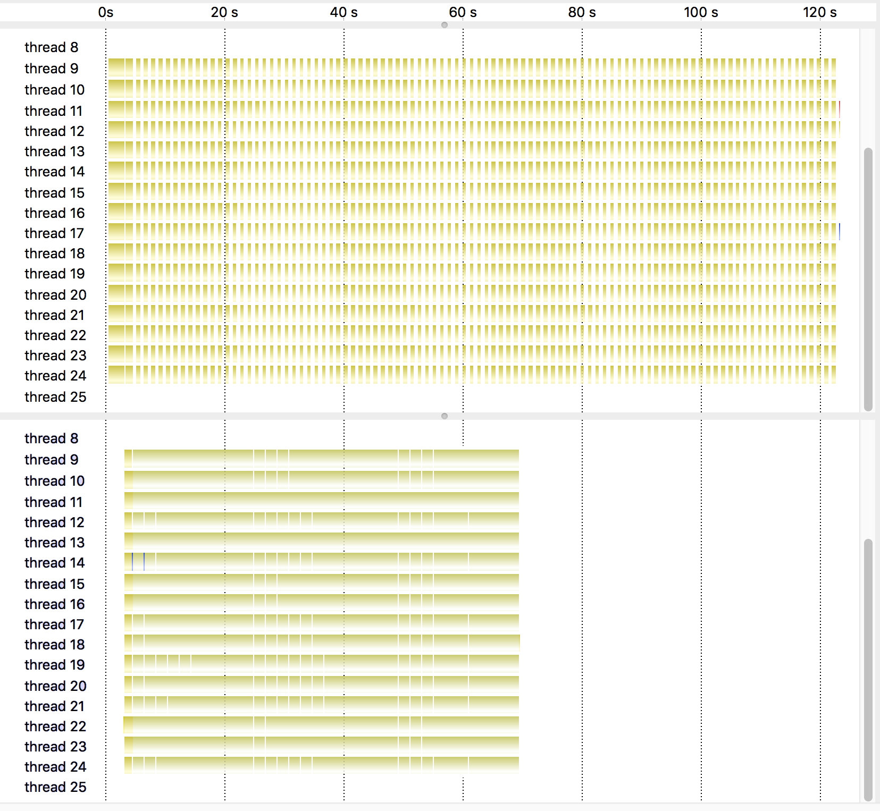
Parallel Algorithms (C++17)

Slide 29
Parallel Algorithms (Extensions)
// uses default executor: par
std::vector<double> d = {...};
hpx::fill(hpx::execution::par, begin(d), end(d), 0.0);
// rebind par to user-defined executor (where and how to execute)
my_executor my_exec = ...;
hpx::fill(hpx::execution::par.on(my_exec), begin(d), end(d), 0.0);
// rebind par to user-defined executor and user defined executor
// parameters (affinities, chunking, scheduling, etc.)
my_params my_par = ...;
hpx::fill(
hpx::execution::par.on(my_exec).with(my_par), begin(d), end(d), 0.0);

Slide 30
Execution Policies (Extensions)
Extensions: asynchronous execution policies
  parallel_task_execution_policy (asynchronous version of parallel_execution_policy), generated with par(task)
  sequenced_task_execution_policy (asynchronous version of sequenced_execution_policy), generated with seq(task)
  In all cases the formerly synchronous functions return a future<T>
    Here T is the value that would be returned by the synchronous version of the algorithm
  Instruct the parallel construct to be executed asynchronously
  Allows integration with asynchronous control flow
Main benefit: allows mitigating effects of fork-join parallel block

Slide 31
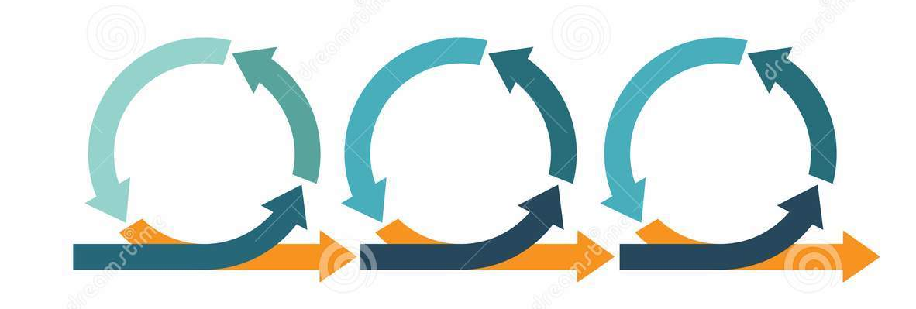
Iterative Parallelism

Slide 32
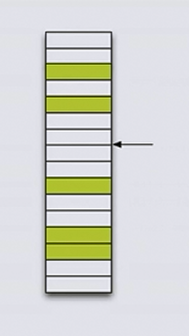
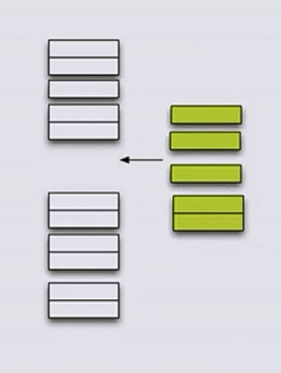
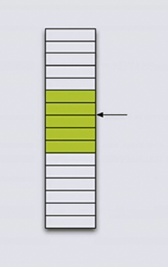
Extending Parallel Algorithms
Sean Parent: C++ Seasoning, Going Native 2013

Slide 33
Extending Parallel Algorithms
Iterator: b
Iterator: first
Iterator: p
Iterator: second
Iterator: l
Sean Parent: C++ Seasoning, Going Native 2013

Slide 34
Extending Parallel Algorithms
New algorithm: gather
template <typename BiIter, typename Pred>
std::pair<BiIter, BiIter> gather(BiIter f, BiIter l, BiIter p, Pred pred)
{
BiIter it1 = std::stable_partition(f, p, std::not1(pred));
BiIter it2 = std::stable_partition(p, l, pred);
return std::make_pair(it1, it2);
}
std::[stable_]partition: Reorders the elements in the range [first, last)
  Such that all elements for which the predicate p returns true precede all elements for which predicate p returns false
  Relative order of the elements is (not) preserved
  Returns iterator to the first element of the second group (partition point)
Sean Parent: C++ Seasoning, Going Native 2013

Slide 35
Extending Parallel Algorithms
template <typename BiIter, typename Pred>
hpx::future<std::pair<BiIter, BiIter>> gather_async(
BiIter f, BiIter l, BiIter p, Pred pred)
{
hpx::future<BiIter> f1 =
hpx::stable_partition(hpx::execution::par(task), f, p, hpx::not1(pred));
hpx::future<BiIter> f2 =
hpx::stable_partition(hpx::execution::par(task), p, l, pred);
return hpx::dataflow(
[](hpx::future<BiIter> fut1, hpx::future<BiIter> fut2) {
return std::make_pair(fut1.get(), fut2.get());
},
f1, f2
);
}

Slide 36
Extending Parallel Algorithms
New algorithm: gather_async
template <typename BiIter, typename Pred>
hpx::future<std::pair<BiIter, BiIter>> gather_async(
BiIter f, BiIter l, BiIter p, Pred pred)
{
hpx::future<BiIter> f1 =
hpx::stable_partition(hpx::execution::par(task), f, p, hpx::not1(pred));
hpx::future<BiIter> f2 =
hpx::stable_partition(hpx::execution::par(task), p, l, pred);
co_return std::make_pair(co_await f1, co_await f2);
}

Slide 37

Recursive Parallelism

Slide 38
Sequential Quicksort
template <typename RandomIter>
void quick_sort(RandomIter first, RandomIter last)
{
std::ptrdiff_t size = last - first;
if (size > 1)
{
RandomIter pivot = std::partition(
first, last,
[p = first[size / 2]](auto v) { return v < p; });
quick_sort(first, pivot);
quick_sort(pivot, last);
}
}

Slide 39
Parallel Quicksort: Parallel
  template <typename RandomIter>
  void quick_sort(RandomIter first, RandomIter last)
  {
  ptrdiff_t size = last - first;
  if (size > threshold) {
  RandomIter pivot = partition(par, first, last,
  [p = first[size / 2]](auto v) { return v < p; });
  quick_sort(first, pivot);
  quick_sort(pivot, last);
  }
  else if (size > 1) {
  sort(seq, first, last);
  }
  }

Slide 40
Parallel Quicksort: Futurized
  template <typename RandomIter>
  future<void> quick_sort(RandomIter first, RandomIter last)
  {
  ptrdiff_t size = last - first;
  if (size > threshold) {
  future<RandomIter> pivot = partition(par(task), first, last,
  [p = first[size / 2]](auto v) { return v < p; });
  return pivot.then([=](auto pf) {
  auto pivot = pf.get();
  return when_all(quick_sort(first, pivot), quick_sort(pivot, last));
  });
  }
  else if (size > 1) {
  sort(seq, first, last);
  }
  return make_ready_future();
  }

Slide 41
Parallel Quicksort: co_await
  template <typename RandomIter>
  hpx::future<void> quick_sort(RandomIter first, RandomIter last)
  {
  ptrdiff_t size = last - first;
  if (size > threshold) {
  RandomIter pivot = co_await partition(par(task), first, last,
  [p = first[size / 2]](auto v) { return v < p; });
  co_await when_all(
  quick_sort(first, pivot), quick_sort(pivot, last));
  }
  else if (size > 1) {
  sort(seq, first, last);
  }
  }

Slide 42
Parallel Algorithms (C++17)

Slide 43
Futurization
Technique allowing to automatically transform code
  Delay direct execution in order to avoid synchronization
  Turns ‘straight’ code into ‘futurized’ code
  Code no longer calculates results, but generates an execution tree representing the original algorithm
  If the tree is executed it produces the same result as the original code
  The execution of the tree is performed with maximum speed, depending only on the data dependencies of the original code
Execution exposes the emergent property of being auto-parallelized

Slide 44
