Slide 1
Introduction to Distributed Parallelism
Lecture 16
Hartmut Kaiser
https://teaching.hkaiser.org/spring2025/csc4700/

Slide 2
Scaling Progression of CPUs
Simplest model
CPU fetches and executes instructions
Many cycles per instruction

Slide 3
Pipelining
Pipelining
Instructions are fetched in a stream
A long trip from memory

Slide 4
Hierarchical Memory
Use special, fast memory to keep data and instructions close

Slide 5
Multicore CPUs
Replicate 2X
Cores share slower memory
Caches need to be kept coherent

Slide 6
Even more Cores
Replicate 4X
Cores share slower memory
Include super-slow DRAM
Caches need to be kept coherent

Slide 7
Symmetric Multi-Processor (SMP)
Multiple CPU chips
Memory may be uniformly shared among sockets
AKA “sockets”
Caches still need to be kept (somewhat) coherent
Uniform memory access (UMA)

Slide 8
Asymmetric Multi-Processor
Multiple CPU chips
Memory may be non- uniformly shared among sockets
AKA “sockets”
Non-uniform memory access (NUMA – most common)
Caches still need to be kept (somewhat) coherent: CC-NUMA

Slide 9
The Next Step
Put sockets on a blade
Put blades in a chassis
Put chassis in a rack
Put racks in a center
Put centers in the cloud

Slide 10
Then you have a Supercomputer
But how do you use it?

Slide 11
Need More Power? Buy More Hardware!
More cores!
More blades!
More chassis!
More racks!
More centers!
More Nuclear Power Stations

Slide 12
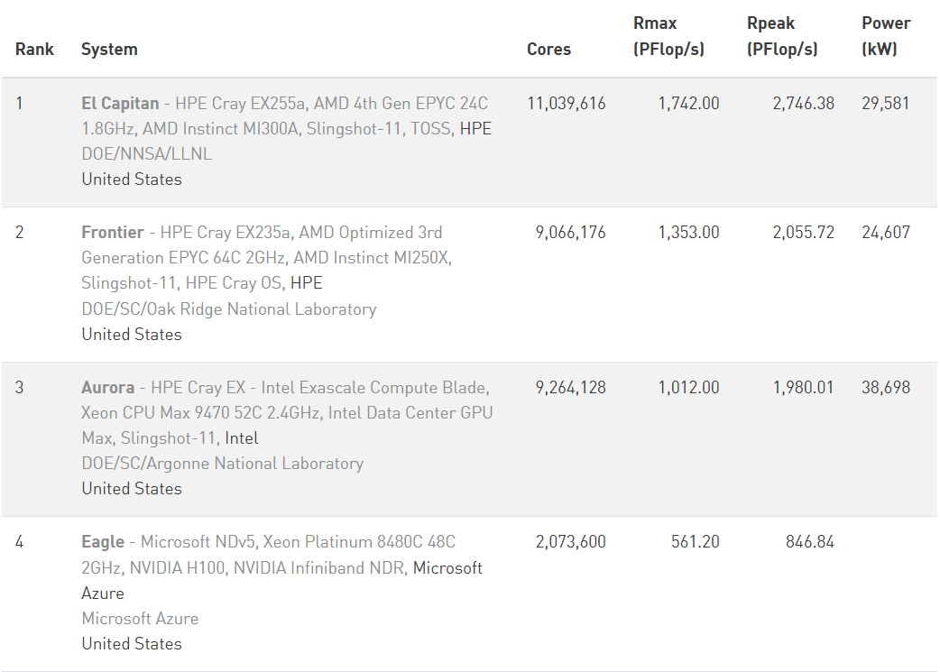
Top500 as of Nov 2024 (top500.org)
11M cores
9M cores
9.2M cores
2M cores
Notes:
93M times faster!

Slide 13
The HPC Canon (as of 2025)
Technology | Paradigm | Hammer
CPU (single core) | Sequential | C compiler
SIMD/Vector (single core) | Data parallel | Intrinsic
Multicore | Threads | pthreads library
NUMA shared memory | Threads | pthreads library
GPU | GPU | CUDA
Clusters | Message passing | MPI
This semester
C++

Slide 14
There are no “parallel” Computers
…It’s really just a bunch of Computers
Separate memory
  (Each has its own memory)
  (Each has its own storage)
  (Each has its own OS)

Slide 15
There are no “parallel” Programs
…It’s really just a bunch of programs
Separate memory
  (Each has its own memory)
  (Each has its own storage)
  (Each has its own OS)
Each runs its own programs

Slide 16
Distributed Memory

Slide 17
Distributed Memory

Slide 18
Distributed Memory

Slide 19
Distributed Memory
Remote memory is not directly accessible
Data needs to be explicitly copied

Slide 20
Distributed Memory

Slide 21
Distributed Memory
This begs new questions:
  Should all nodes do exactly the same thing?
  Will there be speedup if we do?
As we add more CPUs, we make the problem bigger
  Can we keep all the data on every node if we keep making the problem bigger?
    Hint: No
But. Do we need all the data on every node?
  Hint: No
What do we keep? What do we not keep?
  Every node has some of the data, however, the union of all should be the whole problem
  “Collectively exhaustive”

Slide 22
Distributed Memory
What about the program?
  Does it grow with problem size?
  Hint: No
We probably need all of it everywhere anyways

Slide 23
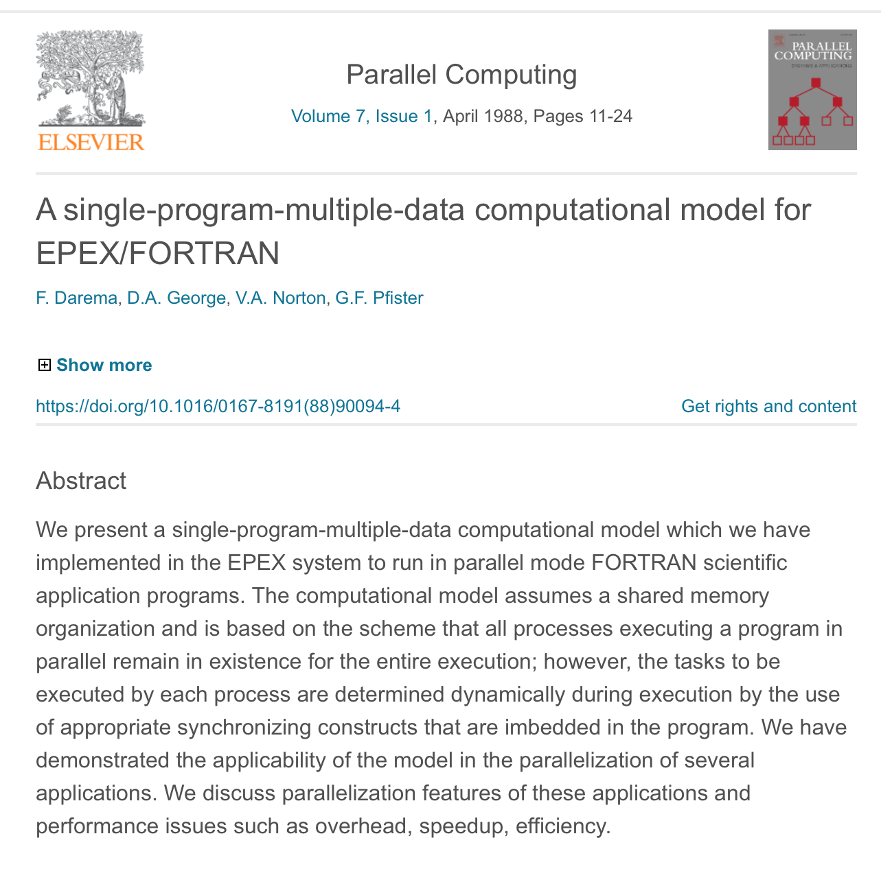
Single Program Multiple Data Model (SPMD)
Frederica Darema (Director, Air Force Office of Scientific Research)
Most widely used model in distributed memory programming

Slide 24
SPMD
Single program
  This is the same on all nodes
Multiple Data
  This is not the same on all nodes, but collectively exhaustive

Slide 25
SPMD
Single program multiple data model (SPMD)
  How do you pronounce “SPMD”?
Recall Flynn: SIMD, MIMD
  “SPMD” is pronounced “spim dee”
Most widely used model in distributed memory programming
  Better model for today’s practice than Flynn’s

Slide 26
Distributed Memory
Every node runs a sequential process (today often: parallel process)
  All of the code is replicated
  All nodes run the same executable
Data is distributed using resource allocation mechanisms
  However, data dependencies are probably not disjoint
  Data has cross-node dependencies
  Data may be needed by another node, but can’t be accessed directly
  Data are partitioned
  The union of the partitions should be the whole problem

Slide 27
Distributed memory
“Sequential” process
“Sequential” process

Slide 28
Distributed Memory

Slide 29
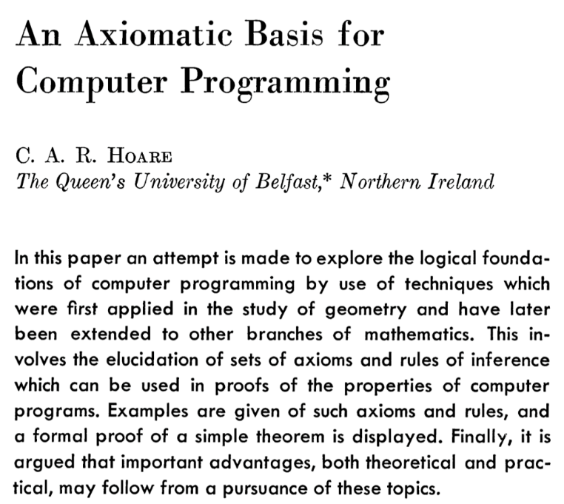
Communicating Sequential Processes
C.A.R (Tony) Hoare
Communicating Sequential Processes “CSP” (pronounced “see ess pea”)

Slide 30

Example
Computing $π$

Slide 31

Back to our trusty Example (one of them)
Find the value of
$$π$$
Using formula
$π=\int_{0}^{1}{\frac{4}{1+x^{2}}dx}$

Slide 32
Numerical Integration

Slide 33
Numerical Integration

Slide 34
Numerical Integration (Sequential)
double pi = 0;
for (int i = 0; i != N; ++i)
pi += h * 4.0 / (1 + sqr(i * h));

Slide 35
Parallelization Strategy
How do we go from a problem we want to solve
And maybe know how to solve sequentially
To a parallel program
That scales

Slide 36
Parallelization Strategy, SPMD version
Decompose problem into pieces that can execute in SPMD
  By task or by data
  Manage sharing (communication)
Fundamental organizing principle
  Around data decomposition?
  Around tasks?
  Around data flow?
Programming paradigms and data structures: SPMD
Manage processes, communication
  Collective operations

Slide 37
Finding Concurrency

Slide 38
Finding Concurrency

Slide 39
Finding Concurrency

Slide 40
Finding Concurrency
Same Program!
Different Data!
SPMD?
double pi = 0;
for (int i = 0; i != N/4; ++i)
pi += h * 4.0 / (1 + sqr(i * h));
double pi = 0;
for (int i = N/4; i != N/2; ++i)
pi += h * 4.0 / (1 + sqr(i * h));
double pi = 0;
for (int i = N/2; i != 3*N/4; ++i)
pi += h * 4.0 / (1 + sqr(i * h));
double pi = 0;
for (int i = 3*N/4; i != N; ++i)
pi += h * 4.0 / (1 + sqr(i * h));

Slide 41
Finding Concurrency
int main()
{
int const N = 1'000'000;
double pi = 0;
for (int i = 0; i != N/4; ++i)
pi += h * 4.0 / (1 + sqr(i * h));
for (int i = N/4; i != N/2; ++i)
pi += h * 4.0 / (1 + sqr(i * h));
for (int i = N/2; i != 3*N/4; ++i)
pi += h * 4.0 / (1 + sqr(i * h));
for (int i = 3*N/4; i != N; ++i)
pi += h * 4.0 / (1 + sqr(i * h));
std::println("pi: {}", pi);
}

Slide 42
Finding Concurrency
void pi_helper(int begin, int end, double h) {
for (int i = begin; i != end; ++i)
pi += h * 4.0 / (1 + sqr(i * h));
}
int main() {
int const N = 1'000'000;
double h = 1.0 / N;
std::thread t0 (pi_helper, 0, N/4, h);
std::thread t1 (pi_helper, N/4, N/2, h);
std::thread t2 (pi_helper, N/2, 3*N/4, h);
std::thread t3 (pi_helper, 3*N/4, N, h);
t0.joint(); t1.join();
t2.join(); t3.join();
std::println("pi: {}", pi);
}

Slide 43
Finding Concurrency
Process
void pi_helper(int begin, int end, double h) {
for (int i = begin; i != end; ++i)
pi += h * 4.0 / (1 + sqr(i * h));
}
int main() {
int const N = 1'000'000;
double h = 1.0 / N;
std::println("pi: {}", pi);
}
Process
Process
Process

Slide 44
Communicating sequential Processes / SPMD
      int main(int argc, char* argv[]) {
      double h = 1.0 / N;
      double pi = 0.0;
      for (long i = 0; i != N/4; ++i)
      pi += h * 4.0 / (1 + sqr(i * h));
      std::println("pi: {}", pi);
      }
      int main(int argc, char* argv[]) {
      double h = 1.0 / N;
      double pi = 0.0;
      for (long i = N/4; i != N/2; ++i)
      pi += h * 4.0 / (1 + sqr(i * h));
      std::println("pi: {}", pi);
      }
      int main(int argc, char* argv[]) {
      double h = 1.0 / N;
      double pi = 0.0;
      for (long i = N/2; i != 3*N/4; ++i)
      pi += h * 4.0 / (1 + sqr(i * h));
      std::println("pi: {}", pi);
      }
      int main(int argc, char* argv[]) {
      double h = 1.0 / N;
      double pi = 0.0;
      for (long i = 3*N/4; i != N / 4; ++i)
      pi += h * 4.0 / (1 + sqr(i * h));
      std::println("pi: {}", pi);
      }

Slide 45
Communicating sequential processes / SPMD
      int main(int argc, char* argv[]) {
      double h = 1.0 / N;
      double pi = 0.0;
      for (long i = 0; i != N/4; ++i)
      pi += h * 4.0 / (1 + sqr(i * h));
      std::println("pi: {}", pi);
      }
      int main(int argc, char* argv[]) {
      double h = 1.0 / N;
      double pi = 0.0;
      for (long i = N/4; i != N/2; ++i)
      pi += h * 4.0 / (1 + sqr(i * h));
      std::println("pi: {}", pi);
      }
      int main(int argc, char* argv[]) {
      double h = 1.0 / N;
      double pi = 0.0;
      for (long i = N/2; i != 3*N/4; ++i)
      pi += h * 4.0 / (1 + sqr(i * h));
      std::println("pi: {}", pi);
      }
      int main(int argc, char* argv[]) {
      double h = 1.0 / N;
      double pi = 0.0;
      for (long i = 3*N/4; i != N / 4; ++i)
      pi += h * 4.0 / (1 + sqr(i * h));
      std::println("pi: {}", pi);
      }

Slide 46
Threads
void pi_helper(int begin, int end, double h) {
for (int i = begin; i != end; ++i)
pi += h * 4.0 / (1 + sqr(i * h));
}
int main() {
int const N = 1'000'000;
double h = 1.0 / N;
std::thread t0 (pi_helper, 0, N/4, h);
std::thread t1 (pi_helper, N/4, N/2, h);
std::thread t2 (pi_helper, N/2, 3*N/4, h);
std::thread t3 (pi_helper, 3*N/4, N, h);
t0.joint(); t1.join();
t2.join(); t3.join();
std::println("pi: {}", pi);
}

Slide 47
Shared Memory Parallelism
N is local to this process
All threads read the same value N
N is exactly equivalent to the sequential N
Because N is at the same memory location for all
  Race conditions aside, there is no additional work needed to make this happen
Same is true for h and pi

Slide 48
Distributed Memory Parallelism
Every N is local to one process
While all programs are identical they need to use the same value for N
No process can directly read (or write) the N from another process
How do we get the right value for N to all processes?

Slide 49
Distributed Memory Parallelism
For each process to read the “right” N
We need to copy it to all of them

Slide 50
Distributed Memory Parallelism
Threads have the same value for N
  The overall result is exactly equivalent to the sequential
Because processes are reading copies of N
  It is as if they were the same N
  Similarly for h and pi
Must make N consistent across processes when writing to maintain as if

Slide 51
SPMD? Single Program Multiple Data?
Single Program Multiple Data?
Only if each process has a different begin, end
int main(int argc, char* argv[])
{
double h = 1.0 / N;
double pi = 0.0;
for (long i = 0; i != N / 4; ++i)
pi += h * 4.0 / (1 + sqr(i * h));
std::println("pi: {}", pi);
}
int main(int argc, char* argv[])
{
double h = 1.0 / N;
double pi = 0.0;
for (long i = begin; i != end; ++i)
pi += h * 4.0 / (1 + sqr(i * h));
std::println("pi: {}", pi);
}

Slide 52
SPMD? Single Program Multiple Data?
The code for each process is the same, but
  We need the same N in every process
  We need different begin and end in each of the processes
How do we achieve this?

Slide 53
Single Program Multiple Data
We can get N from the command line
But from every node?
  That’s a lot of typing
Better to get it at just one node and send it around
But we want to have a single program
  So we let every process attempt to get N from the command line
  And send N from one of the processes to all others
int main(int argc, char* argv[])
{
long N = 1'000'000'000;
if (argc > 1)
N = std::stol(argv[1]);
double h = 1.0 / N;
double pi = 0.0;
for (long i = 0; i != N / 4; ++i)
pi += h * 4.0 / (1 + sqr(i * h));
std::println("pi: {}", pi);
}

Slide 54
Single Program Multiple Data
How do we get the same program to do different things?
While keeping them the same?
  Hint: multiple data
  Likely use an if statement
So we need means to distinguish the process that executes the code
Let’s say ”the world has P processes”
And each process knows the value of its own id
And each process has an id in the range [0, P)

Slide 55
Single HPX (SPMD) Program
  int main(int argc, char* argv[]) {
  long N = 1'000'000'000;
  std::uint32_t num_localities = hpx::get_num_localities(hpx::launch::sync);
  std::uint32_t locality_id = hpx::get_locality_id();
  if (locality_id == 0 && argc > 1) N = std::stol(argv[1]);
  // send (‘broadcast’) N to all nodes if locality_id == 0
  std::size_t blocksize = N / num_localities;
  std::size_t begin = blocksize * locality_id, end = blocksize * (locality_id + 1);
  double h = 1.0 / N, pi = 0.0;
  for (long i = begin; i != end; ++i)
  pi += h * 4.0 / (1 + sqr(i * h));
  // collect (‘reduce’) results from all localities
  if (locality_id == 0)
  std::println("pi: {}", pi);
  }

Slide 56

A better Name than MIMD or SPMD
Andrew Lumsdaine
Distinguished replicated processes, distributed data (DRPDD)
  Pronounced “drop dee”

Slide 57
HPX Collective Operations
We assume that process with locality_id == 0 receives N from the command line
This process sends N to all others
  This is an operation that is called broadcast
hpx::collectives::broadcast(
hpx::collectives::get_world_communicator(), N);
Every process calculates its own begin and end based on its locality_id
Every process now computes part of the overall solution
In the end, every process needs to provide its partial result, all of which need to be consolidated
  This is an operation that is called reduce
hpx::collectives::reduce(
hpx::collectives::get_world_communicator(),
pi, std::plus{});

Slide 58
Single Program Multiple Data
  int main(int argc, char* argv[]) {
  long N = 1'000'000'000;
  std::uint32_t num_localities = hpx::get_num_localities(hpx::launch::sync);
  std::uint32_t locality_id = hpx::get_locality_id();
  if (locality_id == 0 && argc > 1) N = std::stol(argv[1]);
  hpx::collectives::broadcast(hpx::collectives::get_world_communicator(), N);
  std::size_t blocksize = N / num_localities;
  std::size_t begin = blocksize * locality_id, end = blocksize * (locality_id + 1);
  double h = 1.0 / N, pi = 0.0;
  for (long i = begin; i != end; ++i)
  pi += h * 4.0 / (1 + sqr(i * h));
  hpx::collectives::reduce(hpx::collectives::get_world_communicator(), pi, std::plus{});
  if (locality_id == 0)
  std::println("pi: {}", pi);
  }

Slide 59
Distributed Memory
Every process:
  Independent memory space
  Code is replicated
Data are partitioned
  The union of the partitions should be the whole problem

Slide 60
Finding Concurrency (Decomposition)
int main()
{
int const N = 1'000'000;
double pi = 0;
for (int i = 0; i != N/4; ++i)
pi += h * 4.0 / (1 + sqr(i * h));
for (int i = N/4; i != N/2; ++i)
pi += h * 4.0 / (1 + sqr(i * h));
for (int i = N/2; i != 3*N/4; ++i)
pi += h * 4.0 / (1 + sqr(i * h));
for (int i = 3*N/4; i != N; ++i)
pi += h * 4.0 / (1 + sqr(i * h));
std::println("pi: {}", pi);
}

Slide 61
Threads to Processes
int main(int argc, char* argv[])
{
double pi = 0.0; double h = 1.0 / N;
for (long i = 0; i != N/4; ++i)
pi += h * 4.0 / (1 + sqr(i * h));
std::println("pi: {}", pi);
}
Process
void pi_helper(int begin, int end, double h, double& pi) {
for (int i = begin; i != end; ++i)
pi += h * 4.0 / (1 + sqr(i * h));
}
int main() {
int const N = 1'000'000;
double h = 1.0 / N;
std::thread t0 (pi_helper, 0, N/4, h, std::ref(pi));
std::thread t1 (pi_helper, N/4, N/2, h, std::ref(pi)));
std::thread t2 (pi_helper, N/2, 3*N/4, h, std::ref(pi)));
std::thread t3 (pi_helper, 3*N/4, N, h, std::ref(pi)));
t0.joint(); t1.join();
t2.join(); t3.join();
std::println("pi: {}", pi);
}
int main(int argc, char* argv[])
{
double pi = 0.0; double h = 1.0 / N;
for (long i = N/4; i != N/2; ++i)
pi += h * 4.0 / (1 + sqr(i * h));
std::println("pi: {}", pi);
}
Process
int main(int argc, char* argv[])
{
double pi = 0.0; double h = 1.0 / N;
for (long i = N/2; i != 3*N/4; ++i)
pi += h * 4.0 / (1 + sqr(i * h));
std::println("pi: {}", pi);
}
Process
int main(int argc, char* argv[])
{
double pi = 0.0; double h = 1.0 / N;
for (long i = 3*N/4; i != N; ++i)
pi += h * 4.0 / (1 + sqr(i * h));
std::println("pi: {}", pi);
}
Process

Slide 62
Distinguished Replicated Processes
int main(int argc, char* argv[])
{
long N = 1'000'000'000;
std::uint32_t num_localities =
hpx::get_num_localities(hpx::launch::sync);
std::uint32_t locality = hpx::get_locality_id();
if (locality == 0 && argc > 1) N = stol(argv[1]);
std::size_t blocksize = N / num_localities;
std::size_t begin = blocksize * locality_id;
std::size_t end = blocksize * (locality_id + 1);
double h = 1.0 / N;
double pi = 0.0;
for (long i = begin; i != end; ++i)
pi += h * 4.0 / (1 + sqr(i * h));
if (locality == 0) println("pi: {}", pi);
}
int main(int argc, char* argv[])
{
long N = 1'000'000'000;
std::uint32_t num_localities =
hpx::get_num_localities(hpx::launch::sync);
std::uint32_t locality = hpx::get_locality_id();
if (locality == 0 && argc > 1) N = stol(argv[1]);
std::size_t blocksize = N / num_localities;
std::size_t begin = blocksize * locality_id;
std::size_t end = blocksize * (locality_id + 1);
double h = 1.0 / N;
double pi = 0.0;
for (long i = begin; i != end; ++i)
pi += h * 4.0 / (1 + sqr(i * h));
if (locality == 0) println("pi: {}", pi);
}
int main(int argc, char* argv[])
{
long N = 1'000'000'000;
std::uint32_t num_localities =
hpx::get_num_localities(hpx::launch::sync);
std::uint32_t locality = hpx::get_locality_id();
if (locality == 0 && argc > 1) N = stol(argv[1]);
std::size_t blocksize = N / num_localities;
std::size_t begin = blocksize * locality_id;
std::size_t end = blocksize * (locality_id + 1);
double h = 1.0 / N;
double pi = 0.0;
for (long i = begin; i != end; ++i)
pi += h * 4.0 / (1 + sqr(i * h));
if (locality == 0) println("pi: {}", pi);
}
int main(int argc, char* argv[])
{
long N = 1'000'000'000;
std::uint32_t num_localities =
hpx::get_num_localities(hpx::launch::sync);
std::uint32_t locality = hpx::get_locality_id();
if (locality == 0 && argc > 1) N = stol(argv[1]);
std::size_t blocksize = N / num_localities;
std::size_t begin = blocksize * locality_id;
std::size_t end = blocksize * (locality_id + 1);
double h = 1.0 / N;
double pi = 0.0;
for (long i = begin; i != end; ++i)
pi += h * 4.0 / (1 + sqr(i * h));
if (locality == 0) println("pi: {}", pi);
}

Slide 63
‘DropDee’ using HPX
  int main(int argc, char* argv[]) {
  long N = 1'000'000'000;
  std::uint32_t num_localities =
  hpx::get_num_localities(hpx::launch::sync);
  std::uint32_t locality = hpx::get_locality_id();
  if (locality == 0 && argc > 1) N = stol(argv[1]);
  hpx::collectives::broadcast(
  hpx::collectives::get_world_communicator(), N)
  std::size_t blocksize = N / num_localities;
  std::size_t begin = blocksize * locality_id,
  std::size_t begin = end = blocksize * (locality_id + 1);
  double h = 1.0 / N, pi = 0.0;
  for (long i = begin; i != end; ++i)
  pi += h * 4.0 / (1 + sqr(i * h));
  hpx::collectives::reduce(
  hpx::collectives::get_world_communicator(), pi);
  if (locality == 0) println("pi: {}", pi);
  }
Get our locality id and number of other nodes
locality 0 gets N, shares N
Everyone computes their own partial result
locality 0 collects all partials, adds them, and prints
This pattern is ubiquitous

Slide 64
