Slide 1
GPU Programming, the C++ Way
Lecture 18
Hartmut Kaiser
https://teaching.hkaiser.org/spring2025/csc4700/

Slide 2
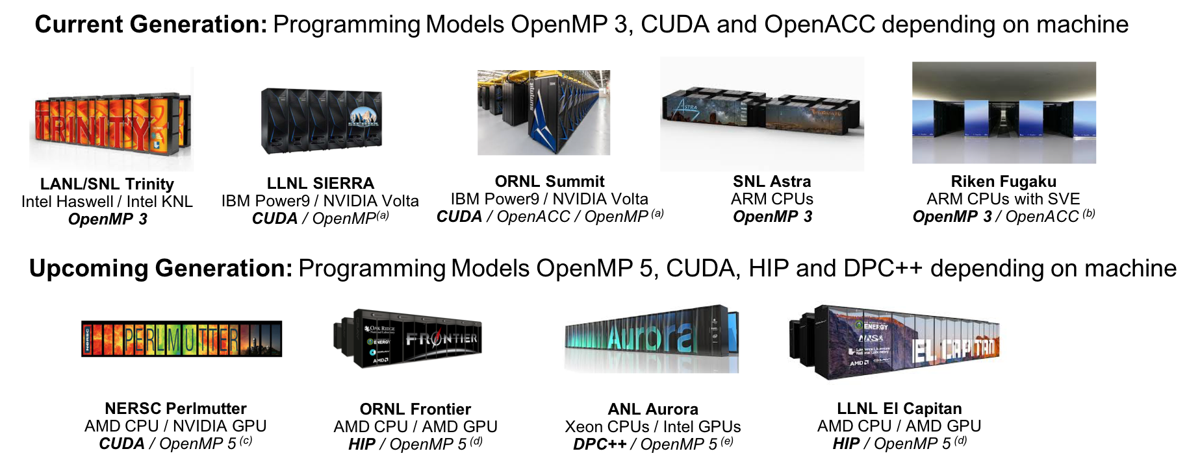
The HPC Hardware Landscape
(a) Initially not working. Now more robust for Fortran than C++, but getting better
(b) Research effort
(c) OpenMP 5 by NVIDIA.
(d) OpenMP 5 by HPE.
(e) OpenMP 5 by Intel.

Slide 3
Industry Estimate: Cost of Coding
Typical HPC production app: 300k-600k lines
Large Scientific Libraries:
E3SM: 1,000k lines
Trilinos: 4,000k lines
Conservative estimate: need to rewrite 10% of an app to switch Programming Model
A full time software engineer writes 10 lines of production code per hour: 20k LOC/year
Just switching Programming Models costs multiple person-years per app!
5/83

Slide 4
What is Kokkos?
A C++ Programming Model for Performance Portability
Implemented as a template library on top CUDA, HIP, OpenMP, HPX, ...
Aims to be descriptive not prescriptive
Aligns with developments in the C++ standard
Expanding solution for common needs of modern science and engineering codes
Math libraries based on Kokkos
Tools for debugging, profiling and tuning
Utilities for integration with Fortran and Python
Is an Open Source project with a growing community
Maintained and developed at https://github.com/kokkos
Hundreds of users at many large institutions

Slide 5
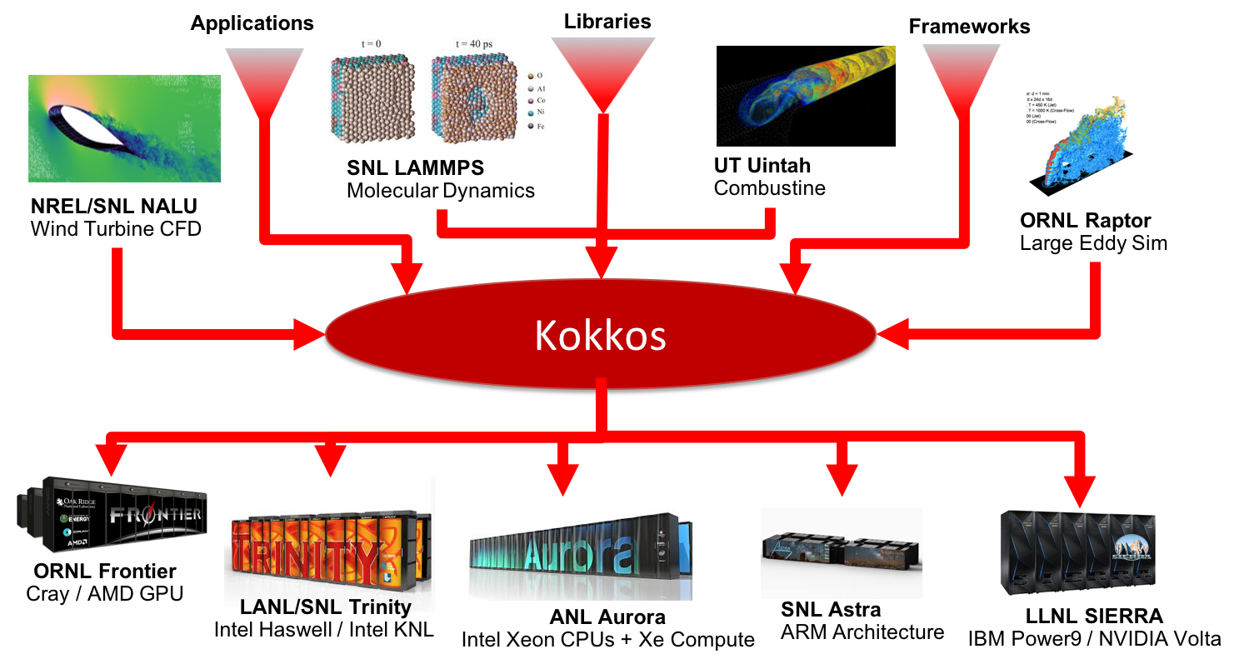
Example Uses of Kokkos

Slide 6
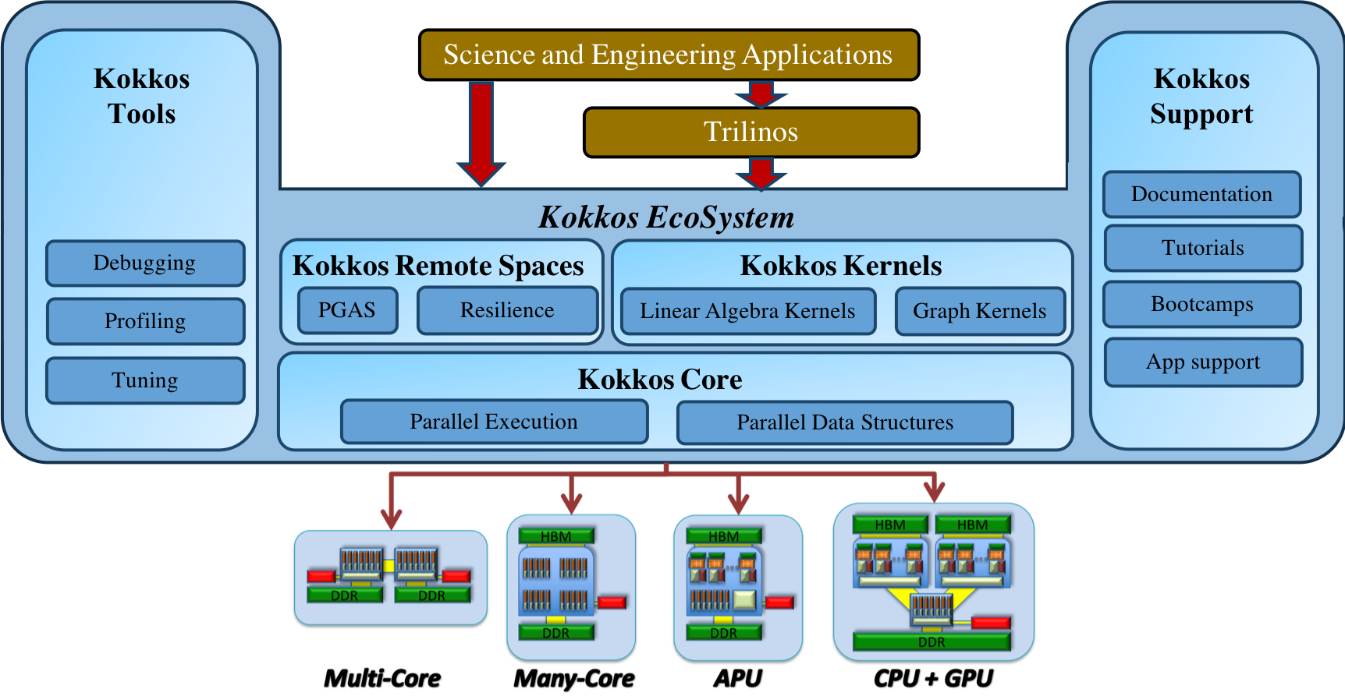
The Kokkos Ecosystem

Slide 7
Data-parallel Patterns (Algorithms)
We will look at:
How computational bodies are passed to the Kokkos runtime
How work is mapped to execution resources
The difference between parallel_for and parallel_reduce
Start parallelizing a simple example

Slide 8
Data-parallel Patterns and Work
Data parallel patterns and work
for (size_t atom_index = 0; atom_index != number_of_atoms; ++atom_index)
{
atom_forces[atom_index] = calculate_force(... data...);
}
Kokkos maps work to execution resources
Each iteration of a computational body is a unit of work
An iteration index identifies a particular unit of work
An iteration range identifies a total amount of work
Important concept: Work mapping, orchestration, and assignment
You give an iteration range and computational body (kernel) to Kokkos, and Kokkos decides how to map that work to execution resources.
13/83

Slide 9
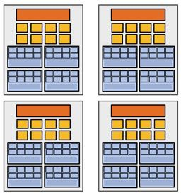
Problem to solve
Discretization/Decomposition
Subproblems (a.k.a. “tasks”, “work to do”)
Assignment
Parallel Threads ** (“workers”)
Parallel program (communicating threads)
Orchestration
Mapping
Execution on parallel machine

Slide 10
Using Kokkos for Data-parallel Patterns (Algorithms)
How are computational bodies given to Kokkos?
As function objects (or lambdas), a common pattern in C++
Quick review, a function object is a function with associated data. Example:
struct parallel_function_object {
// ...
void operator()(/* a work assignment */) const
{
// ... computational body ...
}
// ...
};
14/83

Slide 11
Using Kokkos for Data-parallel Patterns (Algorithms)
How is work assigned to function object operators?
A total amount of work items is given to a Kokkos pattern (algorithm)
parallel_function_object fo;
Kokkos::parallel_for(number_of_iterations, fo);
And work items are assigned to function objects one-by-one:
struct parallel_function_object {
void operator()(size_t const index) const { /* computational body */ }
};
Warning: concurrency and order
Concurrency and ordering of parallel iterations is not guaranteed by the Kokkos runtime.
14/83

Slide 12
Using Kokkos for Data-parallel Patterns (Algorithms)
The complete picture (using function objects):
1) Defining the function object (operator+data):
struct atom_force_function_object {
ForceType atom_forces; // array of forces between atoms
AtomDataType atom_data; // array of data items for atoms
atom_force_function_object(ForceType atom_forces, AtomDataType data)
: atom_forces(forces), atom_data(data) {}
void operator()(int64_t atom_index) const {
atom_forces[atom_index] = calculate_force(atom_data);
}
};
2) Executing in parallel with Kokkos pattern (algorithm):
atom_force_function_object fo(atom_forces, data);
Kokkos::parallel_for(number_of_atoms, fo);

Slide 13
Using Kokkos for Data-parallel Patterns (Algorithms)
The complete picture (using function objects):
Function objects are tedious -- Lambdas are concise
Defining the function object as a lambda and executing in parallel with Kokkos pattern
Kokkos::parallel_for(number_of_atoms,
[=](int64_t atom_index) const {
atom_forces[atom_index] = calculate_force(data);
});
A lambda is not magic, it is the compiler auto-generating a function object for you
Warning: Lambda capture and C++ containers
For portability to GPU, a lambda must capture by value: [=]
Don’t capture containers (e.g., std::vector) by value because it will copy the container’s entire contents

Slide 14
Scalar Integration Example
Riemann-sum-style numerical integration:
$$y=\int_{lower}^{upper}{func\left(x\right) dx}$$
double total_integral = 0;
for (int64_t i = 0; i < number_of_intervals; ++i) {
double const x = lower + (i / number_of_intervals) * (upper - lower);
total_integral += func(x);
}
total_integral *= dx;
How do we parallelize it?
Correctly?
19/83

Slide 15
Scalar Integration Example
Riemann-sum-style numerical integration:
$$y=\int_{lower}^{upper}{func\left(x\right) dx}$$
double total_integral = 0;
Kokkos::parallel_for(number_of_intervals,
[=](int64_t const index) {
double const x = lower + (index / number_of_intervals) * (upper - lower);
total_integral += func(x);
}, );
total_integral *= dx;
Compilation error (cannot increment total_integral)!
Lambda captures are const by default
19/83

Slide 16
Scalar Integration Example
An (incorrect) solution to the (incorrect) attempt:
double total_integral = 0;
double* total_integral_pointer = &total_integral;
Kokkos::parallel_for(number_of_intervals,
[=](int64_t const index) {
double const x = lower + (index / number_of_intervals) * (upper - lower);
*total_integral_pointer += func(x);
});
total_integral *= dx;
Body is executed in GPU address space!
Can’t directly ‘point’ to CPU addresses
Use of pointers is generally a bad idea
Race condition, total_integral_pointer is shared

Slide 17
Use reduce instead of plain for
Reductions combine the results contributed by parallel work
double total_integral = 0;
Kokkos::parallel_reduce(
number_of_intervals,
[=](int64_t const index, double& value_to_update) {
value_to_update += func(...);
},
total_integral);
The operator takes two arguments: a work index and a value to update.
The second argument is a thread-private value that is managed by Kokkos; it is not the final reduced value
Before returning, the thread-local variables are reduced using the reduction operation (default Kokkos::Sum<>)

Slide 18
Kokkos Debug Support
Giving unique names to each kernel is immensely helpful for debugging and profiling. You will regret it if you don’t do that!
Non-nested parallel patterns can take an optional string argument
The label doesn’t need to be unique, but it is helpful
Anything convertible to std::string
Used by profiling and debugging tools
double total_integral = 0;
Kokkos::parallel_reduce(
"reduction", number_of_intervals,
[=](int64_t const index, double& value_to_update) {
value_to_update += func(...);
},
total_integral);

Slide 19
Summary so far
Simple usage is similar to C++ standard algorithms, advanced features are also straightforward
In fact, as we will see, you can use HPX to invoke Kokkos ‘patterns’
Three common data-parallel patterns are parallel_for, parallel_reduce, and parallel_scan
Kokkos calls these ‘patterns’, we call them ‘algorithms’
A parallel computation is characterized by its pattern, policy, and body
User provides computational bodies as function objects or lambdas that handle a single work item
All of this is very similar to C++ standard parallel algorithms

Slide 20
Kokkos Views

Slide 21
Kokkos Views: Motivation
Example: running daxpy (vector scaling/addition) on the GPU:
double* x = new double[N]; // also y
Kokkos::parallel_for("DAXPY", N,
[=](int64_t const i) {
y[i] = a * x[i] + y[i];
});
Problem: x and y reside in CPU memory
Solution: We need a way of storing data (multidimensional arrays) that can be communicated to an accelerator (GPU)
⇒ Kokkos Views

Slide 22
Kokkos Views
View abstraction
A lightweight C++ class with a pointer to array data and a little meta-data,
that is templated on the data type (and other things)
High-level example of Views for daxpy using lambda:
Kokkos::View<double*, ...> x(...), y(...);
// ... populate x, y...
Kokkos::parallel_for("DAXPY", N,
[=](int64_t const i) {
// Views x and y are captured by value (copy)
y(i) = a * x(i) + y(i);
});
Important point
Views are lightweight (like pointers), so copy them into your function objects

Slide 23
Kokkos Views
View overview:
Multi-dimensional array of 0 or more dimensions
scalar (0), vector (1), matrix (2), etc.
Number of dimensions (rank) is fixed at compile-time.
Arrays are rectangular, not ragged.
Sizes of dimensions set at compile-time or runtime e.g., 2x20, 50x50, etc.
Access elements via ”(...)” operator.
Example:
Kokkos::View<double***> data ("label", N0, N1, N2); // 3 runtime, 0 compile
Kokkos::View<double**[N2]> data ("label", N0, N1); // 2 runtime, 1 compile
Kokkos::View<double*[N2][N1]> data ("label", N0); // 1 runtime, 2 compile
Kokkos::View<double[N2][N1][N0]> data ("label"); // 0 runtime, 3 compile
data (i, j, k) = 5.3; // access
Note: runtime-sized dimensions must come first.

Slide 24
Lifecycle of a Kokkos View
Allocations only happen when explicitly specified
i.e., there are no hidden allocations
Copy construction and assignment are shallow (like pointers)
So, you pass Views by value, not by reference
Reference counting is used for automatic deallocation
They behave like std::shared_ptr
Example:
Kokkos::View<double*[5]> a("a", N), b("b", K);
a = b;
View<double**> c(b);
b(0, 2) = 2;
c(0, 2) = 3;
print_value(a(0, 2)); // prints 3.0

Slide 25
View Properties
Accessing a View’s sizes is done via its extent(dim) function
Static extents can additionally be accessed via static_extent(dim)
You can retrieve a raw pointer via its data() function.
The label can be accessed via label()
Example:
Kokkos::View<double*[5]> a("A", N0);
assert(a.extent(0) == N0);
assert(a.extent(1) == 5);
static_assert(a.static_extent(1) == 5);
assert(a.data() != nullptr);
assert(a.label() == "A");

Slide 26
Execution Spaces

Slide 27
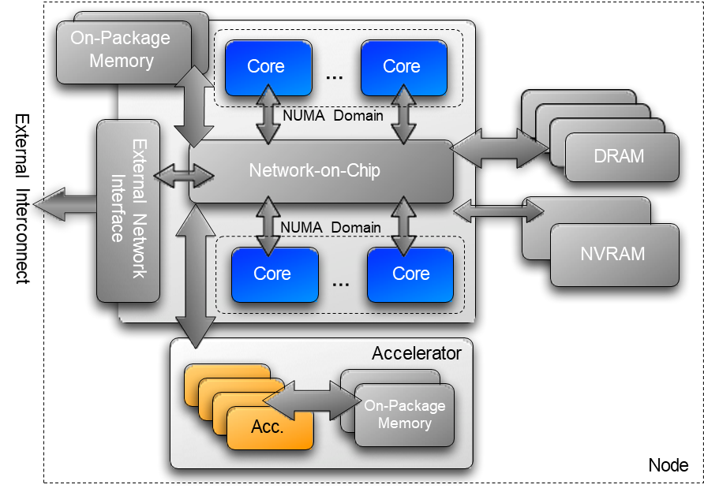
Execution Spaces
A homogeneous set of cores and an execution mechanism (i.e., “place to run code”)
Execution spaces: Serial, Threads, OpenMP, Cuda, HIP, HPX, ...

Slide 28
Execution Spaces
Changing the parallel execution space:
// default execution space
Kokkos::parallel_for("Label",
number_of_intervals, // => RangePolicy<>(0, number_of_intervals)
[=](int64_t const i) {
/* ... body ... */
});
// custom execution space
Kokkos::parallel_for("Label",
Kokkos::RangePolicy<ExecutionSpace>(0, number_of_intervals),
[=](int64_t const i) {
/* ... body ... */
});

Slide 29
Execution Spaces
Requirements for enabling execution spaces:
Kokkos must be compiled with the execution spaces enabled
Execution spaces must be initialized (and finalized)
Functions must be marked with a macro for non-CPU spaces
Lambdas must be marked with a macro for non-CPU spaces
struct parallel_function_object {
KOKKOS_INLINE_FUNCTION double helper_function(int64_t const index) const
{ /*...*/ }
KOKKOS_INLINE_FUNCTION void operator()(int64_t const index) const
{
helper_function(index);
}
};
// Where Kokkos defines:
#define KOKKOS_INLINE_FUNCTION inline /* #if CPU only */
#define KOKKOS_INLINE_FUNCTION inline __device__ __host__ /* #if CPU+Cuda */

Slide 30
Execution Spaces
Lambda annotation with KOKKOS_LAMBDA macro
Kokkos::parallel_for("Label",
number_of_intervals,
KOKKOS_LAMBA(int64_t const i) {
/* ... body ... */
});
#define KOKKOS_LAMBDA [=] /* #if CPU only */
#define KOKKOS_LAMBDA [=] __device__ __host__ /* #if CPU+Cuda */

Slide 31
Memory Spaces

Slide 32
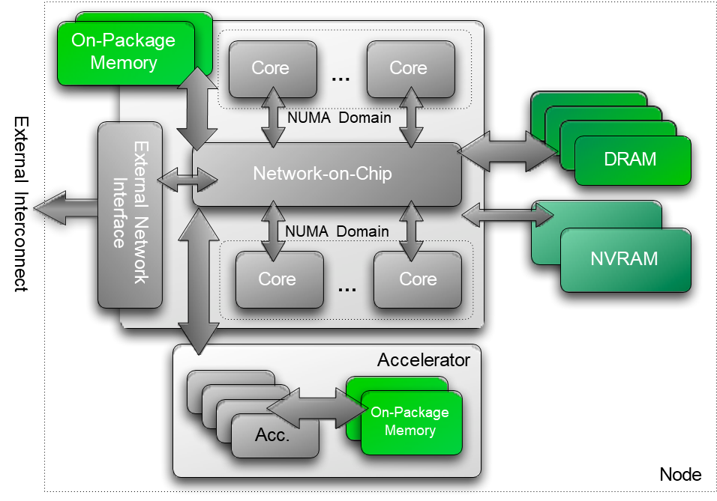
Memory Spaces
Memory space:
Explicitly-manageable memory resource (i.e., “place to put data”)

Slide 33
Memory Spaces
Every view stores its data in a memory space set at compile time.
Kokkos::View<double***, MemorySpace> data(...);
Available memory spaces:
HostSpace, CudaSpace, CudaUVMSpace, ... more
Each execution space has a default memory space
If no Space is provided, the view’s data resides in the default memory space of the default execution space
// Equivalent:
Kokkos::View<double*> a("A", N);
Kokkos::View<double*, Kokkos::DefaultExecutionSpace::memory_space> b("B", N);

Slide 34
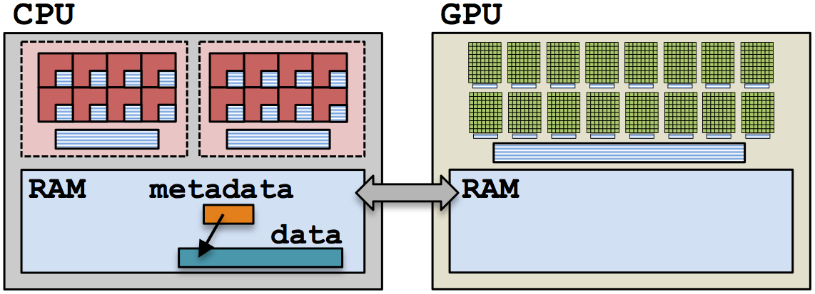
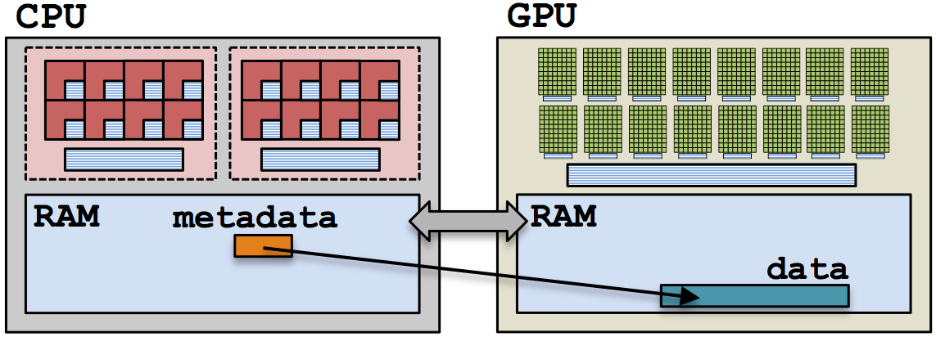
Memory Spaces
Example: HostSpace
Kokkos::View<double**, Kokkos::HostSpace> host_view(/*...*/);
Example: CudaSpace
Kokkos::View<double**, Kokkos::CudaSpace> cuda_view(/*...*/);

Slide 35
Execution and Memory Spaces
Example: summing an array with the GPU
(failed) Attempt 1: View lives in CudaSpace
Kokkos::View<double*, Kokkos::CudaSpace> array("array", size);
for (int64_t i = 0; i < size; ++i)
{
array(i) = // ...read from file
}
double sum = 0;
Kokkos::parallel_reduce(
"Label", Kokkos::RangePolicy<Kokkos::Cuda>(0, size),
KOKKOS_LAMBDA(int64_t const index, double& value_to_update) {
value_to_update += func(array(index));
},
sum);
Fault!

Slide 36
Execution and Memory Spaces
Example: summing an array with the GPU
(failed) Attempt 2: View lives in HostSpace
Kokkos::View<double*, Kokkos::HostSpace> array("array", size);
for (int64_t i = 0; i < size; ++i)
{
array(i) = // ...read from file
}
double sum = 0;
Kokkos::parallel_reduce(
"Label", Kokkos::RangePolicy<Kokkos::Cuda>(0, size),
KOKKOS_LAMBDA(int64_t const index, double& value_to_update) {
value_to_update += func(array(index));
},
sum);
Illegal Access!

Slide 37
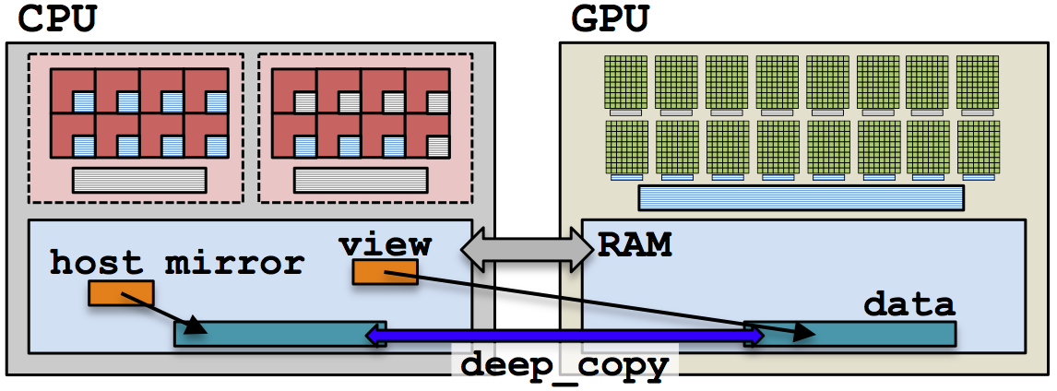
Execution and Memory Spaces
What’s the solution?
CudaUVMSpace
CudaHostPinnedSpace (skipping)
Mirroring
Mirrors are views of equivalent arrays residing in possibly different memory spaces
// Mirroring schematic
using view_type = Kokkos::View<double**, Space>;
view_type view(...);
view_type::HostMirror host_view =
Kokkos::create_mirror_view(view);

Slide 38
Mirroring Pattern
Create a view’s array in some memory space
using view_type = Kokkos::View<double*, Space>;
view_type view(...);
Create host_view, a mirror of the view’s array residing in the host memory space.
view_type::HostMirror host_view = Kokkos::create_mirror_view(view);
Populate host_view on the host (from file, etc.)
Deep copy host_view’s array to view’s array
Kokkos::deep_copy(view, host_view);
Launch a kernel processing the view’s array
Kokkos::parallel_for("Label", Kokkos::RangePolicy<Space>(0, size),
KOKKOS_LAMBDA(int64_t const index) { /* use and change view; */ });
If needed, deep copy the view’s updated array back to the host_view’s array to write file, etc.
Kokkos::deep_copy(host_view, view);

Slide 39
Mirrors of Views in HostSpace
What if the View is in HostSpace too? Does it make a copy?
using view_type = Kokkos::View<double*, Space>;
view_type view("test", 10);
view_type::HostMirror host_view = Kokkos::create_mirror_view(view);
create_mirror_view allocates data only if the host process cannot access view’s data, otherwise host_view references the same data
create_mirror always allocates data
Reminder: Kokkos never performs a hidden deep copy

Slide 40
Views and Spaces Summary
Data is stored in Views that are “pointers” to multi-dimensional arrays residing in memory spaces
Views abstract away platform-dependent allocation, (automatic) deallocation, and access
Heterogeneous nodes have one or more memory spaces
Mirroring is used for performant access to views in host and device memory
Heterogeneous nodes have one or more execution spaces
You control where parallel code is run by a template parameter on the execution policy, or by compile-time selection of the default execution space

Slide 41
Managing Memory Access Patterns for Performance Portability
How the View’s Layout parameter controls data layout
How memory access patterns result from Kokkos mapping parallel work indices and layout of multidimensional array data

Slide 42
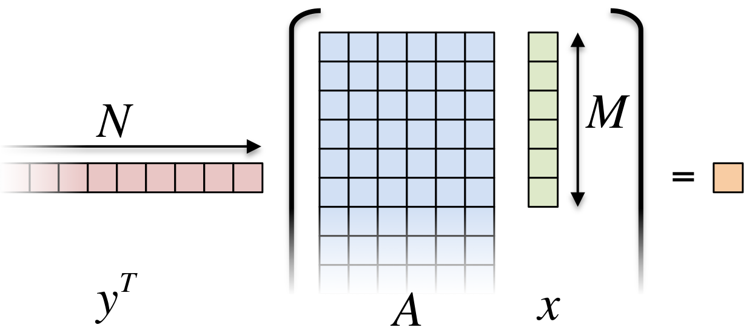
Example: Inner Product
Kokkos::parallel_reduce(
"Label", RangePolicy<ExecutionSpace>(0, N),
KOKKOS_LAMBDA(size_t row, double& value_to_update) {
double this_rows_sum = 0;
for (size_t entry = 0; entry < M; ++entry)
this_rows_sum += A(row, entry) * x(entry);
value_to_update += y(row) * this_rows_sum;
},
result);
Driving question: How should A be laid out in memory?
52/83

Slide 43
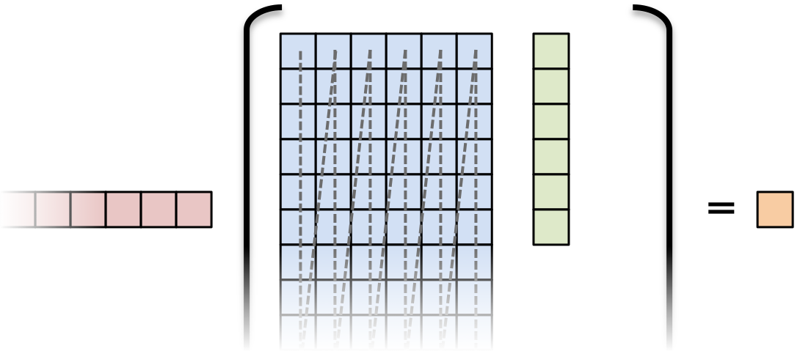
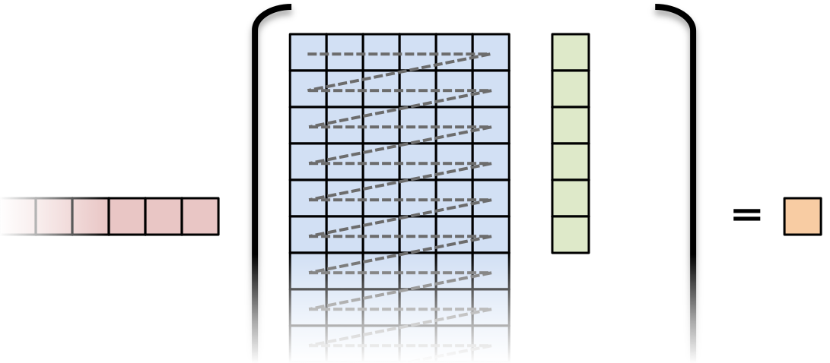
Example: Inner Product
Layout is the mapping of multi-index to memory:
LayoutLeft
in 2D, “column-major”
LayoutRight
in 2D, “row-major”

Slide 44
Important concept: Layout
Layout
Every View has a (optional) multidimensional array Layout set at compile-time
Kokkos::View<double***, Layout, Space> name(...);
Most-common layouts are:
LayoutLeft and LayoutRight
LayoutLeft: left-most index is stride 1.
LayoutRight: right-most index is stride 1.
If no layout specified, the default for that memory space is used.
LayoutLeft for CudaSpace
LayoutRight for HostSpace.
Layouts are extensible: ≈ 50 lines
You could create your own, e.g., with custom striding or tiling
Advanced layouts: LayoutStride, LayoutTiled, ...
54/83

Slide 45
What was not covered
Didn’t cover many things
BuildSystem integration
Non-Sum reductions / multiple reductions
Multidimensional loops
Advanced data structures
Subviews
Atomic operations and Scatter Contribute patterns
Team Scratch memory (GPU shared memory)
SIMD vectorization
Tools for Profiling, Debugging and Tuning
Math Kernels
Etc.
81/83

Slide 46
Kokkos and HPX

Slide 47
Integrate Kokkos with HPX
Use HPX/Kokkos interoperability library
https://github.com/STEllAR-GROUP/hpx-kokkos
Pre-installed in Docker container used for assignments
It implements:
Asynchronous versions of Kokkos::parallel_for, Kokkos::parallel_reduce, and Kokkos::parallel_scan
Asynchronous version of Kokkos::deep_copy
HPX executors that forward work to corresponding Kokkos execution spaces
HPX execution policy that forwards work to corresponding Kokkos execution spaces for use with HPX parallel algorithms
Synchronous and asynchronous
HPX parallel algorithm specializations for the execution policy above

Slide 48
Build System Support
Build system support is straightforward (using CMake)
project(spring2025-csc4700-hpx-kokkos)
set(CMAKE_CXX_STANDARD 23) # possible values: 17, 20, 23
find_package(HPX REQUIRED)
find_package(Kokkos REQUIRED)
find_package(HPXKokkos REQUIRED)
# create an executable hpx_kokkos_example from hpx_kokkos_example.cpp
# and link it to HPXKokkos, Kokkos, and HPX add_executable(hpx_kokkos_example hpx_kokkos_example.cpp)
target_link_libraries(hpx_kokkos_example PRIVATE
HPXKokkos::hpx_kokkos Kokkos::kokkos HPX::hpx)

Slide 49
Asynchronous parallel_for
void async_parallel_for()
{
Kokkos::View<int*, Kokkos::HostSpace> result_host("result_host", N);
Kokkos::View<int*, Kokkos::CudaSpace> result("result", N);
for (std::size_t i = 0; i != N; ++i) result_host(i) = 0;
Kokkos::CudaSpace inst;
hpx::future<void> f1 = hpx::kokkos::deep_copy_async(inst, result, result_host);
hpx::future<void> f2 = hpx::kokkos::parallel_for_async(
Kokkos::RangePolicy<Kokkos::CudaSpace>(inst, 0, N),
KOKKOS_LAMBDA(int i) { result(i) = i; });
hpx::future<void> f3 = hpx::kokkos::deep_copy_async(inst, result_host, result);
hpx::wait_all(f1, f2, f3);
for (std::size_t i = 0; i != N; ++i) assert(result_host(i) == i);
}

Slide 50
Asynchronous parallel_reduce
void async_parallel_reduce()
{
Kokkos::View<int*, Kokkos::HostSpace> result_host("result_host", N);
Kokkos::View<int*, Kokkos::CudaSpace> result("result", N);
for (std::size_t i = 0; i != N; ++i) result_host(i) = i;
hpx::future<void> f1 = hpx::kokkos::deep_copy_async(inst, result, result_host);
int sum = 0;
hpx::future<void> f2 = hpx::kokkos::parallel_reduce_async(
Kokkos::RangePolicy<Kokkos::CudaSpace>(inst, 0, N),
KOKKOS_LAMBDA(int const& i, int& acc) { acc += result(i); },
Kokkos::Sum<int>(sum));
hpx::future<void> f3 = hpx::kokkos::deep_copy_async(inst, result, result_host);
hpx::wait_all(f1, f2, f3);
assert(sum == N * (N - 1) / 2);
}

Slide 51
HPX Executors for Kokkos
HPX executors that correspond to Kokkos execution spaces
namespace hpx::kokkos {
// The following are always defined
class default_executor;
class default_host_executor;
// The following are conditionally defined
class cuda_executor;
class hip_executor;
class sycl_executor;
class hpx_executor;
class openmp_executor;
class serial_executor;
}

Slide 52
Execution Policies for Kokkos
The following execution policy can be used with HPX parallel algorithms
It uses the default Kokkos host execution space
Unless customized with .on()
namespace hpx::kokkos {
constexpr kokkos_policy kok;
}

Slide 53
HPX Algorithms
void hpx_for_each()
{
Kokkos::View<int*, Kokkos::HostSpace> data_host("data_host", N);
Kokkos::View<int*, Kokkos::CudaSpace> data_cuda("data_cuda", N);
for (std::size_t i = 0; i != N; ++i) data_host(i) = i;
Kokkos::deep_copy(data_cuda, data_host);
hpx::kokkos::cuda_executor exec;
hpx::for_each(
hpx::kokkos::kok
.on(exec)
.label("for_each_sync"),
data_cuda.data(), data_cuda.data() + data_cuda.size(),
KOKKOS_LAMBDA(int& x) { x *= 2; });
Kokkos::deep_copy(data_host, cuda_data);
for (std::size_t i = 0; i != N; ++i) assert(data_host(i) == 2 * i);
}

Slide 54
Asynchronous HPX Algorithms
void hpx_async_for_each()
{
Kokkos::View<int*, Kokkos::HostSpace> data_host("data_host", N);
Kokkos::View<int*, Kokkos::CudaSpace> data_cuda("data_cuda", N);
for (std::size_t i = 0; i != N; ++i) data_host(i) = i;
Kokkos::deep_copy(data_cuda, data_host);
hpx::kokkos::cuda_executor exec;
hpx::future<void> f = hpx::for_each(
hpx::kokkos::kok(hpx::execution::task)
.on(exec)
.label("for_each_task"),
data_cuda.data(), data_cuda.data() + data_cuda.size(),
KOKKOS_LAMBDA(int& x) { x *= 3; });
hpx::wait_all(f);
Kokkos::deep_copy(data_host, data_cuda);
for (std::size_t i = 0; i < N; ++i) assert(data_host(i) == 3 * i);
}

Slide 55
Multi-dimensional Arrays
void hpx_for_each_mdrange() {
Kokkos::View<int**, Kokkos::HostSpace> data_host("data_host", N, M);
Kokkos::View<int**, Kokkos::CudaSpace> data_cuda(
"data_cuda", Kokkos::CudaSpace::array_layout, N, M);
for (std::size_t i = 0; i != N; ++i)
for (std::size_t j = 0; j != M; ++j)
data_host(i, j) = 0;
Kokkos::deep_copy(data_cuda, data_host);
hpx::kokkos::cuda_executor exec;
hpx::ranges::for_each(
hpx::kokkos::kok.on(exec).label("for_each task mdrange"),
Kokkos::MDRangePolicy<Kokkos::Rank<2>>({0, 0}, {N, M}),
KOKKOS_LAMBDA(int i, int j) { data_cuda(i, j) = i + j; });
Kokkos::deep_copy(data_host, data_cuda);
for (std::size_t i = 0; i < n; ++i)
for (std::size_t j = 0; j < m; ++j)
assert(data_host(i, j) == i + j);
}

Slide 56
Conclusions
Kokkos is a abstraction library that
Hides accelerator architectures and idiosyncrasies
Provides portable access to wide variety of ‘backends’ from sequential CPU based execution (debugging) to CUDA, HIP, SYCL, and HPX
HPX parallel algorithms are very versatile and not limited to standard C++ parallel execution
Usable for accelerator parallelization
Usable for asynchronous operation

Slide 57
