Slide 1
Working with Types
Lecture 2
Hartmut Kaiser
https://teaching.hkaiser.org/spring2025/csc4700/

Slide 2
What is a Type?

Slide 3
Abstract
What are types? What are objects?
A pattern for regular types: singleton
  Semi-regular singleton
  Regular singleton
  Totally ordered singleton
Another useful regular type: instrumented

Slide 4
What is a ‘type’?
A ‘type’ (of an object) defines the following things:
  The amount of memory required to store all the data that is needed to support the operations valid for a type
  The rules of how to interpret the bits in that memory as values in order to be able to make sense of the bit-salad
  The set of values that are valid
  The set of operations that are valid on those values
Examples of types:
  int, double, float (built-in types)
  token, token_stream, std::vector, etc. (user-defined types)

Slide 5
What is an ’object’?
An object is an instance of a type
  Occupies memory
  Has an optional name (is a variable)
  Has a lifetime
Objects in C++ don’t change their type
  C++ is a type-safe language
  C++ checks types and type compatibility at compile time
Examples of objects:
  int i = 0;
  token t('+');
  std::vector<int> v = {1, 2, 3, 4, 5};

Slide 6
Type Regularity

Slide 7
Regular Types
Let’s informally define what it means for a type to be ‘Regular’
  It behaves like an int (or any other built-in type)
Regularity defines a set of properties a type should have
Understanding regularity is important as it will allow us to understand what algorithms are allowed to do
  Use only operations allowed for regular types
Regular types are those that can be stored in standard containers (like std::vector<T>)
  What properties must T have to be regular?
  IOW, what properties must T have in order for it to be stored in a std::vector<T>
We should be able to rely on std::vector<T> being regular if T is regular
We will use concepts to describe those properties

Slide 8
Semiregular Types: Copy constructor
Semiregular is a bit weaker than Regular
We should be able to write:
  Copy constructor (initializes a)
    T a(b);
    T a = b;
  Both are equivalent, even the same, if b is of type T
What are the semantics of this operation?
  After this operation a should be equivalent to b
What is equivalence?
  A relation R(a, b) = true is equivalence, if it satisfies
    symmetric: R(a, b) <=> R(b, a)
    reflexive: R(a, a)
    transitive: R(a, b) and R(b, c) => R(a, c)

Slide 9
Semiregular Types
We actually want something significantly stronger. We want equality
A copy is something which is equal to the original, but not identical to it
  After a is copy-constructed from b then a == b, whatever the meaning of equality
  After a is copy-constructed from b they have distinct identity markers.
    In C++ the identity marker is usually the object’s address: &a != &b (location in memory)
All copy constructors must behave this way.
  If somebody clever comes and says, “oh we’re going to have semantics where we’re going to have this shared thing”.
  Will it work? No. Copy has to construct a different thing.

Slide 10
Semiregular Types: Assignment
Assignment operator:
  T a; a = b;
Construction (initialization) and assignment must be equivalent (lead to the same results):
  T a1(b) <=> T a2; a2 = b; → a1 == a2
Initialization creates an initial state for a new object
Assignment first cleans up old state of an existing object and then initializes its new state
In order for these operations to have correct semantics, the types involved have to have equality defined (operator==())
  How would you know otherwise if two instances are equal?

Slide 11
Semiregular Types: Destructor
Even if you don’t call destructors directly (the compiler does, though):
  ~T();
Ends the lifetime of an object

Slide 12
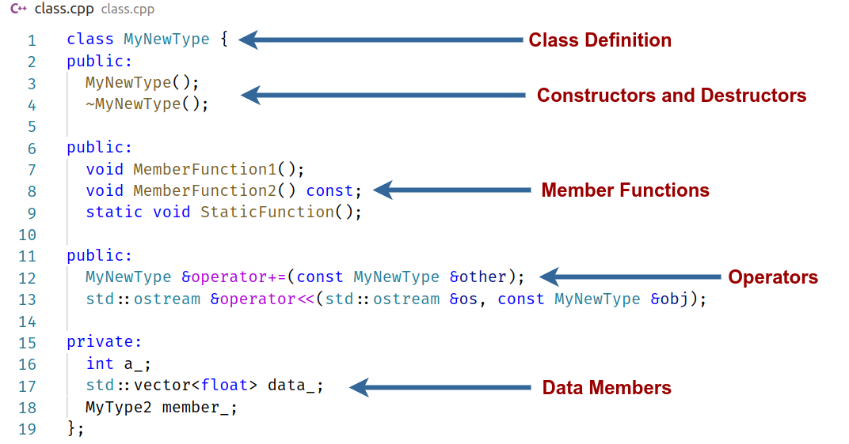
C++ Class Anatomy

Slide 13
Regular Types
The concept Regular extends Semiregular with equality operators which are == and !=
We should define == so that after constructing a copy, the original and the copy are equal
!= should always behave like: !(a == b)
Fundamentally equal is a symmetric function. It compares two things
  We will implement it as a friend function, not as a member function

Slide 14
Total orderings
The concept TotallyOrdered extends Regular by adding a comparison operator <
operator < must obey the following mathematical properties:
  Axiom 1: Anti-reflexive: !(a < a)
  Axiom 2: Transitive: If a < b and b < c then a < c
  Axiom 3: Anti-symmetric: If a < b then !(b < a)
  Axiom 4: If a != b then a < b or b > a
The semantics of < must be totally bound to the semantics of equality and related operations
  The following should always be true, otherwise the world perishes.
    a >= b --> !(a < b)
    a > b --> b < a
    a <= b --> !(b < a)

Slide 15
Spaceship operator <=>
C++20 introduced a simplified way of writing relational operators for user defined types
Instead of implementing all relation operators (<, <=, >, >=, ==, !=), you can implement a three-way comparison operator <=>
  Returns < 0, if a < b
  Returns == 0, if a == b
  Returns > 0, if a > b
The other relational operators are automatically synthesized by the compiler
Simplest way is to define a member function for X:
  friend auto operator(X const&, X const&) = default;
  Will apply spaceship operator member-wise

Slide 16
Singleton

Slide 17
A Pattern for Regular Types
We’ll develop the simplest possible Regular (even TotallyOrdered) type: singleton
The dictionary says: singleton, pair, triple, quadruple, etc.
  A pair has two things, well a singleton has just one thing
Can be used as a pattern (or “template”) for any types you will want to create
  It is the most simple class possible
    It will have no (functionality oriented) code whatsoever
  It is the most complete class possible
    It will have all the language details about type creation that you need to know
  It is a ‘pure’ regular type

Slide 18
Template Type Functions
Singleton:
  template <typename T>
  struct singleton
  {
  T value;
  };
template <typename T>
  Why template?
    We want to write something which takes one type and returns another type, i.e. a ‘type function’
    In C++ the template mechanism is just that
Simplest type function example
  int*: i.e. get an int and return an int*
  Transform one type into another type
Singleton is a type function that takes a T and gives us a singleton<T>

Slide 19
Create new Types with Classes and Structs
Classes are used to encapsulate data
    along with methods to process them
Every class or struct defines a new type
Terminology:
  Type or class to talk about the defined type
A variable of such type is an instance of class (or an object)
Classes allow C++ to be used as an Object Oriented Programming language
  std::string, std::vector, etc. are all classes (predefined in the C++ standard library)

Slide 20
Compiler Generated Functions
In C++, each user defined type has 6 special functions
  Those are being generated by the compiler, if not explicitly provided
  These functions are always available
Here are the 6 functions
  Default constructor
  Destructor
  Copy constructor
  Copy assignment
  Move constructor
  Move assignment
The special functions are being automatically used in certain situations
The compiler generated functions simply apply its operation to all members of the type
Unfortunately the spaceship operator is not automatically generated, you have to be explicit

Slide 21
Compiler Generated Functions
Constructors are automatically used whenever a new instance of a user defined type is created (start lifetime of object)
  Default constructor is used when no additional arguments are supplied:
singleton<int> s;
Destructor is automatically called whenever an instance of a user defined type goes out of scope (ends the lifetime of an object)
Copy constructor is used whenever a new instance of a user defined type is created and initialized from another instance of that type:
singleton<int> s1 = s;
Copy assignment is used whenever an existing instance of a user defined type is assigned to another instance of that type:
singleton<int> s2; s2 = s1;

Slide 22
Compiler Generated Functions
Any compiler generated special function by default invokes the corresponding special functions for all member data of the user defined type
  Default constructor invokes default constructor of all members (in order of their definition)
  Destructor invokes destructors of all members (in reverse order)
  Etc.

Slide 23
Semi-regular singleton
Let’s implement support to make singleton Semiregular
struct singleton {
// Semiregular:
singleton() {} // default constructor: could be implicitly declared sometimes
~singleton() {} // destructor: could be implicitly declared
singleton(singleton const& x) // copy constructor: could be implicitly declared
: value(x.value)
{
}
singleton& operator=(singleton const& x) // copy assignment operator: could be implicitly declared
{
value = x.value;
return *this;
}
};

Slide 24
Semi-regular singleton
Let’s implement support to make singleton Semiregular
// Semiregular:
singleton() = default; // default constructor
~singleton() = default; // destructor
// copy constructor
singleton(singleton const& x) = default;
// copy assignment
singleton& operator=(singleton const& x) = default;

Slide 25
Semi-regular singleton
What are the semantics of the default constructor?
  In this case you want whatever the default value of T is, to be constructed. The compiler will do this for us.
The default constructor will always be synthesized by the compiler unless you have another constructor.
  Always add it to avoid surprises!

Slide 26
Semi-regular singleton
Should the destructor be virtual?
  No! Why should it be?
  Some people say ‘all destructors have to be virtual’ – they couldn’t be more wrong than that!
Feel free to make singleton final to prevent people from deriving from it
  There is no point in ever deriving from it anyways:
template <typename T>
struct singleton final
{
// ...
};

Slide 27
Regular singleton
// Regular
friend bool operator==(singleton const& x, singleton const& y)
{
return x.value == y.value;
}
friend bool operator!=(singleton const& x, singleton const& y)
{
return !(x == y);
}
Recall that we decided not to define these as member functions
  they are symmetric
  friend functions inside the class declaration are not member functions
    but still have all the access to all the members
  More importantly this signature is nice. If you put it outside you discover you have to write an ugly thing

Slide 28
Equality and the three laws of thought
The law of identity: a == a
  Popeye the Sailor used to say, “I am, what I am”
The law of non-contradiction:
  You cannot have a predicate P be true and !P be true at the same time.
The law of excluded middle:
  Every predicate P must be either true, or false.
Exercise: Figure out a type that violates the law of identity

Slide 29
Totally ordered singleton
// TotallyOrdered
friend bool operator<(singleton const& x, singleton const& y)
{
return x.value < y.value;
}
friend bool operator>(singleton const& x, singleton const& y)
{
return y < x;
}
friend bool operator<=(singleton const& x, singleton const& y)
{
return !(y < x);
}
friend bool operator>=(singleton const& x, singleton const& y)
{
return !(x < y);
}

Slide 30
Totally ordered singleton (C++20)
// TotallyOrdered, synthesizes ==, !=, <, >, <=, >=
friend auto operator<=>(singleton const& x, singleton const& y)
{
return x.value <=> y.value;
}
Or even better:
// TotallyOrdered, synthesizes ==, !=, <, >, <=, >=
friend auto operator<=>(singleton const& x, singleton const& y) = default;
Spaceship operator <=>: should have been part of the language forever and should be synthesized by the compiler (same as 6 predefined functions)
  Unfortunately it is not predefined

Slide 31
Concepts in C++ (since C++20)
What requirements do we have to apply to T in order for singleton<T> to be valid?
  C++20 introduced concepts allowing to constrain use of singleton
template <typename T>
requires(std::regular<T> || std::semiregular<T> || std::totally_ordered<T>)
struct singleton final
{
// ...
};
You might wonder how == will work, if you plug-in only a semiregular type T
  In C++ templates, things don’t have to be defined unless they are used
    If T has no equality, singleton<T> will have copy constructor and assignment but no equality.
    If T has an equality, then singleton<T> will have equality
    Etc.
Exercise: Copy the file for singleton and modify it to write pair

Slide 32
Instrumented
A performance measuring tool

Slide 33
instrumented<T>
We will write a wrapper (adapter, decorator) class instrumented<T> which will take a type T and behave exactly like T
We will be able to use instrumented<T> for any algorithm or container
  It will behave normally, just like a T
  In addition it will count all the operations that are applied to it
Which operations should we count?
  The ones specified by our concepts!
T will be SemiRegular, Regular, or TotallyOrdered
  Redefine all the operations: copy constructor, assignment, operator<, etc, adding code to count them

Slide 34
instrumented<T>
For example:
std::vector<double> vec;
my_func(vec.begin(), vec.end());
Could be replaced by:
std::vector<instrumented<double>> vec;
my_func(vec.begin(), vec.end());
And it will count all operations
Writing this particular class will teach to write Regular classes right.

Slide 35
instrumented<T>
What to do with all the counts? Where do they get stored?
We will define a base class to hold this data:
struct instrumented_base
{
enum operations {
n = 0, copy, assignment, destructor, default_constructor,
equality, comparison, construction
};
static constexpr size_t number_ops = 8;
static constexpr char const* counter_names[number_ops] = {
"n", "copy", "assignment", "destructor", "default_constructor",
"equality", "comparison", "construction"
};
static double counts[number_ops];
};

Slide 36
instrumented<T>
Use this base class as:
template <typename T>
requires(std::semiregular<T> || std::regular<T> || std::totally_ordered<T>)
struct instrumented : instrumented_base
{
// ...
};
Note that the base class does not change the size of instrumented<T>, i.e.
sizeof(instrumented<T>) == sizeof(T)

Slide 37
instrumented<T>
Copy and paste the singleton.hpp file we created
Replace the string singleton with instrumented
In addition to existing operations, we’ll add counting, e.g.:
instrumented(instrumented const& x) // copy constructor
: value(x.value)
{
++counts[copy]; // ‘copy’ is a constant index
}
instrumented() // default constructor
{
++counts[default_constructor]; // ‘default_constructor’ is another constant index
}

Slide 38
Number of Unique Elements
  Counting operations and measuring execution time:
    Using std::set
  std::vector<instrumented<int>> v = {...};
  std::set<instrumented<int>> set_of_ints(v.begin(), v.end());
  std::println("{}", set_of_ints.size());
    Using std::sort and std::unique:
  std::sort(v.begin(), v.end());
  std::println("{}", std::unique(v.begin(), v.end()) - v.begin());

Slide 39
Measuring Execution Time
We will use a simple class timer:
  class timer {
  private:
  using time_t = std::chrono::time_point<std::chrono::system_clock>;
  time_t start_time, stop_time;
  public:
  timer() = default;
  time_t start() { return (start_time = std::chrono::system_clock::now()); }
  time_t stop() { return (stop_time = std::chrono::system_clock::now()); }
  double elapsed() {
  auto diff = stop_time - start_time;
  return std::chrono::duration_cast<std::chrono::milliseconds>(diff).count();
  }
  };

Slide 40
Measuring Execution Time
  #include "timer.hpp"
  int main(int argc, char* argv[]) {
  timer t;
  t.start();
  // do something that you would like t to measure the
  // execution time for
  t.stop();
  std::println("The code took {} milliseconds to execute", t.elapsed());
  return 0;
  }

Slide 41
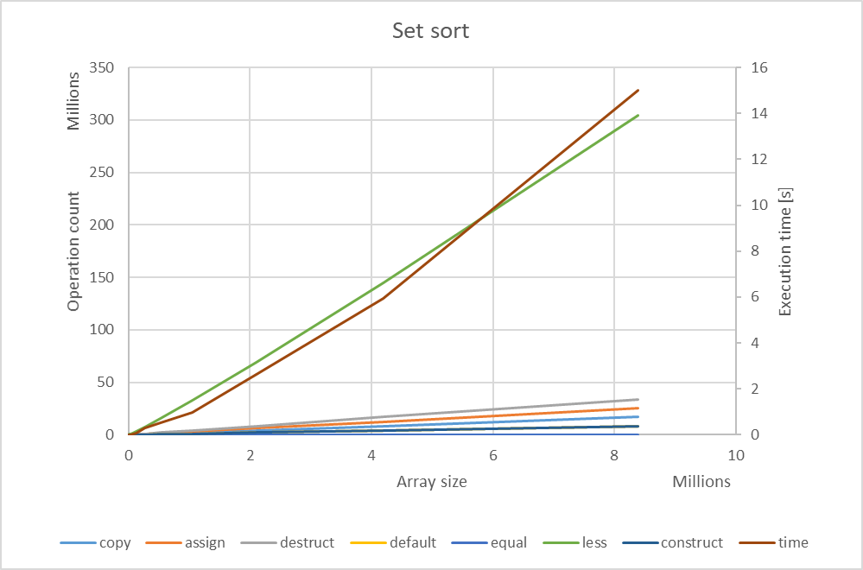
Using std::set

Slide 42
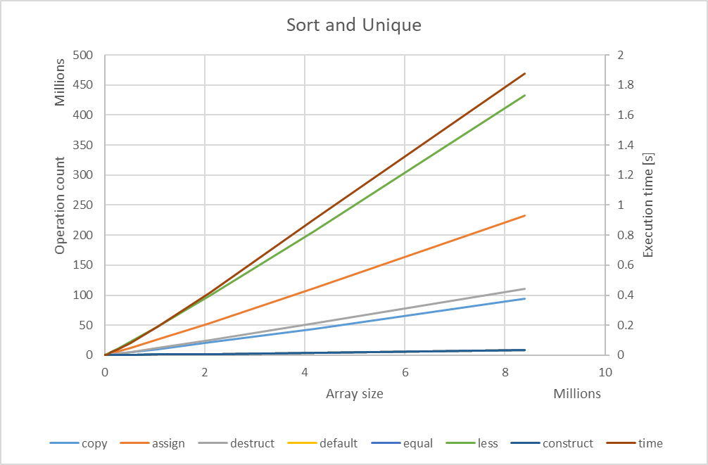
Using std::sort and std::unique

Slide 43
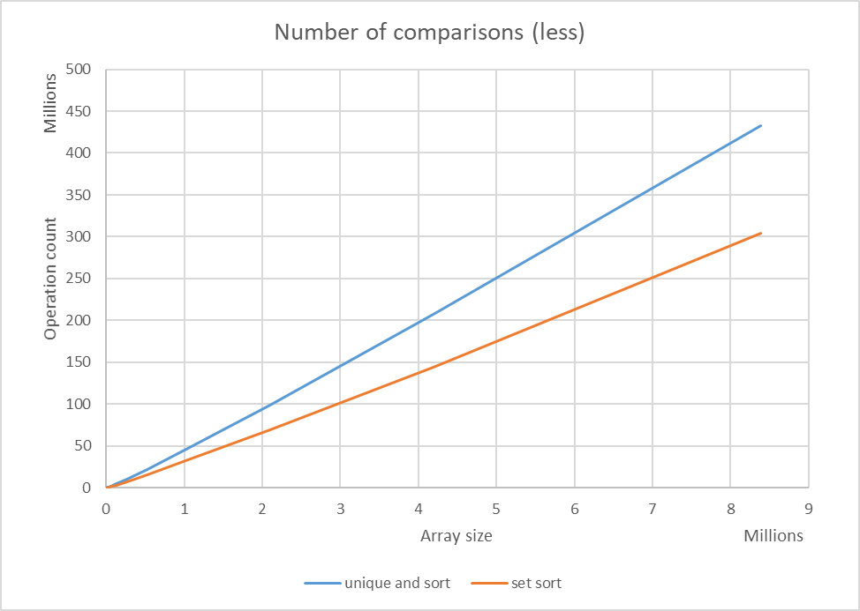
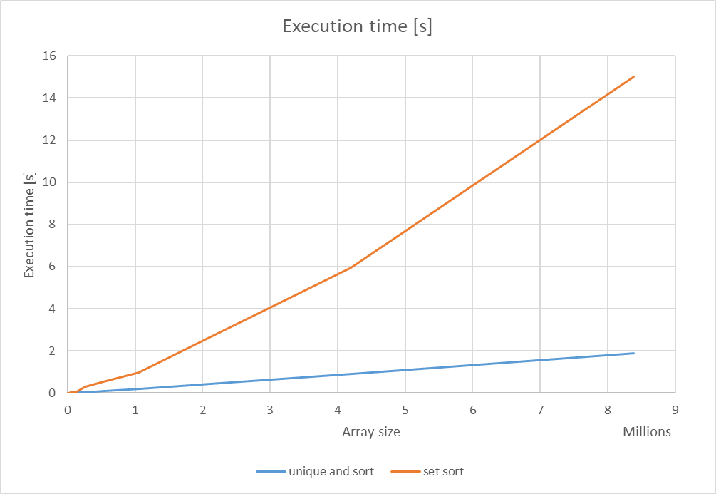
Number of unique elements

Slide 44
Conclusions
Even if the number of operations is larger, the code may run faster
Textbook solutions are often outdated
  They are based on the understanding of how computers worked 15 years ago
Understanding computer architecture is critically important in order to write efficient software
Understanding Big-O complexity characteristics of algorithms (and data structure functionalities) is equally important
All depends on the used data structures and how well those are aligned with how computers work
  Always use std::vector<T>
  If you think you can’t use it, try again and find a way so you can

Slide 45
Exercise
Measure and compare the amount of operations and the overall execution time for
  std::sort
  std::stable_sort
Explain what you’re seeing

Slide 46
Summary
We know that singleton<T> and instrumented<T> conform to the type requirements (concepts) that all standard algorithms and containers expect
  They can be used anywhere it would be valid to use T
This guarantees that these types can be used with all algorithms and containers
  This will not change the semantics of the algorithms
The understanding of what concepts are assumed to apply for a given function or data structure is important
  Allows to formalize in what contexts a function or data structure is guaranteed to produce correct results
If a function or data structure works with a type that conforms to a set of concepts
  We know that it will work with any other type that conforms to those concepts as well

Slide 47








