Slide 1
Distributed Parallelism with HPX (2)
Lecture 20
Hartmut Kaiser
https://teaching.hkaiser.org/spring2025/csc4400/

Slide 2
Overview
SPMD / CSP recap
A simple mental model
Basic HPX
Four Function HPX Point to Point Version
Four Function HPX Collective Version
Laplace’s equation on a regular grid

Slide 3
A Distributed Laplace’s Equation Solver

Slide 4
Laplace’s Equation on a Regular Grid
Discretization
The values of each
point on the grid
The average of its neighbors

Slide 5
Laplace’s Equation on a Regular Grid

Slide 6
Laplace’s Equation on a Regular Grid
k, k+1: Iteration timesteps

Slide 7
Laplace’s Equation on a Regular Grid
while (!converged) {
for (size_t i = 1; i != N + 1; ++i) {
for (size_t j = 1; j != N + 1; ++j) {
y(i, j) = (x(i - 1, j) + x(i + 1, j) +
x(i, j - 1) + x(i, j + 1)) / 4.0;
swap(x, y);
}

Slide 8
Main Sequential Jacobi Sweep
  using grid = Matrix;
  double jacobi_step(grid const& x, grid& y)
  {
  assert(x.rows() == y.rows() && x.columns() == y.columns());
  double rnorm = 0.0;
  for (size_t i = 1; i != x.rows() - 1; ++i)
  {
  for (size_t j = 1; j != y.columns() - 1; ++j)
  {
  y(i, j) =
  (x(i - 1, j) + x(i + 1, j) + x(i, j - 1) + x(i, j + 1)) / 4.0;
  rnorm += sqr(y(i, j) - x(i, j));
  }
  }
  return std::sqrt(rnorm);
  }

Slide 9
Sequential Jacobi Solver
    int jacobi(grid&x0, grid& x1, size_t max_iterations, double epsilon)
    {
    for (size_t step = 0; step != max_iterations; ++step)
    {
    double rnorm = jacobi_step(x0, x1);
    if (rnorm < epsilon) return 0;
    std::swap(x0, x1);
    }
    return -1;
    }

Slide 10
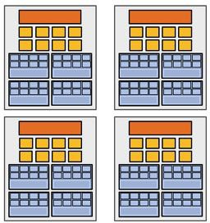
Problem to solve
Discretization/Decomposition
Subproblems (a.k.a.
“tasks”, “work to do”)
Assignment
Parallel Threads ** (“workers”)
Parallel program (communicating threads)
Orchestration
Mapping
Execution on parallel machine

Slide 11
Decomposition
for (size_t i = 1; i != N - 1; ++i)
for (size_t j = 1; j != N - 1; ++j)
y(i, j) = (x(i - 1, j) + x(i + 1, j) +
x(i, j - 1) + x(i, j + 1)) / 4.0;

Slide 12
Decomposition
for (size_t i = 1; i != N - 1; ++i)
for (size_t j = 1; j != N - 1; ++j)
y(i, j) = (x(i - 1, j) + x(i + 1, j) +
x(i, j - 1) + x(i, j + 1)) / 4.0;

Slide 13
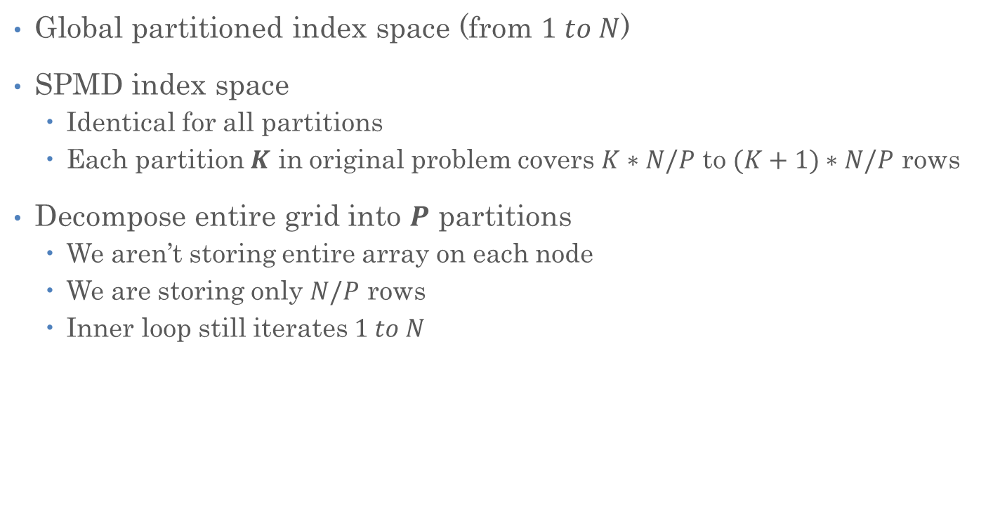
Decomposition
Global partitioned index space (from $1 to N$)
SPMD index space
  Identical for all partitions
  Each partition $K$ in original problem covers $K∗N/P$ to $(K+1)∗N/P$ rows
Decompose entire grid into $P$ partitions
  We aren’t storing entire array on each node
  We are storing only $N/P$ rows
  Inner loop still iterates $1 to N$

Slide 14
Decomposition (global indices)
for (size_t i = K * N/P + 1; i != (K + 1) * N/P - 1; ++i)
for (size_t j = 1; j != N - 1; ++j)
y(i, j) = (x(i - 1, j) + x(i + 1, j) +
x(i, j - 1) + x(i, j + 1)) / 4.0;

Slide 15
Decomposition (local indices)
for (size_t i = 1; i != N/P - 1; ++i)
for (size_t j = 1; j != N - 1; ++j)
y(i, j) = (x(i - 1, j) + x(i + 1, j) +
x(i, j - 1) + x(i, j + 1)) / 4.0;

Slide 16
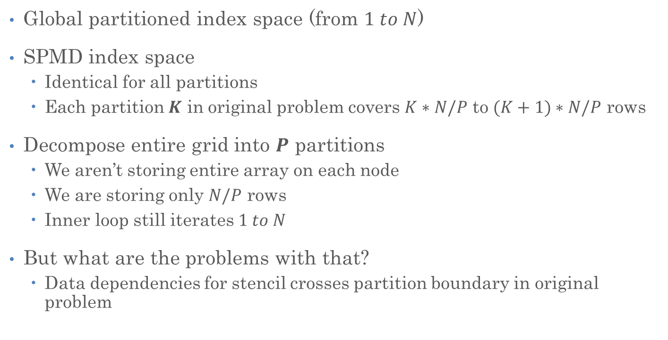
Decomposition
Global partitioned index space (from $1 to N$)
SPMD index space
  Identical for all partitions
  Each partition $K$ in original problem covers $K∗N/P$ to $(K+1)∗N/P$ rows
Decompose entire grid into $P$ partitions
  We aren’t storing entire array on each node
  We are storing only $N/P$ rows
  Inner loop still iterates $1 to N$
But what are the problems with that?
  Data dependencies for stencil crosses partition boundary in original problem

Slide 17
Decomposition

Slide 18
Decomposition
The code reads/writes local data
  Stencil accesses elements from neighboring
  partitions
Problem in distributed memory
  Causes read to non-existing (local) data
We need to make these into valid reads
  And preserve the as-if property
Add an extra row (on some nodes) for
the boundary
  Needed for as-if

Slide 19
Decomposition
Add a boundary to each of the partitions
  Not part of the original problem
  But needed to create the (as-if) illusion
  To the local / SPMD code, the boundary and as-if are the same

Slide 20
As-If
Last row of upper partition needs
to be as-if it was the second row
of lower partition
First row of lower partition needs
to be as-if it was the second to the
last row of lower partition

Slide 21
As-If
Note that the additional boundary rows are not changed during an iteration
We access elements of the boundary only for reading
The grid y is only written to, while the grid x is only read from
Does the boundary row always have to have the same value as the other row?
  No, only for the duration of one iteration
  The boundary changes only on every outer iteration (on the swap())
  We need to make as-if true after the swap
for (size_t i = 1; i != N/P - 1; ++i)
for (size_t j = 1; j != N - 1; ++j)
y(i, j) = (x(i - 1, j) + x(i + 1, j) +
x(i, j - 1) + x(i, j + 1)) / 4.0;

Slide 22
Compute / Communicate
To ensure “as-if”,
  We need to update the boundary cells with “as-if” values from the neighboring partition
  Before they are read at the next outer iteration

Slide 23
Compute / Communicate
while (!converged) {
for (size_t i = 1; i != N + 1; ++i) {
for (size_t j = 1; j != N + 1; ++j) {
y(i, j) = (x(i - 1, j) + x(i + 1, j) +
x(i, j - 1) + x(i, j + 1)) / 4.0;
swap(x, y);
make_as_if(x); // collectively communicate ghost cells
}
Standard terminology for
as-if boundary is ghost cell
ghost
ghost

Slide 24
Compute / Communicate
The alternating sequence of compute and communicate is an almost universal pattern in SPMD programs
As we will see, this is also one of the universal performance problems with SPMD program as well
  Especially if required computation is not uniform across localities
  Always waits for the ‘slowest guy’ before proceeding to next timestep
while (!converged) {
for (size_t i = 1; i != N + 1; ++i) {
for (size_t j = 1; j != N + 1; ++j) {
y(i, j) = (x(i - 1, j) + x(i + 1, j) +
x(i, j - 1) + x(i, j + 1)) / 4.0;
swap(x, y);
make_as_if(x); // communicate ghost cells (collectively)
}
Compute
Communicate

Slide 25
Compute / Communicate
“Bulk Synchronous Parallel” (BSP) programming model
  Processors are still only loosely coupled
  But the compute / communicate pattern keeps them (collectively) synched in a bulk sense (after each time step)
Performs and scales reasonably well as long as computation is load balanced
  However: always uses only ‘half’ of the machine

Slide 26
Parallel Jacobi Solver
    int jacobi(grid&x0, grid& x1, size_t max_iterations, double epsilon)
    {
    for (size_t step = 0; step != max_iterations; ++step)
    {
    double rnorm = jacobi_step(x0, x1);
    if (rnorm < epsilon) return 0;
    std::swap(x0, x1);
    }
    return -1;
    }
As-if: This needs to happen on all nodes, use all_reduce instead of reduce
As-if: Update ghost cells

Slide 27
Main Parallel Jacobi Step
  using grid = Matrix;
  double jacobi_step(grid const& x, grid& y)
  {
  assert(x.rows() == y.rows() && x.columns() == y.columns());
  double rnorm = 0.0;
  for (size_t i = 1; i != x.rows() - 1; ++i)
  {
  for (size_t j = 1; j != y.columns() - 1; ++j)
  {
  y(i, j) =
  (x(i - 1, j) + x(i + 1, j) + x(i, j - 1) + x(i, j + 1)) / 4.0;
  rnorm += sqr(y(i, j) - x(i, j));
  }
  }
  return std::sqrt(rnorm);
  }
No changes!

Slide 28
hpx::collectives::all_reduce
  template <typename T, typename F>
  T all_reduce(hpx::launch::sync_policy, communicator comm,
  T&& value, F&& op,
  this_site_arg this_site = this_site_arg(),
  generation_arg generation = generation_arg());

Slide 29
hpx::collectives::all_reduce
The value is the ‘send buffer’ for all localities
After all_reduce returns, all localities have the reduction result of the values supplied by all localities
Note (true for all collective operations):
  All localities connected to the given communicator must call the function
  Otherwise none of the localities will finish the operation

Slide 30
hpx::collectives::all_reduce
  template <typename T, typename F>
  T all_reduce(hpx::launch::sync_policy, communicator comm,
  T&& value, F&& op,
  this_site_arg this_site = this_site_arg(),
  generation_arg generation = generation_arg());
Here:
  sync_policy: special predefined type that instructs to execute the all_reduce operation synchronously (wait for operation to finish)
  comm: the communicator instance used for this message
  value: local data value to use for reduction
  this_site: the local ‘endpoint’ (defaults to this locality)
  generation: a sequence number of the operation (defaults to invocation counter)
Returns the reduced value from all participating localities

Slide 31
Parallel Jacobi Solver
int jacobi_parallel(grid& x0, grid& x1, size_t max_iterations, double epsilon)
{
for (size_t step = 0; step != max_iterations; ++step)
{
double local_norm = jacobi_step(x0, x1);
double rnorm = all_reduce(hpx::launch::sync,
hpx::collectives::get_world_communicator(), local_norm, std::plus{});
if (rnorm < epsilon) return step;
std::swap(x0, x1);
update_ghosts(x0); // maintain as-if, exchange ghost cells
}
return max_iterations;
}

Slide 32
Updating Ghost Cells
void update_ghosts(grid& x) {
using ghost_cells = std::vector<double>;
if (locality_id != 0) {
// send our ghost cells to partition above
set(hpx::launch::sync, channel_comm, that_site_arg(locality_id - 1),
ghost_cells(row(x, 1)), tag_arg(2));
// receive ghost cells from partition above
row(x, 0) = get<ghost_cells>(hpx::launch::sync, channel_comm,
that_site_arg(locality_id - 1), tag_arg(1));
}
if (locality_id != num_localities - 1) {
// send our ghost cells to partition below
set(hpx::launch::sync, channel_comm, that_site_arg(locality_id + 1),
ghost_cells(row(x, x.rows() - 2)), tag_arg(1));
// receive ghost cells from partition below
row(x, x.rows() - 1) = get<ghost_cells>(hpx::launch::sync, channel_comm,
that_site_arg(locality_id + 1), tag_arg(2));
}
}

Slide 33
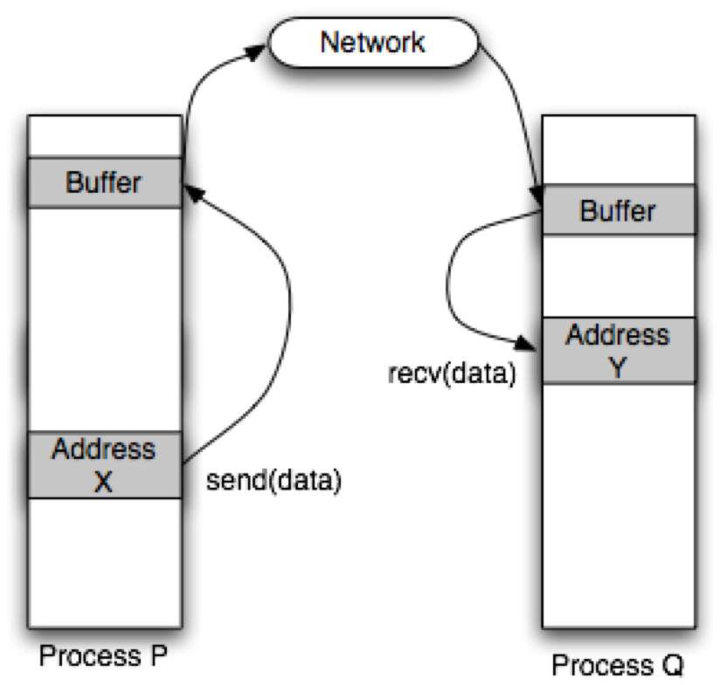
Updating Ghost Cells
Why does that work?
System will buffer the data
The set() API will return once the channel
has ‘accepted the data
  The corresponding get<>() does not need to have
  succeeded yet
However, as we will see later, using
asynchronous communication is beneficial
(in many ways)

Slide 34
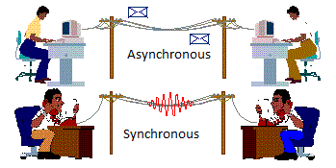
Asynchronous Communication

Slide 35
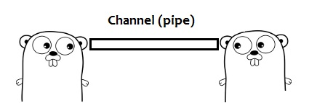
Asynchronous Channels
High level abstraction of communication operations
  Perfect for asynchronous boundary exchange
Modelled after Go-channels
Create on one thread, refer to it from another thread
  Also: create on one locality (node), refer to it from another locality
  Conceptually similar to bidirectional P2P communications
Asynchronous in nature
  channel::get() and channel::set() return futures

Slide 36
Asynchronous Jacobi (Take 1)
double jacobi_step_parallel_async(grid& x, grid& y) {
auto comm = get_world_channel_communicator();
auto [num_localities, locality_id] = comm.get_info();
// exchange ghost cells with partition above and below
std::vector<hpx::future<void>> ghost_updates;
if (locality_id != 0) ghost_update_above(comm, x, ghost_updates);
if (locality_id != num_localities - 1) ghost_update_below(comm, x, ghost_updates);
double rnorm = jacobi_step(x0, x1); // local stencil application (without ghost cells)
hpx::wait_all(ghost_updates); // wait for boundary exchange to be finished
return std::sqrt(rnorm + jacobi_step_ghosts()); // apply stencil to ghost cells
}

Slide 37
Asynchronous Jacobi (Take 1)
// exchange ghost cells with partition above
void ghost_update_above(hpx::collectives::channel_communicator comm, grid& x,
std::vector<hpx::future<void>>& ghost_updates)
{
using namespace hpx::collectives;
auto [_, locality_id] = comm.get_info();
// receive our ghost cells from partition above
hpx::future<ghost_cells> recv =
get<ghost_cells>(comm, that_site_arg(locality_id - 1), tag_arg(1));
ghost_updates.emplace_back(
recv.then([&](hpx::future<ghost_cells>&& f) { row(x, 0) = f.get(); }));
// send our ghost cells to partition above
ghost_updates.emplace_back(set(comm, that_site_arg(locality_id - 1),
ghost_cells(row(x, 1)), tag_arg(2)));
}

Slide 38
Asynchronous Jacobi (Take 1)
double jacobi_step_ghosts_row(grid const& x, grid& y, size_t i)
{
double rnorm = 0.0;
for (size_t j = 1; j != x.columns() - 1; ++j)
{
y(i, j) = (x(i - 1, j) + x(i + 1, j) + x(i, j - 1) + x(i, j + 1)) / 4.0;
rnorm += sqr(y(i, j) - x(i, j));
}
return rnorm;
}
// apply stencil to ghost cells (first and last rows)
double jacobi_step_ghosts(grid const& x, grid& y)
{
return jacobi_step_ghosts_row(x, y, 1) +
jacobi_step_ghosts_row(x, y, x.rows() - 2);
}

Slide 39
Futurized 2D Jacobi: Timestep i
Timestep: i
A
B
Channels
Partitions
C
D
Notes:
In the bottom left grid, iteration is in column-major order

Slide 40
Futurized 2D Jacobi : Timestep i+1
Timestep: i
Timestep: i+1
A
B
C
D

Slide 41
Futurized 2D Jacobi
Timestep: i
Timestep: i+1
A
B
C
D

Slide 42
Futurized 2D Jacobi : Main Loop
    // execute this for each partition concurrently
    hpx::future<void> simulate(std::size_t steps)
    {
    for (size_t t = 0; t != steps; ++t)
    {
    co_await perform_one_time_step(t);
    }
    }

Slide 43
One Timestep: Update Boundaries
  future<void> upper_boundary(int t); // same for other boundaries
  future<void> perform_one_time_step(int t)
  {
  // Update our boundaries from neighbors
  co_await when_all(upper_boundary(t), right_boundary(t),
  lower_boundary(t), left_boundary(t));
  // Apply stencil to partition
  co_await for_loop(par(task), min + 1, max - 1,
  [&](size_t idx) { /* apply stencil to each inner point */ });
  }

Slide 44
One Timestep: Ghost Cells
  future<void> upper_boundary(int t)
  {
  // Update upper boundary from upper neighbor
  vector<double> data = co_await channel_up_from.get(t);
  // process upper ghost-zone data using received data
  for_loop(seq, 1, size(data) - 1,
  [&](size_t idx) { /* apply stencil to each point in data */ });
  // send new ghost zone data back to upper neighbor
  co_await channel_up_to.set(data, t + 1);
  }

Slide 45
2D Jacobi, Fully Parallelized
Partitions are distributed across machine
More partitions per node (locality) than cores
  Oversubscription
Code equivalent regardless whether neighboring partition is on the same node
Overlap of communication and computation
  More parallelism (work) than compute resources (cores)

Slide 46
Summary
As-if is the most important principle in distributed parallelization (correctness first)
SPMD has high degree of self-similarity – solving global problem is same as solving local problem – communication enforces as-if
Ubiquitous compute / communicate cycle
Adding asynchrony helps decoupling localities
Adding local parallelism is orthogonal and straight-forward

Slide 47
