Slide 1
Monte Carlo Methods
Lecture 3
Hartmut Kaiser
https://teaching.hkaiser.org/spring2025/csc4700/

Slide 3
Pseudo Random Numbers

Slide 4
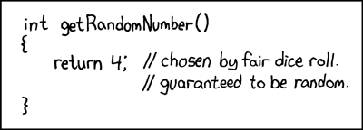
Random Numbers
https://xkcd.com/221/

Slide 5
Pseudo Random Numbers
Deterministic, but have statistical properties resembling true random numbers
Common approach: each successive pseudorandom number is a function of previous
Random pattern: Passes statistical tests (e.g., can use chi-squared)
Long period: Go as long as possible without repeating
Efficiency
Repeatability: Produce same sequence if started with same initial conditions
Portability

Slide 6
Example
Use:
$$x_{n+1}=\left(ax_{n}+b\right) mod c$$
Choose constants carefully, e.g.
a = 1664525
b = 1013904223
c = 2³² – 1
Results in integer in $[0, c)$
Not suitable for Monte Carlo: e.g. exhibit serial correlations

Slide 7
Pseudo Random Numbers
To get floating-point numbers in $[0..1)$, divide integer numbers by $c + 1$
To get integers in range $[u.v]$, divide by $(c+1)/(v–u+1)$, truncate, and add $u$
Better statistics than using $mod (v –u+1)$
Only works if $u$ and $v$ small compared to $c$
C++:
Separates generation from distribution
std::uniform_int_distribution<int>
std::uniform_real_distribution<double>
std::normal_distribution<double>
https://en.cppreference.com/w/cpp/named_req/RandomNumberDistribution

Slide 8
Random Numbers (Don’t do this)
#include <cstdlib> // Include for using rand
#include <ctime> // Include for getting the current time
#include <print>
int main()
{
// Use the current time as random seed
std::srand(std::time(0));
// Get one random number
int random_value = std::rand();
// print result
std::println("Random value in range [0, {}]: {}", RAND_MAX, random_value);
}

Slide 9
Statistically distributed Random Numbers
#include <print>
#include <random> // Include for advanced random numbers
int main()
{
// Create a random number device
std::random_device rd;
// Use the standard mersenne_twister_engine
std::mt19937 gen(rd());
// Specify the interval [1, 6]
std::uniform_int_distribution<int> dis(1, 6);
// Specify the interval [1.0, 6.0]
std::uniform_real_distribution<double> disd(1, 6);
std::println("random int: {}, real: {}", dis(gen), disd(gen));
}

Slide 10
Random Number Distribution
Histogram allows to approximate probability distribution:
template <typename T>
class histogram {
std::vector<size_t> bucket_data;
T min_value, max_value;
public:
histogram(size_t num_buckets, T smallest, T largest);
void add_value(T value);
std::vector<T> buckets() const;
std::vector<size_t> normalized_data() const;
};
This is a semi-regular type!

Slide 11
Random Number Distribution
// Store num_buckets counters evenly distributed in between the smallest
// and largest values. It will also store counters in two additional
// buckets, one for values smaller and one for values larger than the range
// given during construction.
histogram(size_t num_buckets, T smallest, T largest)
: bucket_data(num_buckets + 2)
, min_value(smallest)
, max_value(largest)
{}

Slide 12
Random Number Distribution
// Increment the counter for the appropriate bucket, which index is computed
// based on the number of buckets and the smallest and largest values that
// were used during construction.
void add_value(T value) {
// for out-of-range values smaller than minimum use first bucket
size_t index = 0;
if (value > max_value) {
// for out-of-range values larger than maximum use last bucket
index = bucket_data.size() - 1;
} else if (value >= min_value) {
auto bucket_size = (max_value - min_value) / (bucket_data.size() - 2);
index = static_cast<size_t>((value - min_value) / bucket_size) + 1;
}
++bucket_data[index];
}

Slide 13
Random Number Distribution
// Return a vector of mid-point values for each bucket.
auto buckets() const {
std::vector<T> buckets;
buckets.reserve(bucket_data.size() - 2);
buckets.push_back(min_value);
T delta = (max_value - min_value) / (bucket_data.size() - 2);
for (size_t i = 0; i != bucket_data.size() - 2; ++i)
buckets.push_back(min_value + i * delta + 0.5 * delta);
buckets.push_back(max_value);
return buckets;
}

Slide 14
Random Number Distribution
// Return a vector of normalized counts for each bucket collected.
auto normalized_data() const {
std::vector<double> data;
data.reserve(bucket_data.size());
auto max = std::max_element(bucket_data.begin(), bucket_data.end());
std::transform(
bucket_data.begin(), bucket_data.end(),
std::back_inserter(data),
[&](size_t value) { return double(value) / *max; });
return data;
}

Slide 15
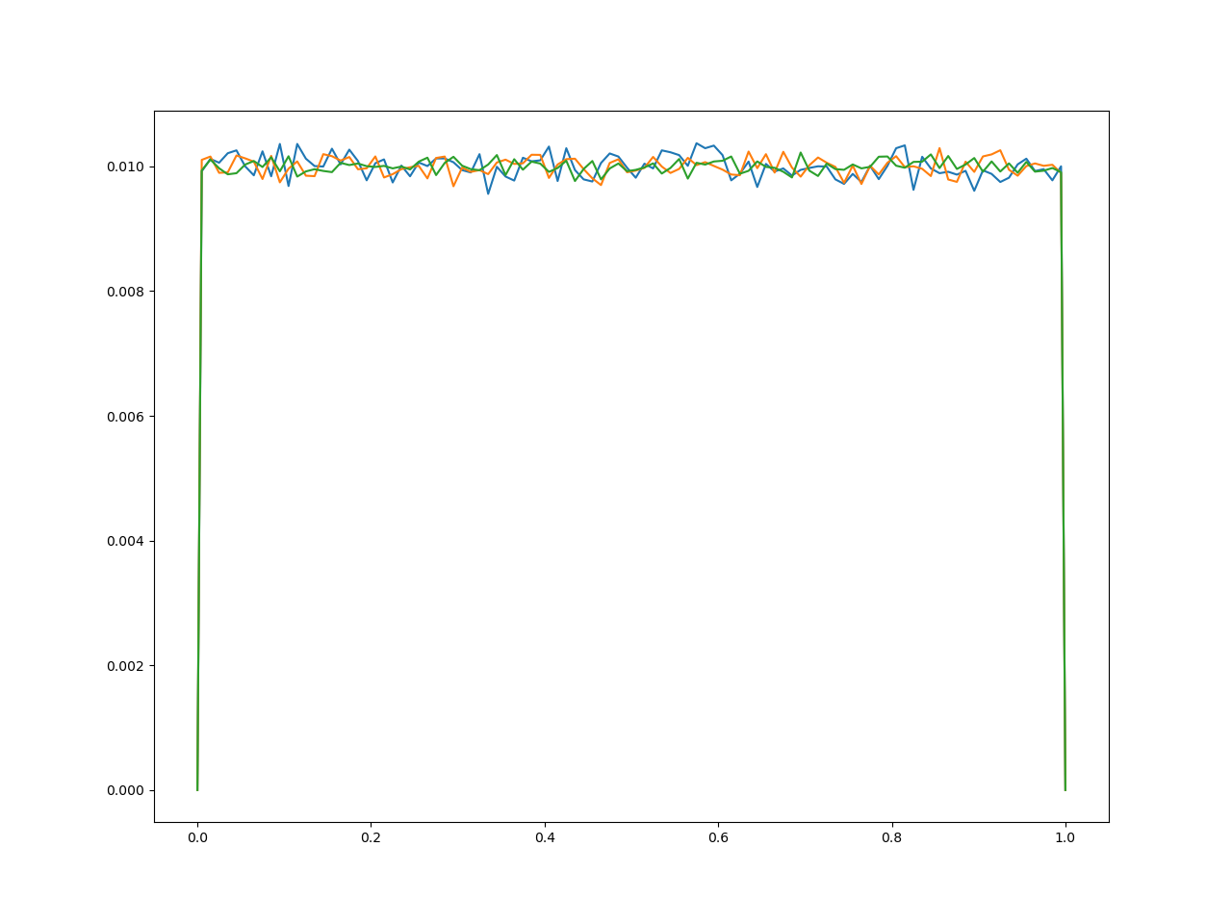
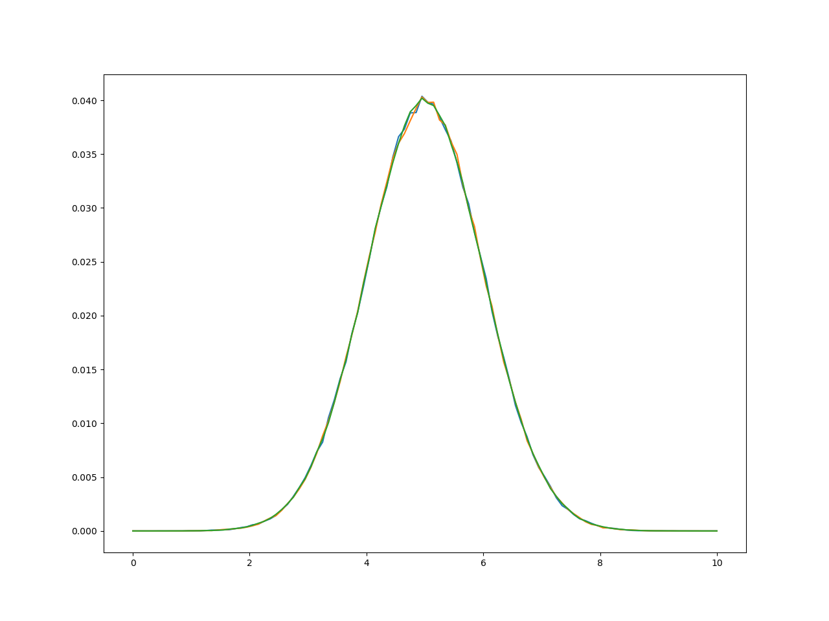
Plotting Distributions
plt::figure_size(1280, 960); // Initialize a 1280 X 960 figure
for (int max_attempts = 17; max_attempts < 21; ++max_attempts) {
int const n_total = 1 << max_attempts; // 2^N
histogram<double> hist(100, 0.0, 1.0);
for (int n = 0; n < n_total; ++n)
hist.add_value(get_random_number());
plt::plot(hist.buckets(), hist.normalized_data());
}
plt::save("random_numbers.png");

Slide 16
Aside: Generating Graphs
We will use matplotlib.h, a wrapper for Pythons matplotlib module
Documentation can be found at https://matplotlib-cpp.readthedocs.io/
Pre-installed on Docker image used for assignments
Minimal example:
#include "matplotlibcpp.h"
#include <vector>
namespace plt = matplotlibcpp;
int main() {
std::vector<double> y = {1, 3, 2, 4};
plt::plot(y);
plt::save("minimal.png");
}

Slide 17
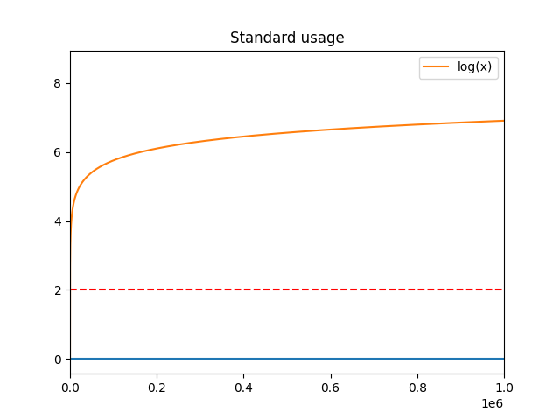
int n = 5000; // 5000 data points
std::vector<double> x(n), y(n), z(n), w(n, 2);
for (int i = 0; i < n; ++i) {
x[i] = i * i;
y[i] = std::sin(2 * pi * i / 360.0);
z[i] = std::log(i);
}
plt::figure(); // declare a new figure (optional if only one is used)
plt::plot(x, y); // automatic coloring: blue
plt::plot(x, w, "r--"); // red dashed line
plt::plot(x, z, {{"label", "log(x)"}}); // legend label "log(x)"
plt::xlim(0, 1000 * 1000); // x-axis interval: [0, 1e6]
plt::title("Standard usage"); // set a title
plt::legend(); // enable the legend
plt::save("standard.png"); // save the figure

Slide 18
Monte-Carlo Simulations

Slide 19
Monte Carlo Simulation
Used when it is not feasible or impossible to compute an exact result with a deterministic algorithm
Especially useful in
Studying systems with a large number of coupled degrees of freedom
Fluids, disordered materials, strongly coupled solids, cellular structures
For modeling phenomena with significant uncertainty in inputs
The calculation of risk in business
These methods are also widely used in mathematics
The evaluation of definite integrals, particularly multidimensional integrals with complicated boundary conditions

Slide 20
Monte Carlo Methods
Monte Carlo methods are computational algorithms
Rely on repeated random sampling to obtain numerical results
Three problem classes:
1. Probability distributions
2. Optimization
3. Numerical integration
General pattern:
1. Define the input parameters
2. Randomly chose input parameters
3. Do deterministic computations on the inputs
4. Aggregate the results

Slide 21
Example: Line Length
Suppose you have a 1×1 square
If two points are randomly picked within the square, what is the expected value (average) of the distance between them?
Exact answer: $I=\frac{2+\sqrt{2}+5∗arcsinh⁡(1)}{15}≈\text{0.52140543316472}\text{...}$
Algorithm
while $n<n_{total}$ repeat
Get two random number pairs $(x, y)$
where: $x, y:[0, 1]$
Calculate length
$length=\sqrt{{(x_{2}−x_{1})}^{2}+{(y_{2}−y_{1})}^{2}}$
Accumulate overall length, update $n$
Compute average length
Interactive question:
Which features of C++ do we need?
Loop, random numbers, std::print
$$l=1$$

Slide 22
Random Numbers
#include <print>
#include <random>
// Initialize random number generator
std::random_device rd;
std::mt19937 gen(rd());
double get_random_number()
{ std::uniform_real_distribution<double> dis(0.0, 1.0);
return dis(gen);
}
// Helper function to square a number
double sqr(double x)
{
return x * x;
}

Slide 23
Average Line Length
int main()
{
std::println("attempts,average length");
int const n_total = 10000;
double accumulated_length = 0.0;
for (int n = 0; n < n_total; ++n)
{
double x1 = get_random_number();
double x2 = get_random_number();
double y1 = get_random_number();
double y2 = get_random_number();
accumulated_length += std::sqrt(sqr(x2 - x1) + sqr(y2 - y1));
}
double length = accumulated_length / n_total;
std::println("{},{}", n_total, length);
return 0;
}

Slide 24
How many Attempts are needed?
attempts | average length | error
2 | 0.674785848 | 2.94E-01
4 | 0.338191643 | 3.51E-01
8 | 0.562140325 | 7.81E-02
16 | 0.583379611 | 1.19E-01
32 | 0.589994035 | 1.32E-01
64 | 0.587350866 | 1.26E-01
128 | 0.528131378 | 1.29E-02
256 | 0.510076918 | 2.17E-02
512 | 0.531026183 | 1.85E-02
1024 | 0.513027098 | 1.61E-02
2048 | 0.515803633 | 1.07E-02
4096 | 0.521301527 | 1.99E-04
8192 | 0.522698539 | 2.48E-03
16384 | 0.521847718 | 8.48E-04
32768 | 0.52195183 | 1.05E-03
65536 | 0.522813535 | 2.70E-03
131072 | 0.521373121 | 6.20E-05
262144 | 0.521448659 | 8.29E-05
524288 | 0.521805565 | 7.67E-04
1048576 | 0.521434376 | 5.55E-05
2097152 | 0.521393597 | 2.27E-05
4194304 | 0.521495376 | 1.72E-04
8388608 | 0.521449764 | 8.50E-05
16777216 | 0.521396853 | 1.65E-05
33554432 | 0.52139758 | 1.51E-05
67108864 | 0.521436921 | 6.04E-05
134217728 | 0.521400739 | 9.00E-06
268435456 | 0.521383023 | 4.30E-05
536870912 | 0.521418749 | 2.55E-05

Slide 25
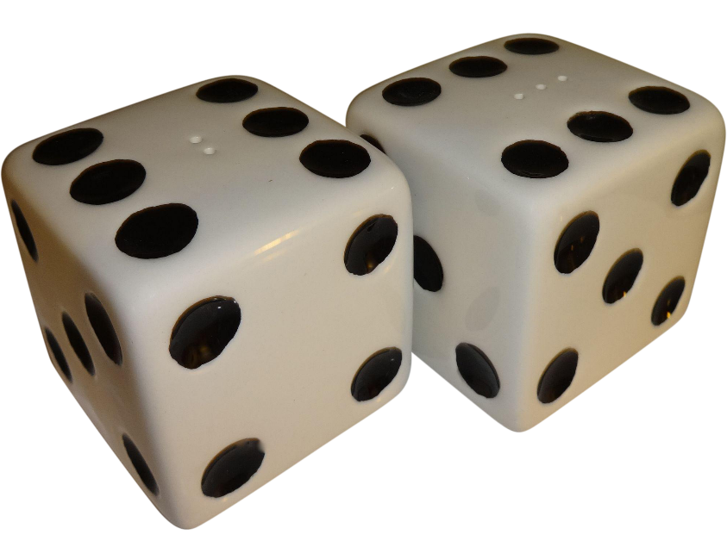
Example: Winning with Dice
Would it be profitable given 24 rolls of a pair of fair dice to bet against there being at least one double six?
Exact Answer: $1 −{\left(\frac{35}{36}\right)}^{24}≈0.49141…$
Algorithm:
while $n<n_{total}$ repeat
Get 24 pairs of two random integers in range [1, 6]
If for one of them both are equal to six: count win
$Probability = wins / n_total$

Slide 26
Random Numbers
#include <print>
#include <random>
// Initialize random number generator
std::random_device rd;
std::mt19937 gen(rd());
int roll_dice()
{ std::uniform_int_distribution<int> dis(1, 6);
return dis(gen);
}

Slide 27
Roll Dice
bool attempt_to_win()
{
for (int r = 0; r < 24; ++r)
{
int r1 = roll_dice();
int r2 = roll_dice();
if (r1 == 6 && r2 == 6)
{
return true;
}
}
return false;
}

Slide 28
Winning with Dice
int main()
{
std::println("attempts,probability");
int const n_total = 10000;
int num_wins = 0;
for (int n = 0; n < n_total; ++n)
{
if (attempt_to_win())
{
++num_wins;
}
}
double probability_of_win = static_cast<double>(num_wins) / n_total;
std::println("{},{}", n_total, probability_of_win);
}

Slide 29
How many Attempts are needed?
attempts | probability | error
2 | 0.5 | 1.75E-02
4 | 0.75 | 5.26E-01
8 | 0.375 | 2.37E-01
16 | 0.4375 | 1.10E-01
32 | 0.5 | 1.75E-02
64 | 0.453125 | 7.79E-02
128 | 0.4765625 | 3.02E-02
256 | 0.546875 | 1.13E-01
512 | 0.47265625 | 3.82E-02
1024 | 0.459960938 | 6.40E-02
2048 | 0.517089844 | 5.23E-02
4096 | 0.480712891 | 2.18E-02
8192 | 0.490112305 | 2.63E-03
16384 | 0.484130859 | 1.48E-02
32768 | 0.493560791 | 4.39E-03
65536 | 0.489471436 | 3.93E-03
131072 | 0.492385864 | 2.00E-03
262144 | 0.492095947 | 1.41E-03
524288 | 0.490514755 | 1.81E-03
1048576 | 0.491295815 | 2.20E-04
2097152 | 0.491357327 | 9.47E-05
4194304 | 0.491046906 | 7.26E-04
8388608 | 0.491469502 | 1.34E-04
16777216 | 0.491607308 | 4.14E-04
33554432 | 0.491272002 | 2.68E-04
67108864 | 0.491418511 | 2.98E-05
134217728 | 0.491410904 | 1.43E-05
268435456 | 0.491398305 | 1.13E-05
536870912 | 0.491401931 | 3.96E-06

Slide 30
Example: Estimate the value of $π$
Ingredients
Unit square $1x1$
Circle with the radius of $r = \frac{1}{2}$
Area of the circle $A_{c}=πr^{2}=\frac{π}{4}$
Area of the square $A_{s}=1x1=1$
Recall: $A_{c}=\frac{π}{4}→4A_{c}=π$
$$r=0.5$$
$$A_{c}$$
$$A_{s}$$
$$l=1$$

Slide 31
Example: Estimate the value of $π$
Now compute $π$ by using the two areas:
$$π=4\frac{A_{c}}{A_{s}}$$
The areas can be approximated by using $N$ random samples $(x, y)$ and count the points inside the circle $N_{c}$:
$$π≈4\frac{N_{c}}{N}$$
$r=$0.5
$$A_{c}$$
$$A_{s}$$
$$l=1$$

Slide 32
Algorithm
while $n<n_{total}$ repeat
Generate random coordinates $\left(x,y\right)∈R^{2}$
Check if $x^{2}+y^{2}≤1$
Increment $n_{c}$ if $≤1$
Increment number of attempts $n$
Calculate and print $4\frac{n_{c}}{n_{total}}$

Slide 33
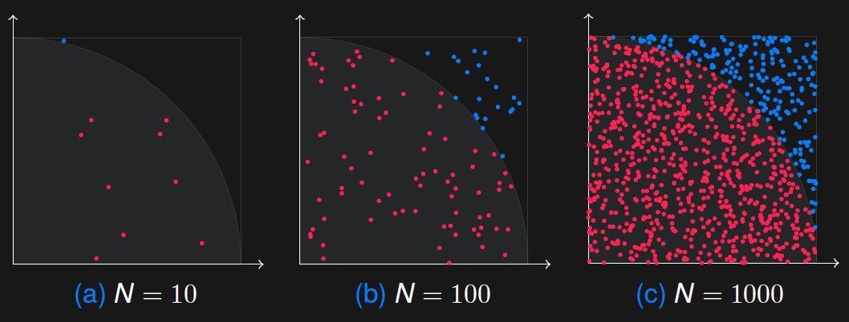
Example for various Numbers of Attempts
Distribution of the point inside the circle (red) and outside of the circle (blue) for $N=10$, $N=100$, and $N=1000$ random numbers.

Slide 34
Calculate $π$
int main()
{
int const n_total = 10000;
int nc = 0;
for (int n = 0; n < n_total; ++n)
{
double x = get_random_number();
double y = get_random_number();
if (sqr(x) + sqr(y) <= 1.0)
{
++nc;
}
}
std::println("Approximated pi for {} attempts: {}", n_total, (4.0 * nc) / n_total);
}

Slide 35
How many random Numbers are needed?
attempts | pi | error
2 | 2 | 3.63E-01
4 | 4 | 2.73E-01
8 | 3.5 | 1.14E-01
16 | 3.5 | 1.14E-01
32 | 3.25 | 3.45E-02
64 | 3.125 | 5.28E-03
128 | 3.3125 | 5.44E-02
256 | 3.140625 | 3.08E-04
512 | 3.265625 | 3.95E-02
1024 | 3.23828125 | 3.08E-02
2048 | 3.169921875 | 9.02E-03
4096 | 3.174804688 | 1.06E-02
8192 | 3.153808594 | 3.89E-03
16384 | 3.117919922 | 7.54E-03
32768 | 3.161254883 | 6.26E-03
65536 | 3.134887695 | 2.13E-03
131072 | 3.14151001 | 2.63E-05
262144 | 3.147781372 | 1.97E-03
524288 | 3.142829895 | 3.94E-04
1048576 | 3.138744354 | 9.07E-04
2097152 | 3.141403198 | 6.03E-05
4194304 | 3.141534805 | 1.84E-05
8388608 | 3.141631603 | 1.24E-05
16777216 | 3.141290188 | 9.63E-05
33554432 | 3.141633153 | 1.29E-05
67108864 | 3.141349852 | 7.73E-05
134217728 | 3.141705692 | 3.60E-05
268435456 | 3.141563967 | 9.13E-06
536870912 | 3.141544454 | 1.53E-05

Slide 36
Calculate $π$ in Parallel

Slide 37
Calculate $π$ Sequentially, Timing
Attempts | pi | Error | Elapsed [ms]
2 | 4 | 0.273239545 | 0
4 | 3 | 0.045070341 | 0
8 | 2.5 | 0.204225285 | 0
16 | 3 | 0.045070341 | 0
32 | 3 | 0.045070341 | 0
64 | 2.75 | 0.124647813 | 0
128 | 3.28125 | 0.044454314 | 0
256 | 3.234375 | 0.029533538 | 0
512 | 3.1171875 | 0.007768402 | 0
1024 | 3.11328125 | 0.0090118 | 0
2048 | 3.236328125 | 0.030155237 | 0
4096 | 3.129882813 | 0.003727358 | 0
8192 | 3.140625 | 0.000308014 | 0
16384 | 3.144775391 | 0.001013097 | 0
32768 | 3.146484375 | 0.001557083 | 1
65536 | 3.129272461 | 0.003921639 | 2
131072 | 3.141235352 | 0.000113733 | 6
262144 | 3.14289856 | 0.000415683 | 10
524288 | 3.143165588 | 0.000500681 | 20
1048576 | 3.142009735 | 0.000132761 | 38
2097152 | 3.143692017 | 0.000668248 | 82
4194304 | 3.140839577 | 0.000239712 | 137
8388608 | 3.141868591 | 8.78E-05 | 268
16777216 | 3.141479254 | 3.61E-05 | 506
33554432 | 3.141817093 | 7.14E-05 | 959
67108864 | 3.141506851 | 2.73E-05 | 2040
134217728 | 3.141727 | 4.28E-05 | 4135
268435456 | 3.141671851 | 2.52E-05 | 8169
536870912 | 3.141656928 | 2.05E-05 | 16252

Slide 38
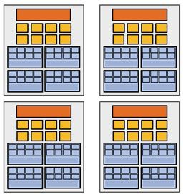
Problem to solve
Decomposition
Subproblems (a.k.a. “tasks”, “work to do”)
Assignment
Parallel Threads ** (“workers”)
Parallel program (communicating threads)
Orchestration
Mapping
Execution on parallel machine

Slide 39
Calculate $π$ in Parallel
Computation of $π$ in parallel is what is called ‘embarrassingly’ parallel
Because it is embarrassingly easy to do so
Decomposition is trivial
Loop iterations are independent and can run in any order, or even concurrently
Assignment to workers is equally trivial when using HPX facilities
Orchestration trivial because there are no interdependencies
Mapping to hardware done by HPX

Slide 40
Calculate $π$ in Parallel
int main() {
int const n_total = 10000;
int nc = 0;
hpx::experimental::for_loop(0, n_total,
[&](int n) {
double x = get_random_number();
double y = get_random_number();
if (sqr(x) + sqr(y) <= 1.0)
++nc;
}
);
std::println("Approximated pi for {} attempts: {}",
n_total, (4.0 * nc) / n_total);
}

Slide 41
Calculate $π$ in Parallel
int main() {
int const n_total = 10000;
int nc = 0;
hpx::experimental::for_loop(hpx::execution::par, 0, n_total,
[&](int n) {
double x = get_random_number();
double y = get_random_number();
if (sqr(x) + sqr(y) <= 1.0)
++nc;
}
);
std::println("Approximated pi for {} attempts: {}",
n_total, (4.0 * nc) / n_total);
}

Slide 42
Calculate $π$ in Parallel (no protection)
Attempts | pi | Error | Elapsed [ms]
2 | 4 | 0.273239545 | 0
4 | 4 | 0.273239545 | 0
8 | 3 | 0.045070341 | 0
16 | 3 | 0.045070341 | 0
32 | 2.75 | 0.124647813 | 0
64 | 3.25 | 0.03450713 | 0
128 | 3.1875 | 0.014612762 | 0
256 | 2.25 | 0.283802756 | 0
512 | 1.953125 | 0.378301004 | 0
1024 | 1.953125 | 0.378301004 | 0
2048 | 1.15625 | 0.631954194 | 0
4096 | 1.108398438 | 0.64718582 | 0
8192 | 1.505859375 | 0.520670074 | 0
16384 | 1.155517578 | 0.632187331 | 0
32768 | 1.228393555 | 0.608990187 | 0
65536 | 1.444702148 | 0.540137024 | 1
131072 | 1.245727539 | 0.603472609 | 3
262144 | 1.131973267 | 0.639681718 | 6
524288 | 1.471549988 | 0.531591091 | 18
1048576 | 1.417877197 | 0.548675671 | 32
2097152 | 1.244888306 | 0.603739745 | 53
4194304 | 1.068852425 | 0.659773706 | 104
8388608 | 1.022730827 | 0.674454667 | 193
16777216 | 1.044085741 | 0.667657187 | 391
33554432 | 1.046907425 | 0.666759017 | 781
67108864 | 1.042102456 | 0.668288486 | 1556
134217728 | 1.049701184 | 0.665869736 | 3114
268435456 | 1.031741291 | 0.671586547 | 7176
536870912 | 1.033411726 | 0.671054831 | 14448

Slide 43
Calculate $π$ in Parallel
int main() {
int const n_total = 10000;
int nc = 0;
hpx::experimental::for_loop(hpx::execution::par, 0, n_total,
[&](int n) {
double x = get_random_number();
double y = get_random_number();
if (sqr(x) + sqr(y) <= 1.0)
++nc;
}
);
std::println("Approximated pi for {} attempts: {}",
n_total, (4.0 * nc) / n_total);
}

Slide 44
Aside: Race Conditions
What are the possible values of x below after all threads finish?
Initially x == 0 and y == 0
Must be 1. Thread B does not interfere.
Thread A
x = 1;
Thread B
y = 2;

Slide 45
Aside: Race Conditions
What are the possible values of x below?
Initially x == 0 and y == 0
1 or 3 or 5 (non-deterministic)
Race Condition: Thread A races against Thread B
Thread A
x = y + 1;
Thread B
y = 2;
y = y * 2;

Slide 46
Relevant Definitions
Synchronization: Coordination among threads, usually regarding shared data
Mutual Exclusion: Ensuring only one thread does a particular thing at a time (one thread excludes the others)
Type of synchronization
Critical Section: Code exactly one thread can execute at once
Result of mutual exclusion
Lock: An object only one thread can hold at a time
Provides mutual exclusion
Also called Mutex

Slide 47
Aside: Mutexes
Mutexes provide two atomic operations:
std::mutex::acquire() – wait until mutex is free; then mark it as busy
After this returns, we say the calling thread holds the lock
std::mutex::release() – mark mutex as free
Should only be called by a thread that currently holds the mutex
After this returns, the calling thread no longer holds the mutex
Wake up one of the threads waiting in acquire
Usage this in conjunction with locking helper types
std::lock_guard
std::unique_lock
…
Locks implemented based on one of C++ main paradigms: RAII
Constructor acquires mutex
Destructor releases mutex

Slide 48
Aside: C++ Lock Guards
#include <mutex>
int global_i = 0;
std::mutex global_mutex;
void safe_increment() {
std::lock_guard lock(global_mutex);
…
++global_i;
// Mutex released when ‘lock’ goes out of scope
}

Slide 49
Calculate $π$ in Parallel (mutex)
int main() {
int const n_total = 10000;
int nc = 0;
hpx::mutex mtx;
hpx::experimental::for_loop(hpx::execution::par, 0, n_total,
[&](int n) {
double x = get_random_number();
double y = get_random_number();
if (sqr(x) + sqr(y) <= 1.0) {
std::unique_lock l(mtx);
++nc;
}
}); std::println("Approximated pi for {} attempts: {}",
n_total, (4.0 * nc) / n_total);
}
Critical section

Slide 50
Calculate $π$ in Parallel (mutex)
Attempts | pi | Error | Elapsed [ms]
2 | 4 | 0.273239545 | 0
4 | 3 | 0.045070341 | 0
8 | 3.5 | 0.114084602 | 0
16 | 3 | 0.045070341 | 0
32 | 3.125 | 0.005281606 | 0
64 | 3.4375 | 0.094190234 | 0
128 | 3.1875 | 0.014612762 | 0
256 | 3.015625 | 0.040096749 | 0
512 | 3.203125 | 0.019586354 | 0
1024 | 3.14453125 | 0.000935384 | 0
2048 | 3.1484375 | 0.002178782 | 0
4096 | 3.103515625 | 0.012120295 | 1
8192 | 3.119628906 | 0.006991278 | 2
16384 | 3.134277344 | 0.002328535 | 4
32768 | 3.150512695 | 0.002839337 | 9
65536 | 3.144775391 | 0.001013097 | 19
131072 | 3.142944336 | 0.000430254 | 42
262144 | 3.141387939 | 6.52E-05 | 94
524288 | 3.143379211 | 0.000568679 | 159
1048576 | 3.140930176 | 0.000210873 | 293
2097152 | 3.140808105 | 0.000249729 | 594
4194304 | 3.14125061 | 0.000108876 | 1233
8388608 | 3.141716003 | 3.93E-05 | 3068
16777216 | 3.14099884 | 0.000189017 | 5742
33554432 | 3.141767263 | 5.56E-05 | 11356
67108864 | 3.141917825 | 0.000103505 | 22906
134217728 | 3.141463876 | 4.10E-05 | 45310
268435456 | 3.141514033 | 2.50E-05 | 90517
536870912 | 3.141645461 | 1.68E-05 | 182228

Slide 51
Calculate $π$ in Parallel (atomic)
int main() {
int const n_total = 10000;
std::atomic<int> nc = 0;
hpx::experimental::for_loop(hpx::execution::par, 0, n_total,
[&](int n) {
double x = get_random_number();
double y = get_random_number();
if (sqr(x) + sqr(y) <= 1.0)
++nc;
});
std::println("Approximated pi for {} attempts: {}",
n_total, (4.0 * nc) / n_total);
}

Slide 52
Calculate $π$ in Parallel (atomic)
Attempts | pi | Error | Elapsed [ms]
2 | 2 | 0.363380228 | 0
4 | 4 | 0.273239545 | 0
8 | 2.5 | 0.204225285 | 0
16 | 3.25 | 0.03450713 | 0
32 | 3.25 | 0.03450713 | 0
64 | 2.9375 | 0.064964709 | 0
128 | 3.21875 | 0.024559946 | 0
256 | 3.09375 | 0.01522879 | 0
512 | 3.078125 | 0.020202382 | 0
1024 | 3.12890625 | 0.004038208 | 0
2048 | 3.1640625 | 0.007152374 | 0
4096 | 3.1796875 | 0.012125966 | 0
8192 | 3.188476563 | 0.014923612 | 0
16384 | 3.147949219 | 0.002023358 | 0
32768 | 3.152709961 | 0.003538749 | 0
65536 | 3.143981934 | 0.000760531 | 1
131072 | 3.137390137 | 0.001337703 | 3
262144 | 3.144088745 | 0.000794531 | 7
524288 | 3.145782471 | 0.00133366 | 13
1048576 | 3.141014099 | 0.00018416 | 30
2097152 | 3.141271591 | 0.000102197 | 57
4194304 | 3.141586304 | 2.02E-06 | 108
8388608 | 3.142357349 | 0.00024341 | 209
16777216 | 3.141206503 | 0.000122916 | 414
33554432 | 3.141438246 | 4.91E-05 | 835
67108864 | 3.141272724 | 0.000101837 | 1650
134217728 | 3.14153868 | 1.72E-05 | 3278
268435456 | 3.141487181 | 3.36E-05 | 7120
536870912 | 3.141568877 | 7.57E-06 | 15258

Slide 53
Calculate $π$ in Parallel (reduction)
int main() {
int const n_total = 10000;
int nc = 0;
hpx::experimental::for_loop(hpx::execution::par, 0, n_total,
hpx::experimental::reduction_plus(nc),
[&](int n ) {
double x = get_random_number();
double y = get_random_number();
if (sqr(x) + sqr(y) <= 1.0)
++nc ;
});
std::println("Approximated pi for {} attempts: {}",
n_total, (4.0 * nc) / n_total);
}
, int& nc_local
_local

Slide 54
Calculate $π$ in Parallel (reduction)
Attempts | pi | Error | Elapsed [ms]
2 | 2 | 0.363380228 | 0
4 | 3 | 0.045070341 | 0
8 | 3.5 | 0.114084602 | 0
16 | 3.5 | 0.114084602 | 0
32 | 3.25 | 0.03450713 | 0
64 | 3.5625 | 0.13397897 | 0
128 | 2.78125 | 0.114700629 | 0
256 | 3.015625 | 0.040096749 | 0
512 | 3.1171875 | 0.007768402 | 0
1024 | 3.16015625 | 0.005908976 | 0
2048 | 3.126953125 | 0.004659907 | 0
4096 | 3.125 | 0.005281606 | 0
8192 | 3.116699219 | 0.007923826 | 0
16384 | 3.156494141 | 0.004743291 | 0
32768 | 3.157592773 | 0.005092996 | 1
65536 | 3.146850586 | 0.001673652 | 1
131072 | 3.140258789 | 0.000424582 | 1
262144 | 3.143157959 | 0.000498252 | 3
524288 | 3.144371033 | 0.000884386 | 7
1048576 | 3.142715454 | 0.000357399 | 30
2097152 | 3.139610291 | 0.000631006 | 34
4194304 | 3.140385628 | 0.000384208 | 57
8388608 | 3.141095161 | 0.000158357 | 93
16777216 | 3.141840696 | 7.90E-05 | 171
33554432 | 3.141717076 | 3.96E-05 | 330
67108864 | 3.141583681 | 2.86E-06 | 662
134217728 | 3.141607851 | 4.84E-06 | 1313
268435456 | 3.141496509 | 3.06E-05 | 2629
536870912 | 3.141562775 | 9.51E-06 | 5170

Slide 55
