Slide 1
Fixed Point Calculations and Finding Roots
Lecture 4
Hartmut Kaiser
https://teaching.hkaiser.org/spring2025/csc4700/

Slide 2
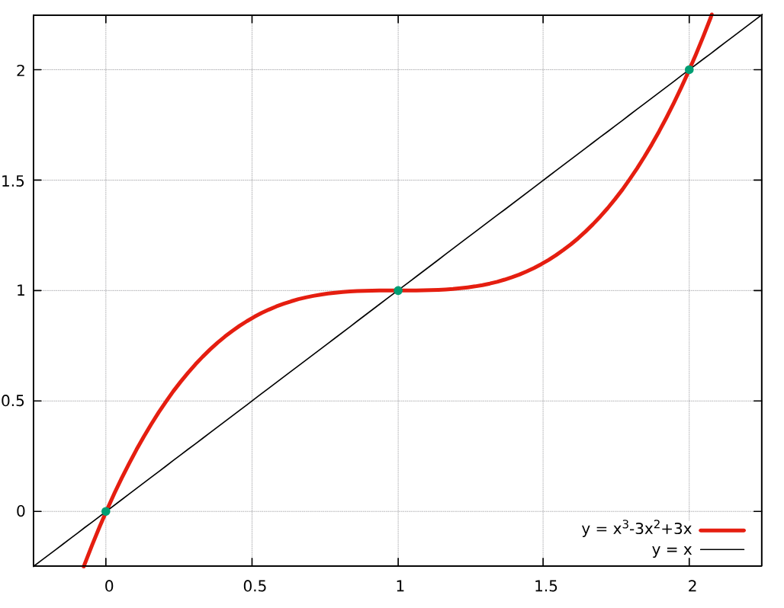
Fixed Point of a Function
Formally, $c$ is a fixed point of a function $f$ if
$c$ belongs to both the domain and the codomain of $f$
$f(c) = c$
If the fixed point iteration
$$x_{n+1}=f\left(x_{n}\right), n=0, 1, 2…$$
Converges to a value $x_{fix}$, i.e. $f\left(x_{fix}\right)= x_{fix}$
Examples:
$y = cos⁡(x)$
$y = x^{3}−3x^{2}+3x$
Many contiguous functions that intersect $y=x$

Slide 3
Fixed Point of a Function
Used in
Economics: study the existence and stability of equilibria in game theory and economic models
Physics: study the behavior of dynamical systems and phase transitions
Computer science: design algorithms for solving equations and optimization problems
Engineering: design control systems and analyze the stability of structures
Numerical root finding
The vector of PageRank values of all web pages is the fixed point of a linear transformation derived from the World Wide Web's link structure
Etc.
Allows us to introduce generic functions in C++

Slide 4
Fixed Point of a Functoin (cos(x))
Simple fixed point iteration using double:
double fixed_point(int max_iterations, double init)
{
double x = init;
for (int i = 0; i < max_iterations; ++i)
x = std::cos(x);
return x;
}
int main()
{
for (int n = 1; n != 85; ++n)
std::println("Iterations: {}, fixed point: {}", n,
fixed_point(n, 0.75));
return 0;
}

Slide 5
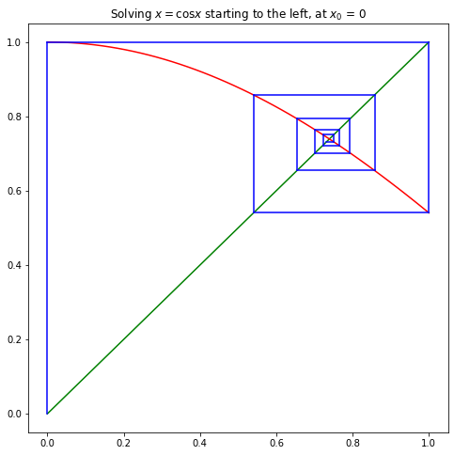
Fixed Point of a Function
Geometrical interpretation

Slide 6
Fixed Point of a Function (cos(x))
Iterations: 1, fixed point: 0.75
Iterations: 2, fixed point: 0.7316888688738209
Iterations: 3, fixed point: 0.7440470847887636
Iterations: 4, fixed point: 0.7357336181872361
Iterations: 5, fixed point: 0.741338598887922
Iterations: 6, fixed point: 0.7375652963392664
Iterations: 7, fixed point: 0.7401080596152839
Iterations: 8, fixed point: 0.7383956911259041
Iterations: 9, fixed point: 0.7395493740083102
...
Iterations: 80, fixed point: 0.7390851332151603
Iterations: 81, fixed point: 0.7390851332151608
Iterations: 82, fixed point: 0.7390851332151606
Iterations: 83, fixed point: 0.7390851332151607
Iterations: 84, fixed point: 0.7390851332151607
Iterations: 85, fixed point: 0.7390851332151607

Slide 7
Fixed Point of a Function
Simple fixed point iteration using double for an arbitrary function:
double fixed_point(double f(double), int max_iterations, double init)
{
double x = init;
for (int i = 0; i < max_iterations; ++i)
x = f(x);
return x;
}
int main()
{
for (int n = 1; n != 85; ++n)
std::println("Iterations: {}, fixed point: {}", n,
fixed_point(/* what should go here? */, n, 0.75));
return 0;
}
Any function f with one double argument returning a double

Slide 8
Using a Named Function
Define a function of one double argument returning a double:
double calculate_cos(double x) {
return std::cos(x);
}
int main()
{
for (int n = 1; n != 85; ++n)
std::println("Iterations: {}, fixed point: {}", n,
fixed_point(
calculate_cos,
n, 0.75));
return 0;
}

Slide 9
Name this famous Person
Alonzo Church (June 14, 1903 – August 11, 1995) was an American mathematician and logician who made major contributions to mathematical logic and the foundations of theoretical computer science.
He is best known for the lambda calculus, Church–Turing thesis, proving the undecidability of the Entscheidungs-problem, Frege–Church ontology, and the Church–Rosser theorem.
He developed various formalisms for computing

Slide 10
Using an Anonymous Function
Simple fixed point iteration using double:
double fixed_point(double f(double), int max_iterations, double init) {
double x = init;
for (int i = 0; i < max_iterations; ++i)
x = f(x);
return x;
}
int main() {
for (int n = 1; n != 85; ++n)
std::println("Iterations: {}, fixed point: {}", n,
fixed_point(
[](double x) -> double { return std::cos(x); },
n, 0.75));
return 0;
}

Slide 11
Using an Anonymous Function
Before:
double calculate_cos(double x) {
return std::cos(x);
}
After:
auto calculate_cos(double x) -> double {
return std::cos(x);
}

Slide 12
Using an Anonymous Function
Before:
auto calculate_cos(double x) -> double {
return std::cos(x);
}
After:
auto calculate_cos = [](double x) -> double {
return std::cos(x);
}
A ‘lambda’ function is a function that has no name
Otherwise the same as named functions: arguments, return type, body, etc.
Return type is optional if it can be deduced from the code
Additionally capture clause: [...]

Slide 13
Using an Anonymous Function
Simple fixed point iteration using double:
double fixed_point(double f(double), int max_iterations, double init) {
double x = init;
for (int i = 0; i < max_iterations; ++i)
x = f(x);
return x;
}
int main() {
for (int n = 1; n != 85; ++n)
std::println("Iterations: {}, fixed point: {}", n,
fixed_point(
[](double x) { return std::cos(x); },
n, 0.75));
return 0;
}

Slide 14
Finding Roots with Fixed Point Iterations
Given an equation of one variable $y=f(x)$
In order to find its root $x$ ($f(x) = 0$), we use fixed point iterations as follows:
Convert the equation to the form $x = g(x)$
Start with an initial guess $x0 ≈ r$, where $r$ is the actual solution (root) of the equation
Iterate, using $x_{n+1}= g(x_{n})$ for $n = 0, 1, 2,…$
If the sequence ${(x_{n})}_{0}^{∞}$ that is defined by $x_{n+1}= g(x_{n})$
Converges to a limit $r$
And the function $g$ is continuous at $x=r$,
Then the limit $r$ is a root of $f(x): f(r) = 0$.

Slide 15
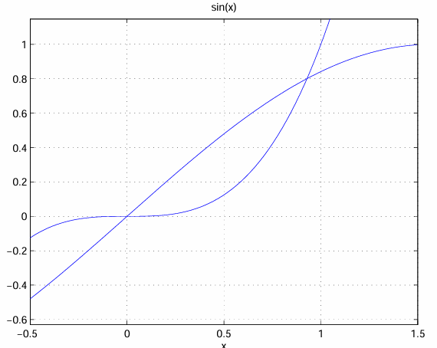
Finding Roots with Fixed Point Iterations
The real trick for using fixed point iterations is
Finding a transformation of the original equation $f(x) = 0$ to $x = g(x)$ such that ${(x_{n})}_{0}^{∞}$ converges
Example: $x^{3} = \sin{x}$, some possibilities:
$x= \frac{\sin{x}}{x^{2}}$, $x= \sqrt[3]{\sin{x}}$, $x=\sin^{−1}{x^{3}}$
$x= \frac{\sin{x}−1}{x^{2}+x+1}+1$, $x=x−\frac{x^{3}−\sin{x}}{3x^{2}−\cos{x}}$

Slide 16
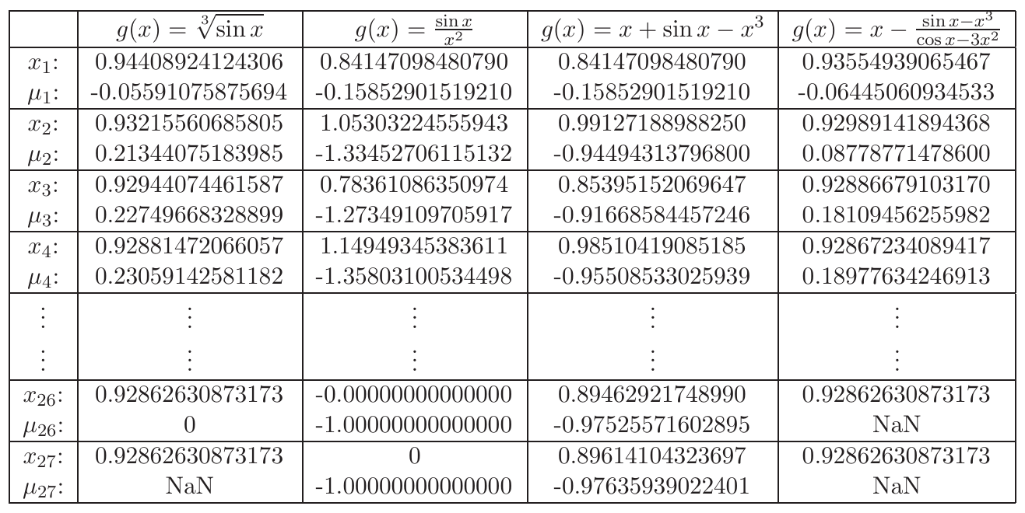
Finding Roots with Fixed Point Iterations
https://pages.cs.wisc.edu/~amos/412/lecture-note

Slide 17
Finding Roots with Fixed Point Iterations
double fixed_point(double f(double), int max_iterations, double init,
double epsilon = 1e-10)
{
double x = init;
for (int i = 0; i < max_iterations; ++i) {
double x1 = f(x);
double error = fabs(x1 - x);
if (error < epsilon)
break;
x = x1;
}
return x;
}
Default value for parameter epsilon – used when no argument supplied

Slide 18
Finding Roots with Fixed Point Iterations (double)
int main()
{
using float_type = double;
for (int n = 1; n != 17; ++n) {
std::cout << n << ": fixed point: "
<< std::setprecision(std::numeric_limits<float_type>::max_digits10)
<< fixed_point([](float_type x) { return cbrt(sin(x)); },
n, float_type(1.0))
<< "\n";
}
return 0;
}

Slide 19
Finding Roots with Fixed Point Iterations (double)
1: fixed point: 1
2: fixed point: 0.94408924124306481
3: fixed point: 0.93215560685804832
4: fixed point: 0.92944074461587356
5: fixed point: 0.92881472066056769
6: fixed point: 0.92866992107978663
7: fixed point: 0.92863640517161028
8: fixed point: 0.92862864617144114
9: fixed point: 0.92862684987924371
10: fixed point: 0.92862643401458511
11: fixed point: 0.92862633773639280
12: fixed point: 0.92862631544670204
13: fixed point: 0.92862631028633946
14: fixed point: 0.92862630909164634
15: fixed point: 0.92862630881505892
16: fixed point: 0.92862630875102514
17: fixed point: 0.92862630875102514

Slide 20
Finding Roots with Fixed Point Iterations (double)
1: fixed point: 1
2: fixed point: 0.94408924124306481
3: fixed point: 0.93215560685804832
4: fixed point: 0.92944074461587356
5: fixed point: 0.92881472066056769
6: fixed point: 0.92866992107978663
7: fixed point: 0.92863640517161028
8: fixed point: 0.92862864617144114
9: fixed point: 0.92862684987924371
10: fixed point: 0.92862643401458511
11: fixed point: 0.92862633773639280
12: fixed point: 0.92862631544670204
13: fixed point: 0.92862631028633946
14: fixed point: 0.92862630909164634
15: fixed point: 0.92862630881505892
16: fixed point: 0.92862630875102514
17: fixed point: 0.92862630875102514

Slide 21
Finding Roots with Fixed Point Iterations (higher precision)
int main()
{
using float_type = boost::multiprecision::cpp_bin_float_100;
for (int n = 1; n != 17; ++n) {
std::cout << n << ": fixed point: "
<< std::setprecision(std::numeric_limits<float_type>::max_digits10)
<< fixed_point([](float_type x) { return cbrt(sin(x)); },
n, float_type(1.0))
<< "\n";
}
return 0;
}

Slide 22
Finding Roots with Fixed Point Iterations (boost::multiprecision::cpp_bin_float_100)
1: fixed point: 1
2: fixed point: 0.944089241243064772796489905791421707986177271664959553698078522871570064411934579118745936250787876720
3: fixed point: 0.932155606858048249474684988263417157224169936732383215275175647443137875417536157059909989658187887988
4: fixed point: 0.929440744615873484632123994139247971690996259633336072084079424012153025423723980382210778877115899499
5: fixed point: 0.928814720660567781783215520305242485635812472510461119981707903825685401351407526118695754617128329540
6: fixed point: 0.928669921079786729387859074885412142600061032763733361261053999997111753068577766851321303428821644809
7: fixed point: 0.928636405171610372219059265638424823009966036114642724072037837674833945290852224528156114090024050366
8: fixed point: 0.928628646171441161484191296888214195056800070647013455516952440258806083550616805431261210169624428491
9: fixed point: 0.928626849879243716263258540756212925876593491829354895505426620683525163508339178372911518916078658964
10: fixed point: 0.928626434014585046489130832967455892221341078431536847619927782503499338460535903901113571179586502621
11: fixed point: 0.928626337736392825227143673673673376736759782464744756767630241473484883293241192697516710218932505286
12: fixed point: 0.928626315446702029560185915704831273294320563218582137429298810160353972119402141742367085884469826987
13: fixed point: 0.928626310286339559395991177006775993414869647206674668698437937242268327820787204755715775611993174586
14: fixed point: 0.928626309091646383142267973238818633802324489671977694438138435110573527350684786415704931468145974351
15: fixed point: 0.928626308815058875585467521446095397987205995632600898761988954484349955114187085492403368952534712871
16: fixed point: 0.928626308751025154660002689362443049928096100019392131283345878828710878915327805630307611296466403022
17: fixed point: 0.928626308751025154660002689362443049928096100019392131283345878828710878915327805630307611296466403022

Slide 23
Finding Roots with Fixed Point Iterations
double fixed_point(double f(double), int max_iterations, double init,
double epsilon = 1e-10)
{
double x = init;
for (int i = 0; i < max_iterations; ++i) {
double x1 = f(x);
double error = fabs(x1 - x);
if (error < epsilon)
break;
x = x1;
}
return x;
}

Slide 24
Generic Fixed Point of a Function
template <typename Float>
Float fixed_point(Float f(Float), int max_iterations, Float init,
Float epsilon = 1e-10)
{
Float x = init;
for (int i = 0; i < max_iterations; ++i) {
Float x1 = f(x); // get next iteration result
// compare with previous iteration result
if (fabs(x1 - x) < epsilon) break;
x = x1; // update for next iteration
}
return x;
}

Slide 25
Generic Fixed Point of a Function
template <typename Data>
std::pair<Data, int> fixed_point(
Data f(Data), bool cond(Data, Data), int n, Data init)
{
Data x = init;
for (int i = 0; i != n; ++i) {
Data x1 = f(x); // get next iteration result
if (cond(x, x1)) // compare with previous iteration result
return {x1, i};
x = x1; // update for next iteration
}
return {x, n};
}

Slide 26
Finding Roots with Fixed Point Iterations (double)
int main() {
using float_type = double;
for (int n = 1; n != 17; ++n) {
std::cout << n << ": fixed point: "
<< std::setprecision(std::numeric_limits<float_type>::max_digits10)
<< fixed_point(
[](float_type x) { return cbrt(sin(x)); },
[](float_type prev, float_type curr) {
return fabs(curr - prev) < 1e-10;
},
n, float_type(1.0))
<< "\n";
}
return 0;
}

Slide 27
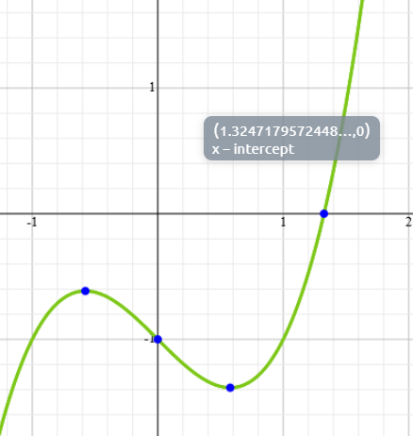
Exercise
Approximate a solution to $x3−x−1=0$on $[1, 2]$ using fixed point iteration
Convert the given function to the form $g(x)=x$
How many iterations do you need to perform to achieve an error less than 10⁻⁵ ?
Assume for the error to be: $e_{n+1}=\left|x_{n+1}−x_{n}\right|$ (the difference between the last to iteration results)
Estimate the solution
Demonstrate that it is indeed the solution by creating a plot that shows$y = x$, your $g(x)=x$, and $f\left(x\right)= x3−x−1$ (as done on Slide 5)

Slide 28
Finding Square Root

Slide 29
Calculating Square Root
Ancient method for calculating the square root of $a$:
$$x_{n+1}=average\left(x_{n}, \frac{a}{x_{n}}\right)=\frac{1}{2}\left(x_{n}+\frac{a}{x_{n}}\right)$$
This corresponds to calculating $\sqrt{a}$
Makes sense, as once $x_{n}=\sqrt{a}$ the equation above becomes true
Alternatively, this can be computed using the fixed_point function
By repeated application of the averaging

Slide 30
Calculating Square Root
template <typename Float>
Float average(Float x1, Float x2) {
return (x1 + x2) / 2;
}
template <typename Float>
Float iterate_sqrt(Float a, int max_iterations, Float init) {
Float x = init;
for (int i = 0; i != max_iterations; ++i)
x = average(x, a / x);
return x;
}

Slide 31
Calculating Square Root
template <typename Float>
Float average(Float x1, Float x2) {
return (x1 + x2) / 2;
}
template <typename Float>
Float iterate_sqrt(Float a, int n, Float init)
{
return fixed_point([a](double x) { return average(x, a / x); }, n, init);
}
Capture a to make it available from inside the lambda’s body

Slide 32
Finding Roots

Slide 33
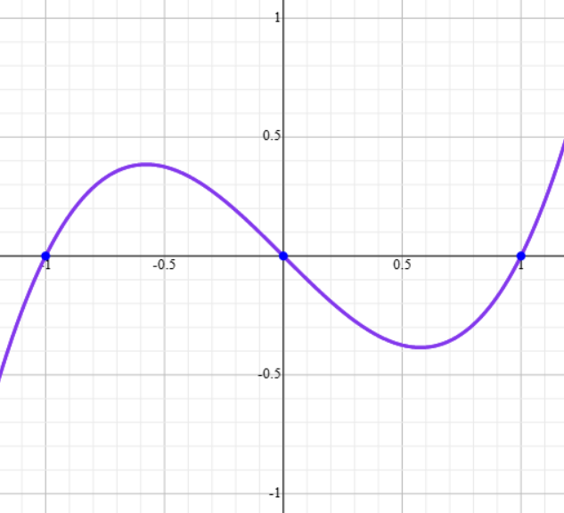
Finding Roots of Functions
Simplest algorithms to find roots of non-linear equations
Bisection method
Newton-Raphson method
Gradient Descent
A root of a (non-linear) equation $f(x)$ is the value of $x$ where the function intersects the x-axis ($f(x) = 0$)
To find the root of a continuous, differentiable function $f(x)$, and assuming the root is near $x=x0$

Slide 34
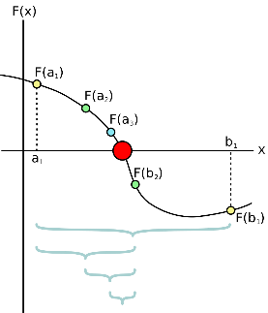
Bisection Method
Based on Intermediate Value Theorem
If for a contiguous function $f\left(x\right)$, $sign(f\left(x_{1})\right)≠sign(f\left(x_{2}\right))$ for $x_{1}<x_{2}$
Then there exists a $x_{0}: x_{1}≤x_{0}{≤x}_{2}$, such that $f\left(x_{0}\right)=0$
Let’s assume root $x$ of contiguous function $f\left(x\right)$ is inside the interval $\left[x_{1}\right., \left.x_{2}\right)$
Divide interval in two sections: $\left[x_{1}\right., \left.x_{0}\right)$ and $\left[x_{0}\right., \left.x_{2}\right)$
If $sign(f\left(x_{1})\right)≠sign(f\left(x_{0}\right))$
Repeat dividing for interval $\left[x_{1}\right., \left.x_{0}\right)$
Otherwise repeat dividing for interval $\left[x_{0}\right., \left.x_{2}\right)$
Continue until $f\left(x_{0}\right)<eps$

Slide 35
Bisection Method
std::pair<double, size_t> bisection (double f(double), size_t max_iterations,
double xn, double xm, double epsilon)
{
for (size_t step = 0; step != max_iterations; ++step) {
double fn = f(xn), fm = f(xm);
if (std::fabs(fn) <= epsilon) return {xn, step};
if (std::fabs(fm) <= epsilon) return {xm, step};
double next_x = (xm + xn) / 2;
if (std::signbit(fn) == std::signbit(f(next_x)))
xn = next_x;
else
xm = next_x;
}
return {0.0, max_iterations};
}

Slide 36
Bisection Method
auto bisection(double f(double), size_t max_iterations, double xn_init,
double xm_init, double epsilon)
{
using value_type = std::pair<double, double>;
return fixed_point(
[f](value_type bounds) { // get next iteration result
double fn = f(bounds.first);
double next_x = (bounds.first + bounds.second) / 2;
if (std::signbit(fn) == std::signbit(f(next_x)))
bounds.first = next_x;
else
bounds.second = next_x;
return bounds;
},
[f, epsilon](value_type, value_type curr) { // check for termination condition
return std::fabs(f(curr.first)) <= epsilon ||
std::fabs(f(curr.second)) <= epsilon;
},
max_iterations, value_type(xn_init, xm_init));
}

Slide 37
Newton’s Method

Slide 38
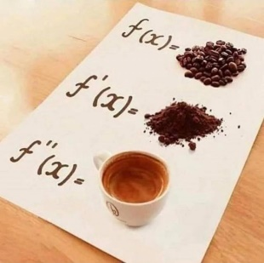
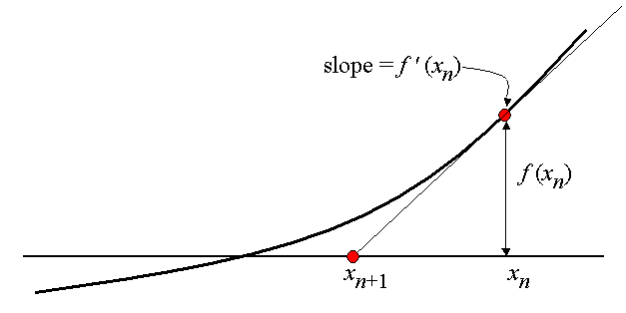
Newton-Raphson Method
Tangent line to the graph of $f(x)$ at the point $x=xn$
has slope $f′(xn)$ and goes through the point $(xn, f(xn))$
This line has equation:
$$y=f^{′}\left(xn​\right)∙(x−xn​)+f(xn​)$$
Now, setting $y=0$ and $x=x_{n+1}$​ we get
$$x_{n+1}​=x_{n}​−\frac{f′(x_{n}​)}{f(x_{n}​)}​$$

Slide 39
Gradient
For univariate function (one independent variable)
The gradient at $x$ is simply the value of the first derivative of $f$ at $x$:
$$f^{′}(x)=\frac{df(x)}{dx}$$

Slide 40
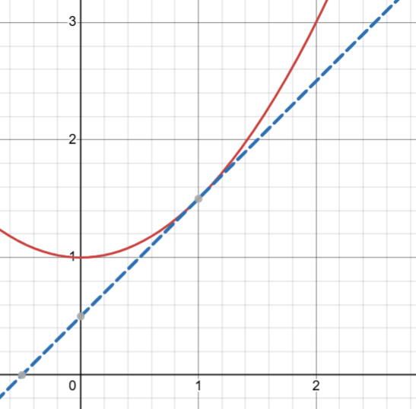
Gradient: Interpretation
The gradient of a function at a given point is the slope of the tangent at that point:

Slide 41
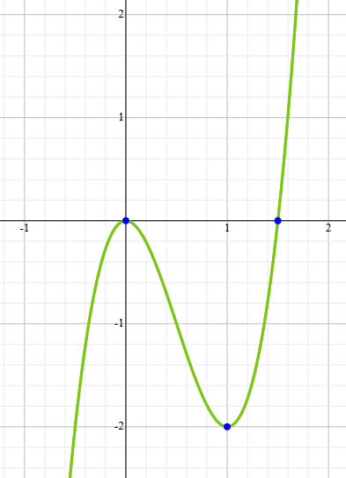
Gradient Examples, Finding Extrema
For univariate function (one independent variable)
$$f\left(x\right)=x^{4}−x^{3}+4, \frac{df\left(x\right)}{dx}=4x^{3}−6x^{2}=x^{2}(4x−6)$$
The minima and maxima of $f\left(x\right)$ can be found by finding the solution of:
$$f^{′}\left(x\right)= \frac{df\left(x\right)}{dx}=0→x=0, x=1.5$$

Slide 42
Newton-Raphson Method
std::pair<double, size_t> newton(double f(double), double f_prime(double),
size_t max_iterations, double xn, double epsilon)
{
for (size_t step = 0; step != max_iterations; ++step) {
double fn = f(xn);
if (fabs(fn) <= epsilon)
return {fn, step};
double gn = f_prime(xn);
xn = xn - gn / fn;
}
return {0.0, max_iterations};
}

Slide 43
Newton-Raphson Method
// Calculate slope (gradient) of f(x) at x.
double f_prime(double f(double), double x, double epsilon)
{
double delta = epsilon / 50;
return (f(x + delta) - f(x - delta)) / (2 * delta);
}

Slide 44
Newton-Raphson Method
std::pair<double, size_t> newton(double f(double),
double f_prime(double(double), double, double),
size_t max_iterations, double xn, double epsilon)
{
for (size_t step = 1; step != max_iterations; ++step) {
double fn = f(xn);
if (fabs(fn) <= epsilon)
return {fn, step};
double gn = f_prime(f, xn, epsilon);
xn = xn - gn / fn;
}
return {0.0, max_iterations};
}

Slide 45
Newton-Raphson Method
std::pair<double, size_t> newton(double f(double),
double f_prime(double(double), double, double),
double init, unsigned int max_iterations = 100, double epsilon = 0.0001)
{
return fixed_point(
[f, f_prime, epsilon](double xn) {
double gn = f_prime(f, xn, epsilon);
return xn - gn / f(xn);
},
[f, epsilon](double, double curr) {
return fabs(f(curr)) <= epsilon;
},
max_iterations, init);
}

Slide 46
Halley’s Method
Very similar, just includes second derivative
$$x_{n+1}​=x_{n}​−\frac{2∙f(x_{n}​)∙f′(x_{n}​)}{2∙{f^{′}\left(x_{n}​\right)}^{2}−f\left(x\right)f′′(x)}$$
Requires contiguous second derivative
This method guarantees
at least cubic convergence rate

Slide 47
Schröder’s Method
Very similar, just includes second derivative
$$x_{n+1}​=x_{n}​−\frac{f\left(x_{n}​\right)}{f^{′}\left(x_{n}​\right)}−\frac{f′′(x_{n})∙{f(x_{n}​)}^{2}}{2∙{f^{′}\left(x_{n}​\right)}^{3}}$$
This method guarantees
at least quadratic convergence rate
is known to work well in the presence of multiple roots
On Infinitely Many Algorithms for Solving Equations

Slide 48
Exercises
Implement Halley’s method
Implement Schröder’s method

Slide 49
Gradient Descent

Slide 50
Gradient
For multi-variate function (more than one independent variable)
The vector of partial derivatives along each of the variable’s axes is defined as:
$$∇f\left(p\right)=\left[\begin{matrix}\frac{δf(p)}{δx_{1}} \\ ⋮ \\ \frac{δf(p)}{δx_{n}}\end{matrix}\right], p=(x_{1},x_{2}, …x_{n})$$

Slide 51
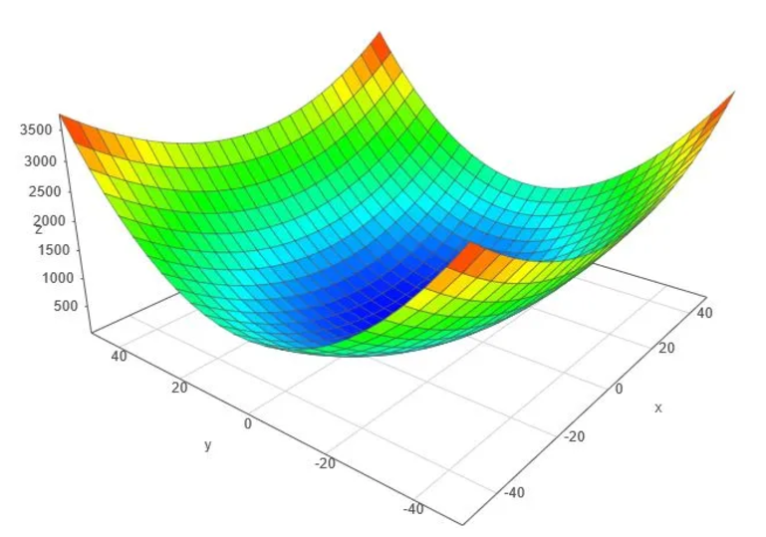
Gradient Examples
For multi-variate function (more than one independent variable)
The vector of partial derivatives along each of the variable’s axes
$$f\left(x,y\right)={0.5x}^{2}+y^{2}, \frac{δf(x, y)}{δx}=x, \frac{δf(x, y)}{δy}=2y$$
$$∇f\left(x, y\right)=\left[\begin{matrix}x \\ 2y\end{matrix}\right]$$

Slide 52
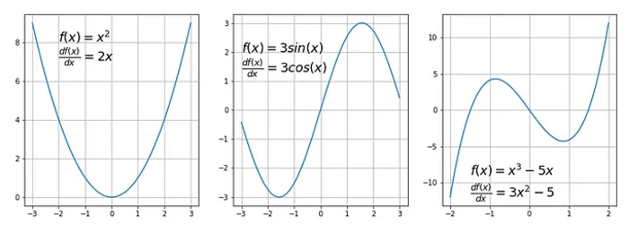
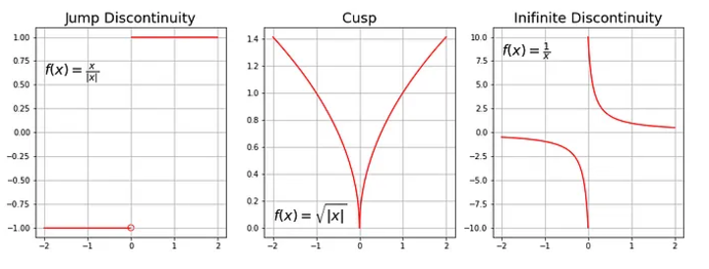
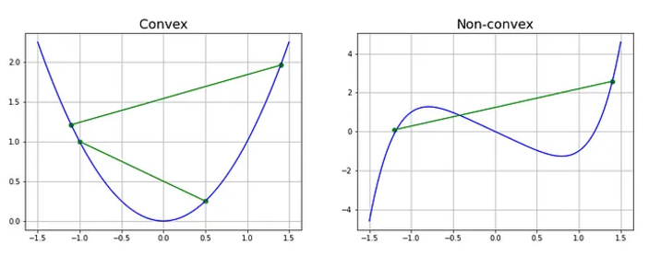
Gradient Descent
Gradient Descent is an algorithm for finding minima/maxima for convex and differentiable functions
Differentiable:
$$\frac{df(x)}{dx} is defined$$
Convex:
$$\frac{d^{2}f(x)}{dx}>0$$

Slide 53
Gradient Descent
Iteratively
Calculate the next point using the gradient $∇f(p_{n})$ at the current position $p_{n}$
Scale the gradient (by a learning rate $η$)
Subtract obtained value from the current position (make a step)
$$p_{n+1}=p_{n}−η∇f(p_{n})$$
Where $η$: learning rate, controls step size
The smaller learning rate the longer GD converges
If learning rate is too big the algorithm may not converge to the optimal point (jump around) or even diverge completely

Slide 54
Gradient Descent

Slide 55
Gradient Descent
std::pair<double, unsigned int> gradient_descent(
double f(double), double xn, unsigned int max_iterations = 100,
double epsilon = 0.0001, double learning_rate = 0.01)
{
return fixed_point(
[&](double xn) {
double gn = f_prime(f, xn, epsilon);
return xn - learning_rate * gn;
},
[&](double prev, double curr) {
return fabs(curr - prev) <= epsilon;
},
max_iterations, xn);
}
Capture all required variables by reference: [&]

Slide 56
Exercises
Implement gradient descent for functions of two (or more) variables
Create a plot visualizing your results for varying learning rates
Implement a second order algorithm that finds extrema for a given function
I.e. find the root of the derivative

Slide 57
