Slide 1
Fractals
Lecture 7
Hartmut Kaiser
https://teaching.hkaiser.org/spring2025/csc4700/

Slide 2
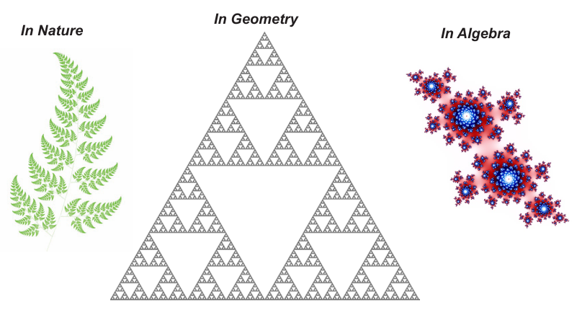
What are Fractals?
A fractal is a never-ending pattern
  Fractals are infinitely complex patterns that are self-similar across different scales
  They are created by repeating a simple process over and over in an ongoing feedback loop
Found everywhere

Slide 3
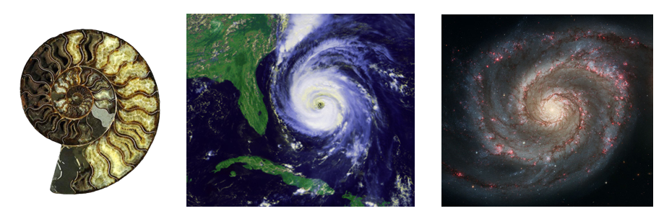
Fractals in Nature
Mostly spirals in various dimensions and scales
Scale: ~1m
Scale: ~100km
Scale: ~100.000 ly

Slide 4
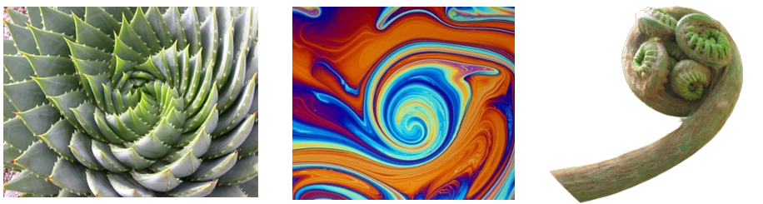
Fractals in Nature
Various phenomena
Scale: ~50cm
Scale: ~5mm
Scale: ~5cm

Slide 5

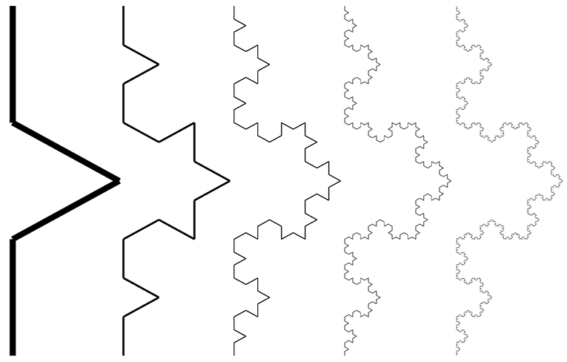
Geometric Fractals
Sierpinski Triangle
The Koch Curve

Slide 6
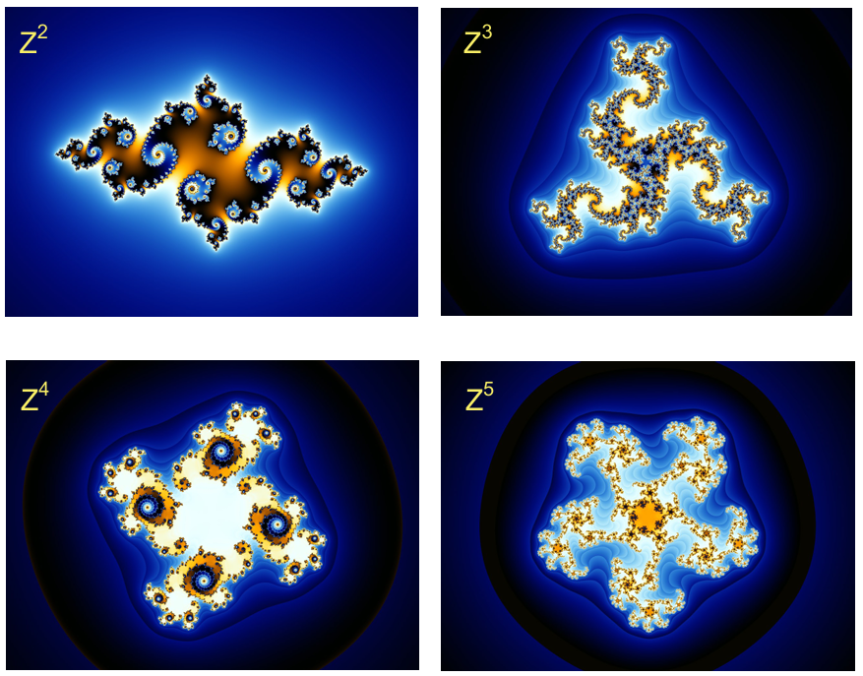
Algebraic Fractals
The Mandelbrot Set

Slide 7

The Mandelbrot Set

Slide 8
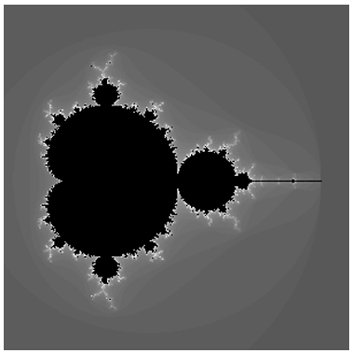
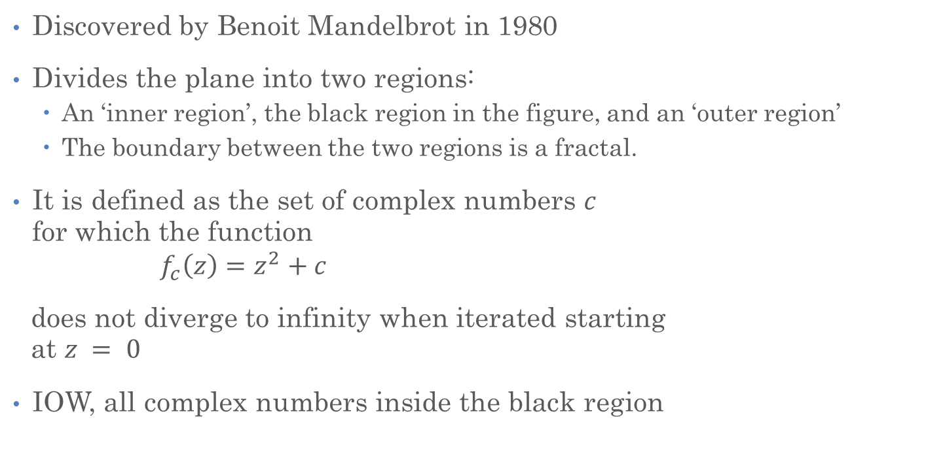
The Mandelbrot Set
Discovered by Benoit Mandelbrot in 1980
Divides the plane into two regions:
  An ‘inner region’, the black region in the figure, and an ‘outer region’
  The boundary between the two regions is a fractal.
It is defined as the set of complex numbers $c$
for which the function
$$f_{c}\left(z\right)=z^{2}+c$$
does not diverge to infinity when iterated starting
at $z = 0$
IOW, all complex numbers inside the black region

Slide 9
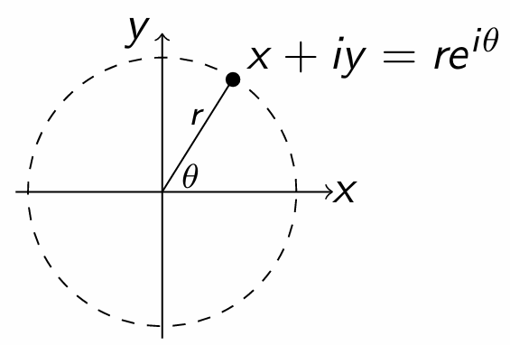
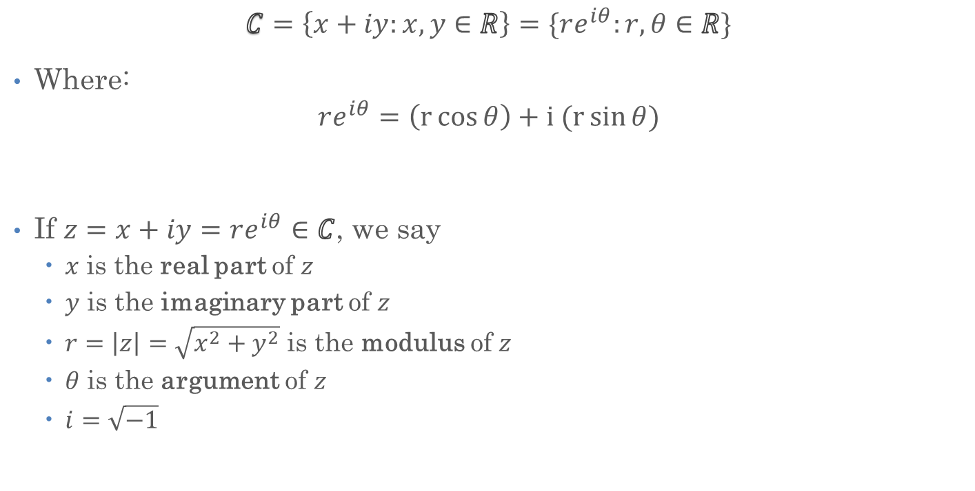
The Complex Plane
$$C=\left\{x+iy:x, y∈R\right\}=\{re^{iθ}:r,θ∈R\}$$
Where:
$$re^{iθ}=\left(r\cos{θ}\right)+i (r\sin{θ})$$
If $z=x+iy=re^{iθ}∈C$, we say
  $x$ is the real part of $z$
  $y$ is the imaginary part of $z$
  $r=\left|z\right|=\sqrt{x^{2}+y^{2}}$ is the modulus of $z$
  $θ$ is the argument of $z$
  $i=\sqrt{−1}$

Slide 10
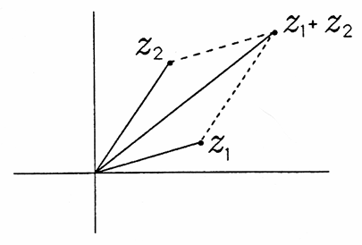
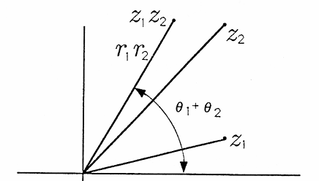


Arithmetic in $C$
Complex number addition:
  Vector style: $z_{1}{+z}_{2}=\left(x_{1}+x_{2}\right)+i(y_{1}+y_{2})$
Complex number multiplication:
  Multiply moduli; add arguments:
  $z_{1}z_{2}=\left(x_{1}x_{2}−y_{1}y_{2}\right)+i\left(x_{1}y_{2}+x_{2}y_{1}\right)=r_{1}r_{2}e^{i(θ_{1}+θ_{2})}$

Slide 11
Aside: Complex Numbers in C++
C++ has special type: std::complex<double>
  The type has operators overloaded: +, -, *, /, ==, !=, <, >, …
  Additional functions: real, imag, arg, norm, conj, …
  Has mathematical functions overloaded: abs, sqrt, pow, exp, log, trigonometric functions, etc.
To use those, you must add the header #include <complex>

Slide 12
Aside: Complex Numbers in C++
std::complex<double> num1(3.0, 4.0); // 3 + 4i
std::complex<double> num2(1.0, 2.0); // 1 + 2i
std::complex<double> sum = num1 + num2; // Adding complex numbers
std::complex<double> difference = num1 - num2; // Subtract them
std::complex<double> product = num1 * num2; // Multiply them
std::complex<double> quotient = num1 / num2; // Divide them
std::cout << "Sum: " << sum << std::endl; // Sum: (4,6)
std::cout << "Difference: " << difference << std::endl; // Difference: (2,2)
std::cout << "Product: " << product << std::endl; // Product: (-5,10)
std::cout << "Quotient: " << quotient << std::endl; // Quotient: (2.2,-0.4)

Slide 13
Aside: Complex Numbers in C++
// defines the complex number: (10 + 2i)
std::complex<double> c(10.0, 2.0);
// prints the real part using the real function
std::cout << "Real part: " << std::real(c) << std::endl;
std::cout << "Imaginary part: " << std::imag(c) << std::endl;
// prints the absolute value of the complex number
std::cout << "The absolute value of " << c << " is: ";
std::cout << std::abs(c) << std::endl;
// use of norm()
std::cout << "The norm of " << c << " is " << std::norm(c) << std::endl;
// prints the argument of the complex number
std::cout << "The argument of " << c << " is: ";
std::cout << std::arg(c) << std::endl;
// use of polar()
std::cout << "The complex whose magnitude is " << 2.0;
std::cout << " and phase angle is " << 0.5;
std::cout << " is " << std::polar(2.0, 0.5) << std::endl;

Slide 14
Aside: Complex Numbers in C++
    // initializing the complex: (-1.0 + 0.0i)
    std::complex<double> c(-1.0, 0.0);
    // use of cos(): (1.54308, 0)
    std::cout << "The cos of " << c << " is " << std::cos(c) << std::endl;
    // use of sin(): (0, 1.1752)
    std::cout << "The sin of " << c << " is " << std::sin(c) << std::endl;
    // use of tan(): (0, 0.761594)
    std::cout << "The tan of " << c << " is " << std::tan(c) << std::endl;

Slide 15
Aside: Complex Numbers in C++
Main takeaway:
  std::complex<double> is a Regular type (even TotallyOrdered)
  Use std::complex<double> as if it was a double
Demonstrates one of the (many) powers of C++
  One can customize the operations for any type to operate as needed
Operator overloading in C++:
  struct my_complex {
  double real, imag;
  my_complex(double r, double i = 0.0) : real(r), imag(i) {}
  friend my_complex operator+(my_complex lhs, my_complex rhs) {
  return {lhs.real + rhs.real, rhs.imag + rhs.imag};
  }
  };

Slide 16
The Mandelbrot Set

Slide 17
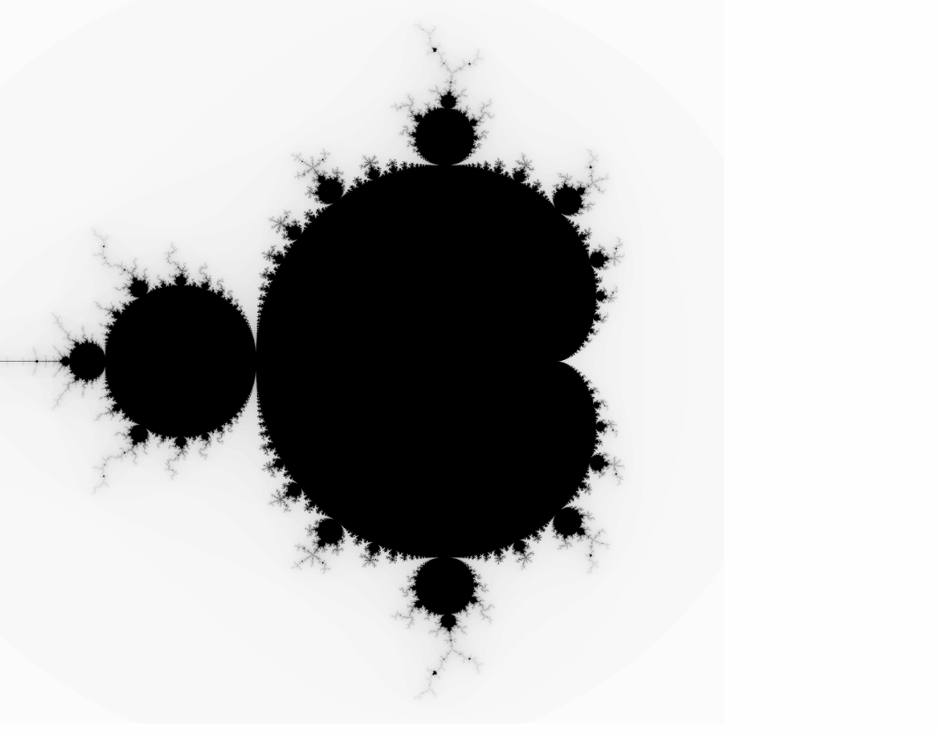
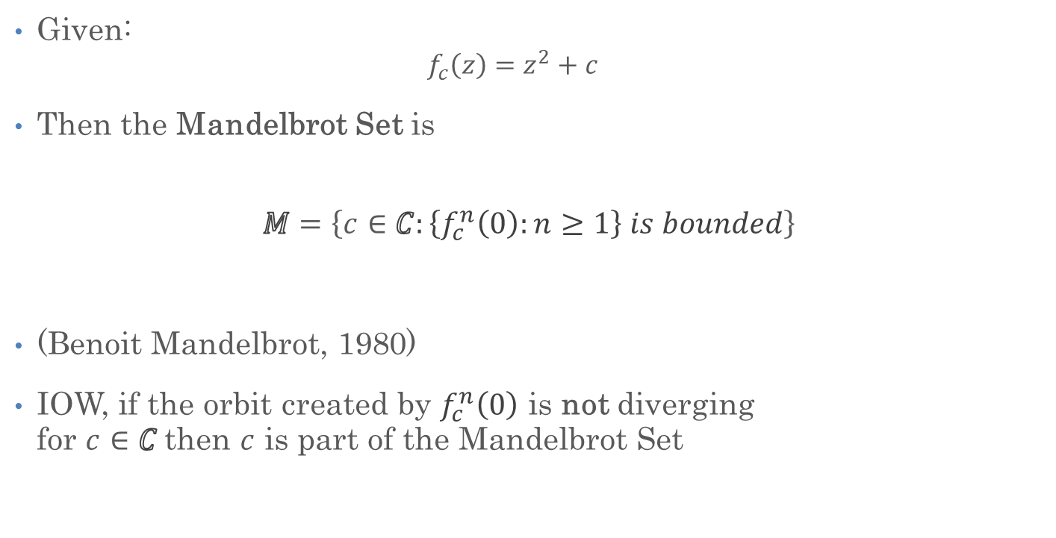
The Mandelbrot Set
Given:
  $$f_{c}\left(z\right)=z^{2}+c$$
Then the Mandelbrot Set is
$$M=\left\{c∈C:\left\{f_{c}^{n}\left(0\right):n≥1\right\} is bounded\right\}$$
(Benoit Mandelbrot, 1980)
IOW, if the orbit created by $f_{c}^{n}\left(0\right)$ is not diverging
for $c∈C$then $c$ is part of the Mandelbrot Set

Slide 18
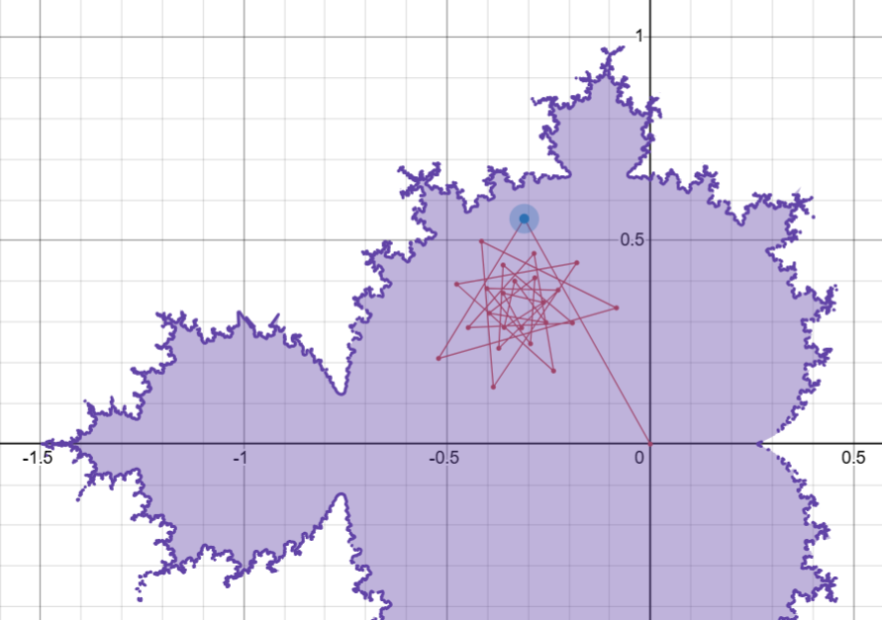
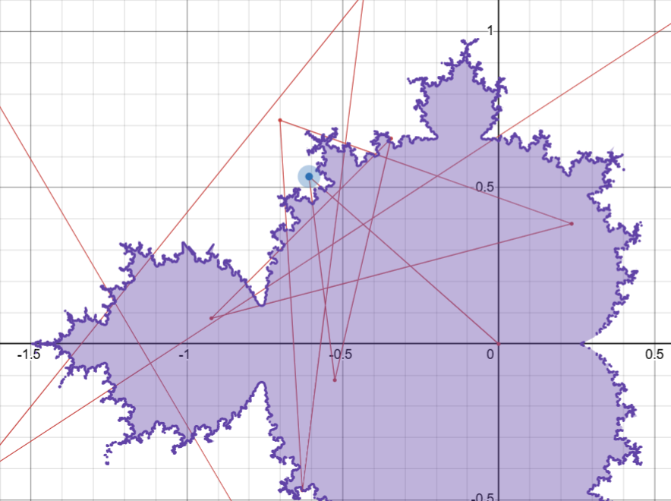
The Mandelbrot Set: Trajectories
Converging
Diverging

Slide 19
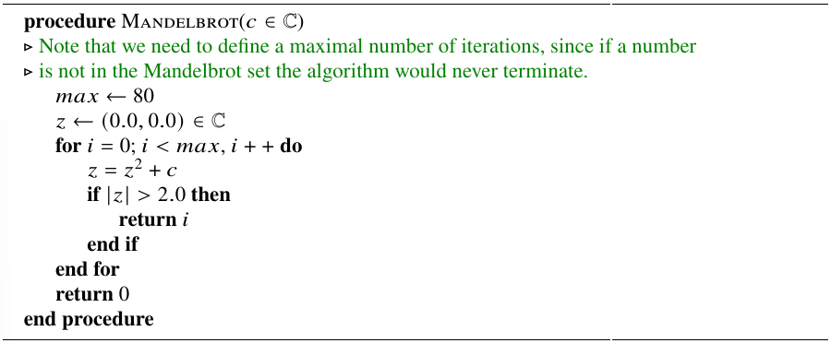
The Mandelbrot Set: The Algorithm

Slide 20
The Mandelbrot Set: The Code
  size_t mandelbrot(std::complex<double> c)
  {
  size_t const max_iterations = 100;
  std::complex<double> z(0.0, 0.0);
  for (size_t i = 0; i != max_iterations; ++i)
  {
  z = z * z + c;
  if (std::abs(z) > 2.0)
  return i; // diverging
  }
  return -1; // not diverging, part of the Mandelbrot Set
  }

Slide 21
The Mandelbrot Set: The Code
template <typename Data>
std::pair<Data, int> fixed_point(
Data f(Data), bool cond(Data, Data), int n, Data init)
{
Data x = init;
for (int i = 0; i != n; ++i) {
Data x1 = f(x); // get next iteration result
if (cond(x, x1)) // compare with previous iteration result
return {x1, i};
x = x1; // update for next iteration
}
return {x, n};
}

Slide 22
The Mandelbrot Set: The Code
  size_t mandelbrot(std::complex<double> c)
  {
  size_t const max_iterations = 100;
  using float_type = std::complex<double>;
  auto [_, iterations] = // unpack returned std::pair
  fixed_point(
  // function to find fixed point for
  [c](float_type z) { return z * z + c; },
  // termination condition
  [](float_type, float_type z) { return std::abs(z) > 2.0; },
  max_iterations, float_type(0, 0));
  return iterations == max_iterations ? -1 : iterations;
  }

Slide 23
The Mandelbrot Set: The Code
std::for_each(counting_iterator(0), counting_iterator(size_y),
[&](size_t pixel_y) {
double imag = scale(pixel_y, 0, size_y, -2.0, 2.0);
for (size_t pixel_x = 0; pixel_x != size_x; ++pixel_x) {
// Get the number of iterations (-1 means not diverging)
double real = scale(pixel_x, 0, size_x, -2.0, 2.0);
int value = mandelbrot(std::complex(real, imag));
if (value == -1)
// Not diverging, part of Mandelbrot Set
mandelbrot_img.SetPixel(pixel_x, pixel_y, RGBApixel(0, 0, 0));
else
// Convert the value to RGB color space and set the pixel color
mandelbrot_img.SetPixel(pixel_x, pixel_y, get_rgb(value));
}
});

Slide 24
The Mandelbrot Set: The Code
  template <typename T1, typename T2>
  T2 scale(T1 value, T1 min_value, T1 max_value, T2 min_range, T2 max_range)
  {
  return (max_range - min_range) / T2(max_value - min_value) *
  T2(value) - min_range;
  }
Simple scaling of value (that is of range [min_value, max_value)) to output range [min_range, max_range)

Slide 25
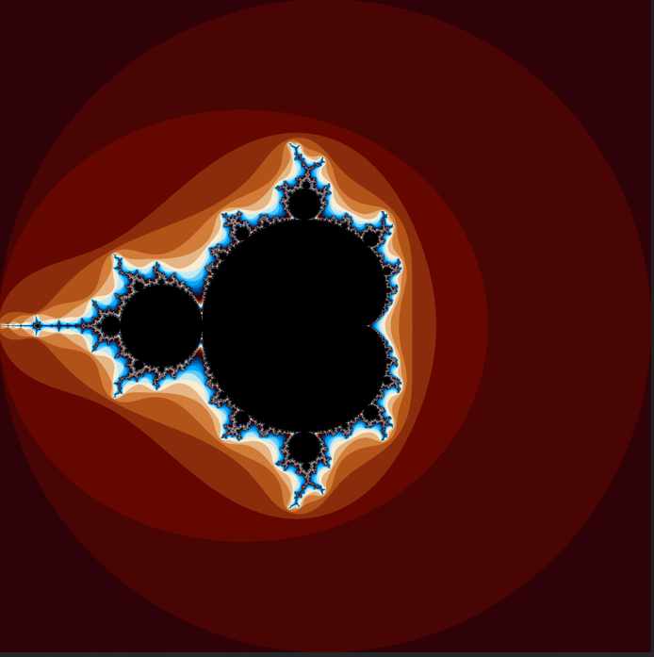
The Mandelbrot Set: The Result

Slide 26
The Mandelbrot Set: Parallelize
Computation for each pixel is
  Independent from computation of any other pixel
  Sequence of computations is irrelevant
  No inter-dependencies between pixels
Embarrassingly parallel
  Decomposition is ‘embarrassingly’ trivial
  Relatively easy to parallelize
Fork-join parallelism as all pixels have to be available before image is done
  Fork: start multiple tasks (threads)
  Join: wait for all tasks (threads) to finish

Slide 27
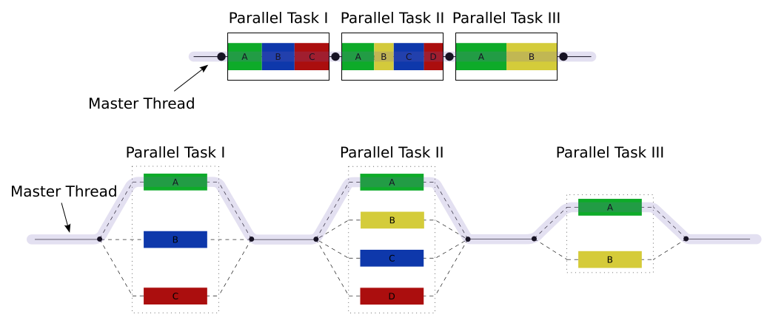
Fork-Join Parallelism
Used for years: OpenMP, CILK, Java concurrency Framework, Task Parallel Library for .NET
Image courtesy of: Wikipedia: http://en.wikipedia.org/wiki/Fork%E2%80%93join_model

Slide 28
Fork-Join Parallelism

Slide 29
The Mandelbrot Set: Parallelize
Computation for each pixel is
  Independent from computation of any other pixel
  Sequence of computations is irrelevant
  No inter-dependencies between pixels
Embarrassingly parallel
  Relatively easy to parallelize
Fork-join parallelism as all pixels have to be available before image is done
C++ has parallel algorithms that are suitable for this kind of problems
  Loop iterations are independent, no sequencing is required
  std::for_each(...) → std::for_each(std::execution::par, ...)

Slide 30
C++ Parallel Algorithms
Mostly, same semantics as sequential algorithms
  Additional, first argument: execution_policy
  Defined in namespace std::execution
    sequenced_execution_policy: seq
    parallel_execution_policy: par
    parallel_unsequenced_execution_policy: par_unseq
    unsequenced_execution_policy: unseq
Entirely fork-join as algorithms return only after all work has been done
  Performance of those algorithms depends on high quality schedulers

Slide 31
C++ Parallel Algorithms
sequenced_execution_policy (seq)
  Iterations must be executed in-order on calling thread, no re-ordering allowed
parallel_execution_policy (par)
  Iterations can be re-ordered and can be run on arbitrary threads
  (parallelization is allowed)
parallel_unsequenced_execution_policy (par_unseq)
  Iterations may be parallelized, vectorized, or migrated across threads
  Special rules related to exception handling
unsequenced_execution_policy (unseq)
  Iterations may be vectorized, e.g., executed on a single thread using instructions that operate on multiple data items.
  Special rules related to exception handling

Slide 32
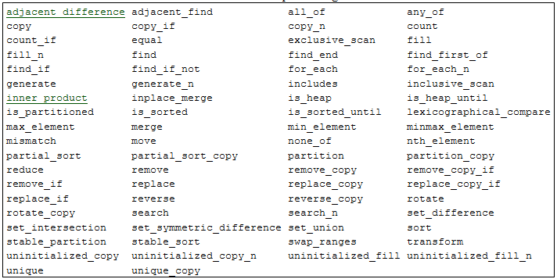
C++ Parallel Algorithms

Slide 33
The Mandelbrot Set: The Code
std::for_each(std::execution::par,
counting_iterator(0), counting_iterator(size_y),
[&](size_t pixel_y) {
double imag = scale(pixel_y, 0, size_y, -2.0, 2.0);
for (size_t pixel_x = 0; pixel_x != size_x; ++pixel_x) {
// Get the number of iterations (-1 means not diverging)
double real = scale(pixel_x, 0, size_x, -2.0, 2.0);
int value = mandelbrot(std::complex(real, imag));
if (value == -1)
// Not diverging, part of Mandelbrot Set
mandelbrot_img.SetPixel(pixel_x, pixel_y, RGBApixel(0, 0, 0));
else
// Convert the value to RGB color space and set the pixel color
mandelbrot_img.SetPixel(pixel_x, pixel_y, get_rgb(value));
}
});

Slide 34
The Mandelbrot Set: The Code
hpx::experimental::for_loop(hpx::execution::par,
0, size_y,
[&](size_t pixel_y) {
double imag = scale(pixel_y, 0, size_y, -2.0, 2.0);
for (size_t pixel_x = 0; pixel_x != size_x; ++pixel_x) {
// Get the number of iterations (-1 means not diverging)
double real = scale(pixel_x, 0, size_x, -2.0, 2.0);
int value = mandelbrot(std::complex(real, imag));
if (value == -1)
// Not diverging, part of Mandelbrot Set
mandelbrot_img.SetPixel(pixel_x, pixel_y, RGBApixel(0, 0, 0));
else
// Convert the value to RGB color space and set the pixel color
mandelbrot_img.SetPixel(pixel_x, pixel_y, get_rgb(value));
}
});

Slide 35
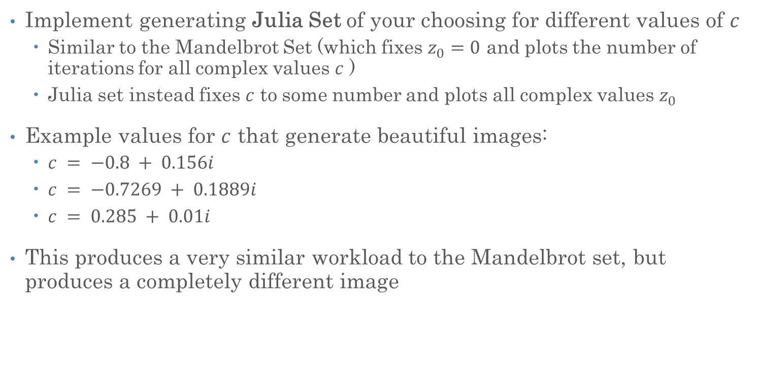
Exercise
Implement generating Julia Set of your choosing for different values of $c$
  Similar to the Mandelbrot Set (which fixes $z_{0}=0$ and plots the number of iterations for all complex values $c$ )
  Julia set instead fixes $c$ to some number and plots all complex values $z_{0}$
Example values for $c$ that generate beautiful images:
  $c = −0.8 + 0.156i$
  $c = −0.7269 + 0.1889i$
  $c = 0.285 + 0.01i$
This produces a very similar workload to the Mandelbrot set, but produces a completely different image

Slide 36
Flynn’s Taxonomy (Aside)
Classic classification of parallel architectures (Michael Flynn, 1966)
Based on multiplicity of instruction streams, data storage
  SISD: plain old sequential
  SIMD: vectorization
  MIMD: conventional multi-threading

Slide 37
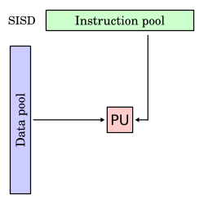
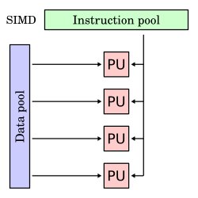
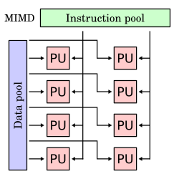
Flynn’s Taxonomy (Aside)

Slide 38
SIMD and MIMD
Two principal parallel computing paradigms (multiple operands)
SIMD:
  Multiple instructions at a time
  All execution units execute in (c)lock step
  But each have their own data

Slide 39
SIMD and MIMD
Two principal parallel computing paradigms (multiple operands)
MIMD:
  Single instruction at a time
  All execution units run independently (with own instructions)
  Shared memory (same computational node)
  Memory not shared (distributed computing, coming soon)

Slide 40
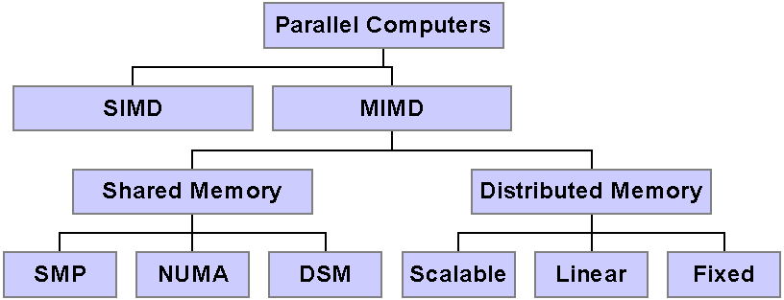
A More Refined (Programmer-Oriented) Taxonomy
Three major modes: SIMD, Shared Memory, Distributed Memory
Different programming approaches are generally associated with different modes of parallelism
  HPX allows to unify all of those
A modern supercomputer will have all three major modes present
We will come back to this soon
http://www.cise.ufl.edu/research/ParallelPatterns/PatternLanguage/Background/ParallelHardware.htm

Slide 41
SIMD in SSE/AVX
One machine instruction
Adds four doubles simultaneously
ymm are 256 bit registers

Slide 42
Vector Registers (x86)
zmm are 512 bit registers
256 bit ymm are aliased with zmm
128 bit xmm are aliased with ymm

Slide 43
Recommendations
Avoid programming in assembler, or intrinsics
  Non-portable, hardware-specific
It is most important to have a mental model for the vector registers and to be aware of what is possible and how to write code to be optimizable
Check your performance against performance models
Monitor what your compiler is doing
  Optimization report
  Full set of flags
  Last resort – read the assembler

Slide 44
Vectorization in C++
C++26 introduces std::simd<T>, a data type that represents a vector register
  Here T is the type to vectorize over, e.g., std::simd<double>
  For us (C++23), this type exists as std::experimental::simd<T>
  T can be any integral or floating point type (depends on architecture)
Provides portable types
  For explicitly stating data-parallelism and
  Structuring data for more efficient SIMD access
An object of type simd<T> behaves analogous to objects of type T
  T stores and manipulates one value
  simd<T> stores and manipulates multiple values
All operators and operations on simd<T> act element-wise
  Well, except for horizontal operations, like reduce

Slide 45
Vectorization in C++
namespace stdx = std::experimental;
int main() {
stdx::simd<int> a = 1; // uniform initialization
print_simd("a: ", a); // prints: a: 1 1 1 1
stdx::simd<int> b([](int i) { return i - 2; });
print_simd("b: ", b); // prints: b: -2 -1 0 1
print_simd("c: {}", a + b); // arithmetic operations
print_simd("d: ", my_abs(c)); // prints: d: 1 0 1 2
auto inner_product = stdx::reduce(c); // horizontal reduction
print_simd("inner product: ", inner_product); // prints: inner product: 2
stdx::simd<long double> x([](int i) { return i; });
print_simd("cos²(x) + sin²(x): ", pow(cos(x), 2) + pow(sin(x), 2));
}

Slide 46
Vectorization in C++
For completeness sake:
template <typename T>
void print_simd(std::string const& name, stdx::simd<T> const& a)
{
std::print(name);
for (std::size_t i = 0; i != std::size(a); ++i)
std::print("{} ", a[i]);
std::println();
}

Slide 47
SIMD Conditionals
This doesn’t work (why?):
Separate facility:
template <typename T>
stdx::simd<T> my_abs(stdx::simd<T> x)
{
if (x < 0) x = -x;
return x;
}
template <typename T>
stdx::simd<T> my_abs(stdx::simd<T> x)
{
stdx::simd_select(x < 0, x) = -x;
return x;
}

Slide 48
SIMD Masks
The class template stdx::simd_mask is a data-parallel type with the element type bool
Relational operators for stdx::simd return a stdx::simd_mask
  Each of the mask’s elements represent the result of the relational operator for the corresponding element
  E.g.,
  stdx::simd_select() masks out all elements for which Boolean is false
All operations on masks are specialized for single bool values as well
// every boolean in m represents result for one element of x
stdx::simd_mask m = x < 0;
// Assign only elements for which mask is true
stdx::simd_select(x < 0, x) = -x;

Slide 49
SIMD Mandelbrot

Slide 50
Aside: Using SIMD with Algorithms
Normal (non-SIMD) iteration over a given array:
std::vector<float> data = {...};
for (size_t i = 0; i != data.size(); ++i)
{
do_something(data[i]);
}
Equivalent algorithm use:
std::for_each(data.begin(), data.end(), do_something);
Equivalent parallel algorithm use:
std::for_each(std::execution::par, data.begin(), data.end(), do_something);
void do_something(float t)
{
// do something with t
}

Slide 51
Aside: Using SIMD with Algorithms
Normal (SIMD) iteration over a given array:
using V = stdx::simd<float>;
size_t i = 0;
// handle vectorizable elements
for (/**/; i + V::size() <= N; i += V::size())
{
// loads V::size() elements
stdx::simd x(&data[i]);
do_something(x);
}
// handle epilogue elements (if any)
for (/**/; i < N; ++i)
{
do_something(data[i]);
}
void do_something(stdx::simd<float> t)
{
// do something with t
}
void do_something(float t)
{
// do something with t
}
template <typename T>
void do_something(T t)
{
// do something with t
}

Slide 52
Aside: Using SIMD with Algorithms
Equivalent algorithm use (only vectorization):
hpx::for_each(hpx::execution::simd,
data.begin(), data.end(), do_something);
Equivalent algorithm use (also parallelize):
hpx::for_each(hpx::execution::par_simd,
data.begin(), data.end(), do_something);
auto do_something = [](auto t)
{
// do something with t
}

Slide 53
SIMD Mandelbrot
stdx::simd<size_t> mandelbrot(stdx::simd<std::complex<float>> z,
stdx::simd<std::complex<float>> const c, stdx::simd<size_t> count)
{
size_t const max_iterations = 100;
auto msk = abs(z) > 2.0f; // evaluates to stdx::simd_mask
for (size_t k = 0; k < max_iterations; ++k) {
z = z * z + c;
// assign iteration count to newly found elements > 2
auto curr_msk = abs(z) > 2.0f;
stdx::simd_select(msk ^ curr_msk, count) = k;
if (std::all_of(curr_msk))
return count; // break if all elements diverge
msk = curr_msk;
}
return count;
}

Slide 54
SIMD Mandelbrot
size_t mandelbrot(std::complex<float> z,
std::complex<float> const c, size_t count)
{
size_t const max_iterations = 100;
auto msk = abs(z) > 2.0f; // evaluates to bool
for (size_t k = 0; k < max_iterations; ++k) {
z = z * z + c;
// assign iteration count to newly found elements > 2
auto curr_msk = abs(z) > 2.0f;
stdx::simd_select(msk ^ curr_msk, count) = k;
if (std::all_of(curr_msk))
return count; // break if all elements diverge
msk = curr_msk;
}
return count;
}

Slide 55
SIMD Mandelbrot
template <typename T, typename Count>
Count mandelbrot(T z, T const c, Count count) {
size_t const max_iterations = 100;
auto msk = abs(z) > 2.0f;
for (size_t k = 0; k < max_iterations; ++k) {
z = z * z + c;
// assign iteration count to newly found elements > 2
auto curr_msk = abs(z) > 2.0f;
stdx::simd_select(msk ^ curr_msk, count) = k;
if (std::all_of(curr_msk))
return count; // break if all elements diverge
msk = curr_msk;
}
return count;
}

Slide 56
SIMD Mandelbrot
Slightly more complicated
  The elements of the simd variable may require different number of iterations
  Break out of loop once all elements have diverged
    Return iteration count for each element
  Otherwise return -1 for elements that do not diverge
This function is fully generic:
size_t m = mandelbrot(
std::complex<float>(0.0, 0.0),
std::complex<float>(c), size_t(-1));
stdx::simd<size_t> m = mandelbrot(
stdx::simd<std::complex<float>>(0.0, 0.0),
stdx::simd<std::complex<float>>(c), stdx::simd<size_t>(-1));

Slide 57
SIMD Mandelbrot
template <typename T, typename Const, typename Count>
Count mandelbrot(T z, Const const c, Count count) {
size_t const max_iterations = 100;
auto msk = abs(z) > 2.0f;
fixed_point(
[c](T z) { return z = z * z + c; },
[&](T, T z) {
auto curr_msk = abs(z) > 2.0f;
stdx::simd_select(msk ^ curr_msk, count) = k;
if (std::all_of(curr_msk))
return true; // break if all elements diverge
msk = curr_msk;
return false;
},
max_iterations, z);
return count;
}

Slide 58
SIMD Execution Policy
hpx::for_each(hpx::execution::par,
counting_iterator(0), counting_iterator(size_y),
[&](size_t pixel_y) {
std::simd<float> imag = scale(pixel_y, 0, size_y, -2.0, 2.0);
hpx::experimental::for_loop(hpx::execution::simd,
0, size_x,
[=, &mandelbrot_img](auto pixels_x) {
std::simd<float> real = scale(pixels_x, 0, size_x, -2.0, 2.0);
auto values = mandelbrot(std::simd<std::complex>(),
std::simd<std::complex>({real, imag}),
std::simd<size_t>());
write_pixels(mandelbrot_img, pixels_x, pixel_y, values);
});
});
Requires: P2663: Interleaved complex values support in std::simd

Slide 59
SIMD Execution Policy
hpx::experimental::for_loop(hpx::execution::par,
0, size_y,
[&](size_t pixel_y) {
std::simd<float> imag = scale(pixel_y, 0, size_y, -2.0, 2.0);
hpx::experimental::for_loop(hpx::execution::simd,
0, size_x,
[=, &mandelbrot_img](auto pixels_x) {
std::simd<float> real = scale(pixels_x, 0, size_x, -2.0, 2.0);
auto values = mandelbrot(std::simd<std::complex>(),
std::simd<std::complex>({real, imag}),
std::simd<size_t>());
write_pixels(mandelbrot_img, pixels_x, pixel_y, values);
});
});
Requires: P2663: Interleaved complex values support in std::simd

Slide 60
Area of Mandelbrot Set

Slide 61
The Mandelbrot Set: The Area
The area of Mandelbrot set has been theoretically approximated:
1.506591856 ± 2.54×10⁻⁸
  https://mrob.com/pub/muency/areaofthemandelbrotset.html
  https://github.com/MaartenStork/Mandelbrot_Set_Approximation/blob/main/Report.pdf
Computational approximation possible:
  Use Monte-Carlo method for this
  Repeat until satisfied:
    Randomly select point in complex plane
    Count if point is part of Mandelbrot Set
  Compute ration of successful hits and overall
  attempts

Slide 62
Exercise
Compute area of the Mandelbrot set using Monte-Carlo methods
Parallelelize the code that approximates the area of the Mandelbrot Set
  Use HPX for_loop with reduction helper
How many iterations did you need for decent approximation?
Plot the approximated value and the estimation error over the number of attempts

Slide 63
