Slide 1
Linear Algebra in C++
Lecture 8
Hartmut Kaiser
https://teaching.hkaiser.org/spring2025/csc4700/

Slide 2
Vector Spaces

Slide 3
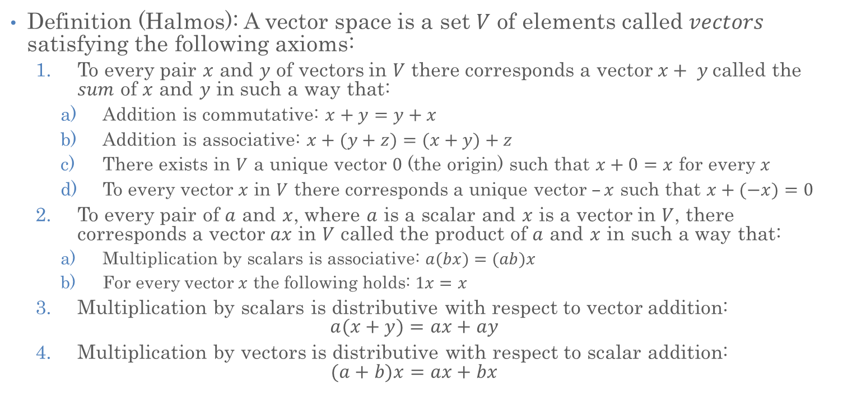
Mathematical Vector Space
Definition (Halmos): A vector space is a set $V$ of elements called $vectors$ satisfying the following axioms:
  To every pair $x$ and $y$ of vectors in $V$ there corresponds a vector $x+ y$called the $sum$ of $x$ and $y$ in such a way that:
    Addition is commutative: $x+y=y+x$
    Addition is associative: $x+(y+z)=(x+y)+z$
    There exists in $V$ a unique vector $0$ (the origin) such that $x+0=x$ for every $x$
    To every vector $x$ in $V$ there corresponds a unique vector $–x$ such that $x+(−x)=0$
  To every pair of $a$ and $x$, where $a$ is a scalar and $x$ is a vector in $V$, there corresponds a vector $ax$ in $V$ called the product of $a$ and $x$ in such a way that:
    Multiplication by scalars is associative: $a(bx)=(ab)x$
    For every vector $x$ the following holds: $1x=x$
  Multiplication by scalars is distributive with respect to vector addition:
  $a(x+y)=ax+ay$
  Multiplication by vectors is distributive with respect to scalar addition:
  $(a+b)x=ax+bx$

Slide 4
Mathematical Vector Space Examples
Math calls this a
  Additive Group
  With the idempotent element of 0
  With an invertive element of -1
Examples
  Set of all integer numbers
  Set of all complex numbers
  Set of all polynomials
  Set of all n-tuples of real numbers
The vector space used in scientific computing

Slide 5
Computer Representation of Vector Space
In the bad old days, vectors were represented as arrays
Add them
Double precision
Add them

Slide 6
Vectors Spaces in C++
Despite the clumsiness of Fortran interface (or maybe because of it) the performance of vector operations was quite good
In C/C++, there are numerous options for vectors (and matrices)
double x[N];
// Not dynamically sizable*
double* x = (double*) malloc(N * sizeof(double));
// memory management hell
std::vector<double> x(N);
// Limited to interface of vector<double> (not a 'vector')
Vector x(N);
// Just right, has proper interface and implementation

Slide 7
Vectors Spaces in C++
Despite the clumsiness of Fortran interface (or maybe because of it) the performance of vector operations was quite good
In C/C++, there are numerous options for vectors (and matrices)
double a[N][M];
// Not dynamically sizable
double** x = ??;
// Really easy to get bad performance
std::vector<std::vector<double>> x(N);
// Not a matrix (or a 2D array for that matter) at all
Matrix<double> x(N, M);
// Just right, has proper interface and implementation

Slide 8
Classes (Types)
First principles: Abstraction, simplicity, consistent specification
Domain: Scientific computing
Domain abstractions: Matrices and vectors
Programming abstractions: Matrix type and Vector type
C++ types enable encapsulation of related data and functions
  Provide visible interfaces
  Hide implementation details

Slide 9
std::vector<double>
Before rushing off to implement fancy interfaces
Understand what we are working with
And how hardware and software interact
std::vector<double> will be our storage
But its interface won’t be our interface
  We will use types defined in Blaze
  But we will look at implementation for those

Slide 10
Linear Algebra Operations

Slide 11

Vector Dot Product
Multiplication of 2 vectors followed by Summation
A[i]
X₁
X₂
X₃
X₄
X₅
… …
X_{n}
B[i]
Y₁
Y₂
Y₃
Y₄
Y₅
… …
Y_{n}
A[i] * B[i]
X₁* Y₁
X₂* Y₂
X₃* Y₃
X₄* Y₄
X₅* Y₅
… …
X_{n}* Y_{n}
$$=\sum_{i=1}^{n}{}$$
∙

Slide 12
Vector Dot Product
  int main()
  {
  std::vector<double> a = {1.0, 2.0, 3.0, 4.0, 5.0};
  std::vector<double> b = {5.0, 4.0, 3.0, 2.0, 1.0};
  double dot_result = 0.0;
  for (size_t i = 0; i != a.size(); ++i)
  dot_result += a[i] * b[i];
  std::println("dot-product: {}", dot_result);
  }

Slide 13
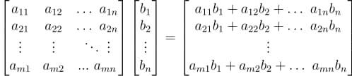
Matrix-Vector Multiplication
Result is a vector that holds the dot-products of each line of the matrix with the given right-hand-side vector

Slide 14
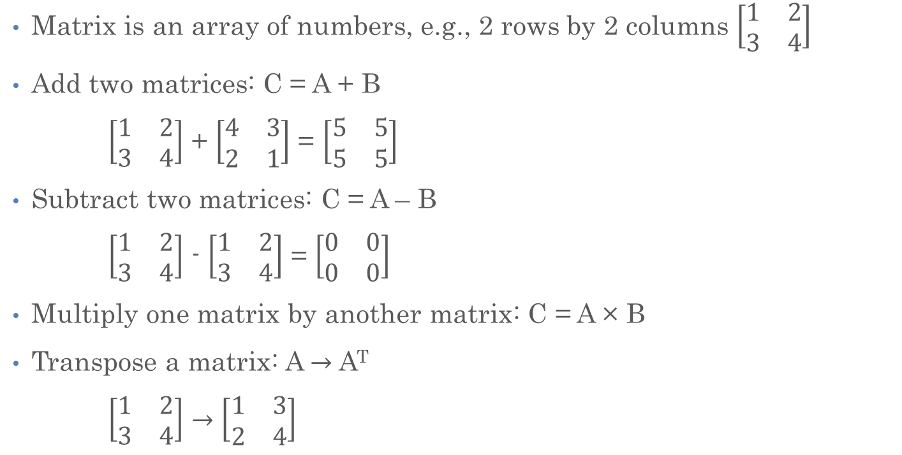
Matrix in Math
Matrix is an array of numbers, e.g., 2 rows by 2 columns $\left[\begin{matrix}1 & 2 \\ 3 & 4\end{matrix}\right]$
Add two matrices: C = A + B
$\left[\begin{matrix}1 & 2 \\ 3 & 4\end{matrix}\right]$ + $\left[\begin{matrix}4 & 3 \\ 2 & 1\end{matrix}\right]$ = $\left[\begin{matrix}5 & 5 \\ 5 & 5\end{matrix}\right]$
Subtract two matrices: C = A – B
$\left[\begin{matrix}1 & 2 \\ 3 & 4\end{matrix}\right]$ - $\left[\begin{matrix}1 & 2 \\ 3 & 4\end{matrix}\right]$ = $\left[\begin{matrix}0 & 0 \\ 0 & 0\end{matrix}\right]$
Multiply one matrix by another matrix: C = A × B
Transpose a matrix: A $→$ A^{T}
$\left[\begin{matrix}1 & 2 \\ 3 & 4\end{matrix}\right]$ $→$ $\left[\begin{matrix}1 & 3 \\ 2 & 4\end{matrix}\right]$

Slide 15
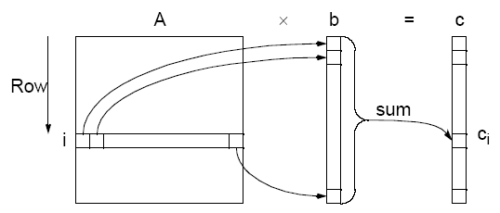

Matrix-Matrix Multiplication
$$C= A×B$$

Slide 16

Matrix Transpose
The transpose of the (m x n) matrix $A$ is the (n x m) matrix formed by interchanging the rows and columns such that row i becomes column i of the transposed matrix

Slide 17
Matrix Representation

Slide 18
Matrix Representation in Computers
Two issues
  Interface (what is the abstraction we want to present?)
  Implementation (how is the abstraction realized?)
Sometimes there are tradeoffs
  Evaluate relative to end user
  In HPC – performance is most important
  Elsewhere – safety, ease of use, standards compliance, etc.
Matrix A(M, K), B(K, M), C(M, N);
for (size_t i = 0; i != A.num_rows(); ++i)
for (size_t j = 0; j != B.num_cols(); ++j)
for (size_t k = 0; k != A.num_cols(); ++k)
C(i, j) += A(i, k) * B(k, j);

Slide 19

Matrix Matrix Product
Notionally 2 Dimensional
Use a 2D data structure
=
$$×$$

Slide 20
Matrix Representation
Matrix A(M, K), B(K, M), C(M, N);
for (size_t i = 0; i != A.num_rows(); ++i)
for (size_t j = 0; j != B.num_cols(); ++j)
for (size_t k = 0; k != A.num_cols(); ++k)
C(i, j) += A(i, k) * B(k, j);
column
row
Use a doubly indexed accessor
A matrix is a doubly indexed set
Use a doubly indexed data structure

Slide 21
Matrix
Representation
Matrix A(M, K), B(K, M), C(M, N);
for (size_t i = 0; i != A.num_rows(); ++i)
for (size_t j = 0; j != B.num_cols(); ++j)
for (size_t k = 0; k != A.num_cols(); ++k)
C(i, j) += A(i, k) * B(k, j);
column
row
To create one memory address
Memory is a contiguous address space
Use a doubly indexed accessor

Slide 22
Matrix Representation
Several options to represent a 2D structure in memory
  Translate double index to single address
Arrays of arrays:
  Use outer pointer to get inner pointer: [i]
  Lookup element from inner pointer: [j]
Vector of vectors:
  Lookup inner vector from outer vector: [i]
  Use inner vector to get data element: [j]
double** storage = ...; // storage[i][j];
std::vector<std::vector<double>> storage; // storage[i][j];

Slide 23
Matrix Representation
Several options to represent a 2D structure in memory
  Translate double index to single address
Use single vector to get data element:
  Need to compute index: [k]
std::vector<double> storage; // storage[k];

Slide 24
Matrix Representation
column
Number of columns
row
Number of columns

Slide 25
Matrix Representation
column
row
Matrix C(M, N);
vector<double> vC(M * N);
Number of columns

Slide 26
Matrix Representation
column
Row oriented:
Increment fastest
along row
row
Matrix C(M, N);
vector<double> vC(M * N);
Number of columns

Slide 27
Matrix Representation
column
Column oriented:
row
Number of rows
Matrix C(M, N);
vector<double> vC(M * N);
Increment fastest
along column

Slide 28
Matrix Implementation
Row oriented memory layout (row major):
  We write:
  But will do this (under the hood):
Column oriented memory layout (column major):
  We write:
  But will do this (under the hood):

Slide 29
Matrix Implementation in C++
Row oriented memory layout (row major):
  We write:
  But will do this (under the hood):
Simultaneously (and safely) need a matrix type with
  (i, j) two dimensional accessor
  Transparent translation to one dimensional accessor
Preprocessor?

Slide 30
Matrix in C++
class Matrix {
public:
Matrix(size_t M, size_t N) : num_rows(M), num_columns(N), storage(N * M) {}
Matrix(size_t M, size_t N, double init)
: num_rows(M), num_columns(N), storage(N * M, init) {}
double& operator()(size_t i, size_t j) {
return storage[i * num_columns + j]; }
double const& operator()(size_t i, size_t j) const {
return storage[i * num_columns + j]; }
size_t rows() const { return num_rows; }
size_t columns() const { return num_columns; }
private:
size_t num_rows, num_columns;
std::vector<double> storage;
};

Slide 31
Matrix in C++: Memory Layouts
Different memory layouts:
  Row-major
  Column-major:
double& operator()(size_t i, size_t j) {
return storage[i * num_columns + j]; }
double const& operator()(size_t i, size_t j) const {
return storage[i * num_columns + j]; }
double& operator()(size_t i, size_t j) {
return storage[j * num_rows + i]; }
double const& operator()(size_t i, size_t j) const {
return storage[j * num_rows + i]; }

Slide 32
Matrix Multiplication

Slide 33
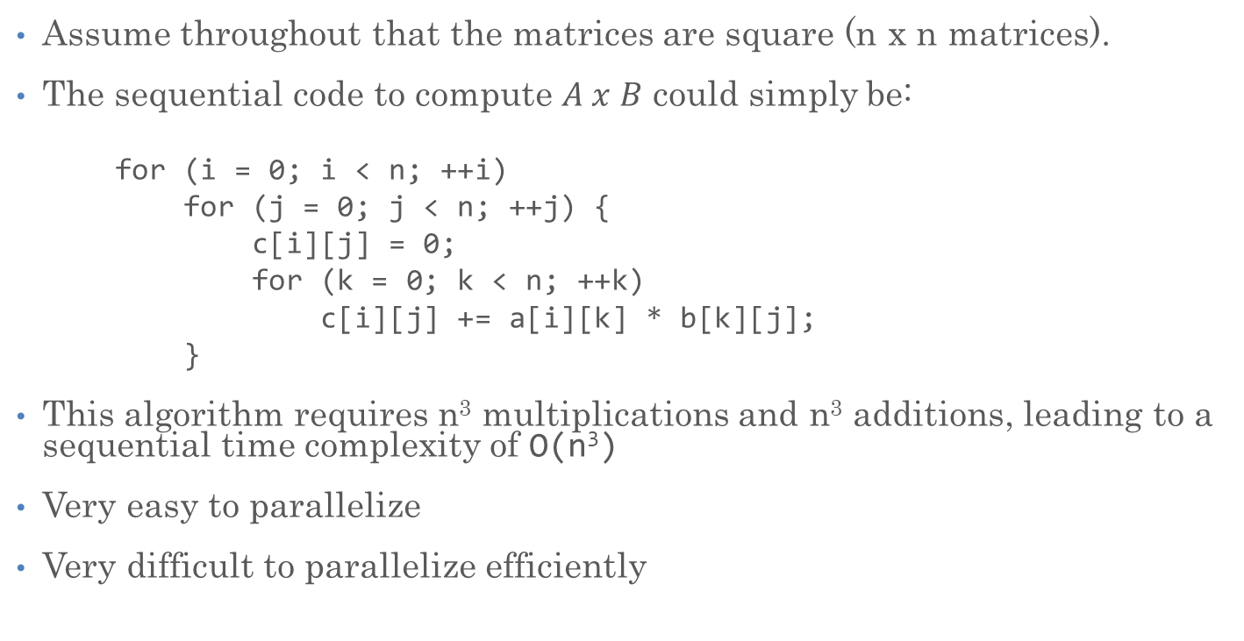
Matrix-Matrix Multiplication, Sequential Code
Assume throughout that the matrices are square (n x n matrices).
The sequential code to compute $A x B$ could simply be:
  for (i = 0; i < n; ++i)
  for (j = 0; j < n; ++j) {
  c[i][j] = 0;
  for (k = 0; k < n; ++k)
  c[i][j] += a[i][k] * b[k][j];
  }
This algorithm requires n³ multiplications and n³ additions, leading to a sequential time complexity of O(n³)
Very easy to parallelize
Very difficult to parallelize efficiently

Slide 34
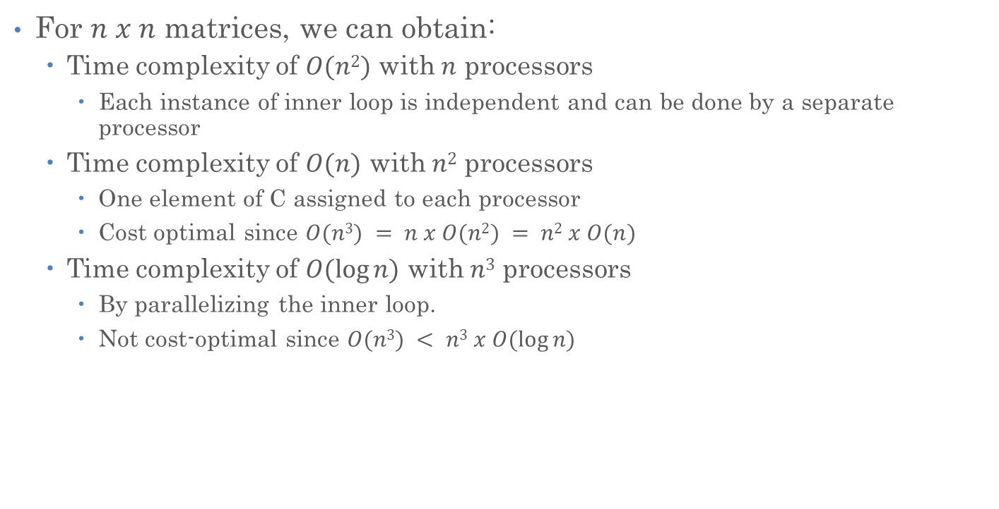
Matrix-Matrix Multiplication
For $n x n$ matrices, we can obtain:
  Time complexity of $O(n2)$ with $n$ processors
    Each instance of inner loop is independent and can be done by a separate processor
  Time complexity of $O(n)$ with $n2$ processors
    One element of C assigned to each processor
    Cost optimal since $O(n3) = n x O(n2) = n2 x O(n)$
  Time complexity of $O(log⁡n)$ with $n3$ processors
    By parallelizing the inner loop.
    Not cost-optimal since $O(n3) < n3 x O(log⁡n)$

Slide 35
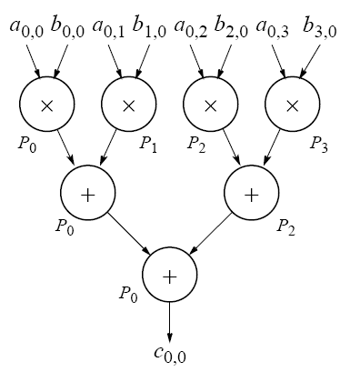

Matrix-Matrix Multiplication
Using tree construction $n$ numbers can be added in $O(log⁡n)$ steps (using $n3$ processors)
$O(log⁡n)$ lower bound for parallel matrix multiplication

Slide 36
Timing and Benchmarking

Slide 37
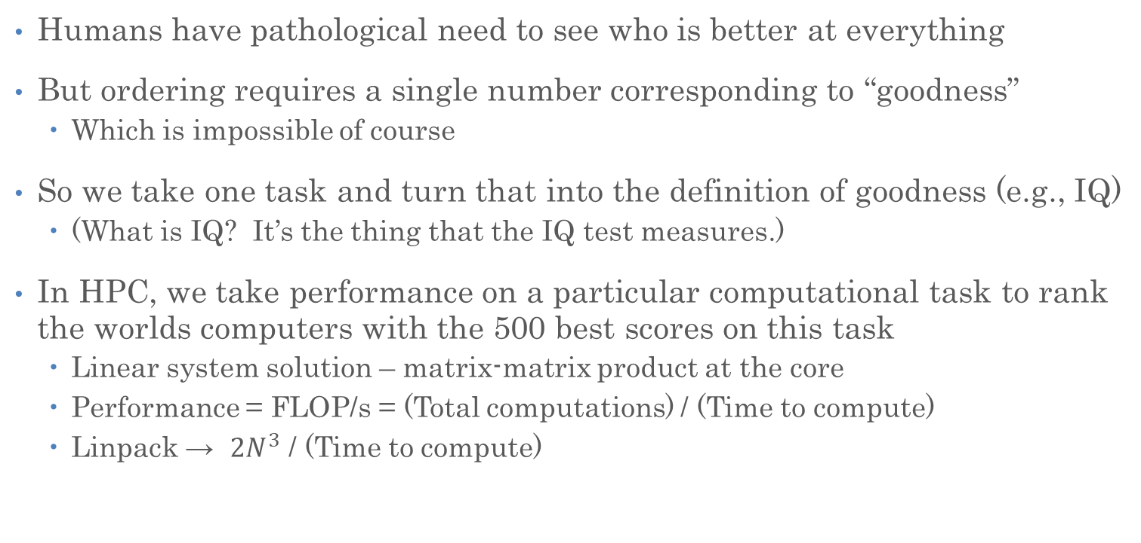
Timing and Benchmarking
Humans have pathological need to see who is better at everything
But ordering requires a single number corresponding to “goodness”
  Which is impossible of course
So we take one task and turn that into the definition of goodness (e.g., IQ)
  (What is IQ? It’s the thing that the IQ test measures.)
In HPC, we take performance on a particular computational task to rank the worlds computers with the 500 best scores on this task
  Linear system solution – matrix-matrix product at the core
  Performance = FLOP/s = (Total computations) / (Time to compute)
  Linpack → ${2N}^{3}$ / (Time to compute)

Slide 38
Timing a Program
The time program in Linux (Unix) will measure time resources a process uses
“real”: Elapsed Wall Clock – this is what we’re interested in

Slide 39
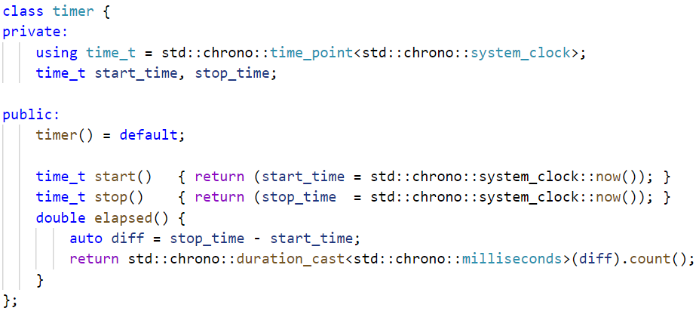
C++ Timer
And this will be provided to you
All you need to worry about

Slide 40
Measuring Matrix-Matrix Product
Three nested loops
  Multiplication
  Addition
  How much data?
  How many FLOP/s?
Matrix A(M, K), B(K, M), C(M, N);
for (size_t i = 0; i != A.num_rows(); ++i)
for (size_t j = 0; j != B.num_cols(); ++j)
for (size_t k = 0; k != A.num_cols(); ++k)
C(i, j) += A(i, k) * B(k, j);

Slide 41
Measuring Matrix Matrix Product
int main()
{
for (int size = 8; size != 1024; size *= 2)
{
Matrix A(size, size), B(size, size);
timer t; // define timer t
t.start() // start timer t
Matrix C = A * B;
t.stop(); // stop timer t
std::println("size: {}, elapsed: {}",
size, t.elapsed());
}
return 0;
}
Insufficient resolution!

Slide 42
What Are We Timing?
Never allocate new memory in performance critical sections of code!
Matrix operator*(Matrix const& A, Matrix const& B)
{
Matrix C(A.num_rows(), A.num_cols(), 0); // allocate and zeroize
// the actual matrix product
for (size_t i = 0; i != A.num_rows(); ++i) {
for (size_t j = 0; j != B.num_cols(); ++j) {
for (size_t k = 0; k != A.num_cols(); ++k) {
C(i, j) += A(i, k) * B(k, j);
}
}
}
return C;
}

Slide 43
Just For Benchmarking
void multiply(Matrix const& A, Matrix const& B, Matrix& C)
{
for (size_t i = 0; i != A.num_rows(); ++i) {
for (size_t j = 0; j != B.num_cols(); ++j) {
for (size_t k = 0; k != A.num_cols(); ++k) {
C(i, j) += A(i, k) * B(k, j);
}
}
}
}
Matrix operator*(Matrix const& A, Matrix const& B)
{
Matrix C(A.num_rows(), A.num_cols(), 0);
multiply(A, B, C);
return C;
}

Slide 44
Benchmarking
int main() {
for (int size = 8; size != 1024; size *= 2) {
matrix A(size, size), B(size, size), C(size, size);
timer t; // define timer t
t.start() // start timer t
for (int i = 0; i != num_samples; ++i)
multiply(A, B, C);
t.stop(); // stop timer t
std::println("size: {}, elapsed: {}", size, t.elapsed());
}
return 0;
}
Run the core loop many times to get sufficient resolution for small(er) sizes

Slide 45
Base Performance Results

Slide 46
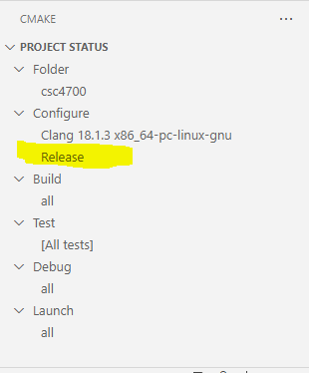
Let’s Make One Small Change
Change build system to Release
Always do that for performance measurements!

Slide 47
Base Performance Results

Slide 48

Locality $→$ Performance
Caches are much smaller than main memory. How do we decide what data to keep in cache to effect higher performance (more accesses)?
Temporal Locality: if a program accesses a memory location, there is a much higher than random probability that the same location will be accessed again
  Cache replacement policies attempt to keep cached elements in the cache for as long as possible
Spatial Locality: if a program accesses a memory location, there is a much higher than random probability that nearby locations will also be accessed (soon)
  Cache policies read contiguous chunks of data – a referenced element and its neighbors – not just single elements

Slide 49
Improving (temporal) Locality
Consider each step of inner loop:
Load C(i, j) into register
Load A(i, k) into register
Load B(k, j) into register
Multiply
Add
Store C(i, j)
Four memory operations and two floating point operations per iteration
  2/6 == 1/3 flop per cycle (if each operation is one cycle)
for (size_t i = 0; i != M; ++i)
for (size_t j = 0; j != N; ++j)
for (size_t k = 0; k != N; ++k)
C(i, j) += A(i, k) * B(k, j);

Slide 50
Hoisting
What can be reused?
  C(i, j)!
  Hoist it!
Load A(i, k)
Load B(k, j)
Multiply
Add
Two memory operations and two floating point operations per iteration
  2/4 == 1/2 flop per cycle (if each operation is one cycle)
for (size_t i = 0; i != M; ++i)
for (size_t j = 0; j != N; ++j) {
double t = C(i, j);
for (size_t k = 0; k != N; ++k)
t += A(i, k) * B(k, j);
C(i, j) = t;
}

Slide 51
Order of Operations

Slide 52
Order of Operations

Slide 53
Order of Operations
How many times is each row used?
How many times is each column used?

Slide 54
Reuse: How Many Times Are Data Reused?
Each is used twice

Slide 55
Improving (temporal) Locality: Unroll
void tiled_multiply_2x2(matrix const& A, matrix const& B, matrix& C) {
for (size_t i = 0; i != A.num_rows(); i += 2)
for (size_t j = 0; j != B.num_cols(); j += 2)
for (size_t k = 0; k != A.num_cols(); ++k) {
C(i, j) += A(i, k) * B(k, j);
C(i, j + 1) += A(i, k) * B(k, j + 1);
C(i + 1, j) += A(i + 1, k) * B(k, j);
C(i + 1, j + 1) += A(i + 1, k) * B(k, j + 1);
}
}
A(i, k), A(i+1, k), B(k, j), B(k, j+1): used twice
C(i, j), C(i, j + 1), C(i + 1, j), C(i + 1, j + 1): can be hoisted
Four memory operations and eight floating point operations per iteration
  8/12 = 2/3 flop per cycle (if each operation is one cycle) – 2X the base case

Slide 56
Example: Register Locality (2 by 2)

Slide 57
2 by 4

Slide 58
4 by 2

Slide 59
4 by 4

Slide 60
Tiling and Hoisting
void hoisted_tiled_multiply_2x2(matrix const& A, matrix const& B, matrix& C)
{
for (size_t i = 0; i != M; ++i) {
for (size_t j = 0; j != N; ++j) {
double t00 = C(i, j), t01 = C(i, j + 1);
double t01 = C(i + 1, j), t11 = C(i + 1, j + 1);
for (size_t k = 0; k != N; ++k) {
t00 += A(i, k) * B(k, j);
t01 += A(i, k) * B(k, j + 1);
t10 += A(i + 1, k) * B(k, j);
t11 += A(i + 1, k) * B(k, j + 1);
}
C(i, j) = t00; C(i, j + 1) = t01;
C(i + 1, j) = t10; C(i + 1, j + 1) = t11;
}
}
}

Slide 61
Tiling 2 by 2 and Hoisting

Slide 62
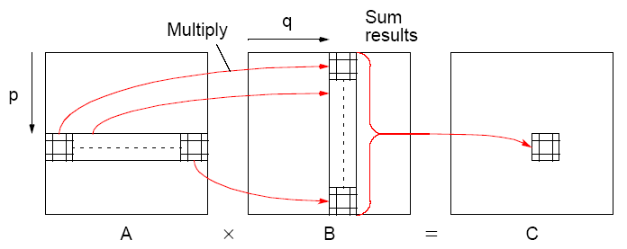
Block Matrix Multiplication
Partitioning into sub-matricies

Slide 63
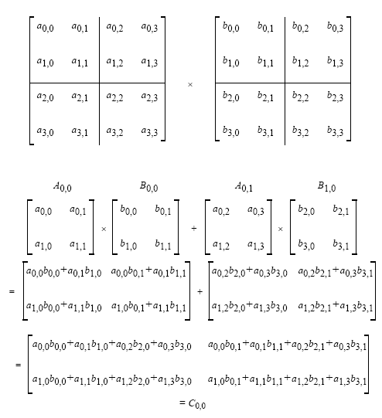
Block Matrix Multiplication

Slide 64
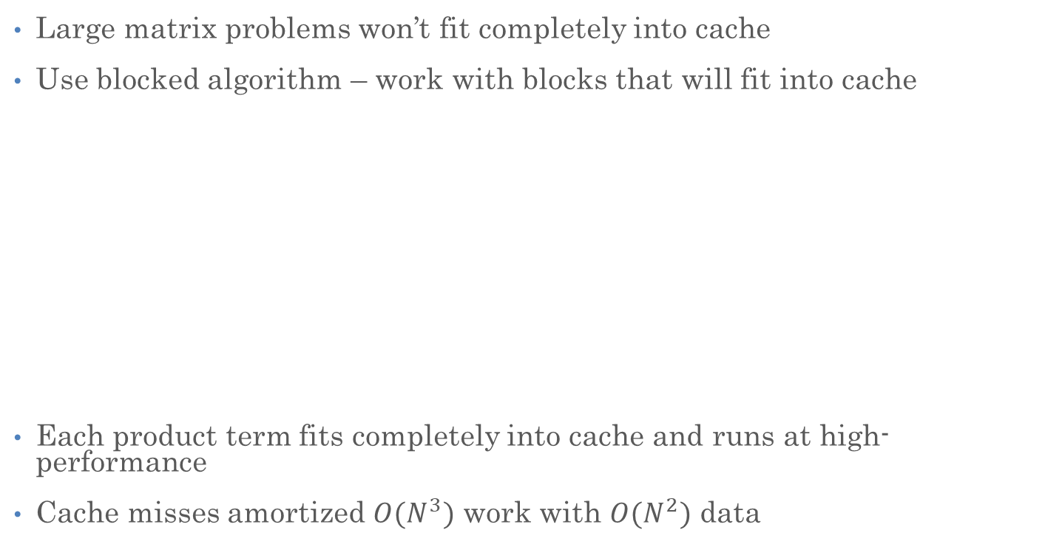
Improving Locality: Cache
Large matrix problems won’t fit completely into cache
Use blocked algorithm – work with blocks that will fit into cache
Each product term fits completely into cache and runs at high-performance
Cache misses amortized $O(N^{3})$ work with $O(N^{2})$ data

Slide 65
Blocking and Tiling
void block_tiled_multiply_2x2(matrix const& A, matrix const& B, matrix& C)
{
for (size_t ii = 0; ii != A.num_rows(); ii += blocksize) {
for (size_t jj = 0; jj != B.num_cols(); jj += blocksize) {
for (size_t kk = 0; kk != A.num_cols(); kk += blocksize) {
for (size_t i = ii; i != ii + blocksize; i += 2) {
for (size_t j = jj; j != jj + blocksize; j += 2) {
for (size_t k = kk; k != kk + blocksize; ++k) {
C(i , j ) += A(i , k) * B(k, j);
C(i , j + 1) += A(i , k) * B(k, j + 1);
C(i + 1, j ) += A(i + 1, k) * B(k, j);
C(i + 1, j + 1) += A(i + 1, k) * B(k, j + 1);
}
}
}
}
}
}
}
Outer loops work across blocks
(for each block)
Inner loops work on blocks

Slide 66
Blocking and Tiling and Hoisting

Slide 67
Copying and Transpose Multiply
What else gets pulled into cache
What else gets pulled into cache

Slide 68
Copying and Transpose Multiply
What else gets pulled into cache
What else gets pulled into cache

Slide 69
Copying and Blocking and Tiling

Slide 70
Blocking and Tiling and Hoisting and Copying

Slide 71
Recap
Locality: Write software so hardware can leverage it
Register (temporal) locality (tiling / unrolling)
  Hoisting
  Blocking
Spatial locality
  Copying / transpose multiply
Always use –O3 for release (not for debug)

Slide 72
Tuning
Magic: the power of apparently influencing the course of events by using mysterious or supernatural forces
Starting with base code
Various compiler optimizations help
Tiling (which size)
Blocking (what size)
What size works best for Tiling and Blocking together?
What loop ordering? Matrix-matrix product has six different orderings? What block ordering?
What about when we add vectorization, and threads, etc?
How do we find the optimal combination?
The answer will be different for different CPUs

Slide 73
Finding the Sweet Spot
Exhaustive parameter space search
  Tiling, Blocking, Compiler flags, AVX instr, loop ordering
  This started as a final course project
  The competition was to write fastest matrix-matrix product
  Students were the good kind of lazy
  And wrote a program to generate different multiply functions
Original project at UC Berkeley phiPAC (Bilmes et. Al.)
Further developed by Whaley and Dongarra → Automatically Tuned Linear Algebra Subprograms (ATLAS)
  Recently honored with “test of time” award

Slide 74
