Slide 1
Roofline Model, Sparse Matrix Computation
Lecture 9
Hartmut Kaiser
https://teaching.hkaiser.org/spring2025/csc4700/

Slide 2
The Roofline Model

Slide 3
Roofline Model
Performance: locality, locality, locality
Because computation is really really fast
And moving data is expensive
Limits on performance: Bandwidth, Latency, Peak Compute
Williams, Samuel, Andrew Waterman, and David Patterson. "Roofline: an insightful visual performance model for multicore architectures." Communications of the ACM 52.4 (2009): 65-76.

Slide 4
Roofline Model
Performance: locality, locality, locality
Because computation is really really fast
And moving data is expensive
Limits on performance: Bandwidth, Latency, Peak Compute

Slide 5
Roofline Model
Performance: locality, locality, locality
Because computation is really really fast
And moving data is expensive
Limits on performance: Bandwidth, Latency, Peak Compute

Slide 6
Roofline Model
Performance: locality, locality, locality
Because computation is really really fast
And moving data is expensive
Limits on performance: Bandwidth, Latency, Peak Compute

Slide 7
Roofline Model
Slope = Gbytes/sec

Slide 8
Roofline Model
Single scalar core

Slide 9
Roofline Model
SSE single core (vectorize using 128 bit registers)

Slide 10
Roofline Model
AVX single core (vectorize using 256 bit registers)

Slide 11
Roofline Model
AVX single core, fused multiply-add (FMA)

Slide 12
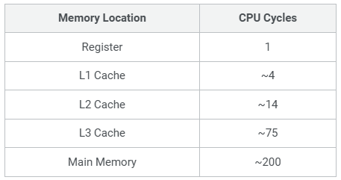
Roofline Model
L2 Cache

Slide 13
Roofline Model
L1 Cache

Slide 14
Roofline Model
DRAM (main memory)

Slide 15
Measured

Slide 16


Numerical Intensity
Inner loop:
  Two FLOP (one add, one multiplication)
  Three doubles moved in/out of memory = 24 bytes
Overall:
  $2N^{2}$ FLOP
  $N^{2}+2N$ doubles = ${8(N}^{2}+2N)$ bytes
void matvec_dense(Matrix const& A, Vector const& x, Vector& y)
{
for (size_t i = 0; i != A.num_rows(); ++i)
for (size_t j = 0; j != A.num_cols(); ++j)
y(i) += A(i, k) * x(j);
}
$$\frac{1}{4} \frac{FLOP}{Byte}$$

Slide 17
Measured
3 GFLOP/s
0.25 FLOP/Byte

Slide 18


No Reuse: Memory-bound
void matmat_dense(Matrix const& A, Matrix const& B, Matrix& C)
{
for (size_t i = 0; i != A.num_rows(); ++i)
for (size_t j = 0; j != B.num_cols(); ++j)
for (size_t k = 0; k != A.num_cols(); ++k)
C(i, j) = A(i, k) * B(k, j);
}
Inner loop:
  Two FLOP (one add, one multiplication)
  Three doubles moved in/out of memory = 24 bytes
Overall:
  $2N^{3}$ FLOP
  ${3N}^{3}$ doubles = ${24N}^{3}$ bytes
$$\frac{1}{12} \frac{FLOP}{Byte}$$

Slide 19
No Reuse: Memory-bound
1.4 GFLOP/s
1/12 FLOP/Byte

Slide 20
No Reuse: Memory-bound
0.4 GFLOP/s

Slide 21


Full reuse: Compute-bound
void matmat_dense(Matrix const& A, Matrix const& B, Matrix& C)
{
for (size_t i = 0; i != A.num_rows(); ++i)
for (size_t j = 0; j != B.num_cols(); ++j)
for (size_t k = 0; k != A.num_cols(); ++k)
C(i, j) = A(i, k) * B(k, j);
}
Inner loop:
  Two FLOP (one add, one multiplication)
  Three doubles moved in/out of memory = 24 bytes
Overall:
  $2N^{3}$ FLOP
  Full reuse: ${3N}^{2}$ doubles = ${24N}^{2}$ bytes
$$\frac{N}{12} \frac{FLOP}{Byte}$$

Slide 22
Full reuse: Compute-bound
45 GFLOP/s
N

Slide 23
Hoisting / Unrolling etc.: L2
5 GFLOP/s
L2 zone

Slide 24
Hoisting / Unrolling etc.: L2
5 GFLOP/s

Slide 25
Summary (Roofline Model)

Slide 26
Sparse Matrices

Slide 27
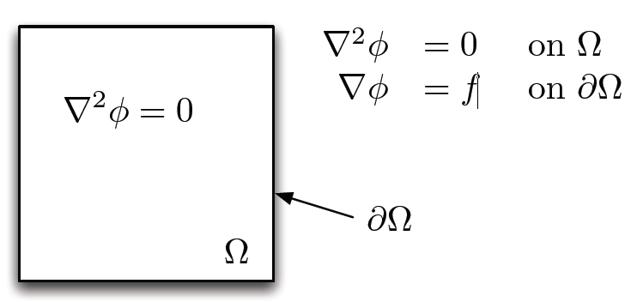
In Practice
Many scientific applications are based on solving systems of partial differential equations that model physical phenomena
Laplace’s equation on unit square is prototypical PDE

Slide 28
Discretized
Finite difference approximation to derivative

Slide 29
Laplace’s Equation on a Regular Grid

Slide 30
Iterating for a Solution
Timesteps

Slide 31
Iterating for a Solution
Only need to use two arrays: old and new
  Array x: average of approximation at iteration k
  Array y: average of approximation at iteration k + 1
while (!converged())
{
for (size_t i = 1; i != N + 1; ++i)
for (size_t j = 1; j != N + 1; ++j)
y(i, j) = (
x(i - 1, j ) +
x(i + 1, j ) +
x(i, j - 1) +
x(i, j + 1)
) / 4.0;
swap(x, y);
}
At end of each outer iteration: new becomes old (and v.v.)

Slide 32
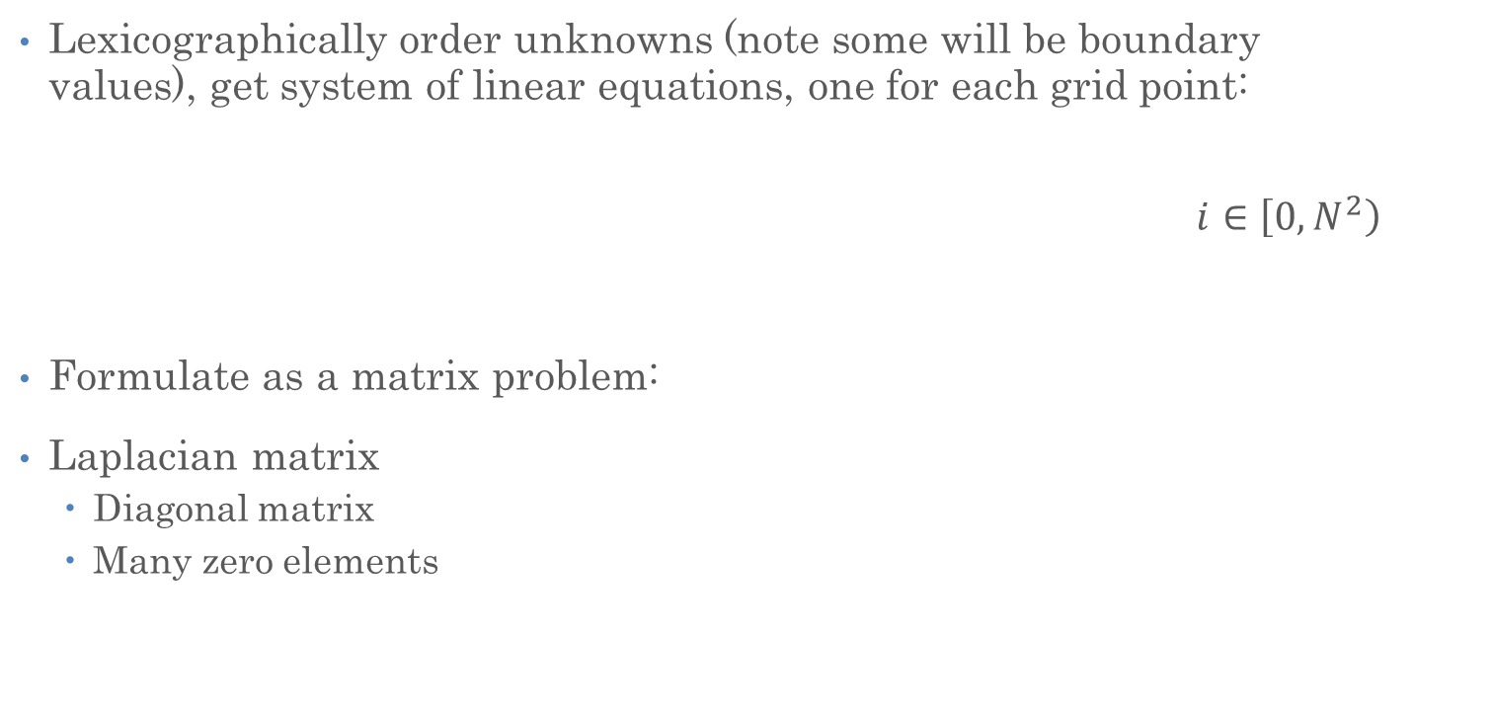
Matrix Formulation
Lexicographically order unknowns (note some will be boundary values), get system of linear equations, one for each grid point:
$$i∈\left[0,\left.N^{2}\right)\right.$$
Formulate as a matrix problem:
Laplacian matrix
  Diagonal matrix
  Many zero elements
0
0

Slide 33
Laplace’s Equation on a Regular Grid
0
0
Discretization
The value of each point on the grid
The average of its neighbors in 4 directions

Slide 34
Laplace’s Equation on a Regular Grid
Why isn’t 0 the solution?
The boundary is non-zero
Non-zeros in here due to boundary
0
0

Slide 35
Linear System Solution

Slide 36
Linear System Solution
Matrix-matrix product is the essential kernel operation
void multiply(Matrix const& A, Matrix const& B, Matrix& C)
{
for (size_t i = 0; i != A.num_rows(); ++i)
for (size_t j = 0; j != B.num_cols(); ++j)
for (size_t k = 0; k != A.num_cols(); ++k)
C(i, j) = A(i, k) * B(k, j);
}
What happens with the Laplacian matrix?
  Multiplying and adding zero to zero (partially)
Work Smarter! Don’t multiply and add zero to zero!

Slide 37
Solution?
Let’s Avoid zeros!
void multiply(Matrix const& A, Matrix const& B, Matrix& C)
{
for (size_t i = 0; i != A.num_rows(); ++i)
for (size_t j = 0; j != B.num_cols(); ++j)
for (size_t k = 0; k != A.num_cols(); ++k)
if (A(i, k) != 0.0 && B(k, j) != 0.0)
C(i, j) = A(i, k) * B(k, j);
}
But we still touch every element
  And that’s what expensive!
We need to avoid zeros, but without looking to see if there is a zero

Slide 38
Solution: Sparse Matrices
In order to avoid zeros, just don’t store them!
  A zero is a null op after all
Use data structures and algorithms accordingly
Sparse matrix techniques
0
0

Slide 39
Solving Sparse Systems
Work only with non-zeros
Direct methods
  Perform LU factorization on sparse matrix
  Create non-zeros during elimination process
  Pre-order (using heuristics) to minimize the amount of fill
  Very sequential
  Fill can be quite significant
    Expensive as space needs to be created!
Iterative methods
  Successively create better approximations to x
  Relaxation methods (e.g., Jacobi) – very very very slow to converge
  Krylov subspace methods (e.g., conjugate gradient)
    Good preconditioning often required

Slide 40
Aside: Conjugate Gradient Algorithm
Initial r⁽⁰⁾=b-Ax⁽⁰⁾
For i=1, 2, …
solve Mz^{(i-1)} = r ^{(i-1)}
ρ _{i-1} = r ^{(i-1) T} z ^{(i-1)}
If i=1
p ⁽¹⁾ =z ⁽⁰⁾
Else
β _{i-1} = ρ_{i-1} /ρ_{i-2}
p^{(i)} =z^{(i-1)} + β _{i-1} p ^{(i-1)}
Endif
q^{(i)} =Ap^{(i)}
α _{i} = ρ_{i-1} / p^{(i)T} q^{(i)}
x^{(i)} = x^{(i-1)} + α _{i} p^{(i)}
r^{(i)} = r^{(i-1)} – α _{i} q^{(i)}
Check convergence
end
mult(A, scaled(x, -1.0), b, r);
while (! iter.finished(r)) {
solve(M, r, z);
rho = dot_conj(r, z);
if ( iter.first() )
copy(z, p);
else {
beta = rho / rho_1;
add(z, scaled(p, beta), p);
}
mult(A, p, q);
alpha = rho / dot_conj(p, q);
add(x, scaled(p, alpha), x);
add(r, scaled(q, -alpha), r);
rho_1 = rho;
++iter;
}

Slide 41
Sparse Storage
A matrix is map from two indices to a value
So if we want to store just elements that are not zero (the “non-zeros”)
We need to store the two indices and the value
0
0

Slide 42
Dense Storage
Dense storage:
  All matrix elements are kept at the location corresponding to their indices
…

Slide 43
Dense Storage
void multiply(
Matrix const& A, Vector const& x, Vector& y)
{
for (size_t i = 0; i != A.num_rows(); ++i)
for (size_t j = 0; j != A.num_cols(); ++j)
y(i) = A(i, k) * x(j);
}
We go through all possible valid indices
  And thus all values of A
  Zeros and non-zeros
With dense storage, we loop through all possible indices and look up corresponding value
…

Slide 44
Sparse Storage
void multiply(
Matrix const& A, Vector const& x, Vector& y)
{
for (size_t i = 0; i != A.num_rows(); ++i)
for (size_t j = 0; j != A.num_cols(); ++j)
y(i) = A(i, k) * x(j);
}
Store only the non-zeros
Goal: Loop over all indices for non-zero entries
  But what is non-zero is a property of matrix
  Algorithm can’t know it
  So we need to store indices also
…

Slide 45
Sparse Storage
void multiply(
Matrix const& A, Vector const& x, Vector& y)
{
for (size_t i = 0; i != A.num_rows(); ++i)
for (size_t j = 0; j != A.num_cols(); ++j)
y(i) = A(i, k) * x(j);
}
Goal: Loop over all indices for non-zero entries
Does order of elements matter?
…

Slide 46
Coordinate Storage (Array of Structs)
Each element has two indices and a value stored
Single array with 3-element structs
  Struct contains two indices and a value

Slide 47
Coordinate Storage (Array of Structs)
Each element has two indices and a value stored
Single array with 3-element structs
  Struct contains two indices and a value
Notes:
NOTE: Amplify this!!1

Slide 48
Coordinate Storage (Struct of Arrays)
Each element has two indices and a value stored
One array has row indices
One array has column indices
One array has element values

Slide 49
Coordinate Storage (Struct of Arrays)
One array has row indices
One array has column indices
One array has element values
Conventional Wisdom:
Struct of Arrays is faster

Slide 50
Performance Comparison

Slide 51
What’s the Catch?
In the Matrix type we:
  Provide indices, compute element in constant time
  Return a reference, so we can modify the element
class Matrix {
public:
Matrix(size_t M, size_t N)
: num_rows_(M), num_cols_(N), storage_(num_rows_ * num_cols_)
{}
double& operator()(size_t i, size_t j) { return storage_[i * num_cols_ + j];}
double const& operator()(size_t i, size_t j) const { return storage_[i * num_cols_ + j]; }
size_t num_rows() const { return num_rows_; }
size_t num_cols() const { return num_cols_; }
private:
size_t num_rows_, num_cols_;
std::vector<double> storage_;
};

Slide 52
Uh…
How do we get to a value in constant time
class COOMatrix {
public:
COOMatrix(size_t M, size_t N)
: num_rows_(M), num_cols_(N)
{}
size_t num_rows() const { return num_rows_; }
size_t num_cols() const { return num_cols_; }
private:
size_t num_rows_, num_cols_;
std::vector<size_t> row_indices_;
std::vector<size_t> col_indices_;
std::vector<double> storage_;
};
We can’t!

Slide 53
Next Problem…
Matrix: nice external function using operator()():
void matvec(Matrix const& A, Vector const& x, Vector& y)
{
for (size_t i = 0; i != A.num_rows(); ++i)
for (size_t j = 0; j != A.num_cols(); ++j)
y(i) = A(i, k) * x(j);
}
COOMatrix: no operator()(), no external function:
void matvec(COOMatrix const& A, Vector const& x, Vector& y)
{
for (size_t i = 0; i != A.num_rows(); ++i)
for (size_t j = 0; j != A.num_cols(); ++j)
// ???
}

Slide 54
Dense Matvec
void matvec(Matrix const& A, Vector const& x, Vector& y)
{
for (size_t i = 0; i != A.num_rows(); ++i)
for (size_t j = 0; j != A.num_cols(); ++j)
y(i) = A(i, k) * x(j);
}
We see that we need three items to properly access the data:
  y(i): here, i is the row index
  A(i, k): this represents the value
  x(j): here, j is the column index
We have all these things in the coordinate format!

Slide 55
Coordinate Matrix Matvec
class COOMatrix {
public:
COOMatrix(size_t M, size_t N)
: num_rows_(M), num_cols_(N)
{}
size_t num_rows() const { return num_rows_; }
size_t num_cols() const { return num_cols_; }
void matvec(Vector const& x, Vector& y) const
{
for (size_t k = 0; k < storage_.size(); ++k)
y(row_indices_[k]) += storage_[k] * x(col_indices_[k]);
}
private:
size_t num_rows_, num_cols_;
std::vector<size_t> row_indices_;
std::vector<size_t> col_indices_;
std::vector<double> storage_;
};
Index into y with row index
Multiply by corresponding value
Index into x with column index

Slide 56
Performance Comparison
10x problem size = 1000x run time

Slide 57
Numerical Intensity
void matvec(Vector const& x, Vector& y) const {
for (size_t k = 0; k < storage_.size(); ++k)
y(row_indices_[k]) += storage_[k] * x(col_indices_[k]);
}
Three doubles + 2 ints = 32 bytes?
Two FLOP
1/6 FLOP/Byte

Slide 58
Measured
1.2 GFLOP/s

Slide 59
Coordinate Storage
class COOMatrix {
public:
COOMatrix(size_t M, size_t N) : num_rows_(M), num_cols_(N) {}
void matvec(Vector const& x, Vector& y) const {
for (size_t k = 0; k < storage_.size(); ++k)
y(row_indices_[k]) += storage_[k] * x(col_indices_[k]);
}
private:
size_t num_rows_, num_cols_;
std::vector<size_t> row_indices_;
std::vector<size_t> col_indices_;
std::vector<double> storage_;
};
How do we initialize storage_?
How do we create a sparse matrix to begin with?

Slide 60
Filling a Sparse Matrix
Matrix is filled with something after being created
  Starts off with zeros only (constructor)
class COOMatrix {
public:
COOMatrix(size_t M, size_t N) : num_rows_(M), num_cols_(N) {}
void push_back(size_t i, size_t j, double val)
{
row_indices_.push_back(i);
col_indices_.push_back(j);
storage_.push_back(val);
}
private:
size_t num_rows_, num_cols_;
std::vector<size_t> row_indices_;
std::vector<size_t> col_indices_;
std::vector<double> storage_;
};
Can also append elements later (no ordering required)

Slide 61
Compressed Sparse Storage
Each array stores same number of elements (number of non-zeros - nnz)
But we can sort the elements by either row index or column index
Values repeat
Notes:
Nnz: num of non-zeros

Slide 62
Compressed Sparse Storage
Unordered elements:
Elements ordered by row:
  Note all arrays get reordered
  Values stay together with their indices

Slide 63
Run Length Encoding of Row Indices
Do we need this?
size_t row_ptr = 0; // keeps running total
for (size_t i = 0; i < num_rows_; ++i) {
for(size_t j = row_ptr; j < row_ptr + run_length[i]; ++j)
y[row_indices_[i]] += storage_[j] * x[col_indices_[j]];
row_ptr += run_length[i];
}

Slide 64

Compressed Sparse Row (CSR) Storage
Store running total instead of computing it:
row_indices size is equal to num_rows_ + 1
  Last entry (12) points to one past the end
row_indices are indices to first element in each row

Slide 65
CSR Implementation
class CSRMatrix {
public:
CSRMatrix(size_t M, size_t N)
: is_open(false), num_rows_(M), num_cols_(N)
, row_indices_(num_rows_ + 1, 0) // note: initial value
{}
// Matrix size accessors
size_t num_rows() const { return num_rows_; }
size_t num_cols() const { return num_cols_; }
// Useful info for sparse matrix
size_t num_nonzeros() const { return storage_.size(); }
private:
bool is_open;
size_t num_rows_, num_cols_;
std::vector<size_t> row_indices_, col_indices_;
std::vector<double> storage_;
};

Slide 66
CSR Implementation (Matrix Vector Multiply)
class CSRMatrix {
public:
CSRMatrix(size_t M, size_t N)
: is_open(false), num_rows_(M), num_cols_(N)
, row_indices_(num_rows_ + 1, 0) // note: initial value
{}
void matvec(Vector const& x, Vector& y) const {
for (size_t i = 0; i < num_rows_; ++i) { // for each row
// for each element in that row
for (size_t j = row_indices_[i]; j < row_indices_[i + 1]; ++j)
y(i) += storage_[j] * x(col_indices_[j]);
}
}
private:
bool is_open;
size_t num_rows_, num_cols_;
std::vector<size_t> row_indices_, col_indices_;
std::vector<double> storage_;
};
Index into y with row index
Multiply by corresponding value
Index into x with column index

Slide 67
Building a CSR Matrix
class CSRMatrix {
public:
CSRMatrix(size_t M, size_t N)
: is_open(false), num_rows_(M), num_cols_(N), row_indices_(num_rows_ + 1, 0) {}
void open_for_push_back() { is_open = true; }
void close_for_push_back() {
is_open = false;
for (size_t i = 0; i < num_rows_; ++i) row_indices_[i + 1] += row_indices_[i];
for (size_t i = num_rows_; i > 0; --i) row_indices_[i] = row_indices_[i - 1];
row_indices_[0] = 0;
}
void push_back(size_t i, size_t j, double value) {
++row_indices_[i];
col_indices_.push_back(j);
storage_.push_back(value);
}
};

Slide 68
Building a CSR Matrix
Start pushing by calling:
  open_for_push_back()
Rows must be added in order and contiguously using push_back()
When done pushing, accumulate run lengths to offsets:
  close_for_push_back()

Slide 69
Performance
Factor of 1M
Starting to see hierarchical memory effects (?)

Slide 70
