Slide 1
Operating Systems
Introduction
Lecture 1
Hartmut Kaiser
https://teaching.hkaiser.org/spring2026/csc4103/

Slide 2
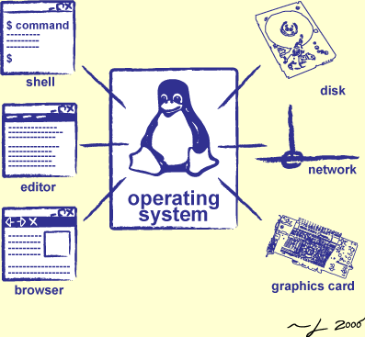
Goals for Today
Why should you care?
Why is it hard?
What is an Operating System?
Administratrivia & Course Policy

Slide 3
Why should you care?

Slide 4
The OS is everywhere
Every device, from your smartwatch, your smart light bulb, to your mobile phone and laptop runs an operating system
Every program you will ever write will run on an operating system
Its performance and execution behavior will depend on the operating system

Slide 5
Why is designing an OS hard?

Slide 6

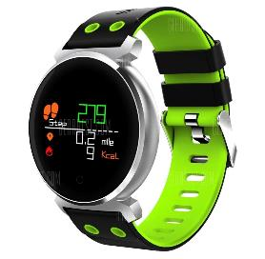




What do these have in common?

Slide 7
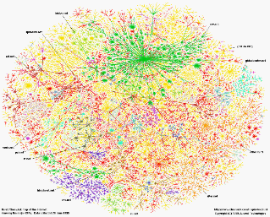

Across many devices
Have an operating system
Communicate over the Internet
Interface across huge diversity of devices

Slide 8
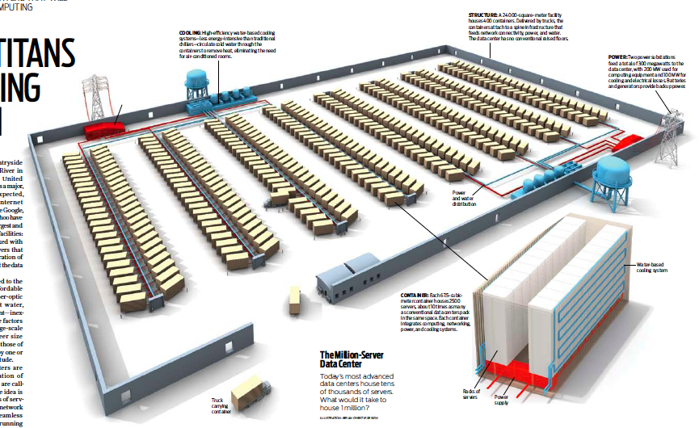
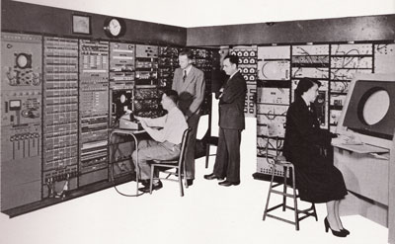
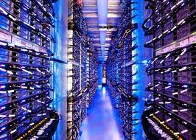
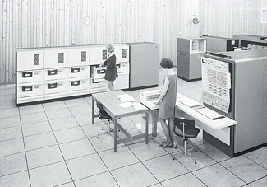
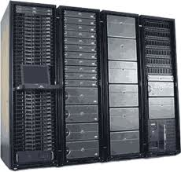
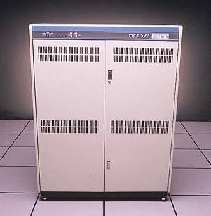
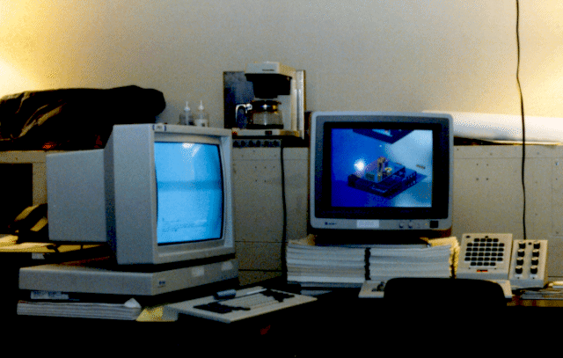

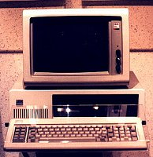


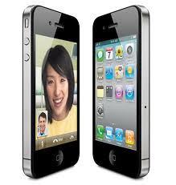


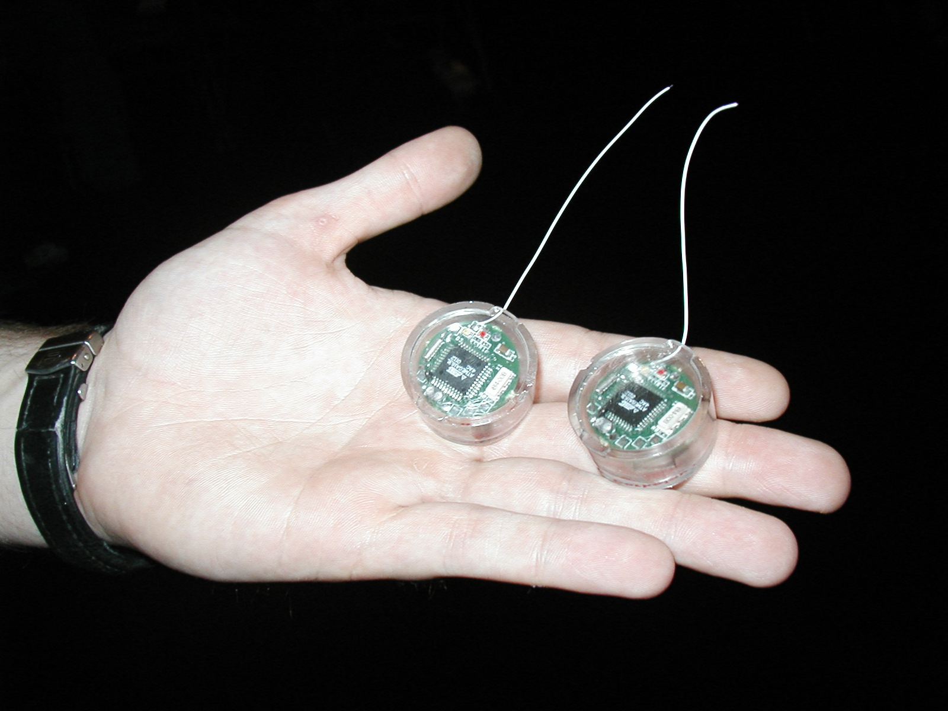
Bell’s Law
Computers
Per Person
Number crunching, Data Storage, Massive Inet Services, ML, …
1:10⁶
Mainframe
Mini
1:10³
Workstation
Productivity,
Interactive
PC
1:1
Laptop
PDA
Cell
Streaming from/to the physical world
10³:1
years
One new device class every 10 years

Slide 9
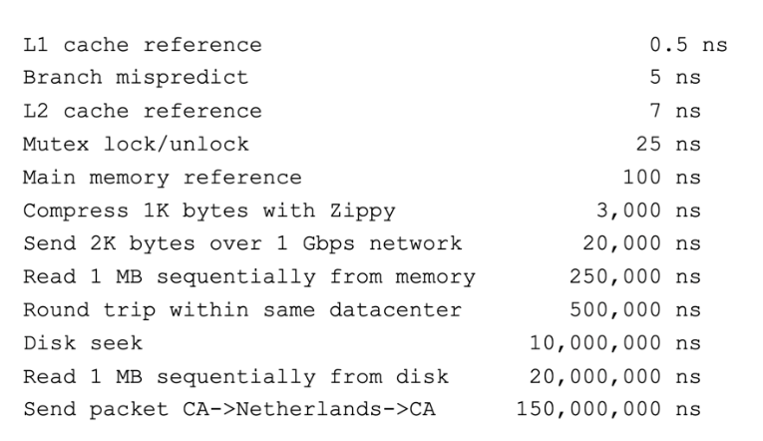
Across many timescales
Jeff Dean’s Numbers Everyone Should Know

Slide 10
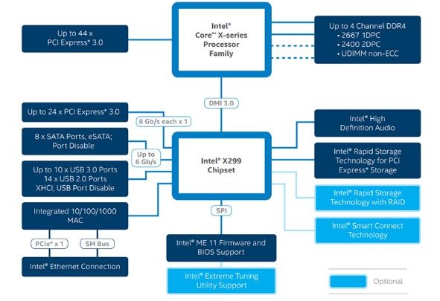
Why so much Complexity?
Hardware is becoming smarter!
Better reliability and security
Better performance (more efficient code, more parallel code)
Better energy efficiency

Slide 11
Increasing Software Complexity

Slide 12
What is an Operating System anyways?

Slide 13
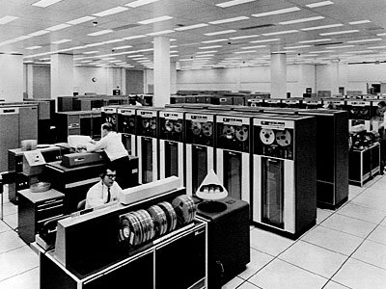

Operating System
Manages multiple tasks and users
A set of interconnected components with an expected behavior observed at the interface with its environment
Operating
System

Slide 14
Operating System (v1)
An operating system is the layer of software that interfaces between (diverse) hardware resources and the (many) applications running on the machine
Application 1
Application 2
Application 3
Operating System
Hardware

Slide 15
Operating System (v2)
An operating system implements a virtual machine for the application whose interface is more convenient than the raw hardware interface (convenient = security, reliability, portability)
Application 1
Application 2
Application 3
Operating System
Hardware

Slide 16



Three main Hats
Referee
  Manage protection, isolation, and sharing of resources
Illusionist
  Provide clean, easy-to-use abstractions of physical resources
Glue
Provides a set of common services

Slide 17
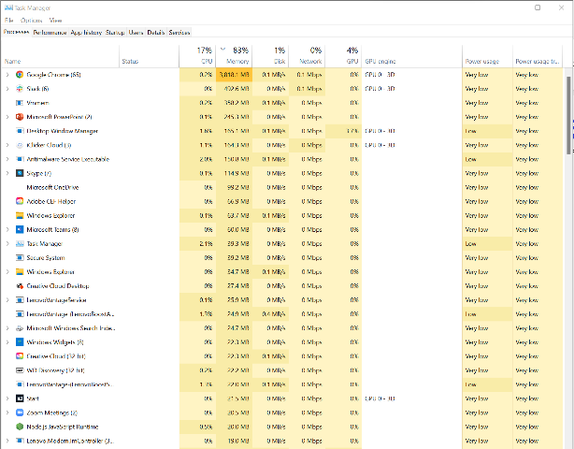
OS as a Referee
Allow multiple (untrusted) applications to run concurrently

Slide 18
OS as a Referee
Fault Isolation
Isolate programs from each other
Isolate OS from other programs
Resource Sharing
How to choose which task to run next?
How to split physical resources?
Communication
How can OS support communication to share results?
Process
Pipes/Sockets
Dual Mode Execution
Scheduling

Slide 19
What does this Program do?
laptop> gcc –o cpu cpu.c -Wall
laptop> ./cpu A
#include <stdio.h>
int main(int argc, char *argv[])
{
char *str = argv[1];
while (1) {
printf("%s\n", str);
}
return 0;
}
A
A
A
A
…
a)
laptop> ./cpu A & ./cpu B & ./cpu C
A
A
A
A
…
b)
A
B
C
A
B
C
…
c)
A
B
B
A
C
B
C
…
laptop> ./cpu ; ./cpu B
Segmentation Fault
B
…

Slide 20
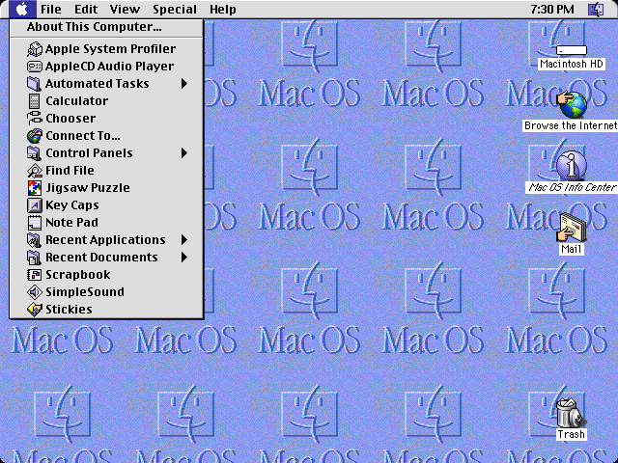
Refereeing is hard!
Mac V8 (1997)
OS cannot force program to give up control!
very-old-laptop> ./cpu A & ./cpu B & ./cpu C
A
A
A
A
A
A
A
…

Slide 21
Three main Hats
Referee
  Manage protection, isolation, and sharing of resources
Illusionist
  Provide clean, easy-to-use abstractions of physical resources
Glue
Provides a set of common services

Slide 22
OS as Illusionist
Mask the restrictions inherent in computer hardware through virtualization
All alone
Provide abstraction that application has exclusive use of resources
All powerful
Provide abstraction that hardware resources are infinite
All expressive
Provide abstraction of hardware capabilities that are not physically present

Slide 23
What does this Program do?
laptop> gcc –o memory memory.c -Wall
#include <stdio.h>
#include <stdlib.h>
#include <unistd.h>
int main(int argc, char *argv[])
{
int *p = malloc(sizeof(int));
printf("(%d) p: %p\n", getpid(), p);
*p = 0;
while (1) {
*p = *p + 1;
printf("(%d) p: %d\n", getpid(), *p);
}
return 0;
}
laptop> ./memory
(120) p: 0x200000
(120) p: 1
(120) p: 2
(120) p: 3
(120) p: 4
laptop> ./memory & ./memory
(120) p: 0x200000
(254) p: 0x200000
a)
(120) p: 1
(120) p: 2
(254) p: 1
(254) p: 2
(254) p: 3
(120) p: 3
…
b)
(120) p: 1
(254) p: 1
(120) p: 2
(254) p: 2
(120) p: 3
(254) p: 3
…

Slide 24
Three main Hats
Referee
  Manage protection, isolation, and sharing of resources
Illusionist
  Provide clean, easy-to-use abstractions of physical resources
Glue
Provides a set of common services

Slide 25
OS as Glue
Provide set of common, standard services to applications to simplify and regularize their design
Make sharing easier
Simpler if all assume same basic primitives
Maximize reuse
Avoid re-implementing functionality from scratch.
Evolve components independently
File System, User Interface, Network, etc.

Slide 26
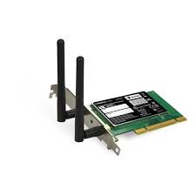


Putting it all together
Referee + Illusionist + Glue => Easy to use virtual machine
Program 1
Program 2
Program 1
Software
OS Hardware Virtualization
ISA
Infinite Processors
Infinite Memory
Hardware
Memory
Storage Mger
Network Mger
Processor
GUI
Ctrlr
Program 2
Storage
Networks
Displays
Infinite Processors
Infite Memory
Storage Mger
Network Mger
Inputs
GUI

Slide 27
Evaluation Criteria: Performance
OS must implement the abstraction efficiently, with low overhead, and equitably
  Overhead: added resource cost of implementing an abstraction
  Fairness: How “well” are resources distributed across applications
  Response time: how long does it take for a task to complete
  Throughput: Rate at which group of tasks can be completed
  Predictability: Are performance metrics constant over time?

Slide 28
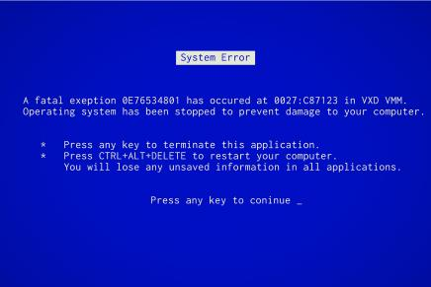
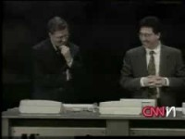
Evaluation Criteria: Reliability
System does what it is supposed to do
OS failures catastrophic!
Availability: mean time to failure + mean time to repair

Slide 29
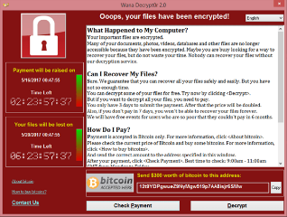
Evaluation Criteria: Security
Minimize vulnerability to attack
Integrity: Computer’s operation cannot be compromised by a malicious attacker
Privacy: data stored on computer accessible to authorized users
Enforcement Policy
How the OS ensures only permitted actions are allowed
Security Policy
What is permitted

Slide 30
Evaluation Criteria: Portability
A portable abstraction does not change as the hardware changes
Can’t rewrite application (or OS!) every time
Must plan for hardware that does not exist yet!
Application
Abstract Machine Interface
Operating System
Hardware Abstraction Layer
Hardware

Slide 31

Administrativia

Slide 32
Three “Prongs” for the Class
Understanding OS principles
System Programming
Lectures
Assignments
Map Concepts to Real Code
Group Projects

Slide 33
Topic Breakdown
Process Abstraction and API
Threads and Concurrency
Virtualizing the CPU
Scheduling
Virtual Memory
Virtualizing Memory
Paging
IO devices
Persistence
File Systems
Challenges with distribution
Distributed Systems
Data Processing & Storage

Slide 34
Enrollment
Class has limit of 100 students
  This semester we will have only 26
The Early Drop Deadline is January 22, 2025
  If you are not serious about taking the class, please drop early
  Really hard to drop afterwards!
  The class involves a group project, it makes life much more difficult for the others if you drop out in the middle
Note: this is a hard class!
  While it requires a lot of work, the class is highly rewarding

Slide 35

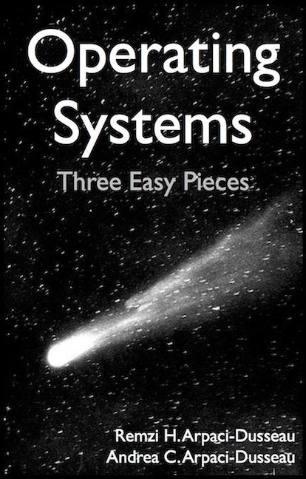
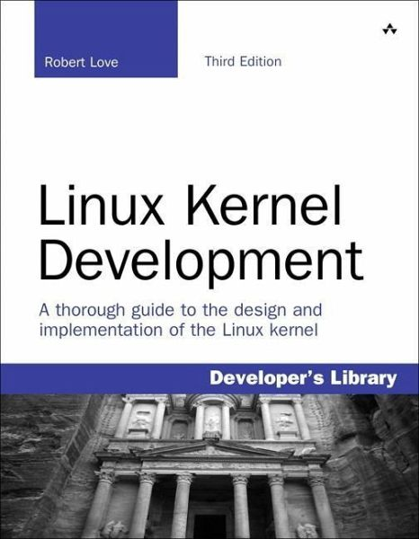
Infrastructure, Textbook & Readings
Infrastructure
  Website: https://teaching.hkaiser.org
  Discord: https://discord.gg/NdKrbJTaUg
Textbook: Operating Systems: Principles and Practice (2nd Edition) Anderson and Dahlin
  Not required, get a copy if you feel that lectures are not sufficient
  Suggested readings posted along with lectures
  Try to keep up with material in book as well as lectures
Supplementary Material
  Operating Systems: Three Easy Pieces, by Remzi and Andrea Arpaci-Dusseau, available for free online
  Linux Kernel Development, 3rd edition, by Robert Love

Slide 36
Class Expectations
Lectures
  Come! Cannot guarantee content will be identical to previous years
  Electronic devices used only for note taking
  Will explain many things related to assignments not otherwise explained
  Attendance not mandatory but highly advised
  If you decide to come, please be on time
  Meet your fellow students, they are your future colleagues!
Office Hours
  Come and ask for help early. There are no stupid questions!
  We like teaching and want to meet you!
Communicate with course staff through Discord and Email.

Slide 37
Honesty
The LSU Code of Student Conduct defines plagiarism in Section 5.1.16:
  "Plagiarism is defined as the unacknowledged inclusion of someone else's words, structure, ideas, or data. When a student submits work as his/her own that includes the words, structure, ideas, or data of others, the source of this information must be acknowledged through complete, accurate, and specific references, and, if verbatim statements are included, through quotation marks as well. Failure to identify any source (including interviews, surveys, etc.), published in any medium (including on the internet) or unpublished, from which words, structure, ideas, or data have been taken, constitutes plagiarism;“
Plagiarism will not be tolerated and will be dealt with in accordance with and as outlined by the LSU Code of Student Conduct : https://www.lsu.edu/saa/students/codeofconduct.php

Slide 38
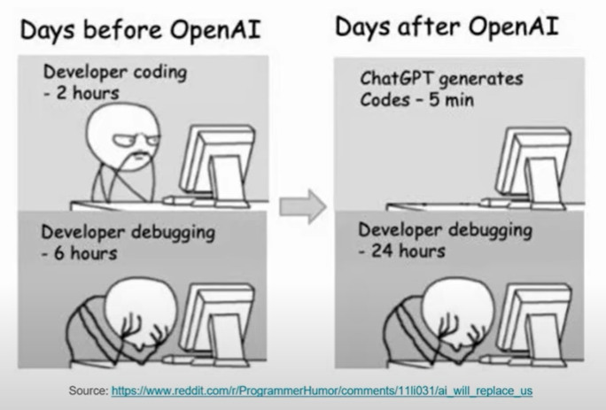
ChatGPT?

Slide 39
ChatGPT
The goal for this course is to train our brains, not ChatGPT
  So, do yourself a favor and don’t use it
  There are too many software ‘developers’ out there who copy & paste their way to the next paycheck
However, if you do use it:
  Never use anything without carefully reviewing it
    Assume what you got is wrong! Prove to yourself it is correct!
  The skill of reading (and understanding) code becomes more important than ever
  Add a note which part of your code was generated
Whatever you do, remember:
  It’s plagiarism if you submit the same code as your neighbor
  No matter where you got it from, be it Google, ChatGPT, or your neighbors computer

Slide 40

Learning by Doing
Individual Assignments (3 weeks)
  0. Tools & Environment, Autograding, recall C, executable
  1. Lists in C
  2. BYOS – build your own shell
  3. Sockets & Threads in HTTP server
  4. possibly more…
Two (and ½) Group Projects (4-6 weeks)
  0. Getting Started (Individual, before you have a group)
  1. User-programs (exec & syscall)
  2. Threads & Scheduling

Slide 41

Group Projects
Project teams have 4 members!
  Never 5, 3 requires serious justification
  Must work in groups in “the real world”
  Suggest teammates via email, we’ll try to accommodate
  Everyone will be randomly assigned to a group by January 24th
Everyone should do work and have clear responsibilities
  You will evaluate your teammates at the end of each project milestone
  Dividing up by Task is the worst approach. Work as a team.
Communicate with supervisor (TAs)
  What is the team’s plan?
  What is each member’s responsibility?
  Short progress reports are required
  Design Documents: High-level description for a manager!

Slide 42
Group Projects
2
Detailed exploration of operating system implementation
This is a project class:
  Every assignment requires substantial programming effort
  Most programming is C; a small amount is IA32 assembly
  Use Git version control for managing your code, making checkins, etc.
  Also, Make/Gdb/etc. Linux tools.
Course uses the PintOS instructional operating system
  A small UNIX-like operating system with very limited capabilities
  Implemented in 2005 for use with Stanford’s CS140 OS class
  Intended to be run on IA32/x86 processor emulator (Bochs, QEMU)
    Can also run on actual IA32 hardware if properly coaxed…
    We have set up a Docker image for this

Slide 43
Assignments and Collaboration
5
The assignments are hard!
I repeat: the assignments are hard!
Lots of code to understand, significant implementation effort, and lots of debugging to do
You are required to work in groups
  Biggest reason: you will have other people to talk with, when designing and debugging systems
Students can drop the class, but this will affect others…
  Please only take this course if you really intend to finish it!
If students drop later in the term, we can adjust the teams
  e.g. move a student into another team (student will have to learn the new team’s code)

Slide 44
Assignments and Collaboration
7
Each team’s submission must be created entirely by that team alone. Teams cannot share implementation code.
Cross-team sharing is encouraged in these areas:
  Design and implementation ideas (but not code or pseudocode!)
  Pitfalls you encountered, and how to solve them
  Help with setup and debugging
Also, PintOS has been around since 2005…
  Do not look for solutions to projects online!
You are encouraged to look at other resources, e.g. Linux sources, other textbooks, OS dev. websites, etc.
  Don’t copy code! (see first point above) Focus on understanding it.
  Cite any external sources in your submission, so I can share them with the class this year and next year.

Slide 45
Assignments and Due-Dates
8
Each assignment specifies a due-date (Monday’s 11.59 pm)
Assignments and Projects are on a tight schedule
Late submissions are penalized
  Usually one day pre-approved extension
  On-time submissions receive 10% bonus
Students/teams can also request extensions due to health or other reasons
  Most important thing is to try to do this beforehand, if possible

Slide 46
Development and Testing Platform
9
PintOS is designed to be built and tested on Linux
Submissions will be tested on 32-bit Ubuntu Linux
  You are encouraged to at least test on this platform
  A very good idea to develop on a similar 32-bit Linux platform
We provide a virtual machine (Docker image) for you to use
  Will have all necessary development tools (Git, gcc, emulators, …)
ARM-based Mac users may have some challenges…
  VirtualBox just released a slow, ARM-based developer preview
  The TAs have put together a Docker image with cross-compiler tools etc.
  I’m afraid your life will be more complicated ®
  You can use Codespaces (i.e. fully online VSCode on github)

Slide 47
Getting started
Assignment 0 has been posted
  Due date: Monday, January 27 2025
  Individual assignment
  Set up development environment, familiarize yourself with tools
Project 0 has been posted as well
  Due date: Monday, February 10 2025
  Individual assignment as well, later projects will be group based
  Familiarize yourself with PintOS, how to debug things
Don’t wait for the last day!
  Assignments and projects require a lot of work

Slide 48
Getting started
Start Assignment 0 and Project 0 right away
  Github account, assignments managed through Github classroom
  Docker image - environment for the course
    Consistent, managed environment on your machine
  Get familiar with all the CSC4103 tools
  Submit to autograder via git, feedback through Github
Study Guides on website
  We suggest to use those as a constant reference
  Answer questions, requires looking around for solutions
  Perfect guidelines for examinations

Slide 49
Preparing Yourself for this Class
Projects will require you to be very comfortable with programming and debugging C
  Pointers (including function pointers, void*)
  Memory Management (malloc, free, stack vs. heap)
  Debugging with GDB
You will be working on a larger, more sophisticated code base than anything you've likely seen before!
"Resources" page on course website
  Ebooks on “git” and “C”
C programming
  Happy to answer questions during lectures

Slide 50
