Slide 1
Scheduling 2: Starvation
Lecture 10
Hartmut Kaiser
https://teaching.hkaiser.org/spring2026/csc4103/

Slide 2
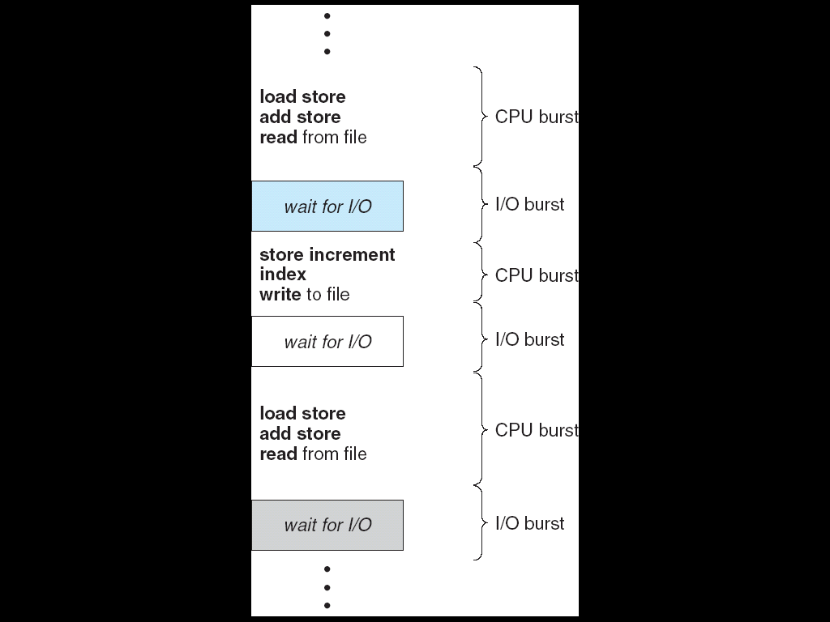
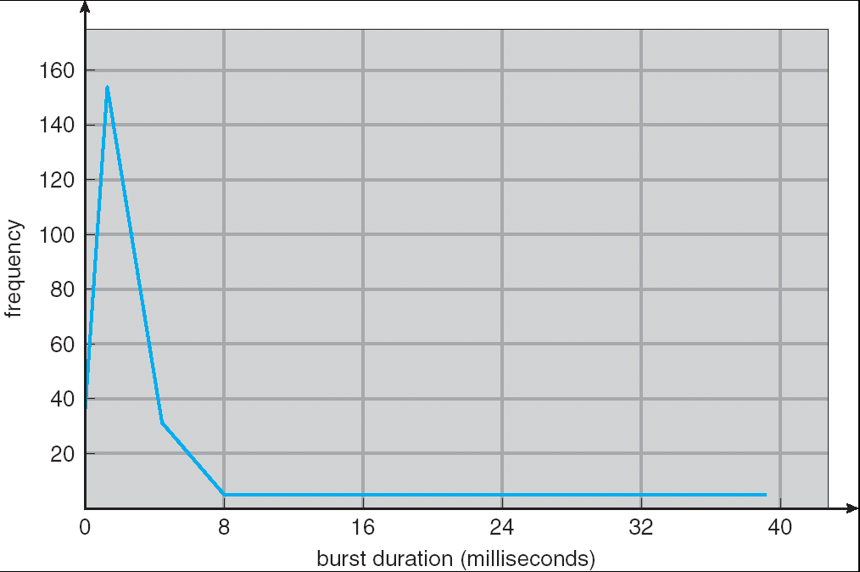
Recall: CPU and I/O Bursts
Programs alternate between bursts of CPU, I/O activity
Scheduler: Which thread (CPU burst) to run next?
Interactive programs vs. Compute Bound vs. Streaming

Slide 3
Evaluating Schedulers
Response Time (ideally low)
What user sees: from keypress to character on screen
Or completion time for non-interactive
Throughput (ideally high)
Total operations (jobs) per second
Overhead (e.g. context switching), artificial blockers
Fairness
Fraction of resources provided to each
May conflict with best avg. throughput, resp. time

Slide 4
Recall: Classic Scheduling Policies
First-Come First-Served: Simple, vulnerable to convoy effect
Round-Robin: Fixed CPU time quantum, cycle between ready threads
Priority: Respect differences in importance
Shortest Job/Remaining Time First: Optimal for average response time, but unrealistic
Multi-Level Feedback Queue: Use past behavior to approximate SRTF and mitigate overhead

Slide 5
What if we knew how long each CPU burst will be, in advance?
Key Idea: remove convoy effect
Short jobs always stay ahead of long ones
Non-preemptive: Shortest Job First
Like FCFS, but if we always chose the best possible ordering
Preemptive Version: Shortest Remaining Time First
If a job arrives and has shorter time to completion than current job, immediately preempt CPU
Sometimes called “Shortest Remaining Time to Completion First”

Slide 6
SRTF Example (Shortest Remaining Time First)
Three jobs in system
A and B are CPU calculations that take a week to run
C: Continuous loop of 1ms CPU time, 9ms of I/O time
FCFS? A or B starve C
I/O throughput problem: lose opportunity to do work for C while CPU runs A or B
A or B
C
C’s
I/O
C’s
I/O
C’s
I/O

Slide 7
SRTF Example (Shortest Remaining Time First)
C
A
B
C
Disk Utilization:
9/201 ~ 4.5%
C’s
I/O
RR 100 ms time slice
C’s
I/O
CABAB…
C
Disk Utilization:
~90% but lots of wakeups!
RR 1ms time slice
C’s
I/O
C’s
I/O
C
A
A
A
Disk Utilization:
90%
SRTF
C’s
I/O
C’s
I/O

Slide 8
Discussion: SJF and SRTF
Provably Optimal with respect to Response Time
But Starvation is possible
What if new short jobs keep arriving?
But: Need to predict the future!
Ask the user when they submit the job? How to prevent cheating?
SRTF useful as a benchmark to measure other policies?

Slide 9
First-Come, First-Served Scheduling (FCFS)
Response Times: T1 = 24, T2 = 27, T3 = 30
Average Response Time = (24+27+30) / 3 = 27
Waiting times: T1 = 0, T2 = 24, T3 = 27
Average Wait Time = (0 + 24 + 27) / 3 = 17
Convoy Effect: Short processes stuck behind long processes
If T2, T3 arrive any time < 24, they must wait
T₁
T₂
T₃
0
24
27
30

Slide 10
Recall: First-Come, First-Serve Scheduling
FCFS Scheme: Potentially bad for short jobs!
Depends on submit order
If you are first in line at supermarket with milk, you don’t care who is behind you, on the other hand…
Idea: What if we preempted long-running jobs to give shorter jobs a chance to run?

Slide 11
Recall: Round-Robin Scheduling (RR)
Give out small units of CPU time ("time quantum")
Typically 10 – 100 milliseconds
When quantum expires, preempt, and schedule
Round Robin: add to end of the queue
Each of N processes gets ~1/N of CPU (in window)
With quantum length Q ms, process waits at most (N-1)*Q ms to run again
Downside: More context switches

Slide 12
Recall: Priority Scheduler
Something gives jobs (processes) priority
Usually the user sets it explicitly, perhaps based on $ rate
Always run the ready thread with highest priority
Low priority thread might never run!
Starvation
Priority 3
Job 1
Job 2
Job 3
Priority 2
Job 4
Priority 1
Priority 0
Job 5
Job 6
Job 7

Slide 13
Adaptive Scheduling
How can we adapt the scheduling algorithm based on threads’ past behavior?
Two steps:
Based on past observations, predict what threads will do in the future.
Make scheduling decisions based on those predictions.
Start with the second step. Suppose we knew the workload in advance. What should the scheduler do?

Slide 14
Recall: What if we know how long each CPU burst will be, in advance?
Key Idea: remove convoy effect
Short jobs always stay ahead of long ones
Non-preemptive: Shortest Job First
Like FCFS if we always chose the best possible ordering
Preemptive Version: Shortest Remaining Time First
If a job arrives and has shorter time to completion than current job, immediately preempt CPU
Sometimes called “Shortest Remaining Time to Completion First”

Slide 15
Adaptive Scheduling
How can we adapt the scheduling algorithm based on threads’ past behavior?
Two steps:
Based on past observations, predict what threads will do in the future.
Make scheduling decisions based on those predictions.

Slide 16
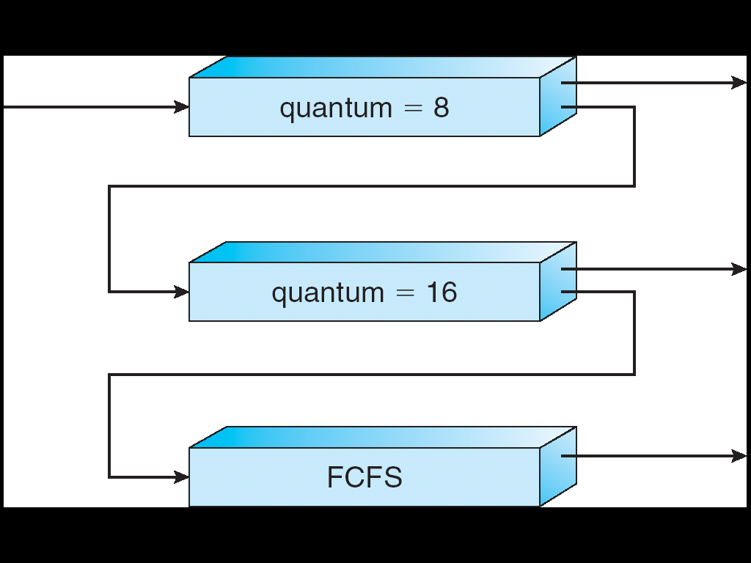
Multi-Level Feedback Queue (MLFQ)
Intuition: approximate SRTF by setting priority level proportional to burst length
Job Exceeds Quantum: Drop to lower queue
Job Doesn't Exceed Quantum: Raise to higher queue
Long-Running Compute Tasks Demoted to Low Priority

Slide 17
How to Implement MLFQ in the Kernel?
We could explicitly build the queue data structures
Or, we can leverage priority-based scheduling!

Slide 18
Recall: Policy Based on Priority Scheduling
Systems may try to set priorities according to some policy goal
Example: Give interactive higher priority than long calculation
Prefer jobs waiting on I/O to those consuming lots of CPU
Try to achieve fairness: elevate priority of threads that don’t get CPU time (ad-hoc, bad if system overload)
Priority 3
Job 1
Job 2
Job 3
Priority 2
Job 4
Priority 1
Priority 0
Job 5
Job 6
Job 7

Slide 19
Linux O(1) Scheduler
MLFQ-Like Scheduler with 140 Priority Levels
40 for user tasks, 100 “realtime” tasks
All algorithms O(1) complexity – low overhead
Timeslices/priorities/interactivity credits all computed when job finishes time slice
Active and expired queues at each priority
Once active is empty, swap them (pointers)
Round Robin within each queue (varying quanta)
Timeslice depends on priority – linearly mapped onto timeslice range
Kernel/Realtime Tasks
User Tasks
0
100
139

Slide 20
Linux O(1) Scheduler
Lots of ad-hoc heuristics
Try to boost priority of I/O-bound tasks
Try to boost priority of starved tasks

Slide 21
So, Does the OS Schedule Processes or Threads?
Many textbooks use the “old model”—one thread per process
Usually it's really: threads (e.g., in Linux)
One point to notice: switching threads vs. switching processes incurs different costs:
Switch threads: Save/restore registers
Switch processes: Change active address space too!
Expensive
Disrupts caching

Slide 22
Multi-Core Scheduling
Algorithmically, not a huge difference from single-core scheduling
Implementation-wise, helpful to have per-core scheduling data structures
Cache coherence
Affinity scheduling: once a thread is scheduled on a CPU, OS tries to reschedule it on the same CPU
Cache reuse

Slide 23
Recall: Spinlock
Spinlock implementation:
int value = 0; // Free
Acquire() { while (test&set(value)) {}; // spin while busy }
Release() { value = 0; // atomic store }
Spinlock doesn’t put the calling thread to sleep—it just busy waits
When might this be preferable?
For multiprocessor cache coherence: every test&set() is a write, which makes value ping-pong around in cache (using lots of memory BW)

Slide 24
Gang Scheduling and Parallel Applications
When multiple threads work together on a multi-core system, try to schedule them together
Makes spin-waiting more efficient (inefficient to spin-wait for a thread that’s suspended)
Alternative: OS informs a parallel program how many processors its threads are scheduled on (Scheduler Activations)
Application adapts to number of cores that it has scheduled
“Space sharing” with other parallel programs can be more efficient, because parallel speedup is often sublinear with the number of cores

Slide 25
Real-Time Scheduling
Goal: Guaranteed Performance
Meet deadlines even if it means being unfair or slow
Limit how bad the worst case is
Hard real-time
Meet all deadlines (if possible)
Ideally: determine in advance if this is possible
Earliest Deadline First (EDF), Least Laxity First (LLF)
Soft real-time
Attempt to meet deadlines with high probability
Constant Bandwidth Server (CBS)

Slide 26
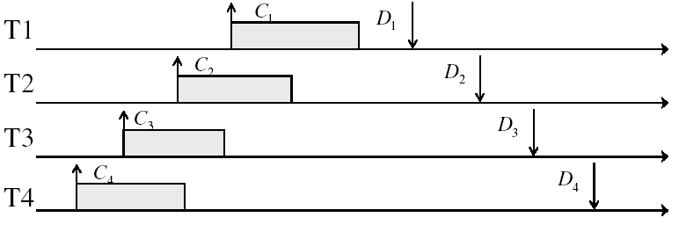
Real-Time Example
Preemptible tasks with known deadlines (D) and known burst times (C)
Real-time systems often have repeating tasks with fixed schedules

Slide 27
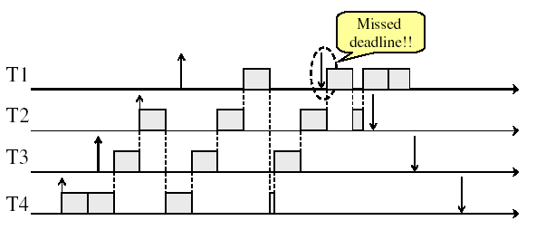
What if we try Round-Robin?

Slide 28
Earliest Deadline First (EDF)
Priority scheduling with preemption
Prefer task with earliest deadline
Priority (inverse) proportional to time until deadline
Example with periodic tasks:
0
5
10
15

Slide 29
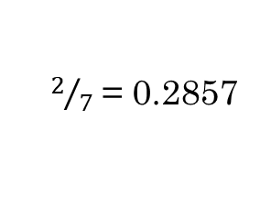
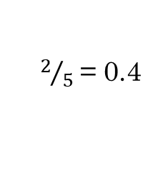

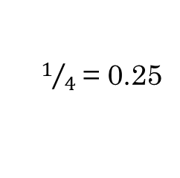
EDF Feasibility Testing
Even EDF won’t work if you have too many tasks
For $n$ tasks with computation time $C_{i}$ and deadline $D_{i}$, a feasible schedule exists if:
$$\sum_{i=1}^{n}{\left(\frac{C_{i}}{D_{i}}\right)}≤1$$
$1/4$ = 0.25
$2/5$ = 0.4
$2/7$ = 0.2857
0
5
10
15

Slide 30
Ensuring Progress
Starvation: thread fails to make progress for an indefinite period of time
Causes of starvation:
Scheduling policy never runs a particular thread on the CPU
Threads wait for each other or are spinning in a way that will never be resolved
Let’s explore what sorts of problems we might fall into and how to avoid them…

Slide 31
Today: Schedulers Prone to Starvation
What kinds of schedulers are prone to starvation?
Of the scheduling policies we’ve studied, which are prone to starvation? And can we fix them?
How might we design scheduling policies that avoid starvation entirely?
Arguably more relevant now than when CPU scheduling was first developed…

Slide 32
Non-Work-Conserving Scheduler
A work-conserving scheduler is one that does not leave the CPU idle when there is work to do
A non-work-conserving scheduler could trivially lead to starvation
In this class, we’ll assume that the scheduler is work-conserving (unless stated otherwise)

Slide 33
Last-Come, First-Served (LCFS)
Stack (LIFO) as a scheduling data structure
Late arrivals get fastest service
Early ones wait – extremely unfair
In the worst case – starvation
When would this occur?
When arrival rate (offered load) exceeds service rate (delivered load)
Queue builds up faster than it drains
Queue can build up in FIFO too, but “serviced in the order received”…

Slide 34
Today: Schedulers Prone to Starvation
What kinds of schedulers are prone to starvation?
Of the scheduling policies we’ve studied, which are prone to starvation? And can we fix them?
How might we design scheduling policies that avoid starvation entirely?
Arguably more relevant now than when CPU scheduling was first developed…

Slide 35
Is FCFS Prone to Starvation?
Scheduled Task (process, thread)
time
Scheduling Queue
arrivals
If a task never yields (e.g., goes into an infinite loop), then other tasks don’t get to run
Problem with all non-preemptive schedulers…

Slide 36
Is Round Robin (RR) Prone to Starvation?
Each of N processes gets ~1/N of CPU (in window)
With quantum length Q ms, process waits at most (N-1)*Q ms to run again
So a process can’t be kept waiting indefinitely
So RR is fair in terms of waiting time
Not necessarily in terms of throughput…

Slide 37
Is Priority Scheduling Prone to Starvation?
Always run the ready thread with highest priority
Low priority thread might never run!
Starvation
But there are more serious problems as well…
Priority inversion: even high priority threads might become starved

Slide 38

Priority Inversion
Job 1 holds lock and suspends
At this point, which job does the scheduler choose?
Job 3 (Highest priority)
Priority 3
Job 3
Priority 2
Job 2
Priority 1
Job 1
Acquire()

Slide 39
Priority Inversion
Job 3 attempts to acquire lock held by Job 1
Priority 3
Job 3
Acquire()
Priority 2
Job 2
Priority 1
Job 1

Slide 40
Priority Inversion
At this point, which job does the scheduler choose?
Job 2 (Medium Priority)
Priority Inversion!
Job 3
Blocked on Acquire
Priority 3
Priority 2
Job 2
Priority 1
Job 1

Slide 41
Priority Inversion
Where high priority task is blocked waiting on low priority task
Low priority one must run for high priority to make progress
Medium priority task can starve a high priority one
When else might priority lead to starvation or “live lock”?
High Priority
Low Priority
while (try_lock) {
…
}
lock.acquire(…)
…
lock.release(…)

Slide 42
One Solution: Priority Donation
Job 3 temporarily grants Job 1 its “high priority” to run on its behalf
Priority 3
Job 3
Acquire()
Priority 2
Job 2
Priority 1
Job 1

Slide 43
One Solution: Priority Donation
Job 3 temporarily grants Job 1 its “high priority” to run on its behalf
Job 3
Blocked on Acquire
Priority 3
Job 1
Release()
Priority 2
Job 2
Priority 1

Slide 44
One Solution: Priority Donation
Job 1 completes critical section and releases lock
Job 3 acquires lock, runs again
How does the scheduler know?
Priority 3
Job 3
Acquire()
Priority 2
Job 2
Priority 1
Job 1
Project 2: Scheduling

Slide 45
Are SRTF and MLFQ Prone to Starvation?
In SRTF, long jobs are starved in favor of short ones
Same fundamental problem as priority scheduling
MLFQ is an approximation of SRTF, so it suffers from the same problem
Long-Running Compute Tasks Demoted to Low Priority

Slide 46
Recall: Evaluating Schedulers
Response Time (ideally low)
What user sees: from keypress to character on screen
Or completion time for non-interactive
Throughput (ideally high)
Total operations (jobs) per second
Overhead (e.g. context switching), artificial blocks
Fairness
Fraction of resources provided to each
May conflict with best avg. throughput, resp. time

Slide 47
Announcements
Project 1: deadline extended to Monday, April 6
Assignment 2: due Monday, April 7

Slide 48
Cause for Starvation: Priorities?
The policies we’ve studied so far:
Always prefer to give the CPU to a prioritized job
Non-prioritized jobs may never get to run
But priorities were a means, not an end
Our end goal was to serve a mix of CPU-bound, I/O bound, and Interactive jobs effectively on common hardware
Give the I/O bound ones enough CPU to issue their next file operation and wait (on those slow discs)
Give the interactive ones enough CPU to respond to an input and wait (on those slow humans)
Let the CPU bound ones grind away without too much disturbance

Slide 49
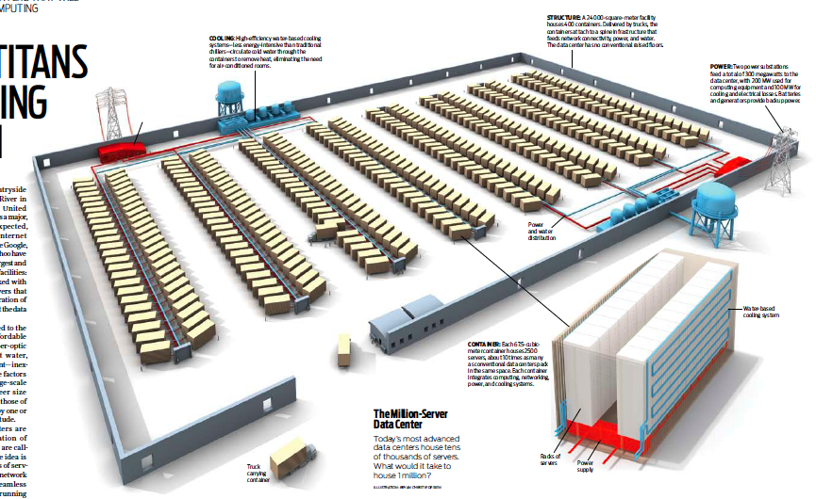
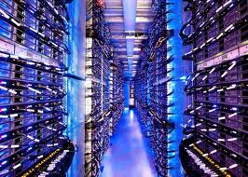
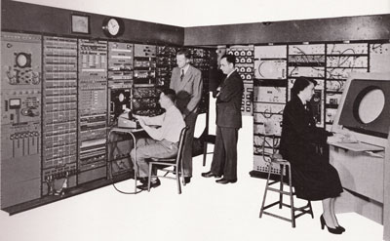
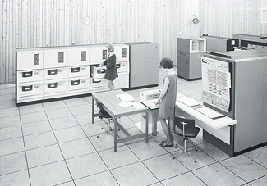
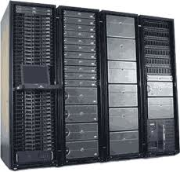
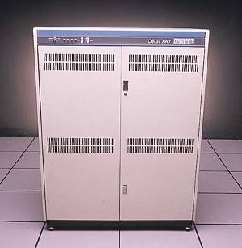

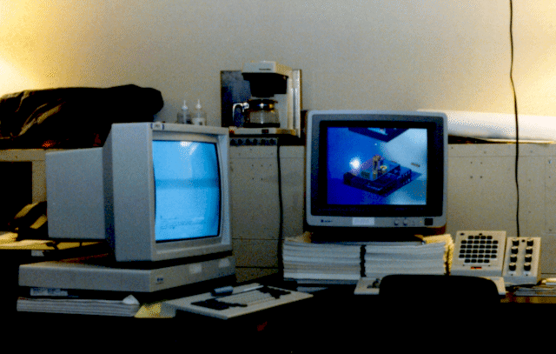

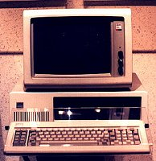




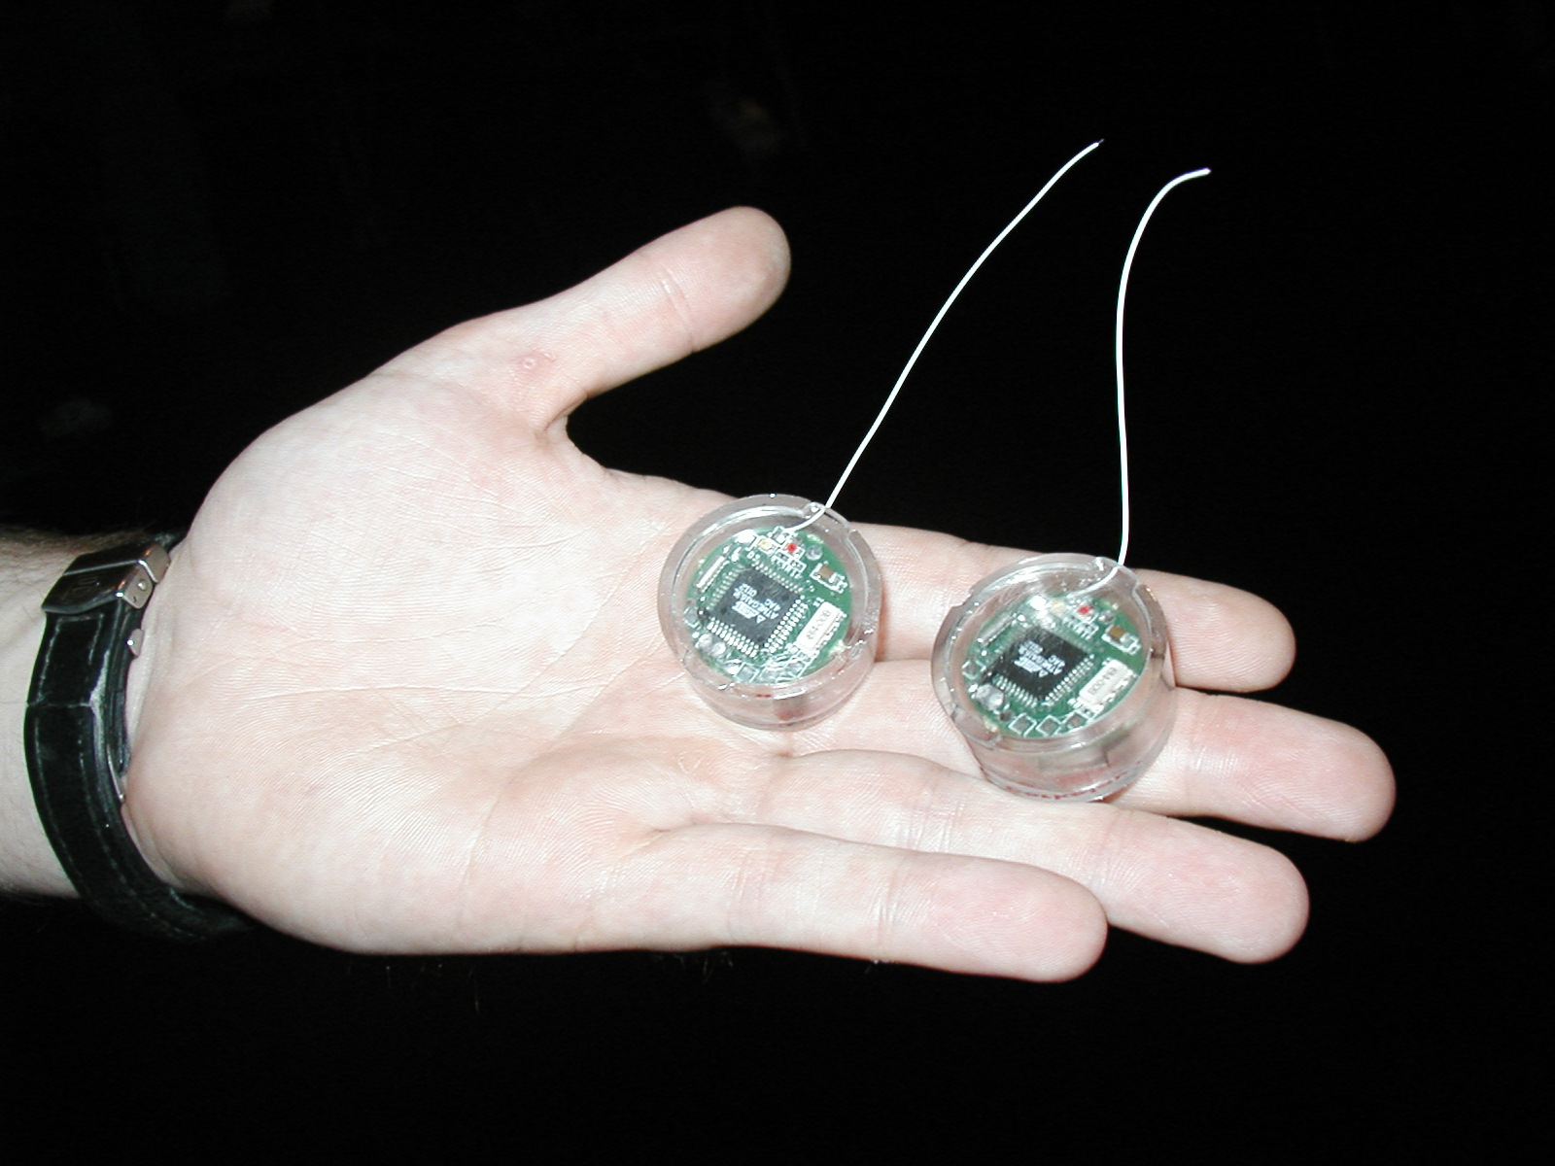
Recall: Changing Landscape…
Computers
Per Person
Number crunching, Data Storage, Massive Inet Services,
ML, …
1:10⁶
Mainframe
Mini
1:10³
Workstation
Productivity,
Interactive
PC
1:1
Laptop
Bell’s Law: New computer class every 10 years
PDA
Cell
Streaming from/to the physical world
10³:1
Mote!
years
The Internet of Things!

Slide 50
Changing Landscape of Scheduling
Priority-based scheduling rooted in “time-sharing”
Allocating precious, limited resources across a diverse workload
CPU bound, vs interactive, vs I/O bound
80’s brought about personal computers, workstations, and servers on networks
Different machines of different types for different purposes
Shift to fairness and avoiding extremes (starvation)
90’s emergence of the web, rise of internet-based services, the data-center-is-the-computer
Server consolidation, massive clustered services, huge flashcrowds
It’s about predictability, 95th percentile performance guarantees

Slide 51
Does prioritizing some jobs necessarily starve those that aren’t prioritized?

Slide 52
Key Idea: Proportional-Share Scheduling
The policies we’ve studied so far:
Always prefer to give the CPU to a prioritized job
Non-prioritized jobs may never get to run
Instead, we can share the CPU proportionally
Give each job a share of the CPU according to its priority
Low-priority jobs get to run less often
But all jobs can at least make progress (no starvation)

Slide 53
Today: Schedulers Prone to Starvation
What kinds of schedulers are prone to starvation?
Of the scheduling policies we’ve studied, which are prone to starvation? And can we fix them?
How might we design scheduling policies that avoid starvation entirely?
Arguably more relevant now than when CPU scheduling was first developed…

Slide 54
Lottery Scheduling
Given a set of jobs (the mix), provide each with a share of a resource
e.g., 50% of the CPU for Job A, 30% for Job B, and 20% for
Idea: Give out tickets according to the proportion each should receive
Every quantum (tick): draw one at random, schedule that job (thread) to run
Q _{i}
Q _{i+1}
time
Job C

Slide 55
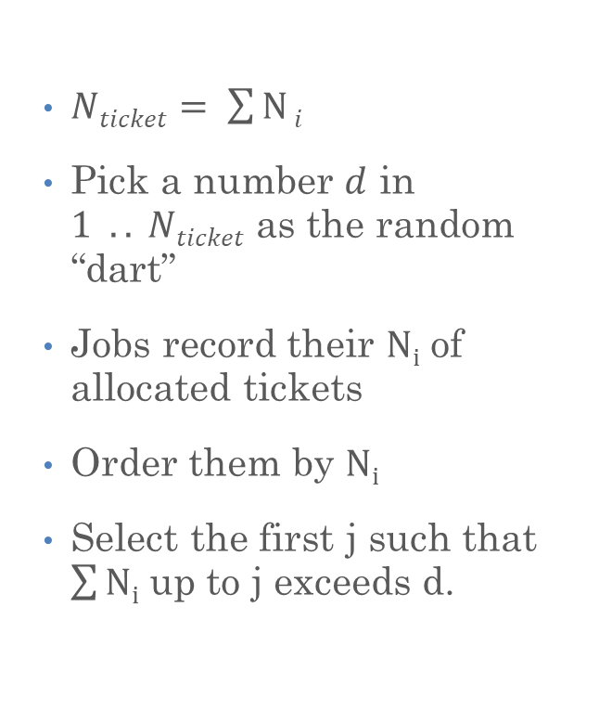
Lottery Scheduling: Simple Mechanism
$Nticket= \sum{N}i$
Pick a number $d$ in $1 .. Nticket$ as the random “dart”
Jobs record their $Ni$ of allocated tickets
Order them by $Ni$
Select the first j such that $\sum{Ni}$ up to j exceeds d.
10
1

Slide 56
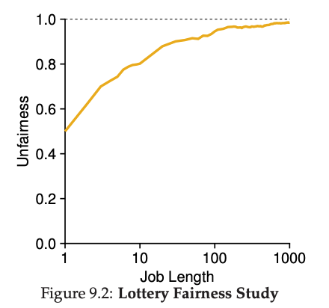
Unfairness
E.g., Given two jobs A and B of same run time (# Qs) that are each supposed to receive 50%
U = finish time of first / finish time of last
As a function of run time
May exhibit short-term unfairness over short periods of time
Evens out for longer runtimes

Slide 57
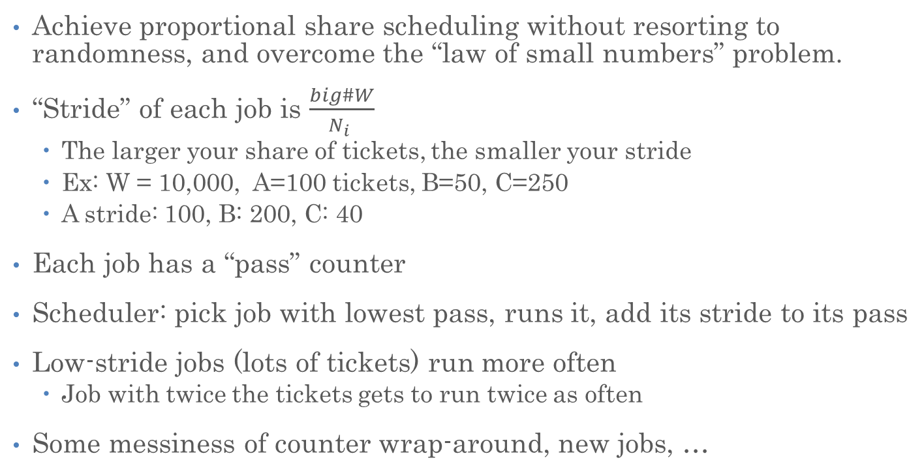
Stride Scheduling
Achieve proportional share scheduling without resorting to randomness, and overcome the “law of small numbers” problem.
“Stride” of each job is $\frac{big\#W}{N_{i} }$
The larger your share of tickets, the smaller your stride
Ex: W = 10,000, A=100 tickets, B=50, C=250
A stride: 100, B: 200, C: 40
Each job has a “pass” counter
Scheduler: pick job with lowest pass, runs it, add its stride to its pass
Low-stride jobs (lots of tickets) run more often
Job with twice the tickets gets to run twice as often
Some messiness of counter wrap-around, new jobs, …

Slide 58
Linux Completely Fair Scheduler (CFS)
Goal: Each process gets an equal share of CPU
N threads “simultaneously” execute on 1/Nth of CPU
Can’t do this with real hardware
OS needs to give out full CPU in time slices
At any time t we would observe:
CPU Time
t/N
T₁
T₂
T₃

Slide 59
Linux Completely Fair Scheduler (CFS)
Instead: track CPU time given to a thread so far
Scheduling Decision:
“Repair” illusion of complete fairness
Choose thread with minimum CPU time
Reset CPU time if thread goes to sleep and wakes back up
T₁
CPU Time
t/N
T₃
T₂

Slide 60
Linux CFS: Responsiveness
In addition to fairness, we want low response time
Constraint 1: Target Latency
Period of time over which every process gets service
Quanta = Target_Latency / n
Target Latency: 20 ms, 4 Processes
Each process gets 5ms time slice
Target Latency: 20 ms, 200 Processes
Each process gets 0.1ms time slice (!!!)
Recall Round-Robin: large context switching overhead if slice gets to small

Slide 61
Linux CFS: Throughput
Goal: Throughput
Avoid excessive overhead
Constraint 2: Minimum Granularity
Minimum length of any time slice
Target Latency 20 ms, Minimum Granularity 1 ms, 200 processes
Each process gets 1 ms time slice

Slide 62
Aside: Priority in Unix – Being Nice
The industrial operating systems of the 60s and 70’s provided priority to enforce desired usage policies.
When it was being developed at Berkeley, instead it provided ways to “be nice”.
nice values range from -20 to 19
Negative values are “not nice”
If you wanted to let your friends get more time, you would nice up your job
Schedule puts higher nice (lower priority) to sleep more …

Slide 63
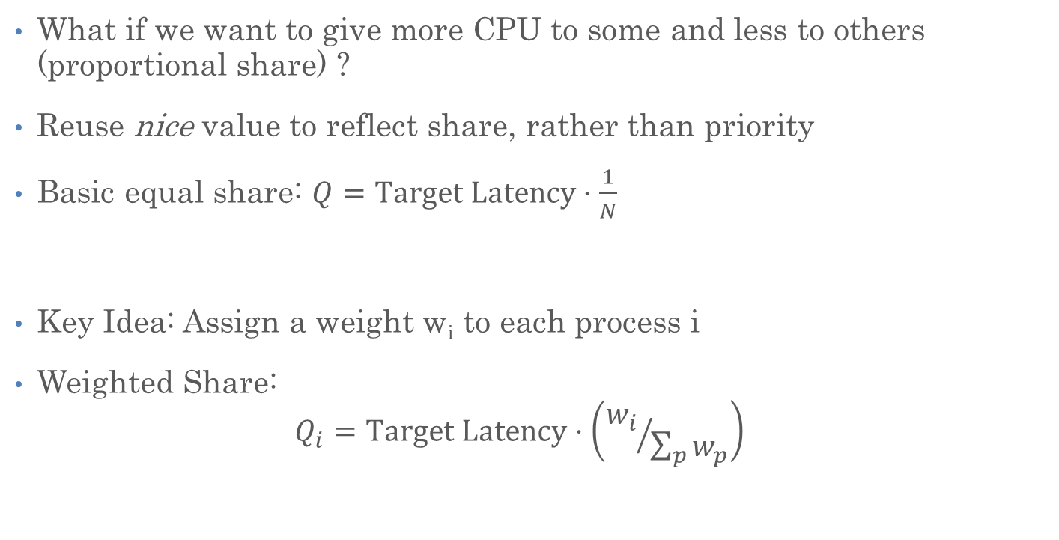
Linux CFS: Proportional Shares
What if we want to give more CPU to some and less to others (proportional share) ?
Reuse nice value to reflect share, rather than priority
Basic equal share: $Q=Target Latency⋅\frac{1}{N}$
Key Idea: Assign a weight w_{i} to each process i
Weighted Share: $Q_{i}=Target Latency⋅\left({w_{i}}/{\sum_{p}{w_{p}}}\right)$

Slide 64
Linux CFS: Proportional Shares
Target Latency = 20ms
Minimum Granularity = 1ms
Two CPU-Bound Threads
Thread A has weight 1
Thread B has weight 4
Time slice for A? 4 ms
Time slice for B? 16 ms

Slide 65
Linux CFS: Proportional Shares
Track a thread's virtual runtime rather than its true physical runtime
Higher weight: Virtual runtime increases more slowly
Lower weight: Virtual runtime increases more quickly
16
B
Physical
CPU Time
4
A

Slide 66
Linux CFS: Proportional Shares
Track a thread's virtual runtime rather than its true physical runtime
Higher weight: Virtual runtime increases more slowly
Lower weight: Virtual runtime increases more quickly
Virtual
CPU Time
B
A
Scheduler’s Decisions are based on Virtual CPU Time

Slide 67
Summary: Choosing the Right Scheduler
If You Care About: | Then Choose:
CPU Throughput | FCFS
Average Response Time | SRTF Approximation
I/O Throughput | SRTF Approximation
Fairness (CPU Time) | Linux CFS
Fairness (Wait Time to Get CPU) | Round Robin
Meeting Deadlines | EDF
Favoring Important Tasks | Priority

Slide 68
