Slide 1
System Performance and Highly Concurrent Systems
Lecture 12
Hartmut Kaiser
https://teaching.hkaiser.org/spring2026/csc4103/

Slide 2
Recall: Deadlock
Starvation vs. Deadlock
Starvation: Thread indefinitely unable to make progress
Deadlock: Thread(s) unable to make progress due to circular wait
Four conditions for deadlock:
Mutual exclusion
Hold and wait
No preemption
Circular Wait
Three different approaches to address deadlock:
Deadlock avoidance: dynamically delay resource requests so deadlock doesn’t happen
Deadlock prevention: write your code in a way that it isn’t prone to deadlock
Deadlock recovery: let deadlock happen, and then figure out how to recover from it
Or deadlock denial: ignore the possibility of deadlock in applications

Slide 3
System Performance
“Back of the Envelope” calculation and modeling
Get the rough picture first… and don’t lose sight of it

Slide 4
Times (s) and Rates (op/s)
Latency – time to complete a task
Measured in units of time (s, ms, us, …, hours, years)
Response Time - time to initiate an operation and get its response
Able to issue an operation that depends on the result of another
Know that it is done (anti-dependence, resource usage)
Throughput or Bandwidth – rate at which tasks are performed
Measured in units of things per unit of time (op/s, FLOP/s)
Performance
Operation time (5 mins to run a mile…)
Rate (mph, mpg, …)

Slide 5
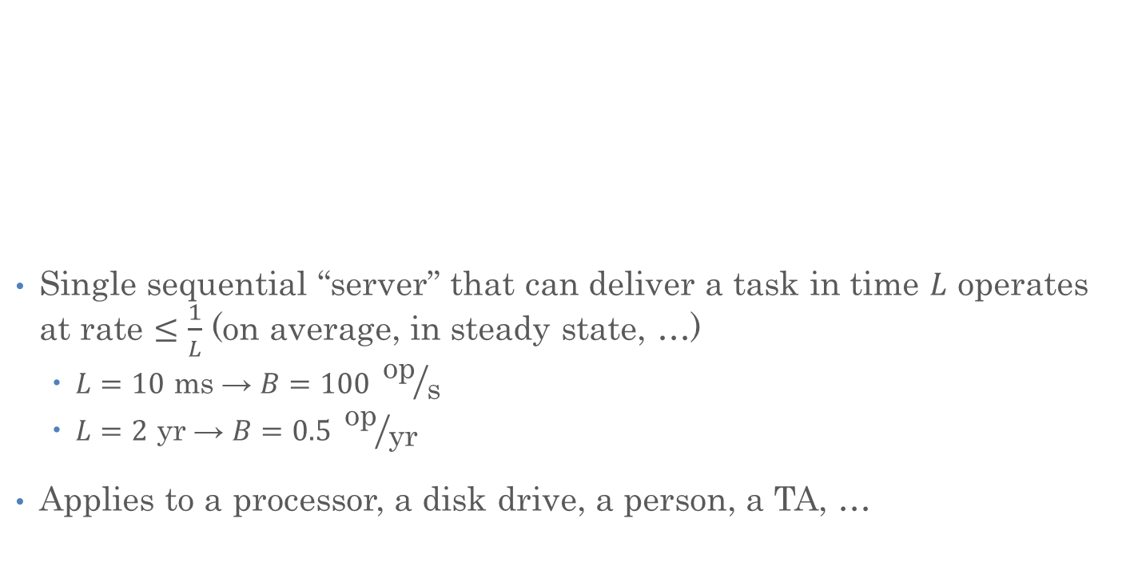
Sequential Server Performance
Single sequential “server” that can deliver a task in time $L$ operates at rate $≤\frac{1}{L}$ (on average, in steady state, …)
$L=10 \text{ms}$ → $B=100 {\text{op}}/{\text{s}}$
$L=2 \text{yr}$ → $B=0.5 {\text{op}}/{\text{yr}}$
Applies to a processor, a disk drive, a person, a TA, …
L
L
L
L
…
L
time

Slide 6
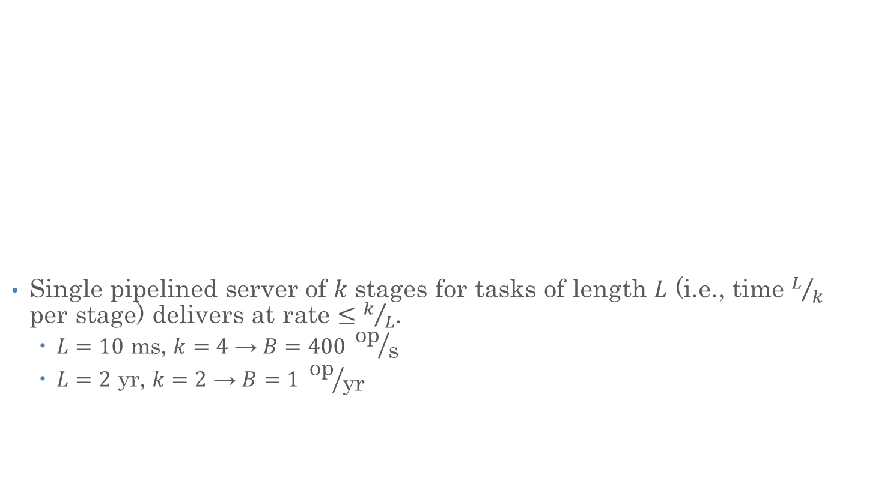
Single Pipelined Server
L
L
Single pipelined server of $k$ stages for tasks of length $L$ (i.e., time $L/k$ per stage) delivers at rate $≤k/L$.
$L=10 \text{ms}$, $k=4$ → $B=400 {\text{op}}/{\text{s}}$
$L=2 \text{yr}$, $k=2$ → $B=1 {\text{op}}/{\text{yr}}$
divided over distinct resources
logical operation
L
L
L
L
L
L
L
…
time

Slide 7
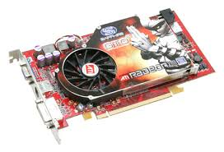
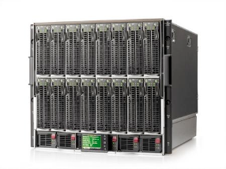
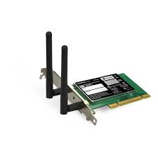
Example Systems “Pipelines”
Anything with queues between operational processes behaves roughly “pipeline like”
Important difference is that “initiations” are decoupled from processing
May have to queue up a burst of operations
Not synchronous and deterministic
I/O Processing
File
System
Upper Driver
Lower Driver
User Process
syscall
Communication

Slide 8
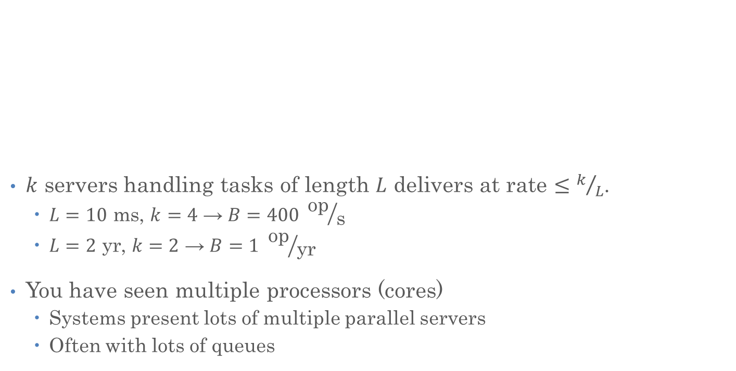
Multiple Servers
$k$ servers handling tasks of length $L$ delivers at rate $≤k/L$.
$L=10 \text{ms}$, $k=4$ → $B=400 {\text{op}}/{\text{s}}$
$L=2 \text{yr}$, $k=2$ → $B=1 {\text{op}}/{\text{yr}}$
You have seen multiple processors (cores)
Systems present lots of multiple parallel servers
Often with lots of queues
L
…
k

Slide 9

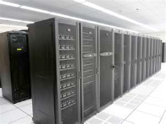
Example System “Parallelism”
I/O Processing
syscall
User Process
File
System
Upper Driver
Lower Driver
User Process
User Process
Communication
Parallel Computation, Databases, …

Slide 10

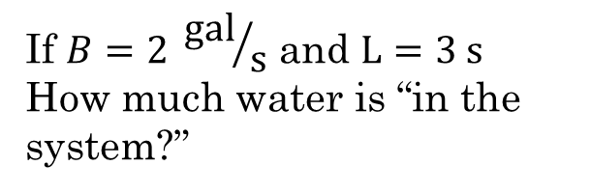
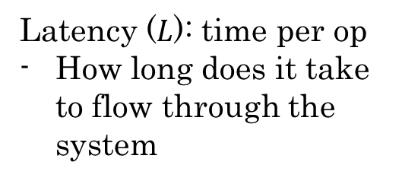
A Simple System Performance Model
Latency ($L$): time per op
How long does it take to flow through the system
Bandwidth ($B$): Rate, Op/s
e.g., flow: gal per min
“Service Time”
If $B=2 {\text{gal}}/{\text{s}}$ and $L=3 \text{s}$
How much water is “in the system?”

Slide 11
A Simple System Performance Model
Latency ($L$): time per op
How long does it take to flow through the system
Bandwidth ($B$): Rate, Op/s
e.g., flow: gal per min
“Service Time”
If $B=2 {\text{gal}}/{\text{s}}$ and $L=3 \text{s}$
How much water is “in the system?”

Slide 12
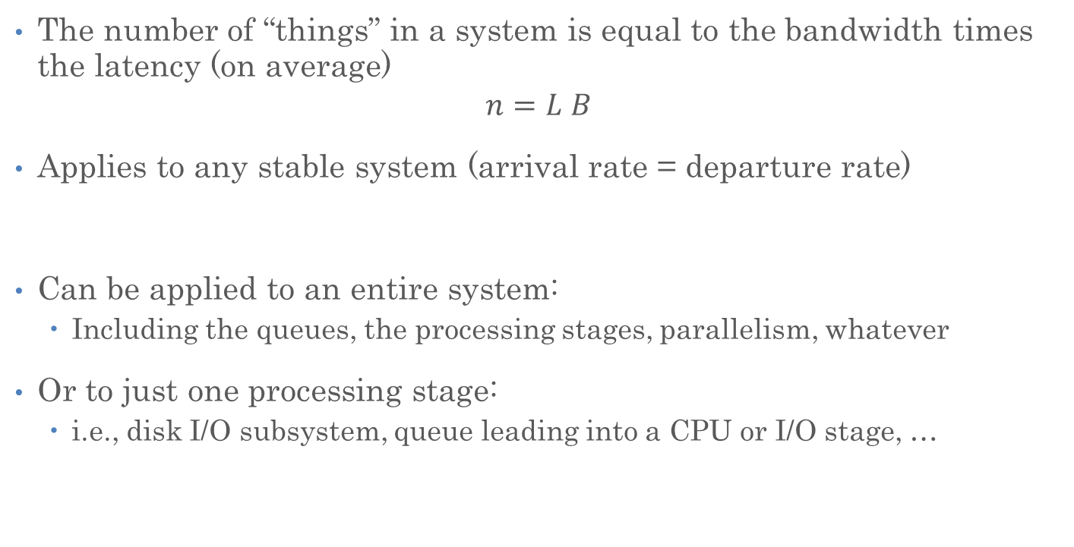
Little’s Law
The number of “things” in a system is equal to the bandwidth times the latency (on average)
$$n=L B$$
Applies to any stable system (arrival rate = departure rate)
Can be applied to an entire system:
Including the queues, the processing stages, parallelism, whatever
Or to just one processing stage:
i.e., disk I/O subsystem, queue leading into a CPU or I/O stage, …

Slide 13



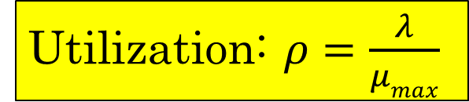
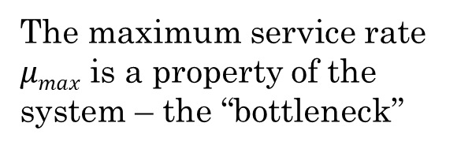


A Simple System Performance Model
Request Rate: $λ$
Latency ($L$)
Queuing delay: $d$
Operation Time: $t$
The maximum service rate $μmax$ is a property of the system – the “bottleneck”
Utilization: $ρ=\frac{λ}{μmax}$
Service Rate: $μ$

Slide 14



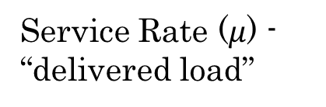
Ideal System Performance
How does $μ$ (service rate) vary with $λ$ (request rate)?
asymptotic peak rate
$$μmax$$
Service Rate ($μ$) - “delivered load”
$$μmax$$
Request Rate ($λ$ ) - “offered load”

Slide 15
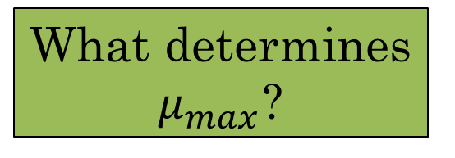
A Simple System Performance Model
Request Rate: $λ$
Latency ($L$)
Queuing delay: $d$
What about “internal” queues?
Operation Time: $t$
The maximum service rate $μmax$ is a property of the system – the “bottleneck”
What determines $μ_{max}$?
Utilization: $ρ=\frac{λ}{μmax}$
Service Rate: $μ$

Slide 16
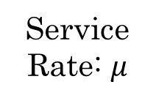
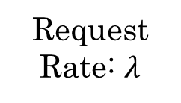
Bottleneck Analysis
L
L
L
L
L
L
L
…
time
Request Rate: $λ$
Service Rate: $μ$
Overall System: Series of Stages

Slide 17
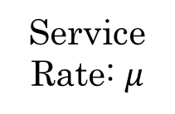
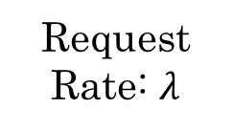



Bottleneck Analysis
Each stage has its own queue and maximum service rate
Suppose the green stage is the bottleneck
$$μ_{max,1}$$
$$μ_{max,2}$$
$$μ_{max,3}$$
Request Rate: $λ$
Service Rate: $μ$
Overall System: Series of Stages

Slide 18
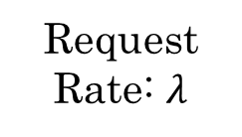
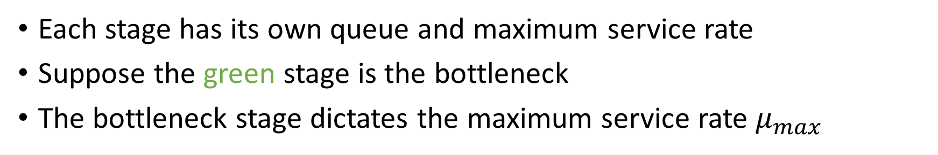

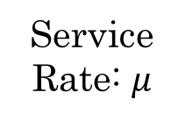
Bottleneck Analysis
Each stage has its own queue and maximum service rate
Suppose the green stage is the bottleneck
The bottleneck stage dictates the maximum service rate $μ_{max}$
$$μ_{max}=μ_{max,3}$$
Request Rate: $λ$
Service Rate: $μ$
System Model: Bottleneck Stage

Slide 19
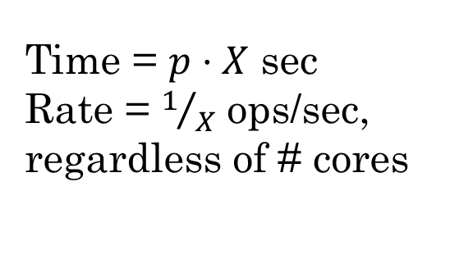
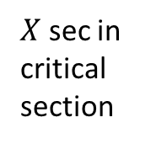
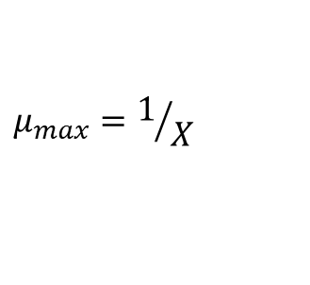

Example: Servicing a Highly Contended Lock
$$p$$
Queue of waiting threads
$$μ_{max}=1/X$$
…
All try to grab lock
$X$ sec in critical section
Time = $p⋅X$ sec
Rate = $1/X$ ops/sec, regardless of # cores
Critical section guarded by lock
…

Slide 20
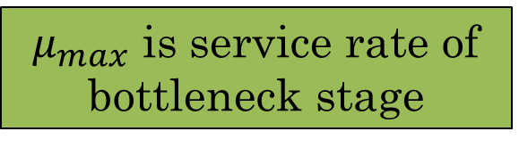
A Simple System Performance Model
Request Rate: $λ$
Latency ($L$)
Queuing delay: $d$
Tank represents queue of bottleneck stage
Including queues of previous stages, in case of backpressure
Operation Time: $t$
The maximum service rate $μmax$ is a property of the system – the “bottleneck”
$μ_{max}$ is service rate of bottleneck stage
Utilization: $ρ=\frac{λ}{μmax}$
Service Rate: $μ$

Slide 21
A Simple System Performance Model
Request Rate: $λ$
Latency ($L$)
Queuing delay: $d$
Useful to apply this model to:
Bottleneck stage
Entire system up to and including bottleneck stage
Entire system
Operation Time: $t$
The maximum service rate $μmax$ is a property of the system – the “bottleneck”
Utilization: $ρ=\frac{λ}{μmax}$
Service Rate: $μ$

Slide 22
Announcements
Assignment 2 due next Monday (April 6)
If auto-grader fails even if locally all is well – attach screenshot to submission
Project 1 due next Monday as well
Assignment 3 was posted (deadline is April 27, no extensions are possible)

Slide 23
Rest of Today’s Lecture
Using this system model, we will:
Explore latency in more depth
Discuss how to build systems that perform well under load

Slide 24
Latency (Response Time)
Total latency (response time): queuing time + service time
Service time depends on the underlying operation
For CPU stage, how much computation
For I/O stage, characteristics of the hardware
What about the queuing time?
Queue
Processing Stage (Server)

Slide 25
A Simple System Performance Model
Request Rate: $λ$
Latency ($L$)
Queuing delay: $d$
When will the queue(s) start to fill?
Operation Time: $t$
The maximum service rate $μmax$ is a property of the system – the “bottleneck”
Utilization: $ρ=\frac{λ}{μmax}$
Service Rate: $μ$

Slide 26
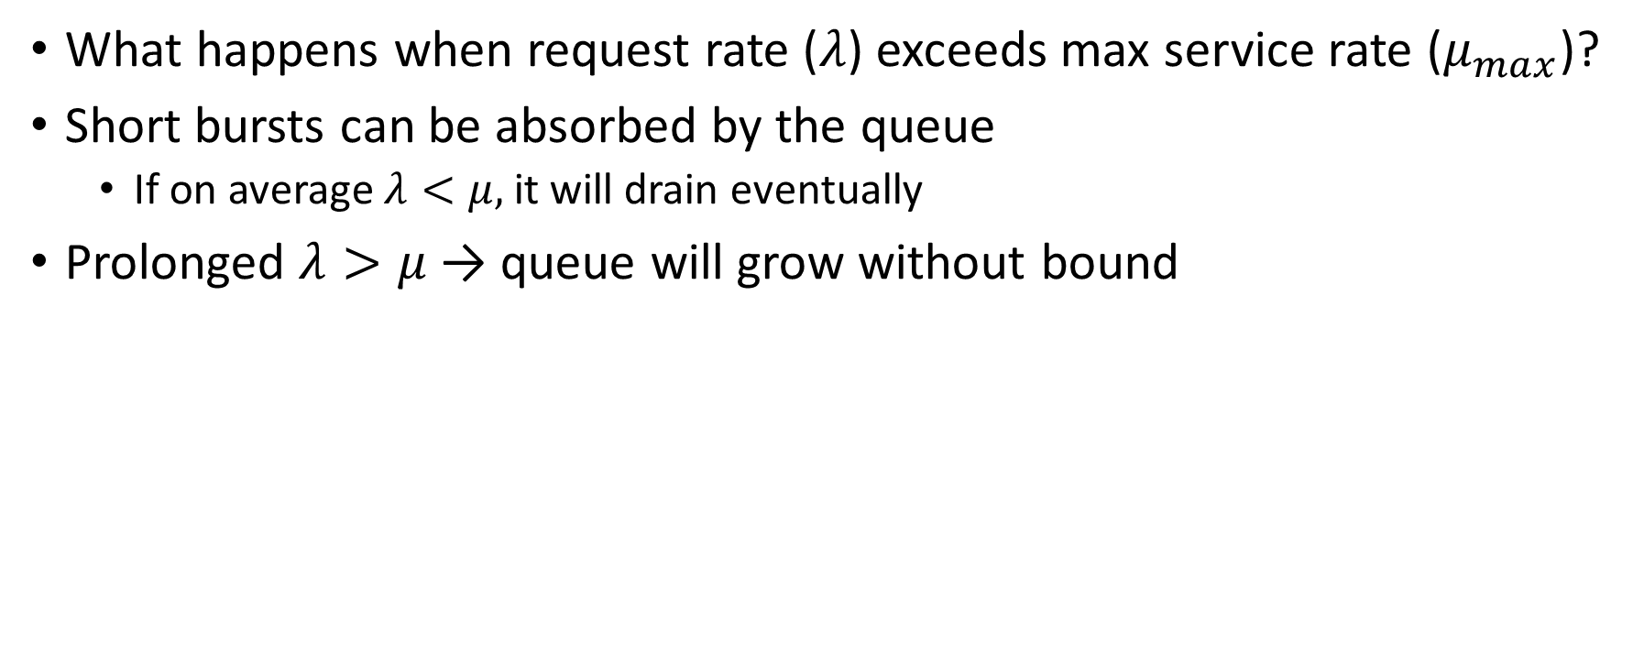
Queuing
What happens when request rate ($λ$) exceeds max service rate ($μ_{max}$)?
Short bursts can be absorbed by the queue
If on average $λ<μ,$it will drain eventually
Prolonged $λ>μ$ → queue will grow without bound

Slide 27








A Simple, Deterministic World
Assume requests arrive at regular intervals, take a fixed time to process, with plenty of time between …
$T_{A}$: time between arrivals
$λ=1/{T_{A}}$
$T_{S}$: service time
$μ=k/{T_{S}}$
$T_{Q}$: queuing time
$L=T_{Q}+T_{S}$
arrivals
Queue
Server
departures
$$T_{Q}$$
$$T_{S}$$
$$T_{A}$$
$$T_{A}$$
$$T_{A}$$
$$T_{S}$$
$$T_{Q}$$

Slide 28
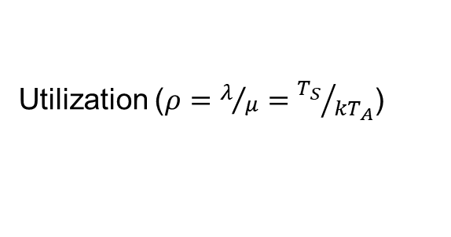
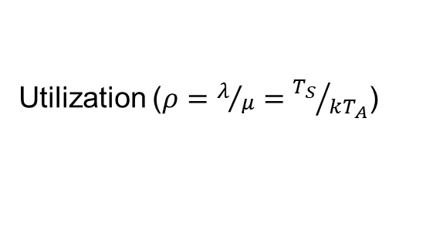
A Simple, Deterministic World
Saturation
1
1
Delivered Throughput
Delivered Throughput
Empty Queue
Unbounded
0
1
0
1
Utilization ($ρ=λ/μ={T_{S}}/{kT_{A}}$)
Utilization ($ρ=λ/μ={T_{S}}/{{kT}_{A}}$)
Queue delay
Queue delay
time
time

Slide 29


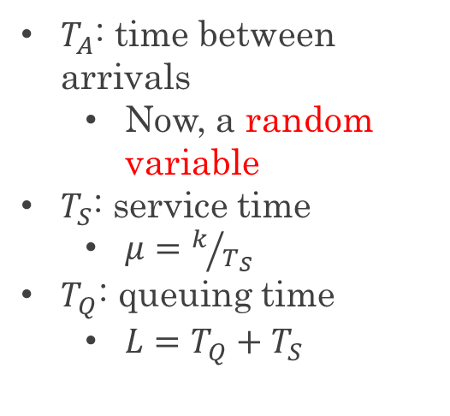

A Bursty World
Requests arrive in a burst, must queue up until served
Same average arrival time, but almost all of the requests experience large queue delays (even though average utilization is low – $TS/TA ≪ 1$)
$T_{A}$: time between arrivals
Now, a random variable
$T_{S}$: service time
$μ=k/{T_{S}}$
$T_{Q}$: queuing time
$L=T_{Q}+T_{S}$
arrivals
Queue
Server
departures
$$T_{Q}$$
$$T_{S}$$
Arrivals
Q depth
Server

Slide 30
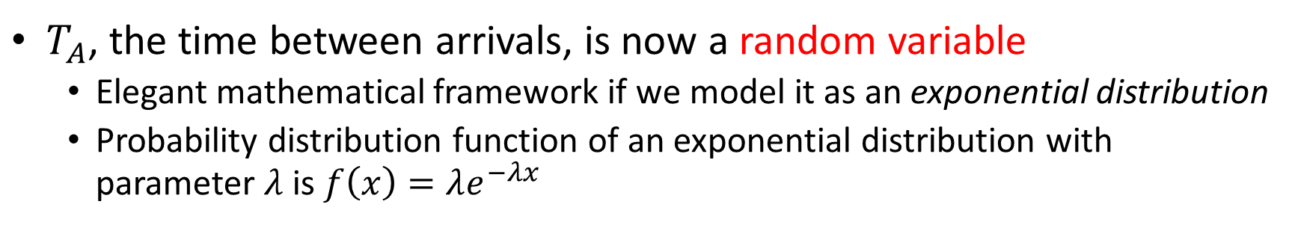


How to model Burstiness of Arrival?
$T_{A}$, the time between arrivals, is now a random variable
Elegant mathematical framework if we model it as an exponential distribution
Probability distribution function of an exponential distribution with parameter $λ$ is $f\left(x\right)=λe^{−λx}$
“Memoryless”: Likelihood of an event occurring is independent of how long we’ve been waiting
mean arrival interval ($1/λ$)
Lots of short arrival intervals (i.e., high instantaneous rate)
Few long gaps (i.e., low instantaneous rate)
$$x (λ)$$

Slide 31
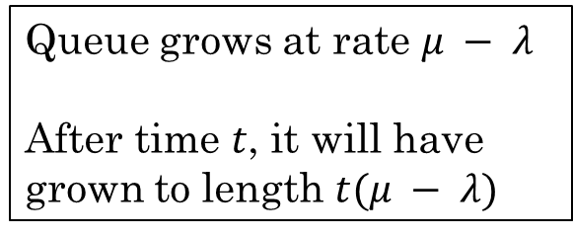
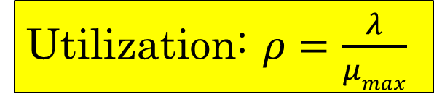
A Simple System Performance Model
Request Rate: $λ$
Latency ($L$)
Queuing delay: $d$
Operation Time: $t$
Queue grows at rate $μ − λ$
After time $t$, it will have grown to length $t(μ − λ)$
Service Rate: $μ$
Utilization: $ρ=\frac{λ}{μmax}$

Slide 32
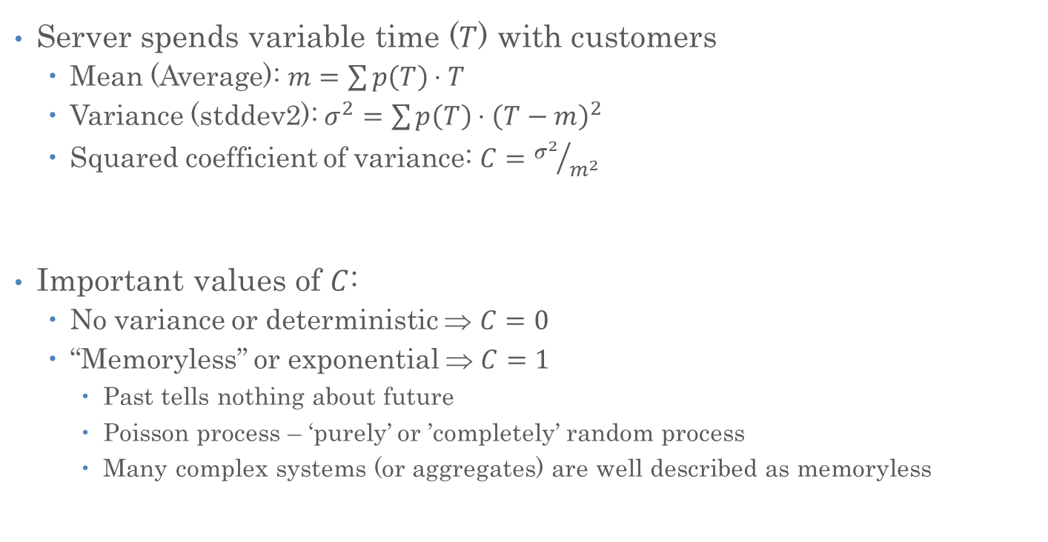
Background: Random Distributions
Server spends variable time ($T$) with customers
Mean (Average): $m=\sum{p\left(T\right)⋅T}$
Variance (stddev2): $σ^{2}=\sum{p\left(T\right)⋅{\left(T−m\right)}^{2}}$
Squared coefficient of variance: $C={σ^{2}}/{m^{2}}$
Important values of $C$:
No variance or deterministic ⇒ $C=0$
“Memoryless” or exponential ⇒ $C=1$
Past tells nothing about future
Poisson process – ‘purely’ or ’completely’ random process
Many complex systems (or aggregates) are well described as memoryless
Mean
(m)
σ
Distribution
of service times
mean
Memoryless

Slide 33

Introduction to Queuing Theory
Queuing Theory applies to long term, steady state behavior
Arrival rate = Departure rate ($λ=μ$)
Arrivals characterized by some probabilistic distribution
Departures characterized by some probabilistic distribution
Arrivals
Departures
Queue
Server
Queuing System

Slide 34
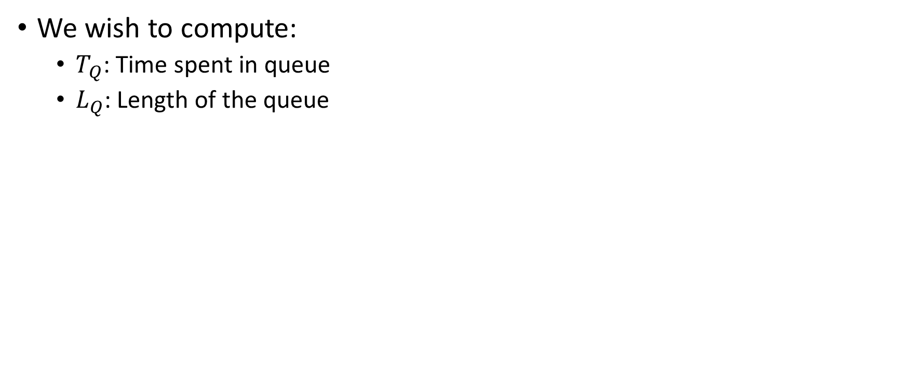
Our Goals with Queuing Theory
We wish to compute:
$T_{Q}$: Time spent in queue
$L_{Q}$: Length of the queue

Slide 35


Little’s Law Applied to a Queue
Before, we had $n=LB$ (for a stable system):
$B$: bandwidth
$L$: latency
$n$: number of operations in the system
When applied to a queue, we get:
Average Arrival Rate
$$L_{Q}=λT_{Q}$$
Average length of the queue
Average time “waiting”

Slide 36
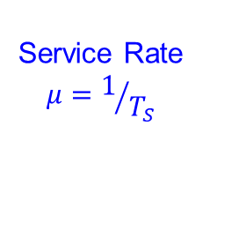

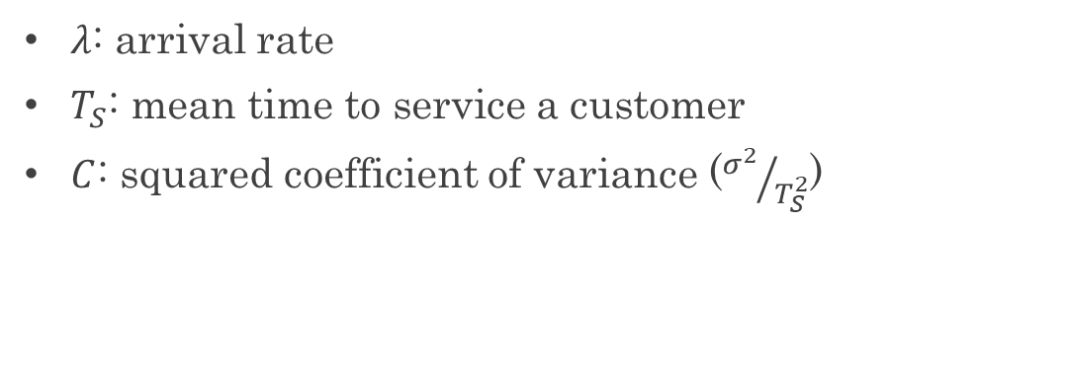
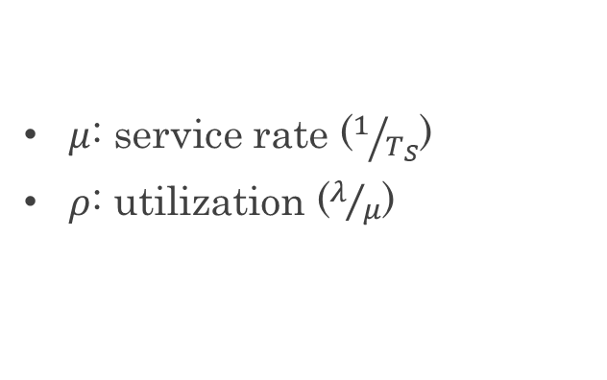
Some Results from Queuing Theory
Assumptions: system in equilibrium, no limit to the queue, time between successive arrivals is random and memoryless
Queue
Server
Arrival Rate
$$λ$$
Service Rate
$$μ=1/{T_{S}}$$
$λ$: arrival rate
$T_{S}$: mean time to service a customer
$C$: squared coefficient of variance (${σ^{2}}/{T_{S}^{2}}$)
$μ$: service rate ($1/{T_{S}}$)
$ρ$: utilization ($λ/μ$)

Slide 37

Some Results from Queuing Theory
Memoryless service distribution ($C=1)$ - an “M/M/1 queue”:
$$T_{Q}=\frac{ρ}{1−ρ}⋅T_{S}$$
General service distribution (no restrictions) - an “M/G/1 queue”:
$$T_{Q}=\frac{1+C}{2}⋅\frac{ρ}{1−ρ}⋅T_{S}$$
$λ$: arrival rate
$T_{S}$: mean time to service a customer
$C$: squared coefficient of variance (${σ^{2}}/{T_{S}^{2}}$)
$μ$: service rate ($1/{T_{S}}$)
$ρ$: utilization ($λ/μ$)
M/M/1:
Input: Markovian (Poisson)
Output: Markovian (Poisson)
Number of servers: 1
M/G/1:
Input: Markovian (Poisson)
Output: General distribution
Number of servers: 1

Slide 38
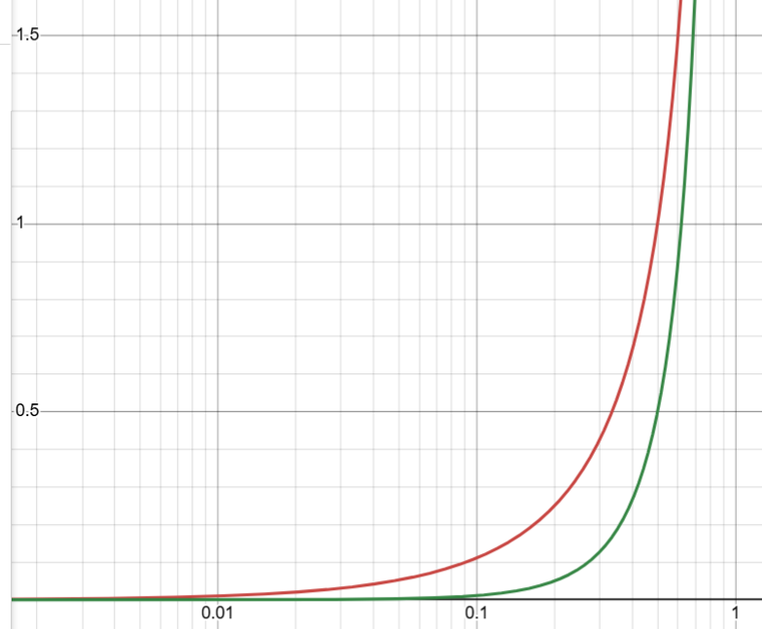

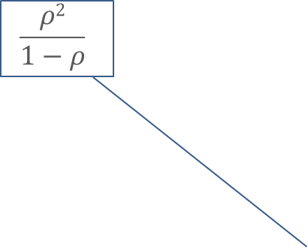
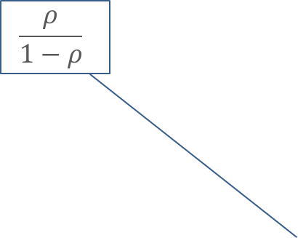
Key Results from Queuing Theory
$T_{Q}=\frac{ρ}{1−ρ}⋅T_{S}$ (memoryless service distribution)
$L_{Q}=λT_{Q}$ (by Little’s Law)
Utilization is $ρ=λ/{μ_{max}}=λT_{S}$, so
$L_{Q}=λT_{Q}=\frac{ρ}{T_{S}}⋅T_{Q}=\frac{ρ^{2}}{1−ρ}$ (for a single server)
$$\frac{ρ}{1−ρ}$$
$$\frac{ρ2}{1−ρ}$$

Slide 39
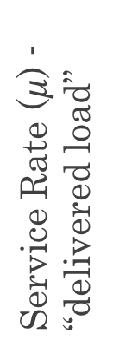
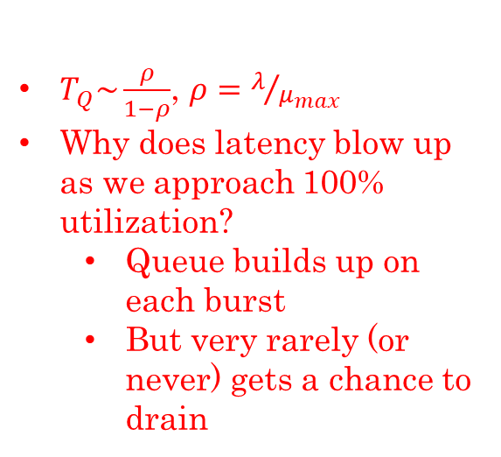



Ideal System Performance
$T_{Q}\sim \frac{ρ}{1−ρ}$, $ρ=λ/{μ_{max}}$
Why does latency blow up as we approach 100% utilization?
Queue builds up on each burst
But very rarely (or never) gets a chance to drain
Latency
Service Rate ($μ$) - “delivered load”
$$μmax$$
Service Time
$$μmax$$
Operation Time
Request Rate ($λ$ ) - “offered load”
“Half-Power Point”: load at which system delivers half of peak performance
Design and provision systems to operate roughly in this regime
Latency low and predictable, utilization good: ~50%

Slide 40
Rest of Today’s Lecture
Using this system model, we will:
Explore latency in more depth
Discuss how to build systems that perform well under load

Slide 41
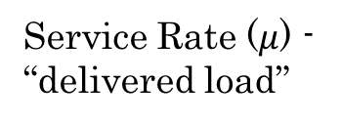



Ideal System Performance
A system that behaves this way is well-conditioned
Delivered load increases with offered load until pipeline saturates
As offered load increases further, throughput remains high
asymptotic peak rate
$$μmax$$
Service Rate ($μ$) - “delivered load”
$$μmax$$
Request Rate ($λ$ ) - “offered load”

Slide 42
Sockets with Protection and Concurrency
Server
Client
Create Server Socket
Create Client Socket
Bind it to an Address
(host:port)
Connect it to server (host:port)
Listen for Connection
Accept syscall()
Connection Socket
Connection Socket
Child
Parent
Close Listen Socket
Close Connection Socket
write request
read request
read response
write response
Close Connection Socket
Close Server Socket
Close Client Socket

Slide 43
Sockets with Concurrency, without Protection
Server
Client
Create Server Socket
Create Client Socket
Bind it to an Address
(host:port)
Connect it to server (host:port)
Listen for Connection
Accept syscall()
Connection Socket
Connection Socket
Spawned Thread
pthread_create
Main Thread
write request
read request
read response
write response
Close Server Socket
Close Connection Socket
Close Client Socket

Slide 44
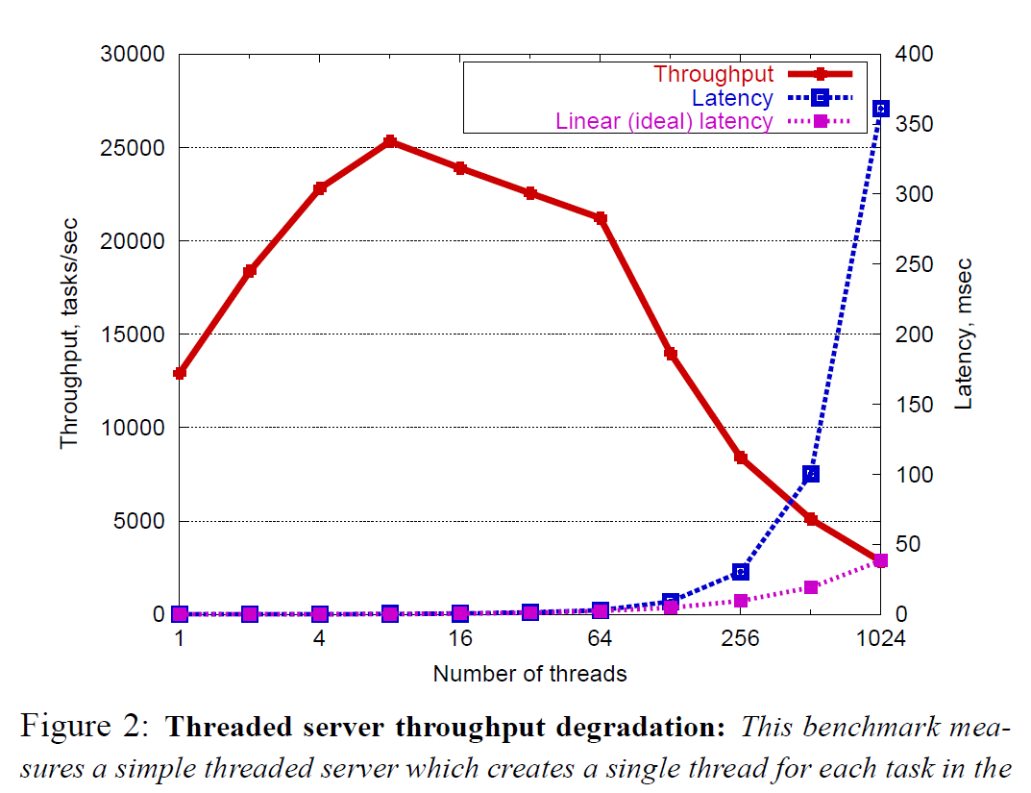
Non-Well-Conditioned Systems
A server that spawns a new pthread per request is not well-conditioned!
https://people.eecs.berkeley.edu/~prabal/teaching/resources/eecs582/welsh01seda.pdf

Slide 45
Building Well-Conditioned Systems
Spawning a new thread or process for each request is not well-conditioned
Too many threads is bad
Scheduling overhead becomes large
Context switch overhead becomes large
E.g., Poor cache performance
Synchronization overhead becomes large
E.g., Lock contention
Was our original (v1) server well-conditioned?
The one that handles requests one at a time, with no concurrency?
Hint: yes!

Slide 46
Building Well-Conditioned Systems
Thread Pools
User-Mode Threads
Event-Driven Execution
We’ll discuss these next time…

Slide 47








